Slide 1
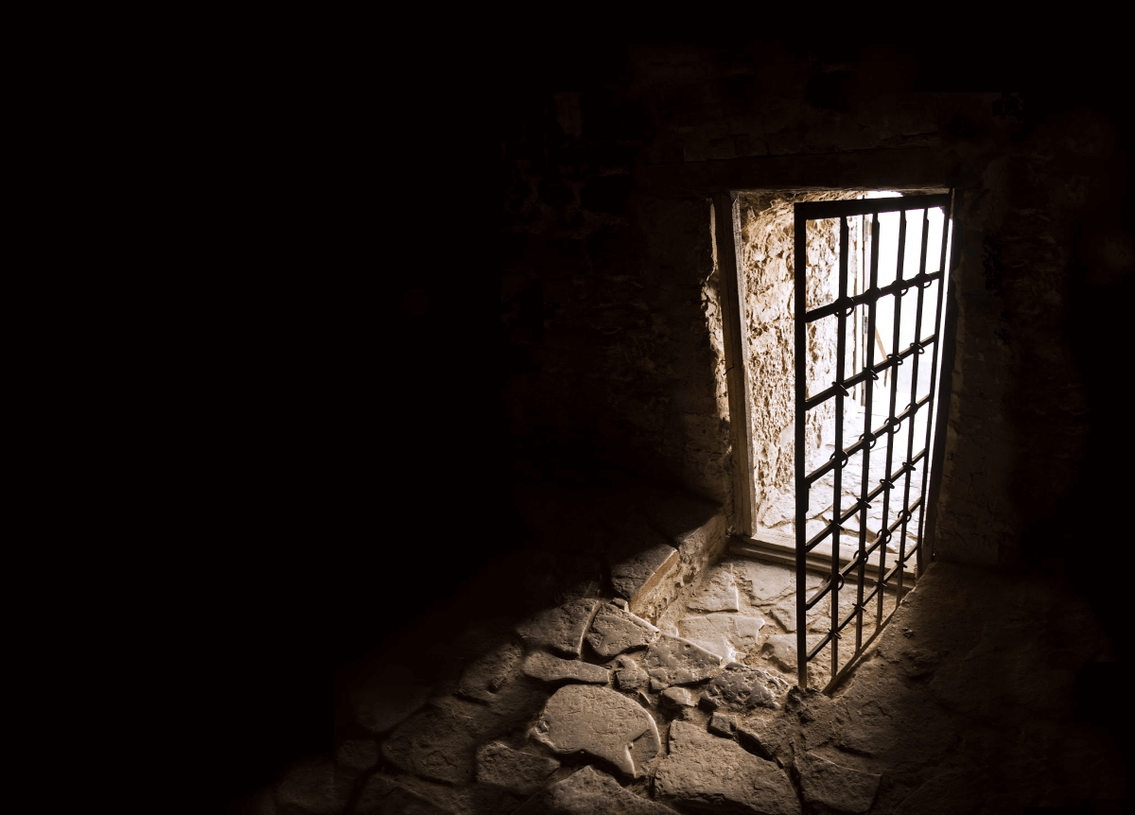
Galatians
Chapter 6
Life Together

Slide 2
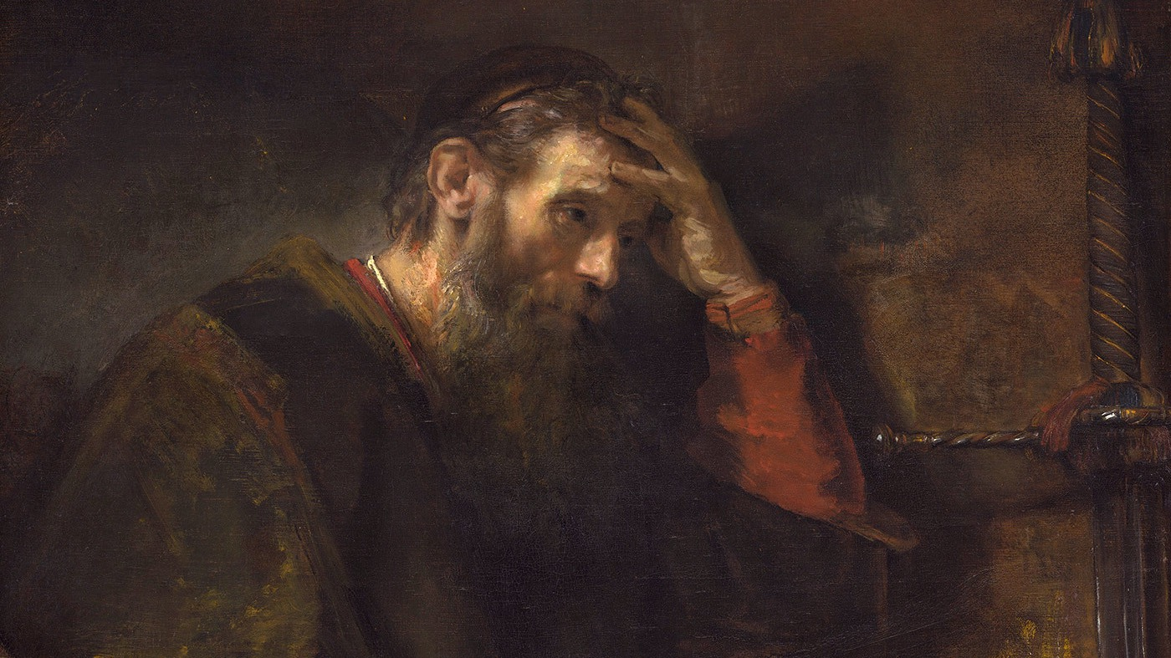
Galatians 5:25-26
If we live by the Spirit, let us also behave in accordance with the Spirit. Let us not become conceited, provoking one another, being jealous of one another.

Slide 3
Galatians 5:25-26
If we live by the Spirit, let us also behave in accordance with the Spirit. Let us not become conceited, provoking one another, being jealous of one another.
our perspective

Slide 4
both amount to an others focus
Galatians 5:25-26
If we live by the Spirit, let us also behave in accordance with the Spirit. Let us not become conceited, provoking one another, being jealous of one another.
our actions

Slide 5
Galatians 5:25-26
results of self focus
If we live by the Spirit, let us also behave in accordance with the Spirit. Let us not become conceited, provoking one another, being jealous of one another.

Slide 6
6:1 Brothers and sisters, if a person is discovered in some sin, you who are spiritual restore such a person in a spirit of gentleness. Pay close attention to yourselves, so that you are not tempted too.
Galatians

Slide 7
6:1 Brothers and sisters, if a person is discovered in some sin, you who are spiritual restore such a person in a spirit of gentleness. Pay close attention to yourselves, so that you are not tempted too.
Galatians

Slide 8
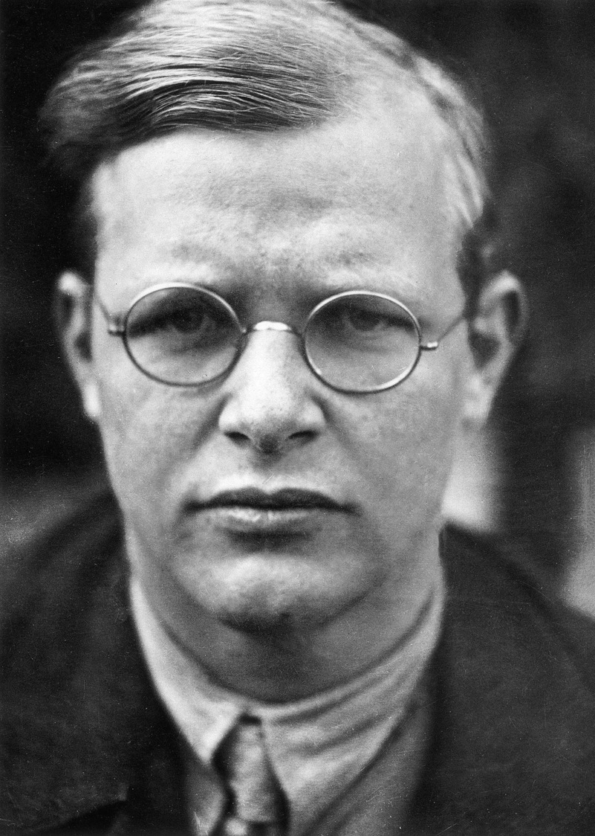
(Dietrich Bonhoeffer) ﻿ ﻿The most experienced psychologist or observer of human nature knows infinitely less of the human heart than the simplest Christian who lives beneath the Cross of Jesus. The greatest psychological insight, ability, and experience cannot grasp this one thing: what sin is…

Slide 9
…Worldly wisdom knows what distress and weakness and failure are, but it does not know the godlessness of men. And so it also does not know that man is destroyed only by his sin and can be healed only by forgiveness. Only the Christian knows this. In the presence of a psychiatrist I can only be a sick man; in the presence of a Christian brother I can dare to be a sinner.

Slide 10
6:1 Brothers and sisters, if a person is discovered in some sin, you who are spiritual restore such a person in a spirit of gentleness. Pay close attention to yourselves, so that you are not tempted too.
The legalist rejoices when someone fails, not so for the spiritual.
Galatians

Slide 11
Complicit by Silence
Real depth in relationship demands truth-telling.
What does it say about your view of the person to withhold?
What does it say about your view of sin?
Inability to speak truth affects you also.
Viewed as arrogant, but what’s really more arrogant?
6:1 Brothers and sisters, if a person is discovered in some sin, you who are spiritual restore such a person in a spirit of gentleness. Pay close attention to yourselves, so that you are not tempted too.
Galatians

Slide 12
Complicit by Silence
Real depth in relationship demands truth-telling.
What does it say about your view of the person to withhold?
What does it say about your view of sin?
Inability to speak truth affects you also.
Viewed as arrogant, but what’s really more arrogant?
6:1 Brothers and sisters, if a person is discovered in some sin, you who are spiritual restore such a person in a spirit of gentleness. Pay close attention to yourselves, so that you are not tempted too.
God does not call us to hold others to our opinion or standard, but his!
Galatians

Slide 13
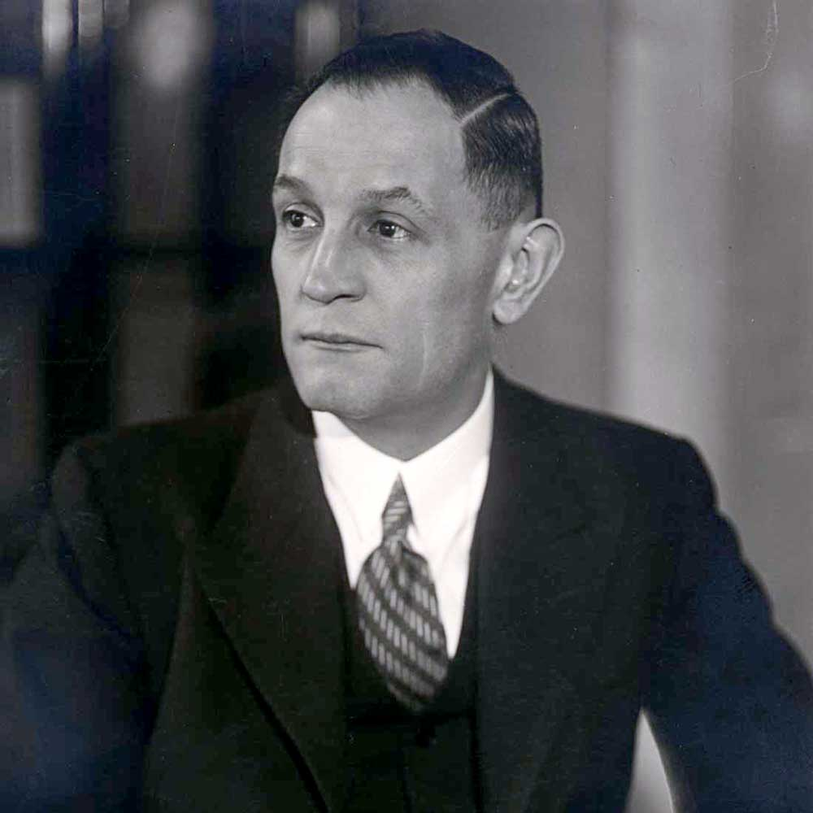
(Martin Niemöler) First they came for the socialists, and I did not speak out—because I was not a socialist. Then they came for the trade unionists, and I did not speak out because I was not a trade unionist. Then they came for the Jews, and I did not speak out—because I was not a Jew. Then they came for me—and there was no one left to speak for me.
(Jas. 4:17) So whoever knows what is good to do and does not do it is guilty of sin.

Slide 14
Without tact we risk alienating the relationship.
6:1 Brothers and sisters, if a person is discovered in some sin, you who are spiritual restore such a person in a spirit of gentleness. Pay close attention to yourselves, so that you are not tempted too.
Gentleness also incorporates humility.
Galatians

Slide 15
(Dietrich Bonhoeffer) ﻿The pious fellowship permits no one to be a sinner. So everybody must conceal his sin from himself and from the fellowship. We dare not be sinners. Many Christians are unthinkably horrified when a real sinner is suddenly discovered among the righteous. So we remain alone with our sin, living in lies and hypocrisy. The fact is that we are sinners!...

Slide 16
… ﻿But it is the grace of the Gospel, which is so hard for the pious to understand, that it confronts us with the truth and says: You are a sinner, a great, desperate sinner; now come, as the sinner that you are, to God who loves you. He wants you as you are; he does not want anything from you, a sacrifice, a work; he wants you alone…

Slide 17
…God has come to you to save the sinner. Be glad! This message is liberation through truth. You can hide nothing from God. The mask you wear before men will do you no good before him. He wants to see you as you are, he wants to be gracious to you. You do not have to go on lying to yourself and your brothers, as if you were without sin; you can dare to be a sinner.

Slide 18
6:1 Brothers and sisters, if a person is discovered in some sin, you who are spiritual restore such a person in a spirit of gentleness. Pay close attention to yourselves, so that you are not tempted too.
The legalist is unable to see the log in his own eye!
Galatians

Slide 19
2. Carry one another’s burdens, and in this way you will fulfill the law of Christ.
Galatians

Slide 20
2. Carry one another’s burdens, and in this way you will fulfill the law of Christ.
(Rom. 15:1-2) But we who are strong ought to bear with the failings of the weak, and not just please ourselves. Let each of us please his neighbor for his good to build him up.
Galatians

Slide 21
(Dietrich Bonhoeffer) ﻿This will prove especially difficult where varying strength and weakness in faith are bound together in a fellowship. The weak must not judge the strong, the strong must not despise the weak. The weak must guard against pride, the strong against indifference. None must seek his own rights…

Slide 22
…If the strong person falls, the weak one must guard his heart against malicious joy at his downfall. If the weak one falls, the strong one must help him rise again in all kindness. The one needs as much patience as the other.

Slide 23
…If the strong person falls, the weak one must guard his heart against malicious joy at his downfall. If the weak one falls, the strong one must help him rise again in all kindness. The one needs as much patience as the other.
(Eccl. 4:9-10) Two people are better than one… For if they fall, one will help his companion up,
but pity the person who falls down and has no one to help him up.

Slide 24
2. Carry one another’s burdens, and in this way you will fulfill the law of Christ.
Are you able to carry others burdens or are you so weighed down by your own you can’t?
Do you spend time in prayer for others?
Do you look for opportunity to give to others?
Galatians

Slide 25
2. Carry one another’s burdens, and in this way you will fulfill the law of Christ.
(Jn. 13:34) “I give you a new commandment—to love one another. Just as I have loved you, you also are to love one another.
Galatians

Slide 26
3. For if anyone thinks he is something when he is nothing, he deceives himself.
(1 Cor. 10:12) So let the one who thinks he is standing be careful that he does not fall.
Galatians

Slide 27
3. For if anyone thinks he is something when he is nothing, he deceives himself.
(2 Cor. 10:12)…But when they measure themselves by themselves and compare themselves with themselves, they are without understanding.
Galatians

Slide 28
4-5. Pay careful attention to your own work, for then you will get the satisfaction of a job well done, and you won’t need to compare yourself to anyone else. For we are each responsible for our own conduct.
Galatians

Slide 29
4-5. Pay careful attention to your own work, for then you will get the satisfaction of a job well done, and you won’t need to compare yourself to anyone else. For we are each responsible for our own conduct.
Galatians

Slide 30
4-5. Pay careful attention to your own work, for then you will get the satisfaction of a job well done, and you won’t need to compare yourself to anyone else. For we are each responsible for our own conduct.
Galatians

Slide 31
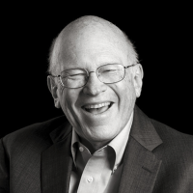
(Ken Blanchard) ﻿The need to compare and draw comfort from comparisons to others is a sign of false pride, insecurity, and fear of inadequacy. Seeking to learn from others and aspiring to emulate good role models are signs of a healthy state of humility in mind and heart…

Slide 32
… ﻿“A little friendly competition” rarely stays little or friendly when the leader makes the rewards for winning too great and the price of failure too high. When you seek to determine your level of self-worth and security by comparison with others, the end result is either complacency or anxiety…

Slide 33
… ﻿In a larger sense, it devalues the promises and provisions of God, who has already guaranteed your value and security based on His unconditional love. You are His beloved.

Slide 34
4-5. Pay careful attention to your own work, for then you will get the satisfaction of a job well done, and you won’t need to compare yourself to anyone else. For we are each responsible for our own conduct.
Galatians

Slide 35
We each have our own responsibilities
4-5. Pay careful attention to your own work, for then you will get the satisfaction of a job well done, and you won’t need to compare yourself to anyone else. For we are each responsible for our own conduct.
Galatians

Slide 36
(Prov. 21:25-26) What the sluggard desires will kill him, for his hands refuse to work. All day long he craves greedily, but the righteous gives and does not hold back.
4-5. Pay careful attention to your own work, for then you will get the satisfaction of a job well done, and you won’t need to compare yourself to anyone else. For we are each responsible for our own conduct.
Galatians

Slide 37
6. Now the one who receives instruction in the word must share all good things with the one who teaches it.
Galatians

Slide 38
6. Now the one who receives instruction in the word must share all good things with the one who teaches it.
God will call certain people to work for him exclusively.
Galatians

Slide 39
7-8. Do not be deceived. God will not be made a fool. For a person will reap what he sows, because the person who sows to his own flesh will reap corruption from the flesh, but the one who sows to the Spirit will reap eternal life from the Spirit.
Galatians

Slide 40
7-8. Do not be deceived. God will not be made a fool. For a person will reap what he sows, because the person who sows to his own flesh will reap corruption from the flesh, but the one who sows to the Spirit will reap eternal life from the Spirit.
Sounds like angry retribution!
Galatians

Slide 41
7-8. Do not be deceived. God will not be made a fool. For a person will reap what he sows, because the person who sows to his own flesh will reap corruption from the flesh, but the one who sows to the Spirit will reap eternal life from the Spirit.
Galatians

Slide 42
7-8. Do not be deceived. God will not be made a fool. For a person will reap what he sows, because the person who sows to his own flesh will reap corruption from the flesh, but the one who sows to the Spirit will reap eternal life from the Spirit.
Galatians

Slide 43
Matthew 6:19-21
“Do not accumulate for yourselves treasures on earth, where moth and rust destroy and where thieves break in and steal. But accumulate for yourselves treasures in heaven, where moth and rust do not destroy, and thieves do not break in and steal. For where your treasure is, there your heart will be also.”

Slide 44
7-8. Do not be deceived. God will not be made a fool. For a person will reap what he sows, because the person who sows to his own flesh will reap corruption from the flesh, but the one who sows to the Spirit will reap eternal life from the Spirit.
You and others benefit!
Galatians

Slide 45
9. So we must not grow weary in doing good, for in due time we will reap, if we do not give up.
Galatians

Slide 46
9. So we must not grow weary in doing good, for in due time we will reap, if we do not give up.
This kind of fellowship is worth fighting for!
Galatians

Slide 47
10. So then, whenever we have an opportunity, let us do good to all people, and especially to those who belong to the family of faith.
(Eph. 5:15-16) Therefore be very careful how you live—not as unwise but as wise, taking advantage of every opportunity, because the days are evil.
Galatians

Slide 48
Interested in learning more?
Pick up a FREE copy of “Discovering God”
First time joining us?

Slide 49
Final Thoughts
Are you willing to take the step of faith required to speak truthfully into another's life?
Perhaps you’re the one who needs to offload your burden?
Does your prayer life reflect your interest in carrying others burdens?
Is your portfolio filled with more corruptible or incorruptible assets?

