Slide 1
Now We See Dimly
1 Corinthians 13:9-12
Servant Team Retreat 2023

Slide 2
The Corinthians and “Knowledge”
“Who can know the Lord’s thoughts? Who knows enough to teach him?” (1 Corinthians 2:16)

Slide 3
The Corinthians and “Knowledge”
Judge nothing before the appointed time; wait until the Lord comes.
He will bring to light what is hidden in darkness and will expose the motives of the heart.
At that time each will receive their praise from God. (1 Corinthians 4:5)

Slide 4
1 Corinthians 13
9 For we know in part and we prophesy in part;
10 but when the perfect comes, the partial will be done away.

Slide 5
1 Corinthians 13
9 For we know in part and we prophesy in part;
10 but when the perfect comes, the partial will be done away.

Slide 6
1 Corinthians 13
9 For we know in part and we prophesy in part;
10 but when the perfect comes, the partial will be done away.
Why do we only know “in part”?
Our perspective is limited

Slide 7
1 Corinthians 13
9 For we know in part and we prophesy in part;
10 but when the perfect comes, the partial will be done away.
Why do we only know “in part”?
Our perspective is limited
We forget things
Our vision and memories are tainted by sin (Matthew 7:5)

Slide 8
You hypocrite, first take the log out of your own eye, and then you will see clearly to take the speck out of your brother’s eye. (Matthew 7:5)
Assumption: You have a log in your eye
First take the log out
Then you will see clearly
Are people stuck in conflict, bitterness or persistent criticism?

Slide 9
Tavris and Aronson, Mistakes Were Made (but not by me) (New York: Houghton Mifflin, 2020), Chapter 3
Chapter 3: “Memory, the Self-Justifying Historian”
When two people produce entirely different memories of the same event, observers usually assume that one of them is lying.
Of course, some people do…

Slide 10
Tavris and Aronson, Mistakes Were Made (but not by me) (New York: Houghton Mifflin, 2020), Chapter 3
All of us, as we tell our stories, add details and omit inconvenient facts;
we give the tale a small, self-enhancing spin.
That spin goes over so well that the next time we add a slightly more dramatic embellishment…

Slide 11
Tavris and Aronson, Mistakes Were Made (but not by me) (New York: Houghton Mifflin, 2020), Chapter 3
Eventually the way we remember the event may bring us a far distance from what actually happened.

Slide 12
Tavris and Aronson, Mistakes Were Made (but not by me) (New York: Houghton Mifflin, 2020), Chapter 3
In this way, memory becomes our personal, live-in, self-justifying historian…

Slide 13
Tavris and Aronson, Mistakes Were Made (but not by me) (New York: Houghton Mifflin, 2020), Chapter 3
In this way, memory becomes our personal, live-in, self-justifying historian…
“Why did you make us leave Egypt?
Didn’t we tell you this would happen while we were still in Egypt?
We said, ‘Leave us alone! Let us be slaves to the Egyptians.’” (Exodus 14:11-12)

Slide 14
Tavris and Aronson, Mistakes Were Made (but not by me) (New York: Houghton Mifflin, 2020), Chapter 3
In this way, memory becomes our personal, live-in, self-justifying historian…
“The heart is deceitful above all things and beyond cure.
Who can understand it?
I, Yahweh, search the heart and examine the mind.” (Jeremiah 17:9-10)

Slide 15
Theresa Lynn Sidebotham, Handling Allegations in a Ministry (Illumify Media Global, 2022), Chapter 7
Chapter 7 – “Memory and Credibility Issues”
One subset of memory change is social contagion theory, or memory conformity theory,
which looks at the effect of social interactions with others on memory and reporting.

Slide 16
Theresa Lynn Sidebotham, Handling Allegations in a Ministry (Illumify Media Global, 2022), Chapter 7
Social contagion theory refers to the spread of a memory from one person to another by means of social interaction…

Slide 17
Theresa Lynn Sidebotham, Handling Allegations in a Ministry (Illumify Media Global, 2022), Chapter 7
In some instances, the speaker can impose a new memory onto the listener,
that is, a memory of something that the listener did not experience.
In other instances, a speaker imposes on the listener an alternative rendering of something that the listener experienced…

Slide 18
Theresa Lynn Sidebotham, Handling Allegations in a Ministry (Illumify Media Global, 2022), Chapter 7
Memory conformity, on the other hand, refers to instances in which two people talk about a past event,
and what one person says can influence what the other person reports about the event…

Slide 19
Theresa Lynn Sidebotham, Handling Allegations in a Ministry (Illumify Media Global, 2022), Chapter 7
This [study] also suggests that people who discuss organizational situations in online settings may have a similar experience of memory conformity…

Slide 20
Theresa Lynn Sidebotham, Handling Allegations in a Ministry (Illumify Media Global, 2022), Chapter 7
Friend groups who discuss events may take the truth of others’ memories for granted
and may be less able to make clear distinctions between what they personally did and did not see…

Slide 21
1 Corinthians 13
9 For we know in part and we prophesy in part;
10 but when the perfect comes, the partial will be done away.
Why do we only know “in part”?
God hides some things from us (Prov 25:2)
Because he wants us to seek (Prov 2:4)
Because we can’t handle it right now? (Job 1-2, 38-42)
Because it’s none of our business

Slide 22
1 Corinthians 13
9 For we know in part and we prophesy in part;
10 but when the perfect comes, the partial will be done away.

Slide 23
1 Corinthians 13
9 For we know in part and we prophesy in part;
10 but when the perfect comes, the partial will be done away.
“Perfect” = Completeness, maturity
Not omniscience (1 Pet 1:12; Zech 1:12; Rev 6:10)
Not oblivion

Slide 24
1 Corinthians 13
9 For we know in part and we prophesy in part;
10 but when the perfect comes, the partial will be done away.
“Perfect” = Completeness, maturity
Not omniscience (1 Pet 1:12; Zech 1:12; Rev 6:10)
Not oblivion
God will upgrade our mental faculties
We can’t currently handle the full light of God

Slide 25
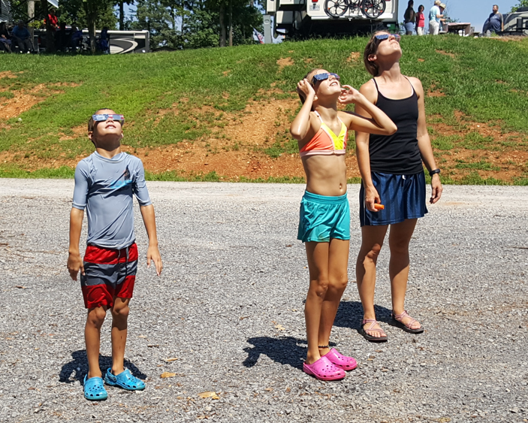
1 Corinthians 13
9 For we know in part and we prophesy in part;
10 but when the perfect comes, the partial will be done away.
“Perfect” = Completeness, maturity
Not omniscience (1 Pet 1:12; Zech 1:12; Rev 6:10)
Not oblivion
God will upgrade our mental faculties
We can’t currently handle the full light of God

Slide 26
1 Corinthians 13
11 When I was a child, I used to speak like a child, think like a child, reason like a child;
when I became a man, I did away with childish things.

Slide 27
1 Corinthians 13
11 When I was a child, I used to speak like a child, think like a child, reason like a child;
when I became a man, I did away with childish things.

Slide 28
1 Corinthians 13
11 When I was a child, I used to speak like a child, think like a child, reason like a child;
when I became a man, I did away with childish things.

Slide 29
1 Corinthians 13
12 For now we see in a mirror dimly, but then face to face;
now I know in part, but then I will know fully just as I also have been fully known.

Slide 30
1 Corinthians 13
12 For now we see in a mirror dimly, but then face to face;
now I know in part, but then I will know fully just as I also have been fully known.
Problems with mirrors
Flipped image
Imperfections
Edge limits field of vision
Can’t see self from most angles
Only show the surface
Narrow band of light
Limited magnification

Slide 31
1 Corinthians 13
12 For now we see in a mirror dimly, but then face to face;
now I know in part, but then I will know fully just as I also have been fully known.
Problems with mirrors
Flipped image
Imperfections
Edge limits field of vision
Can’t see self from most angles
Only show the surface
Narrow band of light
Limited magnification
Only show the present

Slide 32
1 Corinthians 13
12 For now we see in a mirror dimly, but then face to face;
now I know in part, but then I will know fully just as I also have been fully known.
Dimly = “in a riddle”
Riddles are confusing at first
Require a key insight to solve

Slide 33
1 Corinthians 13
12 For now we see in a mirror dimly, but then face to face;
now I know in part, but then I will know fully just as I also have been fully known.
Dimly = “in a riddle”
Riddles are confusing at first
Require a key insight to solve
Often, our knowledge is not inaccurate – just incomplete

Slide 34
The Contrast Between Now and Then
We know in part…
I was a child… like a child … like a child … like a child … childish things
Through a mirror…
In a riddle
When maturity comes…
I will become an adult and put away childish things…
Face to face with God…
I will know fully just as I am fully known
What might we know and learn?

Slide 35
How God used our efforts to serve him
Our financial giving (Phil 4:17; Matt 6:4)
Who gave money to support the people and ministries that reached me for Christ?
What about the ones that reached my parents?
How did God use the money I’ve given away
World Missions? (~36,000 people, 2400 leaders)
Columbus?

Slide 36
How God used our efforts to serve him
Our prayers
Who were my Christian ancestors? Did they pray for me?
Who else prayed for me? I want them to see how God answered those prayers.
How did God answer my own prayers? (2 Cor 5:7)

Slide 37
How God used our efforts to serve him
Our service
Thanking those who had an impact on my life
In this church and around the world
Learning how God used my service (Matt 6:5)
It’s hard to tell what God uses
Seeing who was truly great in the kingdom of God

Slide 38
Seeing God’s Providence
How God worked all things together for good. (Rom 8:28)
God knows alternate futures. Will he reveal some to us? (1 Sam 23:10-13)
Choices we made
Providential circumstances
How many times have we whined and groaned about the very circumstances God used to save us? (Alcorn 450)

Slide 39
Knowing Angels
”Don’t be afraid!” Elisha told him. “For there are more on our side than on theirs!”
Then Elisha prayed, “O Yahweh, open his eyes and let him see!”
Yahweh opened the young man’s eyes, and when he looked up, he saw
that the hillside around Elisha was filled with horses and chariots of fire. (2 Kings 6:16-17)

Slide 40
Knowing Angels
Will we get to know angels and learn from them?
What was it like to watch God create the world? (Job 38:4-7)
Tell me about the fall of Satan (Rev 12:7-8)
Did you get to sing the night Jesus was born? (Lk 2:13)

Slide 41
Knowing Angels
Will we meet our guardian angels? (Mt. 18:10; Ps. 91:11)

Slide 42
Knowing People
The martyrs and their stories
Deepening existing friendships
Making new friends
Children who have passed away – including the unborn
We will see people in the fullness of youth and health
Elderly or bedridden Christians don’t look back to the peak of their prowess.
They look forward to it. (Alcorn 439)

Slide 43
Knowing God’s Comfort
What about disappointments and missed opportunities?

Slide 44
Randy Alcorn, Heaven (Tyndale House, 2004) p. 434
The smartest person God ever created in this world may never have learned to read because he or she had no opportunity.
The most musically gifted person may never have touched a musical instrument.

Slide 45
Randy Alcorn, Heaven (Tyndale House, 2004) p. 434
The greatest athlete may never have competed in a game.
The sport you’re best at may be a sport you’ve never tried,
your favorite hobby one you’ve never thought of.

Slide 46
Randy Alcorn, Heaven (Tyndale House, 2004) p. 434
Living under the Curse means we miss countless opportunities.
The reversing of the Curse, and the resurrection of our bodies and our Earth,
mean we’ll regain lost opportunities and inherit many more besides.

Slide 47
Knowing God’s Comfort
How can we be happy in heaven when people we loved are not there?
He will wipe every tear from their eyes (Revelation 21:4)

Slide 48
Knowing God’s Comfort
What about the deepest hurts in our lives?
You have collected all my tears in your bottle (Psalm 56:8)
He will wipe every tear from their eyes (Revelation 21:4)

Slide 49
There’s a lot we don’t know right now
But we know the One who knows

