Slide 1
Christians in the age of outrage:
Chapter 8 – Kingdom Ambassadors in a Foreign Land

Slide 2
God’s Ambassadors
Ambassadors are devoted to the king’s mission
Ambassadors increase receptivity to their king
Ambassadors are realistic and hopeful
2 Corinthians 5:17 – 6:10

Slide 3
God’s Ambassadors
Ambassadors are devoted to the king’s mission
Why?
Therefore if anyone is in Christ, he is a new creature; the old things passed away; behold, new things have come. Now all these things are from God, who reconciled us to Himself through Christ
2 Cor.5:17f

Slide 4
God’s Ambassadors
Ambassadors are devoted to the king’s mission
He reconciled us to himself.
Therefore if anyone is in Christ, he is a new creature; the old things passed away; behold, new things have come. Now all these things are from God, who reconciled us to Himself through Christ
2 Cor.5:17f

Slide 5
For while we were still helpless, at the right time Christ died for the ungodly. For one will hardly die for a righteous man; though perhaps for the good man someone would dare even to die. But God demonstrates His own love toward us, in that while we were yet sinners, Christ died for us. For if while we were enemies we were reconciled to God through the death of His Son, much more, having been reconciled, we shall be saved by His life. And not only this, but we also exult in God through our Lord Jesus Christ, through whom we have now received the reconciliation.
Romans 5:6-8, 10-11

Slide 6
God’s Ambassadors
Ambassadors are devoted to the king’s mission
He reconciled us to himself.
He has given us a new identity
Therefore if anyone is in Christ, he is a new creature; the old things passed away; behold, new things have come. Now all these things are from God, who reconciled us to Himself through Christ
2 Cor.5:17f

Slide 7
God’s Ambassadors
Ambassadors are devoted to the king’s mission
He reconciled us to himself.
He has given us a new identity
He has given us a great work – represent him
God, who reconciled us to Himself through Christ, gave us the ministry of reconciliation…He has committed to us the word of reconciliation. Therefore, we are ambassadors for Christ, as though God were making an appeal through us: 2 Corinthians 5:18b,19b,20a

Slide 8
God’s Ambassadors
Ambassadors are devoted to the king’s mission
He reconciled us to himself.
He has given us a new identity
He has given us a great work – represent him
BTW – You are a leaky bucket…if you don’t keep on delighting, your devotion will weaken
…since we receive a kingdom which cannot be shaken, let’s show gratitude, by which we may offer to God an acceptable service with reverence and awe… Hebrews 12:28

Slide 9
God’s Ambassadors
Ambassadors are devoted to the king’s mission
He reconciled us to himself.
He has given us a new identity
He has given us a great work – represent him
He wants us to tell others an important truth

Slide 10
…we are ambassadors for Christ, as though God were making an appeal through us: “We beg you on behalf of Christ, be reconciled to God. He made Him who knew no sin to be sin on our behalf, so that we might become the righteousness of God in Him. And working together with Him, we also urge you not to receive the grace of God in vain - for He says, “At the acceptable time I listened to you, And on the day of salvation I helped you.” Behold, now is “the acceptable time,” behold, now is “the day of salvation”” 2 Corinthians 5:20-6:2

Slide 11
“We beg you on behalf of Christ, be reconciled to God. He made Him who knew no sin to be sin on our behalf, so that we might become the righteousness of God in Him. And working together with Him, we also urge you not to receive the grace of God in vain - for He says, “At the acceptable time I listened to you, And on the day of salvation I helped you.” Behold, now is “the acceptable time,” behold, now is “the day of salvation”” 2 Corinthians 5:20-6:2

Slide 12
God’s Ambassadors
Ambassadors are devoted to the king’s mission
He reconciled us to himself.
He has given us a new identity
He has given us a great work – represent him
Come to him just as you are because Jesus solved the problem without you.
Ask for the gift; don’t leave it on the table.

Slide 13
God’s Ambassadors
Ambassadors are devoted to the king’s mission
Ambassadors increase receptivity to their king
by immersing themselves in the culture
Plausibility vs. Credibility
Certainty undermining learning & relating

Slide 14
God’s Ambassadors
Ambassadors are devoted to the king’s mission
Ambassadors increase receptivity to their king
by immersing themselves in the culture
by cultivating relationships
The problem of loneliness

Slide 16
God’s Ambassadors
Ambassadors are devoted to the king’s mission
Ambassadors increase receptivity to their king
by immersing themselves in the culture
by cultivating relationships
The problem of loneliness
Relationships discourage bias & encourage learning

Slide 17
God’s Ambassadors
Ambassadors are devoted to the king’s mission
Ambassadors increase receptivity to their king
…immersing themselves in the culture
…cultivating relationships
by having godly character/behavior
…giving no cause for offense in anything, so that the ministry will not be discredited, but in everything commending ourselves as servants of God…
2 Corinthians 6:3

Slide 18
God’s Ambassadors
Ambassadors are devoted to the king’s mission
Ambassadors increase receptivity to their king
by having godly character/behavior
More concerned about Jesus’ credibility than their own rights or freedoms (v.3)
Character/Behavior 5x more than verbal witness
See Titus 3:1-2 and 2 Tim. 2:14-26

Slide 19
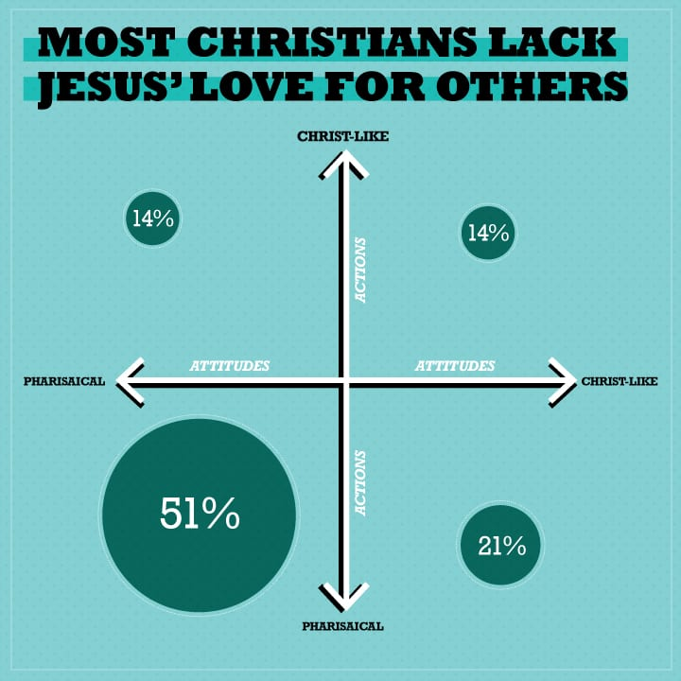
Christians: More Like Jesus or Pharisees?
Barna.com June 3, 2013

Slide 20
…giving no cause for offense in anything, so that the ministry will not be discredited, but in everything commending ourselves as servants of God, in much endurance, in afflictions, in hardships, in distresses, in beatings, in imprisonments, in tumults, in labors, in sleeplessness, in hunger, 2 Corinthians 6:4-5
By…dishonor, by evil report…regarded as deceivers…as unknown…as dying…as punished…as sorrowful…as poor…as having nothing… vv. 8-10
Circumstantial hardship and social rejection.

Slide 21
God’s Ambassadors
Ambassadors are devoted to the king’s mission
Ambassadors increase receptivity to their king
by having godly character/behavior
Sacrificing personal comfort and reputation

Slide 22
…giving no cause for offense in anything, so that the ministry will not be discredited, but in everything commending ourselves as servants of God, in much endurance, in afflictions, in hardships, in distresses, in beatings, in imprisonments, in tumults, in labors, in sleeplessness, in hunger, in purity, in knowledge, in patience, in kindness, in the Holy Spirit, in genuine love, in the word of truth, in the power of God; by the weapons of righteousness for the right hand and the left… 2 Corinthians 6:3-7

Slide 23
God’s Ambassadors
Ambassadors are devoted to the king’s mission
Ambassadors increase receptivity to their king
by having godly character/behavior
Sacrificing personal comfort and reputation
Living an upright life

Slide 24
…giving no cause for offense in anything, so that the ministry will not be discredited, but in everything commending ourselves as servants of God, in much endurance, in afflictions, in hardships, in distresses, in beatings, in imprisonments, in tumults, in labors, in sleeplessness, in hunger, in purity, in knowledge, in patience, in kindness, in the Holy Spirit, in genuine love, in the word of truth, in the power of God; by the weapons of righteousness for the right hand and the left… 2 Corinthians 6:3-7

Slide 25
God’s Ambassadors
Ambassadors are devoted to the king’s mission
Ambassadors increase receptivity to their king
by having godly character/behavior
Sacrificing personal comfort and reputation
Living an upright life
Depending on and using God’s word

Slide 26
…giving no cause for offense in anything, so that the ministry will not be discredited, but in everything commending ourselves as servants of God, in much endurance, in afflictions, in hardships, in distresses, in beatings, in imprisonments, in tumults, in labors, in sleeplessness, in hunger, in purity, in knowledge, in patience, in kindness, in the Holy Spirit, in genuine love, in the word of truth, in the power of God; by the weapons of righteousness for the right hand and the left… 2 Corinthians 6:3-7

Slide 27
God’s Ambassadors
Ambassadors are devoted to the king’s mission
Ambassadors increase receptivity to their king
by having godly character/behavior
Sacrificing personal comfort and reputation
Living an upright life
Depending on and using God’s word
Loving others

Slide 28
…giving no cause for offense in anything, so that the ministry will not be discredited, but in everything commending ourselves as servants of God, in much endurance, in afflictions, in hardships, in distresses, in beatings, in imprisonments, in tumults, in labors, in sleeplessness, in hunger, in purity, in knowledge, in patience, in kindness, in the Holy Spirit, in genuine love, in the word of truth, in the power of God; by the weapons of righteousness for the right hand and the left… 2 Corinthians 6:3-7

Slide 29
God’s Ambassadors
These are the weapons of righteousness!
Ambassadors are devoted to the king’s mission
Ambassadors increase receptivity to their king
by having godly character/behavior
Sacrificing personal comfort and reputation
Living an upright life
Depending on and using God’s word
Loving others
Depending on the power of God

Slide 30
God’s Ambassadors
Ambassadors are devoted to the king’s mission
Ambassadors increase receptivity to their king
Ambassadors are realistic and hopeful

Slide 31
(we commend ourselves as servants of God v.4)…by glory and dishonor, by evil report and good report; regarded as deceivers and yet true; 9 as unknown yet well-known, as dying yet behold, we live; as punished yet not put to death, 10 as sorrowful yet always rejoicing, as poor yet making many rich, as having nothing yet possessing all things.
2 Corinthians 6:8-10

Slide 32
(we commend ourselves as servants of God v.4)…by glory and dishonor, by evil report and good report; regarded as deceivers and yet true; 9 as unknown yet well-known, as dying yet behold, we live; as punished yet not put to death, 10 as sorrowful yet always rejoicing, as poor yet making many rich, as having nothing yet possessing all things.
2 Corinthians 6:8-10

Slide 33
God’s Ambassadors
Ambassadors are devoted to the king’s mission
Ambassadors increase receptivity to their king
Ambassadors are realistic and hopeful
Some will respond & some will not

Slide 34
(we commend ourselves as servants of God v.4)…by glory and dishonor, by evil report and good report; regarded as deceivers and yet true; 9 as unknown yet well-known, as dying yet behold, we live; as punished yet not put to death, 10 as sorrowful yet always rejoicing, as poor yet making many rich, as having nothing yet possessing all things.
2 Corinthians 6:8-10

Slide 35
God’s Ambassadors
Ambassadors are devoted to the king’s mission
Ambassadors increase receptivity to their king
Ambassadors are realistic and hopeful
Some will respond & some will not
We are loved by God and so we are hopeful

Slide 36
God’s Ambassadors
Ambassadors are devoted to the king’s mission
Ambassadors increase receptivity to their king
Ambassadors are realistic and hopeful

