Slide 1
1 Peter 3:1-9
Marriage God’s Way

Slide 2
1 Peter
1 Peter 2: Complicated relationships
Christians living in a non-Christian society
Slaves
1 Peter 2:21 – “For you have been called for this purpose, since Christ also suffered for you, leaving you an example for you to follow in His steps”

Slide 3
1 Peter 3
1 In the same way, you wives, be submissive to your own husbands so that even if any of them are disobedient to the word, they may be won without a word by the behavior of their wives,
2 as they observe your chaste and respectful behavior.

Slide 4
1 Peter 3
3 Your adornment must not be merely external—braiding the hair, and wearing gold jewelry, or putting on dresses;
4 but let it be the hidden person of the heart, with the imperishable quality of a gentle and quiet spirit, which is precious in the sight of God.

Slide 5
1 Peter 3
5 For in this way in former times the holy women also, who hoped in God, used to adorn themselves, being submissive to their own husbands;
6 just as Sarah obeyed Abraham, calling him lord, and you have become her children if you do what is right without being frightened by any fear.
Is the Bible misogynistic?

Slide 6
1 Peter 3
From this passage:
v1 - wives, be submissive to your own husbands
v1 – “In the same way, you wives…”
“In the same way as Christ”
v1-6 is addressed directly to women

Slide 7
1 Peter 3
In comparison:
Talmudic Judaism:
“A man’s wickedness is better than a woman’s goodness; women bring shame and disgrace.” (Sirach 42:14)

Slide 8
1 Peter 3
In comparison:
Quran:
Men are the managers of the affairs of women for that God has preferred in bounty one of them over another…
Righteous women are therefore obedient, guarding the secret for God's guarding.
And those you fear may be rebellious admonish; banish them to their couches, and beat them.
Surah 4:34

Slide 9
1 Peter 3
In comparison:
Atheism:
Nietzsche: Yet woman is not capable of friendship: women are still always cats and birds.
Or, in the best case, cows.

Slide 10
1 Peter 3
In comparison:
Christianity:
Jerome: As long as woman is for birth and children, she is as different from man as body is from soul.
But when she wishes to serve Christ more than the world,
then she will cease to be a woman and will be called Man.

Slide 11
1 Peter 3
From this passage:
v1 - wives, be submissive to your own husbands
v1 – “In the same way, you wives…”
“In the same way as Christ”
v1-6 is addressed directly to women
We made the point last week that what looks regressive to us looked very progressive to them

Slide 12
1 Peter 3
1 In the same way, you wives, be submissive to your own husbands so that even if any of them are disobedient to the word, they may be won without a word by the behavior of their wives,
2 as they observe your chaste and respectful behavior.

Slide 13
Jobes, Karen. 1 Peter: Baker Exegetical Commentary on the New Testament. Grand Rapids, MI: Baker Pub. Group, 2005. 203.
In Greco-Roman society it was expected that the wife would have no friends of her own and would worship the gods of her husband (Plutarch, Advice §19).
If this expectation is applied to a Christian wife, it might result in trouble for several reasons.

Slide 14
Jobes, Karen. 1 Peter: Baker Exegetical Commentary on the New Testament. Grand Rapids, MI: Baker Pub. Group, 2005. 203.
First, the very fact that a woman would adopt any religion other than her husband’s violated the Greco-Roman ideal of an orderly home (Oborn 1939: 133).
Because prosperity and well-being were seen as dependent on religious forces, disorder in the home was a threat not only to the family but to society.

Slide 15
Jobes, Karen. 1 Peter: Baker Exegetical Commentary on the New Testament. Grand Rapids, MI: Baker Pub. Group, 2005. 203.
Christians were frequently blamed as the cause of public calamity because they introduced a new god, upsetting the religious status quo of the empire.
Second, the husband and society would perceive the wife’s worship of Jesus Christ as rebellion, especially if she worshipped Christ exclusively.

Slide 16
Jobes, Karen. 1 Peter: Baker Exegetical Commentary on the New Testament. Grand Rapids, MI: Baker Pub. Group, 2005. 203.
If the wife persisted in her new religion to the extent that others outside the household learned of it, the husband would also feel embarrassment and suffer criticism for not properly managing his household.

Slide 17
Jobes, Karen. 1 Peter: Baker Exegetical Commentary on the New Testament. Grand Rapids, MI: Baker Pub. Group, 2005. 203.
This could seriously damage his social standing, even to the point of disqualifying him for certain honors and offices.

Slide 18
Jobes, Karen. 1 Peter: Baker Exegetical Commentary on the New Testament. Grand Rapids, MI: Baker Pub. Group, 2005. 203.
Third, the wife’s attendance at Christian worship would provide the opportunity for her to have fellowship with other Christians who possibly were not her husband’s friends.
So what?
Remember: women had no power

Slide 19
1 Peter 3
1 In the same way, you wives, be submissive to your own husbands so that even if any of them are disobedient to the word, they may be won over without a word by the behavior of their wives,
2 as they observe your chaste and respectful behavior.
Time to switch to ‘silent witness’

Slide 20
1 Peter 3
1 In the same way, you wives, be submissive to your own husbands so that even if any of them are disobedient to the word, they may be won over without a word by the behavior of their wives,
2 as they observe your chaste and respectful behavior.
This is not just for this context
There are timeless principles (Eph 5, Col 3)
Marriage today isn’t working
Maybe we should turn to the Creator of marriage

Slide 21
1 Peter 3
1 In the same way, you wives, be submissive to your own husbands so that even if any of them are disobedient to the word, they may be won over without a word by the behavior of their wives,
2 as they observe your chaste and respectful behavior.
For them: How to win your husbands
Timeless: Men want to be respected

Slide 22
1 Peter 3
1 In the same way, you wives, be subject to your own husbands so that even if any of them are disobedient to the word, they may be won over without a word by the behavior of their wives,
2 as they observe your chaste and respectful behavior.
For them: How to win your husbands
Timeless: Men want to be respected

Slide 23
1 Peter 3
3 Your adornment must not be merely external—braiding the hair, wearing gold jewelry, or putting on dresses;
4 but let it be the hidden person of the heart, with the imperishable quality of a gentle and quiet spirit, which is precious in the sight of God.
For them: Don’t look suspicious
Timeless: Focus more on the inside than the outside

Slide 24
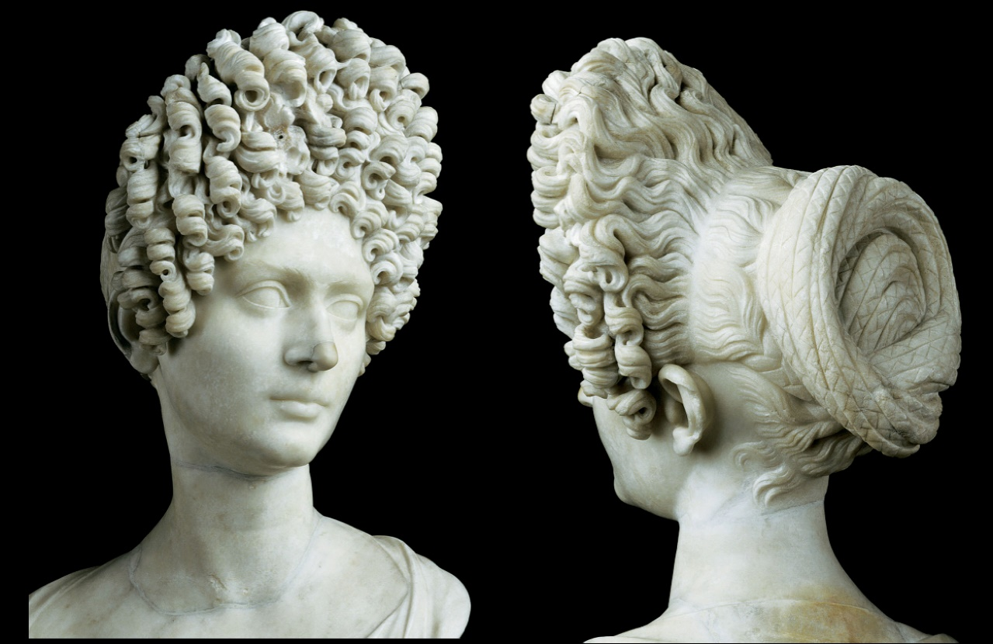
1 Peter 3
Beauty
Our culture is obsessed with looks
You can only keep up appearances for so long
True beauty never fades
3 Your adornment must not be merely external—braiding the hair, wearing gold jewelry, or putting on dresses;
4 but let it be the hidden person of the heart, with the imperishable quality of a gentle and quiet spirit, which is precious in the sight of God.
For them: Don’t look suspicious
Timeless: Focus more on the inside than the outside

Slide 25
1 Peter 3
3 Your adornment must not be merely external—braiding the hair, wearing gold jewelry, or putting on dresses;
4 but let it be the hidden person of the heart, with the imperishable quality of a gentle and quiet spirit, which is precious in the sight of God.
Jesus called Himself gentle (Matt 11:29)

Slide 26
1 Peter 3
5 For in this way in former times the holy women also, who hoped in God, used to adorn themselves, being submissive to their own husbands,
6 just as Sarah obeyed Abraham, calling him lord; and you have become her children if you do what is right without being frightened by any fear.
For them: Other women can relate
Timeless: Respect takes courage

Slide 27
1 Peter 3
7 You husbands in the same way, live with your wives in an understanding way, as with someone weaker, since she is a woman;
and show her honor as a fellow heir of the grace of life, so that your prayers will not be hindered.

Slide 28
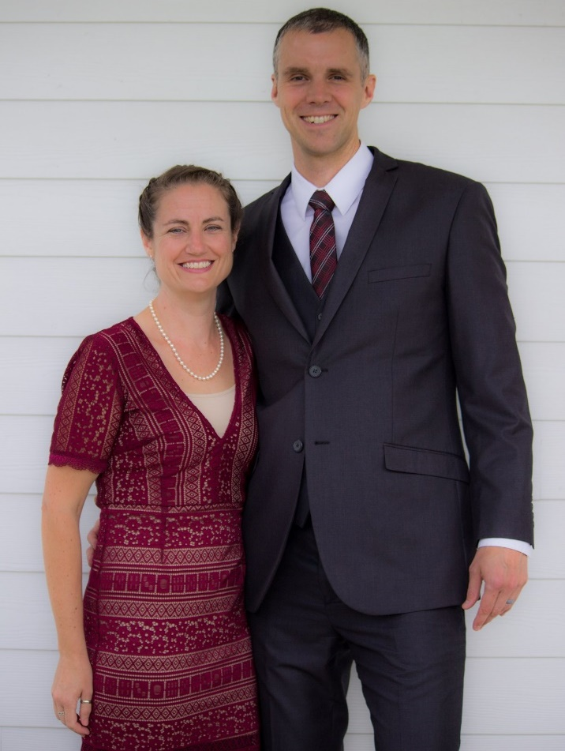
1 Peter 3
7 You husbands in the same way, live with your wives in an understanding way, as with someone weaker, since she is a woman;
and show her honor as a fellow heir of the grace of life, so that your prayers will not be hindered.

Slide 29
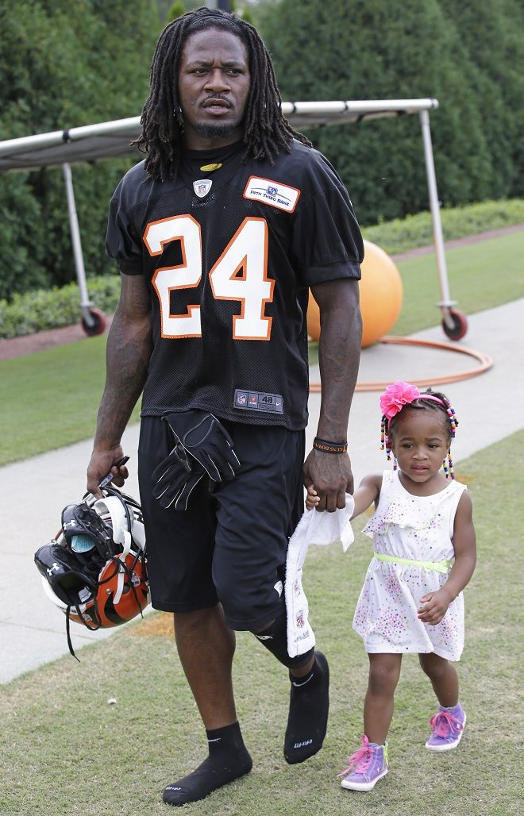
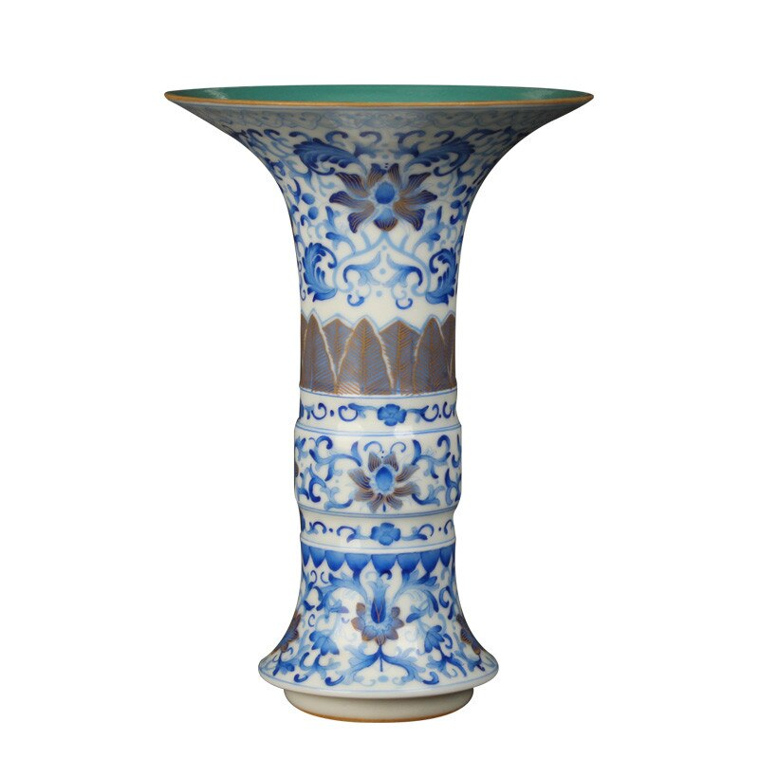
1 Peter 3
7 You husbands in the same way, live with your wives in an understanding way, as with someone weaker, since she is a woman;
and show her honor as a fellow heir of the grace of life, so that your prayers will not be hindered.
Lit: “A weaker vessel”

Slide 30
1 Peter 3
7 You husbands in the same way, live with your wives in an understanding way, as with someone weaker, since she is a woman;
and show her honor as a fellow heir of the grace of life, so that your prayers will not be hindered.
For them: Husbands need to be present and gentle
Timeless: Husbands need to be present and gentle

Slide 31
1 Peter 3
8 To sum up, all of you be harmonious, sympathetic, brotherly, kindhearted, and humble in spirit;
9 not returning evil for evil or insult for insult, but giving a blessing instead; for you were called for the very purpose that you might inherit a blessing.
For everyone: Relationships with God will look different…in a good way

Slide 32
1 Peter 3
8 To sum up, all of you be harmonious, sympathetic, brotherly, kindhearted, and humble in spirit;
9 not returning evil for evil or insult for insult, but giving a blessing instead; for you were called for the very purpose that you might inherit a blessing.
1 Peter 2:24 – and He Himself bore our sins in His body on the cross, so that we might die to sin but live to righteousness, for by His wounds you were healed.

Slide 33
Conclusions
If you are here and you are married – there is hope for your marriage
If you are here and you are single – there is hope for your relationships
If you are here and you are investigating – God wants you to know those first two are available through a relationship with Him

Slide 34
1 Peter 3:1-9
Questions?
Comments?
Experiences?
risleyc@dwellcc.org
See the Dwell App OR teachings.dwellcc.org
Next time: 1 Peter 3:10-22 – Reasons to believe

