Slide 2
Aristotle
Aristotle: The megalopsycholos (or “great-souled” man) is “the sort of person who does good, but is ashamed when he receives it; for doing good is proper to the superior person, and receiving it to the inferior.”
Aristotle, Nicomachean Ethics (1124b1110–1114).

Slide 3
Aristotle
Joseph Stalin
Joseph Stalin: “[Gratitude] is a sickness suffered by dogs.”
Nikolai Tolstoy, Stalin’s Secret War (1981). Cited in Susan Ratcliffe, Oxford Treasury of Sayings and Quotations (Oxford: Oxford University Press, 2011), 196.

Slide 4
Aristotle
Joseph Stalin
Naturalism
G.K. Chesterton: “The worst moment for an atheist is when he is really thankful and has no one to thank.”
G.K. Chesterton, St. Francis of Assisi, 74-77.

Slide 5
Aristotle
Joseph Stalin
Naturalism
New Age thought
Biblical gratitude is not “mind power.”
Our beliefs have an effect in us, but they do not affect the external world around us!

Slide 6
(Lk. 18:11-12) “The Pharisee [said], ‘God, I thank You
that I am not like other people:
swindlers, unjust, adulterers, or even like this tax collector. I fast twice a week; I pay tithes of all that I get.’”
Aristotle
Joseph Stalin
Naturalism
New Age thought
Legalistic religious systems

Slide 7
(Lk. 18:11-12) “The Pharisee [said], ‘God, I thank You
that I am not like other people:
swindlers, unjust, adulterers, or even like this tax collector. I fast twice a week; I pay tithes of all that I get.’”
Aristotle
Joseph Stalin
Naturalism
New Age thought
Legalistic religious systems

Slide 8
Aristotle
Joseph Stalin
Naturalism
New Age thought
Legalistic religious systems
Biblical gratitude
Grounded in God’s love for us who are unrighteous, rather than in self-righteousness.
“Gratitude” (Latin gratia) which means “grace, graciousness, or gratefulness.”
“Thanksgiving” (Greek eucharistos).
Why does God command us to give thanks?

Slide 9
(Rom. 1:21) Even though they knew God, they did not honor Him as God
or give thanks,
but they became futile in their speculations, and their foolish heart was darkened.
Why do I feel dull and lifeless when it comes to spiritual things?

Slide 10
(Lk. 17:12) As [Jesus] entered a village, ten leprous men who stood at a distance met Him;
¹³ and they raised their voices, saying, “Jesus, Master, have mercy on us!”
Why do I always feel like God is holding back on me?

Slide 11
(Lk. 17:14) When He saw them, He said to them,
“Go and show yourselves to the priests.”
And as they were going, they were cleansed.
Why do I always feel like God is holding back on me?

Slide 12
(Lk. 17:15) Now one of them, when he saw that he had been healed, turned back, glorifying God with a loud voice,
¹⁶ and he fell on his face at His feet, giving thanks to Him. And he was a Samaritan.
Why do I always feel like God is holding back on me?

Slide 13
(Lk. 17:17) Then Jesus answered and said,
“Were there not ten cleansed?
But the nine—where are they?”
Why do I always feel like God is holding back on me?

Slide 14
(Eph. 5:18-20) “Be filled with the Spirit…
always giving thanks for all things in the name of our Lord Jesus Christ to God.”
Why do I feel like my efforts to serve God lack His power?

Slide 15
(Col. 4:2) Devote yourselves to prayer, keeping alert in it
with an attitude of thanksgiving.
(1 Tim. 2:1) First of all, then, I urge that entreaties and prayers,
petitions and thanksgivings,
be made on behalf of all men.
Why have I never really been able to develop a healthy prayer life?

Slide 16
(1 Thess. 5:16-18) “Rejoice always; pray without ceasing;
in everything give thanks;
for this is God’s will for you in Christ Jesus.”
Why have I never really been able to develop a healthy prayer life?

Slide 17
(Phil. 4:6) Be anxious for nothing, but in everything by prayer and supplication
with thanksgiving
let your requests be made known to God.
Why am I gripped with anxiety when I’m not in any real danger?

Slide 18
(Phil. 4:7) And the peace of God, which surpasses all comprehension, will guard your hearts and your minds in Christ Jesus.
Why am I gripped with anxiety when I’m not in any real danger?

Slide 19
(Col. 2:6-7) “Just as you have received Christ Jesus the Lord,
so walk in Him, having been firmly rooted and now being built up in Him and established in your faith…
overflowing with gratitude.”
Why have I become less passionate for Christ over time?

Slide 20
(Col. 3:15) Let the peace of Christ rule in your hearts, to which indeed you were called in one body;
and be thankful.
Why am I habitually in conflict with other believers around me?

Slide 21
Effects on:
(1) Emotional health
(2) Physical health
(3) Relational health

Slide 22
Effects on:
(1) Emotional health
(2) Physical health
(3) Relational health

Slide 23
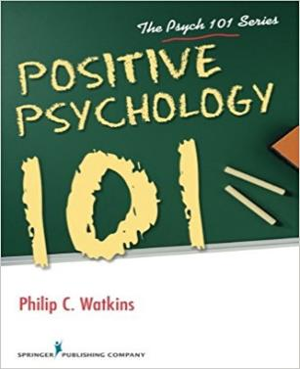
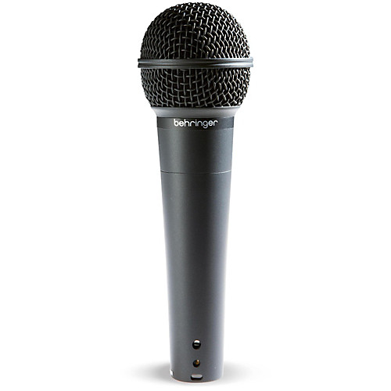
Philip Watkins
(Professor of psychology at Eastern Washington University)
Philip Watkins, Positive Psychology 101 (New York: Springer Publishing Co., 2016), 74.
Gratitude encourages happiness by amplifying the good in one’s life.

Slide 24
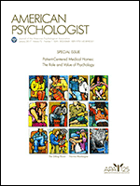
Martin Seligman
(University of Pennsylvania Psychologist and President of the APA in 1998)
Martin Seligman, “Positive Psychology Progress.” American Psychologist, 60 (5), 2005, 410-421.
[The “gratitude visit” immediately increased happiness by 10%.
But these results cut in half in a week, and were totally gone in six months.]

Slide 25
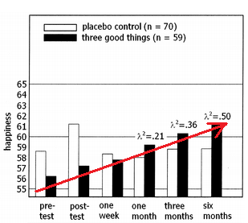
Martin Seligman
(University of Pennsylvania Psychologist and President of the APA in 1998)
Martin Seligman, “Positive Psychology Progress.” American Psychologist, 60 (5), 2005, 410-421.
[The “three good things” exercise produced only a 2% increase in happiness in a week, a 5% increase after a month, but 9% at six months.]

Slide 26
Martin Seligman
(University of Pennsylvania Psychologist and President of the APA in 1998)
Martin Seligman, “Positive Psychology Progress.” American Psychologist, 60 (5), 2005, 410-421.
[Depressive symptoms declined by 28% after one week, and continued to lower as it continued.]

Slide 27
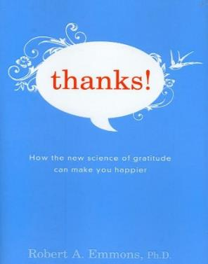
Robert Emmons
(Psychologist at University of California)
Robert Emmons, Thanks! How the New Science of Gratitude Can Make You Happier (New York: Houghton Mifflin Co., 2007), 30.
[Study #1: On a weekly regimen, three different groups recorded either (1) “blessings,” (2) “hassles,” or (3) “events.”]

Slide 28
Robert Emmons
(Psychologist at University of California)
Robert Emmons, Thanks! How the New Science of Gratitude Can Make You Happier (New York: Houghton Mifflin Co., 2007), 30.
[The blessings group] were a full 25 percent happier than the other participants.

Slide 29
Robert Emmons
(Psychologist at University of California)
Robert Emmons, Thanks! How the New Science of Gratitude Can Make You Happier (New York: Houghton Mifflin Co., 2007), 31-32.
[In another study] “Significant others rated participants in the gratitude group as actually more helpful compared to those in the other groups.”

Slide 30
Robert Emmons
(Psychologist at University of California)
Robert Emmons, Thanks! How the New Science of Gratitude Can Make You Happier (New York: Houghton Mifflin Co., 2007), 31-32.
(These friends were not aware of which experimental condition the participants were in).

Slide 31
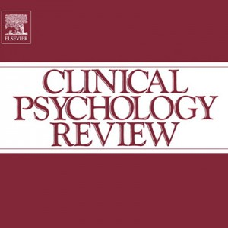
Alex Wood
(Professor of Behavioral Science at the University of Stirling)
Alex M. Wood (et al.), “Gratitude and well-being: A review and theoretical integration” Clinical Psychology Review (2010).
[Dr. Alex Wood was originally a skeptic of gratitude research, thinking it was simply New Age pseudoscience.]

Slide 32
Alex Wood
(Professor of Behavioral Science at the University of Stirling)
Alex M. Wood (et al.), “Gratitude and well-being: A review and theoretical integration” Clinical Psychology Review (2010), 6.
12 studies have supported the link between gratitude and subjective well-being.

Slide 33
Alex Wood
(Professor of Behavioral Science at the University of Stirling)
Alex M. Wood (et al.), “Gratitude and well-being: A review and theoretical integration” Clinical Psychology Review (2010), 4-5.
Thankfulness predicted signiﬁcantly lower risk of major depression, generalized anxiety disorder, phobia, nicotine dependence, alcohol dependence, and drug ‘abuse’ or dependence.

Slide 34
Alex Wood
(Professor of Behavioral Science at the University of Stirling)
Alex M. Wood (et al.), “Gratitude and well-being: A review and theoretical integration” Clinical Psychology Review (2010), 4-5.
Additionally, thankfulness was related to a much lower risk of bulimia nervosa…
Increase[d] gratitude may have beneﬁts for people with PTSD.

Slide 35
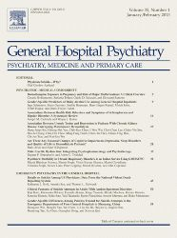
Jeff Huffman
(Associate Professor of Psychiatry at Harvard Medical School)
Jeff C. Huffman (et al.), “Feasibility and utility of positive psychology exercises for suicidal inpatients,” General Hospital Psychiatry, 36 (2014) 88–94.
[He gave the patients nine different positive psychological exercises.]
The two best exercises were
writing a “gratitude letter” and “counting [their] blessings.”

Slide 36
Effects on:
(1) Emotional health
(2) Physical health
(3) Relational health

Slide 37
Effects on:
(1) Emotional health
(2) Physical health
(3) Relational health

Slide 38
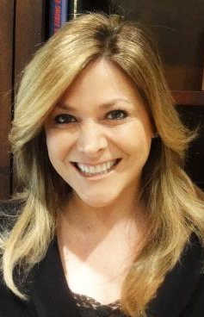
Wendy Mendes
(University of California, social and biological psychologist)
Lecture given for the John Templeton Foundation’s “Greater Good Science Center” (2014), Wendy Mendes, “Effects of Measured and Manipulated Gratitude on Biomarkers of Health and Aging.”
At a biological level, we find that people who are higher in gratitude have lower resting blood pressure.

Slide 39
Wendy Mendes
(University of California, social and biological psychologist)
Lecture given for the John Templeton Foundation’s “Greater Good Science Center” (2014), Wendy Mendes, “Effects of Measured and Manipulated Gratitude on Biomarkers of Health and Aging.”
When we expose them to a stressor, they also respond with lower blood pressure responses…

Slide 40
Wendy Mendes
(University of California, social and biological psychologist)
Lecture given for the John Templeton Foundation’s “Greater Good Science Center” (2014), Wendy Mendes, “Effects of Measured and Manipulated Gratitude on Biomarkers of Health and Aging.”
Again, NOT New Age mind power, but likely related to the physiological effects of stress.
Alex M. Wood (et al.), “Gratitude and well-being: A review and theoretical integration” Clinical Psychology Review (2010), 7.
Higher levels of gratitude are related to higher good cholesterol and lower bad cholesterol.

Slide 41
Robert Emmons
(Psychologist at University of California)
Robert Emmons, Thanks! How the New Science of Gratitude Can Make You Happier (New York: Houghton Mifflin Co., 2007), 67.
People who scored high on optimism had a 50 percent lower risk of premature death than those who scored as being more pessimistic.

Slide 42
Effects on:
(1) Emotional health
(2) Physical health
(3) Relational health

Slide 43
Effects on:
(1) Emotional health
(2) Physical health
(3) Relational health

Slide 44
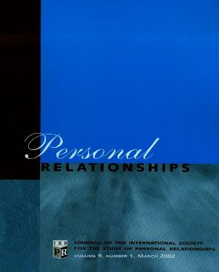
Sara Algoe
(Professor of Psychology at the University of North Carolina, Chapel Hill)
Sara B. Algoe (et al.), “It’s the little things: Everyday gratitude as a booster shot for romantic relationships,” Personal Relationships, 17 (2010), 228.
[Both partners answered yes or no to these two statements: (1) “I did something thoughtful for my partner” and (2) “My partner did something thoughtful for me.”]

Slide 45
Sara Algoe
(Professor of Psychology at the University of North Carolina, Chapel Hill)
Sara B. Algoe (et al.), “It’s the little things: Everyday gratitude as a booster shot for romantic relationships,” Personal Relationships, 17 (2010), 228.
[Then they rated their emotions on a scale of 0-6.
Participants then answered the question: “Today our relationship was _______.” (1-9 scale).]

Slide 46
Sara Algoe
(Professor of Psychology at the University of North Carolina, Chapel Hill)
Sara B. Algoe (et al.), “It’s the little things: Everyday gratitude as a booster shot for romantic relationships,” Personal Relationships, 17 (2010), 228.
[When one person reported feeling more gratitude from their partner,
their partner independently felt better about the relationship than they did the day before.]

Slide 47
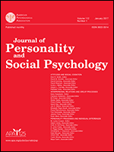
John Gottman
(Professor Emeritus of Psychology at the University of Washington)
John Gottman, “Marital processes predictive of later dissolution: Behavior, physiology, and health,” Journal of Personality and Social Psychology, Vol 63 (2), Aug 1992, 221-233.
[Gottman performed a study of 73 married couples where he quantified positive versus negative interactions between couples.]

Slide 48
John Gottman
(Professor Emeritus of Psychology at the University of Washington)
John Gottman, “Marital processes predictive of later dissolution: Behavior, physiology, and health,” Journal of Personality and Social Psychology, Vol 63 (2), Aug 1992, 221-233.
[Contemptuous expression (-0.4)
Whining (-1.0).
Expression of disgust (-3.0)]

Slide 49
John Gottman
(Professor Emeritus of Psychology at the University of Washington)
John Gottman, “Marital processes predictive of later dissolution: Behavior, physiology, and health,” Journal of Personality and Social Psychology, Vol 63 (2), Aug 1992, 221-233.
[After filming the couples having conflict, he was able to predict
with 94% accuracy whether they would stay married or get divorced.]

Slide 50
John Gottman
(Professor Emeritus of Psychology at the University of Washington)
John Gottman, “Marital processes predictive of later dissolution: Behavior, physiology, and health,” Journal of Personality and Social Psychology, Vol 63 (2), Aug 1992, 221-233.
[His famous “5:1 ratio” is that couples need five positive interactions for
every one negative interaction.]

Slide 51
Effects on:
(1) Emotional health
(2) Physical health
(3) Relational health

Slide 52
Our role—not God’s role.

Slide 53
Our role—not God’s role.
Requires thoughtful reflection.
To “recognize” is to re-cognize
(Ps. 103:2) “Let all that I am praise the Lord; may I never forget the good things he does for me.”

Slide 54
Our role—not God’s role.
Requires thoughtful reflection.
Avoid platitudes and clichés.
Ask the question, “Why am I thankful for that today?”

Slide 55
Our role—not God’s role.
Requires thoughtful reflection.
Avoid platitudes and clichés.
Imagine if various gifts were taken away.
Imagine if…
You thought you might go to hell if you died tomorrow.
You could never read the Bible for the rest of your life.
You had never met any of your close Christian friends.
One of your loved ones was gone…

Slide 56
Our role—not God’s role.
Requires thoughtful reflection.
Avoid platitudes and clichés.
Imagine if various gifts were taken away.
Focus on expressing gratitude, rather than just feeling it.

Slide 57
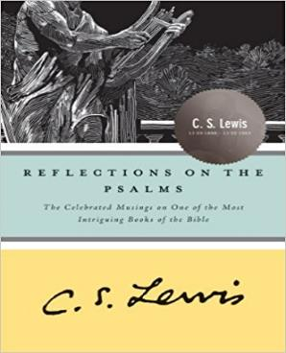
C.S. Lewis
(Christian academic, author, apologist)
C.S. Lewis, Reflections on the Psalms (New York: Harvest Book; Houghton Mifflin, 1958), 95.
I think we delight to praise what we enjoy because the praise not merely expresses but completes the enjoyment…

Slide 58
C.S. Lewis
(Christian academic, author, apologist)
C.S. Lewis, Reflections on the Psalms (New York: Harvest Book; Houghton Mifflin, 1958), 95.
It is not out of compliment that lovers keep on telling one another how beautiful they are;
the delight is incomplete till it is expressed.

Slide 59
Potential areas to explore:
For how God made me.
Psalms 139:14
2 Corinthians 12:9-10

Slide 60
Potential areas to explore:
For how God made me.
For God’s power in spiritual growth.
1 Thessalonians 4:3
Philippians 1:6
Romans 7:24-25

Slide 61
Potential areas to explore:
For how God made me.
For God’s power in spiritual growth.
For God’s power in spiritual service.
2 Corinthians 2:14
1 Corinthians 15:58
Galatians 6:9
Matthew 16:18

Slide 62
Potential areas to explore:
For how God made me.
For God’s power in spiritual growth.
For God’s power in spiritual service.
For those under our spiritual care.
Paul gave thanks for the churches in:
Rome (Rom. 1:8).
Asia Minor (Eph. 1:16).
Philippi (Phil. 1:3).
Colossae (Col. 1:3).
Corinth (1 Cor. 1:4).
Thessalonica (1 Thess. 1:2).
All the Gentile churches (Rom. 16:4).

Slide 63
Potential areas to explore:
For how God made me.
For God’s power in spiritual growth.
For God’s power in spiritual service.
For those under our spiritual care.
For the privilege of serving God.
1 Timothy 1:12-13 2 Corinthians 4:1

Slide 64
Potential areas to explore:
For how God made me.
For God’s power in spiritual growth.
For God’s power in spiritual service.
For those under our spiritual care.
For the privilege of serving God.
Marriage, kids, work.
“[God] Himself is kind to ungrateful and evil men” (Lk. 6:35).
“She knows how I feel.”
“When is the last time I told her how much I appreciate her love, sacrifice, and hard work?”

Slide 65
Potential areas to explore:
For how God made me.
For God’s power in spiritual growth.
For God’s power in spiritual service.
For those under our spiritual care.
For the privilege of serving God.
Marriage, kids, work.
More than mere etiquette.
“Three things” every night.
When we sit around the dinner table…
…do we spend most of our time complaining about serving God?

Slide 66
Potential areas to explore:
For how God made me.
For God’s power in spiritual growth.
For God’s power in spiritual service.
For those under our spiritual care.
For the privilege of serving God.
Marriage, kids, work.
Current job was the lowest on the list, and work was the least likely place to give thanks.
However, people desired to be thanked more often at work!
Gratitude Study for the John Templeton Foundation: Emiliana R. Simon-Thomas & Jeremy Adam Smith, “How Grateful are Americans?” Greater Good Magazine (January 10, 2013),

Slide 67
Our major problem isn’t that God has held back blessing us…
But that we don’t recognize it!
Will another blessing from God really change an ungrateful attitude in our hearts?

