Slide 1
How To Talk So Your Kids Will Listen and How To Listen So Kids Will Talk
CARE Group Dec 2018

Slide 2
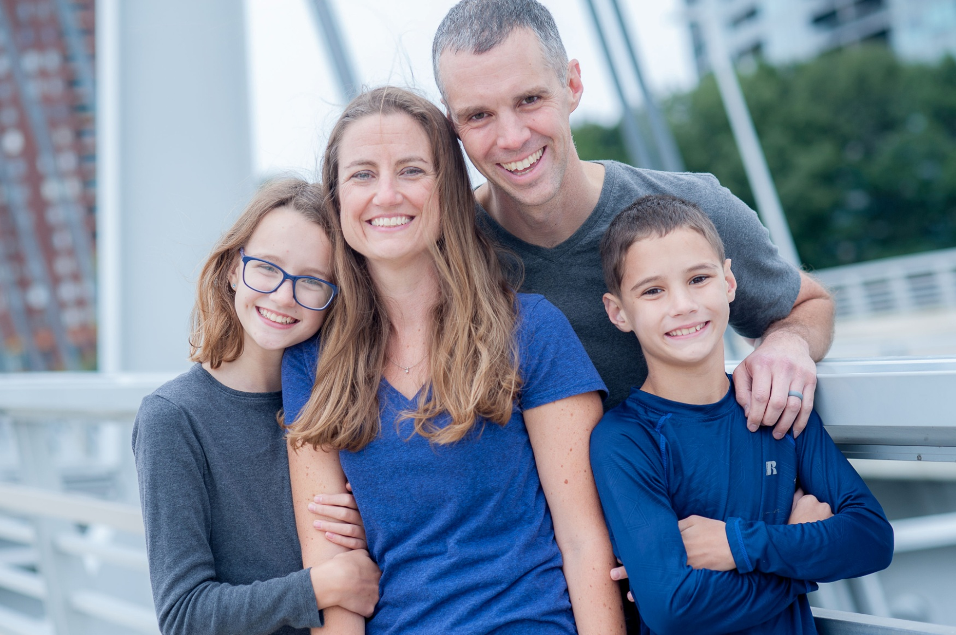

Slide 3
Our goal as parents is to build a relationship with our kids, to relate to them the way God relates to us.
Psalm 27:8 - My heart has heard you say, “Come and talk with me.”
And my heart responds, “Lord, I am coming.”

Slide 4
How To Listen
Ever notice how much the Lord lets you talk?
The Psalms are just God listening, and the psalmist talks himself into the correct perspective.
We may have learned listening skills with our friends, but ever notice how you don’t use them with your kids?

Slide 5
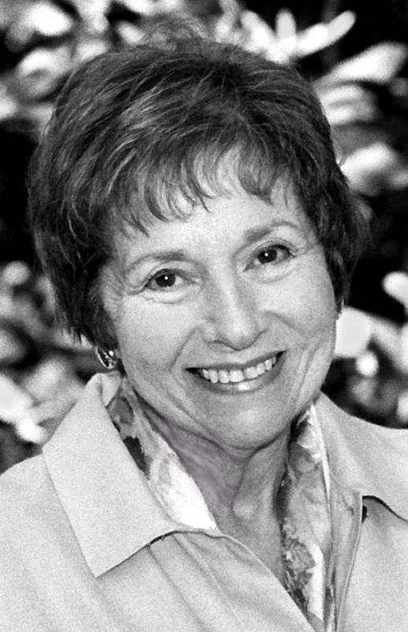
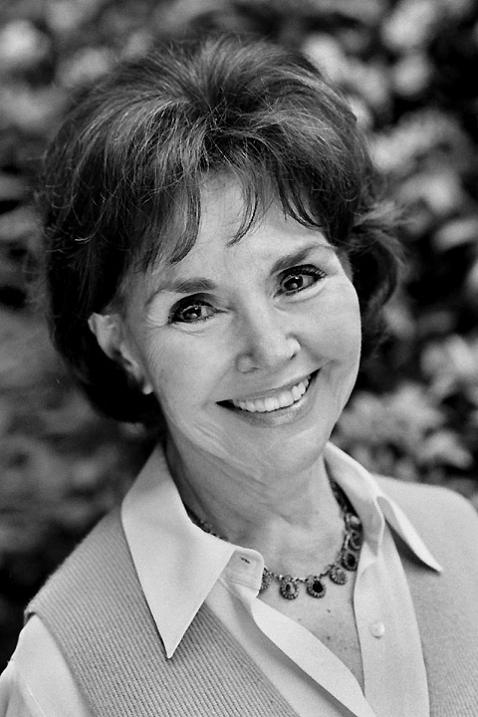
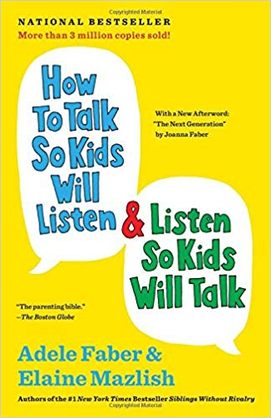
Adele
Elaine

Slide 6
How To Listen
Helping with Feelings

Slide 7
Faber and Mazlish
Authors and Moms
Faber and Mazlish, ‘How to Talk so Kids Will Listen & Listen So Kids Will Talk (New York: Scribner, 2012), p.8.
When I’m upset or hurting, the last thing I want to hear is advice, philosophy, psychology, or the other fellow’s point of view.
That kind of talk makes me only feel worse than before.

Slide 8
Faber and Mazlish
Authors and Moms
Faber and Mazlish, ‘How to Talk so Kids Will Listen & Listen So Kids Will Talk (New York: Scribner, 2012), p.8.
Pity leaves me feeling pitiful; questions put me on the defensive; and most infuriating of all is to hear that I have no reason to feel what I’m feeling.
My overriding reaction to most of these responses is “Oh, forget it. . . . What’s the point of going on?”

Slide 9
Faber and Mazlish
Authors and Moms
Faber and Mazlish, ‘How to Talk so Kids Will Listen & Listen So Kids Will Talk (New York: Scribner, 2012), p.8.
But let someone really listen, let someone acknowledge my inner pain and give me a chance to talk more about what’s troubling me,
and I begin to feel less upset, less confused, more able to cope with my feelings and my problem.

Slide 10
How To Listen
Helping with Feelings
Eye contact

Slide 11
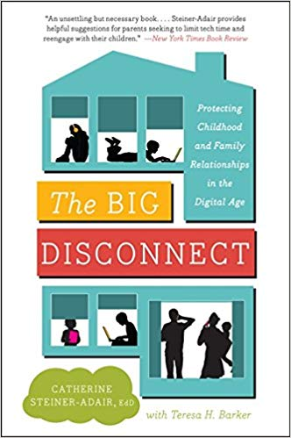
Catherine Steiner-Adair
The Big Disconnect: Protecting Childhood and Family Relationships in the Digital Age, quoted in https://www.npr.org/sections/alltechconsidered/2014/04/16/303749247/when-parents-are-the-ones-too-distracted-by-devices
[For her book, Steiner-Adair interviewed more than 1,000 kids from the ages of 4 to 18. She talked to hundreds of teachers and parents.]

Slide 12
Catherine Steiner-Adair
The Big Disconnect: Protecting Childhood and Family Relationships in the Digital Age, quoted in https://www.npr.org/sections/alltechconsidered/2014/04/16/303749247/when-parents-are-the-ones-too-distracted-by-devices
"One of the many things that absolutely knocked my socks off," she says,
"was the consistency with which children — whether they were 4 or 8 or 18 or 24 — talked about feeling exhausted and frustrated and sad or mad

Slide 13
Catherine Steiner-Adair
The Big Disconnect: Protecting Childhood and Family Relationships in the Digital Age, quoted in https://www.npr.org/sections/alltechconsidered/2014/04/16/303749247/when-parents-are-the-ones-too-distracted-by-devices
trying to get their parents' attention, competing with computer screens or iPhone screens or any kind of technology,
much like in therapy you hear kids talk about sibling rivalry."

Slide 14
How To Listen
Helping with Feelings
Eye contact
A few other tips that stuck with me…

Slide 15
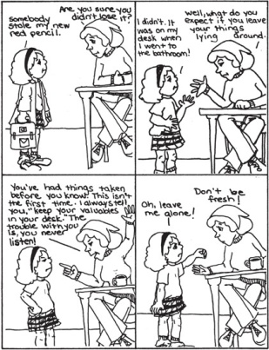
INSTEAD OF QUESTIONS AND ADVICE

Slide 16
INSTEAD OF QUESTIONS AND ADVICE

Slide 17
ACKNOWLEDGE WITH A WORD

Slide 18
ACKNOWLEDGE WITH A WORD

Slide 19
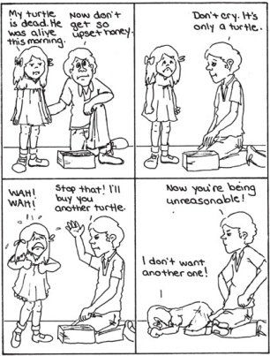
INSTEAD OF DENYING THE FEELING

Slide 20
INSTEAD OF DENYING THE FEELING

Slide 21
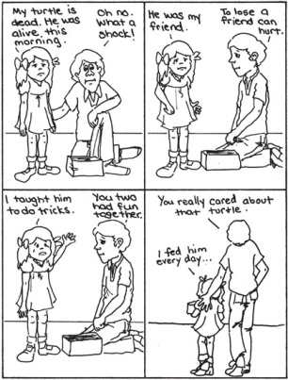
GIVE THE FEELING A NAME

Slide 22
GIVE THE FEELING A NAME

Slide 23
INSTEAD OF EXPLANATION AND LOGIC

Slide 24
INSTEAD OF EXPLANATION AND LOGIC

Slide 25
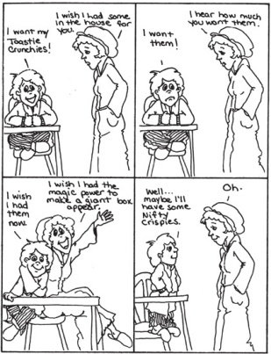
GIVE A CHILD HIS WISHES IN FANTASY

Slide 26
GIVE A CHILD HIS WISHES IN FANTASY

Slide 27
How To Listen
Focused Attention: Dates
Share what’s going on in your life
John 15:15
I no longer call you servants, because a servant does not know his master’s business.
Instead, I have called you friends, for everything that I learned from my Father I have made known to you.

Slide 28
How To Listen
Focused Attention: Dates
Share what’s going on in your life
Do something to get them talking
Bedtime: this takes wisdom

Slide 29
All Of This Is Under Grace
Luke 11:13 – “If you then, though you are evil, know how to give good gifts to your children, how much more will your Father in heaven give the Holy Spirit to those who ask him!”
Eph 2:8-9 – For by grace you have been saved through faith, and that not of yourselves, it is the gift of God; and not as a result of works, so that no one may boast.

Slide 30
How To Talk
Be kind
Requests, please and thank you

Slide 31
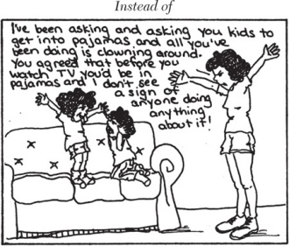
SAY IT WITH A WORD
Instead of this:

Slide 32
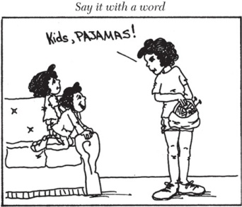
SAY IT WITH A WORD
Try this:

Slide 33
SAY IT WITH A WORD
“SHOES”
“LUNCH”
“COATS”
“DOOR”
Try this:

Slide 34
How To Talk
If you are getting frustrated, just tell them. They can tell anyway.
Apologize
Compare this: “I’m sorry I got angry but you weren’t listening!”
With this: “I’m sorry I got angry. I was frustrated when you weren’t listening, but I should not have lost my temper like that. Will you forgive me?”

Slide 35
How To Talk
Give them choices

Slide 40
How To Talk
Give them choices
Try to pick the right battles
So many other things we could discuss…

Slide 41
Conclusions
Parenting is an art and a skill – it takes practice
God wants to enable you to grow as a parent, and to build strong relationships with your kids

Slide 42
How To Listen, How To Talk
Questions?
Comments?
Experiences?
chris.risley@gmail.com
xenos.org/parenting

