Slide 1
Proverbs
THE BOOK OF
1:1-7: Searching for Wisdom

Slide 2
Where is the life we have lost in living? Where is the wisdom we have lost in knowledge? Where is the knowledge we have lost in information?
̶ T.S. Eliot

Slide 3
We’re living in the “information age,” but we certainly aren’t living in the “age of wisdom.” Many people who are wizards with their computers seem to be amateurs when it comes to making a success out of their lives. Computers can store data and obey signals, but they can’t give us the ability to use that knowledge wisely. What’s needed today is wisdom.
̶ Warren Wiersbe

Slide 4
What is biblical wisdom?

Slide 5
Proverbs 1
¹ These are the proverbs of Solomon, David’s son, king of Israel.
² Their purpose is to teach people wisdom and discipline, to help them understand the insights of the wise.

Slide 6
Proverbs 1
¹ These are the proverbs of Solomon, David’s son, king of Israel.
² Their purpose is to teach people wisdom and discipline, to help them understand the insights of the wise.
Hb. hokmah = “skill” or “craft”
Exodus 36:2: Moses summoned…every skilled [hokmah] person to whom the LORD had given ability [hokmah] and who was willing to come and do the work.

Slide 7
Proverbs 1
¹ These are the proverbs of Solomon, David’s son, king of Israel.
² Their purpose is to teach people wisdom and discipline, to help them understand the insights of the wise.
Hb. hokmah = “skill” or “craft”
Laws of Observation
Proverbs 13:16: Wise people think before they act; fools don’t—and even brag about their foolishness.

Slide 8
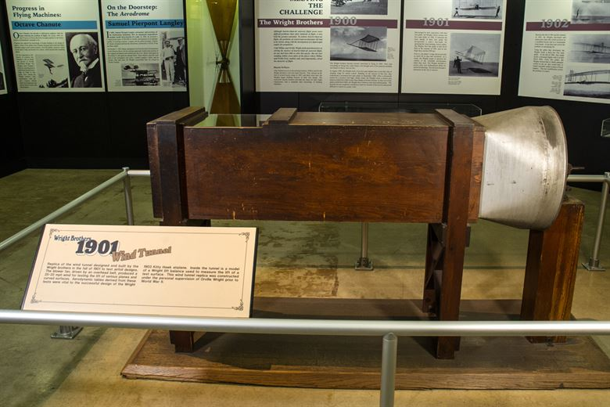
The Wright Bros Wind Tunnel

Slide 9
Proverbs 1
¹ These are the proverbs of Solomon, David’s son, king of Israel.
² Their purpose is to teach people wisdom and discipline, to help them understand the insights of the wise.
Laws of Observation
Proverbs 3:19: By wisdom the Lord laid the earth’s foundations, by understanding he set the heavens in place.

Slide 10
Proverbs 1
¹ These are the proverbs of Solomon, David’s son, king of Israel.
² Their purpose is to teach people wisdom and discipline, to help them understand the insights of the wise.
Laws of Observation
The book of Proverbs sometimes refers to its wisdom as a “law.”
Proverbs 14:12: There is a way that seems right to a man, but in the end it leads to death.

Slide 11
Proverbs 1
¹ These are the proverbs of Solomon, David’s son, king of Israel.
² Their purpose is to teach people wisdom and discipline, to help them understand the insights of the wise.
Laws of Observation
Whereas, Moses obtained direct revelation from God, the authors of Proverbs obtained revelation by observing God’s created order.

Slide 12
Proverbs 1
¹ These are the proverbs of Solomon, David’s son, king of Israel.
² Their purpose is to teach people wisdom and discipline, to help them understand the insights of the wise.
Laws of Observation
Whereas, Moses obtained direct revelation from God, the authors of Proverbs obtained revelation by observing God’s created order.
Epicurean philosopher: “Eat, drink and be merry, because tomorrow we die.”

Slide 13
Proverbs 1
¹ These are the proverbs of Solomon, David’s son, king of Israel.
² Their purpose is to teach people wisdom and discipline, to help them understand the insights of the wise.
Laws of Observation
Whereas, Moses obtained direct revelation from God, the authors of Proverbs obtained revelation by observing God’s created order.
Ecclesiastes 3:13: “Eat, drink, and be merry, for it is the gift of God.”

Slide 14
Proverbs 1
¹ These are the proverbs of Solomon, David’s son, king of Israel.
² Their purpose is to teach people wisdom and discipline, to help them understand the insights of the wise.
Gaining Wisdom from Proverbs
The Hebrew word proverb means “a comparison.”
Proverbs 26:14: As a door swings back and forth on its hinges, so the lazy person turns over in bed.

Slide 15
Proverbs 1
¹ These are the proverbs of Solomon, David’s son, king of Israel.
² Their purpose is to teach people wisdom and discipline, to help them understand the insights of the wise.
Gaining Wisdom from Proverbs
The Proverbs serve as axioms for living
“The early bird gets the worm.”
“Where there is smoke, there is fire.”

Slide 16
Proverbs 1
¹ These are the proverbs of Solomon, David’s son, king of Israel.
² Their purpose is to teach people wisdom and discipline, to help them understand the insights of the wise.
Gaining Wisdom from Proverbs
The Proverbs serve as axioms for living
“A man who lives in a glass house should change his clothes in the basement.”
“A peacock that sits on its tail is just another turkey.”

Slide 17
Proverbs 1
¹ These are the proverbs of Solomon, David’s son, king of Israel.
² Their purpose is to teach people wisdom and discipline, to help them understand the insights of the wise.
Reading Proverbs
Context doesn’t always add clarity to a proverb’s meaning.

Slide 18
Proverbs 1
¹ These are the proverbs of Solomon, David’s son, king of Israel.
² Their purpose is to teach people wisdom and discipline, to help them understand the insights of the wise.
Reading Proverbs
They give balance to each other.
Proverbs 10:15: The rich man’s wealth is his fortress.

Slide 19
Proverbs 1
¹ These are the proverbs of Solomon, David’s son, king of Israel.
² Their purpose is to teach people wisdom and discipline, to help them understand the insights of the wise.
Reading Proverbs
They give balance to each other.
Proverbs 23:4-5: Do not weary yourself to gain wealth, cease from your consideration of it. When you set your eyes on it, it is gone. For wealth certainly makes itself wings like an eagle that flies toward the heavens.

Slide 20
Proverbs 1
¹ These are the proverbs of Solomon, David’s son, king of Israel.
² Their purpose is to teach people wisdom and discipline, to help them understand the insights of the wise.
Reading Proverbs
At times, it describes a cause-and-effect relationship it doesn’t endorse (e.g. 10:15).
Proverbs 11:4: Wealth is worthless in the day of wrath, but righteousness delivers from death.

Slide 21
Proverbs 1
¹ These are the proverbs of Solomon, David’s son, king of Israel.
² Their purpose is to teach people wisdom and discipline, to help them understand the insights of the wise.
Reading Proverbs
They aren’t precise statements that hold true in every situation.
Proverbs 17:17: A friend loves at all times.
Proverbs 15:1: A gentle answer turns away wrath.

Slide 22
Fear of the Lord

Slide 23
Proverbs 1
⁶ For understanding proverbs and parables, the sayings and riddles of the wise.
⁷ The fear of the LORD is the beginning of knowledge, but fools despise wisdom and instruction.

Slide 24
Proverbs 1
⁶ For understanding proverbs and parables, the sayings and riddles of the wise.
⁷ The fear of the LORD is the beginning of knowledge, but fools despise wisdom and instruction.
Warren Wiersbe: “It’s not the servile fear of the slave before the master, but the reverential and respectful fear of the child before the parent.”

Slide 25
Proverbs 1
⁶ For understanding proverbs and parables, the sayings and riddles of the wise.
⁷ The fear of the LORD is the beginning of knowledge, but fools despise wisdom and instruction.
Proverbs 3
⁵ Trust in the LORD with all your heart and do not lean on your own understanding.
⁶ In all your ways acknowledge Him, and He will make your paths straight.
⁷ Do not be wise in your own eyes; fear the LORD and turn away from evil
Warren Wiersbe: “It’s not the servile fear of the slave before the master, but the reverential and respectful fear of the child before the parent.”

Slide 26
Proverbs 1
⁶ For understanding proverbs and parables, the sayings and riddles of the wise.
⁷ The fear of the LORD is the beginning of knowledge, but fools despise wisdom and instruction.
Proverbs 3
⁵ Trust in the LORD with all your heart and do not lean on your own understanding.
⁶ In all your ways acknowledge Him, and He will make your paths straight.
⁷ Do not be wise in your own eyes; fear the LORD and turn away from evil
Warren Wiersbe: “It’s not the servile fear of the slave before the master, but the reverential and respectful fear of the child before the parent.”

Slide 27
Proverbs 1
⁶ For understanding proverbs and parables, the sayings and riddles of the wise.
⁷ The fear of the LORD is the beginning of knowledge, but fools despise wisdom and instruction.
Proverbs 3
⁵ Trust in the LORD with all your heart and do not lean on your own understanding.
⁶ In all your ways acknowledge Him, and He will make your paths straight.
⁷ Do not be wise in your own eyes; fear the LORD and turn away from evil
Warren Wiersbe: “It’s not the servile fear of the slave before the master, but the reverential and respectful fear of the child before the parent.”
Proverbs 12:15: The way of a fool seems right to him, but a wise man listens to advice.

Slide 28
Our World’s
God’s
Wisdom:
Wisdom:
“Trust your feelings. The serve as the most reliable guide for interpreting reality.”
“If you act on the truth contained in Scripture, your feelings often follow.”

Slide 30
Our World’s
God’s
Wisdom:
Wisdom:
“Trust your feelings. The serve as the most reliable guide for interpreting reality.”
“If you act on the truth contained in Scripture, your feelings often follow.”
John 4:50-54: “Go…your son will live.” The man took Jesus at his word and departed.
While he was still on the way, his servants met him with the news that his boy was living.

Slide 31
Our World’s
God’s
Wisdom:
Wisdom:
“Trust your feelings. The serve as the most reliable guide for interpreting reality.”
“If you act on the truth contained in Scripture, your feelings often follow.”
John 4:50-54: When he inquired as to the time when his son got better, they said to him, “Yesterday, at one in the afternoon, the fever left him.”

Slide 32
Our World’s
God’s
Wisdom:
Wisdom:
“Trust your feelings. The serve as the most reliable guide for interpreting reality.”
“If you act on the truth contained in Scripture, your feelings often follow.”
John 4:50-54: Then the father realized that this was the exact time at which Jesus had said to him, “Your son will live.”

Slide 33
Our World’s
God’s
Wisdom:
Wisdom:
“Your circumstances and the people around you are responsible for your unhappiness.”
“It’s possible to find joy and contentment in any and every situation.”
Philippians 4:6-7: Rejoice in the Lord always. I will say it again: Rejoice! …Do not be anxious about anything, but in every situation, by prayer and petition, with thanksgiving, present your requests to God. And the peace of God, which transcends all understanding, will guard your hearts and your minds in Christ Jesus.

Slide 34
Our World’s
God’s
Wisdom:
Wisdom:
“Your circumstances and the people around you are responsible for your unhappiness.”
“It’s possible to find joy and contentment in any and every situation.”
Philippians 4:6-7: Rejoice in the Lord always. I will say it again: Rejoice! …Do not be anxious about anything, but in every situation, by prayer and petition, with thanksgiving, present your requests to God. And the peace of God, which transcends all understanding, will guard your hearts and your minds in Christ Jesus.

Slide 35
Our World’s
God’s
Psalm 139:13-18: You created my inmost being; you knit me together in my mother’s womb…Your eyes saw my unformed body; all the days ordained for me were written in your book before one of them came to be. How precious to me are your thoughts, God! How vast is the sum of them! Were I to count them, they would outnumber the grains of sand.
Wisdom:
Wisdom:
“Your circumstances and the people around you are responsible for your unhappiness.”
“It’s possible to find joy and contentment in any and every situation.”
Philippians 4:6-7: Rejoice in the Lord always. I will say it again: Rejoice! …Do not be anxious about anything, but in every situation, by prayer and petition, with thanksgiving, present your requests to God. And the peace of God, which transcends all understanding, will guard your hearts and your minds in Christ Jesus.

Slide 36
Our World’s
God’s
Psalm 139:13-18: You created my inmost being; you knit me together in my mother’s womb…Your eyes saw my unformed body; all the days ordained for me were written in your book before one of them came to be. [How precious are your thoughts concerning me!] How vast is the sum of them! Were I to count them, they would outnumber the grains of sand.
Wisdom:
Wisdom:
“Your circumstances and the people around you are responsible for your unhappiness.”
“It’s possible to find joy and contentment in any and every situation.”
Philippians 4:6-7: Rejoice in the Lord always. I will say it again: Rejoice! …Do not be anxious about anything, but in every situation, by prayer and petition, with thanksgiving, present your requests to God. And the peace of God, which transcends all understanding, will guard your hearts and your minds in Christ Jesus.

Slide 38
Our World’s
God’s
Wisdom:
Wisdom:
“Your circumstances and the people around you are responsible for your unhappiness.”
“It’s possible to find joy and contentment in any and every situation.”
Philippians 4:6-7: Rejoice in the Lord always. I will say it again: Rejoice! …Do not be anxious about anything, but in every situation, by prayer and petition, with thanksgiving, present your requests to God. And the peace of God, which transcends all understanding, will guard your hearts and your minds in Christ Jesus.
Ephesians 3:12: Because of Christ and our faith in him, we can now come boldly and confidently into God’s presence.

Slide 39
Our World’s
God’s
Wisdom:
Wisdom:
“Your circumstances and the people around you are responsible for your unhappiness.”
“It’s possible to find joy and contentment in any and every situation.”
Philippians 4:6-7: Rejoice in the Lord always. I will say it again: Rejoice! …Do not be anxious about anything, but in every situation, by prayer and petition, with thanksgiving, present your requests to God. And the peace of God, which transcends all understanding, will guard your hearts and your minds in Christ Jesus.

Slide 40
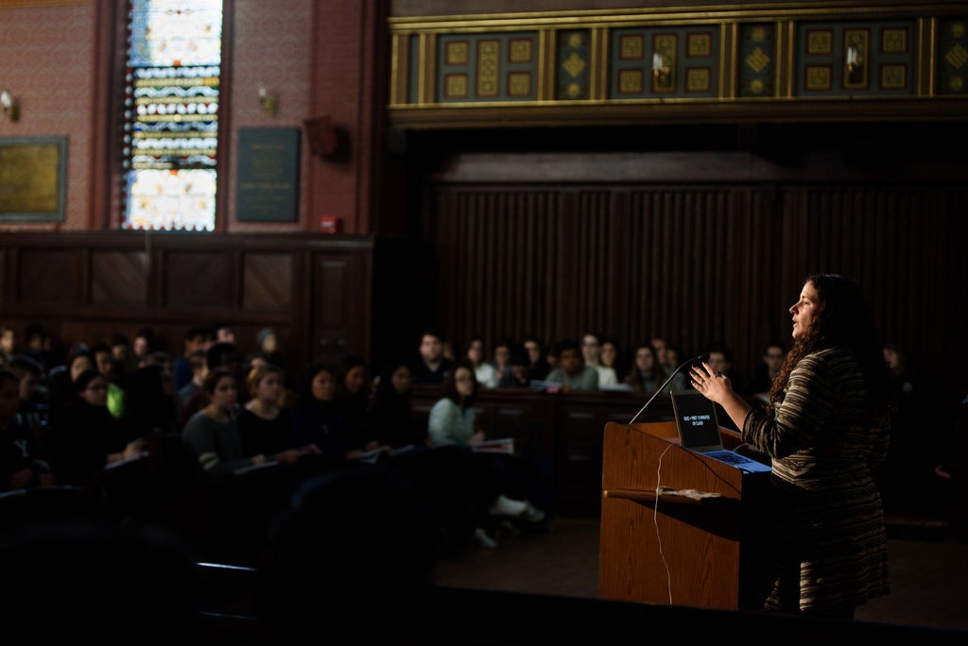
Psych 157, “Psychology and the Good Life”: Yale’s Most Popular Class

Slide 41
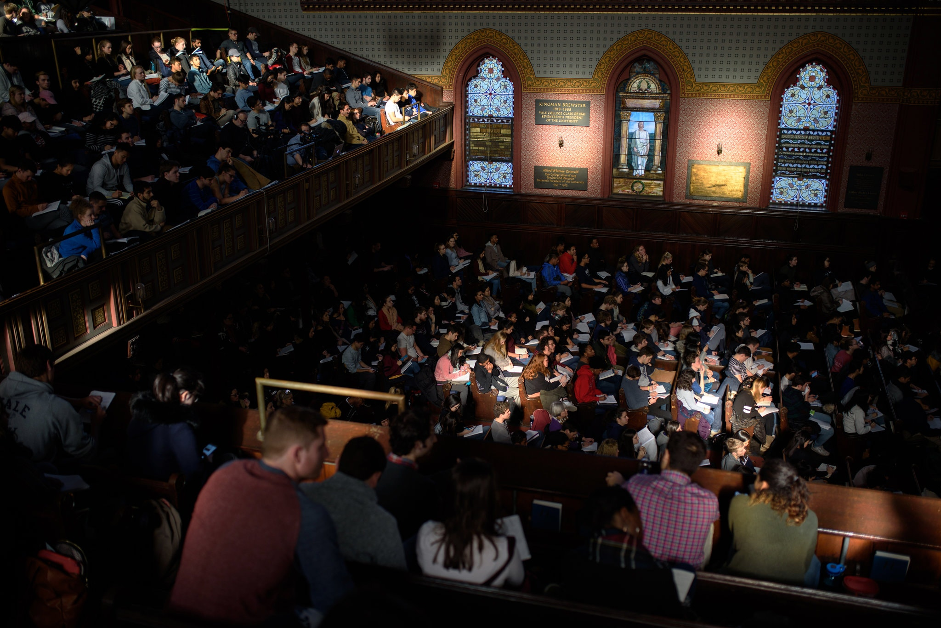
Psych 157, “Psychology and the Good Life”: Yale’s Most Popular Class

Slide 42
Sonja Lyubomirsky
Professor of Psychology at the University of California, Riverside

Slide 45
Our World’s
God’s
Wisdom:
Wisdom:
“Your circumstances and the people around you are responsible for your unhappiness.”
“It’s possible to find joy and contentment in any and every situation.”
Philippians 4:6-7: Rejoice in the Lord always. I will say it again: Rejoice! …Do not be anxious about anything, but in every situation, by prayer and petition, with thanksgiving, present your requests to God. And the peace of God, which transcends all understanding, will guard your hearts and your minds in Christ Jesus.

Slide 46
Proverbs 1
⁶ For understanding proverbs and parables, the sayings and riddles of the wise.
⁷ The fear of the LORD is the beginning of knowledge, but fools despise wisdom and instruction.
Proverbs 3
⁵ Trust in the LORD with all your heart and do not lean on your own understanding.
⁶ In all your ways acknowledge Him, and He will make your paths straight.
⁷ Do not be wise in your own eyes; fear the LORD and turn away from evil
Warren Wiersbe: “It’s not the servile fear of the slave before the master, but the reverential and respectful fear of the child before the parent.”
“an awareness of” and “fellowship with” someone.

Slide 47
Proverbs 1
⁶ For understanding proverbs and parables, the sayings and riddles of the wise.
⁷ The fear of the LORD is the beginning of knowledge, but fools despise wisdom and instruction.
Proverbs 17:12: Better to meet a bear robbed of her cubs than a fool in his folly.

Slide 48
Proverbs 1
⁶ For understanding proverbs and parables, the sayings and riddles of the wise.
⁷ The fear of the LORD is the beginning of knowledge, but fools despise wisdom and instruction.

Slide 49
Proverbs
THE BOOK OF
1:1-7: Searching for Wisdom

