Slide 1
FIRST PETER
THE BOOK OF

Slide 2
1 Peter 4
⁷ The end of all things is near; therefore, be of sound judgment and sober spirit for the purpose of prayer.

Slide 3
1 Peter 4
⁷ The end of all things is near; therefore, be of sound judgment and sober spirit for the purpose of prayer.
“You will hear of wars and threats of wars, but don’t panic. Yes, these things must take place, but the end won’t follow immediately. Nation will go to war against nation…There will be famines and earthquakes in many parts of the world. But all this is only the first of the birth pains, with more to come. Then you will be arrested, persecuted, and killed. You will be hated all over the world because you are my followers… Sin will be rampant everywhere, and the love of many will grow cold” (Matthew 24:7-9, 12)

Slide 5
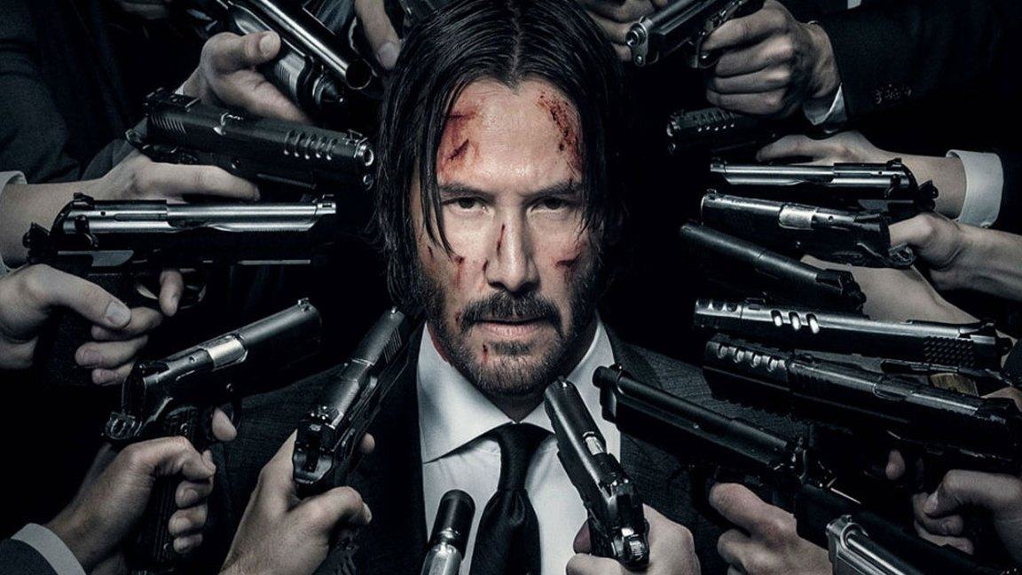

Slide 7
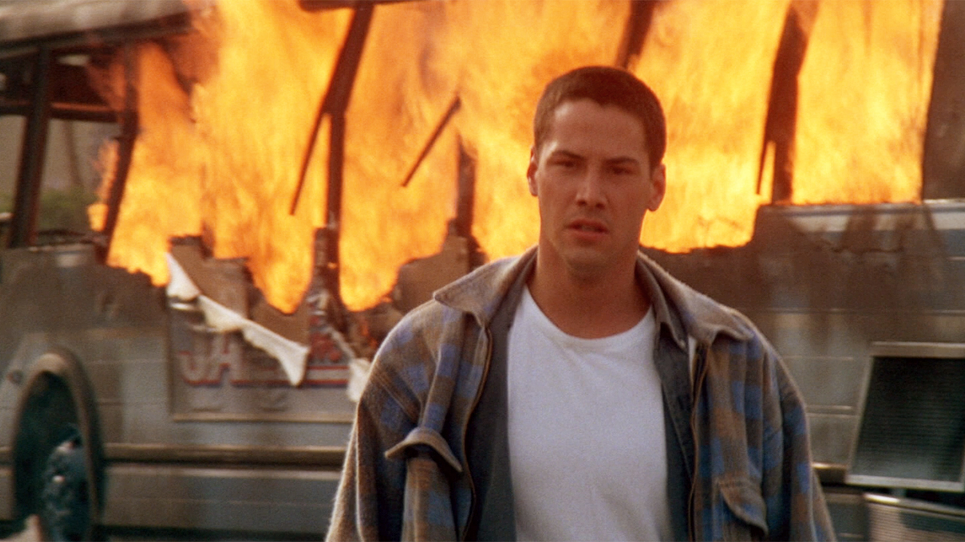

Slide 9
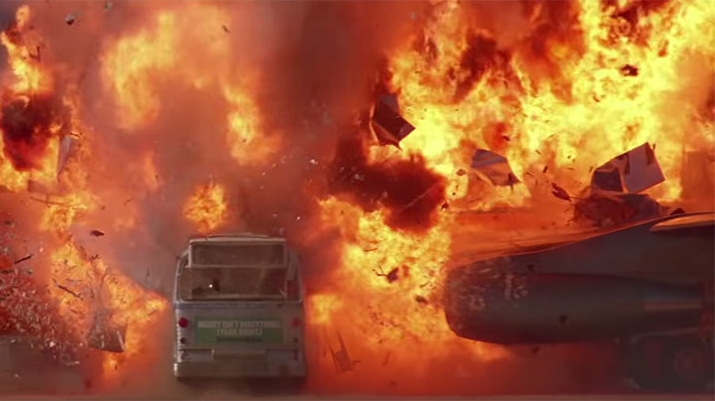

Slide 10
1 Peter 4
⁷ The end of all things is near; therefore, be of sound judgment and sober spirit for the purpose of prayer.
sound judgment = “clear headed”

Slide 11
1 Peter 4
⁷ The end of all things is near; therefore, be of sound judgment and sober spirit for the purpose of prayer.
sober spirit = “heightened sense of awareness”

Slide 12
1 Peter 4
⁷ The end of all things is near; therefore, be of sound judgment and sober spirit for the purpose of prayer.

Slide 13
1 Peter 4
⁸ Above all, keep fervent in your love for one another, because love covers a multitude of sins.

Slide 14
1 Peter 4
⁸ Above all, keep fervent in your love for one another, because love covers a multitude of sins.

Slide 15
1 Peter 4
⁸ Above all, keep fervent in your love for one another, because love covers a multitude of sins.

Slide 16
1 Peter 4
⁸ Above all, keep fervent in your love for one another, because love covers a multitude of sins.
The Christian life is something we do together.

Slide 17
1 Peter 4
⁸ Above all, keep fervent in your love for one another, because love covers a multitude of sins.
Our culture is doing less and less together.

Slide 18
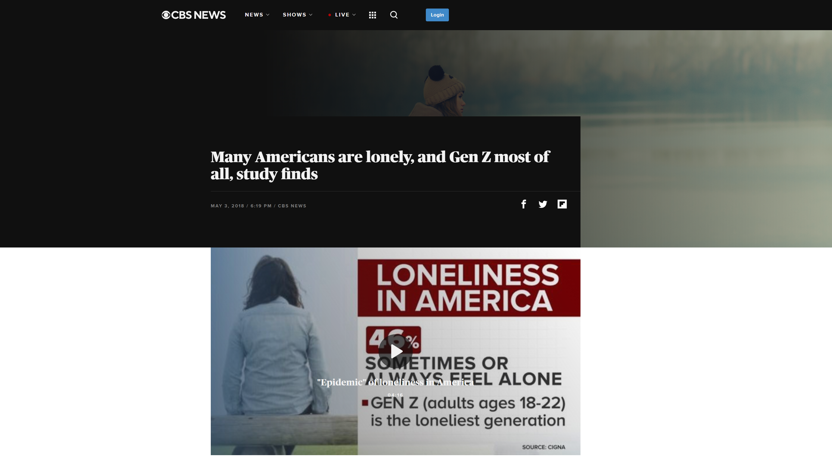

Slide 19
“The study, published by the global health service company Cigna, found that 46 percent of U.S. adults report sometimes or always feeling lonely…Cigna calls those “epidemic levels.”
“Surprisingly, the study found loneliness affects younger Americans more than the elderly.
Generation Z, or those between the ages of 18 and 22, were the loneliest generation, with a ‘loneliness score’ of 48.3.”

Slide 20
“Millennials (ages 23 to 37) were close behind with a score of 45.3, followed by Generation X (ages 38 to 51) with a loneliness score of 45.1. The so-called Greatest Generation, those age 72 or over, ranked as the least lonely, with a score of 38.6.”

Slide 21
1 Peter 4
⁸ Above all, keep fervent in your love for one another, because love covers a multitude of sins.
Our culture is doing less and less together.
27% of millennials have no close friends
22% no friends at all
27% “don’t feel like I need friends”

Slide 22
1 Peter 4
⁸ Above all, keep fervent in your love for one another, because love covers a multitude of sins.
Many of you in this room value relationships…
But you feel internal resistance toward them.

Slide 23
1 Peter 4
⁸ Above all, keep fervent in your love for one another, because love covers a multitude of sins.
“I love the idea of being part of something…
“But not right now.”

Slide 24
1 Peter 4
⁸ Above all, keep fervent in your love for one another, because love covers a multitude of sins.
“I want to spend time with others…
“But I also want the freedom to do what I want with my time.”

Slide 25
1 Peter 4
⁸ Above all, keep fervent in your love for one another, because love covers a multitude of sins.
“I want people I can depend on…
“And yet, be totally independent.”

Slide 26
1 Peter 4
⁸ Above all, keep fervent in your love for one another, because love covers a multitude of sins.
“I want people to feel like they can depend on me…
“In small, convenient blocks of time.”

Slide 27
1 Peter 4
⁸ Above all, keep fervent in your love for one another, because love covers a multitude of sins.
“I want to be known…
“But not too well.”

Slide 28
1 Peter 4
⁸ Above all, keep fervent in your love for one another, because love covers a multitude of sins.
“I want to feel connected to people…
“But people are messy…
“And hurtful…
“And annoying.”

Slide 29
1 Peter 4
⁸ Above all, keep fervent in your love for one another, because love covers a multitude of sins.
Yet, we are made for close relationships

Slide 30
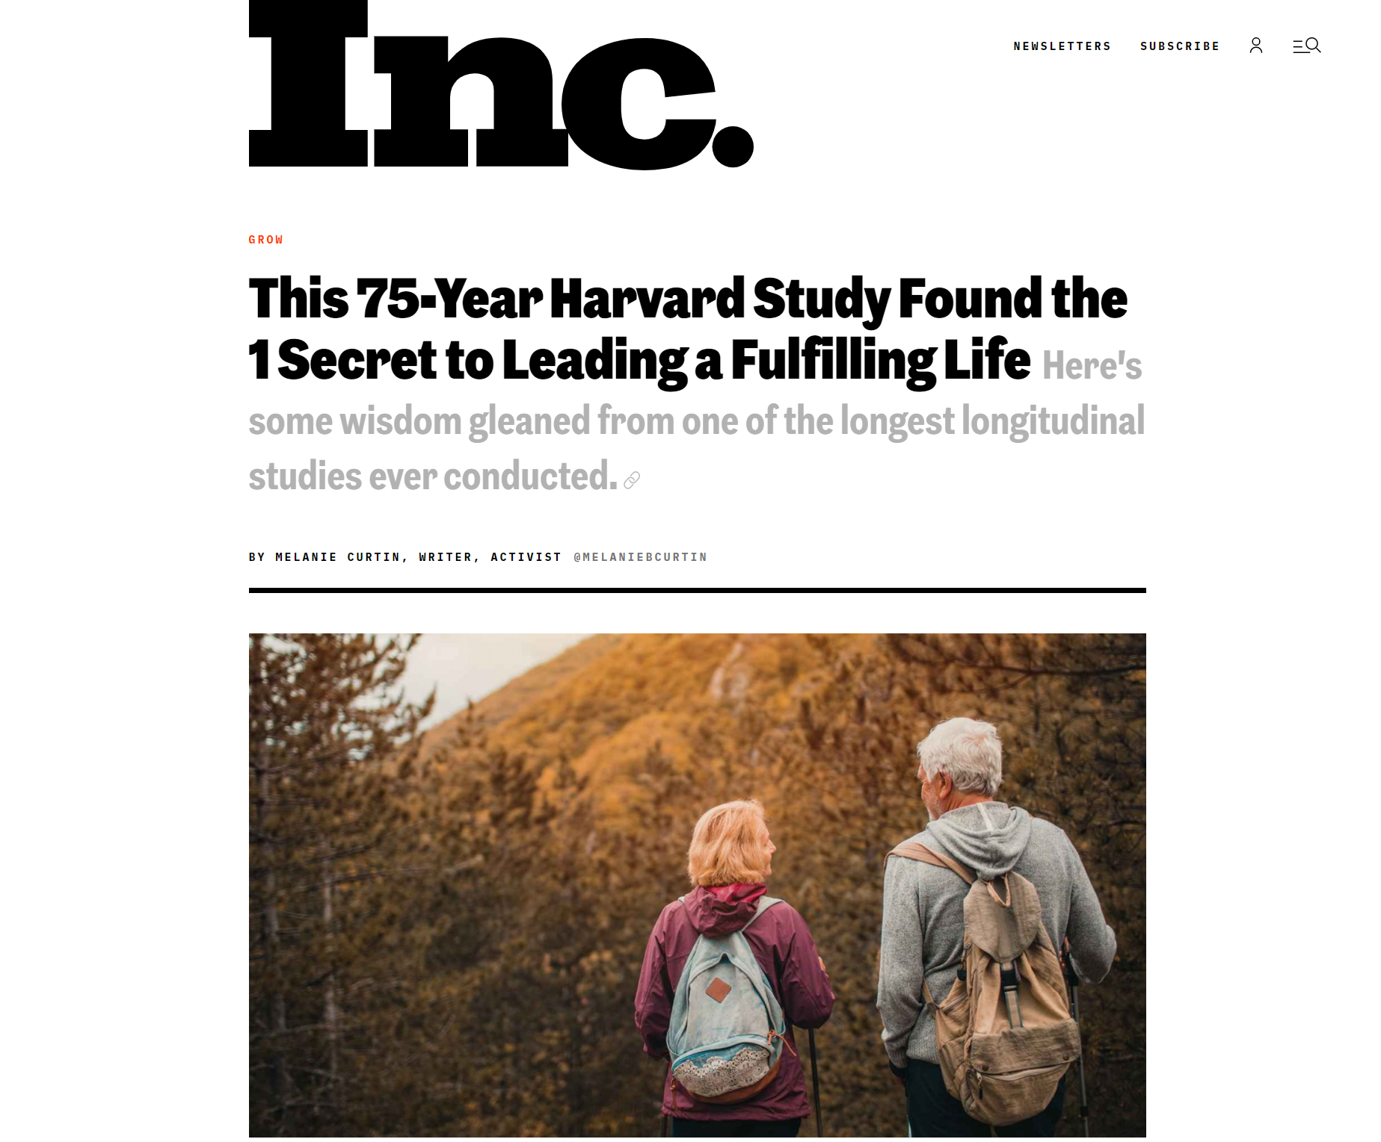

Slide 31
“For over 75 years, Harvard’s Grant and Glueck study has tracked the physical and emotional well-being of two populations, poor men growing up in Boston from 1939 to 1944…[and] male graduates from Harvard’s classes of 1939-1944. Due to the length of the research period, this has required multiple generations of researchers. Since before WWII, they’ve diligently analyzed blood samples, conducted brain scans…and pored over self-reported surveys, as well as actual interactions with these men, to compile the findings.

Slide 32
The conclusion? According to Robert Waldinger, director of the Harvard Study of Adult Development, one thing surpasses all the rest in terms of importance: “The clearest message that we get from this 75-year study is this: Good relationships keep us happier and healthier. Period.”
“The biggest predictor of your happiness and fulfillment overall in life is, basically, love.”
“It doesn’t matter whether you have a huge group of friends and go out every weekend…

Slide 33
It’s the quality of the relationships--how much
vulnerability and depth exists within them; how safe you feel sharing with one another; the extent to which you can relax and be seen for who you truly are, and truly see another.

Slide 34
1 Peter 4
⁸ Above all, keep fervent in your love for one another, because love covers a multitude of sins.
How fervent is your love these days?
» How long has it been since you made a new friend?
» What’s one step you could take to fervently love someone with whom you have a close friendship?
» In what ways can you stretch yourself, to make yourself more available for relationships?
“I don’t have enough time.”

Slide 35
1 Peter 4
⁸ Above all, keep fervent in your love for one another, because love covers a multitude of sins.
Proverbs 10:12: “The mouth of the righteous is a fountain of life, but the mouth of the wicked conceals violence. Hatred stirs up dissension, but love covers over all wrongs.”

Slide 36
1 Peter 4
⁸ Above all, keep fervent in your love for one another, because love covers a multitude of sins.
I think Peter is advocating for an atmosphere of grace both in the way we treat people and the way we speak about them.

Slide 37
1 Peter 4
⁸ Above all, keep fervent in your love for one another, because love covers a multitude of sins.
⁹ Be hospitable to one another without complaint.

Slide 38
1 Peter 4
⁸ Above all, keep fervent in your love for one another, because love covers a multitude of sins.
⁹ Be hospitable to one another without complaint.
Being hospitable means being a good host.

Slide 39
1 Peter 4
⁸ Above all, keep fervent in your love for one another, because love covers a multitude of sins.
⁹ Be hospitable to one another without complaint.

Slide 40
1 Peter 4
¹⁰ As each one has received a special gift, employ it in serving one another as good stewards of the manifold grace of God.
¹¹ Whoever speaks, is to do so as one who is speaking the utterances of God; whoever serves is to do so as one who is serving by the strength which God supplies; so that in all things God may be glorified through Jesus Christ, to whom belongs the glory and dominion forever and ever. Amen.

Slide 41
1 Peter 4
¹⁰ As each one has received a special gift, employ it in serving one another as good stewards of the manifold grace of God.
¹¹ Whoever speaks, is to do so as one who is speaking the utterances of God; whoever serves is to do so as one who is serving by the strength which God supplies; so that in all things God may be glorified through Jesus Christ, to whom belongs the glory and dominion forever and ever. Amen.

Slide 42
1 Peter 4
¹⁰ As each one has received a special gift, employ it in serving one another as good stewards of the manifold grace of God.
¹¹ Whoever speaks, is to do so as one who is speaking the utterances of God; whoever serves is to do so as one who is serving by the strength which God supplies; so that in all things God may be glorified through Jesus Christ, to whom belongs the glory and dominion forever and ever. Amen.

Slide 43
1 Peter 4
¹⁰ As each one has received a special gift, employ it in serving one another as good stewards of the manifold grace of God.
¹¹ Whoever speaks, is to do so as one who is speaking the utterances of God; whoever serves is to do so as one who is serving by the strength which God supplies; so that in all things God may be glorified through Jesus Christ, to whom belongs the glory and dominion forever and ever. Amen.

Slide 44
1 Peter 4
¹⁰ As each one has received a special gift, employ it in serving one another as good stewards of the manifold grace of God.
¹¹ Whoever speaks, is to do so as one who is speaking the utterances of God; whoever serves is to do so as one who is serving by the strength which God supplies; so that in all things God may be glorified through Jesus Christ, to whom belongs the glory and dominion forever and ever. Amen.
It’s our job to discover our spiritual gifts.

Slide 45
1 Peter 4
¹⁰ As each one has received a special gift, employ it in serving one another as good stewards of the manifold grace of God.
¹¹ Whoever speaks, is to do so as one who is speaking the utterances of God; whoever serves is to do so as one who is serving by the strength which God supplies; so that in all things God may be glorified through Jesus Christ, to whom belongs the glory and dominion forever and ever. Amen.

Slide 46
1 Peter 4
¹⁰ As each one has received a special gift, employ it in serving one another as good stewards of the manifold grace of God.
¹¹ Whoever speaks, is to do so as one who is speaking the utterances of God; whoever serves is to do so as one who is serving by the strength which God supplies; so that in all things God may be glorified through Jesus Christ, to whom belongs the glory and dominion forever and ever. Amen.

Slide 47
FIRST PETER
THE BOOK OF

