Slide 1
GALATIANS
THE BOOK OF

Slide 2
Galatians 6
¹ Brothers and sisters, if someone is caught in a sin, you who are spiritual should restore him gently. But watch yourselves, or you also may be tempted.

Slide 3
Galatians 6
¹ Brothers and sisters, if someone is caught in a sin, you who are spiritual should restore him gently. But watch yourselves, or you also may be tempted.
Not: “if you catch someone in sin.”

Slide 4
Galatians 6
¹ Brothers and sisters, if someone is caught in a sin, you who are spiritual should restore him gently. But watch yourselves, or you also may be tempted.
Getting rid of sin isn’t the goal of the church.

Slide 5
Galatians 6
¹ Brothers and sisters, if someone is caught in a sin, you who are spiritual should restore him gently. But watch yourselves, or you also may be tempted.
“if another believer is overcome by some sin” (NLT)

Slide 6
Galatians 6
¹ Brothers and sisters, if someone is caught in a sin, you who are spiritual should restore him gently. But watch yourselves, or you also may be tempted.
Paul doesn’t use the normal word for sin (hamartia).

Slide 7
Galatians 6
¹ Brothers and sisters, if someone is caught in a sin, you who are spiritual should restore him gently. But watch yourselves, or you also may be tempted.
To “put in order,” so as to “restore to its former condition”

Slide 8
Galatians 6
¹ Brothers and sisters, if someone is caught in a sin, you who are spiritual should restore him gently. But watch yourselves, or you also may be tempted.
Medical term for setting a fractured or dislocated bone.

Slide 9
Galatians 6
¹ Brothers and sisters, if someone is caught in a sin, you who are spiritual should restore him gently. But watch yourselves, or you also may be tempted.
Most of our problems don’t magically disappear when we come to Christ.

Slide 10
Galatians 6
¹ Brothers and sisters, if someone is caught in a sin, you who are spiritual should restore him gently. But watch yourselves, or you also may be tempted.
“Who are you to tell others how to live their lives? You should just love and accept people for who they are.”
The biblical definition of love entails gentle correction
» Assumes people often mess up and need to change.
Dietrick Bonhoeffer: “The pious [church] permits no one to be a sinner. Everybody must conceal his sin from himself and from the [church]. We dare not be sinners…

Slide 11
Galatians 6
¹ Brothers and sisters, if someone is caught in a sin, you who are spiritual should restore him gently. But watch yourselves, or you also may be tempted.
“Who are you to tell others how to live their lives? You should just love and accept people for who they are.”
The biblical definition of love entails gentle correction
» Assumes people often mess up and need to change.
Dietrick Bonhoeffer: “Many Christians are unthinkably horrified when a real sinner is suddenly discovered among the righteous…

Slide 12
Galatians 6
¹ Brothers and sisters, if someone is caught in a sin, you who are spiritual should restore him gently. But watch yourselves, or you also may be tempted.
“Who are you to tell others how to live their lives? You should just love and accept people for who they are.”
The biblical definition of love entails gentle correction
» Assumes people often mess up and need to change.
Dietrick Bonhoeffer: “So we remain alone with our sin, living in lies and hypocrisy.”

Slide 13
Galatians 6
¹ Brothers and sisters, if someone is caught in a sin, you who are spiritual should restore him gently. But watch yourselves, or you also may be tempted.
“Who are you to tell others how to live their lives? You should just love and accept people for who they are.”
The biblical definition of love entails gentle correction
» Assumes people often mess up and need to change.
» Assumes God’s written word sets the standard for right and wrong and instructions for how we ought to live.

Slide 14
Galatians 6
¹ Brothers and sisters, if someone is caught in a sin, you who are spiritual should restore him gently. But watch yourselves, or you also may be tempted.
» God calls on every believer in his spiritual community to restore others.
» Suggests deep involvement in each other’s lives.

Slide 15
“Of respondents to a national survey [who] reported feeling lonely “frequently” or “almost all the time or all the time”…

Slide 16
“61 percent of those aged 18 to 25 reported high levels…even more troubling when combined
with June [2020] data from the [CDC] showing that 63 percent of young people reported experiencing substantial symptoms of anxiety and depression…

Slide 17
“Older teens and young adults may be particularly susceptible because they are often [going
through major transitions]…Students in college may be struggling to fit in and feel homesick...

Slide 18
“Young people are also often making critical decisions about their professional and personal lives and relationships, which can add to the stress and sense of isolation.”

Slide 19
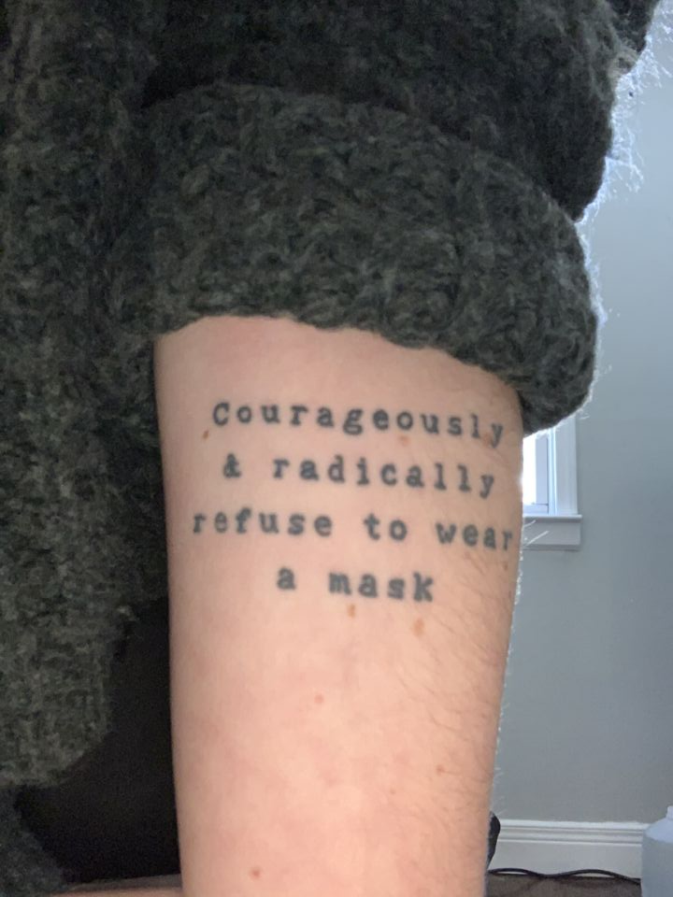

Slide 20
Galatians 6
¹ Brothers and sisters, if someone is caught in a sin, you who are spiritual should restore him gently. But watch yourselves, or you also may be tempted.
» God calls on every believer in his spiritual community to restore others.
» Suggests deep involvement in each other’s lives.
• In God’s spiritual community, we know each other well enough to carry each other’s burdens.

Slide 21
Galatians 6
¹ Brothers and sisters, if someone is caught in a sin, you who are spiritual should restore him gently. But watch yourselves, or you also may be tempted.
» God calls on every believer in his spiritual community to restore others.
» Suggests deep involvement in each other’s lives.
» Implies an understanding of Scripture and some proficiency in applying it to people’s lives.

Slide 22
Galatians 6
¹ Brothers and sisters, if someone is caught in a sin, you who are spiritual should restore him gently. But watch yourselves, or you also may be tempted.
But watch yourselves, or you also may be tempted.

Slide 23
Galatians 6
² Carry each other’s burdens, and in this way you will fulfill the law of Christ.
³ If anyone thinks they are something when they are not, they deceive themselves.
⁴ Each one should test their own actions. Then they can take pride in themselves alone, without comparing themselves to someone else.

Slide 24
Galatians 6
² Carry each other’s burdens, and in this way you will fulfill the law of Christ.
³ If anyone thinks they are something when they are not, they deceive themselves.
⁴ Each one should test their own actions. Then they can take pride in themselves alone, without comparing themselves to someone else.
John 13:35: “A new command I give you: Love one another. As I have loved you, so you must love one another.

Slide 25
Galatians 6
² Carry each other’s burdens, and in this way you will fulfill the law of Christ.
³ If anyone thinks they are something when they are not, they deceive themselves.
⁴ Each one should test their own actions. Then they can take pride in themselves alone, without comparing themselves to someone else.
Often, we expect others to carry our burdens.

Slide 26
Galatians 6
² Carry each other’s burdens, and in this way you will fulfill the law of Christ.
³ If anyone thinks they are something when they are not, they deceive themselves.
⁴ Each one should test their own actions. Then they can take pride in themselves alone, without comparing themselves to someone else.
God calls on us to take our eyes off of ourselves and to put our focus onto others.

Slide 27
Galatians 6
² Carry each other’s burdens, and in this way you will fulfill the law of Christ.
³ If anyone thinks they are something when they are not, they deceive themselves.
⁴ Each one should test their own actions. Then they can take pride in themselves alone, without comparing themselves to someone else.
Comparison breeds discontent.

Slide 28
Galatians 6
² Carry each other’s burdens, and in this way you will fulfill the law of Christ.
³ If anyone thinks they are something when they are not, they deceive themselves.
⁴ Each one should test their own actions. Then they can take pride in themselves alone, without comparing themselves to someone else.
“Pay careful attention to your own work” (NLT).

Slide 29
Galatians 6
⁵ For each one should carry their own load.
Proverbs 20:4: The sluggard does not plow after the autumn, So he begs during the harvest and has nothing.

Slide 30
Galatians 6
⁶ Nevertheless, the one who receives instruction in the word should share all good things with their instructor.
» Unfortunately, modern Western people are suspicious of Christian leaders using their influence to line their pockets.
» Christian leaders should live a simple lifestyle, so as not dishonor God and discredit the message of Jesus.

Slide 31
Galatians 6
⁷ Do not be deceived: God cannot be mocked. A man reaps what he sows.
⁸ Whoever sows to please their flesh, from the flesh will reap destruction; whoever sows to please the Spirit, from the Spirit will reap eternal life.

Slide 32
Galatians 6
⁷ Do not be deceived: God cannot be mocked. A man reaps what he sows.
⁸ Whoever sows to please their flesh, from the flesh will reap destruction; whoever sows to please the Spirit, from the Spirit will reap eternal life.

Slide 33
Galatians 6
⁷ Do not be deceived: God cannot be mocked. A man reaps what he sows.
⁸ Whoever sows to please their flesh, from the flesh will reap destruction; whoever sows to please the Spirit, from the Spirit will reap eternal life.
1 Timothy 6:9-10: Those who want to get rich fall into temptation and a trap and into many foolish and harmful desires that plunge people into ruin and destruction… Some people, eager for money, have wandered from the faith and pierced themselves with many griefs.

Slide 34
Galatians 6
⁹ Let us not become weary in doing good, for at the proper time we will reap a harvest if we do not give up.

Slide 35
Others-Centered Life
» Not boastful or egocentric
» Not competitive
» Willing to correct in love
» Humble
» Bearing others’ burdens
» Bearing our own burdens
» Sacrificial Giving
» Not giving up!
What would it be like to live in a community where everyone bought into this picture?

Slide 36
GALATIANS
THE BOOK OF

