Slide 1
1 Peter 3
Giving an Account

Slide 2
1 Peter 3
15 Always be prepared to give an answer to everyone who asks you to give the reason for the expectation that you have. But do this with gentleness and respect

Slide 3
1 Peter 3
15 Always be prepared to give an answer to everyone who asks you to give the reason for the expectation that you have. But do this with gentleness and respect

Slide 4
1 Peter 3
15 Always be prepared to give an answer to everyone who asks you to give the reason for the expectation that you have. But do this with gentleness and respect

Slide 5
1 Peter 3
15 Always be prepared to give an answer to everyone who asks you to give the reason for the expectation that you have. But do this with gentleness and respect
Compare to irrational faith or blind faith

Slide 6
Reasonable Faith:

Slide 7
Reasonable Faith:
Why believe in something?

Slide 8
Reasonable Faith:
Why believe in something?
- Because your parents or someone told you to?

Slide 9
Reasonable Faith:
Why believe in something?
- Because your parents or someone told you to?

Slide 10
Reasonable Faith:
Why believe in something?
- Because your parents or someone told you to?
- Because believing in it makes you feel better?

Slide 11
Reasonable Faith:
Why believe in something?
- Because your parents or someone told you to?
- Because believing in it makes you feel better?

Slide 12
Reasonable Faith:
Why believe in something?
- Because your parents or someone told you to?
- Because believing in it makes you feel better?
- Because your friends believe in it?

Slide 13
Reasonable Faith:
Why believe in something?
- Because your parents or someone told you to?
- Because believing in it makes you feel better?
- Because your friends believe in it?

Slide 14
Reasonable Faith:
Why believe in something?
- Because your parents or someone told you to?
- Because believing in it makes you feel better?
- Because your friends believe in it?
Because it’s true!

Slide 15
What reasons do we have for believing in Jesus?
- Multiple lines of evidence
- None are inescapable

Slide 16
Typical examples:
- Origin of the universe
- Cosmological fine tuning
- Existence of the soul
- Argument from ability to reason
- Fulfilled prophecy
- Key historical arguments
- From comparative religion
- Several presuppositional
- Argument from design

Slide 17
Typical examples:
- Origin of the universe
- Cosmological fine tuning
- Existence of the soul
- Argument from ability to reason
- Fulfilled prophecy
- Key historical arguments
- From comparative religion
- Several presuppositional
- Argument from design

Slide 18
Rom. 1:20 For since the creation of the world His invisible attributes, His eternal power and divine nature, have been clearly seen, being understood through what has been made, so that they are without excuse.
Natural origin of life:
Plausible or implausible?

Slide 19
Rom. 1:20 For since the creation of the world His invisible attributes, His eternal power and divine nature, have been clearly seen, being understood through what has been made, so that they are without excuse.
Natural origin of life:
Plausible or implausible?
A living organism must be capable of
Self-propagation
Feeding
Metabolizing food into energy
Fabricating proteins and other compounds
And that requires information

Slide 20
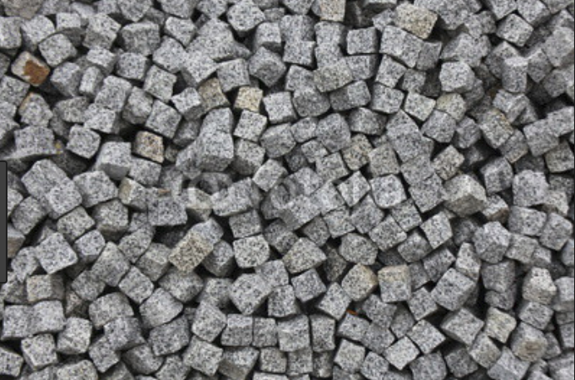
Rom. 1:20 For since the creation of the world His invisible attributes, His eternal power and divine nature, have been clearly seen, being understood through what has been made, so that they are without excuse.
Natural origin of life:
Plausible or implausible?
A living organism must be capable of
Self-propagation
Feeding
Metabolizing food into energy
And to fabricate proteins and other compounds
And that requires information

Slide 21
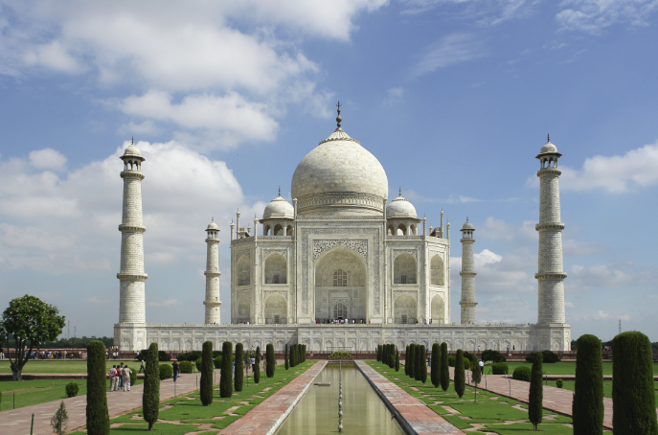
Rom. 1:20 For since the creation of the world His invisible attributes, His eternal power and divine nature, have been clearly seen, being understood through what has been made, so that they are without excuse.
Natural origin of life:
Plausible or implausible?
A living organism must be capable of
Self-propagation
Feeding
Metabolizing food into energy
And to fabricate proteins and other compounds
And that requires information

Slide 22
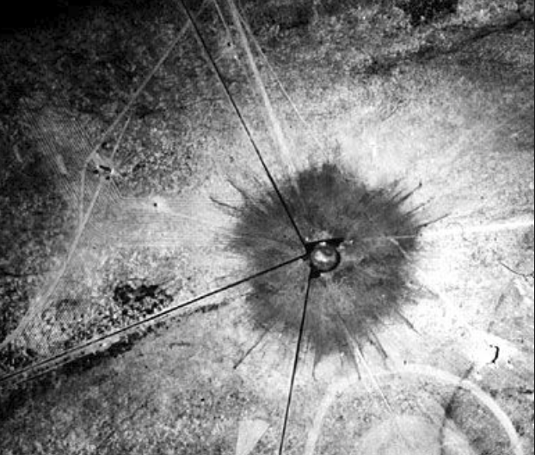
Rom. 1:20 For since the creation of the world His invisible attributes, His eternal power and divine nature, have been clearly seen, being understood through what has been made, so that they are without excuse.
Natural origin of life:
Plausible or implausible?
A living organism must be capable of
Self-propagation
Feeding
Metabolizing food into energy
And to fabricate proteins and other compounds
And that requires information

Slide 23
Rom. 1:20 For since the creation of the world His invisible attributes, His eternal power and divine nature, have been clearly seen, being understood through what has been made, so that they are without excuse.
Natural origin of life:
Plausible or implausible?
Even minimally complex life requires extreme levels of information
Information is non-material
Must be functional information
Biologically significant polymers neither exist nor replicate themselves apart from vast, specific information

Slide 24
Rom. 1:20 For since the creation of the world His invisible attributes, His eternal power and divine nature, have been clearly seen, being understood through what has been made, so that they are without excuse.
Natural origin of life:
Plausible or implausible?
Even minimally complex life requires extreme levels of information
Information is non-material
Must be functional information
Biologically significant polymers neither exist nor replicate themselves apart from vast, specific information

Slide 25
Rom. 1:20 For since the creation of the world His invisible attributes, His eternal power and divine nature, have been clearly seen, being understood through what has been made, so that they are without excuse.
Natural origin of life:
Plausible or implausible?
Even minimally complex life requires extreme levels of information
Information is non-material
Must be functional information
Biologically significant polymers neither exist nor replicate themselves apart from vast, specific information
Dean Kenyon, PhD
Chemistry Prof.
Coauthor, Chemical Predestination

Slide 26
Rom. 1:20 For since the creation of the world His invisible attributes, His eternal power and divine nature, have been clearly seen, being understood through what has been made, so that they are without excuse.
Natural origin of life:
Plausible or implausible?
Even minimally complex life requires extreme levels of information
Information is non-material
Must be functional information
Biologically significant polymers neither exist nor replicate themselves apart from vast, specific information

Slide 27
Rom. 1:20 For since the creation of the world His invisible attributes, His eternal power and divine nature, have been clearly seen, being understood through what has been made, so that they are without excuse.
Natural origin of life:
Plausible or implausible?
Even minimally complex life requires extreme levels of information
Information is non-material
Must be functional information
Biologically significant polymers neither exist nor replicate themselves apart from vast, specific information
James Tour, Professor, organic chemistry, Rice University

Slide 28
1 Peter 3
15 Always be prepared to give an answer to everyone who asks you to give the reason for the hope that you have. But do this with gentleness and respect

Slide 29
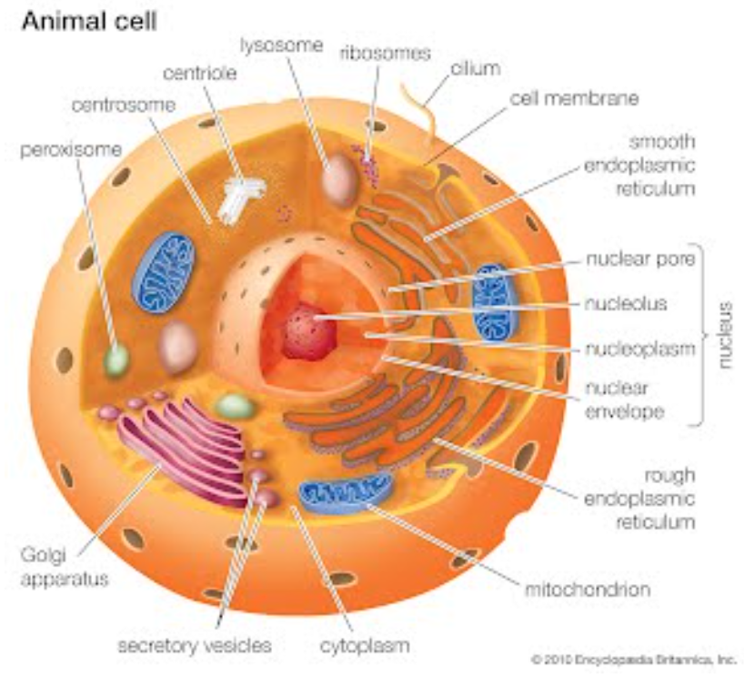
1 Peter 3
15 Always be prepared to give an answer to everyone who asks you to give the reason for the hope that you have. But do this with gentleness and respect

Slide 30
1 Peter 3
The presence of design =
15 Always be prepared to give an answer to everyone who asks you to give the reason for the hope that you have. But do this with gentleness and respect

Slide 31
1 Peter 3
The presence of design =
The presence of a designer!
15 Always be prepared to give an answer to everyone who asks you to give the reason for the hope that you have. But do this with gentleness and respect

Slide 32
1 Peter 3
15 Always be prepared to give an answer to everyone who asks you to give the reason for the expectation that you have. But do this with gentleness and respect

Slide 33
1 Peter 3
15 Always be prepared to give an answer to everyone who asks you to give the reason for the expectation that you have. But do this with gentleness and respect

