Slide 2
Divorce: Biblical truth over cultural compromise

Slide 3
Introduction
Why are we doing this now?
How it got started 2 years ago
50% of Americans
33% of evangelicals
How do we apply scripture on this in a modern context?

Slide 4
Introduction
Why are we doing this now?
How it got started
The cultural complexities
The changing definition of “abuse”
When is divorce the lesser of two evils?
How do we help protect spouses and children?

Slide 5
Introduction
Why are we doing this now?
How it got started
The cultural complexities
The situation the elders were in
Ruling on “righteous divorce”
Divorcing where both couples stay in fellowship and start to date other people?
Who gets the church in the divorce?

Slide 6
Introduction
Questions that needed clarification
What does the Bible say about divorce and remarriage?
What should the role of leaders be in adjudicating conflicts?
How do we stand with scripture and against abusers?

Slide 7
Introduction
Why are we doing this now?
Who we talked to and why
Networking with other churches
Every church is struggling with this
Finding out after the fact
“covenant marriage”

Slide 8
Introduction
Why are we doing this now?
Who we talked to and why
Craig Treneff the mayor of Westerville
Bev Delashmutt
Our counseling department
More lawyers

Slide 9
Introduction
Why are we doing this now?
Why we waited 2 years
COVID
Racial justice
Election
Vaccine
MORE COVID

Slide 10
Sensitivities
We’re not out to make people who are divorced feel bad
We’re not trying to convince people in abusive situations that they have an obligation to withstand the abuse

Slide 11
Sensitivities
We are trying to elevate marriage in our thinking while also providing ways to protect the vulnerable

Slide 12
Malachi 2:14-16
(Mal. 2:14-16 NIV) The LORD is acting as the witness between you and the wife of your youth, because you have broken faith with her, though she is your partner, the wife of your marriage covenant. ¹⁵ Has not the LORD made them one? In flesh and spirit they are his. And why one? Because he was seeking godly offspring.

Slide 13
Malachi 2:14-16
So guard yourself in your spirit, and do not break faith with the wife of your youth. ¹⁶ “I hate divorce,” says the LORD God of Israel, “and I hate a man’s covering himself with violence as well as with his garment,” says the LORD Almighty. “So guard yourself in your spirit, and do not break faith.”

Slide 14
Wiersbe, W. W. (1996). (pp. 150151). Wheaton, IL: Victor Books.
“Hostility (Mal. 2:16). “I hate divorce!” (niv) is about as clear a statement as God can make. Those who want to please God certainly wouldn’t want to do anything that God so abhors, but would do everything possible to heal the marriage. God gave Adam one wife, not many, and He declared that the two were one flesh (Gen. 2:21–25). Divorce pulls apart that which God put together, and Jesus warned us not to do that (Matt. 19:6). It’s like an act of violence in an area where there ought to be tenderness.

Slide 15
Wiersbe, W. W. (1996). (pp. 150151). Wheaton, IL: Victor Books.
Why does Malachi mention a “garment” and “violence?” In modern Western society, a man puts an engagement ring on a woman’s finger to propose marriage, but in ancient Israel, he placed a corner of his garment over her (Ezek. 16:8; Ruth 3:9). If a man divorces his wife, instead of having a garment that symbolized love, he had a garment that symbolized violence. He wrenched apart that which God said is one; by his infidelity, he made the marriage bed a place of violence.”

Slide 16
Full disclosure
I am the only one of our current elders that is from a divorced home.
I come at this from this from a biblical perspective, but keeping marriages together is very personal for me.

Slide 17
Full disclosure
My talk with Bev

Slide 18
The problems are many
Our culture says divorce is “normal” or even “healthy”

Slide 19
11 Reasons Divorce Is Better Than Staying In A Bad Marriage (Huffington Post)
2. Being a single parent is better than modeling an unhealthy relationship.
3. Divorce clears the way for you to meet the right partner.
4. You get to focus on you for once.
7. You and your partner may be stifling each other’s growth.

Slide 20
The Problems are many
People don’t think through the long- term implications
You bring your problems with you in the next marriage
What will be done about grandchildren?
Holidays?
Family inheritances?
Is going back out into the dating scene going to make you happy?

Slide 21
Dell Curry and Sonya Curry
33 years of marriage

Slide 22
Dell Curry and Sonya Curry
"After exploring a trial separation over the past year and much thoughtful consideration, we have decided to end our marriage. As this comes with a great deal of sadness, our focus and desire is for our family's continued happiness," Sonya and Dell, 58, tell PEOPLE. "We are so thankful for all the many blessings and successes! We stay committed to and supportive of our children and grandchildren and will remain on connected paths. We ask that our privacy be respected and prayer for our family as we move forward."

Slide 23
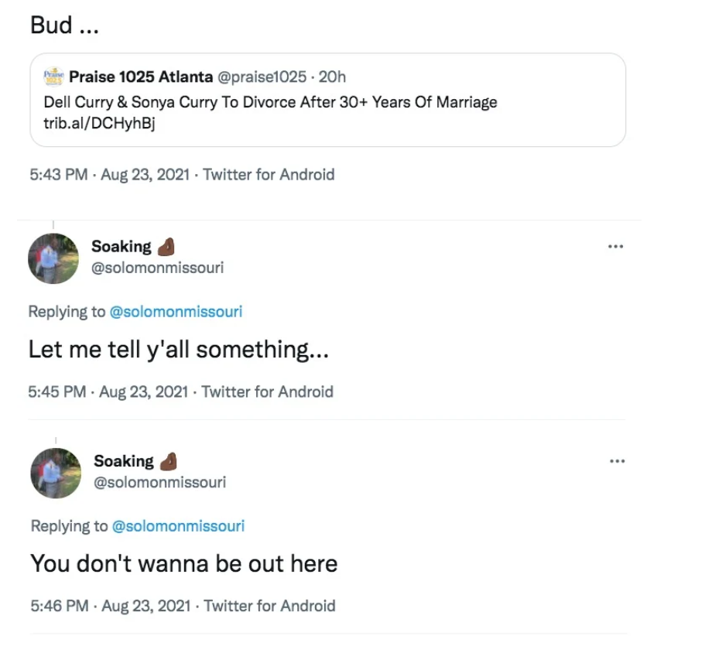
Dell Curry’s experience

Slide 24
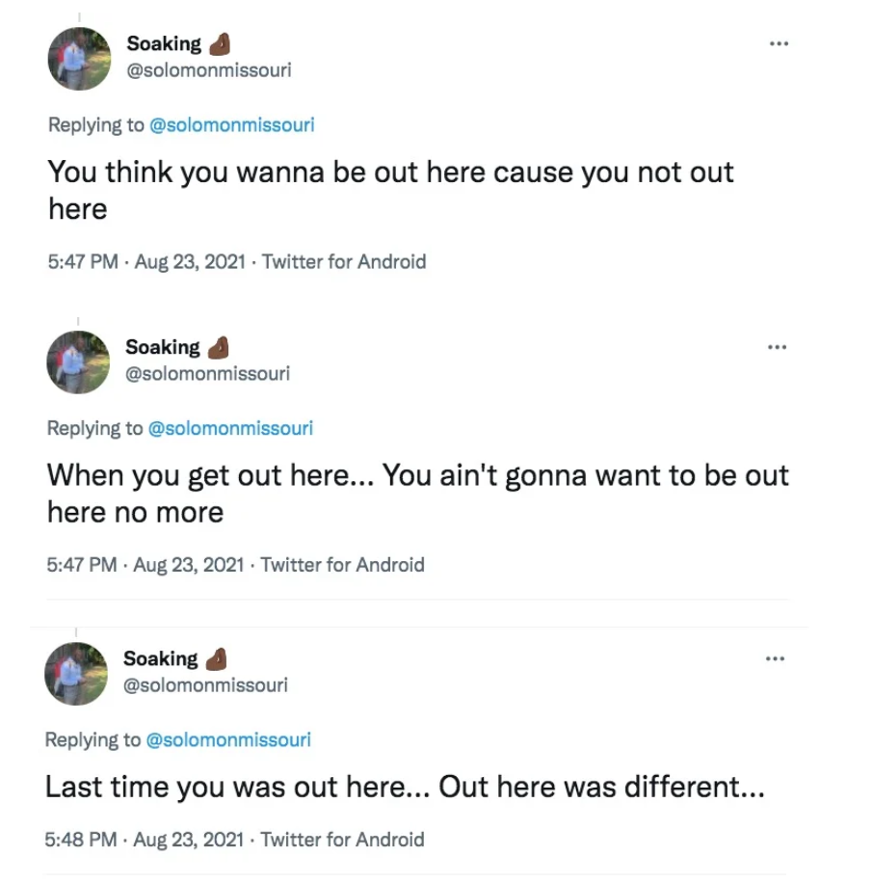
Dell Curry’s experience

Slide 25
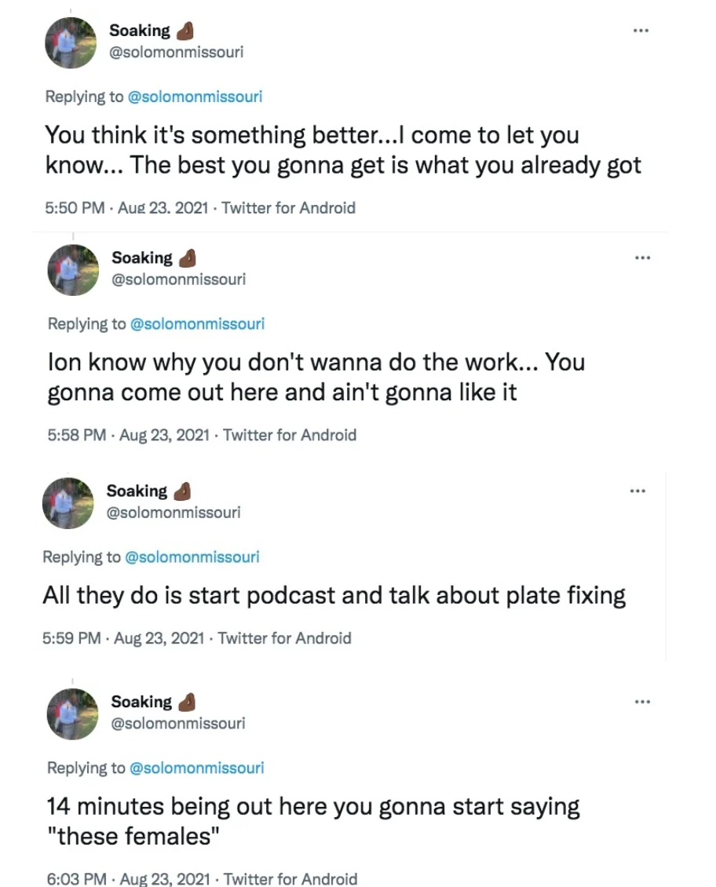
Dell Curry’s experience

Slide 26
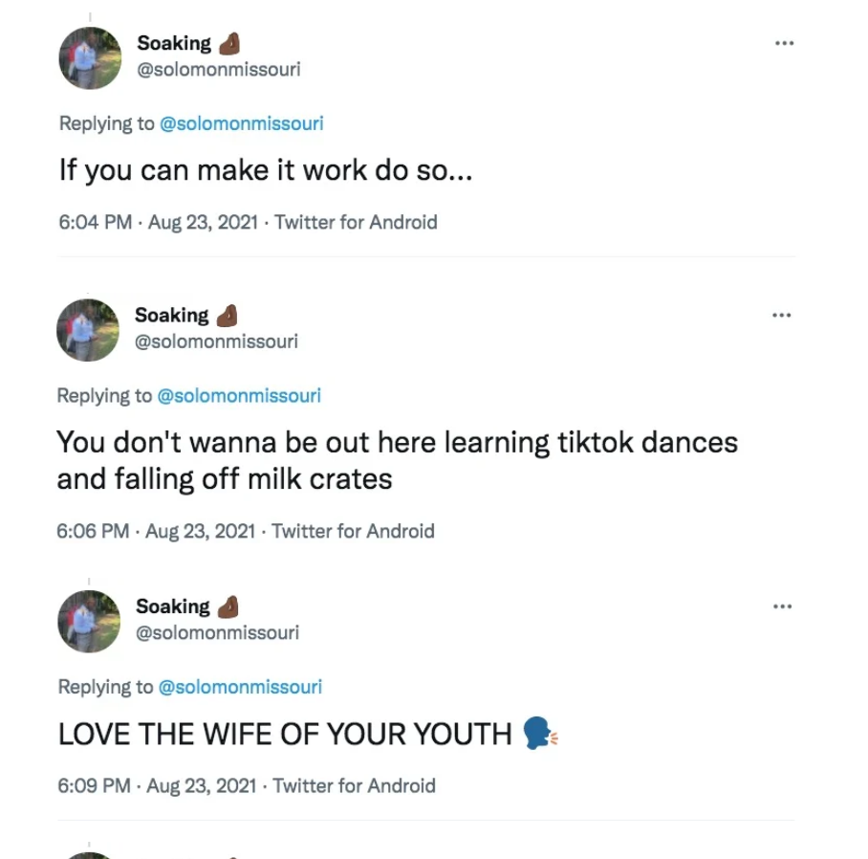
Dell Curry’s experience

Slide 27
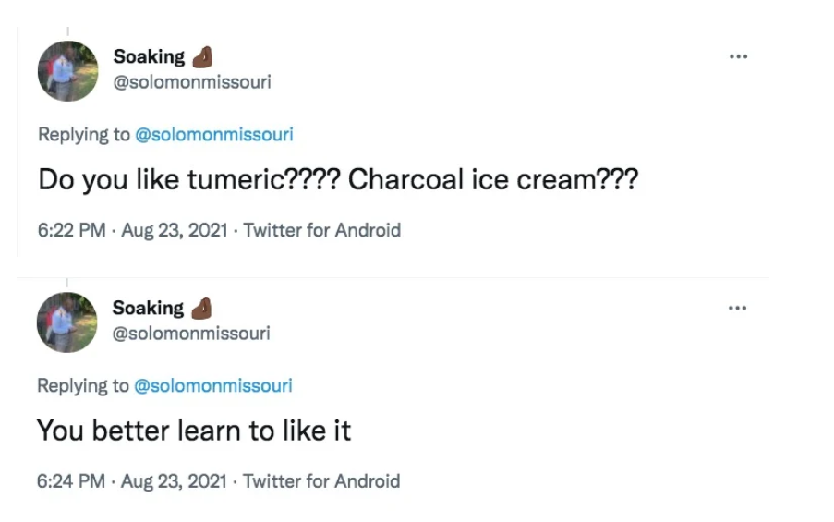
Dell Curry’s experience

Slide 28
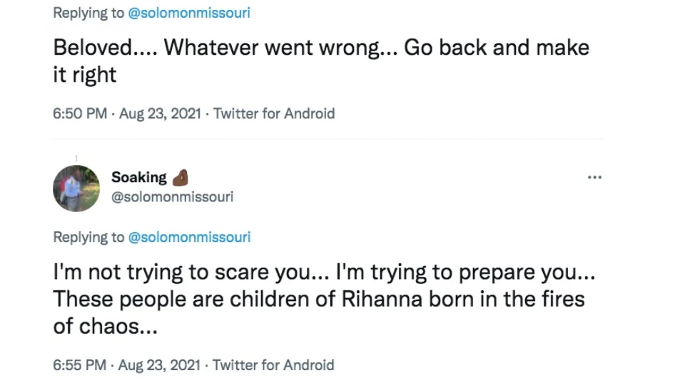
Dell Curry’s experience

Slide 29
Dell Curry’s experience

Slide 30
Dell Curry’s experience

Slide 31
We need to provide excellent marriage support
Bible teaching
Ministry Houses
Discipleship
Pre-Marital Counseling
Marriage Mentors
Couples Counseling

Slide 32
We need to provide excellent marriage support
We’ve written a paper

Slide 33
In extreme cases
Legal Separation for the purpose of reconciliation

Slide 34
Legal Separation
An EXTREME step
Leaves the door open for reconciliation
No dating, you are still married
Can bring the intentions and the heart of each person into clarity
Gives you the opportunity to have a clear conscience
Offers protection against abusers for both spouses and children

Slide 36
This was created by God himself.
(Gen. 1:27; 2:24; Prov. 2:17; Mal. 2:14; Mt. 19:5; 1 Cor. 6:16; 1 Tim. 4:4; Heb. 13:4)
(Heb. 13:4) Marriage is to be held in honor among all.

Slide 37
Any other exception would need to be tantamount to these.
Case study: Believers should stay married to unbelievers.
(1 Cor. 7:12-13; 2 Cor. 6:14; 1 Pet. 3:1-2)
This was created by God himself.
(Gen. 1:27; 2:24; Prov. 2:17; Mal. 2:14; Mt. 19:5; 1 Cor. 6:16; 1 Tim. 4:4; Heb. 13:4)
Divorce is only explicitly permitted for extremely severe circumstances.
#1. Adultery (Mt. 19:3-9)
#2. Abandonment (1 Cor. 7:10-15, 27-28)
#3. Death (Rom. 7:2-3; 1 Cor. 7:39; 1 Tim. 5:14)

Slide 38
This is a moderate view that is held by most Bible believing theologians and ethicists alive today.
This was created by God himself.
(Gen. 1:27; 2:24; Prov. 2:17; Mal. 2:14; Mt. 19:5; 1 Cor. 6:16; 1 Tim. 4:4; Heb. 13:4)
Divorce is only explicitly permitted for extremely severe circumstances.
#1. Adultery (Mt. 19:3-9)
#2. Abandonment (1 Cor. 7:10-15, 27-28)
#3. Death (Rom. 7:2-3; 1 Cor. 7:39; 1 Tim. 5:14)

Slide 39
This was created by God himself.
(Gen. 1:27; 2:24; Prov. 2:17; Mal. 2:14; Mt. 19:5; 1 Cor. 6:16; 1 Tim. 4:4; Heb. 13:4)
Divorce is only explicitly permitted for extremely severe circumstances.
#1. Adultery (Mt. 19:3-9)
#2. Abandonment (1 Cor. 7:10-15, 27-28)
#3. Death (Rom. 7:2-3; 1 Cor. 7:39; 1 Tim. 5:14)
What about ethically confusing cases?
(e.g. The Paradox of the Heap)

Slide 48
Legal Separation: Benefits
Protects spouses and children from various forms of abuse.
Leaves open reconciliation.
May help to reveal who is seeking an unrighteous divorce.
May help to clear one’s conscience.
This was created by God himself.
(Gen. 1:27; 2:24; Prov. 2:17; Mal. 2:14; Mt. 19:5; 1 Cor. 6:16; 1 Tim. 4:4; Heb. 13:4)
Divorce is only explicitly permitted for extremely severe circumstances.
#1. Adultery (Mt. 19:3-9)
#2. Abandonment (1 Cor. 7:10-15, 27-28)
#3. Death (Rom. 7:2-3; 1 Cor. 7:39; 1 Tim. 5:14)
What about ethically confusing cases?
(e.g. The Paradox of the Heap)

Slide 49
Legal Separation: Costs
Heavy medicine!
Financially expensive: equivalent in cost to getting a divorce.
Yet, divorce is also expensive, often including hidden costs.
In divorce, everyone is a victim.
This was created by God himself.
(Gen. 1:27; 2:24; Prov. 2:17; Mal. 2:14; Mt. 19:5; 1 Cor. 6:16; 1 Tim. 4:4; Heb. 13:4)
Divorce is only explicitly permitted for extremely severe circumstances.
#1. Adultery (Mt. 19:3-9)
#2. Abandonment (1 Cor. 7:10-15, 27-28)
#3. Death (Rom. 7:2-3; 1 Cor. 7:39; 1 Tim. 5:14)
What about ethically confusing cases?
(e.g. The Paradox of the Heap)

Slide 54
A key exception was in the case of domestic violence (p.12).

Slide 58
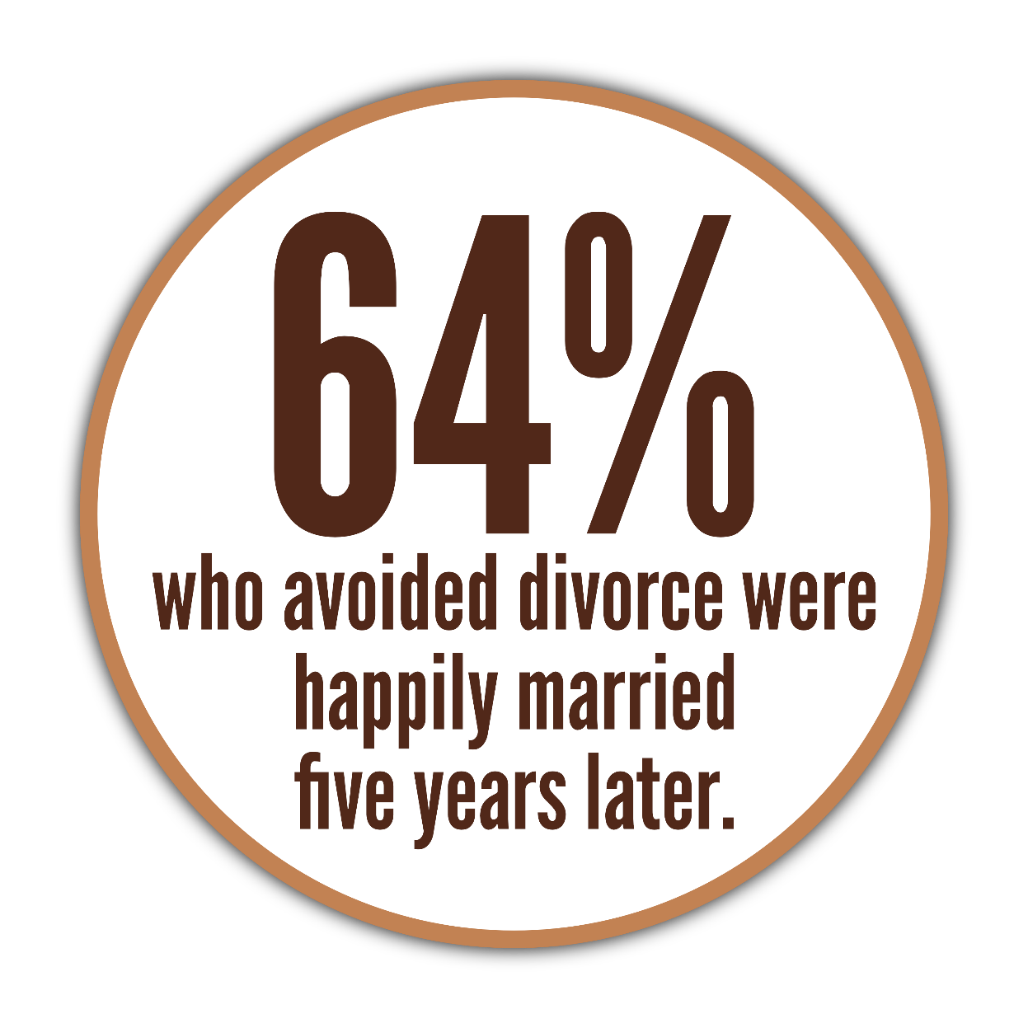

Slide 60
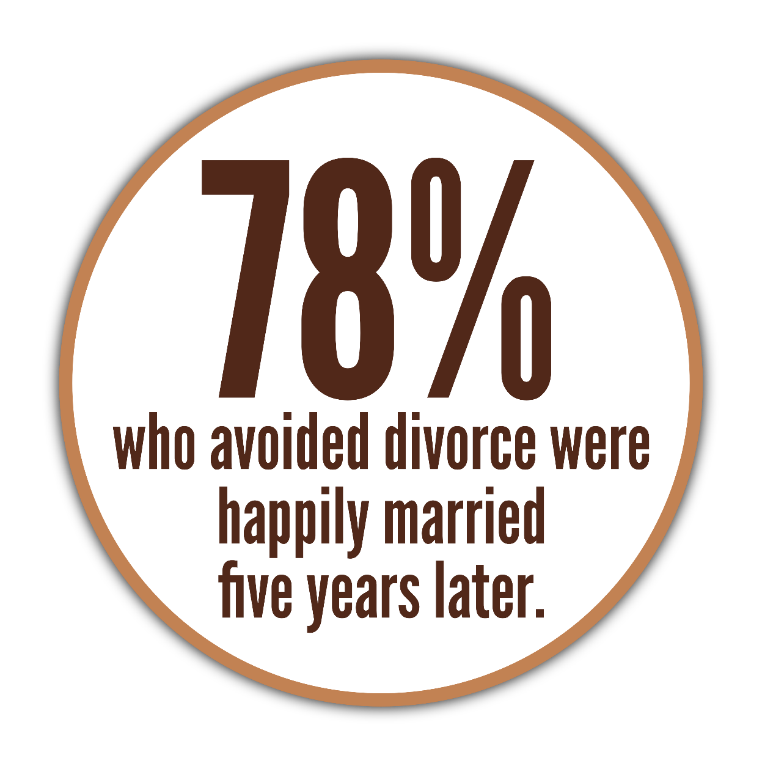

Slide 61
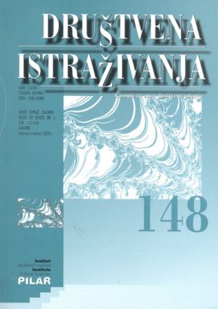
Paul Amato
(Professor of Sociology at Penn State University)
Paul Amato, “The Consequences of Divorce for Adults and Children.” Društvena istraživanja Vol 23, No 1 (2014). 12-13.
[Children of divorce exhibit…]
more conduct problems
more emotional problems
lower academic test scores and school grades
more problems with social relationships

Slide 62
Paul Amato
(Professor of Sociology at Penn State University)
Paul Amato, “The Consequences of Divorce for Adults and Children.” Društvena istraživanja Vol 23, No 1 (2014). 12-13.
[Children of divorce exhibit…]
weaker emotional ties with parents—especially fathers
obtain less education
earn less income
a greater risk of depression

Slide 63
Paul Amato
(Professor of Sociology at Penn State University)
Paul Amato, “The Consequences of Divorce for Adults and Children.” Društvena istraživanja Vol 23, No 1 (2014). 12-13.
Adolescents need stability
Who do I blame for the pain I feel?
Whose side am I on?
Where am I going to live?
Am I switching schools?
Do I get to keep my friends?
[Children of divorce exhibit…]
poorer physical health
more self-reported problems in their own marriages
a higher likelihood of seeing their own marriages ending in disruption
Meanwhile, 80% of Americans consider divorce morally acceptable.
W. Bradford Wilcox (ed.)m “State of our Unions,” The National Marriage Project: Wheatley Institution (2019).

Slide 64
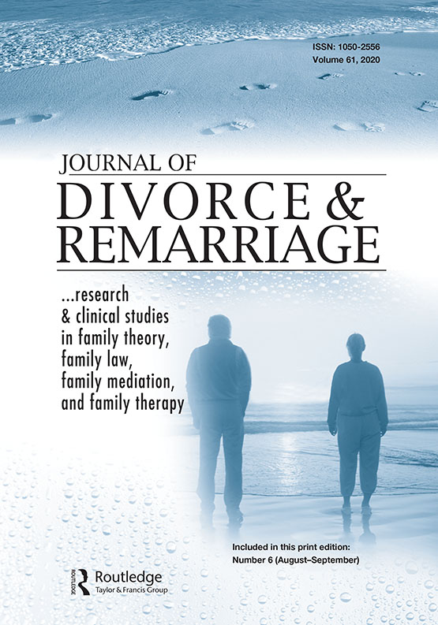
Laura Hartman (et al.)
(Bloorview Research Institute)
Laura Hartman (et al.). “What Does Parental Divorce or Marital Separation Mean for Adolescents? A Scoping Review of North American Literature” Journal of Divorce & Remarriage, 52:490-518, 2011. 509.
[Meta-analysis of 53 studies]
The “most prevalent theme in the sample was the study of
the parent-adolescent relationship.”

Slide 65
Laura Hartman (et al.)
(Bloorview Research Institute)
Laura Hartman (et al.). “What Does Parental Divorce or Marital Separation Mean for Adolescents? A Scoping Review of North American Literature” Journal of Divorce & Remarriage, 52:490-518, 2011. 509.
“decreased scholastic achievement.”
“less favorable attitudes toward marriage in girls.”
“increased disorders.”

Slide 66
Laura Hartman (et al.)
(Bloorview Research Institute)
Laura Hartman (et al.). “What Does Parental Divorce or Marital Separation Mean for Adolescents? A Scoping Review of North American Literature” Journal of Divorce & Remarriage, 52:490-518, 2011. 509.
“decreased coping ability.”
“decreased feelings of well-being.”
“decreased quality of the father-son relationship.”
“[decreased] mother-daughter relationship.”

Slide 67
Laura Hartman (et al.)
(Bloorview Research Institute)
Laura Hartman (et al.). “What Does Parental Divorce or Marital Separation Mean for Adolescents? A Scoping Review of North American Literature” Journal of Divorce & Remarriage, 52:490-518, 2011. 509.
“increased adolescent anxiety.”
“decreased academic achievement.”
“showed no general benefits for the adolescents.”

Slide 82
Caucasian, middle-class children with well-educated parents.
The parents had been married for an avg of 11 yrs.
Children had “never been referred to counseling for emotional problems” (p.355).

Slide 83
Unhappy childhoods (p.361)
Higher promiscuity (p.361)
3x less support for college (p.362)
50% less higher ed. than peers (p.362)
50% less higher ed. than parents (p.362)
10% would talk to their fathers about personal problems (p.364)
Most feared marriage & parenting (p.364)
4x more likely to divorce (p.365)

Slide 84
Conclusion?
“This 25-year study points to divorce not as an acute stress from which the child recovers
but as a life-transforming experience for the child.” (p.367)

Slide 85
This is painful to talk about…
…But even more painful to ignore.
Join in helping others to experience a healthy marriage, and avoid the pain of divorce!
If you’ve experienced divorce, there is a solid reason for hope!
These stats don’t take into account the power of God to change lives (e.g. Timothy).

Slide 86
This is painful to talk about…
…But even more painful to ignore.
Join in helping others to experience a healthy marriage, and avoid the pain of divorce!
If you’ve experienced divorce, there is a solid reason for hope!
These stats don’t take into account the power of God to change lives (e.g. Timothy).
Consider this example of a marriage that was on the verge of divorce…

