Slide 1
Matthew 12
Principles of the Law

Slide 2
Context
The Sermon on the Mount
Jesus’ preaching ministry
How to know God better
How to love others better
How to live a fulfilled life

Slide 3
Context
Jesus’ healing ministry
Helping people in need
Demonstrating God’s compassion and love
Authenticating His message

Slide 4
Context
Tension is rising
Jesus is gaining followers
Pharisees are becoming highly annoyed
Jesus’ teachings are increasingly confrontational

Slide 5
Matthew 12
12:1 At that time Jesus went through the grainfields on the Sabbath, and His disciples became hungry and began to pick the heads of grain and eat. 2 But when the Pharisees saw this, they said to Him, “Look, Your disciples do what is not lawful to do on a Sabbath.”

Slide 6
The problem
Was NOT that they were eating grain from someone else’s field
Deut 23:25 “When you enter your neighbor’s standing grain, then you may pluck the heads with your hand, but you shall not wield a sickle in your neighbor’s standing grain.

Slide 7
The problem
WAS from the Pharisee’s point of view, they were “working” on the Sabbath.

Slide 8
Sabbath Law
Gen.2:3-Then God blessed the seventh day and sanctified it, because in it He rested from all His work which God had created and made.
LEV 23:3-‘For six days work may be done, but on the seventh day there is a sabbath of complete rest, a holy convocation. You shall not do any work; it is a sabbath to the Lord in all your dwellings.

Slide 9
The Pharisee view of Sabbath
We shall not work?
What defines work?
Thirty-nine kinds of work forbidden on the Sabbath (M Shabbath 7:2)

Slide 10
39 kinds of work?
Selecting
"Selecting" (Hebrew: בורר) in the Talmudic sense usually refers exclusively to the separation of debris from grain - i.e. to any separation of intermixed materials which renders edible that which was inedible. Thus, filtering undrinkable water to make it drinkable falls under this category, as does picking small bones from fish

Slide 11
39 kinds of work?
Weaving
two loops (Shabbos 25)
Weaving at least two threads (Shabbos 25)
Separating two threads (Shabbos 25)

Slide 12
39 kinds of work?
Transferring between domains
There are 11 chapters on this topic
The tractate distinguishes four domains: private, public, semi-public and an exempt area.

Slide 13
39 kinds of work?
Transferring between domains
It holds that the transfer of an article from a private to a public domain is Biblically forbidden; transferring an article between a semi-public to a private or public domain is Rabbinically prohibited; transferring of an article between an exempt area and any other domain is permissible;

Slide 14
39 kinds of work?
Transferring between domains
Carrying an article out of a domain and returning to the same domain with it does not constitute transferring.
This may fall into the category of "wearing".

Slide 15
39 kinds of work?
Transferring between domains
Carrying an article out of a domain and returning to the same domain with it does not constitute transferring.
This may fall into the category of "wearing".
This is the mentality of the people who see Jesus and his disciples picking heads of wheat as the walk through a field.

Slide 16
The Religious mindset
Matthew 23:24–25 (NASB95) — 24 “You blind guides, who strain out a gnat and swallow a camel! 25 “Woe to you, scribes and Pharisees, hypocrites! For you clean the outside of the cup and of the dish, but inside they are full of robbery and self-indulgence.
The Blind have sight
The lame are healed
1,000 years of prophecy fulfilled

Slide 17
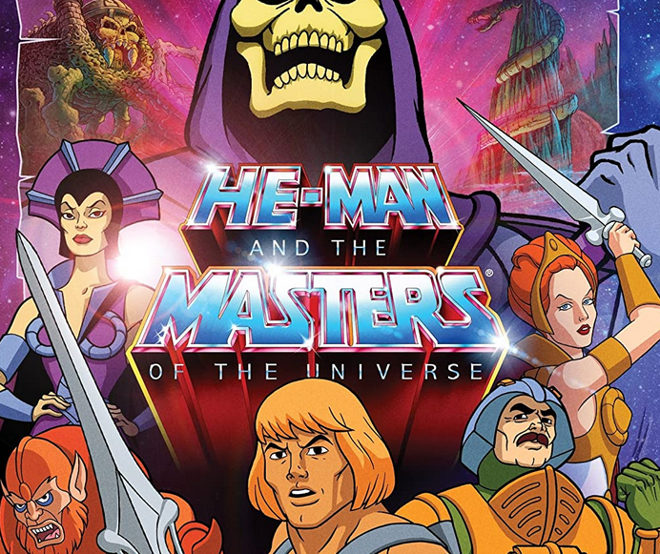
Modern day pharisees
Following the rules without caring about their meaning
Go to church on Sunday
I put money in the hat
I keep “impure” influences away

Slide 18
Modern day pharisees
Following the rules without caring about their meaning
Go to church on Sunday
I put money in the hat
I keep “impure” influences away

Slide 19
Modern day pharisees
Following the rules without caring about their meaning
Go to church on Sunday
I put money in the hat
I keep “impure” influences away

Slide 20
Modern day pharisees
I do these things because I want to show people that I am a spiritual person
Righteous appearances take precedence over reason
We end up making Christ look ridiculous and unreasonable

Slide 21
The Relational mindset
The rules are guides that help me grow
Go to Bible Studies
I give to God’s work
I think critically about influences that oppose God’s teaching

Slide 22
Matthew 12
3 But He said to them, “Have you not read what David did when he became hungry, he and his companions, 4 how he entered the house of God, and they ate the consecrated bread, which was not lawful for him to eat nor for those with him, but for the priests alone?

Slide 23
Jesus takes them to the scriptures
1 Sam. 21-David on the run gives the showbread to his men
Show Bread Lev 24:5 ff

Slide 24
Jesus takes them to the scriptures
Jesus’ point
It wasn’t lawful for them to do, but David’s men were starving, and David is justified

Slide 25
Matthew 12
5 “Or have you not read in the Law, that on the Sabbath the priests in the temple break the Sabbath and are innocent?

Slide 26
Jesus takes them to the scriptures
Jesus points out that priests work on the sabbath
In fact, Numbers 28:9-10 shows the offering and work of the priest's doubles on the Sabbath

Slide 27
Jesus takes them to the scriptures
Jesus points out that priests work on the sabbath
In fact, Numbers 28:9-10 shows the offering and work of the priest's doubles on the Sabbath
Notice how both examples Jesus gives pertain to the temple and priests

Slide 28
Matthew 12
6 “But I say to you that something greater than the temple is here.
The big boom!
It’s ok for David to eat the bread
It’s ok for Priests to work
Those were temple rules, I am greater than the temple!

Slide 29
Matthew 12
6 “But I say to you that something greater than the temple is here.
The big boom!
It’s ok for David to eat the bread
It’s ok for Priests to work
Those were temple rules, I am greater than the temple!
Jesus clarifies what he means

Slide 30
Matthew 12
7 “But if you had known what this means, ‘I desire mercy, and not a sacrifice,’ you would not have condemned the innocent.

Slide 31
Matthew 12
7 “But if you had known what this means, ‘I desire mercy, and not a sacrifice,’ you would not have condemned the innocent.
Jesus is pointing out the difference between the letter of the law and the principle behind it.
Hosea 6:6

Slide 32
The principle of the law
People in the OT knew the Sacrificial system was to teach them about God
It wasn’t that God was blood thirsty
It wasn’t that animal sacrifice forgave sin
It WAS a means to teach them about a relationship with Him

Slide 33
The principle of the law
Psalm 51:15-17
15 O Lord, open my lips,
That my mouth may declare Your praise. 16 For You do not delight in sacrifice, otherwise I would give it; You are not pleased with burnt offering. 17 The sacrifices of God are a broken spirit; A broken and a contrite heart, O God, You will not despise.
People in the OT knew the Sacrificial system was to teach them about God
It wasn’t that God was blood thirsty
It wasn’t that animal sacrifice forgave sin
It WAS a means to teach them about a relationship with Him

Slide 34
The Law
Teaches us about God’s character and will
Shows us right and wrong
But is insufficient as a means of a relationship

Slide 35
Gal 3:23-26
But before faith came, we were kept in custody under the law, being shut up to the faith which was later to be revealed. 24 Therefore the Law has become our tutor to lead us to Christ, so that we may be justified by faith. 25 But now that faith has come, we are no longer under a tutor. 26 For you are all sons of God through faith in Christ Jesus.

Slide 36
The Law
Children need things to be black & white but as we grow, we begin to understand and live by principles.
Ex. Thou Shalt not Kill

Slide 37
Thou Shalt not Kill
Is killing always wrong?
Wrong to join the armed services?
Wrong to defend your self or your family?
Scripture calls for capital punishment in certain circumstances
A black and white approach falls short of what God wants us to understand

Slide 38
Thou Shalt not Kill
The principle is that life has great value and murder is wrong
No prohibition in scripture from joining the army
It is not wrong to defend your loved ones
Prayer, scripture, and good counsel from others

Slide 39
A Holy Kiss?
2 Cor. 13:12- Greet one another with a holy kiss.
Do we follow this law to the letter?
Do we ignore it?
Or should we follow the principle behind it?

Slide 40
A Holy Kiss?
2 Cor. 13:12- Greet one another with a holy kiss.
Do we follow this law to the letter?
Do we ignore it?
Or should we follow the principle behind it?
Back to the Sabbath issue

Slide 41
Matthew 12
The principle behind the Law of the Sabbath?
See Mark 2:27
27 Jesus said to them, “The Sabbath was made for man, and not man for the Sabbath

Slide 42
The principle of the Sabbath
A day of rest, reflection, and enjoyment of God and one another
The Pharisees were concerned about the law of not working
NOT the relational principle behind it
This is the difference between following a religion and having a relationship

Slide 43
Conclusion
Where might we be missing the point?
What attitude do we have about coming to church?
Our devotional lives?
Sharing our faith?
Loving our enemies?
Sometimes all we can muster is cold obedience, but we’re missing out if we settle for that.

Slide 44
Conclusion
Where might we be missing the point?
Christianity isn’t about restriction it is about freedom
Matthew 11:28–30 (NASB95) — 28 “Come to Me, all who are weary and heavy-laden, and I will give you rest. 29 “Take My yoke upon you and learn from Me, for I am gentle and humble in heart, and you will find rest for your souls. 30 “For My yoke is easy and My burden is light.”

Slide 45
Our continuing Study
Next week
Matt 13
Parable of the soils

