Slide 1
Acts
The Church in Jerusalem
Acts 2: Pentecost

Slide 2
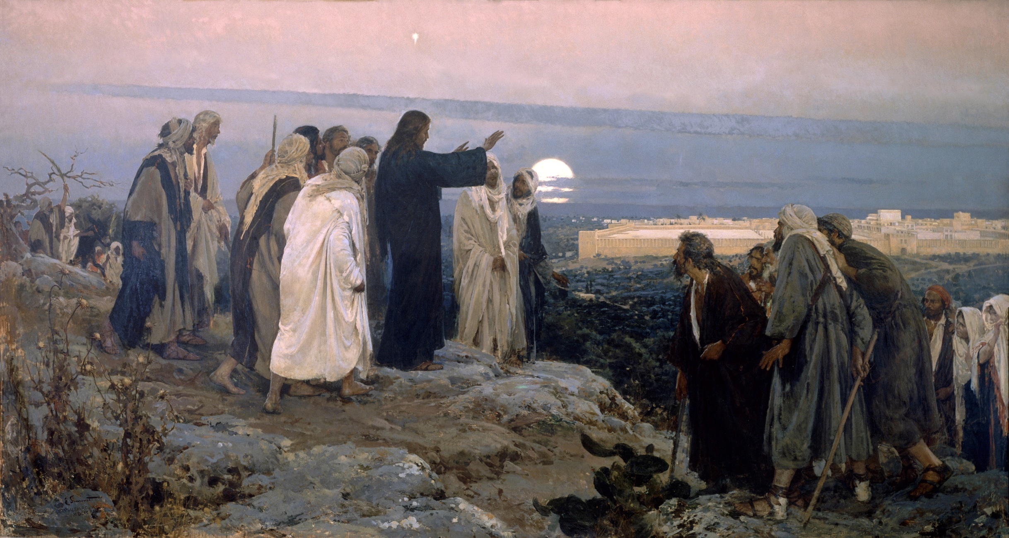
⁸ but you will receive power when the Holy Spirit has come upon you; and you shall be My witnesses both in Jerusalem, and in all Judea and Samaria, and even to the remotest part of the earth.”
^{Acts1:8} you will receive power when the Holy Spirit has come upon you; and you shall be My witnesses both in Jerusalem, and in all Judea and Samaria, and even to the remotest part of the earth.”
^{Acts1:8} you will receive power when the Holy Spirit has come upon you; and you shall be My witnesses both in Jerusalem, and in all Judea and Samaria, and even to the remotest part of the earth.”

Slide 3
^{Acts1:4} He commanded them not to leave Jerusalem, but to wait for what the Father had promised, “Which,” He said, “you heard of from Me; ⁵ for John baptized with water, but you will be baptized with the Holy Spirit not many days from now.”
^{Acts1:4} He commanded them not to leave Jerusalem, but to wait for what the Father had promised, “Which,” He said, “you heard of from Me; ⁵ for John baptized with water, but you will be baptized with the Holy Spirit not many days from now.”

Slide 4
^{Acts2:1} When the day of Pentecost had come, they were all together in one place.
^{Acts2:1} When the day of Pentecost had come, they were all together in one place.

Slide 5
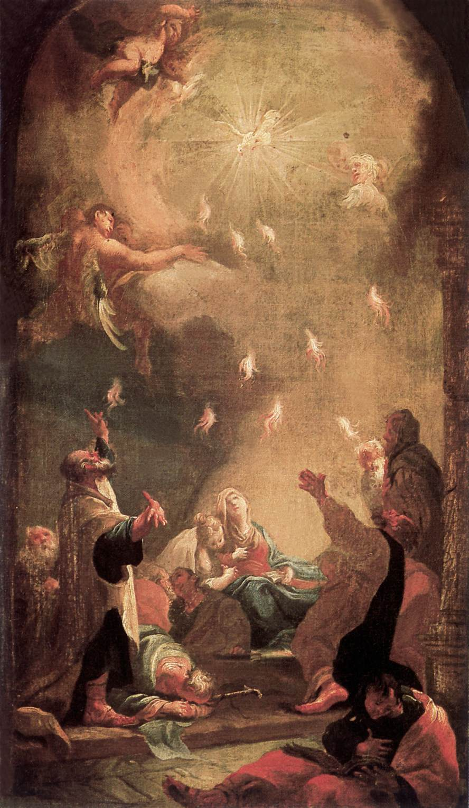
^{Acts2:2} And suddenly there came from heaven a noise like a violent rushing wind, and it filled the whole house where they were sitting. ³ And there appeared to them tongues as of fire distributing themselves, and they rested on each one of them. ⁴ And they were all filled with the Holy Spirit and began to speak with other tongues, as the Spirit was giving them utterance.
^{Acts2:2} And suddenly there came from heaven a noise like a violent rushing wind, and it filled the whole house where they were sitting. ³ And there appeared to them tongues as of fire distributing themselves, and they rested on each one of them. ⁴ And they were all filled with the Holy Spirit and began to speak with other tongues, as the Spirit was giving them utterance.
Luke is trying to describe something indescribable
Yet concrete / tangible
Auditory
Visual
Presence
Experiential
Account of a miraculous event

Slide 6
^{Acts2:5} Now there were Jews living in Jerusalem, devout men from every nation under heaven. ⁶ And when this sound occurred, the crowd came together, and were bewildered because each one of them was hearing them speak in his own language. ⁷ They were amazed and astonished, saying, “Why, are not all these who are speaking Galileans? ⁸ And how is it that we each hear them in our own language to which we were born?
^{Acts2:5} Now there were Jews living in Jerusalem, devout men from every nation under heaven. ⁶ And when this sound occurred, the crowd came together, and were bewildered because each one of them was hearing them speak in his own language. ⁷ They were amazed and astonished, saying, “Why, are not all these who are speaking Galileans? ⁸ And how is it that we each hear them in our own language to which we were born?
^{Acts2:5} Now there were Jews living in Jerusalem, devout men from every nation under heaven. ⁶ And when this sound occurred, the crowd came together, and were bewildered because each one of them was hearing them speak in his own language. ⁷ They were amazed and astonished, saying, “Why, are not all these who are speaking Galileans? ⁸ And how is it that we each hear them in our own language to which we were born?

Slide 7
^{Acts2:5} Now there were Jews living in Jerusalem, devout men from every nation under heaven. ⁶ And when this sound occurred, the crowd came together, and were bewildered because each one of them was hearing them speak in his own language. ⁷ They were amazed and astonished, saying, “Why, are not all these who are speaking Galileans? ⁸ And how is it that we each hear them in our own language to which we were born?
^{Acts2:5} Now there were Jews living in Jerusalem, devout men from every nation under heaven. ⁶ And when this sound occurred, the crowd came together, and were bewildered because each one of them was hearing them speak in his own language. ⁷ They were amazed and astonished, saying, “Why, are not all these who are speaking Galileans? ⁸ And how is it that we each hear them in our own language to which we were born?
^{Acts2:5} Now there were Jews living in Jerusalem, devout men from every nation under heaven. ⁶ And when this sound occurred, the crowd came together, and were bewildered because each one of them was hearing them speak in his own language. ⁷ They were amazed and astonished, saying, “Why, are not all these who are speaking Galileans? ⁸ And how is it that we each hear them in our own language to which we were born?
^{Acts2:5} Now there were Jews living in Jerusalem, devout men from every nation under heaven. ⁶ And when this sound occurred, the crowd came together, and were bewildered because each one of them was hearing them speak in his own language. ⁷ They were amazed and astonished, saying, “Why, are not all these who are speaking Galileans? ⁸ And how is it that we each hear them in our own language to which we were born?
“Galileans had difficulty pronouncing gutturals and had the habit of swallowing syllables when speaking; so they were looked down upon by the people of Jerusalem as being provincial.”
Richard Longenecker – The Expositor’s Bible Commentary

Slide 8
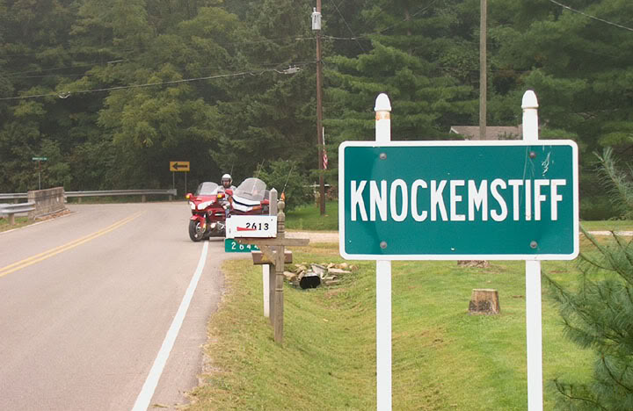

Slide 9
^{Acts2:5} Now there were Jews living in Jerusalem, devout men from every nation under heaven. ⁶ And when this sound occurred, the crowd came together, and were bewildered because each one of them was hearing them speak in his own language. ⁷ They were amazed and astonished, saying, “Why, are not all these who are speaking Galileans? ⁸ And how is it that we each hear them in our own language to which we were born?
^{Acts2:5} Now there were Jews living in Jerusalem, devout men from every nation under heaven. ⁶ And when this sound occurred, the crowd came together, and were bewildered because each one of them was hearing them speak in his own language. ⁷ They were amazed and astonished, saying, “Why, are not all these who are speaking Galileans? ⁸ And how is it that we each hear them in our own language to which we were born?
^{Acts2:5} Now there were Jews living in Jerusalem, devout men from every nation under heaven. ⁶ And when this sound occurred, the crowd came together, and were bewildered because each one of them was hearing them speak in his own language. ⁷ They were amazed and astonished, saying, “Why, are not all these who are speaking Galileans? ⁸ And how is it that we each hear them in our own language to which we were born?
^{Acts2:5} Now there were Jews living in Jerusalem, devout men from every nation under heaven. ⁶ And when this sound occurred, the crowd came together, and were bewildered because each one of them was hearing them speak in his own language. ⁷ They were amazed and astonished, saying, “Why, are not all these who are speaking Galileans? ⁸ And how is it that we each hear them in our own language to which we were born?
What in the world??

Slide 10
^{Acts2:5} Now there were Jews living in Jerusalem, devout men from every nation under heaven. ⁶ And when this sound occurred, the crowd came together, and were bewildered because each one of them was hearing them speak in his own language. ⁷ They were amazed and astonished, saying, “Why, are not all these who are speaking Galileans? ⁸ And how is it that we each hear them in our own language to which we were born?
^{Acts2:5} Now there were Jews living in Jerusalem, devout men from every nation under heaven. ⁶ And when this sound occurred, the crowd came together, and were bewildered because each one of them was hearing them speak in his own language. ⁷ They were amazed and astonished, saying, “Why, are not all these who are speaking Galileans? ⁸ And how is it that we each hear them in our own language to which we were born?
^{Acts2:5} Now there were Jews living in Jerusalem, devout men from every nation under heaven. ⁶ And when this sound occurred, the crowd came together, and were bewildered because each one of them was hearing them speak in his own language. ⁷ They were amazed and astonished, saying, “Why, are not all these who are speaking Galileans? ⁸ And how is it that we each hear them in our own language to which we were born?
^{Acts 2:9} Parthians and Medes and Elamites, and residents of Mesopotamia, Judea and Cappadocia, Pontus and Asia, ¹⁰ Phrygia and Pamphylia, Egypt and the districts of Libya around Cyrene, and visitors from Rome, both Jews and proselytes, ¹¹ Cretans and Arabs—we hear them in our own tongues speaking of the mighty deeds of God.” ¹² And they all continued in amazement and great perplexity, saying to one another, “What does this mean?” ¹³ But others were mocking and saying, “They are full of sweet wine.”
^{Acts 2:9} Parthians and Medes and Elamites, and residents of Mesopotamia, Judea and Cappadocia, Pontus and Asia, ¹⁰ Phrygia and Pamphylia, Egypt and the districts of Libya around Cyrene, and visitors from Rome, both Jews and proselytes, ¹¹ Cretans and Arabs—we hear them in our own tongues speaking of the mighty deeds of God.” ¹² And they all continued in amazement and great perplexity, saying to one another, “What does this mean?” ¹³ But others were mocking and saying, “They are full of sweet wine.”
^{Acts 2:9} Parthians and Medes and Elamites, and residents of Mesopotamia, Judea and Cappadocia, Pontus and Asia, ¹⁰ Phrygia and Pamphylia, Egypt and the districts of Libya around Cyrene, and visitors from Rome, both Jews and proselytes, ¹¹ Cretans and Arabs—we hear them in our own tongues speaking of the mighty deeds of God.” ¹² And they all continued in amazement and great perplexity, saying to one another, “What does this mean?” ¹³ But others were mocking and saying, “They are full of sweet wine.”
^{Acts 2:9} Parthians and Medes and Elamites, and residents of Mesopotamia, Judea and Cappadocia, Pontus and Asia, ¹⁰ Phrygia and Pamphylia, Egypt and the districts of Libya around Cyrene, and visitors from Rome, both Jews and proselytes, ¹¹ Cretans and Arabs—we hear them in our own tongues speaking of the mighty deeds of God.” ¹² And they all continued in amazement and great perplexity, saying to one another, “What does this mean?” ¹³ But others were mocking and saying, “They are full of sweet wine.”
The Holy Spirit is getting a reaction!

Slide 11
God keeps His Promises
… in His perfect timing
What does Luke want us to get from this account?

Slide 12
God keeps His Promises
That power comes from above
There is a change in the way God operates
“Upon” Vs “Indwell”
^{1Cor 3:16} Do you not know that you are a temple of God and that the Spirit of God dwells in you?
What does Luke want us to get from this account?

Slide 13
God keeps His Promises
That power comes from above
There is a change in the way God operates
“Upon” Vs “Indwell”
Temporary Vs Permanent
^{Eph 1:13} In Him, you also, after listening to the message of truth, the gospel of your salvation—having also believed, you were sealed in Him with the Holy Spirit of promise, ¹⁴ who is given as a pledge of our inheritance, with a view to the redemption of God’s own possession, to the praise of His glory.
What does Luke want us to get from this account?

Slide 14
God keeps His Promises
That power comes from above
There is a change in the way God operates
“Upon” Vs “Indwell”
Temporary Vs Permanent
Select Vs All
^{Acts2:3} And there appeared to them tongues as of fire distributing themselves, and they rested on each one of them.
What does Luke want us to get from this account?

Slide 15
God keeps His Promises
That power comes from above
There is a change in the way God operates
Spirit is distributed to all who believe in Christ
^{1Cor 12:13} For by one Spirit we were all baptized into one body, whether Jews or Greeks, whether slaves or free, and we were all made to drink of one Spirit.
What does Luke want us to get from this account?

Slide 16
God keeps His Promises
That power comes from above
There is a change in the way God operates
Spirit is distributed to all who believe in Christ
The Spirit’s empowering is for a purpose
The promise of the “Helper” has always been in the context of the mission
And this account puts a fine point on that
What does Luke want us to get from this account?

Slide 17
^{Acts2:4} And they were all filled with the Holy Spirit and began to speak with other tongues, as the Spirit was giving them utterance. ⁵ Now there were Jews living in Jerusalem, devout men from every nation under heaven. ⁶ And when this sound occurred, the crowd came together, and were bewildered because each one of them was hearing them speak in his own language. ⁷ They were amazed and astonished, saying, “Why, are not all these who are speaking Galileans? … ¹¹ we hear them in our own tongues speaking of the mighty deeds of God.” ¹² And they all continued in amazement and great perplexity, saying to one another, “What does this mean?” ¹³ But others were mocking and saying, “They are full of sweet wine.”
^{Acts2:4} And they were all filled with the Holy Spirit and began to speak with other tongues, as the Spirit was giving them utterance. ⁵ Now there were Jews living in Jerusalem, devout men from every nation under heaven. ⁶ And when this sound occurred, the crowd came together, and were bewildered because each one of them was hearing them speak in his own language. ⁷ They were amazed and astonished, saying, “Why, are not all these who are speaking Galileans? … ¹¹ we hear them in our own tongues speaking of the mighty deeds of God.” ¹² And they all continued in amazement and great perplexity, saying to one another, “What does this mean?” ¹³ But others were mocking and saying, “They are full of sweet wine.”
God keeps His Promises
That power comes from above
There is a change in the way God operates
The Spirit is distributed to everyone
The Spirit’s empowering is for a message
What does Luke want us to get from this account?

Slide 18
God keeps His Promises
That power comes from above
There is a change in the way God operates
Spirit is distributed to all who believe in Christ
The Spirit’s empowering is for a purpose
^{Acts2:3} And there appeared to them tongues as of fire distributing themselves, and they rested on each one of them.
What does Luke want us to get from this account?

Slide 19
God keeps His Promises
That power comes from above
There is a change in the way God operates
Spirit is distributed to all who believe in Christ
The Spirit’s empowering is for a message
God is displaying His power– but He is also telling us what that power is FOR:
it’s for the gospel
What does Luke want us to get from this account?

Slide 20
The Holy Spirit is not a good luck charm… If Jesus had come as a professional basketball player, and I said His Spirit was in me, you’d expect my game to improve. But Jesus came as a servant and a witness to God’s power. When the Spirit of God comes into us, we become extraordinary at that. The Spirit isn’t given so we can be empowered for ease and wealth, but so that we can be more like Him and more engaged in His mission. I once heard a man credit the Spirit for his good parking space at the mall. In Luke, the Spirit parked Jesus on the cross. In Acts, He “parked’” the Apostles in prison. - J.D. Greear
God keeps His Promises
^{Luke 24:46} “Thus it is written, that the Christ would suffer and rise again from the dead the third day, ⁴⁷ and that repentance for forgiveness of sins would be proclaimed in His name to all the nations, beginning from Jerusalem.
That power comes from above
There is a change in the way God operates
Spirit is distributed to all who believe in Christ
The Spirit’s empowering is for a message
God is displaying His power– but He is also telling us what that power is FOR:
it’s for the gospel
What does Luke want us to get from this account?

Slide 21
God keeps His Promises
That power comes from above
There is a change in the way God operates
Spirit is distributed to all who believe in Christ
The Spirit’s empowering is for a message
The Spirit moves toward outsiders
The Spirit draws a crowd
He speaks to people in their own language
He reaches people from all over the world
What does Luke want us to get from this account?

Slide 22
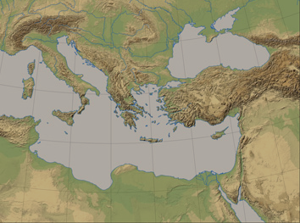
The message will be spoken in many tongues, to the “remotest parts of the earth”
Rome
Asia
Phrygia
Pontus
Pamphylia
Cappadocia
Mesopotamia
Crete
Parthian Empire
Cyrene
Jerusalem
Media
Libya
Elam
Egypt

Slide 23
What will be the immediate manifestation of the coming of the Holy Spirit?
Luke is presenting us with changed disciples
^{Acts2:14} But Peter, taking his stand with the eleven, raised his voice and declared to them: “Men of Judea and all you who live in Jerusalem, let this be known to you and give heed to my words.
^{Acts2:14} But Peter, taking his stand with the eleven, raised his voice and declared to them: “Men of Judea and all you who live in Jerusalem, let this be known to you and give heed to my words.
^{Acts2:14} But Peter, taking his stand with the eleven, raised his voice and declared to them: “Men of Judea and all you who live in Jerusalem, let this be known to you and give heed to my words.
^{Acts2:14} But Peter, taking his stand with the eleven, raised his voice and declared to them: “Men of Judea and all you who live in Jerusalem, let this be known to you and give heed to my words.

Slide 24
The role of “speeches” in Acts

Slide 25
“Rhetoric, or the art of persuasion, was considered primary to education in the first-century Greco-Roman world… Rhetoric was, to the ancients, power, whether for good or for ill. In the Greco-Roman world, speaking was central to success. Thus, in ancient history books, speeches are not mere commentary on events nor accompaniment to events: speeches must be seen as events in their own right. In other words, ancient historians tended to focus on battles and speeches as the events that shaped history. So it is not surprising to find that Acts has 32 speeches, which make up 25% of the narrative.
Ajith Fernando– NIV Application Commentary
The role of “speeches” in Acts

Slide 26
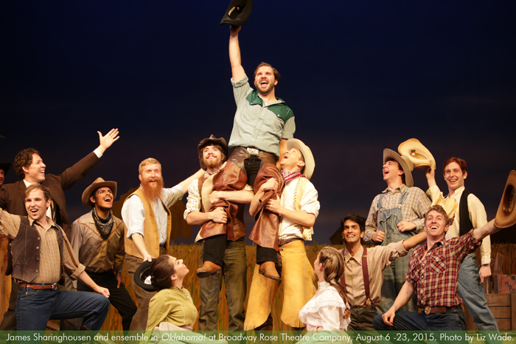
Tempting to say
“let’s skip the speech and get back to the story…”
Events in and of themselves
“landmarks” in the book
Presenting and driving the key arguments and themes
Often representative of the kinds of things being proclaimed
The role of “speeches” in Acts

Slide 27
^{Acts 2:14} “Men of Judea and all you who live in Jerusalem, let this be known to you and give heed to my words. ¹⁵ For these men are not drunk, as you suppose, for it is only the third hour of the day ¹⁶ but this is what was spoken of through the prophet Joel:

Slide 28
^{Acts 2:14} “Men of Judea and all you who live in Jerusalem, let this be known to you and give heed to my words. ¹⁵ For these men are not drunk, as you suppose, for it is only the third hour of the day ¹⁶ but this is what was spoken of through the prophet Joel:

Slide 29
Point: This was predicted and promised, and is part of God’s plan being fulfilled before your eyes
Joel 2:28, 29
^{Acts 2:17} ‘And it shall be in the last days,’ God says, ‘That I will pour forth of My Spirit on all mankind; And your sons and your daughters shall prophesy, And your young men shall see visions, And your old men shall dream dreams; ¹⁸ Even on My bondslaves, both men and women, I will in those days pour forth of My Spirit And they shall prophesy.

Slide 30
Describing apocalyptic judgement?
Peter is not saying Joel has been 100% fulfilled
The first part about the Spirit was fulfilled today
… which means the second part will be too
Therefore you should take heed and be saved
Joel 2:30-32
^{Acts 2:19} ‘And I will grant wonders in the sky above And signs on the earth below, Blood, and fire, and vapor of smoke. ²⁰ ‘The sun will be turned into darkness And the moon into blood, Before the great and glorious day of the Lord shall come. ²¹ ‘And it shall be that everyone who calls on the name of the Lord will be saved.’
^{Acts 2:19} ‘And I will grant wonders in the sky above And signs on the earth below, Blood, and fire, and vapor of smoke. ²⁰ ‘The sun will be turned into darkness And the moon into blood, Before the great and glorious day of the Lord shall come. ²¹ ‘And it shall be that everyone who calls on the name of the Lord will be saved.’

Slide 31
Point: There is still time to be made right with God – by calling on His name in faith
^{Acts 2:19} ‘And I will grant wonders in the sky above And signs on the earth below, Blood, and fire, and vapor of smoke. ²⁰ ‘The sun will be turned into darkness And the moon into blood, Before the great and glorious day of the Lord shall come. ²¹ ‘And it shall be that everyone who calls on the name of the Lord will be saved.’
^{Acts 2:19} ‘And I will grant wonders in the sky above And signs on the earth below, Blood, and fire, and vapor of smoke. ²⁰ ‘The sun will be turned into darkness And the moon into blood, Before the great and glorious day of the Lord shall come. ²¹ ‘And it shall be that everyone who calls on the name of the Lord will be saved.’

Slide 32
^{Acts 2:22} “Men of Israel, listen to these words: Jesus the Nazarene, a man attested to you by God with miracles and wonders and signs which God performed through Him in your midst, just as you yourselves know—
^{Acts 2:22} “Men of Israel, listen to these words: Jesus the Nazarene, a man attested to you by God with miracles and wonders and signs which God performed through Him in your midst, just as you yourselves know—
^{Acts 2:22} “Men of Israel, listen to these words: Jesus the Nazarene, a man attested to you by God with miracles and wonders and signs which God performed through Him in your midst, just as you yourselves know—

Slide 33
Point: You killed Him, but God raised Him up according to His plan
^{Acts 2:23} this Man, delivered over by the predetermined plan and foreknowledge of God, you nailed to a cross by the hands of godless men and put Him to death. ²⁴ But God raised Him up again, putting an end to the agony of death, since it was impossible for Him to be held in its power.
^{Acts 2:23} this Man, delivered over by the predetermined plan and foreknowledge of God, you nailed to a cross by the hands of godless men and put Him to death. ²⁴ But God raised Him up again, putting an end to the agony of death, since it was impossible for Him to be held in its power.
^{Acts 2:23} this Man, delivered over by the predetermined plan and foreknowledge of God, you nailed to a cross by the hands of godless men and put Him to death. ²⁴ But God raised Him up again, putting an end to the agony of death, since it was impossible for Him to be held in its power.

Slide 34
David is writing in the 1st person
And yet…
Psalm 16:8-11
^{Acts 2:25} For David says of Him, ‘I saw the Lord always in my presence; For He is at my right hand, so that I will not be shaken. ²⁶ ‘Therefore my heart was glad and my tongue exulted; Moreover my flesh also will live in hope; ²⁷ Because You will not abandon my soul to Hades, Nor allow Your Holy One to undergo decay. ²⁸ ‘You have made known to me the ways of life; You will make me full of gladness with Your presence.’
^{Acts 2:25} For David says of Him, ‘I saw the Lord always in my presence; For He is at my right hand, so that I will not be shaken. ²⁶ ‘Therefore my heart was glad and my tongue exulted; Moreover my flesh also will live in hope; ²⁷ Because You will not abandon my soul to Hades, Nor allow Your Holy One to undergo decay. ²⁸ ‘You have made known to me the ways of life; You will make me full of gladness with Your presence.’

Slide 35
David is writing in the 1st person
And yet…
David must be writing about someone else…
“Holy One” was a term for Messiah
^{Acts 2:29} “Brethren, I may confidently say to you regarding the patriarch David that he both died and was buried, and his tomb is with us to this day.

Slide 36
David is writing in the 1st person
And yet…
David must be writing about someone else…
“Holy One” was a term for Messiah
Psalm 132:11
^{Acts 2:30} And so, because he was a prophet and knew that God had sworn to him with an oath to seat one of his descendants on his throne, ³¹ he looked ahead and spoke of the resurrection of the Christ, that He was neither abandoned to Hades, nor did His flesh suffer decay.

Slide 37
Point: David spoke of a promised descendent – a savior king who would rule forever
Not news to them – they expected a Messiah to fulfill these promises
Psalm 132:11
^{Acts 2:30} And so, because he was a prophet and knew that God had sworn to him with an oath to seat one of his descendants on his throne, ³¹ he looked ahead and spoke of the resurrection of the Christ, that He was neither abandoned to Hades, nor did His flesh suffer decay.

Slide 38
Point: Jesus is the fulfillment of these promises: He ascended to heaven rather than “undergoing decay”
And the evidence is right before your eyes
^{Acts 2:32} This Jesus God raised up again, to which we are all witnesses. ³³ Therefore having been exalted to the right hand of God, and having received from the Father the promise of the Holy Spirit, He has poured forth this which you both see and hear.
^{Acts 2:32} This Jesus God raised up again, to which we are all witnesses. ³³ Therefore having been exalted to the right hand of God, and having received from the Father the promise of the Holy Spirit, He has poured forth this which you both see and hear.
^{Acts 2:32} This Jesus God raised up again, to which we are all witnesses. ³³ Therefore having been exalted to the right hand of God, and having received from the Father the promise of the Holy Spirit, He has poured forth this which you both see and hear.

Slide 39
“Exhibit C”
^{Acts 2:34} For it was not David who ascended into heaven, but he himself says: ‘The Lord said to my Lord, “Sit at My right hand, ³⁵ Until I make Your enemies a footstool for Your feet.”’
^{Acts 2:34} For it was not David who ascended into heaven, but he himself says: ‘The Lord said to my Lord, “Sit at My right hand, ³⁵ Until I make Your enemies a footstool for Your feet.”’
Psalm 110:1

Slide 40
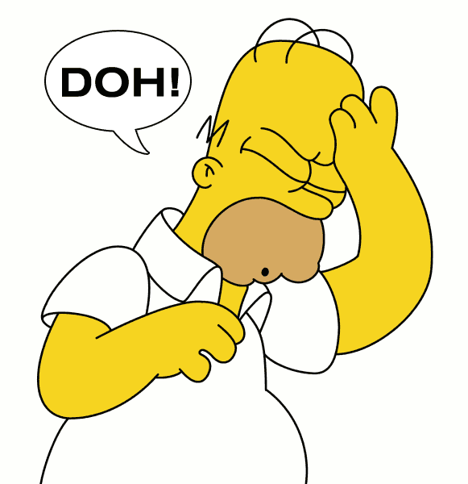
Punchline: God kept His promise and sent the Messiah, and you crucified Him!
Peter is connecting the dots…
Think about what you know in the scriptures, what you saw in Jesus, and what you are seeing today…
It all points to ONE MAN…
^{Acts 2:36} Therefore let all the house of Israel know for certain that God has made Him both Lord and Christ—this Jesus whom you crucified.”

Slide 41
Application: “repent for forgiveness of sins”
Good news: Jesus voluntarily went to the cross to stand in our place – to pay for human sin past present and future
^{Acts 2:37} Now when they heard this, they were pierced to the heart, and said to Peter and the rest of the apostles, “Brethren, what shall we do?” ³⁸ Peter said to them, “Repent, and each of you be baptized in the name of Jesus Christ for the forgiveness of your sins; and you will receive the gift of the Holy Spirit.
^{Acts 2:37} Now when they heard this, they were pierced to the heart, and said to Peter and the rest of the apostles, “Brethren, what shall we do?” ³⁸ Peter said to them, “Repent, and each of you be baptized in the name of Jesus Christ for the forgiveness of your sins; and you will receive the gift of the Holy Spirit.

Slide 42
Application: “repent for forgiveness of sins”
Quite a speech: “You put the exclamation point on human sin… but because of Jesus even you can receive the HS today, and so can anyone else!”
^{Acts 2:39} For the promise is for you and your children and for all who are far off, as many as the Lord our God will call to Himself.” ⁴⁰ And with many other words he solemnly testified and kept on exhorting them, saying, “Be saved from this perverse generation!” ⁴¹ So then, those who had received his word were baptized; and that day there were added about three thousand souls.
^{Acts 2:39} For the promise is for you and your children and for all who are far off, as many as the Lord our God will call to Himself.” ⁴⁰ And with many other words he solemnly testified and kept on exhorting them, saying, “Be saved from this perverse generation!” ⁴¹ So then, those who had received his word were baptized; and that day there were added about three thousand souls.

Slide 43
Peter:
Presented His case from the scriptures
Bore witness to the resurrection
Pointed to evidence in plain sight
Proclaimed the Gospel
How do we see the Holy Spirit at work
in Peter’s speech?

Slide 44
Peter:
Presented His case from the scriptures
Bore witness to the resurrection
Pointed to evidence in plain sight
Proclaimed the Gospel
The Holy Spirit:
Empowered His speech
How do we see the Holy Spirit at work
in Peter’s speech?

Slide 45
Peter:
Presented His case from the scriptures
Bore witness to the resurrection
Pointed to evidence in plain sight
Proclaimed the Gospel
The Holy Spirit:
Illuminated the Scriptures
How do we see the Holy Spirit at work
in Peter’s speech?

Slide 46
Peter:
Presented His case from the scriptures
Bore witness to the resurrection
Pointed to evidence in plain sight
Proclaimed the Gospel
The Holy Spirit:
Convicted the hearts of the hearers
How do we see the Holy Spirit at work
in Peter’s speech?

Slide 47
^{Acts 2:37} Now when they heard this, they were pierced to the heart, and said to Peter and the rest of the apostles, “Brethren, what shall we do?”
This is something that He does in Love
Conviction softens our heart to hear from Him
The Holy Spirit:
Convicted the hearts of the hearers
^{Jn 16:8} And He, when He comes, will convict the world concerning sin and righteousness and judgment;
How do we see the Holy Spirit at work
in Peter’s speech?

Slide 48
^{Acts 2:37} Now when they heard this, they were pierced to the heart, and said to Peter and the rest of the apostles, “Brethren, what shall we do?”
This is something that He does in Love
Conviction softens our heart to hear from Him
³⁸ Peter said to them, “Repent, and each of you be baptized in the name of Jesus Christ for the forgiveness of your sins; and you will receive the gift of the Holy Spirit.
³⁸ Peter said to them, “Repent, and each of you be baptized in the name of Jesus Christ for the forgiveness of your sins; and you will receive the gift of the Holy Spirit.
³⁸ Peter said to them, “Repent, and each of you be baptized in the name of Jesus Christ for the forgiveness of your sins; and you will receive the gift of the Holy Spirit.
Conviction is always followed up with an invitation

Slide 49
What made it great was that God decided to use it
God wants to use our speech in just the same way
If we are willing to open our mouths
We should look for opportunities to speak truth in one another’s lives, and we should pray for and expect the same empowering today!
What made Peter’s Speech so great?

