Slide 1
Joshua
Courage from God

Slide 2
Joshua 1
1-2. After Moses the Lord’s servant died, the Lord said to Joshua son of Nun, Moses’ assistant: “Moses my servant is dead. Get ready! Cross the Jordan River! Lead these people into the land which I am ready to hand over to them.

Slide 3
Joshua 1
1-2. After Moses the Lord’s servant died, the Lord said to Joshua son of Nun, Moses’ assistant: “Moses my servant is dead. Get ready! Cross the Jordan River! Lead these people into the land which I am ready to hand over to them.

Slide 4
Joshua 1
1-2. After Moses the Lord’s servant died, the Lord said to Joshua son of Nun, Moses’ assistant: “Moses my servant is dead. Get ready! Cross the Jordan River! Lead these people into the land which I am ready to hand over to them.
(Josh. 24:29) After all this Joshua son of Nun, the Lord’s servant, died at the age of one hundred ten.

Slide 5
Joshua 1
1-2. After Moses the Lord’s servant died, the Lord said to Joshua son of Nun, Moses’ assistant: “Moses my servant is dead. Get ready! Cross the Jordan River! Lead these people into the land which I am ready to hand over to them.

Slide 6
Joshua 1
3. I am handing over to you every place you set foot, as I promised Moses.
God calls on Joshua to lead, but backs it up with a promise.

Slide 7
Joshua 1
4. Your territory will extend from the wilderness in the south to Lebanon in the north. It will extend all the way to the great River Euphrates in the east (including all of Syria) and all the way to the Mediterranean Sea in the west.

Slide 8
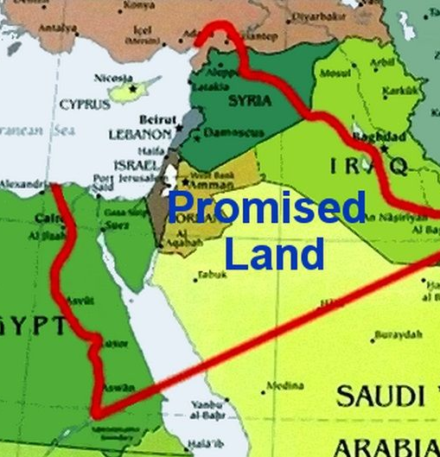
Joshua 1
4. Your territory will extend from the wilderness in the south to Lebanon in the north. It will extend all the way to the great River Euphrates in the east (including all of Syria) and all the way to the Mediterranean Sea in the west.
Clearly some encouragement was needed!
(Num. 13:28) But the people living there are powerful, and their towns are large and fortified. We even saw giants there, the descendants of Anak!

Slide 10
(Jas. 4:14) You do not know about tomorrow. What is your life like? For you are a puff of smoke that appears for a short time and then vanishes.
~Meaningless~ Life
Here I lay broken hearted
Sat to poop
But only farted
Apart from God there is little reason to care about anything, but with God we have unlimited, eternal, encouragement!

Slide 11
Joshua 1
5. No one will be able to resist you all the days of your life. As I was with Moses, so I will be with you. I will not abandon you or leave you alone.

Slide 12
Joshua 1
(Heb. 13:7) Remember those who led you, who spoke the word of God to you; and considering the result of their conduct, imitate their faith.
5. No one will be able to resist you all the days of your life. As I was with Moses, so I will be with you. I will not abandon you or leave you alone.
God will put Godly examples of faith in our lives to remind us that he is with us.

Slide 13
Joshua 1
5. No one will be able to resist you all the days of your life. As I was with Moses, so I will be with you. I will not abandon you or leave you alone.
(Deut. 31:6) “So be strong and courageous! Do not be afraid and do not panic before them. For the Lord your God will personally go ahead of you. He will neither fail you nor abandon you.”

Slide 14
Joshua 1
5. No one will be able to resist you all the days of your life. As I was with Moses, so I will be with you. I will not abandon you or leave you alone.
(Rom. 8:31-32) If God is for us, who can ever be against us? Since he did not spare even his own Son but gave him up for us all, won’t he also give us everything else?

Slide 15
Joshua 1
5. No one will be able to resist you all the days of your life. As I was with Moses, so I will be with you. I will not abandon you or leave you alone.
(Matt. 28:20) “[Jesus said], be sure of this: I am with you always, even to the end of the age.”

Slide 16
Joshua 1
6. Be strong and courageous! You must lead these people in the conquest of this land that I solemnly promised their ancestors I would hand over to them.

Slide 17
Joshua 1
6. Be strong and courageous! You must lead these people in the conquest of this land that I solemnly promised their ancestors I would hand over to them.
When we are not courageous for God…
Perpetual follower.
Easily distracted by the world.
Little ability to form internal motivation.
Loss of determination.
Settles for easiest path.
Live in fear.

Slide 18
Joshua 1
6. Be strong and courageous! You must lead these people in the conquest of this land that I solemnly promised their ancestors I would hand over to them.
When we are not courageous for God…
Perpetual follower.
Easily distracted by the world.
Little ability to form internal motivation.
Loss of determination.
Settles for easiest path.
Live in fear.
(Gal. 6:9) So let’s not get tired of doing what is good. At just the right time we will reap a harvest of blessing if we don’t give up.

Slide 19
Joshua 1
6. Be strong and courageous! You must lead these people in the conquest of this land that I solemnly promised their ancestors I would hand over to them.
If we aren’t taking our courage from God, then leading people towards God becomes nearly impossible!

Slide 20
Joshua 1
6. Be strong and courageous! You must lead these people in the conquest of this land that I solemnly promised their ancestors I would hand over to them.
Is God like people in that he breaks his promises?

Slide 21
Joshua 1
6. Be strong and courageous! You must lead these people in the conquest of this land that I solemnly promised their ancestors I would hand over to them.
Broken Promises!
Is God like people in that he breaks his promises?
1991
2016
1929
2011
1951
1957

Slide 22
Joshua 1
(Eph. 1:3) Blessed is the God and Father of our Lord Jesus Christ, who has blessed us with every spiritual blessing in the heavenly realms in Christ.
6. Be strong and courageous! You must lead these people in the conquest of this land that I solemnly promised their ancestors I would hand over to them.
Courage from God:
1. Rests on his promises.

Slide 23
Joshua 1
(2 Pt. 3:13) But we are looking forward to the new heavens and new earth he has promised, a world filled with God’s righteousness.
6. Be strong and courageous! You must lead these people in the conquest of this land that I solemnly promised their ancestors I would hand over to them.
Courage from God:
1. Rests on his promises.

Slide 24
Joshua 1
(1 Jn 2:25) Now this is the promise that he himself made to us: eternal life.
6. Be strong and courageous! You must lead these people in the conquest of this land that I solemnly promised their ancestors I would hand over to them.
Courage from God:
1. Rests on his promises.

Slide 25
Joshua 1
(Heb 6:18) So God has given both his promise and his oath. These two things are unchangeable because it is impossible for God to lie…
6. Be strong and courageous! You must lead these people in the conquest of this land that I solemnly promised their ancestors I would hand over to them.
Courage from God:
1. Rests on his promises.

Slide 26
Joshua 1
(Heb 6:18)…Therefore, we who have fled to him for refuge can have great confidence as we hold to the hope that lies before us.
6. Be strong and courageous! You must lead these people in the conquest of this land that I solemnly promised their ancestors I would hand over to them.
Courage from God:
1. Rests on his promises.

Slide 27
Joshua 1
7. Be strong and very courageous. Be careful to obey all the instructions Moses gave you. Do not deviate from them, turning either to the right or to the left. Then you will be successful in everything you do.

Slide 28
Joshua 1
7. Be strong and very courageous. Be careful to obey all the instructions Moses gave you. Do not deviate from them, turning either to the right or to the left. Then you will be successful in everything you do.

Slide 29
Joshua 1
7. Be strong and very courageous. Be careful to obey all the instructions Moses gave you. Do not deviate from them, turning either to the right or to the left. Then you will be successful in everything you do.
Courage from God:
2. Comes through the power of his word.

Slide 30
Joshua 1
8. Study this book of instruction continually. Meditate on it day and night so you will be careful to do everything written in it. Only then will you prosper and succeed in all you do.

Slide 31
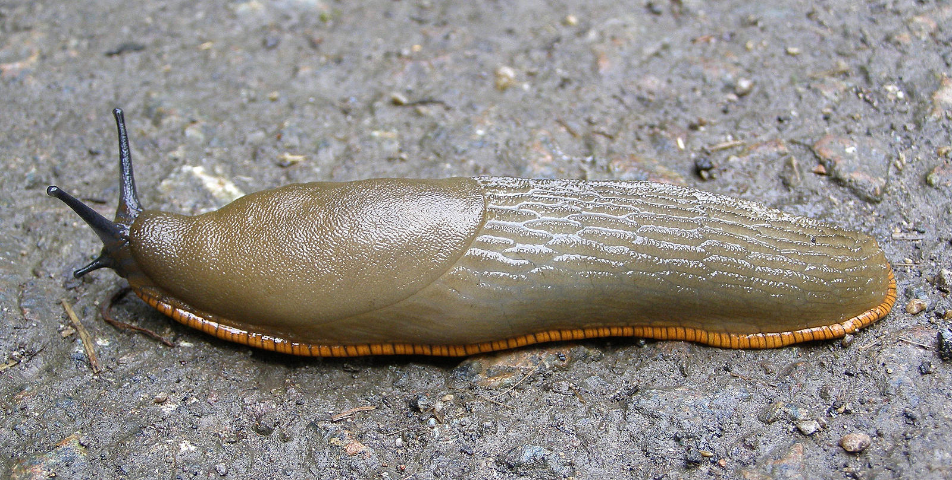
Joshua 1
When I’m unwilling to study and learn, what’s the real difference between me and this disgusting slug?
8. Study this book of instruction continually. Meditate on it day and night so you will be careful to do everything written in it. Only then will you prosper and succeed in all you do.
(2 Tim. 3:16-17) All Scripture is inspired by God and is useful to teach us what is true and to make us realize what is wrong in our lives. It corrects us when we are wrong and teaches us to do what is right. God uses it to prepare and equip his people to do every good work.

Slide 32
Joshua 1
8. Study this book of instruction continually. Meditate on it day and night so you will be careful to do everything written in it. Only then will you prosper and succeed in all you do.
We need to recapture the lost art of memorization!

Slide 33
Joshua 1
8. Study this book of instruction continually. Meditate on it day and night so you will be careful to do everything written in it. Only then will you prosper and succeed in all you do.
(Jn. 13:17) Now that you know these things, God will bless you for doing them.

Slide 34
Joshua 1
9. I repeat, be strong and courageous!

Slide 35
Joshua 1
9. I repeat, be strong and courageous!
Don’t be afraid and don’t panic

Slide 36
Joshua 1
9. I repeat, be strong and courageous!
Don’t be afraid and don’t panic
I, the Lord your God, am with you in all you do.”

Slide 37
Joshua 1
9. I repeat, be strong and courageous!
Don’t be afraid and don’t panic
I, the Lord your God, am with you in all you do.”
Courage from God:
3. Is realized by his presence.

Slide 38
Joshua 1
(Isaiah 40:28-31) Have you never heard? Have you never understood? The Lord is the everlasting God, the Creator of all the earth. He never grows weak or weary. No one can measure the depths of his understanding…
9. I repeat, be strong and courageous!
Don’t be afraid and don’t panic
I, the Lord your God, am with you in all you do.”
Courage from God:
3. Is realized by his presence.

Slide 39
Joshua 1
(Isaiah 40:28-31)…He gives power to the weak and strength to the powerless. Even youths will become weak and tired, and young men will fall in exhaustion…
9. I repeat, be strong and courageous!
Don’t be afraid and don’t panic
I, the Lord your God, am with you in all you do.”
Courage from God:
3. Is realized by his presence.

Slide 40
Joshua 1
(Isaiah 40:28-31)…But those who trust in the Lord will find new strength. They will soar high on wings like eagles. They will run and not grow weary. They will walk and not faint.
9. I repeat, be strong and courageous!
Don’t be afraid and don’t panic
I, the Lord your God, am with you in all you do.”
Courage from God:
3. Is realized by his presence.

Slide 41
Joshua 1
10-11. Joshua instructed the leaders of the people: “Go through the camp and command the people, ‘Prepare your supplies, for within three days you will cross the Jordan River and begin the conquest of the land the Lord your God is ready to hand over to you.’”

Slide 42
Final Thoughts…
God offers you his promise of eternal life. Will you accept this?

Slide 43
Final Thoughts…
God speaks to us through the power of his word. Will you turn to it?

Slide 44
Final Thoughts…
God promises to be with you always. Do you believe that?

Slide 45
Final Thoughts…
(Jn. 16:33) “I have told you these things so that in me you may have peace. In the world you have trouble and suffering, but take courage, I have conquered the world.”
Where will you draw your courage from?

Slide 46
Joshua
Comments?
Thoughts?
Questions?

