Slide 1
FIRST PETER
THE BOOK OF

Slide 2
1 Peter 2
¹¹ Beloved, I urge you as aliens and strangers…

Slide 3
1 Peter 2
¹¹ Beloved, I urge you as aliens and strangers…
As temporary residents in a foreign land, you are not going to adopt the values of the land in which you are staying.

Slide 4
1 Peter 2
¹¹ Beloved, I urge you as aliens and strangers…
Human nature dictates that we tend to watch strangers closely.

Slide 5
1 Peter 2
¹¹ Beloved, I urge you as aliens and strangers…
Abstain from fleshly lusts which wage war against the soul.
¹² Keep your behavior excellent among the Gentiles, so that in the thing in which they slander you as evildoers, they may because of your good deeds, as they observe them, glorify God in the day of visitation.

Slide 6
1 Peter 2
¹¹ Beloved, I urge you as aliens and strangers…
Abstain from fleshly lusts which wage war against the soul.
¹² Keep your behavior excellent among the Gentiles, so that in the thing in which they slander you as evildoers, they may because of your good deeds, as they observe them, glorify God in the day of visitation.
» In the 1st century, much of Greek moral philosophy and Greco-Roman idealism, renounced a life dominated by satisfying your desires.
» Our values are more celebrated in their breach, than in their observance.
» At the very least, people in our culture should notice that we are different in these areas.

Slide 7
1 Peter 2
¹¹ Beloved, I urge you as aliens and strangers…
Abstain from fleshly lusts which wage war against the soul.
¹² Keep your behavior excellent among the Gentiles, so that in the thing in which they slander you as evildoers, they may because of your good deeds, as they observe them, glorify God in the day of visitation.

Slide 8
1 Peter 2
¹¹ Beloved, I urge you as aliens and strangers…
Abstain from fleshly lusts which wage war against the soul.
¹² Keep your behavior excellent among the Gentiles, so that in the thing in which they slander you as evildoers, they may because of your good deeds, as they observe them, glorify God in the day of visitation.
Slander against Christians in the early church

Slide 16
1 Peter 2
¹¹ Beloved, I urge you as aliens and strangers…
Abstain from fleshly lusts which wage war against the soul.
¹² Keep your behavior excellent among the Gentiles, so that in the thing in which they slander you as evildoers, they may because of your good deeds, as they observe them, glorify God in the day of visitation.
¹⁵ For such is the will of God that by doing right you may silence the ignorance of foolish men.

Slide 17
1 Peter 2
¹¹ Beloved, I urge you as aliens and strangers…
Abstain from fleshly lusts which wage war against the soul.
¹² Keep your behavior excellent among the Gentiles, so that in the thing in which they slander you as evildoers, they may because of your good deeds, as they observe them, glorify God in the day of visitation.
¹⁵ For such is the will of God that by doing right you may silence the ignorance of foolish men.

Slide 18
1 Peter 2
¹¹ Beloved, I urge you as aliens and strangers…
Abstain from fleshly lusts which wage war against the soul.
¹² Keep your behavior excellent among the Gentiles, so that in the thing in which they slander you as evildoers, they may because of your good deeds, as they observe them, glorify God in the day of visitation.
¹⁵ For such is the will of God that by doing right you may silence the ignorance of foolish men.

Slide 19
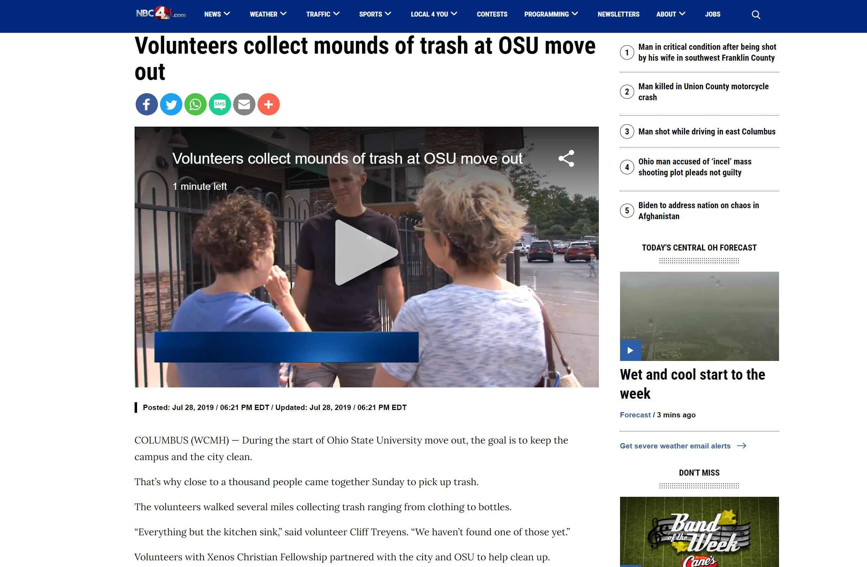

Slide 20
1 Peter 2
¹¹ Beloved, I urge you as aliens and strangers…
Abstain from fleshly lusts which wage war against the soul.
¹² Keep your behavior excellent among the Gentiles, so that in the thing in which they slander you as evildoers, they may because of your good deeds, as they observe them, glorify God in the day of visitation.
¹⁵ For such is the will of God that by doing right you may silence the ignorance of foolish men.

Slide 21
1 Peter 2
¹¹ Beloved, I urge you as aliens and strangers…
Abstain from fleshly lusts which wage war against the soul.
¹² Keep your behavior excellent among the Gentiles, so that in the thing in which they slander you as evildoers, they may because of your good deeds, as they observe them, glorify God in the day of visitation.
“We just need to let our good deeds speak for themselves and people will come to Christ.”

Slide 22
1 Peter 2
¹³ Submit yourselves for the Lord’s sake to every human institution, whether to a king as the one in authority,
¹⁴ or to governors as sent by him for the punishment of evildoers and the praise of those who do right.

Slide 23
1 Peter 2
¹³ Submit yourselves for the Lord’s sake to every human institution, whether to a king as the one in authority,
¹⁴ or to governors as sent by him for the punishment of evildoers and the praise of those who do right.
» God has set up government, in part, to curb evil in the world.
» Peter was writing this in the early 60s, when Nero was the Emperor.

Slide 24
1 Peter 2
¹³ Submit yourselves for the Lord’s sake to every human institution, whether to a king as the one in authority,
¹⁴ or to governors as sent by him for the punishment of evildoers and the praise of those who do right.
» Critics would say these passages perpetuate oppression.
» God’s way is not about changing society through public policy or legislation, it’s about transforming our culture one person at a time.

Slide 25
1 Peter 2
¹³ Submit yourselves for the Lord’s sake to every human institution, whether to a king as the one in authority,
¹⁴ or to governors as sent by him for the punishment of evildoers and the praise of those who do right.
In our political context, we can call on the government to govern justly (cf. Civil Right Movement).

Slide 26
1 Peter 2
¹³ Submit yourselves for the Lord’s sake to every human institution, whether to a king as the one in authority,
¹⁴ or to governors as sent by him for the punishment of evildoers and the praise of those who do right.
¹⁷ Honor all people, love the brotherhood, fear God, honor the king.

Slide 27
1 Peter 2
¹³ Submit yourselves for the Lord’s sake to every human institution, whether to a king as the one in authority,
¹⁴ or to governors as sent by him for the punishment of evildoers and the praise of those who do right.
¹⁷ Honor all people, love the brotherhood, fear God, honor the king.
Not, “Worship the king.”

Slide 28
1 Peter 2
¹³ Submit yourselves for the Lord’s sake to every human institution, whether to a king as the one in authority,
¹⁴ or to governors as sent by him for the punishment of evildoers and the praise of those who do right.
¹⁷ Honor all people, love the brotherhood, fear God, honor the king.
timnaō = “to show proper respect.”

Slide 29
1 Peter 2
¹⁸ Servants, be submissive to your masters with all respect, not only to those who are good and gentle, but also to those who are unreasonable.
¹⁹ For this finds favor, if for the sake of conscience toward God a person bears up under sorrows when suffering unjustly.
²⁰ For what credit is there if, when you sin and are harshly treated, you endure it with patience? But if when you do what is right and suffer for it you patiently endure it, this finds favor with God.

Slide 30
1 Peter 2
¹⁸ Servants, be submissive to your masters with all respect, not only to those who are good and gentle, but also to those who are unreasonable.
¹⁹ For this finds favor, if for the sake of conscience toward God a person bears up under sorrows when suffering unjustly.
²⁰ For what credit is there if, when you sin and are harshly treated, you endure it with patience? But if when you do what is right and suffer for it you patiently endure it, this finds favor with God.
Some have taken passages like this to argue that the Bible condones slavery.
» The “proper relations” within the household in Greco-Roman society.
The Servile Wars

Slide 31
1 Peter 2
¹⁸ Servants, be submissive to your masters with all respect, not only to those who are good and gentle, but also to those who are unreasonable.
¹⁹ For this finds favor, if for the sake of conscience toward God a person bears up under sorrows when suffering unjustly.
²⁰ For what credit is there if, when you sin and are harshly treated, you endure it with patience? But if when you do what is right and suffer for it you patiently endure it, this finds favor with God.
Some have taken passages like this to argue that the Bible condones slavery.
» The “proper relations” within the household in Greco-Roman society.
» Unlike the Peter’s instruction to submit to the governing authorities, he gives no theological basis for slaves submitting to their masters.

Slide 32
1 Peter 2
¹⁸ Servants, be submissive to your masters with all respect, not only to those who are good and gentle, but also to those who are unreasonable.
¹⁹ For this finds favor, if for the sake of conscience toward God a person bears up under sorrows when suffering unjustly.
²⁰ For what credit is there if, when you sin and are harshly treated, you endure it with patience? But if when you do what is right and suffer for it you patiently endure it, this finds favor with God.
Some have taken passages like this to argue that the Bible condones slavery.
» God sowed a dangerous idea in the Roman Empire.
Galatians 3:28: “There is neither Jew nor Greek, slave nor free…for you are all one in Christ Jesus.”

Slide 33
1 Peter 2
¹⁸ Servants, be submissive to your masters with all respect, not only to those who are good and gentle, but also to those who are unreasonable.
¹⁹ For this finds favor, if for the sake of conscience toward God a person bears up under sorrows when suffering unjustly.
²⁰ For what credit is there if, when you sin and are harshly treated, you endure it with patience? But if when you do what is right and suffer for it you patiently endure it, this finds favor with God.
Some have taken passages like this to argue that the Bible condones slavery.
» God sowed a dangerous idea in the Roman Empire.
1 Corinthians 7:21-23: “Are you a slave? …If you get a chance to be free, take it. And remember, if you were a slave when the Lord called you, you are now free in the Lord…God paid a high price for you, so don’t be enslaved by people.”

Slide 34
1 Peter 2
¹⁸ Servants, be submissive to your masters with all respect, not only to those who are good and gentle, but also to those who are unreasonable.
¹⁹ For this finds favor, if for the sake of conscience toward God a person bears up under sorrows when suffering unjustly.
²⁰ For what credit is there if, when you sin and are harshly treated, you endure it with patience? But if when you do what is right and suffer for it you patiently endure it, this finds favor with God.
Some have taken passages like this to argue that the Bible condones slavery.
» God sowed a dangerous idea in the Roman Empire.
Manumission

Slide 35
1 Peter 2
¹⁸ Servants, be submissive to your masters with all respect, not only to those who are good and gentle, but also to those who are unreasonable.
¹⁹ For this finds favor, if for the sake of conscience toward God a person bears up under sorrows when suffering unjustly.
²⁰ For what credit is there if, when you sin and are harshly treated, you endure it with patience? But if when you do what is right and suffer for it you patiently endure it, this finds favor with God.
Some have taken passages like this to argue that the Bible condones slavery.
» God sowed a dangerous idea in the Roman Empire.
» Peter was not calling upon slaves to endure injustice in order to preserve the status quo, he was calling upon them to endure injustice for a greater good.

Slide 36
1 Peter 2
¹⁸ Servants, be submissive to your masters with all respect, not only to those who are good and gentle, but also to those who are unreasonable.
¹⁹ For this finds favor, if for the sake of conscience toward God a person bears up under sorrows when suffering unjustly.
²⁰ For what credit is there if, when you sin and are harshly treated, you endure it with patience? But if when you do what is right and suffer for it you patiently endure it, this finds favor with God.
Some have taken passages like this to argue that the Bible condones slavery.
» How does this apply to us today?

Slide 37
1 Peter 2
²¹ For you have been called for this purpose, since Christ also suffered for you, leaving you an example for you to follow in His steps,
²² WHO COMMITTED NO SIN, NOR WAS ANY DECEIT FOUND IN HIS MOUTH

Slide 38
1 Peter 2
²¹ For you have been called for this purpose, since Christ also suffered for you, leaving you an example for you to follow in His steps,
²² WHO COMMITTED NO SIN, NOR WAS ANY DECEIT FOUND IN HIS MOUTH

Slide 39
1 Peter 2
²³ While being reviled, He did not revile in return; while suffering, He uttered no threats, but kept entrusting Himself to Him who judges righteously;
²⁴ and He Himself bore our sins in His body on the cross, so that we might die to sin and live to righteousness; for by His wounds you were healed.

Slide 40
1 Peter 2
²³ While being reviled, He did not revile in return; while suffering, He uttered no threats, but kept entrusting Himself to Him who judges righteously;
²⁴ and He Himself bore our sins in His body on the cross, so that we might die to sin and live to righteousness; for by His wounds you were healed.

Slide 41
Conclusions
» Remember you are temporary residents in a foreign land.
» Remember, you are representing Christ in your neighborhood and workplace.
» Heavenly citizenship is available for you.

Slide 42
FIRST PETER
THE BOOK OF

