Slide 1
1 Peter 4
Friendships and The End of the World

Slide 2
1 Peter
Since the end is near, we need to be ready to suffer during the little remaining time
You are going to need your relationships! (Matt 22:37-39)
1 Peter 4:1-6
1 Peter 4:7-11
1 Peter 4:12-19

Slide 3
1 Peter 4
7 The end of all things is near;
therefore, be of sound judgment and sober spirit for the purpose of prayer.
Be Alert In Prayer

Slide 4
1 Peter 4
7 The end of all things is near;
therefore, be of sound judgment and sober spirit for the purpose of prayer.
Was Peter wrong?
God sees time from a different perspective (2 Pet 3:8)
Christ could return any moment
Your end is near
Be Alert In Prayer

Slide 5
1 Peter 4
7 The end of all things is near;
therefore, be of sound judgment and sober spirit for the purpose of prayer.
Be Alert In Prayer

Slide 6
1 Peter 4
7 The end of all things is near;
therefore, be of sound judgment and sober spirit for the purpose of prayer.
Because Jesus emphasized prayer (Lk 5:16; 11:1; Mt 26:36-45)
Because the early church emphasized prayer (Acts 1, 2, 3, 4, 6, 12)
Because prayer shapes our perspective
Be Alert In Prayer

Slide 7
I am the one often changed by prayer.
Many times as I am praying God will speak to me.
He will show me His way and His plan, which is always so much better than what I had in mind.

Slide 8
While in prayer, God deals with me and shows me the folly of certain things that I have been insisting, and practically demanding, from Him.
I respond, “Thank you, Lord, for not answering me during the last five years.”

Slide 9
He knew what was best for me all the time!
At this point in my life, as I look back, I am as thankful for the prayers He did not answer as those He did.

Slide 10
1 Peter 4
7 The end of all things is near;
therefore, be of sound judgment and sober spirit for the purpose of prayer.
Through prayer we experience closeness with God and receive his comfort
Be Alert In Prayer

Slide 11
Hallesby, Prayer, p. 66
When our prayer chamber thus becomes a resting place, then we begin to long for it
and to look forward to it with joy and anticipation from one prayer session to the next.

Slide 12
Hallesby, Prayer, p. 66
Our seasons of prayer become real hours of rest to our weary souls.
They become quiet hours, hours in which we lie at the feet of Jesus and point to all those things which we lack and which make our hearts tired and weary.

Slide 13
1 Peter 4
7 The end of all things is near;
therefore, be of sound judgment and sober spirit for the purpose of prayer.
Through prayer we experience closeness with God and receive his comfort
Through prayer we accomplish our mission
Keeps us watching and ready
The hidden work before the visible work
Be Alert In Prayer

Slide 14
1 Peter 4
7 The end of all things is near;
therefore, be of sound judgment and sober spirit for the purpose of prayer.
Tips:
Do some reading on prayer
Seek out what works for you (list, notecards, journal, walks, app)
Set aside time
Minimize distractions
Be Alert In Prayer

Slide 15
1 Peter 4
8 Above all, keep fervent in your love for one another, because love covers a multitude of sins.
Keep Fervent In Love

Slide 16
1 Peter 4
8 Above all, keep fervent in your love for one another, because love covers a multitude of sins.
Keep Fervent In Love

Slide 17
1 Peter 4
8 Above all, keep fervent in your love for one another, because love covers a multitude of sins.
Keep Fervent In Love

Slide 18
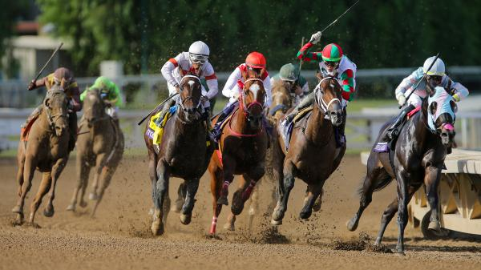
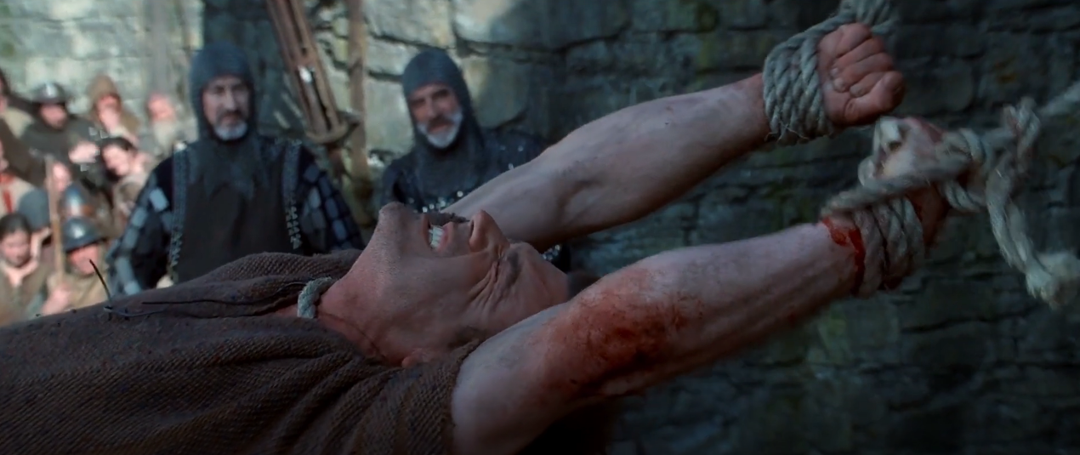
1 Peter 4
8 Above all, keep fervent in your love for one another, because love covers a multitude of sins.
We need each other! (Mt 24:12)
Keep Fervent In Love

Slide 19
1 Peter 4
8 Above all, keep fervent in your love for one another, because love covers a multitude of sins.
Keep Fervent In Love

Slide 20
1 Peter 4
8 Above all, keep fervent in your love for one another, because love covers a multitude of sins.
If you get close to people, you will find a multitude of sins
Your own
Theirs
An atmosphere of grace
A challenge to us all!
Keep Fervent In Love

Slide 21
1 Peter 4
9 Be hospitable to one another without complaint.
Keep Fervent In Love

Slide 22
1 Peter 4
9 Be hospitable to one another without complaint.
Asks: “How can I use my stuff to serve others?”
How do people feel when they come into your home?
Some are “hospitable” complainers
Dedicate your stuff to God!
Keep Fervent In Love

Slide 23
1 Peter 4
10 As each one has received a special gift,
employ it in serving one another as good stewards of the manifold grace of God.
Keep Fervent In Love

Slide 24
1 Peter 4
10 As each one has received a special gift,
employ it in serving one another as good stewards of the manifold grace of God.
Keep Fervent In Love

Slide 25
1 Peter 4
10 As each one has received a special gift,
employ it in serving one another as good stewards of the manifold grace of God.
(Lk 12:42; 16:1-11)
Keep Fervent In Love

Slide 26
1 Peter 4
10 As each one has received a special gift,
employ it in serving one another as good stewards of the manifold grace of God.
Word
Wisdom
Knowledge
Evangelism
Prophecy
Apostle
Teaching
Exhorting
(Lk 12:42)
Service
Administration
Helps
Service
Giving Money
Leadership
Mercy
Prayer
Works of Power
Faith
Healings
Discerning Spirits
Tongues
Interpret Tongues
Keep Fervent In Love

Slide 27
1 Peter 4
10 As each one has received a special gift,
employ it in serving one another as good stewards of the manifold grace of God.
How to discover your gifts
Start with becoming a Christian
Then try serving people
May need to get equipped
Watch for feedback, and be patient
Keep Fervent In Love

Slide 28
1 Peter 4
10 As each one has received a special gift,
employ it in serving one another as good stewards of the manifold grace of God.
Qualifications:
Not for comparisons
Not for limitations
Not for self-promotion
Keep Fervent In Love

Slide 29
1 Peter 4
11 Whoever speaks, is to do so as one who is speaking the utterances of God;
Keep Fervent In Love

Slide 30
1 Peter 4
11 Whoever speaks, is to do so as one who is speaking the utterances of God;
Good case for learning the Scriptures and using what you learn
Pray that God would speak through you
Implies not speaking sometimes
Keep Fervent In Love

Slide 31
1 Peter 4
11 Whoever speaks, is to do so as one who is speaking the utterances of God;
whoever serves is to do so as one who is serving by the strength which God supplies;
Implies learning how to depend on God
“Why am I so burned out by serving people?”
Keep Fervent In Love

Slide 32
1 Peter 4
11 Whoever speaks, is to do so as one who is speaking the utterances of God;
whoever serves is to do so as one who is serving by the strength which God supplies;
so that in all things God may be glorified through Jesus Christ, to whom belongs the glory and dominion forever and ever. Amen.
Keep Fervent In Love

Slide 33
Conclusions
The end of all things is near!
We need to be tight with God
We need to be tight with each other
Fervently loving
Hospitable without complaint
Using our gifts to build up one another

Slide 34
1 Peter 4
Questions?
Comments?
Experiences?
risleys@dwellcc.org
See the Dwell App OR teachings.dwellcc.org
Next time: 1 Peter 5 – Spiritual Leadership

