Slide 1
Jesus One on One
Acts 9

Slide 2
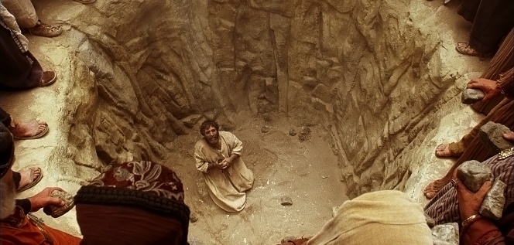
Luke is introducing a new principle character…
^{Acts 7:57} But they cried out with a loud voice, and covered their ears and rushed at him with one impulse. ⁵⁸ When they had driven him out of the city, they began stoning him; and the witnesses laid aside their robes at the feet of a young man named Saul.
^{Acts 7:57} But they cried out with a loud voice, and covered their ears and rushed at him with one impulse. ⁵⁸ When they had driven him out of the city, they began stoning him; and the witnesses laid aside their robes at the feet of a young man named Saul.
Last week: Stephen’s Defense

Slide 3
^{Acts 8:1} Saul was in hearty agreement with putting him to death. And on that day a great persecution began against the church in Jerusalem, and they were all scattered throughout the regions of Judea and Samaria, except the apostles.
^{Acts 7:57} But they cried out with a loud voice, and covered their ears and rushed at him with one impulse. ⁵⁸ When they had driven him out of the city, they began stoning him; and the witnesses laid aside their robes at the feet of a young man named Saul.
Scattered amidst building persecution

Slide 4
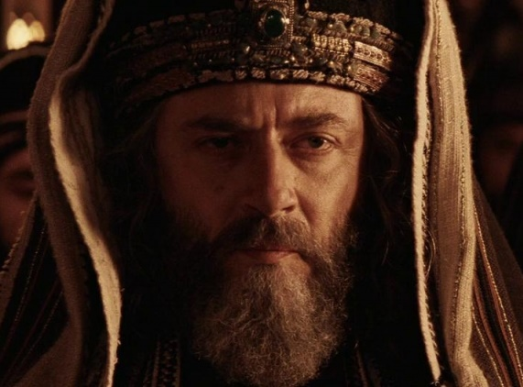
So who is Saul?
- Elite social pedigree
^{Acts22:3} “I am a Jew, born in Tarsus of Cilicia, but brought up in this city, educated under Gamaliel, strictly according to the law of our fathers, being zealous for God just as you all are today.
^{Acts22:3} “I am a Jew, born in Tarsus of Cilicia, but brought up in this city, educated under Gamaliel, strictly according to the law of our fathers, being zealous for God just as you all are today.
^{Acts22:3} “I am a Jew, born in Tarsus of Cilicia, but brought up in this city, educated under Gamaliel, strictly according to the law of our fathers, being zealous for God just as you all are today.
^{Acts22:3} “I am a Jew, born in Tarsus of Cilicia, but brought up in this city, educated under Gamaliel, strictly according to the law of our fathers, being zealous for God just as you all are today.

Slide 5
So who is Saul?
- Elite social pedigree
- Elite religious pedigree
- Standout Rising star
^{Acts22:3} “I am a Jew, born in Tarsus of Cilicia, but brought up in this city, educated under Gamaliel, strictly according to the law of our fathers, being zealous for God just as you all are today.

Slide 6
So who is Saul?
- Elite social pedigree
- Elite religious pedigree
- Standout Rising star
^{Phil 3:4} If anyone else has a mind to put confidence in the flesh, I far more:

Slide 7
So who is Saul?
- Elite social pedigree
- Elite religious pedigree
- Standout Rising star
^{Phil 3:5} circumcised the eighth day, of the nation of Israel, of the tribe of Benjamin, a Hebrew of Hebrews; as to the Law, a Pharisee; ⁶ as to zeal, a persecutor of the church; as to the righteousness which is in the Law, found blameless.
^{Phil 3:5} circumcised the eighth day, of the nation of Israel, of the tribe of Benjamin, a Hebrew of Hebrews; as to the Law, a Pharisee; ⁶ as to zeal, a persecutor of the church; as to the righteousness which is in the Law, found blameless.
^{Phil 3:5} circumcised the eighth day, of the nation of Israel, of the tribe of Benjamin, a Hebrew of Hebrews; as to the Law, a Pharisee; ⁶ as to zeal, a persecutor of the church; as to the righteousness which is in the Law, found blameless.
^{Phil 3:5} circumcised the eighth day, of the nation of Israel, of the tribe of Benjamin, a Hebrew of Hebrews; as to the Law, a Pharisee; ⁶ as to zeal, a persecutor of the church; as to the righteousness which is in the Law, found blameless.

Slide 8
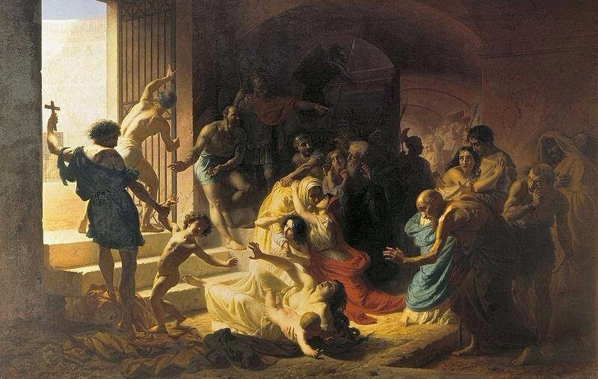
So who is Saul?
- Elite social pedigree
- Elite religious pedigree
- Standout Rising star
^{Acts 8:1} Saul was in hearty agreement with putting him to death. And on that day a great persecution began against the church in Jerusalem, and they were all scattered throughout the regions of Judea and Samaria, except the apostles.
^{Acts 8:1} Saul was in hearty agreement with putting him to death. And on that day a great persecution began against the church in Jerusalem, and they were all scattered throughout the regions of Judea and Samaria, except the apostles.

Slide 9
So who is Saul?
- Elite social pedigree
- Elite religious pedigree
- Standout Rising star
^{Acts 8:1} Saul was in hearty agreement with putting him to death. And on that day a great persecution began against the church in Jerusalem, and they were all scattered throughout the regions of Judea and Samaria, except the apostles.
^{Acts 8:1} Saul was in hearty agreement with putting him to death. And on that day a great persecution began against the church in Jerusalem, and they were all scattered throughout the regions of Judea and Samaria, except the apostles.

Slide 10
^{Acts 8:2} Some devout men buried Stephen, and made loud lamentation over him. ³ But Saul began ravaging the church, entering house after house, and dragging off men and women, he would put them in prison.
^{Acts 8:2} Some devout men buried Stephen, and made loud lamentation over him. ³ But Saul began ravaging the church, entering house after house, and dragging off men and women, he would put them in prison.
^{Acts 8:2} Some devout men buried Stephen, and made loud lamentation over him. ³ But Saul began ravaging the church, entering house after house, and dragging off men and women, he would put them in prison.
^{Acts 8:2} Some devout men buried Stephen, and made loud lamentation over him. ³ But Saul began ravaging the church, entering house after house, and dragging off men and women, he would put them in prison.

Slide 11
^{Acts 9:1}
^{Acts 9:1} Now Saul, still breathing threats and murder against the disciples of the Lord, went to the high priest, ² and asked for letters from him to the synagogues at Damascus, so that if he found any belonging to the Way, both men and women, he might bring them bound to Jerusalem.
^{Acts 9:1} Now Saul, still breathing threats and murder against the disciples of the Lord, went to the high priest, ² and asked for letters from him to the synagogues at Damascus, so that if he found any belonging to the Way, both men and women, he might bring them bound to Jerusalem.
^{Acts 9:1} Now Saul, still breathing threats and murder against the disciples of the Lord, went to the high priest, ² and asked for letters from him to the synagogues at Damascus, so that if he found any belonging to the Way, both men and women, he might bring them bound to Jerusalem.
^{Acts 9:1} Now Saul, still breathing threats and murder against the disciples of the Lord, went to the high priest, ² and asked for letters from him to the synagogues at Damascus, so that if he found any belonging to the Way, both men and women, he might bring them bound to Jerusalem.

Slide 13
What is going to happen with this guy???

Slide 14
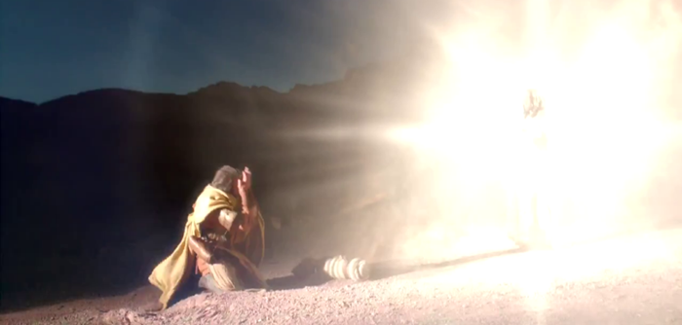
^{Acts 9:3} As he was traveling, it happened that he was approaching Damascus, and suddenly a light from heaven flashed around him; ⁴ and he fell to the ground and heard a voice saying to him, “Saul, Saul, why are you persecuting Me?”
^{Acts 9:3} As he was traveling, it happened that he was approaching Damascus, and suddenly a light from heaven flashed around him; ⁴ and he fell to the ground and heard a voice saying to him, “Saul, Saul, why are you persecuting Me?”
^{Acts 9:3} As he was traveling, it happened that he was approaching Damascus, and suddenly a light from heaven flashed around him; ⁴ and he fell to the ground and heard a voice saying to him, “Saul, Saul, why are you persecuting Me?”
^{Acts 9:3} As he was traveling, it happened that he was approaching Damascus, and suddenly a light from heaven flashed around him; ⁴ and he fell to the ground and heard a voice saying to him, “Saul, Saul, why are you persecuting Me?”
^{Acts 9:3} As he was traveling, it happened that he was approaching Damascus, and suddenly a light from heaven flashed around him; ⁴ and he fell to the ground and heard a voice saying to him, “Saul, Saul, why are you persecuting Me?”

Slide 15
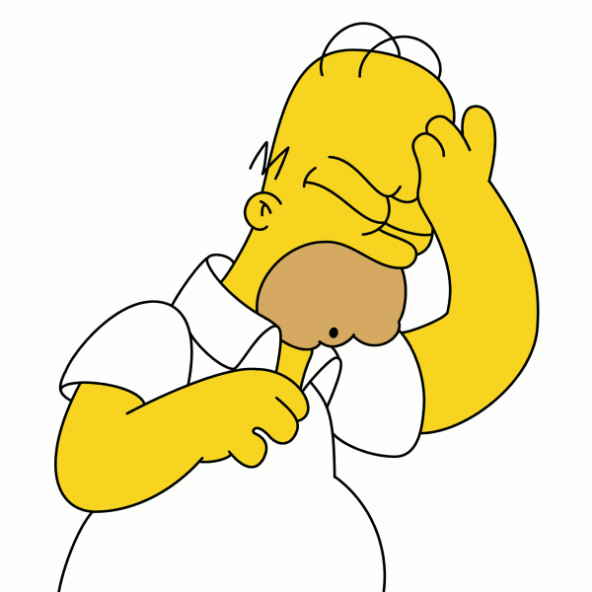
Jesus One on One: Jesus and Saul
^{Acts 9:5} And he said, “Who are You, Lord?”
^{Acts 9:5} And he said, “Who are You, Lord?”
And He said, “I am Jesus whom you are persecuting,”

Slide 16
Jesus One on One: Jesus and Saul
^{Acts 9:5} And he said, “Who are You, Lord?”
^{Acts 9:5} And he said, “Who are You, Lord?”
And He said, “I am Jesus whom you are persecuting,”
^{Acts 9:5} And he said, “Who are You, Lord?”
And He said, “I am Jesus whom you are persecuting,”

Slide 17
^{Acts 9:6} And then God struck Saul with lightning. Saul exploded in a multitude of tiny pieces, and there was great rejoicing throughout all Judea and Samaria.

Slide 18
^{Acts 9:6} but get up and enter the city, and it will be told you what you must do.” ⁷ The men who traveled with him stood speechless, hearing the voice but seeing no one.
^{Acts 9:6} but get up and enter the city, and it will be told you what you must do.” ⁷ The men who traveled with him stood speechless, hearing the voice but seeing no one.

Slide 19
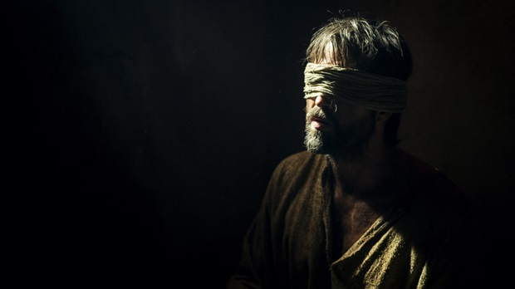
^{Acts 9:8} Saul got up from the ground, and though his eyes were open, he could see nothing; and leading him by the hand, they brought him into Damascus. ⁹ And he was three days without sight, and neither ate nor drank.

Slide 20
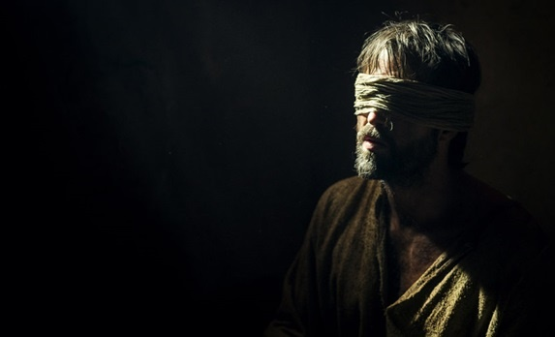
^{Acts 9:8} Saul got up from the ground, and though his eyes were open, he could see nothing; and leading him by the hand, they brought him into Damascus. ⁹ And he was three days without sight, and neither ate nor drank.
^{Acts 9:8} Saul got up from the ground, and though his eyes were open, he could see nothing; and leading him by the hand, they brought him into Damascus. ⁹ And he was three days without sight, and neither ate nor drank.
^{Acts 9:8} Saul got up from the ground, and though his eyes were open, he could see nothing; and leading him by the hand, they brought him into Damascus. ⁹ And he was three days without sight, and neither ate nor drank.

Slide 21
What do you think was going through Saul’s head over these 3 days?
^{Acts 9:8} Saul got up from the ground, and though his eyes were open, he could see nothing; and leading him by the hand, they brought him into Damascus. ⁹ And he was three days without sight, and neither ate nor drank.
^{Acts 9:8} Saul got up from the ground, and though his eyes were open, he could see nothing; and leading him by the hand, they brought him into Damascus. ⁹ And he was three days without sight, and neither ate nor drank.
^{Acts 9:8} Saul got up from the ground, and though his eyes were open, he could see nothing; and leading him by the hand, they brought him into Damascus. ⁹ And he was three days without sight, and neither ate nor drank.

Slide 22
^{Acts 9:10} Now there was a disciple at Damascus named Ananias; and the Lord said to him in a vision, “Ananias.” And he said, “Here I am, Lord.” ¹¹ And the Lord said to him, “Get up and go to the street called Straight, and inquire at the house of Judas for a man from Tarsus named Saul, for he is praying,

Slide 23
^{Acts 9:10} Now there was a disciple at Damascus named Ananias; and the Lord said to him in a vision, “Ananias.” And he said, “Here I am, Lord.” ¹¹ And the Lord said to him, “Get up and go to the street called Straight, and inquire at the house of Judas for a man from Tarsus named Saul, for he is praying,
^{Acts 9:10} Now there was a disciple at Damascus named Ananias; and the Lord said to him in a vision, “Ananias.” And he said, “Here I am, Lord.” ¹¹ And the Lord said to him, “Get up and go to the street called Straight, and inquire at the house of Judas for a man from Tarsus named Saul, for he is praying,

Slide 24
^{Acts 9:12} and he has seen in a vision a man named Ananias come in and lay his hands on him, so that he might regain his sight.”

Slide 25
^{Acts 9:13} But Ananias answered, “Lord, I have heard from many about this man, how much harm he did to Your saints at Jerusalem; ¹⁴ and here he has authority from the chief priests to bind all who call on Your name.”

Slide 26
What is Jesus doing?
^{Acts 9:15} But the Lord said to him, “Go, for he is a chosen instrument of Mine, to bear My name before the Gentiles and kings and the sons of Israel; ¹⁶ for I will show him how much he must suffer for My name’s sake.”

Slide 27
God loves His enemies
^{Acts 9:15} But the Lord said to him, “Go, for he is a chosen instrument of Mine, to bear My name before the Gentiles and kings and the sons of Israel; ¹⁶ for I will show him how much he must suffer for My name’s sake.”

Slide 28
God loves His enemies
^{Acts7:59} They went on stoning Stephen as he called on the Lord and said, “Lord Jesus, receive my spirit!” ⁶⁰ Then falling on his knees, he cried out with a loud voice, “Lord, do not hold this sin against them!”

Slide 29
God’s Mercy . . .
^{Acts7:59} They went on stoning Stephen as he called on the Lord and said, “Lord Jesus, receive my spirit!” ⁶⁰ Then falling on his knees, he cried out with a loud voice, “Lord, do not hold this sin against them!”

Slide 30
God’s GRACE
Showed him his guilt
Having already paid for it Himself
And God has an invitation for Saul
To change his mind, and be completely forgiven, and receive the HS, and to live eternally in the unconditional love of his Father in Heaven
^{Luke 24:46} “Thus it is written, that the Christ would suffer and rise again from the dead the third day, ⁴⁷ and that repentance for forgiveness of sins would be proclaimed in His name to all the nations, beginning from Jerusalem.
^{Luke 24:46} “Thus it is written, that the Christ would suffer and rise again from the dead the third day, ⁴⁷ and that repentance for forgiveness of sins would be proclaimed in His name to all the nations, beginning from Jerusalem.

Slide 31
God’s GRACE
Showed him his guilt
Having already paid for it Himself
And God has an invitation for Saul
To change his mind, and be completely forgiven, and receive the HS, and to live eternally in the unconditional love of his Father in Heaven
God has a plan to redeem Saul’s life!
^{Acts 9:15} “Go, for he is a chosen instrument of Mine, to bear My name before the Gentiles and kings and the sons of Israel; ¹⁶ for I will show him how much he must suffer for My name’s sake.”
^{Acts 9:15} “Go, for he is a chosen instrument of Mine, to bear My name before the Gentiles and kings and the sons of Israel; ¹⁶ for I will show him how much he must suffer for My name’s sake.”

Slide 32
God’s GRACE
Showed him his guilt
Having already paid for it Himself
And God has an invitation for Saul
To change his mind, and be completely forgiven, and receive the HS, and to live eternally in the unconditional love of his Father in Heaven
God has a plan to redeem Saul’s life!
^{Acts 9:15} “Go, for he is a chosen instrument of Mine, to bear My name before the Gentiles and kings and the sons of Israel; ¹⁶ for I will show him how much he must suffer for My name’s sake.”
^{Acts 9:15} “Go, for he is a chosen instrument of Mine, to bear My name before the Gentiles and kings and the sons of Israel; ¹⁶ for I will show him how much he must suffer for My name’s sake.”

Slide 33
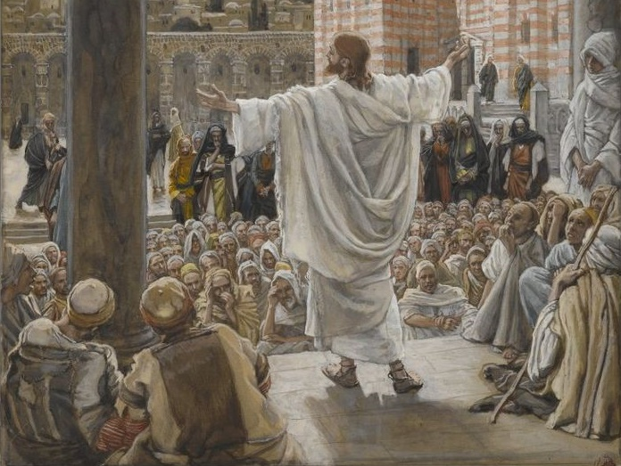
God’s GRACE
Casting a vision!
Showed him his guilt
Having already paid for it Himself
And God has an invitation for Saul
To change his mind, and be completely forgiven, and receive the HS, and to live eternally in the unconditional love of his Father in Heaven
God has a plan to redeem Saul’s life!
^{Acts 9:15} “Go, for he is a chosen instrument of Mine, to bear My name before the Gentiles and kings and the sons of Israel; ¹⁶ for I will show him how much he must suffer for My name’s sake.”

Slide 34
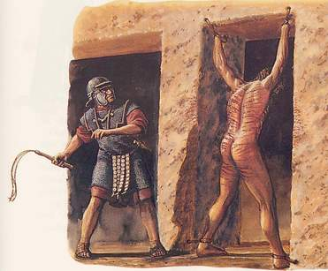
God’s GRACE
Casting a vision!
Showed him his guilt
Having already paid for it Himself
^{Acts 5:41} So they went on their way from the presence of the Council, rejoicing that they had been considered worthy to suffer shame for His name.
And God has in invitation for Saul
To change his mind, and be completely forgiven, and receive the HS, and to live eternally in the unconditional love of his Father in Heaven
God has plan to redeem Saul’s life!
^{Acts 9:15} “Go, for he is a chosen instrument of Mine, to bear My name before the Gentiles and kings and the sons of Israel; ¹⁶ for I will show him how much he must suffer for My name’s sake.”
^{Acts 9:15} “Go, for he is a chosen instrument of Mine, to bear My name before the Gentiles and kings and the sons of Israel; ¹⁶ for I will show him how much he must suffer for My name’s sake.”

Slide 35
God’s GRACE
He was my enemy, but now he will be my ally, sharing in my work and in my glory – he will have the honor of suffering alongside Me
Casting a vision!
Showed him his guilt
Having already paid for it Himself
This is a prophetic vision of Saul’s future ministry
And God has in invitation for Saul
To change his mind, and be completely forgiven, and receive the HS, and to live eternally in the unconditional love of his Father in Heaven
… and it’s true!
^{Phil 3:4} If anyone else has a mind to put confidence in the flesh, I far more: ⁵ circumcised the eighth day, of the nation of Israel, of the tribe of Benjamin, a Hebrew of Hebrews; as to the Law, a Pharisee; ⁶ as to zeal, a persecutor of the church; as to the righteousness which is in the Law, found blameless.
God has plan to redeem Saul’s life!
^{Acts 9:15} “Go, for he is a chosen instrument of Mine, to bear My name before the Gentiles and kings and the sons of Israel; ¹⁶ for I will show him how much he must suffer for My name’s sake.”
^{Acts 9:15} “Go, for he is a chosen instrument of Mine, to bear My name before the Gentiles and kings and the sons of Israel; ¹⁶ for I will show him how much he must suffer for My name’s sake.”

Slide 36
God’s GRACE
He was my enemy, but now he will be my ally, sharing in my work and in my glory – he will have the honor of suffering alongside Me
Casting a vision!
Showed him his guilt
Having already paid for it Himself
This is a prophetic vision of Saul’s future ministry
And God has in invitation for Saul
To change his mind, and be completely forgiven, and receive the HS, and to live eternally in the unconditional love of his Father in Heaven
… and it’s true!
^{Phil 3:7} But whatever things were gain to me, those things I have counted as loss for the sake of Christ. ⁸ More than that, I count all things to be loss in view of the surpassing value of knowing Christ Jesus my Lord, for whom I have suffered the loss of all things, and count them but rubbish so that I may gain Christ,
^{Phil 3:7} But whatever things were gain to me, those things I have counted as loss for the sake of Christ. ⁸ More than that, I count all things to be loss in view of the surpassing value of knowing Christ Jesus my Lord, for whom I have suffered the loss of all things, and count them but rubbish so that I may gain Christ,
^{Phil 3:7} But whatever things were gain to me, those things I have counted as loss for the sake of Christ. ⁸ More than that, I count all things to be loss in view of the surpassing value of knowing Christ Jesus my Lord, for whom I have suffered the loss of all things, and count them but rubbish so that I may gain Christ,
God has plan to redeem Saul’s life!
^{Acts 9:15} “Go, for he is a chosen instrument of Mine, to bear My name before the Gentiles and kings and the sons of Israel; ¹⁶ for I will show him how much he must suffer for My name’s sake.”
^{Acts 9:15} “Go, for he is a chosen instrument of Mine, to bear My name before the Gentiles and kings and the sons of Israel; ¹⁶ for I will show him how much he must suffer for My name’s sake.”

Slide 37
God’s GRACE
He was my enemy, but now he will be my ally, sharing in my work and in my glory – he will have the honor of suffering alongside Me
Casting a vision!
Showed him his guilt
Having already paid for it Himself
This is a prophetic vision of Saul’s future ministry
And God has in invitation for Saul
To change his mind, and be completely forgiven, and receive the HS, and to live eternally in the unconditional love of his Father in Heaven
… and it’s true!
^{Phil 3:9} and may be found in Him, not having a righteousness of my own derived from the Law, but that which is through faith in Christ, the righteousness which comes from God on the basis of faith, ¹⁰ that I may know Him and the power of His resurrection and the fellowship of His sufferings
^{Phil 3:9} and may be found in Him, not having a righteousness of my own derived from the Law, but that which is through faith in Christ, the righteousness which comes from God on the basis of faith, ¹⁰ that I may know Him and the power of His resurrection and the fellowship of His sufferings
^{Phil 3:9} and may be found in Him, not having a righteousness of my own derived from the Law, but that which is through faith in Christ, the righteousness which comes from God on the basis of faith, ¹⁰ that I may know Him and the power of His resurrection and the fellowship of His sufferings
^{Phil 3:9} and may be found in Him, not having a righteousness of my own derived from the Law, but that which is through faith in Christ, the righteousness which comes from God on the basis of faith, ¹⁰ that I may know Him and the power of His resurrection and the fellowship of His sufferings
^{Phil 3:9} and may be found in Him, not having a righteousness of my own derived from the Law, but that which is through faith in Christ, the righteousness which comes from God on the basis of faith, ¹⁰ that I may know Him and the power of His resurrection and the fellowship of His sufferings
God has plan to redeem Saul’s life!
^{Acts 9:15} “Go, for he is a chosen instrument of Mine, to bear My name before the Gentiles and kings and the sons of Israel; ¹⁶ for I will show him how much he must suffer for My name’s sake.”
^{Acts 9:15} “Go, for he is a chosen instrument of Mine, to bear My name before the Gentiles and kings and the sons of Israel; ¹⁶ for I will show him how much he must suffer for My name’s sake.”

Slide 38
God had all that in store for Saul even before he had any inkling…

Slide 39
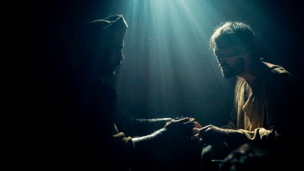
^{Acts 9:17} So Ananias departed and entered the house, and after laying his hands on him said, “Brother Saul, the Lord Jesus, who appeared to you on the road by which you were coming, has sent me so that you may regain your sight and be filled with the Holy Spirit.”
^{Acts 9:17} So Ananias departed and entered the house, and after laying his hands on him said, “Brother Saul, the Lord Jesus, who appeared to you on the road by which you were coming, has sent me so that you may regain your sight and be filled with the Holy Spirit.”

Slide 40
He deserved…
He Got …
^{Acts 9:18} And immediately there fell from his eyes something like scales, and he regained his sight, and he got up and was baptized; ¹⁹ and he took food and was strengthened.
^{Acts 9:18} And immediately there fell from his eyes something like scales, and he regained his sight, and he got up and was baptized; ¹⁹ and he took food and was strengthened.
^{Acts 9:18} And immediately there fell from his eyes something like scales, and he regained his sight, and he got up and was baptized; ¹⁹ and he took food and was strengthened.

Slide 41
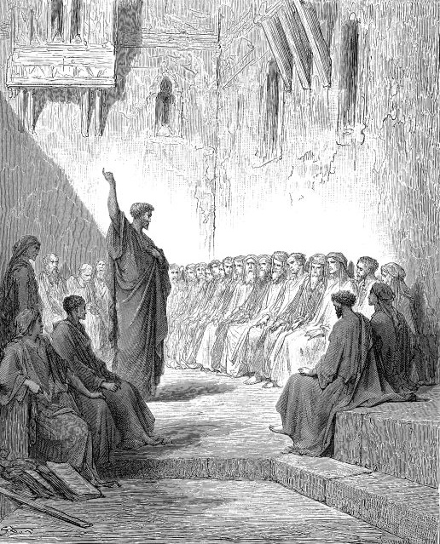
^{Acts 9:19} Now for several days he was with the disciples who were at Damascus,²⁰ and immediately he began to proclaim Jesus in the synagogues, saying “He is the Son of God.”
Grace changes people

Slide 42
^{Acts 9:21} All those hearing him continued to be amazed, and were saying, “Is this not he who in Jerusalem destroyed those who called on this name, and who had come here for the purpose of bringing them bound before the chief priests?”
^{Acts 9:21} All those hearing him continued to be amazed, and were saying, “Is this not he who in Jerusalem destroyed those who called on this name, and who had come here for the purpose of bringing them bound before the chief priests?”
He deserved…
He Got …
Grace changes people

Slide 43
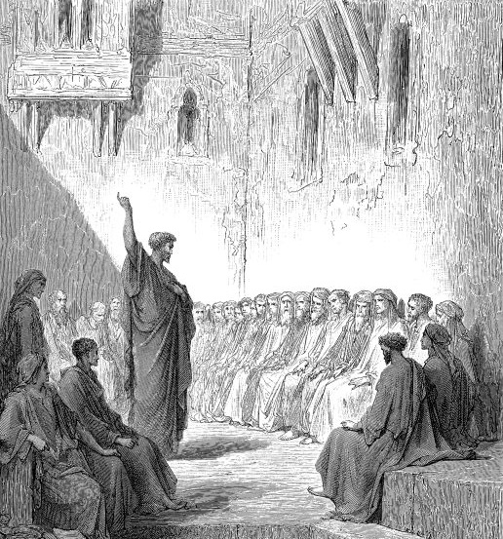
^{Acts 9:21} All those hearing him continued to be amazed, and were saying, “Is this not he who in Jerusalem destroyed those who called on this name, and who had come here for the purpose of bringing them bound before the chief priests?”
^{Acts 9:21} All those hearing him continued to be amazed, and were saying, “Is this not he who in Jerusalem destroyed those who called on this name, and who had come here for the purpose of bringing them bound before the chief priests?”
He deserved…
He Got …
God overcomes His enemies

Slide 44
^{Acts 9:22} But Saul kept increasing in strength and confounding the Jews who lived at Damascus by proving that this Jesus is the Christ.
He deserved…
He Got …
God overcomes His enemies

Slide 45
^{Acts 9:22} But Saul kept increasing in strength and confounding the Jews who lived at Damascus by proving that this Jesus is the Christ.
He deserved…
He Got …
Complete Reversal!

Slide 46
^{Acts 9:23} When many days had elapsed, the Jews plotted together to do away with him, ²⁴ but their plot became known to Saul.
He deserved…
He Got …
Complete Reversal!

Slide 47
^{Acts 9:24} They were also watching the gates day and night so that they might put him to death; ²⁵ but his disciples took him by night and let him down through an opening in the wall, lowering him in a large basket.
He deserved…
He Got …
Complete Reversal!

Slide 48
^{Acts 9:26} When he came to Jerusalem, he was trying to associate with the disciples; but they were all afraid of him, not believing that he was a disciple.
^{Acts 9:26} When he came to Jerusalem, he was trying to associate with the disciples; but they were all afraid of him, not believing that he was a disciple.

Slide 49
^{Acts 9:27} But Barnabas took hold of him and brought him to the apostles and described to them how he had seen the Lord on the road, and that He had talked to him, and how at Damascus he had spoken out boldly in the name of Jesus. And he was with them, moving about freely in Jerusalem, speaking out boldly in the name of the Lord.

Slide 50
What does this encounter teach us about God?
His mercy and grace is nothing short of scandalous
That God loves His enemies

Slide 51
What does this teach us about Salvation?
No one is too much of an “enemy” to be accepted by God
^{Rom 5:10} For while we were enemies we were reconciled to God through the death of His Son,
His invitation stands today for each and every person

Slide 52
What does this teach us about ourselves?
That sometimes our passions, even our spiritual ones, get misplaced.
God has a purposeful plan for each of our lives
And it might be a lot different from your plan

