Slide 2
Mark 15
The most important event in history

Slide 3
The Cross
Impossible to exaggerate the importance of the cross!
1 Cor. 1:23,24 “We preach Christ crucified: a stumbling block to Jews and foolishness to Gentiles, but to those whom God has called, both Jews and Greeks, Christ; the power of God and the wisdom of God.”

Slide 4
The Cross
Why does this act hold the key to understanding God like no other thing?
Impossible to exaggerate the importance of the cross!
1 Cor. 1:23,24 “We preach Christ crucified: a stumbling block to Jews and foolishness to Gentiles, but to those whom God has called, both Jews and Greeks, Christ; the power of God and the wisdom of God.”

Slide 5
The Cross
Context:
Already Jesus had come from the environment of heaven to live in an environment of poverty, obscurity, evil and filth…
Then, a dominant theme: Rejection

Slide 6
The Cross
Context:
Already Christ had come from the environment of heaven to live in an environment of poverty, obscurity, evil and filth…
Then, a dominant theme: Rejection
John 6:66 As a result of this many of His disciples withdrew, and were not walking with Him anymore.

Slide 7
The Cross
Context:
Already Christ had come from the environment of heaven to live in an environment of poverty, obscurity, evil and filth…
Then, a dominant theme: Rejection
John 7:5 “For not even His brothers were believing in Him”

Slide 8
The Cross
John 16:32 “Behold, an hour is coming, and has already come, for you to be scattered, each to his own home, and to leave Me alone; and yet I am not alone, because the Father is with Me.”
Context:
Already Christ had come from the environment of heaven to live in an environment of poverty, obscurity, evil and filth. . .
Then, a dominant theme: Rejection

Slide 9
The Cross
Context:
Already Christ had come from the environment of heaven to live in an environment of poverty, obscurity, evil and filth. . .
Then, a dominant theme: Rejection

Slide 10
The Cross
Mar 14:32 And they came to an olive grove called Gethsemane, and Jesus said, “Sit here while I go and pray.”

Slide 11
The Cross
Mar 14:32 And they came to an olive grove called Gethsemane, and Jesus said, “Sit here while I go and pray.”
33 He took Peter, James, and John with him, and he began to be filled with horror and deep distress.

Slide 12
The Cross
Mar 14:32 And they came to an olive grove called Gethsemane, and Jesus said, “Sit here while I go and pray.”
33 He took Peter, James, and John with him, and he began to be filled with horror and deep distress.

Slide 13
The Cross
Mar 14:32 And they came to an olive grove called Gethsemane, and Jesus said, “Sit here while I go and pray.”
33 He took Peter, James, and John with him, and he began to be filled with horror and deep distress.
From a stem meaning “loathing”

Slide 14
The Cross
34 He told them, “My soul is crushed with grief to the point of death. Stay here and watch with me.”

Slide 15
The Cross
34 He told them, “My soul is crushed with grief to the point of death. Stay here and watch with me.”

Slide 16
The Cross
35 He went on a little farther and fell face down on the ground. He prayed that, if it were possible, the awful hour awaiting him might pass him by.

Slide 17
The Cross
36 “Abba, Father,” he said, “everything is possible for you. Please take this cup of suffering away from me. Yet I want your will, not mine.”

Slide 18
The Cross
37 Then he returned and found the disciples asleep. “Simon!” he said to Peter. “Are you asleep? Couldn’t you stay awake and watch with me even one hour?

Slide 19
The Cross
38 Keep alert and pray. Otherwise temptation will overpower you. The spirit is willing, but the flesh is weak.”

Slide 20
The Cross
38 Keep alert and pray. Otherwise temptation will overpower you. The spirit is willing, but the flesh is weak.”
39 Then Jesus left them again and prayed, repeating his pleadings.

Slide 21
The Cross
38 Keep alert and pray. Otherwise temptation will overpower you. The spirit is willing, but the flesh is weak.”
39 Then Jesus left them again and prayed, repeating his pleadings.
Luke 23:44 And being in agony He was praying very fervently; and His sweat became like drops of blood, falling down upon the ground.

Slide 22
The Cross
40 Again he returned to them and found them sleeping, for they just couldn’t keep their eyes open. And they didn’t know what to say.

Slide 23
The Cross
40 Again he returned to them and found them sleeping, for they just couldn’t keep their eyes open. And they didn’t know what to say.
41 When he returned to them the third time, he said, “Still sleeping? Still resting?

Slide 24
The Cross
“Enough! The time has come. The Son of Man, is betrayed into the hands of sinners.

Slide 25
The Cross
“Enough! The time has come. The Son of Man, is betrayed into the hands of sinners.
42 Up, let’s be going. See, my betrayer is here!”

Slide 26
The Cross
Knowing that Jesus had anticipated the cross, why was he so horrified on this night?
“Enough! The time has come. I, the Son of Man, am betrayed into the hands of sinners.
42 Up, let’s be going. See, my betrayer is here!”

Slide 27
The Cross
The physical torment of crucifixion
Preceded by flogging

Slide 28
The Cross
The physical torment of crucifixion
Preceded by flogging
JAMA March 21, 1986
“On the Physical Death of Jesus Christ”

Slide 29
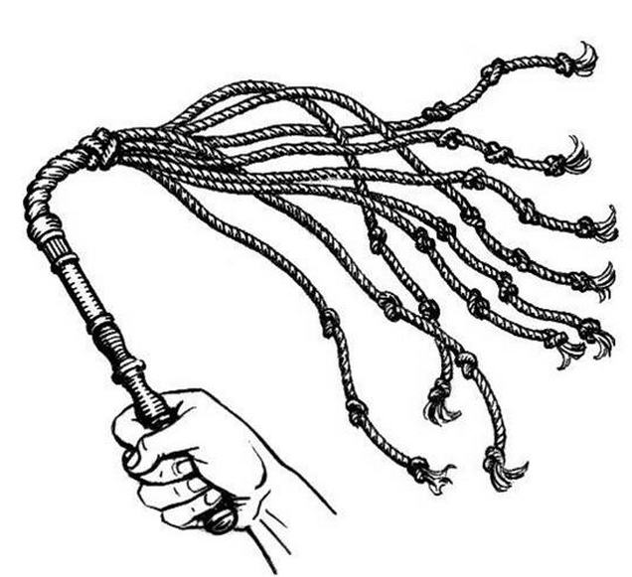
The Cross
The physical torment of crucifixion
Preceded by flogging

Slide 30
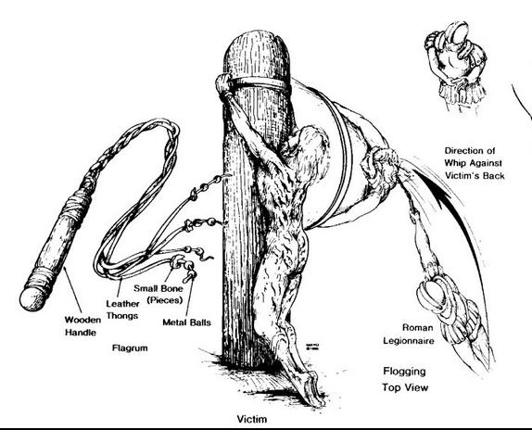
The Cross
The physical torment of crucifixion
Preceded by flogging

Slide 31
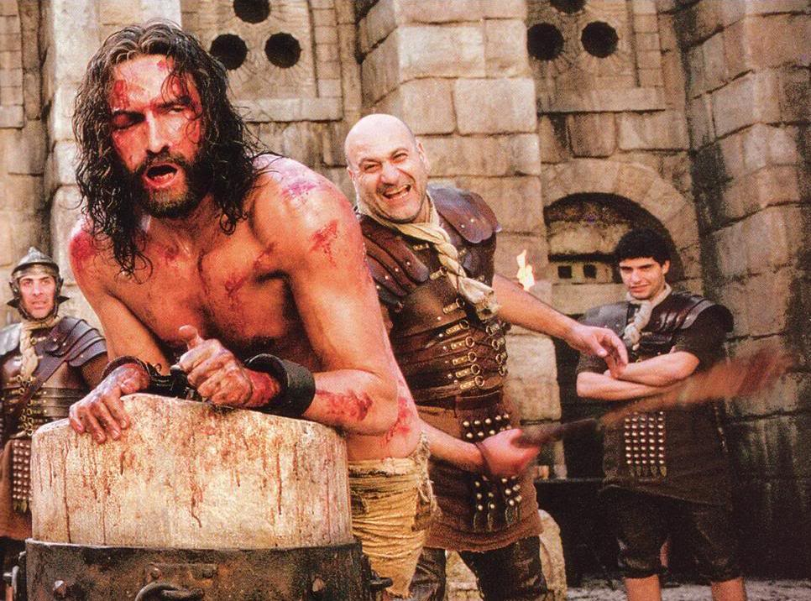
The Cross
The physical torment of crucifixion
Preceded by flogging

Slide 32
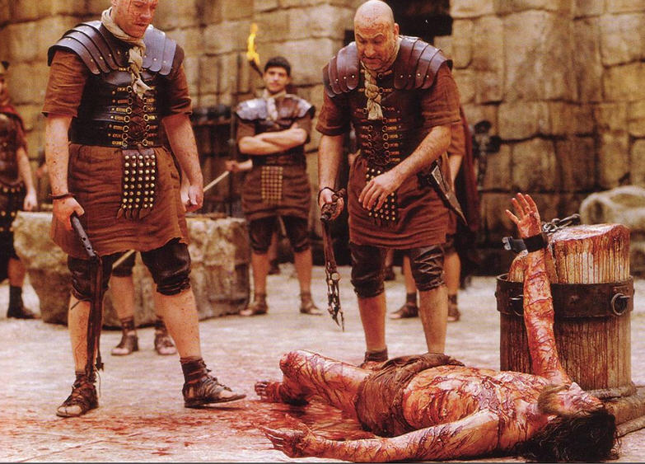
The Cross
The physical torment of crucifixion
Preceded by flogging

Slide 33
The Cross
The physical torment of crucifixion
Preceded by flogging
Stripped naked
Reserved for slaves and worst offenders
Designed to be as cruel as possible

Slide 34
The Cross
The physical torment of crucifixion
Average time to death = 36 hours
Some lived for 9 days
Cause of death = usually asphyxiation, also heart failure & traumatic fever

Slide 35
The Cross
The psychological torment

Slide 36
The Cross
The psychological torment
^{Mat27:27} Then the governor’s soldiers took Jesus into the Praetorium and gathered the whole company of soldiers around him.

Slide 37
The Cross
The psychological torment
²⁸ They stripped him and put a scarlet robe on him,
²⁹ and then twisted together a crown of thorns and set it on his head.

Slide 38
The Cross
The psychological torment
They put a staff in his right hand and knelt in front of him and mocked him. “Hail, king of the Jews!” they said.

Slide 39
The Cross
The psychological torment
³⁰ They spit on him, and took the staff and struck him on the head again and again.

Slide 40
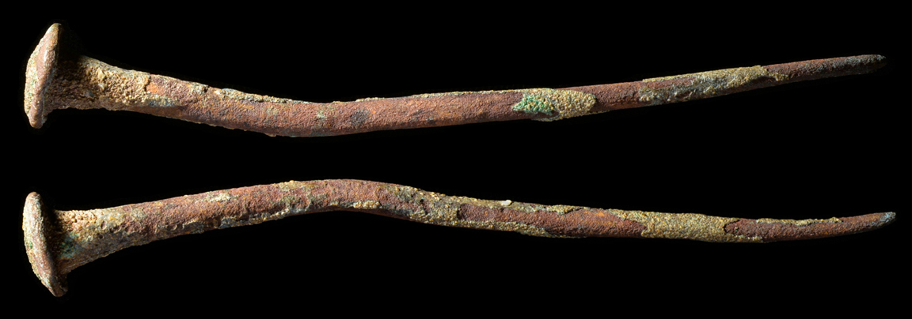
The Cross
The psychological torment
³⁰ They spit on him, and took the staff and struck him on the head again and again.

Slide 41
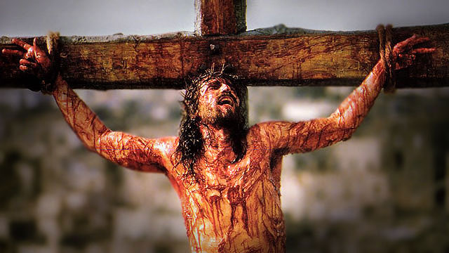
The Cross
The psychological torment
³⁰ They spit on him, and took the staff and struck him on the head again and again.

Slide 42
The Cross
The psychological torment
Mt. 27:39 And the people passing by shouted abuse, shaking their heads in mockery. 40 “So! You can destroy the Temple and build it again in three days, can you? Well then, if you are the Son of God, save yourself and come down from the cross!”

Slide 43
The Cross
The psychological torment
Luke 23:35 And the people stood by, looking on. And even the rulers were sneering at Him, saying, “He saved others; let Him save Himself if this is the Christ of God, His Chosen One.”

Slide 44
The Cross
The psychological torment
Mat. 27:42 “So he is the king of Israel, is he? Let him come down from the cross, and we will believe in him!”

Slide 45
The Cross
The spiritual torment
The pain of bearing human sin
2 Cor. 5:21 “He made Him who knew no sin to be sin on our behalf, that we might become the righteousness of God in Him.”

Slide 46
The Cross
The spiritual torment
The pain of bearing human sin
1 Pet. 2:24 He Himself bore our sins in His body on the cross, that we might die to sin and live to righteousness; for by His wounds you were healed.

Slide 47
The Cross
The spiritual torment
The pain of being rejected by God the Father

Slide 48
The Cross
The spiritual torment
The pain of being rejected by God the Father
Mark 15:33 At noon, darkness fell across the whole land until three o’clock.

Slide 49
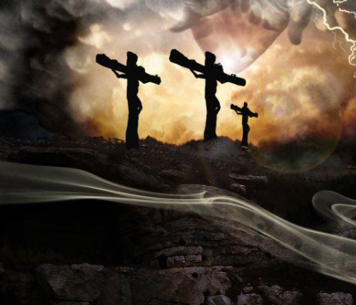
The Cross
The spiritual torment
The pain of being rejected by God the Father
Mark 15:33 At noon, darkness fell across the whole land until three o’clock.

Slide 50
The Cross
The spiritual torment
34 Then, at that time Jesus called out with a loud voice, “Eloi, Eloi, lama sabachthani?” which means, “My God, my God, why have you forsaken me?”

Slide 51
The Cross
Psalms 22:1 My God, my God, why have you forsaken me?…
The spiritual torment
34 Then, at that time Jesus called out with a loud voice, “Eloi, Eloi, lama sabachthani?” which means, “My God, my God, why have you forsaken me?”

Slide 52
The Cross
Psalms 22:1 My God, my God, why have you forsaken me?… 7 All who see me mock me; they hurl insults, shaking their heads:
The spiritual torment
34 Then, at that time Jesus called out with a loud voice, “Eloi, Eloi, lama sabachthani?” which means, “My God, my God, why have you forsaken me?”

Slide 53
The Cross
Psalms 22:1 My God, my God, why have you forsaken me?… 7 All who see me mock me; they hurl insults, shaking their heads:
8 “He trusts in the Lord; let the Lord rescue him. Let him deliver him, since he delights in him.”
The spiritual torment
34 Then, at that time Jesus called out with a loud voice, “Eloi, Eloi, lama sabachthani?” which means, “My God, my God, why have you forsaken me?”

Slide 54
The Cross
14 I am poured out like water, and all my bones are out of joint My heart has turned to wax; it has melted away within me.
The spiritual torment
34 Then, at that time Jesus called out with a loud voice, “Eloi, Eloi, lama sabachthani?” which means, “My God, my God, why have you forsaken me?”

Slide 55
The Cross
14 I am poured out like water, and all my bones are out of joint My heart has turned to wax; it has melted away within me. 15 My strength is dried up like a potsherd, and my tongue sticks to the roof of my mouth; you lay me in the dust of death.
The spiritual torment
34 Then, at that time Jesus called out with a loud voice, “Eloi, Eloi, lama sabachthani?” which means, “My God, my God, why have you forsaken me?”

Slide 56
The Cross
16 Dogs have surrounded me; a band of evil men has encircled me, they have pierced my hands and my feet.
The spiritual torment
34 Then, at that time Jesus called out with a loud voice, “Eloi, Eloi, lama sabachthani?” which means, “My God, my God, why have you forsaken me?”

Slide 57
The Cross
16 Dogs have surrounded me; a band of evil men has encircled me, they have pierced my hands and my feet.
The spiritual torment
34 Then, at that time Jesus called out with a loud voice, “Eloi, Eloi, lama sabachthani?” which means, “My God, my God, why have you forsaken me?”

Slide 58
The Cross
16 Dogs have surrounded me; a band of evil men has encircled me, they have pierced my hands and my feet.
The spiritual torment
34 Then, at that time Jesus called out with a loud voice, “Eloi, Eloi, lama sabachthani?” which means, “My God, my God, why have you forsaken me?”

Slide 59
The Cross
16 Dogs have surrounded me; a band of evil men has encircled me, they have pierced my hands and my feet. 17 I can count all my bones; people stare and gloat over me.
The spiritual torment
34 Then, at that time Jesus called out with a loud voice, “Eloi, Eloi, lama sabachthani?” which means, “My God, my God, why have you forsaken me?”

Slide 60
The Cross
18 They divide my garments among them and cast lots for my clothing…
The spiritual torment
34 Then, at that time Jesus called out with a loud voice, “Eloi, Eloi, lama sabachthani?” which means, “My God, my God, why have you forsaken me?”

Slide 61
The Cross
The spiritual torment
34 Then, at that time Jesus called out with a loud voice, “Eloi, Eloi, lama sabachthani?” which means, “My God, my God, why have you forsaken me?”

Slide 62
The Cross
The spiritual torment
34 Then, at that time Jesus called out with a loud voice, “Eloi, Eloi, lama sabachthani?” which means, “My God, my God, why have you forsaken me?”
Then, something happened between Jesus and the Father!

Slide 63
The Cross
The spiritual torment
34 Then, at that time Jesus called out with a loud voice, “Eloi, Eloi, lama sabachthani?” which means, “My God, my God, why have you forsaken me?”
Then, something happened between Jesus and the Father!
Is. 53:10 But it was the Lord’s good plan to crush him and cause him grief. Yet his life is made an offering for sin

Slide 64
The Cross
The spiritual torment
34 Then, at that time Jesus called out with a loud voice, “Eloi, Eloi, lama sabachthani?” which means, “My God, my God, why have you forsaken
Then, something happened between Jesus and the Father!
Smitten of God, and afflicted Is. 53:4

Slide 65
The Cross
Mark 15:26 Jesus’ certificate of debt:

Slide 66
The Cross
Mark 15:26 Jesus’ certificate of debt:
26 The written notice of the charge against him read: “THE KING OF THE JEWS.”

Slide 67
The Cross
Mark 15:26 Jesus’ certificate of debt:
26 The written notice of the charge against him read: “THE KING OF THE JEWS.”
John 19:21 And so the chief priests of the Jews were saying to Pilate, “Do not write, ‘The King of the Jews’; but that He said, ‘I am King of the Jews’”

Slide 68
The Cross
Mark 15:26 Jesus’ certificate of debt:
22 Pilate answered, “What I have written I have written.”

Slide 69
The Cross
Mark 15:26 Jesus’ certificate of debt:
Jesus’ crime = being king of the Jews

Slide 70
The Cross
Col. 2:13-14 “He forgave us of all our sins, having canceled out the certificate of debt consisting of decrees against us and which was hostile to us;
Mark 15:26 Jesus’ certificate of debt:
Jesus’ crime = being king of the Jews

Slide 71
The Cross
Col. 2:13-14 “He forgave us of all our sins, having canceled out the certificate of debt consisting of decrees against us and which was hostile to us; and he has taken it out of the way, having nailed it to the cross.”
Mark 15:26 Jesus’ certificate of debt:
Jesus’ crime = being king of the Jews

Slide 72
The Cross
Col. 2:13-14 “He forgave us of all our sins, having canceled out the certificate of debt consisting of decrees against us and which was hostile to us; and he has taken it out of the way, having nailed it to the cross.”
Mark 15:26 Jesus’ certificate of debt:
Jesus’ crime = being king of the Jews

Slide 73
The Cross
Col. 2:13-14 “He forgave us of all our sins, having canceled out the certificate of debt consisting of decrees against us and which was hostile to us; and he has taken it out of the way, having nailed it to the cross.”
Mark 15:26 Jesus’ certificate of debt:
Jesus’ crime = being king of the Jews
Jesus’ final cry:

Slide 74
The Cross
Col. 2:13-14 “He forgave us of all our sins, having canceled out the certificate of debt consisting of decrees against us and which was hostile to us; and he has taken it out of the way, having nailed it to the cross.”
Mark 15:26 Jesus’ certificate of debt:
Jesus’ crime = being king of the Jews
Jesus’ final cry:
Tetelestai!

Slide 75
The Big Picture
God’s heart: Self- sacrifice to rescue us

Slide 76
The Big Picture
Have you asked to have your certificate of debt nailed onto the Jesus’ cross?

Slide 77
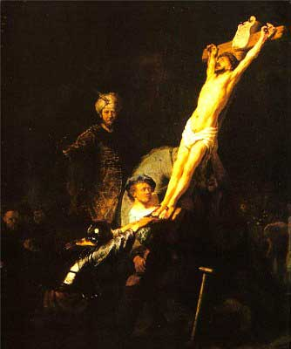
The Big Picture
Have you asked to have your certificate of debt nailed onto the Jesus’ cross?

Slide 78
The Big Picture
Have you asked to have your certificate of debt nailed onto the Jesus’ cross?

Slide 79
The Big Picture
Have you asked to have your certificate of debt nailed onto the Jesus’ cross?

