Slide 1
Combating Brain Rot:
For Leaders
Abbey Merker
Counseling Workshop
Notes:
Let me pray for us.
Ok, this morning we’ll do a bit of recitation, some discussion, and some time for prayer at the end…

Slide 2
Agenda
01
What is brain rot?
Slide 03
02
3 Negative Effects
Slide 07
03
3 Responses
Slide 19
04
Pray
Notes:
Here’s the agenda for this morning…
What is it - what are the 3 biggest trends in terms of the way that the digital environment is affecting people - how can we persuade people to maintain healthy relat’s w their screens, and then we’ll break up to pray through some of these ideas.
Now, this is material that’s been condensed from a 4 week class that I taught. So, it’s 8 hours of material repackaged into 8 hour. So, for the sake of brevity, we won’t go over a lot of the research. But, I’ve included a lot of that material in a handout that you can grab a hard copy of, or there’ll be a QR code at the end that you can scan. Just, to clarify…

Slide 3
the supposed deterioration of a person’s mental or intellectual state, especially viewed as the result of overconsumption of material (now particularly online content) considered to be trivial or unchallenging.
BRAIN ROT
Notes:
It was Oxford’s word of the year last year, in ‘24. Here’s their definition…
- a term used to capture concerns about the impact of consuming excessive amounts of low-quality online content, especially on social media.
Also: something characterized as likely to lead to such deterioration… The term is kind of interchangeable - the experience or the content.
What does it feel like?...

Slide 4
Experiencing brain rot:
Fogginess
Inability to focus
Agitation
Anxiety
Negativity
Depression
Notes:
… this is what it feels like when we experience digital information overload.
You feel lethargic, your attention span isn’t what it used to be. Am I cognitively declining? Well, depending on how much screen time you’re getting, maybe.
And then there’s brain rot language…

Slide 5
the supposed deterioration of a person’s mental or intellectual state, especially viewed as the result of overconsumption of material (now particularly online content) considered to be trivial or unchallenging.
BRAIN ROT
“Let him cook”
“Skibidi gyatt”
Notes:
terms like skibidi gyatt and ‘let him cook’ are brain rot language - they originated online in viral culture (tiktok and youtube) and spread to general culture due to the overconsumption of said trivial content - (can anyone define these terms? Skibidi = meaningless, gyatt = butt; LHC = let him do what he do, what he’s good at)...

Slide 6
the supposed deterioration of a person’s mental or intellectual state, especially viewed as the result of overconsumption of material (now particularly online content) considered to be trivial or unchallenging.
BRAIN ROT
How is this coming up with your people? What results of overconsumption are you noticing?
Notes:
(people can barely read, can’t follow a train of thought. People lack genuine conviction based on the word or deep thinking. People just regurgitate soundbites they heard online. People don’t have self-generated thoughts.)
Good! Ok, so let’s break down some of the observable effects of brain rot, just so we know we’re not crazy…

Slide 7
3 negative effects
The way we think
The way we relate
The way we spend our time
Repetition:
Shallow thinking & weakened concentration,
Selfish
Notes:
3 negative effects of constant screens:
Repetition is often how we learn - to creates neural pathways. Behaviorism/ + and - reinforcement. The screen in your hand is constant reinforcement, designed to keep us engaged…

Slide 8
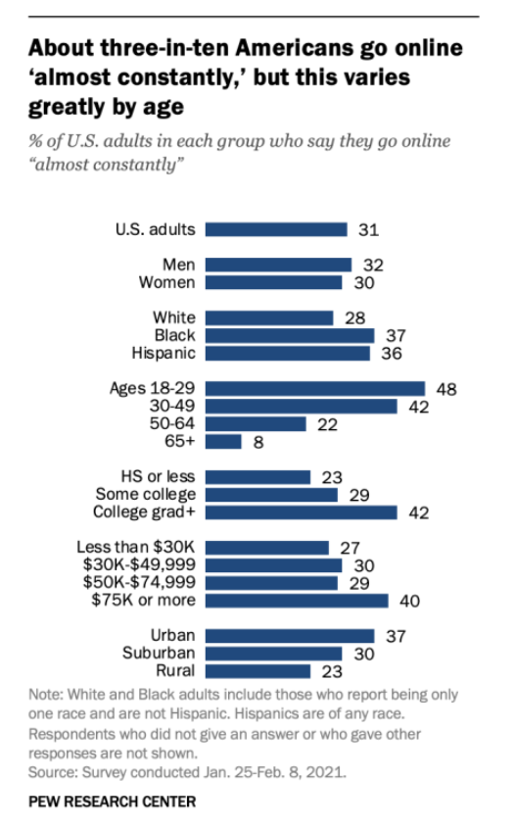
The internet
Notes:
Here’s a ‘21 study from the Pew Research Center about how much people are using the internet. ⅓ “almost constantly”. Almost 50% of 18-29yr olds!
To break it down even more specifically…

Slide 9
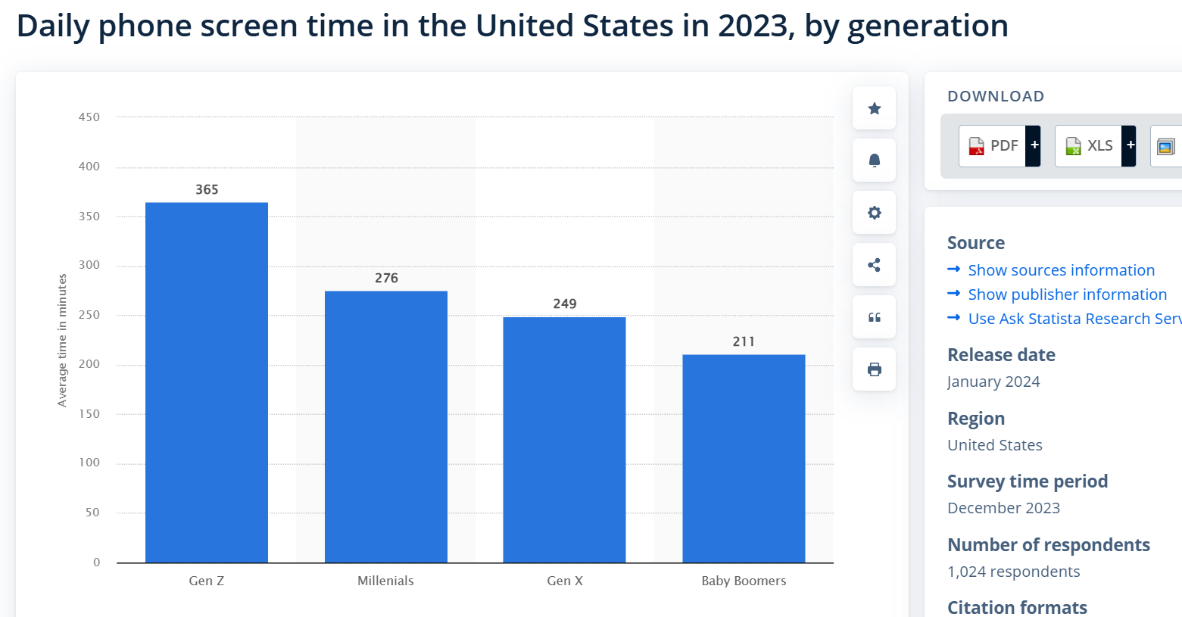
6 hours
4.6 hours
3.5 hours
4.1 hours
Notes:
This is maybe a little hard to see, but Gen Z averages 365 minutes/day. That’s 6 hours/day. Millennials don’t fare much better at 4.6 hours. Gen X comes in at 4.1, and boomers at 3.5.
These are just averages. It’s not uncommon for people to clock wayyy more that this. Some people are putting in 60hs a week scrolling on a screen. Right - 3/10 people are online “almost constantly.” Is it not reasonable to think that doing something for 6 hrs a day might have an affect on you? Or even 3.5 hours a day. That spending that much time in one environment might change how you think, feel, what you believe.
Turns out, it does…

Slide 10
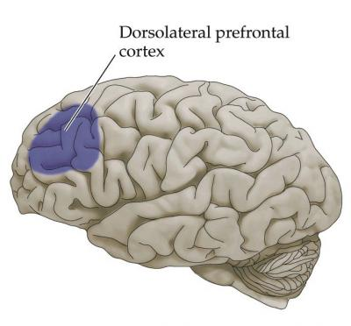
Notes:
‘09 - brain scans while searching Google - experience web users had distinctive neural pathways in their DPC, vs that of novices. f/u 6 days later w novices who spend 1hr/day online - the prefrontal cortex showed extensive activity. After one hour. So, low and behold, it changes our brains…
What would happen if you were spending 9 hrs a day online?
It changes the way that we think, the way that our brains work…

Slide 11
3 negative effects
The way we think
The way we relate
The way we spend our time
Repetition:
Shallow thinking & weakened concentration,
Selfish
Notes:
Helpful analogy - Short term and long term memory - s.t. = thimble, l.t. = bathtub. Books are slow drip, Internet is faucet. Constant overload. Inability to think deeply or concentrate.
Screens are designed for the individual - your entertainment, your promotion, your “story,” you - your experience is paramount.
Not to mention - the algorithm, literally doing our thinking for us. 4 to 6hrs/day, conservatively…

Slide 12
3 negative effects
The way we think
The way we relate
The way we spend our time
Repetition:
Shallow thinking & weakened concentration,
Selfish
SM promotes rage-bait
Notes:
Constant online absorption also affects the way we relate. Think about SM - this is the content that generates the most interaction, and big tech knows it… For example - 2018 Irish digital media company ad falsely claiming that two thirds of people wanted Santa to be either female or gender neutral. “Can you believe this?!!” SHARE SHARE SHARE...

Slide 13
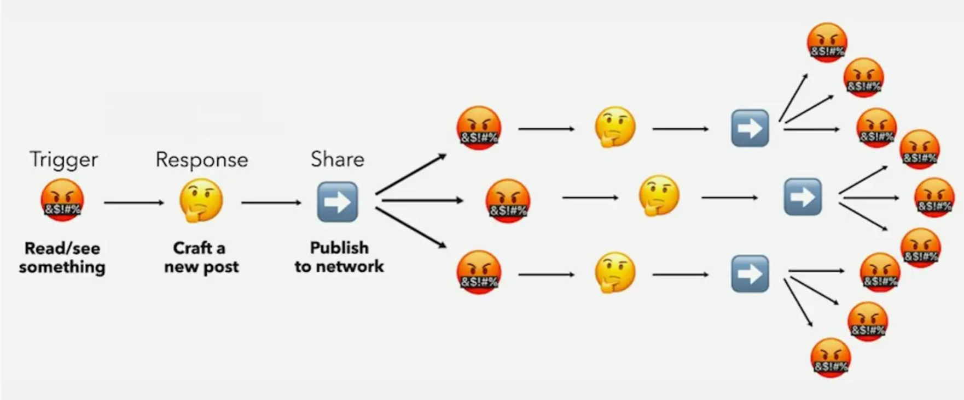
3 negative effects
The way we think
The way we relate
The way we spend our time
Repetition:
Shallow thinking & weakened concentration,
Selfish
SM promotes outrage
Mention as many objectives as you want. Consider what is feasible and relevant to your business. Duplicate this slide if you need more space.
Notes:
It works like this - It’s not puppies and kitties and memes that people interact w most of SM - it’s outrage content. That is what skyrockets to the top of your algorithm. We’re swimming in hate in social media, normalizing it. And how do we respond?...

Slide 14
3 negative effects
The way we think
The way we relate
The way we spend our time
Repetition:
Shallow thinking & weakened concentration,
Selfish
SM promotes outrage
Spew shame and punishment
Notes:
Sm promotes me v you, and how do we respond - with a mob. We’ve always loved mobs, and the internet makes it so easy to galvanize. Cancel culture is synonymous w SM on the internet - it’s big and it’s fast, and it’s feels morally justified (we all get to be heroes or vigilantes). And yet, it just drives us apart…

Slide 15
3 negative effects
The way we think
The way we relate
The way we spend our time
Repetition:
Shallow thinking & weakened concentration,
Selfish
SM promotes outrage
Spew shame and punishment
Notes:
The surgeon general declared the loneliness in our country to be an epidemic.
We’re not really solving society’s shame and guilt problem.
So we channel our fear and our guilt into outrage and shaming other. Takes the heat off me and makes me feel good, like I’m a part of something - I’m the hero. All the while, it’s destroying our relationships.
And finally…

Slide 16
3 negative effects
The way we think
The way we relate
The way we spend our time
Repetition:
Shallow thinking & weakened concentration,
Selfish
SM promotes outrage
Spew shame and punishment
Endless consumption &
meaningless waste
Porn
Notes:
Screens are meant for novelty seeking in insolation and it’s limitless. Yes, porn, for sure. It’s a public health crisis. But you could consume whatever your mind could conceive. And we give these devices to children. 50% of MSers, and 90% of HSers. Stats indicate that it’s wrecking their mental health - The Anxious Generation, iGen, etc. Here’s a study published in Haidt’s book…

Slide 17
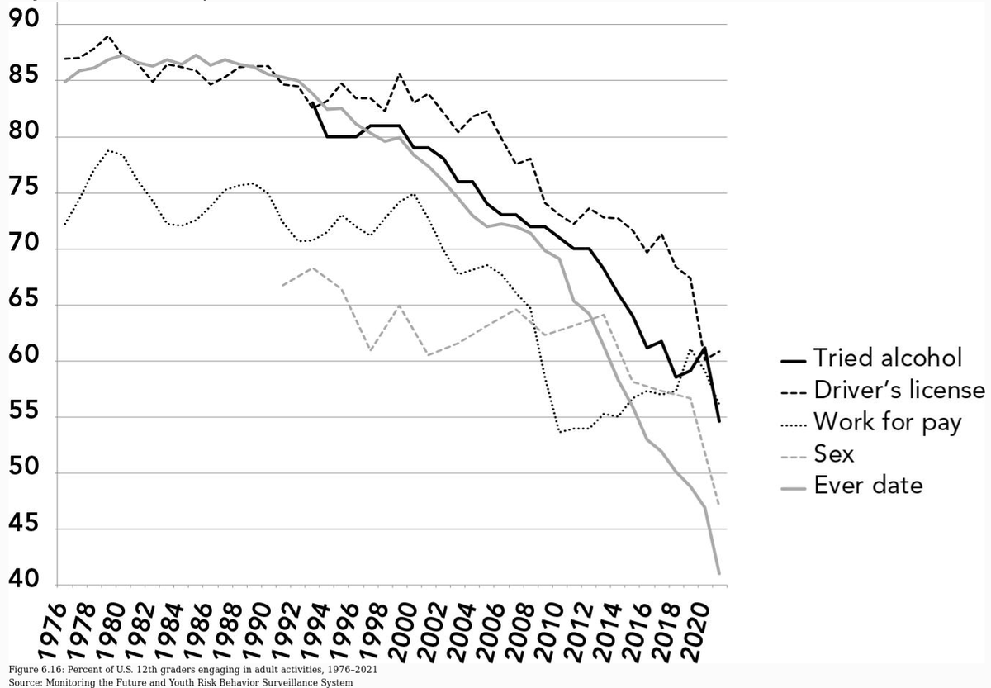
3 negative effects
The way we think
The way we relate
The way we spend our time
Repetition:
Shallow thinking & weakened concentration,
Selfish
SM promotes outrage
Spew shame and punishment
Endless consumption &
meaningless waste
Porn
Notes:
This is a ‘21 study of HS seniors and all the things they’re not doing.
Why are these numbers declining so much? Could it be bc kids are staying home and consuming endless content. Who needs to hook up with a real-life girl when there’s an open invitation to a seemingly risk-free fantasy to consume beautiful bodies without any rejection or commitment?
People and especially youths are emotionally, relationally, and mentally absent and dislocated - I’m sitting in front of you, but I’m scrolling and I’m an ocean away, and it’s quite damaging…

Slide 18
3 negative effects
The way we spend our time
Endless consumption &
meaningless waste
Porn
Executive functioning damage
Notes:
Here’s a ‘23 Chinese study - This study looked at how social media addiction affects how we think and make decisions (we call this executive functioning), focusing on things like emotions and sleep. Researchers surveyed over 1,000 young adults in China and found that:
Social media addiction can harm our ability to think clearly and make good decisions.
It also causes emotional problems and leads to poor sleep.
All this meaningless time spent on tiktok and playing video games ISN’T just harmless. It’s damaging people’s ability to think and make good decisions - it’s playing with people emotions and ruining their sleep!

Slide 19
3 negative effects
The way we think
The way we relate
The way we spend our time
Repetition:
Shallow thinking & weakened concentration,
Selfish
SM promotes outrage
Spew shame and punishment
Endless consumption &
meaningless waste
Porn
Notes:
None is this is particularly shocking or new information. This is the water that we’re all swimming in. So, how can we use this information to inform the way that we lead and serve? How do we help people who can’t seem to generate their own convictions, who seems pretty antisocial, who are up to their eyeballs in porn?...

Slide 20
3 responses
BRAIN ROTTED DISCIPLES
Ideas to help
Habits
Rhythms to train us to transcend our feelings
Gathering
Jesus
Notes:
The path of least resistance, the neural pathways are already there - the phones are in their hands. It will take intentionality to build new habits, since the habit to scroll, zone out, etc is STRONG. Teach people to build new habits. If you were hoping to guidelines for how much screen time to allow in your ministry house, sorry. We know that spiritual growth is often built on habits - in the OT: festivals, sacrifices, reading the law, etc. In the NT…

Slide 21
3 responses
BRAIN ROTTED DISCIPLES
Ideas to help
Every athlete exercises self-control in all things. They do it to receive a perishable wreath, but we an imperishable... I discipline my body and keep it under control…
1 Corinthians 9:25-27
Habits
Rhythms to train us to transcend our feelings
Gathering
Jesus
Notes:
Paul says…

Slide 22
3 responses
BRAIN ROTTED DISCIPLES
Ideas to help
Habits
Rhythms to train us to transcend our feelings
Gathering
Jesus
Notes:
Habits are rhythms that train us to transcend our feelings. I don’t have to wade through whether I feel like brushing my teeth - it’s a habit. I do it before i leave the house and I don’t need to feel anything. Here’s this great quote from Samuel D. James…

Slide 23
3 responses
BRAIN ROTTED DISCIPLES
Ideas to help
“Habits create habitats for our hearts; they shape our identity and train our desires so that our feelings, which can change quickly, are not solely bearing up the weight of our character.”
Digital Liturgies, p.170
Habits
Rhythms to train us to transcend our feelings
Gathering
Jesus
Notes:
I mean, think about it - what if your character development, your spiritual growth, was dependent on your feelings… It would be really nice if we always wanted to do spiritual things… but that’s just not how it works… luckily, we can build habits!

Slide 24
3 responses
BRAIN ROTTED DISCIPLES
Ideas to help
Help people to develop a “theology of habits”
Suggest a 3-day detox to develop self-awareness of screen usage in someone’s life
Read something like Atomic Habits
Help them think through how their current habits affect their spiritual growth
Ask “How do you want me to help you with this habit?”
Or, “Why don’t you tell me when it’s become a habit?”
Habits
Rhythms to train us to transcend our feelings
Gathering
Jesus
Notes:
Some ideas…
Look through scripture and develop a theology of habit - what does the bible say?
Suggest a detox for a reality check. What do you notice about when you want to use your screen most? Which app/media are you most drawn toward? Why? How hard was the detox? Just to develop self-awareness and teach then that they can cut it, if needed.
Lots of books on habits - Atomic Habits, Switch, The Power of Habit, Changing for Good.
“What are your current habits? How are they working out for you? Are they helping you? What new or different habits would be more helpful?” etc

Slide 25
3 responses
BRAIN ROTTED DISCIPLES
Ideas to help
Ideas for how to help people build better habits without “micromanaging”?
Habits
Rhythms to train us to transcend our feelings
Gathering
Jesus
Notes:
Let’s discuss: How do you approach helping people build better habits? How do we avoid the critique of “micromanaging” or the dreaded “You’re putting me under law?”...

Slide 26
3 responses
BRAIN ROTTED DISCIPLES
Ideas to help
Habits
Rhythms to train us to transcend our feelings
Gathering
People must be taught social skills & conflict management
Jesus
Notes:
So you’re noticing your people are having a hard time staying focused, thinking their own thoughts, etc - 1) teach intentional, God-formed habits, and 2) promote gathering in actual embodied communities. This is the way to resist dehumanizing people with hate. And we have the potential for some strong communities here!
But, Americans live in such isolation (we all lived through the isolation of covid, we’re all experiencing a loneliness epidemic) - people often don’t even know how to talk to people, let alone how to navigate conflict! W a screen, if you don’t like someone, you just mute them or unfriend them. But, in real life, in your ministry house or in your HC - what do you do!?
Here’s an example from a college HC leader: “I disciple this girl who was raised on YouTube. Her dad died when she was young, so her mom was always working. And so she was just always on YouTube… it shows :( she’s come a long way from HS group, but I’ve had to give her a lot of direct feedback like, “it’s rude to pull out your phone when you’re hanging out one on one with another person” or even listening to a podcast together to hear how people dialogue and listen to each other… anyway- I think there are a lot of students in that boat that feel lost on how to relate to other people in real life settings.”
So…

Slide 27
3 responses
BRAIN ROTTED DISCIPLES
Ideas to help
not abandoning our own meeting together, as is the habit of some people, but encouraging one another; and all the more as you see the day drawing near.
Hebrews 13:25
Habits
Rhythms to train us to transcend our feelings
Gathering
People must be taught social skills & conflict management
Jesus
Notes:
We prioritize actually gathering together in community. And we do the work to help people to learn real-life social skills and conflict management. Here’s a list of great resources…

Slide 28
3 responses
BRAIN ROTTED DISCIPLES
Ideas to help
How to Know A Person: The Art of Seeing Others Deeply and Being Deeply Seen (Brooks)
Side by Side: Walking with Others in Wisdom and Love (Welch)
You’re Not Listening: What You’re Missing and Why It Matters (Murphy)
Getting to Yes: Negotiating Agreement without Giving In (Fisher)
Captivate: The Science of Succeeding with People (Van Edwards)
The Peacemaker: A Biblical Guide to Resolving Personal Conflict (Sande)
The Relationship Cure: A 5-Step Guide to Strengthening Your Marriage, Family, and Friendships (Gottman)
RW360 blogs (“10 Ways to Connect Deeply at Thanksgiving”, “17 Ways to Respond to Explosive Politics”, etc)
Habits
Rhythms to train us to transcend our feelings
Gathering
People must be taught social skills & conflict management
Jesus
Notes:
It’s much more appealing to actually spend time with people and show up to HC if you have some social skills and you can avoiding pissing people off all the time. These are some resources to help our people and our churches. But, sometimes we need to literally spend time teaching our disciples or our small groups these skills, these priorities.
David Brooks - how to actually build deeper connections with people (secular author and cultural commentator, but the dude is a believer)
Welch - a Xian counselor, how to support people through life’s struggles.
Kate Murphy - how to be humble, curious, and intentional.
Fisher and Ury - how do you reach mutually beneficial agreements.
Captivate - how to learn charisma and people skills, that they can be taught.
Probably most people are familiar w Sande and Gottman, so pick your favorite, OR, try one of Sande’s blog posts.
What a shame if people never learn the art of conversation, never learn to enjoy homechurch, never figure out how to get along with people and say sorry…

Slide 29
3 responses
BRAIN ROTTED DISCIPLES
Ideas to help
Habits
Rhythms to train us to transcend our feelings
Gathering
People must be taught social skills & conflict management
Jesus
Notes:
And then finally, this might seem a little practically underwhelming, but teaching people to pursue a person (JC). Not just, less video games and more limits on screens added to the house covenant, etc. But that we’re moving toward someone. Here’s another quote from the book, Digital Liturgies (my favorite on this topic, so far)...

Slide 30
3 responses
BRAIN ROT CLIENT
Ideas for us and to help leaders
“In a world of unceasing noise, His voice will break through and lead us. In a world of rootless identity crisis, He reminds us that we belong to Him, that we are created by and for Him, and that He will wipe every tear from our eyes as we finally see the one face we have longed to see (Rev. 21). In a world of shame, He tells us that our record of debt is canceled and that nothing can separate us from His love. In a world of lust, He offers His own broken body in the place of our defiled body (Luke 22:19). The digital [messages] that captivate so easily wither in light of who our wisdom really is and how much He has done, is doing, and will do for us.”
Digital Liturgies, p.180
Habits
Rhythms to train us to transcend our feelings
Gathering
People must be taught social skills & conflict management
Jesus

Slide 31
3 responses
BRAIN ROTTED DISCIPLES
Ideas to help
How do we ascertain if someone is just regurgitating vs actually hearing from Jesus?
How do we help people to “grow Jesus bigger” in their lives?
Habits
Rhythms to train us to transcend our feelings
Gathering
People must be taught social skills & conflict management
Jesus
Notes:
Now, we’ve got great training resources here in Dwell - you’re currently attending one. So people can learn biblical principles at LTC or take a class on MOG. Very cool. But are we, as the leaders and servants in this community, sitting down with the individuals who have been entrusted to us, and engaging them about communing with JC in a spiritual way. How do you ascertain if someone is/can do that? How do you teach that? This is really what the MOG are for… As disciplers, in our cell groups…
(What are you hearing from JC these days? What is JC inviting you to consider? What have you discovered about him this year that you didn’t know last year, etc, studying a gospel and looking at what we can learn about JC, asking him Qs. Reading bible to get to know God, not get something for self. Modeling: what is God showing me, here’s what I heard from God. Praying God’s promises - that He remind or show something.)

Slide 32
Combating Brain Rot
The way we think
The way we relate
How we spend our time
Habits: creating habitats for our hearts
Gathering: teaching social skills & conflict resolution
Jesus: hearing from Him & growing Him bigger
Notes:
So, here’s what we covered today - we can help our people be intentional about their habits, teach social and relational skills, and prioritize hearing from Jesus…

Slide 33
Comments?
Questions?
Notes:
There’s a QR code for the resources covered this morning, or take a hard copy…

Slide 34
In small groups or individually, let’s pray.
We need the power of the Spirit to take a stand against the pull of the digital current.
Notes:
We wanted to leave some time to pray through this stuff, pray through our people and our small groups. The current is just too strong without the power of the HS. We have no hope. But, with Him, we can do all things. So, let’s pray. If you know people, came here w coleaders, feel free to gather in small groups to pray together. If you came alone, just feel free to pray quietly by yourself.
And I’ll put my email up, if you need to contact me for whatever reason.

Slide 35
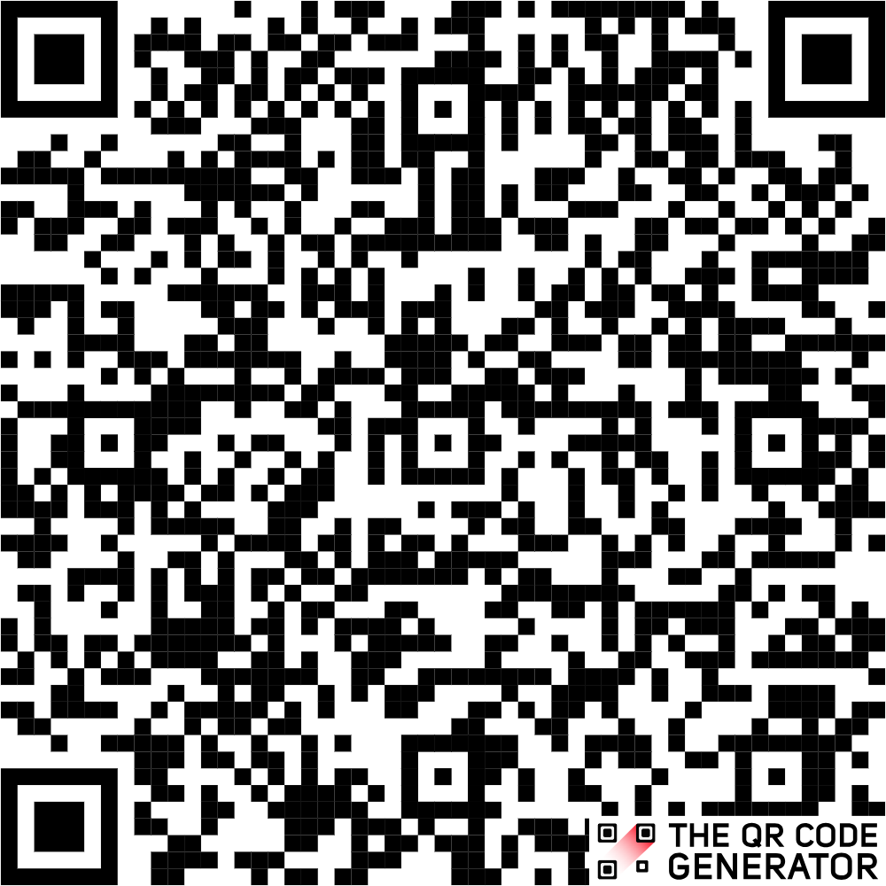
Thank you
My email
merkera@dwellcc.org

