Slide 1
Xenos Parenting May 2018 Building Healthy Relationships
How does my Child's Moral Compass
Impact Relationships?
Beth Himsworth

Slide 2
Unconditional love & Affirmation
Why it doesn’t “work”
“narcissism in children is cultivated by parental overvaluation: parents believing their child to be more special and more entitled than others.” Snowflake Syndrome

Slide 3
What is healthy “unconditional Love”?

Slide 4
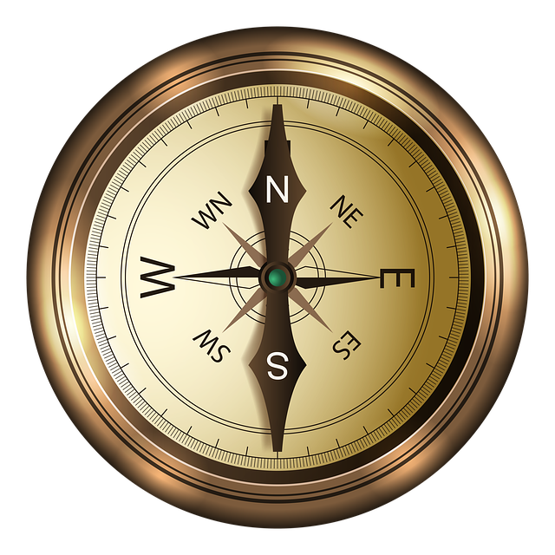
Moral compass

Slide 5
North: God as the ultimate reference point
Identity – a place in the universe
Vision – Being a part of the narrative of history
Security – A clear understanding of Grace and Works
Notes:
Identity – a place in the universe
Vision – Being a part of the narrative of history
Security – A clear understanding of Grace and Works
What keeps me on this path? Maintains my security and sense of self? – grace alone

Slide 6
East: Engagement
Created to connect
All moral development depends on empathy

Slide 7
South: Suffering
How we define suffering matters
How we face suffering and disappointment may be the most important gift we give our children

Slide 8
West: Wealth and Work
In the image of God …
Meaningful work
Provision for self and others

Slide 9
Compass Point - East
The Bible is profoundly and above all else, a relational book
“Bear with one another…” “Turn the other cheek…” “be devoted to one another…” “So far as it depends on you, be at peace…” “stop passing judgment on one another”
TODAY: How can my child develop healthy relationships?

Slide 10
All of the Compass points come together
Relationships are dependent on an integrated life
What does God have to do with relationship?
What does Work have to do with relationship?
What does Suffering have to do with relationship?

Slide 11
Core needs – the problem of the empty core
Emotional bolstering cannot compensate for an empty core
In our emptiness; insecurity. Needy. Hungry for affirmation
Taker – narcissist
Giver – Messiah See: Boundaries for Children

Slide 12
Intuitive violation of conscience
What does it mean? Children understand when they are habitually selfish or mean – they may justify their actions but the actions still produce anxiety
Creates anxiety, withdrawal and, hostility (bullying, etc)

Slide 13
Healthy things to cultivate
Empathy (vs. Injury to conscience)
See “A Trick to Teach Kids Compassion”
Gratitude (vs. Entitlement)
See “How not to raise a Narcissist in 9 easy steps”
Resilience (vs. Focus on “Happiness”)
Hurt vs. Harm
Notes:
The first two are focused on others, the third looks to self

Slide 14
Healthy “unconditional love”
Warm See: How to Really Love your Child – Ross Campbell Eye contact, Focused Attention, Touch
Engaged
Supportive of the child’s conscience / Mentoring

Slide 15
Healthy Relationships begin with a realistic and grateful perspective on life
"Gratitude is not only the greatest of virtues,
but the parent of all others." (Cicero)

Slide 18
Healthy “unconditional love”
Warm
Engaged
Supportive of the child’s conscience / Mentoring

Slide 21
How does my Child's Moral Compass Impact Relationships?
RELATIONAL RESILIENCE
VS.
“SUPERMODEL” EMOTIONAL LIFE

Slide 22
RESILIENCE
The ability to maintain healthy sense of self when in conflict or hurt/slighted by another
“SUPERMODEL” LIFE
The expectation that a feeling of happiness and well-being is normal - conflict or being hurt or slighted by another is very bad & to be avoided or compensated

Slide 23
RESILIENCE
“SUPERMODEL” LIFE
I am a valuable person, loved by God
What I have, I receive with gratitude
My life has some things I want and some things I don’t want
I am the most important person, everyone should love me
I deserve to receive the best
I should demand what I want, avoid what I don’t want

Slide 24
They may have identical life circumstances but …
One will be always looking for more and be
unhappy when life doesn’t feel “Perfect”
What does this have to do with “Moral Compass” ?
Most of the ways we violate our conscience have to do with feeling dissatisfied or “owed”

Slide 25
Hurt vs Harm
Resilience vs Reactivity
Feelings and Reality

Slide 26
HURT VS. HARM
Painful – short term experience
Damaging – long term impact

Slide 27
RESILIENCE vs REACTIVITY
How others respond to my circumstance or experience teaches me how to respond and how to perceive
We are always developing either greater maturity for engagement or self-protection

Slide 28
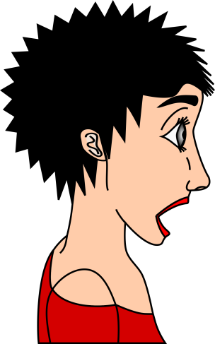
How we respond to our children or others, helps them to form their expectations and sense of what is normal.

Slide 29
FEELINGS and REALITY
Our feelings don’t define reality
The difference between: Thoughts or Beliefs and Feelings

Slide 30
Discussion question: what examples have I seen of hurt vs harm? How can I help see to it that hurt does not produce harm relationally? Discussion question: how do my reactions to my child’s painful experiences help to form their life expectations ? Discussion question: what are some situations in which my feelings have changed significantly without a change in situation? How did that happen?

