Slide 2
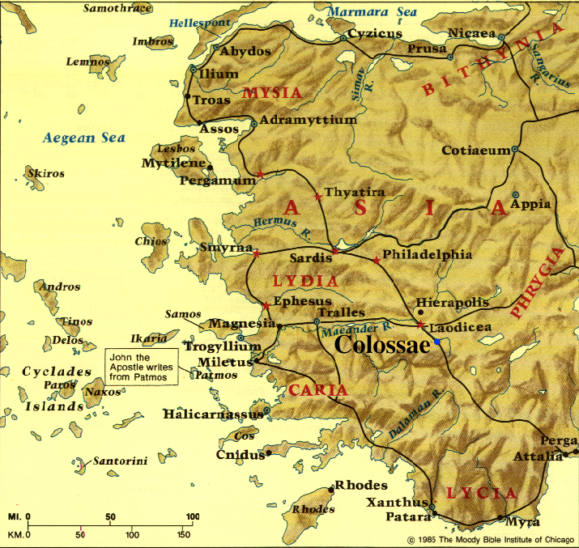

Slide 3
^{2:8} See to it that no one takes you captive through philosophy and empty deception, according to the tradition of men, according to the elementary principles of the world, rather than according to Christ.

Slide 4
FALSE TEACHERS: “Jesus is a ‘junior’ spirit who can only give you a spiritual ‘starter kit.’ You must go beyond Jesus to other spiritual powers & knowledge in order to achieve spiritual fullness.”

Slide 5
FALSE TEACHERS: “Jesus is a ‘junior’ spirit who can only give you a spiritual ‘starter kit.’ You must go beyond Jesus to other spiritual powers & knowledge in order to achieve spiritual fullness.”
^{2:9} For in Him (Jesus) all the fullness of Deity dwells in bodily form, ¹⁰ and in Him you have been made complete (full), and He is the head over all rule and authority.

Slide 6
Christian spiritual development is not about getting something more; it is about appropriating what God has already given you through Jesus
^{2:9} For in Him (Jesus) all the fullness of Deity dwells in bodily form, ¹⁰ and in Him you have been made complete (full), and He is the head over all rule and authority.

Slide 7
FALSE TEACHERS: “Jesus’ death on the cross accomplished nothing that was spiritually significant”

Slide 8
FALSE TEACHERS: “Jesus’ death on the cross accomplished nothing that was spiritually significant”
^{1:19} For it was the Father’s good pleasure for all the fullness to dwell in Him, ²⁰ and through Him to reconcile all things to Himself, having made peace through the blood of His cross; through Him, I say, whether things on earth or things in heaven.
^{1:22} Jesus has now reconciled you in His fleshly body through death, in order to present you before Him holy and blameless and beyond reproach . . .

Slide 9
Colossians 2:13,14 What Jesus Accomplished through His Death on the Cross – Part 1
^{2:13} When you were dead in your transgressions . . . He made you alive together with Him, having forgiven us all our transgressions, ¹⁴ having canceled out the certificate of debt consisting of decrees against us, which was hostile to us; and He has taken it out of the way, having nailed it to the cross.

Slide 10
Colossians 2:13,14 What Jesus Accomplished through His Death on the Cross – Part 1
WHY WE NEED GOD’S FORGIVENESS
HOW GOD PROVIDED FORGIVENESS
THE EXTENT OF GOD’S FORGIVENESS
^{2:13} When you were dead in your transgressions . . . He made you alive together with Him, having forgiven us all our transgressions, ¹⁴ having canceled out the certificate of debt consisting of decrees against us, which was hostile to us; and He has taken it out of the way, having nailed it to the cross.

Slide 11
Colossians 2:13,14 What Jesus Accomplished through His Death on the Cross – Part 1
WHY WE NEED GOD’S FORGIVENESS
^{2:13} When you were dead in your transgressions . . . He made you alive together with Him, having forgiven us all our transgressions, ¹⁴ having canceled out the certificate of debt consisting of decrees against us, which was hostile to us; and He has taken it out of the way, having nailed it to the cross.

Slide 12
Colossians 2:13,14 What Jesus Accomplished through His Death on the Cross – Part 1
WHY WE NEED GOD’S FORGIVENESS
Spiritual death – separation from God – is the just consequence of our true moral guilt (Isa. 59:1,2)
^{2:13} When you were dead in your transgressions . . . He made you alive together with Him, having forgiven us all our transgressions, ¹⁴ having canceled out the certificate of debt consisting of decrees against us, which was hostile to us; and He has taken it out of the way, having nailed it to the cross.

Slide 13
Colossians 2:13,14 What Jesus Accomplished through His Death on the Cross – Part 1
WHY WE NEED GOD’S FORGIVENESS
Our true moral guilt constitutes a criminal debt to God that must be punished by His righteous wrath
^{2:13} When you were dead in your transgressions . . . He made you alive together with Him, having forgiven us all our transgressions, ¹⁴ having canceled out the certificate of debt consisting of decrees against us, which was hostile to us; and He has taken it out of the way, having nailed it to the cross.

Slide 14
Colossians 2:13,14 What Jesus Accomplished through His Death on the Cross – Part 1
HOW GOD PROVIDED FORGIVENESS
^{2:13} When you were dead in your transgressions . . . He made you alive together with Him, having forgiven us all our transgressions, ¹⁴ having canceled out the certificate of debt consisting of decrees against us, which was hostile to us; and He has taken it out of the way, having nailed it to the cross.

Slide 15
Colossians 2:13,14 What Jesus Accomplished through His Death on the Cross – Part 1
HOW GOD PROVIDED FORGIVENESS
Forgiveness is not God deciding to overlook our true moral guilt;
^{2:13} When you were dead in your transgressions . . . He made you alive together with Him, having forgiven us all our transgressions, ¹⁴ having canceled out the certificate of debt consisting of decrees against us, which was hostile to us; and He has taken it out of the way, having nailed it to the cross.

Slide 16
Colossians 2:13,14 What Jesus Accomplished through His Death on the Cross – Part 1
HOW GOD PROVIDED FORGIVENESS
Forgiveness is not God deciding to overlook our true moral guilt; it is God releasing us from its debt by providing a Substitute who pays it for us
^{2:13} When you were dead in your transgressions . . . He made you alive together with Him, having forgiven us all our transgressions, ¹⁴ having canceled out the certificate of debt consisting of decrees against us, which was hostile to us; and He has taken it out of the way, having nailed it to the cross.

Slide 17
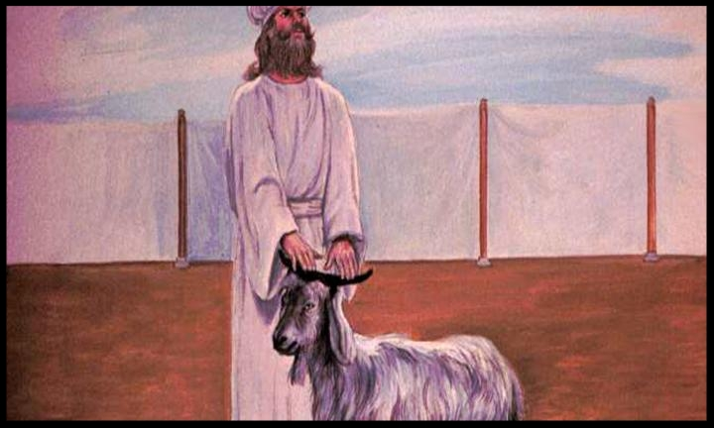
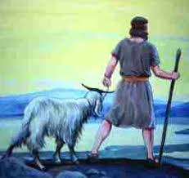
Colossians 2:13,14 What Jesus Accomplished through His Death on the Cross – Part 1
HOW GOD PROVIDED FORGIVENESS

Slide 18
Colossians 2:13,14 What Jesus Accomplished through His Death on the Cross – Part 1
HOW GOD PROVIDED FORGIVENESS
^{2:13} When you were dead in your transgressions . . . He made you alive together with Him, having forgiven us all our transgressions, ¹⁴ having canceled out the certificate of debt consisting of decrees against us, which was hostile to us; and He has taken it out of the way, having nailed it to the cross.

Slide 19
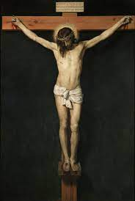
Colossians 2:13,14 What Jesus Accomplished through His Death on the Cross – Part 1
HOW GOD PROVIDED FORGIVENESS
Pilate had a certificate of debt nailed to Jesus’ cross to declare His alleged crime against the Roman Empire . . .
^{2:13} When you were dead in your transgressions . . . He made you alive together with Him, having forgiven us all our transgressions, ¹⁴ having canceled out the certificate of debt consisting of decrees against us, which was hostile to us; and He has taken it out of the way, having nailed it to the cross.

Slide 20
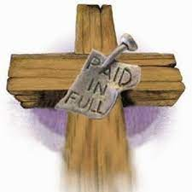
Colossians 2:13,14 What Jesus Accomplished through His Death on the Cross – Part 1
HOW GOD PROVIDED FORGIVENESS
. . . But God nailed our certificates of debt to Jesus, & poured out His wrath on Him
^{2:13} When you were dead in your transgressions . . . He made you alive together with Him, having forgiven us all our transgressions, ¹⁴ having canceled out the certificate of debt consisting of decrees against us, which was hostile to us; and He has taken it out of the way, having nailed it to the cross.

Slide 21
Colossians 2:13,14 What Jesus Accomplished through His Death on the Cross – Part 1
THE EXTENT OF GOD’S FORGIVENESS
^{2:13} When you were dead in your transgressions . . . He made you alive together with Him, having forgiven us all our transgressions, ¹⁴ having canceled out the certificate of debt consisting of decrees against us, which was hostile to us; and He has taken it out of the way, having nailed it to the cross.

Slide 22
Colossians 2:13,14 What Jesus Accomplished through His Death on the Cross – Part 1
THE EXTENT OF GOD’S FORGIVENESS
Past, present & future sins
^{2:13} When you were dead in your transgressions . . . He made you alive together with Him, having forgiven us all our transgressions, ¹⁴ having canceled out the certificate of debt consisting of decrees against us, which was hostile to us; and He has taken it out of the way, having nailed it to the cross.

Slide 23
Colossians 2:13,14 What Jesus Accomplished through His Death on the Cross – Part 1
THE EXTENT OF GOD’S FORGIVENESS
Past, present & future sins
“Little” sins & “big” sins
^{2:13} When you were dead in your transgressions . . . He made you alive together with Him, having forgiven us all our transgressions, ¹⁴ having canceled out the certificate of debt consisting of decrees against us, which was hostile to us; and He has taken it out of the way, having nailed it to the cross.

Slide 24
Colossians 2:13,14 What Jesus Accomplished through His Death on the Cross – Part 1
THE EXTENT OF GOD’S FORGIVENESS
Past, present & future sins
“Little” sins & “big” sins
Permanent remission
^{2:13} When you were dead in your transgressions . . . He made you alive together with Him, having forgiven us all our transgressions, ¹⁴ having canceled out the certificate of debt consisting of decrees against us, which was hostile to us; and He has taken it out of the way, having nailed it to the cross.

Slide 25
Colossians 2:13,14 What Jesus Accomplished through His Death on the Cross – Part 1
THE EXTENT OF GOD’S FORGIVENESS
Justified: declared in right standing with God
^{2 Corinthians 5:20} . . . We beg you on behalf of Christ, be reconciled to God. ²¹ He made Him who knew no sin to be sin on our behalf, so that we might become the righteousness of God in Him.

Slide 26
Colossians 2:13,14 What Jesus Accomplished through His Death on the Cross – Part 1
THE EXTENT OF GOD’S FORGIVENESS
Justified: declared in right standing with God
^{Romans} ^{3:22} We are made right with God by placing our faith in Jesus Christ. And this is true for everyone who believes, no matter who we are. ²³ For everyone has sinned; we all fall short of God’s glorious standard. ²⁴ Yet God, in His grace, freely makes us right in His sight. He did this through Christ Jesus when He freed us from the penalty for our sins. ²⁵ For God presented Jesus as the sacrifice for sin. People are made right with God when they believe that Jesus sacrificed His life, shedding his blood.

Slide 27
Colossians 2:13,14 What Jesus Accomplished through His Death on the Cross – Part 1
THE EXTENT OF GOD’S FORGIVENESS
Justified: declared in right standing with God
^{Romans} ^{3:22} We are made right with God by placing our faith in Jesus Christ. And this is true for everyone who believes, no matter who we are. ²³ For everyone has sinned; we all fall short of God’s glorious standard. ²⁴ Yet God, in His grace, freely makes us right in His sight. He did this through Christ Jesus when He freed us from the penalty for our sins. ²⁵ For God presented Jesus as the sacrifice for sin. People are made right with God when they believe that Jesus sacrificed His life, shedding his blood.

Slide 28
Colossians 2:13,14 What Jesus Accomplished through His Death on the Cross – Part 1
APPROPRIATING GOD’S JUSTIFICATION
^{Romans 5:1} Therefore, having been justified by faith, we have peace with God through our Lord Jesus Christ, ² through whom also we have obtained our introduction by faith into this grace in which we stand; and we exult in hope of the glory of God.

Slide 29
Colossians 2:13,14 What Jesus Accomplished through His Death on the Cross – Part 1
APPROPRIATING GOD’S JUSTIFICATION
God will never again have a retributive response when I sin
^{Romans 5:1} Therefore, having been justified by faith, we have peace with God through our Lord Jesus Christ, ² through whom also we have obtained our introduction by faith into this grace in which we stand; and we exult in hope of the glory of God.

Slide 30
Colossians 2:13,14 What Jesus Accomplished through His Death on the Cross – Part 1
APPROPRIATING GOD’S JUSTIFICATION
God will never again have a retributive response when I sin
I have access to God in spite of my sins
^{Ephesians 3:12} (Through Jesus) we have boldness and confident access through faith in Him.
^{Romans 5:1} Therefore, having been justified by faith, we have peace with God through our Lord Jesus Christ, ² through whom also we have obtained our introduction by faith into this grace in which we stand; and we exult in hope of the glory of God.

Slide 31
Colossians 2:13,14 What Jesus Accomplished through His Death on the Cross – Part 1
APPROPRIATING GOD’S JUSTIFICATION
God will never again have a retributive response when I sin
I have access to God in spite of my sins
God guarantees my entrance into His eternal kingdom
^{Romans 5:1} Therefore, having been justified by faith, we have peace with God through our Lord Jesus Christ, ² through whom also we have obtained our introduction by faith into this grace in which we stand; and we exult in hope of the glory of God.

Slide 32
Colossians 2:13,14 What Jesus Accomplished through His Death on the Cross – Part 1
^{1 Peter 1:3} Blessed be the God and Father of our Lord Jesus Christ, who according to His great mercy has caused us to be born again to a living hope . . . ⁴ to obtain an inheritance which is imperishable and undefiled and will not fade away, reserved in heaven for you, ⁵ who are protected by the power of God through faith for a salvation ready to be revealed in the last time.
APPROPRIATING GOD’S JUSTIFICATION
God will never again have a retributive response when I sin
I have access to God in spite of my sins
God guarantees my membership in His eternal kingdom
^{Romans 5:1} Therefore, having been justified by faith, we have peace with God through our Lord Jesus Christ, ² through whom also we have obtained our introduction by faith into this grace in which we stand; and we exult in hope of the glory of God.

