Slide 1
The Greatest Stories Never Told
XSI 2017
Scott Risley

Slide 2
Why teach narratives?
There are so many!
They are enjoyable
They are memorable
Bad reasons:
Postmodernism: Because we’ve given up on propositional truth
Liberal scholarship: Because the events described never happened

Slide 3
My interest in teaching narratives
Teaching “Intro to the Bible”
Just as exciting each time. Impactful too.
Exposure to some good books on this subject
Hearing others teach narratives
I couldn’t stop listening, and it got past my defenses

Slide 4
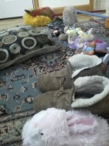
My interest in teaching narratives
Reading to my kids
Narnia
Hobbit, LOTR

Slide 5
My interest in teaching narratives
Behold the mighty army of Orcs as they prepared to attack Helm's Deep earlier this afternoon.
They managed to break through the first line of couch cushions
before being defeated by Legolas (played by Sophie)
and Legolas (also played by Matt).
Reading to my kids
Narnia
Hobbit, LOTR

Slide 6
My interest in teaching narratives
Reading to my kids
Narnia
Hobbit, LOTR
Lots of other books too
I’m usually a lot more awake and interested when I’m telling the story
Often able to stop and talk about the themes that are coming up

Slide 7
My interest in teaching narratives
Reading to my kids
Narnia
Hobbit, LOTR
Lots of other books too
Also the Action Bible!

Slide 8
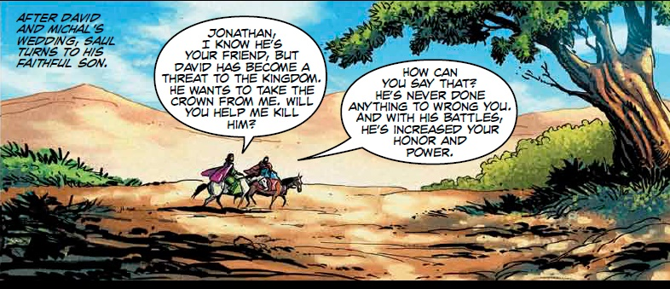

Slide 9
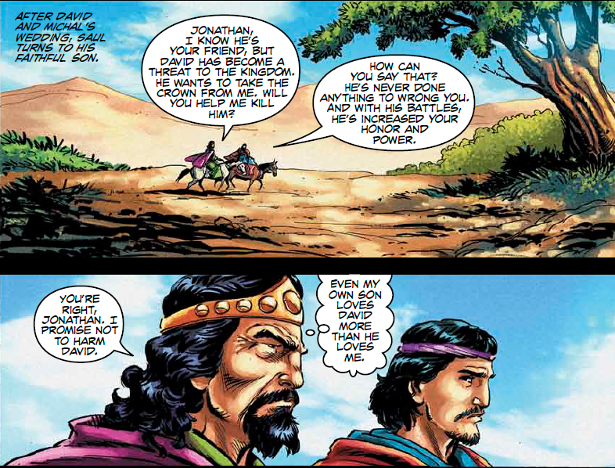

Slide 10
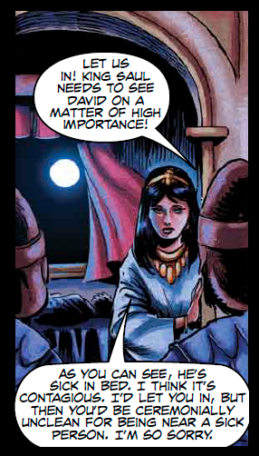
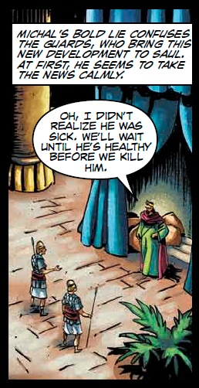
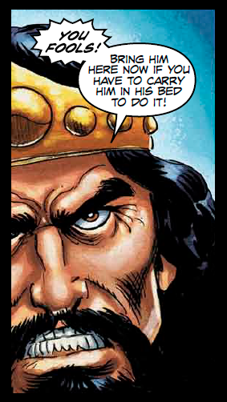
A half page later…

Slide 11
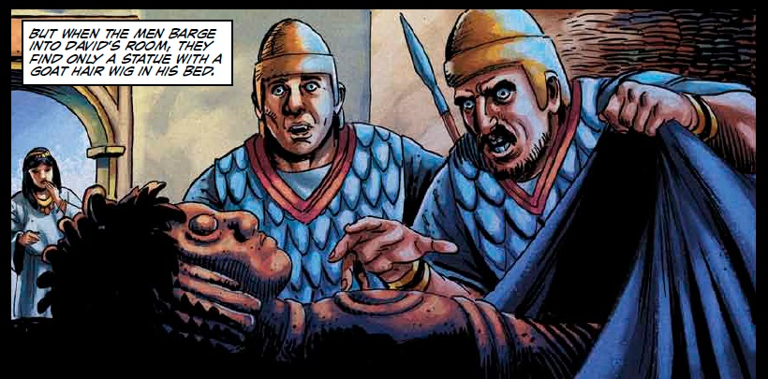

Slide 12
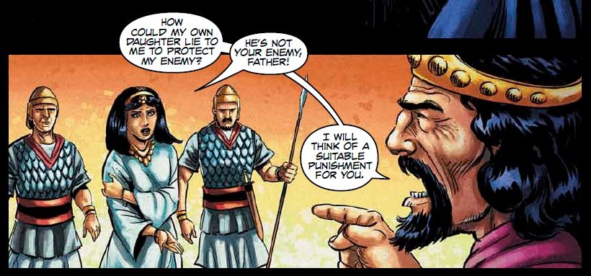

Slide 13
Fee and Stuart
Christian Scholars and Authors
Fee and Stuart, How to Read the Bible for All Its Worth (Zondervan, 2003), p. 89
In our experience, people force incorrect interpretations and applications on narrative portions of the Bible as much or more than they do on any other parts.
The intended value and meaning are replaced with ideas read into rather than out of the text.

Slide 14
Tips for interpreting narratives
1. Scene = the basic unit of narratives
Kaiser: “A brief synopsis of what is in each scene is most helpful.”
Can get overwhelming (e.g. Gen 11:1-10)
Helpful for simplifying longer narratives

Slide 15
Tips for interpreting narratives
2. Plot
Tension builds to a peak before resolution/release of the tension
Try to identify the tension and the peak(s)
Gen 22 has one peak
Gen 27 has two peaks
Prodigal Son parable has two peaks

Slide 16
Tips for interpreting narratives
3. Characters
Description is sparse, so make the most of it. What you do get is important
Saul is tall
But why won’t he fight Goliath?
Why is he hiding in the luggage and talking about how insignificant his family is?
Samuel’s verdict: “Although you may think little of yourself, are you not the leader of the tribes of Israel?” (1 Sam 15:17)

Slide 17
Tips for interpreting narratives
3. Characters
Compare and contrast can be good here
Samuel vs the sons of Eli
Jonah vs the pagan sailors

Slide 18
Tips for interpreting narratives
4. Dialogue

Slide 19
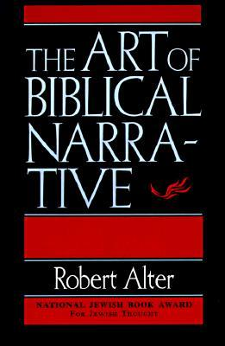
Robert Alter
Jewish Hebrew Scholar, Univ. of California, Berkeley
Alter, The Art of Biblical Narrative (Basic Books, 1981), p. 182
Everything in the world of biblical narrative ultimately gravitates towards dialogue…

Slide 20
Robert Alter
Jewish Hebrew Scholar, Univ. of California, Berkeley
Alter, The Art of Biblical Narrative (Basic Books, 1981), p. 182
This “gravitation” often means that phrases or whole sentences first stated by the narrator
do not reveal their full significance until they are repeated, whether faithfully or with distortions, in direct speech…

Slide 21
Robert Alter
Jewish Hebrew Scholar, Univ. of California, Berkeley
Alter, The Art of Biblical Narrative (Basic Books, 1981), p. 182
It also means that, quantitatively, a remarkably large part of the narrative burden is carried by dialogue…

Slide 22
Robert Alter
Jewish Hebrew Scholar, Univ. of California, Berkeley
Alter, The Art of Biblical Narrative (Basic Books, 1981), p. 182
As a rule, when a narrative event in the Bible seems important, the writer will render it mainly through dialogue,
so the transitions from narration to dialogue provide in themselves some implicit measure of what is deemed essential…

Slide 23
Robert Alter
Jewish Hebrew Scholar, Univ. of California, Berkeley
Alter, The Art of Biblical Narrative (Basic Books, 1981), p. 183
Finally, we should be alert to the seeming discontinuities of biblical dialogue and ponder what that might imply.

Slide 24
Robert Alter
Jewish Hebrew Scholar, Univ. of California, Berkeley
Alter, The Art of Biblical Narrative (Basic Books, 1981), p. 183
When do characters… answer one another without truly responding to what the other person has said?
When does the dialogue break off sharply, withholding from us the rejoinder we might have expected from one of the two speakers?

Slide 25
Tips for interpreting narratives
4. Dialogue
Discontinuities – not answering the question or breaking off sharply
E.g. Jonah 4

Slide 26
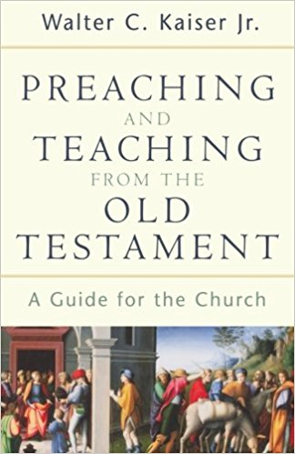
Walter Kaiser, Jr.
OT Scholar and Author
Kaiser, Preaching and Teaching from the Old Testament (Grand Rapids, MI: Baker Academic, 2003), p. 72
It is especially important to pay attention to those times when one character repeats a part or the whole of what another has just said.
Often in these repetitions, there is a small deviation, slight alteration, reversal of order, elaboration, deletion, or another difference.

Slide 27
Tips for interpreting narratives
4. Dialogue
Discontinuities – not answering the question or breaking off sharply
Differences when repeating dialogue
Gen 2:15-17 vs. 3:1-4
Ex. 3:18 vs. Ex. 5:1, 3

Slide 28
Tips for interpreting narratives
4. Dialogue
Discontinuities – not answering the question or breaking off sharply
Differences
Gen 2:15-17 vs. 3:1-4
Ex. 3:18 vs. Ex. 5:1, 3
Ex. 3:18 – Go to the king of Egypt and say to him, ‘The Lord, the God of the Hebrews, has met with us. Let us take a three-day journey into the wilderness to offer sacrifices to the Lord our God.
Ex. 5:1 – Moses and Aaron went to Pharaoh and said, “This is what the Lord, the God of Israel, says: ‘Let my people go, so that they may hold a festival to me in the wilderness.’

Slide 29
Tips for interpreting narratives
4. Dialogue
Discontinuities – not answering the question or breaking off sharply
Differences
Gen 2:15-17 vs. 3:1-4
Ex. 3:18 vs. Ex. 5:1, 3
Ex. 3:18 – Go to the king of Egypt and say to him, ‘The Lord, the God of the Hebrews, has met with us. Let us take a three-day journey into the wilderness to offer sacrifices to the Lord our God.
Ex. 5:3 – Then they said, “The God of the Hebrews has met with us. Now let us take a three-day journey into the wilderness to offer sacrifices to the Lord our God, or he may strike us with plagues or with the sword.”

Slide 30
Tips for interpreting narratives
4. Dialogue
Discontinuities – not answering the question or breaking off sharply
Differences when repeating dialogue
Differences between what happened and what is said
Ex 32:24 – “I simply threw it into the fire—and out came this calf!”
See Elijah’s claims in 1 Kings 18 and 19

Slide 31
Tips for interpreting narratives
We know Obadiah has hidden hundreds of prophets in caves all over Israel
1 Ki 18:22 – “I alone am left a prophet of the Lord”
2 Ki 19:10 – “And I alone am left…”
2 Ki 19:14 – “And I alone am left…”
God: “Go anoint Elisha.
And by the way, I’ve got like 7,000 you don’t even know about.”
4. Dialogue
Discontinuities – not answering the question or breaking off sharply
Differences when repeating dialogue
Differences between what happened and what is said
Ex 32:24 – “I simply threw it into the fire—and out came this calf!”
See Elijah’s claims in 1 Kings 18 and 19

Slide 32
Tips for interpreting narratives
5. Repetition
Key words
John 18:18; 21:9 – “charcoal fire”
Ex 9:8 – “Take handfuls of soot from a brick kiln, and have Moses toss it into the air…” – What would the Egyptians be reminded of?
When Moses turns the Nile into blood, what would the Egyptians be reminded of?

Slide 33
Tips for interpreting narratives
5. Repetition
Events (Compare and contrast)
Jeroboam’s 2 golden calves
1 Ki 12:28 – “behold your gods, O Israel, that brought you up from the land of Egypt.”
Moses sends 12 spies publicly. Joshua sends 2 spies secretly.

Slide 34
Tips for interpreting narratives
5. Repetition
Patterns
Judges and the cycle of sin
Judges 17:6; 21:25 – “In those days there was no king in Israel; everyone did what was right in his own eyes.” (also 18:1; 19:1)
Samson

Slide 35
Tips for interpreting narratives
6. Summaries or Conclusions
Often through dialogue
Gen 50:19-20 – “Don’t be afraid. Am I in the place of God? You intended to harm me, but God intended it for good…”
Or the narrator
Gen 25:34 – So Esau despised his birthright.
2 Sam 11:27b – But the thing David had done displeased the Lord.

Slide 36
Tips for interpreting narratives
7. Irony
Matt 27 – The ironies of the cross
Matt 27:41 – “Come down from the cross, if you are the Son of God!”
Matt 27:42 – “He saved others,” they said, “but he can’t save himself!”

Slide 37
Tips for interpreting narratives
7. Irony
What Lot went for (comfort and wealth) and what he got instead (cave incest and lost everything)
Uriah tells David, “I could never go and sleep with my wife while Israel is at war.”
This is ironic, because David had no problem sleeping with Uriah’s wife while Israel was at war.

Slide 38
Tips for interpreting narratives
Finally, get some background knowledge
Bible Dictionaries
IVP Bible Background Commentary
Zondervan Illustrated Bible Background Commentary

Slide 39
Common mistakes
1. Allegorizing
Seeing “types” in everything
“What are your walls of Jericho?”
Prevention: look for explicit NT identification of OT types

Slide 40
Common mistakes
2. Failing to tie into the bigger story
E.g. Genesis
The Fall and the Promised One (Gen. 3:15) has to be in the background for any study of Genesis
Also the Abrahamic covenant (12:1-3)
This is a good way to tie in the gospel in the OT
E.g. Acts (Acts 1:8)

Slide 41
Common mistakes
3. Shallow application or moralizing
Consider:
What do we learn about God and his promises?
What does faithfulness or unfaithfulness to God look like?

Slide 42
Common mistakes
4. Summarizing something you should have read
Save summaries for larger blocks of verses

Slide 43
Common mistakes
5. Stopping so long you lose the story
If you lose the story you lose everything
Stopping and applying is cool
Stopping to supply background info is cool (e.g. “Who was Felix?”)
Stopping for apologetic explanation is cool (e.g. “Long lives in Genesis 5?”)
If in the OT, stopping to mention how the NT picks up this theme is cool.

Slide 44
Common mistakes
5. Stopping so long you lose the story
If your stop is so long that it’s going to kill the story, just save it for the end. (Or shorten or cut it)

Slide 45
Common mistakes
6. Taking a deductive rather than inductive approach
Giving away the ending in your introduction
“This is the story of how Rahab hid the spies in exchange for her own life”
“Tonight we’ll learn about how Ruth became a believer and married Boaz”
Listing your “three main points”
Rearranging the story to fit your outline

Slide 46
Inductive vs Deductive
Rahab
Plain reading of the story, skipping the last half
Rahab is an example of God’s grace (what she probably expected and what she got)
Rahab is an example of faith
Know (v. 9-11)
Believe (v. 12-13)
Act (v. 3-6, 15-21)

Slide 47
Inductive vs Deductive
Rahab
Set up the scene, get the spies to her house
Why were they there?
Why was Rahab there?

Slide 48
Inductive vs Deductive
Rahab
In all seriousness Rahab probably had a pretty rough background. Prostitution was directly related to poverty and debt...
I’m not sure if you have ever found yourself in this position. You started out with one idea of who you wanted to be, what you wanted your life to look like…

Slide 49
Inductive vs Deductive
Rahab
Then someone tips off the king and his soldiers show up? What’s going to happen? Surely this poverty-stricken woman will rat them out.
But here’s where our story takes an unexpected twist (she lies)
v. 6 (Actually, she had taken them up to the roof and hidden them beneath bundles of flax she had laid out.)

Slide 50
Inductive vs Deductive
Rahab
Now they were trapped and at the mercy of this woman they had just met, who apparently had bit more savvy then they first gave her credit for.
And now she comes to the spies under cover of darkness to reveal what she is really thinking.

Slide 51
Inductive vs Deductive
Rahab
What could she possibly want from them? Let’s listen in.
V. 9 “I know the Lord has given you this land…”
Whoa. What a bold statement.
We see that the spies had not just fallen in with some random lowlife, or a con-artist trying to exploit them in their hour of need.

Slide 52
Inductive vs Deductive
Rahab
This Rahab was a woman of faith. And God had used the most unlikely circumstances to direct them to the most unlikely person.
Let’s think for a minute about Rahab’s faith…
You see, Rahab had biblical faith. And true biblical faith starts with what we KNOW.

Slide 53
Presentation tips
Visual Aids
Show maps & timelines (printed is good)

Slide 54
Acts 18
23 After spending some time in Antioch,
Paul went back through Galatia and Phrygia...

Slide 55
Presentation tips
Visual Aids
Show maps & timelines (printed is good)
Show ancient people, places, artifacts
E.g. the end of Acts 23…

Slide 56
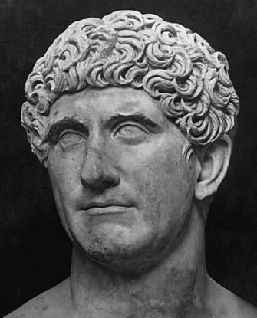
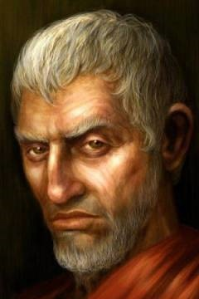
Governor Antonius Felix
Ruled Judea from 52-58 AD
More details
Quote from Tacitus

Slide 57
Acts 24
1 Five days later Ananias, the high priest, arrived…

Slide 58
Presentation tips
Visual Aids
Gestures
Voice
Face
Walsh, The Art of Storytelling has some good suggestions here

Slide 59
Discussion Questions
How do you think she is feeling right now?
How would you feel (or what would you do) if you were in this situation?
What did you notice about they way he responded?
What sticks out to you about Jacob’s prayer?
What can we learn about God here?
What are some lessons we could take away from this story?

Slide 60
Conclusions
Stories are powerful
Especially when they are part of God’s word
Your job is to faithfully hold them out to people
And to enjoy them

Slide 61
Helpful Resources
John Walsh, The Art of Storytelling
Walter Kaiser, Jr, Preaching and Teaching the Old Testament
Steven Mathewson, The Art of Preaching Old Testament Narrative

