Slide 2
(1 Pet. 4:12) Dear friends, do not be surprised at the painful trial you are suffering, as though something strange were happening to you.

Slide 3
(1 Pet. 4:12) Dear friends, do not be surprised at the painful trial you are suffering, as though something strange were happening to you.
The psychological aspect of suffering only adds fuel to the fire
Our suffering isn’t as bad as
our thoughts about our suffering.
(e.g. aerophobia: fear of flying)
(e.g. trypanophobia: fear of needles)
Some crumble from minor suffering.
Some are composed in major suffering.
“Arm yourselves!” (1 Pet. 4:1)

Slide 4
(1 Pet. 4:12) Dear friends, do not be surprised at the painful trial you are suffering, as though something strange were happening to you.
The psychological aspect of suffering only adds fuel to the fire
(1) “Suffering happens to other people.”
“Why me?”
“What makes me exempt?”

Slide 5
(1 Pet. 4:12) Dear friends, do not be surprised at the painful trial you are suffering, as though something strange were happening to you.
The psychological aspect of suffering only adds fuel to the fire
(1) “Suffering happens to other people.”
(2) “I don’t want to suffer.”

Slide 6
(1 Pet. 4:12) Dear friends, do not be surprised at the painful trial you are suffering, as though something strange were happening to you.
Suffering is on it’s way!
Singleness/breakups?
Struggling in school?
Rejection or betrayal?
Marital problems?
Seeing your kids hurting?
Family conflict?
Unemployment?
Negative medical diagnosis?
Death: parents, spouse, kids?
The psychological aspect of suffering only adds fuel to the fire
(1) “Suffering happens to other people.”
(2) “I don’t want to suffer.”

Slide 7
Some suffering is avoidable (v.15).
Many “avoidance-techniques” result in mutating new species of suffering.
Avoiding pain/sickness/death = various neuroses.
Self-medicating = “rebound effect.”
Social anxiety = loneliness or numbness.
(1 Pet. 4:12) Dear friends, do not be surprised at the painful trial you are suffering, as though something strange were happening to you.
The psychological aspect of suffering only adds fuel to the fire
(1) “Suffering happens to other people.”
(2) “I don’t want to suffer.”
(3) “I’ll avoid suffering.”

Slide 8
(1 Pet. 4:12) Dear friends, do not be surprised at the painful trial you are suffering, as though something strange were happening to you.
Complaining doesn’t help to fix our circumstances.
(e.g. Teenager on a Caribbean cruise)
The psychological aspect of suffering only adds fuel to the fire
(1) “Suffering happens to other people.”
(2) “I don’t want to suffer.”
(3) “I’ll avoid suffering.”
(4) “I didn’t choose this.”

Slide 9
(1 Pet. 4:12) Dear friends, do not be surprised at the painful trial you are suffering, as though something strange were happening to you.
The psychological aspect of suffering only adds fuel to the fire
(1) “Suffering happens to other people.”
(2) “I don’t want to suffer.”
(3) “I’ll avoid suffering.”
(4) “I didn’t choose this.”
(5) “I don’t deserve this. It isn’t fair.”
“I want mercy.”
“I want justice.”
What exactly do you think you deserve?
What can you demand of God?
What do you have to negotiate with?

Slide 10
(1 Pet. 4:12) Dear friends, do not be surprised at the painful trial you are suffering, as though something strange were happening to you.
“My purpose in life is to be well liked and well off.”
A car crash leaves you physically disfigured, and the medical bills leave you broke.
What a horrific tragedy!
It didn’t just take your money—it took your meaning!
The psychological aspect of suffering only adds fuel to the fire
(1) “Suffering happens to other people.”
(2) “I don’t want to suffer.”
(3) “I’ll avoid suffering.”
(4) “I didn’t choose this.”
(5) “I don’t deserve this. It isn’t fair.”
(6) “I’ll trust in _____ for my purpose.”

Slide 11
(1 Pet. 4:12) Dear friends, do not be surprised at the painful trial you are suffering, as though something strange were happening to you.
The psychological aspect of suffering only adds fuel to the fire
(1) “Suffering happens to other people.”
(2) “I don’t want to suffer.”
(3) “I’ll avoid suffering.”
(4) “I didn’t choose this.”
(5) “I don’t deserve this. It isn’t fair.”
(6) “I’ll trust in _____ for my purpose.”

Slide 12
“Can’t you see that I’m already suffering enough? Why does God expect one more thing out of me?”
(1 Pet. 4:13) Instead, rejoice that you participate in the sufferings of Christ,
so that you may be overjoyed when his glory is revealed.
What’s the alternative to gratitude?
Think about nothing?
Restlessly seek sympathy from others?
Allow your mind to race?
Reject God?

Slide 13
(1 Pet. 4:13) Instead, rejoice that you participate in the sufferings of Christ,
so that you may be overjoyed when his glory is revealed.
“Can’t you see that I’m already suffering enough? Why does God expect one more thing out of me?”

Slide 14
(1 Pet. 4:13) Instead, rejoice that you participate in the sufferings of Christ,
so that you may be overjoyed when his glory is revealed.
Why is gratitude the solution?
(1) Gratitude gives us a “mental break.”
“Can’t you see that I’m already suffering enough? Why does God expect one more thing out of me?”

Slide 15
(1 Pet. 4:13) Instead, rejoice that you participate in the sufferings of Christ,
so that you may be overjoyed when his glory is revealed.
Why is gratitude the solution?
(1) Gratitude gives us a “mental break.”
(2) Gratitude places suffering in context.
“Can’t you see that I’m already suffering enough? Why does God expect one more thing out of me?”

Slide 17
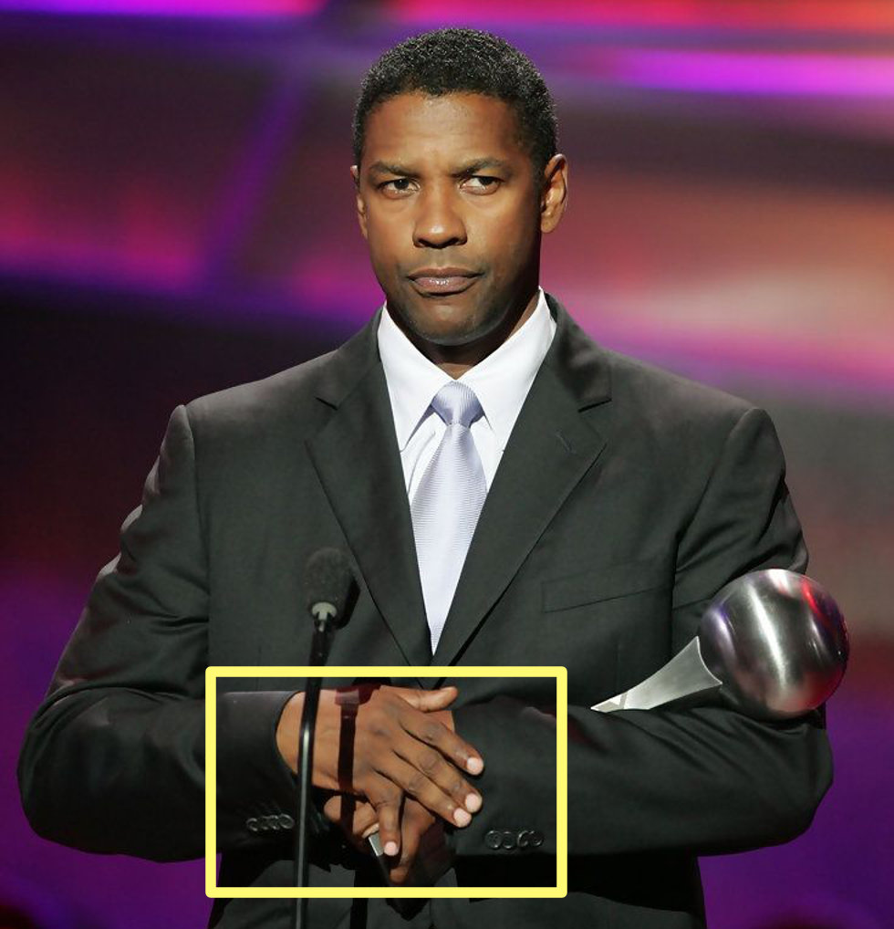

Slide 18
(1 Pet. 4:13) Instead, rejoice that you participate in the sufferings of Christ,
so that you may be overjoyed when his glory is revealed.
Why is gratitude the solution?
(1) Gratitude gives us a “mental break.”
(2) Gratitude places suffering in context.
“Can’t you see that I’m already suffering enough? Why does God expect one more thing out of me?”

Slide 19
(1 Pet. 4:13) Instead, rejoice that you participate in the sufferings of Christ,
so that you may be overjoyed when his glory is revealed.
Why is gratitude the solution?
(1) Gratitude gives us a “mental break.”
(2) Gratitude places suffering in context.
(3) Gratitude reminds us that we aren’t imprisoned victims of our circumstances.
“Can’t you see that I’m already suffering enough? Why does God expect one more thing out of me?”

Slide 20
(1 Pet. 4:14) If you are insulted because of the name of Christ, you are blessed,
for the Spirit of glory and of God rests on you.
Even during verbal lashings, we can have happiness from the Holy Spirit!

Slide 21
(1 Pet. 4:15) Make sure that none of you suffers as a murderer, thief, evildoer, or troublesome meddler.

Slide 22
(1 Pet. 4:16) However, if anyone suffers as a Christian,
he is not to be ashamed,
but is to glorify God in this name.
When these things are all going wrong…
It’s easy to feel like we are in the wrong.

Slide 23
(1 Pet. 4:16) However, if anyone suffers as a Christian,
he is not to be ashamed,
but is to glorify God in this name.
NO!! You’ve been wronged because you’re living for what is right!
(2 Tim. 3:12; Lk. 6:22-26).
When these things are all going wrong…
It’s easy to feel like we are in the wrong.

Slide 24
(1 Pet. 4:17) For it is time for judgment to begin with the family of God.
And if it begins with us, what will the outcome be for those who do not obey the gospel of God?
¹⁸ If it is hard for the righteous to be saved,
what will become of the ungodly and the sinner?
(Rom. 8:1) There is now no condemnation for those who are in Christ Jesus.
Do Christians face judgment? (krima)
(1) Greater context of Scripture (Rom. 8:1).

Slide 25
(1 Pet. 4:17) For it is time for judgment to begin with the family of God.
And if it begins with us, what will the outcome be for those who do not obey the gospel of God?
¹⁸ If it is hard for the righteous to be saved,
what will become of the ungodly and the sinner?
Do Christians face judgment? (krima)
(1) Greater context of Scripture (Rom. 8:1).
(2) Immediate context contrasts those who receive punitive judgment (vv.17-19).

Slide 26
(1 Pet. 4:17) For it is time for judgment to begin with the family of God.
And if it begins with us, what will the outcome be for those who do not obey the gospel of God?
¹⁸ If it is hard for the righteous to be saved,
what will become of the ungodly and the sinner?
(1 Cor. 11:32) When we are judged,
we are disciplined by the Lord
so that we will not be condemned along with the world.
Do Christians face judgment? (krima)
(1) Greater context of Scripture (Rom. 8:1).
(2) Immediate context contrasts those who receive punitive judgment (vv.17-19).
(3) God is using this suffering as “discipline” and “testing” (v.12), not eternal judgment.

Slide 27
(1 Pet. 4:17) For it is time for judgment to begin with the family of God.
And if it begins with us, what will the outcome be for those who do not obey the gospel of God?
¹⁸ If it is hard for the righteous to be saved,
what will become of the ungodly and the sinner?

Slide 28
(1 Pet. 4:19) So then, those who suffer according to God’s will should entrust themselves to their faithful Creator and continue to do good.
Is God trustworthy or not?

Slide 29
(1 Pet. 4:19) So then, those who suffer according to God’s will should entrust themselves to their faithful Creator and continue to do good.

