Slide 2
Jesus One on One
^{Luke 22}

Slide 3
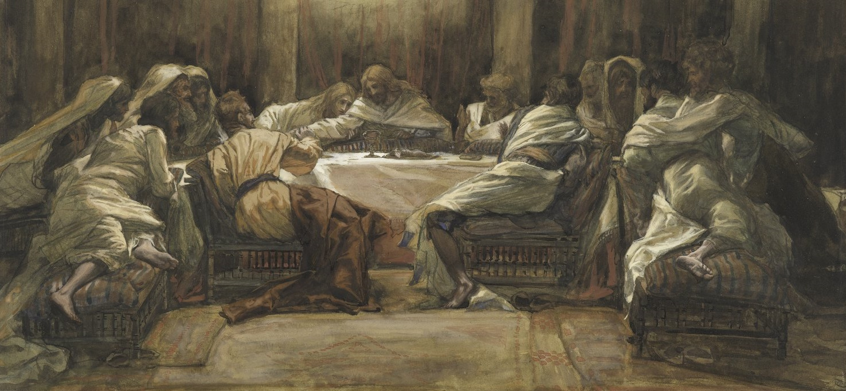
Jesus One on One
^{Luke 22}

Slide 4
^{Luke 22:28} “You are the ones who have stood by Me in My trials; ²⁹ and just as My Father has granted Me a kingdom, I grant you ³⁰ that you may eat and drink at My table in My kingdom, and you will sit on thrones judging the twelve tribes of Israel.

Slide 5
Jesus One on One: Jesus & Simon Peter
^{Luke 22:31} “Simon, Simon, behold …

Slide 6
Jesus One on One: Jesus & Simon Peter
^{Luke 22:31} “Simon, Simon, behold, Satan has demanded to sift you men like wheat; ³² but I have prayed for you, that your faith will not fail; and you, when you have turned back, strengthen your brothers.”

Slide 7
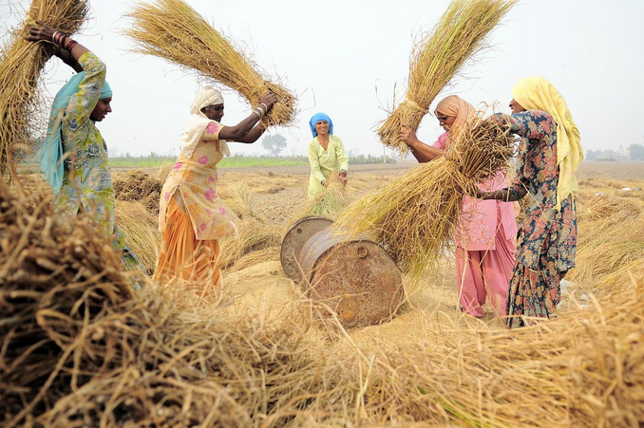
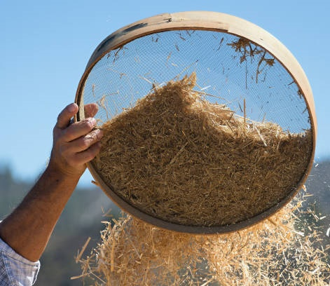
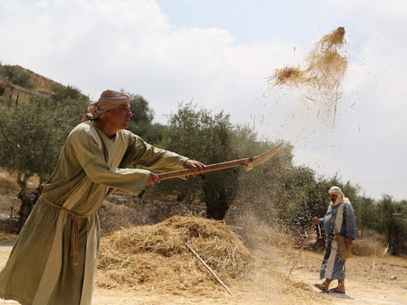
Jesus One on One: Jesus & Simon Peter
^{Luke 22:31} “Simon, Simon, behold, Satan has demanded to sift you men like wheat; ³² but I have prayed for you, that your faith will not fail; and you, when you have turned back, strengthen your brothers.”

Slide 8
Jesus One on One: Jesus & Simon Peter
^{Luke 22:31} “Simon, Simon, behold, Satan has demanded to sift you men like wheat; ³² but I have prayed for you, that your faith will not fail; and you, when you have turned back, strengthen your brothers.”

Slide 9
Jesus One on One: Jesus & Simon Peter
^{Luke 22:31} “Simon, Simon, behold, Satan has demanded to sift you men like wheat; ³² but I have prayed for you, that your faith will not fail; and you, when you have turned back, strengthen your brothers.”

Slide 10
Jesus One on One: Jesus & Simon Peter
^{Luke 22:33} But he said to Him, “Lord, I am ready to go with You both to prison and to death!”

Slide 11
Jesus One on One: Jesus & Simon Peter
^{Mark 14:27} And Jesus said to them, “You will all fall away, because it is written, ‘I will strike down the shepherd, and the sheep shall be scattered.’ ²⁸ But after I have been raised, I will go ahead of you to Galilee.”
²⁹ But Peter said to Him, “Even though all may fall away, yet I will not.” ³⁰ And Jesus said to him, “Truly I say to you, that this very night, before a rooster crows twice, you yourself will deny Me three times.” ³¹ But Peter kept saying insistently, “Even if I have to die with You, I will not deny You!”
^{Luke 22:34} But He said, “I tell you, Peter, the rooster will not crow today until you have denied three times that you know Me.”

Slide 12
Scene 2
^{Luke 22:54} Now they arrested Him and led Him away, and brought Him to the house of the high priest but Peter was following at a distance.

Slide 13
Scene 2
^{Luke 22:54} Now they arrested Him and led Him away, and brought Him to the house of the high priest but Peter was following at a distance.

Slide 14
Scene 2
^{Luke 22:55} After they kindled a fire in the middle of the courtyard and sat down together, Peter was sitting among them. ⁵⁶ And a slave woman, seeing him as he sat in the firelight, and staring at him, said,

Slide 15
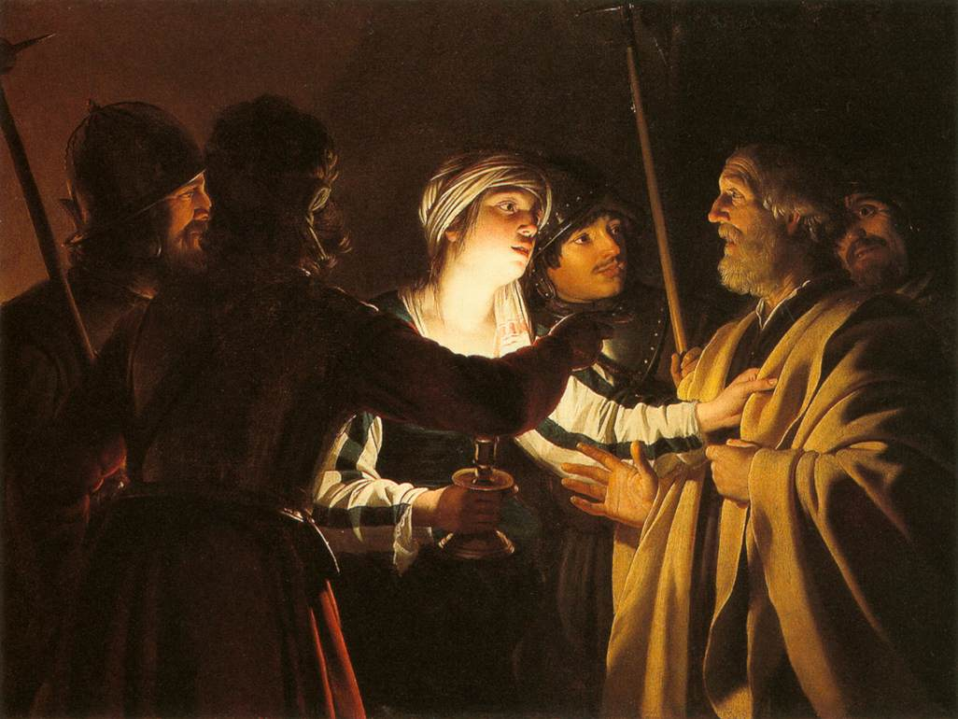
⁵⁶ “This man was with Him as well.”
^{Luke 22:55} After they kindled a fire in the middle of the courtyard and sat down together, Peter was sitting among them. ⁵⁶ And a slave woman, seeing him as he sat in the firelight, and staring at him, said,

Slide 16
⁵⁶ “This man was with Him as well.”
⁵⁷ “I do not know Him, woman!”
^{Luke 22:57} But he denied it, saying,

Slide 17
⁵⁸ “You are one of them too!”
⁵⁸ “Man, I am not!”
^{Luke 22:58} And a little later, another
person saw him and said,
But Peter said,

Slide 18
⁵⁹ “Certainly this man also was with Him, for he, too, is a Galilean.”
⁶⁰ “Man, I do not know what you are talking about!”
^{Mark 14:71} But he began to curse and swear, “I do not know this man you are talking about!
^{Luke 22:59} And after about an hour had passed,
some other man began to insist, saying,
⁶⁰ But Peter said,

Slide 19
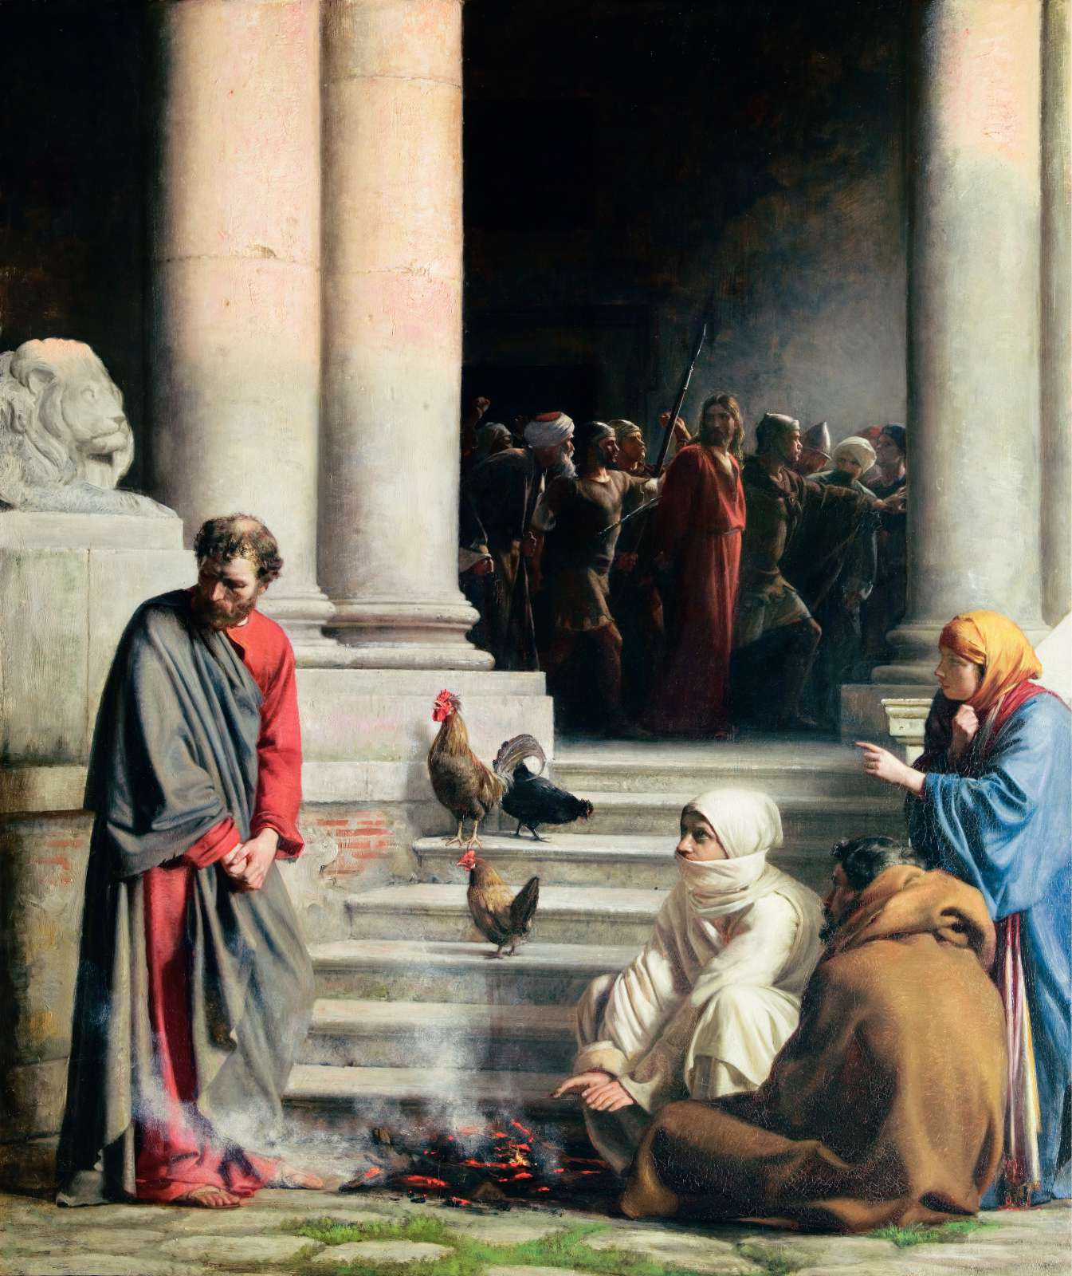
^{Luke 22:60} And immediately, while he was still speaking, a rooster crowed.
⁶¹ And then the Lord turned and looked at Peter.

Slide 20
^{Luke 22:60} And immediately, while he was still speaking, a rooster crowed.
⁶¹ And then the Lord turned and looked at Peter. And Peter remembered the word of the Lord, how He had told him, “Before a rooster crows today, you will deny Me three times.”
⁶² And he went out and wept bitterly.

Slide 21
Excellent intentions resulting in failure
A failure of faith: failure to put into action the trust he had in Jesus

Slide 22
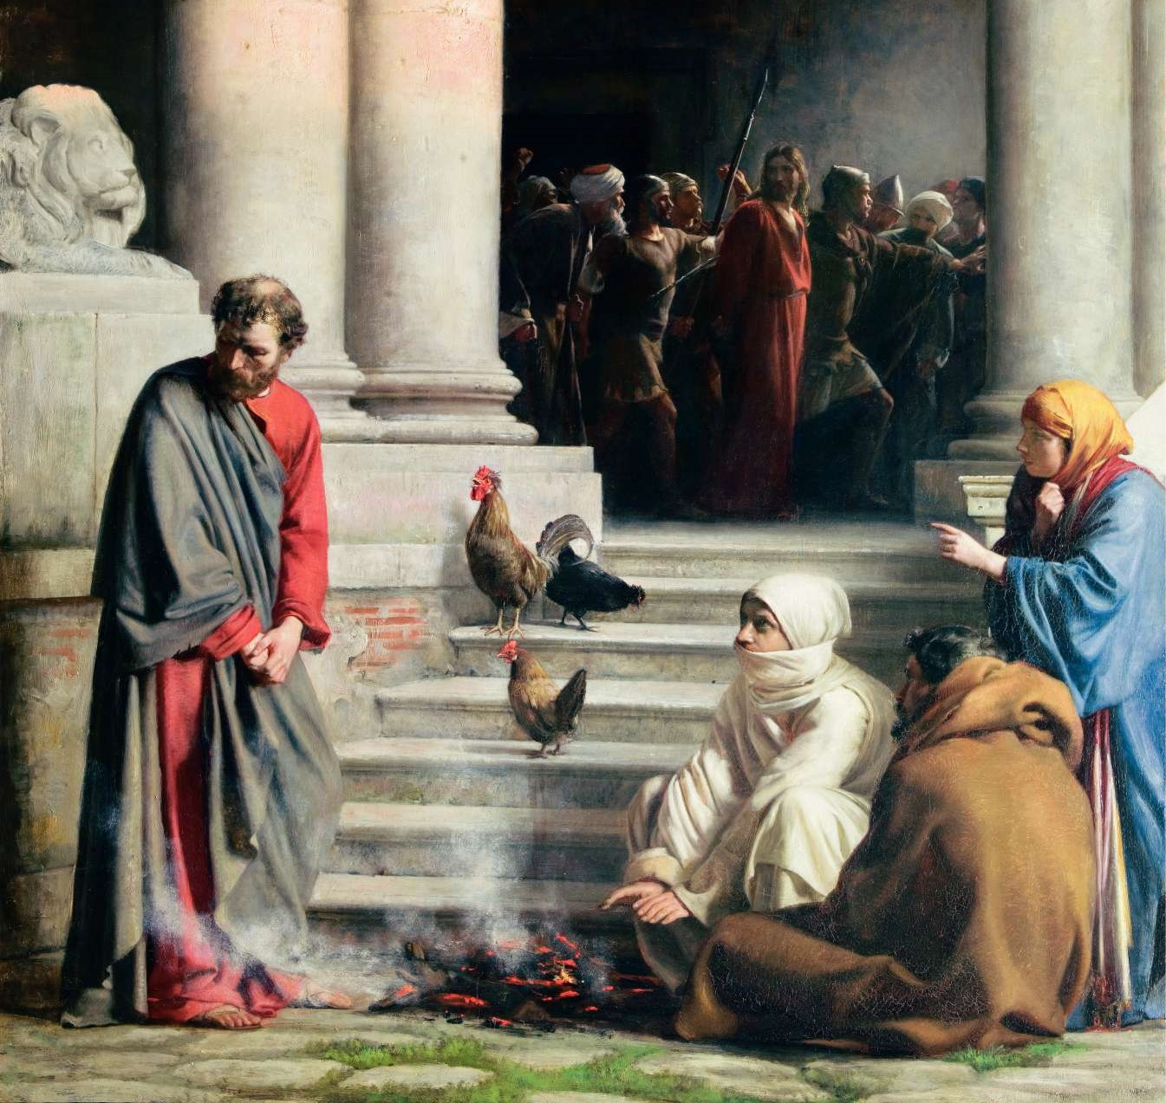
What does it teach us about ourselves?
We overestimate the strength of our own intentions and faithfulness
We are prone to failures of faith
If you walk with Jesus very long, you are going to pile up some spectacular failures

Slide 23
What does it teach us about Jesus?
1) Jesus anticipates our failures
^{Luke 22:31} “Simon, Simon, behold, Satan has demanded to sift you men like wheat; ³² but I have prayed for you, that your faith will not fail; and you, when you have turned back, strengthen your brothers.”

Slide 24
What does it teach us about Jesus?
1) Jesus anticipates our failures
^{Luke 22:31} “Simon, Simon, behold, Satan has demanded to sift you men like wheat; ³² but I have prayed for you, that your faith will not fail; and you, when you have turned back, strengthen your brothers.”

Slide 25
What does it teach us about Jesus?
2) Jesus is compassionately concerned about our failures
^{Luke 22:31} “Simon, Simon, behold, Satan has demanded to sift you men like wheat; ³² but I have prayed for you, that your faith will not fail; and you, when you have turned back, strengthen your brothers.”

Slide 26
What does it teach us about Jesus?
2) Jesus is compassionately concerned about our failures
^{Luke 22:31} “Simon, Simon, behold, Satan has demanded to sift you men like wheat; ³² but I have prayed for you, that your faith will not fail; and you when you have turned back, strengthen your brothers.”

Slide 27
What does it teach us about Jesus?
3) Jesus has a vision for us beyond our failures
^{Luke 22:31} “Simon, Simon, behold, Satan has demanded to sift you men like wheat; ³² but I have prayed for you, that your faith will not fail; and you when you have turned back, strengthen your brothers.”

Slide 28
What does it teach us about Jesus?
3) Jesus has a vision for us beyond our failures
^{Luke 22:31} “Simon, Simon, behold, Satan has demanded to sift you men like wheat; ³² but I have prayed for you, that your faith will not fail; and you, when you have turned back, strengthen your brothers.”

Slide 29
What does it teach us about Jesus?
3) Jesus has a vision for us beyond our failures
^{Luke 22:31} “Simon, Simon, behold, Satan has demanded to sift you men like wheat; ³² but I have prayed for you, that your faith will not fail; and you, when you have turned back, strengthen your brothers.”

Slide 30
Scene 3
John 21
¹After these things Jesus manifested Himself again to the disciples at the Sea of Tiberias, and He manifested Himself in this way. ² Simon Peter, and Thomas called Didymus, and Nathanael of Cana in Galilee, and the sons of Zebedee, and two others of His disciples were together. ³ Simon Peter said to them, “I am going fishing.” They said to him, “We will also come with you.” They went out and got into the boat; and that night they caught nothing.

Slide 31
Scene 3
John 21
¹After these things Jesus manifested Himself again to the disciples at the Sea of Tiberias, and He manifested Himself in this way. ² Simon Peter, and Thomas called Didymus, and Nathanael of Cana in Galilee, and the sons of Zebedee, and two others of His disciples were together. ³ Simon Peter said to them, “I am going fishing.” They said to him, “We will also come with you.” They went out and got into the boat; and that night they caught nothing.

Slide 32
^{John 21:4} But when the day was now breaking, Jesus stood on the beach; yet the disciples did not know that it was Jesus. ⁵ So Jesus said to them, “Children, you do not have any fish, do you?” They answered Him, “No.” ⁶ And He said to them, “Cast the net on the right-hand side of the boat and you will find a catch.” So they cast, and then they were not able to haul it in because of the great number of fish. ⁷ Therefore that disciple whom Jesus loved said to Peter, “It is the Lord.” So when Simon Peter heard that it was the Lord, he put his outer garment on (for he was stripped for work), and threw himself into the sea. ⁸ But the other disciples came in the little boat, for they were not far from the land, but about one hundred yards away, dragging the net full of fish.

Slide 33
^{John 21:9} So when they got out on the land, they saw a charcoal fire already laid and fish placed on it, and bread. ¹⁰ Jesus said to them, “Bring some of the fish which you have now caught.” ¹¹ Simon Peter went up and drew the net to land, full of large fish, a hundred and fifty-three; and although there were so many, the net was not torn.

Slide 34
^{John21:12} Jesus said to them, “Come and have breakfast.”
¹⁵ Now when they had finished breakfast, Jesus said to Simon Peter,

Slide 35
^{John 21:15} “Simon, son of John, do you love Me more than these?” He said to Him, “Yes, Lord; You know that I love You.” He said to him, “Tend My lambs.”

Slide 36
^{John 21:16} He said to him again, a second time, “Simon, son of John, do you love Me?” He said to Him, “Yes, Lord; You know that I love You.” He said to him, “Shepherd My sheep.”

Slide 37
^{John 21:17} He said to him the third time, “Simon, son of John, do you love Me?” Peter was hurt because He said to him the third time, “Do you love Me?”

Slide 38
4) Jesus forgives our failures
He restores us relationally with Him
How can he do that?
^{John 21:17} And he said to Him, “Lord, You know all things; You know that I love You.” Jesus said to him, “Tend My sheep.”

Slide 39
^{John 21:15} “Simon, son of John, do you love Me more than these?” He said to Him, “Yes, Lord; You know that I love You.” He said to him, “Tend My lambs.” ¹⁶ He said to him again, a second time, “Simon, son of John, do you love Me?” He said to Him, “Yes, Lord; You know that I love You.” He said to him, “Shepherd My sheep.” ¹⁷ He said to him the third time, “Simon, son of John, do you love Me?” Peter was hurt because He said to him the third time, “Do you love Me?” And he said to Him, “Lord, You know all things; You know that I love You.” Jesus said to him, “Tend My sheep.”

Slide 40
5) Jesus exposes our failure
So that we can have real and complete resolution
^{John 21:15} “Simon, son of John, do you love Me more than these?” He said to Him, “Yes, Lord; You know that I love You.” He said to him, “Tend My lambs.” ¹⁶ He said to him again, a second time, “Simon, son of John, do you love Me?” He said to Him, “Yes, Lord; You know that I love You.” He said to him, “Shepherd My sheep.” ¹⁷ He said to him the third time, “Simon, son of John, do you love Me?” Peter was hurt because He said to him the third time, “Do you love Me?” And he said to Him, “Lord, You know all things; You know that I love You.” Jesus said to him, “Tend My sheep.”
God doesn’t overlook anything. But He did shed his blood for everything

Slide 41
5) Jesus exposes our failure
So that we can have real and complete resolution
^{John 21:15} “Simon, son of John, do you love Me more than these?” He said to Him, “Yes, Lord; You know that I love You.” He said to him, “Tend My lambs.” ¹⁶ He said to him again, a second time, “Simon, son of John, do you love Me?” He said to Him, “Yes, Lord; You know that I love You.” He said to him, “Shepherd My sheep.” ¹⁷ He said to him the third time, “Simon, son of John, do you love Me?” Peter was hurt because He said to him the third time, “Do you love Me?” And he said to Him, “Lord, You know all things; You know that I love You.” Jesus said to him, “Tend My sheep.”
We can’t learn anything from failures that we don’t fully own

Slide 42
^{John 21:15} “Simon, son of John, do you agapao Me more than these?” He said to Him, “Yes, Lord; You know that I love You.” He said to him, “Tend My lambs.” ¹⁶ He said to him again, a second time, “Simon, son of John, do you love Me?” He said to Him, “Yes, Lord; You know that I love You.” He said to him, “Shepherd My sheep.” ¹⁷ He said to him the third time, “Simon, son of John, do you love Me?” Peter was hurt because He said to him the third time, “Do you love Me?” And he said to Him, “Lord, You know all things; You know that I love You.” Jesus said to him, “Tend My sheep.”

Slide 43
^{John 21:15} “Simon, son of John, do you agapao Me more than these?” He said to Him, “Yes, Lord; You know that I phileo You.” He said to him, “Tend My lambs.” ¹⁶ He said to him again, a second time, “Simon, son of John, do you love Me?” He said to Him, “Yes, Lord; You know that I love You.” He said to him, “Shepherd My sheep.” ¹⁷ He said to him the third time, “Simon, son of John, do you love Me?” Peter was hurt because He said to him the third time, “Do you love Me?” And he said to Him, “Lord, You know all things; You know that I love You.” Jesus said to him, “Tend My sheep.”

Slide 44
^{John 21:15} “Simon, son of John, do you agapao Me more than these?” He said to Him, “Yes, Lord; You know that I phileo You.” He said to him, “Tend My lambs.” ¹⁶ He said to him again, a second time, “Simon, son of John, do you agapao Me?” He said to Him, “Yes, Lord; You know that I love You.” He said to him, “Shepherd My sheep.” ¹⁷ He said to him the third time, “Simon, son of John, do you love Me?” Peter was hurt because He said to him the third time, “Do you love Me?” And he said to Him, “Lord, You know all things; You know that I love You.” Jesus said to him, “Tend My sheep.”

Slide 45
^{John 21:15} “Simon, son of John, do you agapao Me more than these?” He said to Him, “Yes, Lord; You know that I phileo You.” He said to him, “Tend My lambs.” ¹⁶ He said to him again, a second time, “Simon, son of John, do you agapao Me?” He said to Him, “Yes, Lord; You know that I phileo You.” He said to him, “Shepherd My sheep.” ¹⁷ He said to him the third time, “Simon, son of John, do you love Me?” Peter was hurt because He said to him the third time, “Do you love Me?” And he said to Him, “Lord, You know all things; You know that I love You.” Jesus said to him, “Tend My sheep.”

Slide 46
^{John 21:15} “Simon, son of John, do you agapao Me more than these?” He said to Him, “Yes, Lord; You know that I phileo You.” He said to him, “Tend My lambs.” ¹⁶ He said to him again, a second time, “Simon, son of John, do you agapao Me?” He said to Him, “Yes, Lord; You know that I phileo You.” He said to him, “Shepherd My sheep.” ¹⁷ He said to him the third time, “Simon, son of John, do you phileo Me?” Peter was hurt because He said to him the third time, “Do you love Me?” And he said to Him, “Lord, You know all things; You know that I love You.” Jesus said to him, “Tend My sheep.”

Slide 47
^{John 21:15} “Simon, son of John, do you agapao Me more than these?” He said to Him, “Yes, Lord; You know that I phileo You.” He said to him, “Tend My lambs.” ¹⁶ He said to him again, a second time, “Simon, son of John, do you agapao Me?” He said to Him, “Yes, Lord; You know that I phileo You.” He said to him, “Shepherd My sheep.” ¹⁷ He said to him the third time, “Simon, son of John, do you phileo Me?” Peter was hurt because He said to him the third time, “Do you love Me?” And he said to Him, “Lord, You know all things; You know that I phileo You.” Jesus said to him, “Tend My sheep.”

Slide 48
6) Jesus works through our failures
to refine our character
^{John 21:15} “Simon, son of John, do you agapao Me more than these?” He said to Him, “Yes, Lord; You know that I phileo You.” He said to him, “Tend My lambs.” ¹⁶ He said to him again, a second time, “Simon, son of John, do you agapao Me?” He said to Him, “Yes, Lord; You know that I phileo You.” He said to him, “Shepherd My sheep.” ¹⁷ He said to him the third time, “Simon, son of John, do you phileo Me?” Peter was hurt because He said to him the third time, “Do you love Me?” And he said to Him, “Lord, You know all things; You know that I phileo You.” Jesus said to him, “Tend My sheep.”
Clearly I don’t love you as much as I thought I did
You don’t have to pass every test to be right with Me
We’re seeing a more mature Peter… a Peter who has been refined by failure

Slide 49
6) Jesus works through our failures
to refine our character
How does failure refine our character?
It teaches us deeper humility
It teaches us our own deficiencies, blind spots and limitations
It teaches us to depend less on ourselves and more on Him
It teaches us the depths of His grace
It teaches us humble confidence in His power and love
It motivates us to love others with the same compassion with which we were loved
^{John 21:15} “Simon, son of John, do you agapao Me more than these?” He said to Him, “Yes, Lord; You know that I phileo You.” He said to him, “Tend My lambs.” ¹⁶ He said to him again, a second time, “Simon, son of John, do you agapao Me?” He said to Him, “Yes, Lord; You know that I phileo You.” He said to him, “Shepherd My sheep.” ¹⁷ He said to him the third time, “Simon, son of John, do you phileo Me?” Peter was hurt because He said to him the third time, “Do you love Me?” And he said to Him, “Lord, You know all things; You know that I phileo You.” Jesus said to him, “Tend My sheep.”

Slide 50
But we always have another chance in our relationship with Jesus
We don’t get a do-over on our failures or their consequences

Slide 51
But He always has a plan for our restoration
And He is always working to grow us in maturity
We don’t get a do-over on our failures or their consequences

Slide 52
But we always get the next opportunity
to be faithful
We don’t get a do-over on our failures or their consequences

Slide 53
^{John 21:15} “Simon, son of John, do you love Me more than these?” He said to Him, “Yes, Lord; You know that I love You.” He said to him, “Tend My lambs.” ¹⁶ He said to him again, a second time, “Simon, son of John, do you love Me?” He said to Him, “Yes, Lord; You know that I love You.” He said to him, “Shepherd My sheep.” ¹⁷ He said to him the third time, “Simon, son of John, do you love Me?” Peter was hurt because He said to him the third time, “Do you love Me?” And he said to Him, “Lord, You know all things; You know that I love You.” Jesus said to him, “Tend My sheep.”
But we always get the next opportunity
to be faithful
We don’t get a do-over on our failures or their consequences

Slide 54
^{John 21:15} “Simon, son of John, do you love Me more than these?” He said to Him, “Yes, Lord; You know that I love You.” He said to him, “Tend My lambs.” ¹⁶ He said to him again, a second time, “Simon, son of John, do you love Me?” He said to Him, “Yes, Lord; You know that I love You.” He said to him, “Shepherd My sheep.” ¹⁷ He said to him the third time, “Simon, son of John, do you love Me?” Peter was hurt because He said to him the third time, “Do you love Me?” And he said to Him, “Lord, You know all things; You know that I love You.” Jesus said to him, “Tend My sheep.”
A desire to serve others is the natural response to experiencing his grace
What do you get the God who has everything?

Slide 55
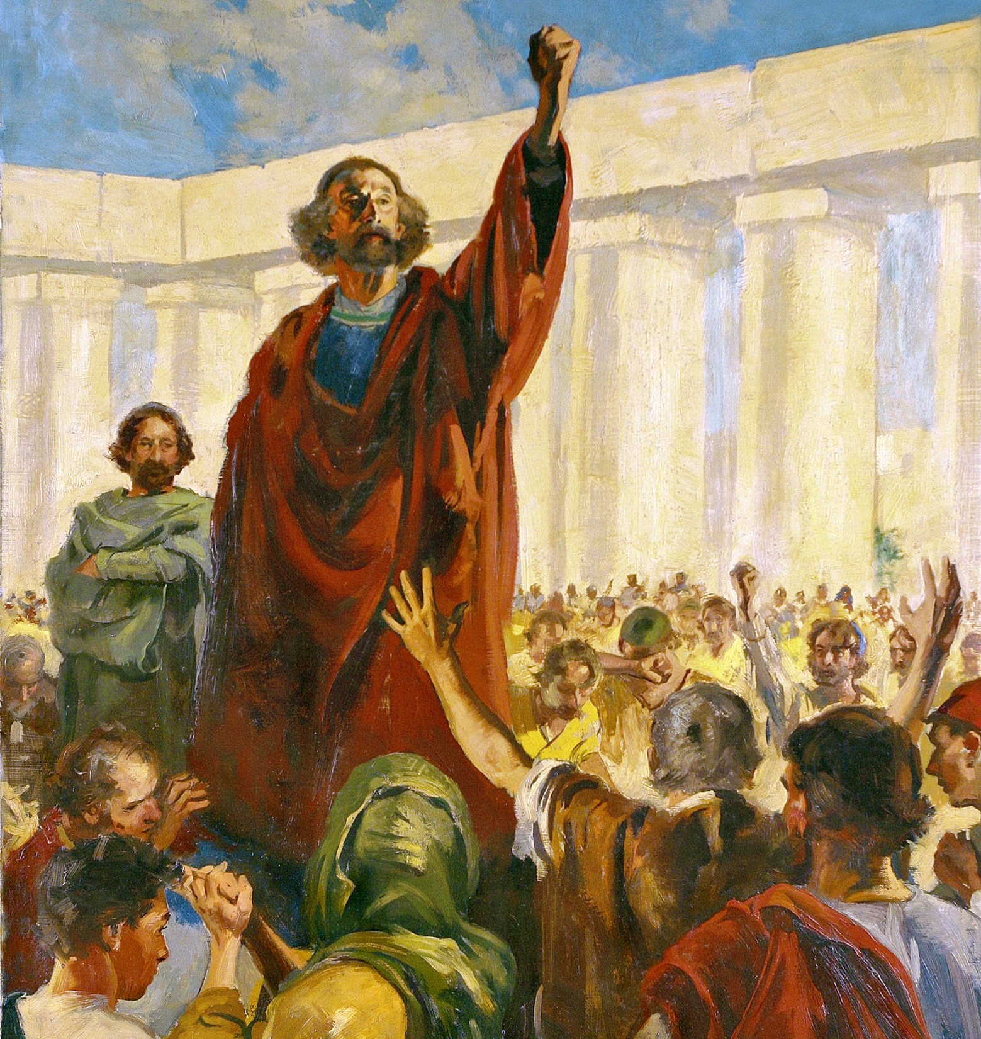
He who has been forgiven much loves much

Slide 56
7) Jesus redeems our failures
Failure shouldn’t mean the end of your course, it’s an important part of the course
If you’re not experiencing spiritual failure…
It’s only truly failure if you quit

Slide 57
So what should I do with my failures?
“What about now?”

