Slide 2
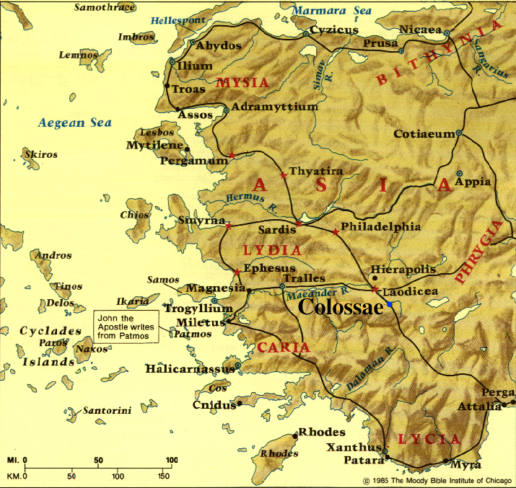

Slide 3
WHAT IS THIS MINISTRY?
WHO IS TO DO IT?
HOW IS IT DONE?
^{Colossians 1:28} We proclaim Him, admonishing every person and teaching every person with all wisdom, so that we may present every person complete in Christ. ²⁹ For this purpose also I labor, striving according to His power, which mightily works within me.

Slide 4
WHAT IS THIS MINISTRY?
^{Colossians 1:28} We proclaim Him, admonishing every person and teaching every person with all wisdom, so that we may present every person complete in Christ. ²⁹ For this purpose also I labor, striving according to His power, which mightily works within me.

Slide 5
Colossians 1:28,29 Disciple-making
WHAT IS THIS MINISTRY?
^{Matthew 28:19} “Go therefore and make disciples of all the nations, baptizing them in the name of the Father and the Son and the Holy Spirit, ²⁰ teaching them to observe all that I commanded you; and lo, I am with you always, even to the end of the age.”
^{Colossians 1:28} We proclaim Him, admonishing every person and teaching every person with all wisdom, so that we may present every person complete in Christ. ²⁹ For this purpose also I labor, striving according to His power, which mightily works within me.

Slide 6
Colossians 1:28,29 Disciple-making
WHAT IS THIS MINISTRY?
Intentionally helping individual Christians toward spiritual maturity
^{Colossians 1:28} We proclaim Him, admonishing every person and teaching every person with all wisdom, so that we may present every person complete in Christ. ²⁹ For this purpose also I labor, striving according to His power, which mightily works within me.

Slide 7
Colossians 1:28,29 Disciple-making
WHAT IS THIS MINISTRY?
Intentionally helping individual Christians toward spiritual maturity
^{Colossians 1:28} We proclaim Him, admonishing every person and teaching every person with all wisdom, so that we may present every person complete in Christ. ²⁹ For this purpose also I labor, striving according to His power, which mightily works within me.

Slide 8
Colossians 1:28,29 Disciple-making
WHAT IS THIS MINISTRY?
Intentionally helping individual Christians toward spiritual maturity
^{Colossians 1:28} We proclaim Him, admonishing every person and teaching every person with all wisdom, so that we may present every person complete in Christ. ²⁹ For this purpose also I labor, striving according to His power, which mightily works within me.

Slide 9
Colossians 1:28,29 Disciple-making
WHAT IS THIS MINISTRY?
Intentionally helping individual Christians toward spiritual maturity
^{Colossians 1:28} We proclaim Him, admonishing every person and teaching every person with all wisdom, so that we may present every person complete in Christ. ²⁹ For this purpose also I labor, striving according to His power, which mightily works within me.

Slide 10
Colossians 1:28,29 Disciple-making
WHO IS TO DO IT?
It is the privilege & responsibility of every Christian
^{Colossians 1:28} We proclaim Him, admonishing every person and teaching every person with all wisdom, so that we may present every person complete in Christ. ²⁹ For this purpose also I labor, striving according to His power, which mightily works within me.

Slide 11
Colossians 1:28,29 Disciple-making
WHO IS TO DO IT?
It is the privilege & responsibility of every Christian
^{Colossians 3:16} Let the word of Christ richly dwell within you, with all wisdom teaching and admonishing one another . . .
^{Colossians 1:28} We proclaim Him, admonishing every person and teaching every person with all wisdom, so that we may present every person complete in Christ. ²⁹ For this purpose also I labor, striving according to His power, which mightily works within me.

Slide 12
Colossians 1:28,29 Disciple-making
WHO IS TO DO IT?
It is the privilege & responsibility of every Christian
^{Colossians 3:16} Let the word of Christ richly dwell within you, with all wisdom teaching and admonishing one another . . .
^{Colossians 1:28} We proclaim Him, admonishing every person and teaching every person with all wisdom, so that we may present every person complete in Christ. ²⁹ For this purpose also I labor, striving according to His power, which mightily works within me.

Slide 13
Colossians 1:28,29 Disciple-making
WHO IS TO DO IT?
It is the privilege & responsibility of every Christian
^{Colossians 3:16} Let the word of Christ richly dwell within you, with all wisdom teaching and admonishing one another . . .
^{Colossians 1:28} We proclaim Him, admonishing every person and teaching every person with all wisdom, so that we may present every person complete in Christ. ²⁹ For this purpose also I labor, striving according to His power, which mightily works within me.

Slide 14
Colossians 1:28,29 Disciple-making
WHO IS TO DO IT?
It is the privilege & responsibility of every Christian
The alternative is churches that are perpetual day-care centers & superficial congregations

Slide 15
Colossians 1:28,29 Disciple-making
WHO IS TO DO IT?
With younger Christians &/or with peers
With those within your home church & with those outside of it
As your primary ministry &/or along with other ministries
Meeting together with one person &/or with a few people
High capacity or limited capacity

Slide 16
Colossians 1:28,29 Disciple-making
HOW IS IT DONE?
By regularly studying & applying biblical truth to each other’s lives
^{Colossians 1:28} We proclaim Him, admonishing every person and teaching every person with all wisdom, so that we may present every person complete in Christ. ²⁹ For this purpose also I labor, striving according to His power, which mightily works within me.

Slide 17
Colossians 1:28,29 Disciple-making
HOW IS IT DONE?
By regularly studying & applying biblical truth to each other’s lives
“Regular personal appointments will help us minister to personal needs and help point to ways of dealing with issues (we) face in life . . . (and) ensure that we are taught the basics of Christianity and begin to feel at home with the Bible.”
Ajith Fernando, The Call to Joy and Pain (Crossway, 2007), p. 163.
^{Colossians 1:28} We proclaim Him, admonishing every person and teaching every person with all wisdom, so that we may present every person complete in Christ. ²⁹ For this purpose also I labor, striving according to His power, which mightily works within me.

Slide 18
Colossians 1:28,29 Disciple-making
HOW IS IT DONE?
By investing consistent effort over a long period of time
^{Colossians 1:28} We proclaim Him, admonishing every person and teaching every person with all wisdom, so that we may present every person complete in Christ. ²⁹ For this purpose also I labor, striving according to His power, which mightily works within me.

Slide 19
Colossians 1:28,29 Disciple-making
HOW IS IT DONE?
By applying consistent effort over a long period of time
^{Colossians 4:12} Epaphras, who is one of your number . . . (is) always laboring earnestly for you in his prayers, that you may stand perfect and fully assured in all the will of God.
^{Colossians 1:28} We proclaim Him, admonishing every person and teaching every person with all wisdom, so that we may present every person complete in Christ. ²⁹ For this purpose also I labor, striving according to His power, which mightily works within me.

Slide 20
Colossians 1:28,29 Disciple-making
HOW IS IT DONE?
By depending on God’s Spirit for wisdom, stamina & patient love
^{Colossians 1:28} We proclaim Him, admonishing every person and teaching every person with all wisdom, so that we may present every person complete in Christ. ²⁹ For this purpose also I labor, striving according to His power, which mightily works within me.

Slide 21
Colossians 1:28,29 Disciple-making
Many of you are involved in this vital ministry . . .

Slide 22
Colossians 1:28,29 Disciple-making
Many of you are involved in this vital ministry . . .
. . . Some of you need to take a step to get involved in it

