Slide 1
John 9
The Blind See

Slide 2
Jesus in Jerusalem
Popping up to preach
Taking on the Pharisees
Melting back into the crowd

Slide 3
John 9:1–41
(NASB95) — 1 As He passed by, He saw a man blind from birth. 2 And His disciples asked Him, “Rabbi, who sinned, this man or his parents, that he would be born blind?”

Slide 4
A Bizarre Question
Is God punishing his parents?
Or did he sin in the womb?
Is there a third option?

Slide 5
Karma (https://www.britannica.com/topic/karma)
Karma, Sanskrit karman (“act”), Pali kamma, in Indian religion and philosophy, the universal causal law by which good or bad actions determine the future modes of an individual’s existence. Karma represents the ethical dimension of the process of rebirth (samsara), belief in which is generally shared among the religious traditions of India. Indian soteriologies (theories of salvation) posit that future births and life situations will be conditioned by actions performed during one’s present life

Slide 6
Karma (https://www.britannica.com/topic/karma)
—which itself has been conditioned by the accumulated effects of actions performed in previous lives. The doctrine of karma thus directs adherents of Indian religions toward their common goal: release (moksha) from the cycle of birth and death. Karma thus serves two main functions within Indian moral philosophy: it provides the major motivation to live a moral life, and it serves as the primary explanation of the existence of evil.

Slide 7
Karma
Treat others well
Or bad things will happen to you either in this life or the next
This really plays well to our sense of justice!
What goes around comes around!

Slide 8
The problem with Karma
If some one is…
Sick, disabled, deformed, poor, abused, unlucky
It is likely because they did something to deserve it
In a caste system
To help someone below you…
Could interfere with cosmic justice

Slide 9
Hinduism or Pharisaical Judaism
Rabbinical teaching 1st century AD
They didn’t believe in reincarnation
But they were very legalistic
Therefore
A man born blind
Either sinned in the womb
Or had sinful parents

Slide 10
Hinduism or Pharisaical Judaism
PLEASE tell me there is another option!
Rabbinical teaching 1st century AD
They didn’t believe in reincarnation
But they were very legalistic
Therefore
A man born blind
Either sinned in the womb
Or had sinful parents

Slide 11
Hinduism or Pharisaical Judaism
PLEASE tell me there is another option!
Ezek. 18:20 The soul who sins is the one who will die. The son will not share the guilt of the father, nor will the father share the guilt of the son. The righteousness of the righteous man will be credited to him, and the wickedness of the wicked will be charged against him.”
Rabbinical teaching 1st century AD
They didn’t believe in reincarnation
But they were very legalistic
Therefore
A man born blind
Either sinned in the womb
Or had sinful parents

Slide 12
John 9:1–41
3 Jesus answered, “It was neither that this man sinned, nor his parents; but it was so that the works of God might be displayed in him. 4 “We must work the works of Him who sent Me as long as it is day; night is coming when no one can work. 5 “While I am in the world, I am the Light of the world.”

Slide 13
A Third Option
At first glance
He was born blind so I can heal him
Not a super satisfactory answer
This is less an explanation of why
More an example of an attitude toward suffering in others

Slide 14
Attitude toward suffering in others
Karma- This person is getting what they deserve
Pharisaical Judaism- Reaping judgement for sin
Jesus- The suffering of others is an opportunity to serve

Slide 15
God’s perspective on suffering

Slide 16
Attitude toward suffering in others
Matthew 25:34–36 (NASB95) — 34 “Then the King will say to those on His right, ‘Come, you who are blessed of My Father, inherit the kingdom prepared for you from the foundation of the world. 35 ‘For I was hungry, and you gave Me something to eat; I was thirsty, and you gave Me something to drink; I was a stranger, and you invited Me in; 36 naked, and you clothed Me; I was sick, and you visited Me; I was in prison, and you came to Me.’ …40 …‘Truly I say to you, to the extent that you did it to one of these brothers of Mine, even the least of them, you did it to Me.’
Karma- This person is getting what they deserve
Legalistic Judaism- Reaping judgement for sin
Jesus- The suffering of others is an opportunity to serve

Slide 17
God’s perspective on suffering
Psalm 68:5–6 (NASB95) — 5 A father of the fatherless and a judge for the widows, Is God in His holy habitation. 6 God makes a home for the lonely; He leads out the prisoners into prosperity, Only the rebellious dwell in a parched land.
Proverbs 14:31 (NASB95) — 31 He who oppresses the poor taunts his Maker, But he who is gracious to the needy honors Him.

Slide 18
God’s perspective on suffering
Leviticus 19:14 (NASB95) — 14 ‘You shall not curse a deaf man, nor place a stumbling block before the blind, but you shall revere your God; I am the Lord.
Psalm 68:5–6 (NASB95) — 5 A father of the fatherless and a judge for the widows, Is God in His holy habitation. 6 God makes a home for the lonely; He leads out the prisoners into prosperity, Only the rebellious dwell in a parched land.
Proverbs 14:31 (NASB95) — 31 He who oppresses the poor taunts his Maker, But he who is gracious to the needy honors Him.

Slide 19
John 9:5–7 (NASB95)
5 “While I am in the world, I am the Light of the world.” 6 When He had said this, He spat on the ground, and made clay of the spittle, and applied the clay to his eyes, 7 and said to him, “Go, wash in the pool of Siloam” (which is translated, Sent). So he went away and washed, and came back seeing.

Slide 20
More evidence for who Christ is
Moving toward suffering with compassion
Doing something ONLY God could
Fulfilling messianic prophecy

Slide 21
More evidence for who Chris is
Isaiah 35:3–6 (NASB95) — 3 Encourage the exhausted, and strengthen the feeble. 4 Say to those with anxious heart, “Take courage, fear not. Behold, your God will come with vengeance; The recompense of God will come, But He will save you.” 5 Then the eyes of the blind will be opened And the ears of the deaf will be unstopped. 6 Then the lame will leap like a deer, And the tongue of the mute will shout for joy. For waters will break forth in the wilderness And streams in the Arabah.
Moving toward suffering with compassion
Doing something ONLY God could
Fulfilling messianic prophecy

Slide 22
John 9:8–12 (NASB95)
8 Therefore the neighbors, and those who previously saw him as a beggar, were saying, “Is not this the one who used to sit and beg?” 9 Others were saying, “This is he,” still others were saying, “No, but he is like him.” He kept saying, “I am the one.” 10 So they were saying to him, “How then were your eyes opened?” 11 He answered, “The man who is called Jesus made clay, and anointed my eyes, and said to me, ‘Go to Siloam and wash’; so I went away and washed, and I received sight.” 12 They said to him, “Where is He?” He said, “I do not know.”

Slide 23
John 9:13–34 (NASB95)
13 They brought to the Pharisees the man who was formerly blind. 14 Now it was a Sabbath on the day when Jesus made the clay and opened his eyes. 15 Then the Pharisees also were asking him again how he received his sight. And he said to them, “He applied clay to my eyes, and I washed, and I see.” 16 Therefore some of the Pharisees were saying, “This man is not from God, because He does not keep the Sabbath.” But others were saying

Slide 24
John 9:13–34 (NASB95)
, “How can a man who is a sinner perform such signs?” And there was a division among them. 17 So they said to the blind man again, “What do you say about Him, since He opened your eyes?” And he said, “He is a prophet.” 18 The Jews then did not believe it of him, that he had been blind and had received sight, until they called the parents of the very one who had received his sight,

Slide 25
John 9:13–34 (NASB95)
19 and questioned them, saying, “Is this your son, who you say was born blind? Then how does he now see?” 20 His parents answered them and said, “We know that this is our son, and that he was born blind; 21 but how he now sees, we do not know; or who opened his eyes, we do not know. Ask him; he is of age, he will speak for himself.” 22 His parents said this because they were afraid of the Jews; for the Jews had already agreed that if anyone confessed Him to be Christ, he was to be put out of the synagogue.

Slide 26
John 9:13–34 (NASB95)
23 For this reason his parents said, “He is of age; ask him.”

Slide 27
The Players
The man
Only knows what he has experienced
But he is sticking to his guns
The parents
Ready to throw their son under the bus
The Pharisees
No rejoicing in the miracle or for the man
Only concerned with evidence that will confirm their presuppositions

Slide 28
John 9:13–34 (NASB95)
24 So a second time they called the man who had been blind, and said to him, “Give glory to God; we know that this man is a sinner.” 25 He then answered, “Whether He is a sinner, I do not know; one thing I do know, that though I was blind, now I see.” 26 So they said to him, “What did He do to you? How did He open your eyes?”

Slide 29
John 9:13–34 (NASB95)
27 He answered them, “I told you already and you did not listen; why do you want to hear it again? You do not want to become His disciples too, do you?” 28 They reviled him and said, “You are His disciple, but we are disciples of Moses. 29 “We know that God has spoken to Moses, but as for this man, we do not know where He is from.”

Slide 30
John 9:13–34 (NASB95)
30 The man answered and said to them, “Well, here is an amazing thing, that you do not know where He is from, and yet He opened my eyes.

Slide 31
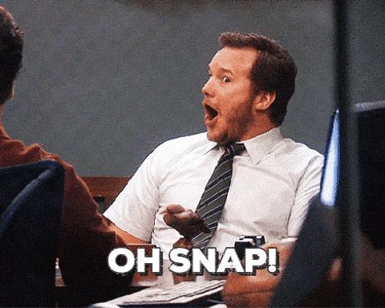
John 9:13–34 (NASB95)
30 The man answered and said to them, “Well, here is an amazing thing, that you do not know where He is from, and yet He opened my eyes.

Slide 32
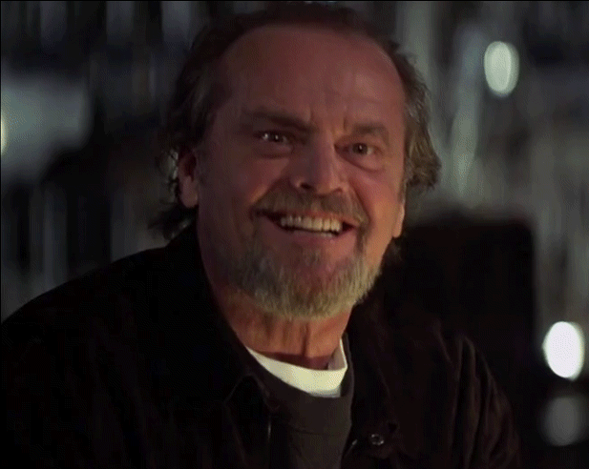
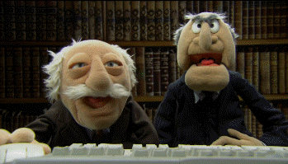
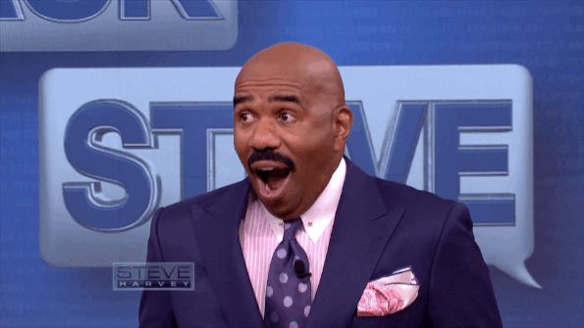
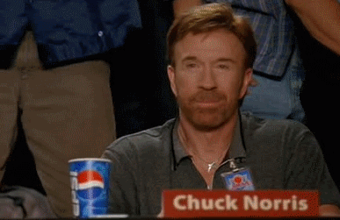
John 9:13–34 (NASB95)
.” 30 The man answered and said to them, “Well, here is an amazing thing, that you do not know where He is from, and yet He opened my eyes.

Slide 33
John 9:31–34 (NASB95)
31 “We know that God does not hear sinners; but if anyone is God-fearing and does His will, He hears him. 32 “Since the beginning of time it has never been heard that anyone opened the eyes of a person born blind. 33 “If this man were not from God, He could do nothing.” 34 They answered him, “You were born entirely in sins, and are you teaching us?” So they put him out.

Slide 34
The Man born blind
Put out of the synagogue
For being healed
For being honest
For being awesome

Slide 35
John 9:35–41 (NASB95)
35 Jesus heard that they had put him out, and finding him, He said, “Do you believe in the Son of Man?” 36 He answered, “Who is He, Lord, that I may believe in Him?” 37 Jesus said to him, “You have both seen Him, and He is the one who is talking with you.” 38 And he said, “Lord, I believe.” And he worshiped Him. 39 And Jesus said, “For judgment I came into this world, so that those who do not see may see,

Slide 36
John 9:35–41 (NASB95)
and that those who see may become blind.” 40 Those of the Pharisees who were with Him heard these things and said to Him, “We are not blind too, are we?” 41 Jesus said to them, “If you were blind, you would have no sin; but since you say, ‘We see,’ your sin remains.

Slide 37
The root of the Pharisee problem
“If you were blind, you would have no sin; but since you say, ‘We see,’ your sin remains.
They won’t admit they have something to learn

Slide 38
The take away
We all have blind spots
Things that others see that we don’t see in ourselves
Psalm 139:23–24 (NASB95) — 23 Search me, O God, and know my heart; Try me and know my anxious thoughts; 24 And see if there be any hurtful way in me, And lead me in the everlasting way.

Slide 39
The take away
We all have blind spots
Things that others see that we don’t see in ourselves
Our blind spots can keep us from Christ
They can keep us from spiritual growth

Slide 40
The take away
We all have blind spots
Things that others see that we don’t see in ourselves
Our blind spots can keep us from Christ
They can keep us from spiritual growth
Hebrews 3:15 (NASB95) — 15 while it is said, “Today if you hear His voice, Do not harden your hearts, as when they provoked Me.”

Slide 41
The take away
Psalm 95:6–7 (NASB95) — 6 Come, let us worship and bow down, Let us kneel before the Lord our Maker. 7 For He is our God, And we are the people of His pasture and the sheep of His hand. Today, if you would hear His voice,
We all have blind spots
Things that others see that we don’t see in ourselves
Our blind spots can keep us from Christ
They can keep us from spiritual growth

Slide 42
The take away
At times we may need to stand against human authority
God is our leader (Col 1:18)
The word is our guide (Ps 119:105)
God works through human leadership (Heb 13:17)
But they have blind spots too

