Slide 1
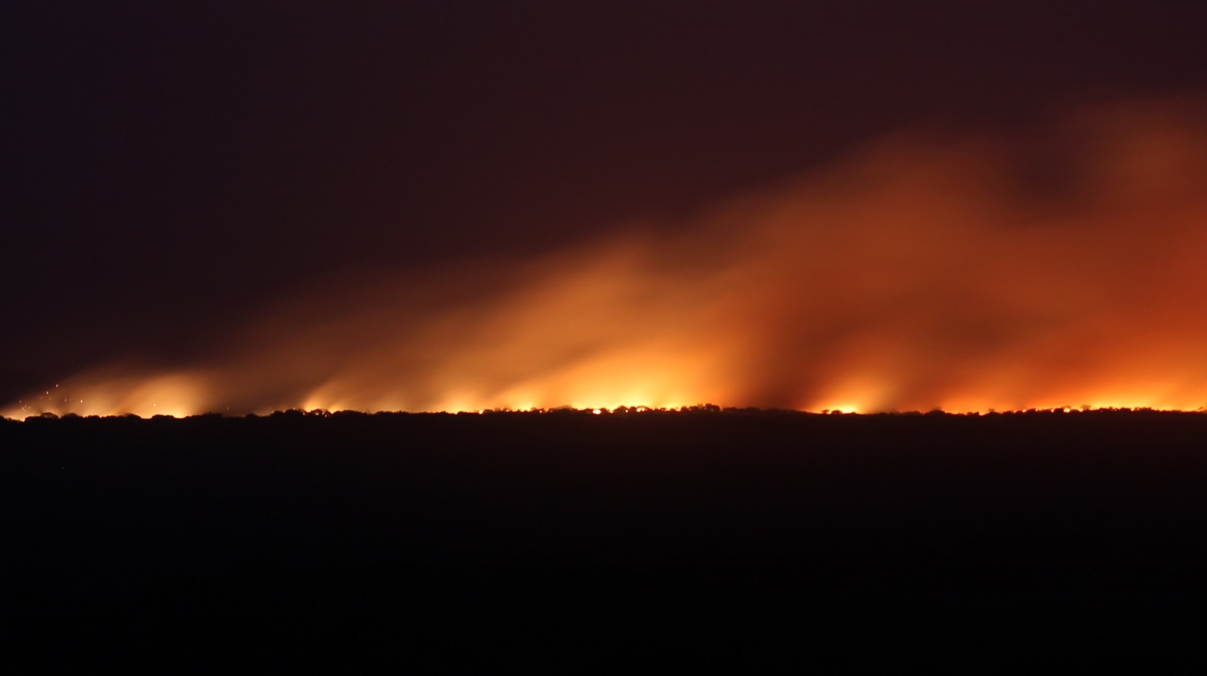
1 Peter 3:8-16
Context: responding to slander
^{2:12} Keep your behavior excellent among the Gentiles, so that in the thing in which they slander you as evildoers, they may because of your good deeds, as they observe them, glorify God on the day of visitation.

Slide 2
1 Peter 3:8-16
Context: responding to slander
^{3:8} To sum up, all of you be harmonious, sympathetic, loving, compassionate, and humble; ⁹ not returning evil for evil or insult for insult, but giving a blessing instead; for you were called for the very purpose that you would inherit a blessing.

Slide 3
1 Peter 3:8-16
Context: responding to slander
^{3:10} For, “The one who desires life, to love and see good days, Must keep his tongue from evil and his lips from speaking deceit. ¹¹ He must turn away from evil and do good; He must seek peace and pursue it.

Slide 4
1 Peter 3:8-16
Context: responding to slander
^{3:12} For the eyes of the Lord are toward the righteous, And His ears attend to their prayer, But the face of the Lord is against evildoers.”

Slide 5
1 Peter 3:8-16
Context: responding to slander
^{3:13} And who is there to harm you if you prove zealous for what is good? ¹⁴ But even if you should suffer for the sake of righteousness, you are blessed. And do not fear their intimidation, and do not be in dread,

Slide 6
1 Peter 3:8-16
Context: responding to slander
^{3:15} but sanctify Christ as Lord in your hearts, always being ready to make a defense to everyone who asks you to give an account for the hope that is in you, but with gentleness and respect; ¹⁶ and keep a good conscience so that in the thing in which you are slandered, those who disparage your good behavior in Christ will be put to shame.

Slide 7
1 Peter 3:8-16
Context: responding to slander
^{3:15} but sanctify Christ as Lord in your hearts, always being ready to make a defense to everyone who asks you to give an account for the hope that is in you, but with gentleness and respect; ¹⁶ and keep a good conscience so that in the thing in which you are slandered, those who disparage your good behavior in Christ will be put to shame.

Slide 8
Live a life that demands an explanation
^{3:15} but sanctify Christ as Lord in your hearts, always being ready to make a defense to everyone who asks you to give an account for the hope that is in you, but with gentleness and respect; ¹⁶ and keep a good conscience so that in the thing in which you are slandered, those who disparage your good behavior in Christ will be put to shame.

Slide 9
Live a life that demands an explanation
…and have that explanation ready
^{3:15} but sanctify Christ as Lord in your hearts, always being ready to make a defense to everyone who asks you to give an account for the hope that is in you, but with gentleness and respect; ¹⁶ and keep a good conscience so that in the thing in which you are slandered, those who disparage your good behavior in Christ will be put to shame.

Slide 10
What characterizes the Christian life that
“demands an explanation?”
^{3:15} but sanctify Christ as Lord in your hearts, always being ready to make a defense to everyone who asks you to give an account for the hope that is in you, but with gentleness and respect; ¹⁶ and keep a good conscience so that in the thing in which you are slandered, those who disparage your good behavior in Christ will be put to shame.

Slide 11
What characterizes the Christian life that
“demands an explanation?”
Harmony
^{John 13:35} By this all people will know that you are My disciples: if you have love for one another.”
ὁμόφρων, homophrōn: “one mind or one heart”
^{3:8} To sum up, all of you be harmonious, sympathetic, loving, compassionate, and humble; ⁹ not returning evil for evil or insult for insult, but giving a blessing instead; for you were called for the very purpose that you would inherit a blessing.

Slide 12
What characterizes the Christian life that
“demands an explanation?”
Harmony
Sympathy
συμπαθής, sympathēs: “suffering alongside,” “feeling the like with another”
^{3:8} To sum up, all of you be harmonious, sympathetic, loving, compassionate, and humble; ⁹ not returning evil for evil or insult for insult, but giving a blessing instead; for you were called for the very purpose that you would inherit a blessing.

Slide 13
What characterizes the Christian life that
“demands an explanation?”
Harmony
Sympathy
Brotherly Love
Φιλάδελφος philadelphos: “brotherly love”
^{3:8} To sum up, all of you be harmonious, sympathetic, loving, compassionate, and humble; ⁹ not returning evil for evil or insult for insult, but giving a blessing instead; for you were called for the very purpose that you would inherit a blessing.

Slide 14
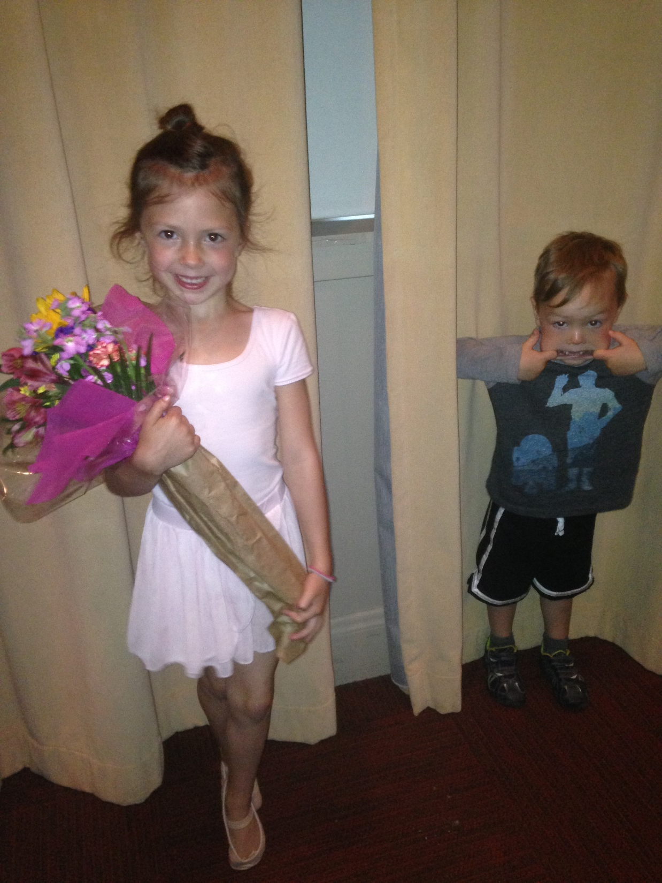

Slide 15
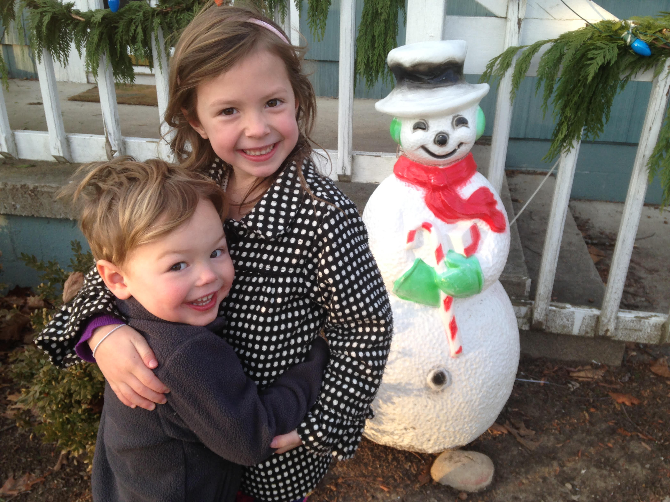

Slide 16
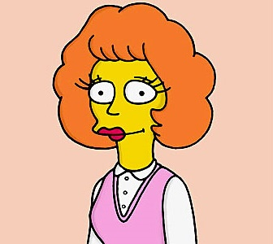
What characterizes the Christian life that
“demands an explanation?”
Harmony
Sympathy
Brotherly Love
Compassion
Εὔσπλαγχνος eusplagchnos: “kind hearted,” “tender hearted”
^{3:8} To sum up, all of you be harmonious, sympathetic, loving, compassionate, and humble; ⁹ not returning evil for evil or insult for insult, but giving a blessing instead; for you were called for the very purpose that you would inherit a blessing.

Slide 17
What characterizes the Christian life that
“demands an explanation?”
Harmony
Sympathy
Brotherly Love
Compassion
Humble-minded
Ταπεινοφροσύνη tapeinophrosynē: “humble-minded”
^{3:8} To sum up, all of you be harmonious, sympathetic, loving, compassionate, and humble; ⁹ not returning evil for evil or insult for insult, but giving a blessing instead; for you were called for the very purpose that you would inherit a blessing.

Slide 18
What characterizes the Christian life that
“demands an explanation?”
Harmony
Sympathy
Brotherly Love
Compassion
Humble-minded
Love for Enemies
expectation-shattering grace
Takes humility!
^{3:8} To sum up, all of you be harmonious, sympathetic, loving, compassionate, and humble; ⁹ not returning evil for evil or insult for insult, but giving a blessing instead; for you were called for the very purpose that you would inherit a blessing.

Slide 19
What characterizes the Christian life that
“demands an explanation?”
Harmony
Sympathy
Brotherly Love
Compassion
Humble-minded
Love for Enemies
Trusting God to Reward
^{3:8} To sum up, all of you be harmonious, sympathetic, loving, compassionate, and humble; ⁹ not returning evil for evil or insult for insult, but giving a blessing instead; for you were called for the very purpose that you would inherit a blessing.

Slide 20
What characterizes the Christian life that
“demands an explanation?”
Harmony
Sympathy
Brotherly Love
Compassion
Humble-minded
Love for Enemies
Trusting God to Reward
^{3:10} For, “The one who desires life, to love and see good days, Must keep his tongue from evil and his lips from speaking deceit. ¹¹ He must turn away from evil and do good; He must seek peace and pursue it. ^{3:12} For the eyes of the Lord are toward the righteous, And His ears attend to their prayer, But the face of the Lord is against evildoers.”

Slide 21
What characterizes the Christian life that
“demands an explanation?”
Harmony
Sympathy
Brotherly Love
Compassion
Humble-minded
Love for Enemies
Trusting God to Reward
Psalm 34:12-16
^{3:10} For, “The one who desires life, to love and see good days, Must keep his tongue from evil and his lips from speaking deceit. ¹¹ He must turn away from evil and do good; He must seek peace and pursue it. ^{3:12} For the eyes of the Lord are toward the righteous, And His ears attend to their prayer, But the face of the Lord is against evildoers.”

Slide 22
What characterizes the Christian life that
“demands an explanation?”
Harmony
Sympathy
Brotherly Love
Compassion
Humble-minded
Love for Enemies
Trusting God to Reward
^{3:10} For, “The one who desires life, to love and see good days, Must keep his tongue from evil and his lips from speaking deceit. ¹¹ He must turn away from evil and do good; He must seek peace and pursue it. ^{3:12} For the eyes of the Lord are toward the righteous, And His ears attend to their prayer, But the face of the Lord is against evildoers.”

Slide 23
What characterizes the Christian life that
“demands an explanation?”
Harmony
Sympathy
Brotherly Love
Compassion
Humble-minded
Love for Enemies
Trusting God to Reward
^{3:10} For, “The one who desires life, to love and see good days, Must keep his tongue from evil and his lips from speaking deceit. ¹¹ He must turn away from evil and do good; He must seek peace and pursue it. ^{3:12} For the eyes of the Lord are toward the righteous, And His ears attend to their prayer, But the face of the Lord is against evildoers.”

Slide 24
What characterizes the Christian life that
“demands an explanation?”
Harmony
Sympathy
Brotherly Love
Compassion
Humble-minded
Love for Enemies
Trusting God to Reward
^{3:10} For, “The one who desires life, to love and see good days, Must keep his tongue from evil and his lips from speaking deceit. ¹¹ He must turn away from evil and do good; He must seek peace and pursue it. ^{3:12} For the eyes of the Lord are toward the righteous, And His ears attend to their prayer, But the face of the Lord is against evildoers.”

Slide 25
What characterizes the Christian life that
“demands an explanation?”
Harmony
Sympathy
Brotherly Love
Compassion
Humble-minded
Love for Enemies
Trusting God to Reward
^{3:10} For, “The one who desires life, to love and see good days, Must keep his tongue from evil and his lips from speaking deceit. ¹¹ He must turn away from evil and do good; He must seek peace and pursue it. ^{3:12} For the eyes of the Lord are toward the righteous, And His ears attend to their prayer, But the face of the Lord is against evildoers.”

Slide 26
What characterizes the Christian life that
“demands an explanation?”
Harmony
Sympathy
Brotherly Love
Compassion
Humble-minded
Love for Enemies
Trusting God to Reward
^{Psalm 32:8} I will instruct you and teach you in the way which you should go; I will counsel you with my eye upon you.”
^{3:10} For, “The one who desires life, to love and see good days, Must keep his tongue from evil and his lips from speaking deceit. ¹¹ He must turn away from evil and do good; He must seek peace and pursue it. ^{3:12} For the eyes of the Lord are toward the righteous, And His ears attend to their prayer, But the face of the Lord is against evildoers.”

Slide 27
What characterizes the Christian life that
“demands an explanation?”
Harmony
Sympathy
Brotherly Love
Compassion
Humble-minded
Love for Enemies
Trusting God to Reward
^{Psalm 31:1} In you, O Lord, I have taken refuge; let me never be ashamed; in your righteousness deliver me. ² incline your ear to me, rescue me quickly; Be to me a rock of strength, a stronghold to save me.
^{3:10} For, “The one who desires life, to love and see good days, Must keep his tongue from evil and his lips from speaking deceit. ¹¹ He must turn away from evil and do good; He must seek peace and pursue it. ^{3:12} For the eyes of the Lord are toward the righteous, And His ears attend to their prayer, But the face of the Lord is against evildoers.”

Slide 29
What characterizes the Christian life that
“demands an explanation?”
Harmony
Sympathy
Brotherly Love
Compassion
Humble-minded
Love for Enemies
Trusting God to Reward
^{3:10} For, “The one who desires life, to love and see good days, Must keep his tongue from evil and his lips from speaking deceit. ¹¹ He must turn away from evil and do good; He must seek peace and pursue it. ^{3:12} For the eyes of the Lord are toward the righteous, And His ears attend to their prayer, But the face of the Lord is against evildoers.”

Slide 30
What characterizes the Christian life that
“demands an explanation?”
Harmony
Sympathy
Brotherly Love
Compassion
Humble-minded
Love for Enemies
Trusting God to Reward
Humble Confidence
^{3:10} For, “The one who desires life, to love and see good days, Must keep his tongue from evil and his lips from speaking deceit. ¹¹ He must turn away from evil and do good; He must seek peace and pursue it. ^{3:12} For the eyes of the Lord are toward the righteous, And His ears attend to their prayer, But the face of the Lord is against evildoers.”

Slide 31
What characterizes the Christian life that
“demands an explanation?”
Harmony
Sympathy
Brotherly Love
Compassion
Humble-minded
Love for Enemies
Trusting God to Reward
Humble Confidence
^{3:13} And who is there to harm you if you prove zealous for what is good? ¹⁴ But even if you should suffer for the sake of righteousness, you are blessed. And do not fear their intimidation, and do not be in dread,

Slide 32
What characterizes the Christian life that
“demands an explanation?”
Harmony
Sympathy
Brotherly Love
Compassion
Humble-minded
Love for Enemies
Trusting God to Reward
Humble Confidence
^{3:13} And who is there to harm you if you prove zealous for what is good? ¹⁴ But even if you should suffer for the sake of righteousness, you are blessed. And do not fear their intimidation, and do not be in dread,

Slide 33
What characterizes the Christian life that
“demands an explanation?”
Harmony
Sympathy
Brotherly Love
Compassion
Humble-minded
Love for Enemies
Trusting God to Reward
Humble Confidence
Isaiah 8:12
^{3:13} And who is there to harm you if you prove zealous for what is good? ¹⁴ But even if you should suffer for the sake of righteousness, you are blessed. And do not fear their intimidation, and do not be in dread,

Slide 34
What characterizes the Christian life that
“demands an explanation?”
Harmony
Sympathy
Brotherly Love
Compassion
Humble-minded
Love for Enemies
Trusting God to Reward
Humble Confidence
Fearless and Bold
^{3:13} And who is there to harm you if you prove zealous for what is good? ¹⁴ But even if you should suffer for the sake of righteousness, you are blessed. And do not fear their intimidation, and do not be in dread,

Slide 35
What characterizes the Christian life that
“demands an explanation?”
Harmony
Sympathy
Brotherly Love
Compassion
Humble-minded
Love for Enemies
Trusting God to Reward
Humble Confidence
Fearless and Bold
^{1 Pet 3:15} but sanctify Christ as Lord in your hearts, always being ready to make a defense to everyone who asks you to give an account for the hope that is in you, but with gentleness and respect

Slide 36
What characterizes the Christian life that
“demands an explanation?”
Harmony
Sympathy
Brotherly Love
Compassion
Humble-minded
Love for Enemies
Trusting God to Reward
Humble Confidence
Fearless and Bold
“Audience of One”
What a picture!
^{1 Pet 3:15} but sanctify Christ as Lord in your hearts, always being ready to make a defense to everyone who asks you to give an account for the hope that is in you, but with gentleness and respect

Slide 37
What characterizes the Christian life that
“demands an explanation?”
Harmony
Sympathy
Brotherly Love
Compassion
Humble-minded
Love for Enemies
Trusting God to Reward
Humble Confidence
Fearless and Bold
“Audience of One”
What a picture!
^{1 Pet 3:15} but sanctify Christ as Lord in your hearts, always being ready to make a defense to everyone who asks you to give an account for the hope that is in you, but with gentleness and respect

Slide 38
Live a life that demands an explanation
…and have that explanation ready
^{1 Pet 3:15} but sanctify Christ as Lord in your hearts, always being ready to make a defense to everyone who asks you to give an account for the hope that is in you, but with gentleness and respect

Slide 39
Live a life that demands an explanation
…and have that explanation ready
He summarizes this way of life as having “hope”
which creates cognitive dissonance
^{1 Pet 3:15} but sanctify Christ as Lord in your hearts, always being ready to make a defense to everyone who asks you to give an account for the hope that is in you, but with gentleness and respect

Slide 40
Live a life that demands an explanation
…and have that explanation ready
A ready mindset
^{1 Pet 3:15} but sanctify Christ as Lord in your hearts, always being ready to make a defense to everyone who asks you to give an account for the hope that is in you, but with gentleness and respect

Slide 41
Live a life that demands an explanation
…and have that explanation ready
Knowing how to explain the “gospel”
^{1 Pet 3:15} but sanctify Christ as Lord in your hearts, always being ready to make a defense to everyone who asks you to give an account for the hope that is in you, but with gentleness and respect

Slide 42
Live a life that demands an explanation
…and have that explanation ready
Knowing how to explain the “gospel”
^{1 Pet 3:15} but sanctify Christ as Lord in your hearts, always being ready to make a defense to everyone who asks you to give an account for the hope that is in you, but with gentleness and respect

Slide 43
Live a life that demands an explanation
…and have that explanation ready
Ready to give your “testimony”
^{1 Pet 3:15} but sanctify Christ as Lord in your hearts, always being ready to make a defense to everyone who asks you to give an account for the hope that is in you, but with gentleness and respect

Slide 44
Live a life that demands an explanation
…and have that explanation ready
ἀπολογία, Apologia: "speaking in defense,”
a formal defense of an opinion, position or action
^{1 Pet 3:15} but sanctify Christ as Lord in your hearts, always being ready to make a defense to everyone who asks you to give an account for the hope that is in you, but with gentleness and respect

Slide 45
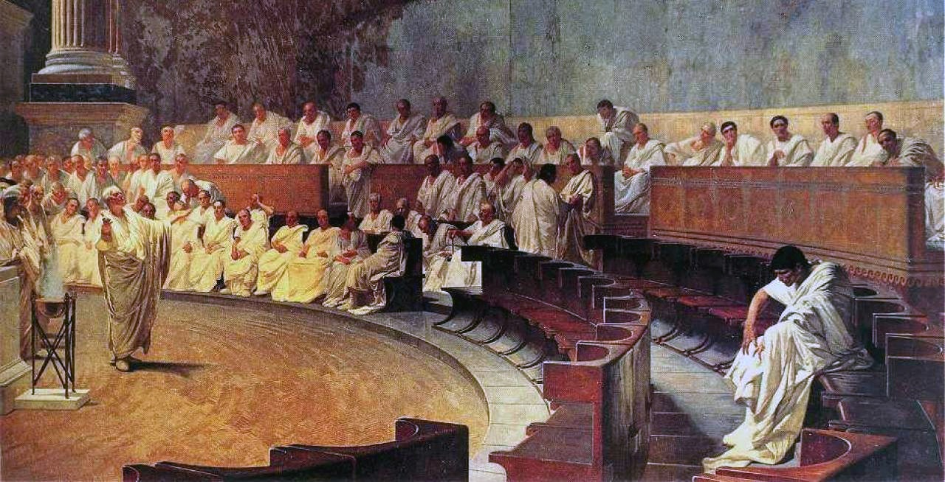
Able to communicate well-reasoned lines of evidence
A reason-based faith
ἀπολογία, Apologia: "speaking in defense,”
a formal defense of an opinion, position or action
^{1 Pet 3:15} but sanctify Christ as Lord in your hearts, always being ready to make a defense to everyone who asks you to give an account for the hope that is in you, but with gentleness and respect

Slide 46
Able to communicate well-reasoned lines of evidence
Evidence form the world around us
Cosmological
Biological
God has given us many lines of evidence!
^{1 Pet 3:15} but sanctify Christ as Lord in your hearts, always being ready to make a defense to everyone who asks you to give an account for the hope that is in you, but with gentleness and respect

Slide 47
Able to communicate well-reasoned lines of evidence
Evidence from humanity
Freewill, consciousness, personhood
The moral argument
God has given us many lines of evidence!
^{1 Pet 3:15} but sanctify Christ as Lord in your hearts, always being ready to make a defense to everyone who asks you to give an account for the hope that is in you, but with gentleness and respect

Slide 48
Able to communicate well-reasoned lines of evidence
Biblical Evidence
Predictive Prophecy
Historical evidence for the resurrection
God has given us many lines of evidence!
^{1 Pet 3:15} but sanctify Christ as Lord in your hearts, always being ready to make a defense to everyone who asks you to give an account for the hope that is in you, but with gentleness and respect

Slide 49
Able to communicate well-reasoned lines of evidence
All converging on one singular explanation
God has given us many lines of evidence!
^{1 Pet 3:15} but sanctify Christ as Lord in your hearts, always being ready to make a defense to everyone who asks you to give an account for the hope that is in you, but with gentleness and respect

Slide 50
Able to communicate well-reasoned lines of evidence
Challenge: take the next step to grow in your ability to “make an apologia”
“apologetics just isn’t my thing”
“Let the people who are gifted in that area know that stuff”
^{1 Pet 3:15} but sanctify Christ as Lord in your hearts, always being ready to make a defense to everyone who asks you to give an account for the hope that is in you, but with gentleness and respect

Slide 51
Able to communicate well-reasoned lines of evidence
“Gentleness and reverence” are keys to making interactions about faith positive experiences
Be a good listener
Be genuinely curious
^{1 Pet 3:15} but sanctify Christ as Lord in your hearts, always being ready to make a defense to everyone who asks you to give an account for the hope that is in you, but with gentleness and respect

Slide 52
Able to communicate well-reasoned lines of evidence
“Gentleness and reverence” are keys to making interactions about faith positive experiences
Try to understand the other person’s “worldview”
Ask good questions
^{1 Pet 3:15} but sanctify Christ as Lord in your hearts, always being ready to make a defense to everyone who asks you to give an account for the hope that is in you, but with gentleness and respect

Slide 53
Able to communicate well-reasoned lines of evidence
“Gentleness and reverence” are keys to making interactions about faith positive experiences
Help them evaluate their own worldview
^{1 Pet 3:15} but sanctify Christ as Lord in your hearts, always being ready to make a defense to everyone who asks you to give an account for the hope that is in you, but with gentleness and respect

Slide 54
Able to communicate well-reasoned lines of evidence
“Gentleness and reverence” are keys to making interactions about faith positive experiences
Don’t overstate your case
Don’t be pushy or condescending
Don’t be defensive
^{1 Pet 3:15} but sanctify Christ as Lord in your hearts, always being ready to make a defense to everyone who asks you to give an account for the hope that is in you, but with gentleness and respect

Slide 55
Able to communicate well-reasoned lines of evidence
“Gentleness and reverence” are keys to making interactions about faith positive experiences
Be patient
^{1 Pet 3:15} but sanctify Christ as Lord in your hearts, always being ready to make a defense to everyone who asks you to give an account for the hope that is in you, but with gentleness and respect

Slide 56
Live a life that demands an explanation
…and have that explanation ready
^{1 Pet 3:15} but sanctify Christ as Lord in your hearts, always being ready to make a defense to everyone who asks you to give an account for the hope that is in you, but with gentleness and respect

