Slide 1
The Devotional Life
“I’m not excited about this topic because, for me, devotional life is an area of….”

Slide 2
The Devotional Life
“I’m not excited about this topic because, for me, devotional life is an area of….”
Obligation?

Slide 3
The Devotional Life
“I’m not excited about this topic because, for me, devotional life is an area of….”
Insecurity? Intimidation?

Slide 4
The Devotional Life
“I’m not excited about this topic because, for me, devotional life is an area of….”
Guilt / Shame?

Slide 5
The Devotional Life
“I’m not excited about this topic because, for me, devotional life is an area of….”
Cynicism?

Slide 6
The Devotional Life
“I’m not excited about this topic because, for me, devotional life is an area of….”
Discouragement?

Slide 7
The Devotional Life
I think there is a lot of giving-up in this area
…which is a huge win for Satan
“Whenever they are attending to the Enemy himself, we are defeated, but there are ways of preventing them from doing so …”
- C.S. Lewis Screwtape Letters

Slide 8
The Devotional Life
All of us can have a great devotional life
A Provision
A Privilege
^{Rom 5:1} … Jesus Christ, ² through whom also we have obtained our introduction by faith into this grace in which we stand …

Slide 9
The Devotional Life
All of us can have a great devotional life
A Provision
A Privilege
A Foretaste of Heaven
An Invitation
An Opportunity

Slide 10
The Devotional Life
^{John 15:4} Abide in Me, and I in you. As the branch cannot bear fruit of itself unless it abides in the vine, so neither can you unless you abide in Me. ⁵ I am the vine, you are the branches; he who abides in Me and I in him, he bears much fruit, for apart from Me you can do nothing.
^{John 15:4} Abide in Me, and I in you. As the branch cannot bear fruit of itself unless it abides in the vine, so neither can you unless you abide in Me. ⁵ I am the vine, you are the branches; he who abides in Me and I in him, he bears much fruit, for apart from Me you can do nothing.
^{John 15:4} Abide in Me, and I in you. As the branch cannot bear fruit of itself unless it abides in the vine, so neither can you unless you abide in Me. ⁵ I am the vine, you are the branches; he who abides in Me and I in him, he bears much fruit, for apart from Me you can do nothing.
What would be unnatural would be for the branch not to relate with the vine!

Slide 11
The Devotional Life
^{Matt6:5} “When you pray, you are not to be like the hypocrites; for they love to stand and pray in the synagogues and on the street corners so that they may be seen by men. Truly I say to you, they have their reward in full. ⁶ But you, when you pray, go into your inner room, close your door and pray to your Father who is in secret, and your Father who sees what is done in secret will reward you. ⁷ “And when you are praying, do not use meaningless repetition as the Gentiles do, for they suppose that they will be heard for their many words. ⁸ So do not be like them; for your Father knows what you need before you ask Him.
^{Matt6:5} “When you pray, you are not to be like the hypocrites; for they love to stand and pray in the synagogues and on the street corners so that they may be seen by men. Truly I say to you, they have their reward in full. ⁶ But you, when you pray, go into your inner room, close your door and pray to your Father who is in secret, and your Father who sees what is done in secret will reward you. ⁷ “And when you are praying, do not use meaningless repetition as the Gentiles do, for they suppose that they will be heard for their many words. ⁸ So do not be like them; for your Father knows what you need before you ask Him.
^{Matt6:5} “When you pray, you are not to be like the hypocrites; for they love to stand and pray in the synagogues and on the street corners so that they may be seen by men. Truly I say to you, they have their reward in full. ⁶ But you, when you pray, go into your inner room, close your door and pray to your Father who is in secret, and your Father who sees what is done in secret will reward you. ⁷ “And when you are praying, do not use meaningless repetition as the Gentiles do, for they suppose that they will be heard for their many words. ⁸ So do not be like them; for your Father knows what you need before you ask Him.
^{Matt6:5} “When you pray, you are not to be like the hypocrites; for they love to stand and pray in the synagogues and on the street corners so that they may be seen by men. Truly I say to you, they have their reward in full. ⁶ But you, when you pray, go into your inner room, close your door and pray to your Father who is in secret, and your Father who sees what is done in secret will reward you. ⁷ “And when you are praying, do not use meaningless repetition as the Gentiles do, for they suppose that they will be heard for their many words. ⁸ So do not be like them; for your Father knows what you need before you ask Him.
^{Matt6:5} “When you pray, you are not to be like the hypocrites; for they love to stand and pray in the synagogues and on the street corners so that they may be seen by men. Truly I say to you, they have their reward in full. ⁶ But you, when you pray, go into your inner room, close your door and pray to your Father who is in secret, and your Father who sees what is done in secret will reward you. ⁷ “And when you are praying, do not use meaningless repetition as the Gentiles do, for they suppose that they will be heard for their many words. ⁸ So do not be like them; for your Father knows what you need before you ask Him.

Slide 12
The Devotional Life
^{Matt6:5} “When you pray, you are not to be like the hypocrites; for they love to stand and pray in the synagogues and on the street corners so that they may be seen by men. Truly I say to you, they have their reward in full. ⁶ But you, when you pray, go into your inner room, close your door and pray to your Father who is in secret, and your Father who sees what is done in secret will reward you. ⁷ “And when you are praying, do not use meaningless repetition as the Gentiles do, for they suppose that they will be heard for their many words. ⁸ So do not be like them; for your Father knows what you need before you ask Him.
^{Matt6:5} “When you pray, you are not to be like the hypocrites; for they love to stand and pray in the synagogues and on the street corners so that they may be seen by men. Truly I say to you, they have their reward in full. ⁶ But you, when you pray, go into your inner room, close your door and pray to your Father who is in secret, and your Father who sees what is done in secret will reward you. ⁷ “And when you are praying, do not use meaningless repetition as the Gentiles do, for they suppose that they will be heard for their many words. ⁸ So do not be like them; for your Father knows what you need before you ask Him.
^{Matt6:5} “When you pray, you are not to be like the hypocrites; for they love to stand and pray in the synagogues and on the street corners so that they may be seen by men. Truly I say to you, they have their reward in full. ⁶ But you, when you pray, go into your inner room, close your door and pray to your Father who is in secret, and your Father who sees what is done in secret will reward you. ⁷ “And when you are praying, do not use meaningless repetition as the Gentiles do, for they suppose that they will be heard for their many words. ⁸ So do not be like them; for your Father knows what you need before you ask Him.
^{Matt6:5} “When you pray, you are not to be like the hypocrites; for they love to stand and pray in the synagogues and on the street corners so that they may be seen by men. Truly I say to you, they have their reward in full. ⁶ But you, when you pray, go into your inner room, close your door and pray to your Father who is in secret, and your Father who sees what is done in secret will reward you. ⁷ “And when you are praying, do not use meaningless repetition as the Gentiles do, for they suppose that they will be heard for their many words. ⁸ So do not be like them; for your Father knows what you need before you ask Him.
^{Matt6:5} “When you pray, you are not to be like the hypocrites; for they love to stand and pray in the synagogues and on the street corners so that they may be seen by men. Truly I say to you, they have their reward in full. ⁶ But you, when you pray, go into your inner room, close your door and pray to your Father who is in secret, and your Father who sees what is done in secret will reward you. ⁷ “And when you are praying, do not use meaningless repetition as the Gentiles do, for they suppose that they will be heard for their many words. ⁸ So do not be like them; for your Father knows what you need before you ask Him.

Slide 13
The Devotional Life
^{Matt6:5} “When you pray, you are not to be like the hypocrites; for they love to stand and pray in the synagogues and on the street corners so that they may be seen by men. Truly I say to you, they have their reward in full. ⁶ But you, when you pray, go into your inner room, close your door and pray to your Father who is in secret, and your Father who sees what is done in secret will reward you. ⁷ “And when you are praying, do not use meaningless repetition as the Gentiles do, for they suppose that they will be heard for their many words. ⁸ So do not be like them; for your Father knows what you need before you ask Him.
^{Matt6:5} “When you pray, you are not to be like the hypocrites; for they love to stand and pray in the synagogues and on the street corners so that they may be seen by men. Truly I say to you, they have their reward in full. ⁶ But you, when you pray, go into your inner room, close your door and pray to your Father who is in secret, and your Father who sees what is done in secret will reward you. ⁷ “And when you are praying, do not use meaningless repetition as the Gentiles do, for they suppose that they will be heard for their many words. ⁸ So do not be like them; for your Father knows what you need before you ask Him.
^{Matt6:5} “When you pray, you are not to be like the hypocrites; for they love to stand and pray in the synagogues and on the street corners so that they may be seen by men. Truly I say to you, they have their reward in full. ⁶ But you, when you pray, go into your inner room, close your door and pray to your Father who is in secret, and your Father who sees what is done in secret will reward you. ⁷ “And when you are praying, do not use meaningless repetition as the Gentiles do, for they suppose that they will be heard for their many words. ⁸ So do not be like them; for your Father knows what you need before you ask Him.
^{Matt6:5} “When you pray, you are not to be like the hypocrites; for they love to stand and pray in the synagogues and on the street corners so that they may be seen by men. Truly I say to you, they have their reward in full. ⁶ But you, when you pray, go into your inner room, close your door and pray to your Father who is in secret, and your Father who sees what is done in secret will reward you. ⁷ “And when you are praying, do not use meaningless repetition as the Gentiles do, for they suppose that they will be heard for their many words. ⁸ So do not be like them; for your Father knows what you need before you ask Him.

Slide 14
The Devotional Life
The Secret Life
^{Matt6:5} “When you pray, you are not to be like the hypocrites; for they love to stand and pray in the synagogues and on the street corners so that they may be seen by men. Truly I say to you, they have their reward in full. ⁶ But you, when you pray, go into your inner room, close your door and pray to your Father who is in secret, and your Father who sees what is done in secret will reward you. ⁷ “And when you are praying, do not use meaningless repetition as the Gentiles do, for they suppose that they will be heard for their many words. ⁸ So do not be like them; for your Father knows what you need before you ask Him.
^{Matt6:5} “When you pray, you are not to be like the hypocrites; for they love to stand and pray in the synagogues and on the street corners so that they may be seen by men. Truly I say to you, they have their reward in full. ⁶ But you, when you pray, go into your inner room, close your door and pray to your Father who is in secret, and your Father who sees what is done in secret will reward you. ⁷ “And when you are praying, do not use meaningless repetition as the Gentiles do, for they suppose that they will be heard for their many words. ⁸ So do not be like them; for your Father knows what you need before you ask Him.
^{Matt6:5} “When you pray, you are not to be like the hypocrites; for they love to stand and pray in the synagogues and on the street corners so that they may be seen by men. Truly I say to you, they have their reward in full. ⁶ But you, when you pray, go into your inner room, close your door and pray to your Father who is in secret, and your Father who sees what is done in secret will reward you. ⁷ “And when you are praying, do not use meaningless repetition as the Gentiles do, for they suppose that they will be heard for their many words. ⁸ So do not be like them; for your Father knows what you need before you ask Him.
^{Matt6:5} “When you pray, you are not to be like the hypocrites; for they love to stand and pray in the synagogues and on the street corners so that they may be seen by men. Truly I say to you, they have their reward in full. ⁶ But you, when you pray, go into your inner room, close your door and pray to your Father who is in secret, and your Father who sees what is done in secret will reward you. ⁷ “And when you are praying, do not use meaningless repetition as the Gentiles do, for they suppose that they will be heard for their many words. ⁸ So do not be like them; for your Father knows what you need before you ask Him.
^{Matt6:5} “When you pray, you are not to be like the hypocrites; for they love to stand and pray in the synagogues and on the street corners so that they may be seen by men. Truly I say to you, they have their reward in full. ⁶ But you, when you pray, go into your inner room, close your door and pray to your Father who is in secret, and your Father who sees what is done in secret will reward you. ⁷ “And when you are praying, do not use meaningless repetition as the Gentiles do, for they suppose that they will be heard for their many words. ⁸ So do not be like them; for your Father knows what you need before you ask Him.
Jesus is describing a relationship

Slide 15
The Devotional Life
The Secret Life
^{Psalm 32:6} Therefore, let everyone who is godly pray to You in a time when You may be found; Surely in a flood of great waters they will not reach him. ⁷ You are my hiding place; You preserve me from trouble; You surround me with songs of deliverance.

Slide 16
The Devotional Life
The Secret Life
^{Psalm 32:6} Therefore, let everyone who is godly pray to You in a time when You may be found; Surely in a flood of great waters they will not reach him. ⁷ You are my hiding place; You preserve me from trouble; You surround me with songs of deliverance.

Slide 17
The Devotional Life
The Secret Life
Launching out and returning back
The rhythm of the Christian life
“Secret Spy”

Slide 18
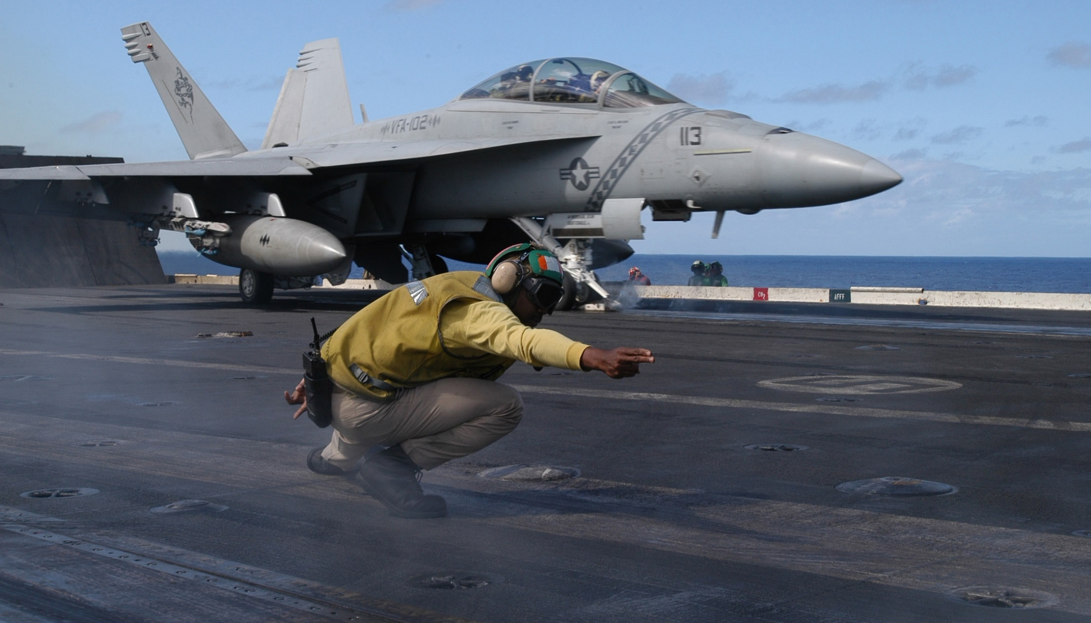
The Devotional Life
The Secret Life
Launching out and returning back
The rhythm of the Christian life

Slide 19
The Secret Life
^{Mark 1:32} When evening came, after the sun had set, they began bringing to Him all who were ill and those who were demon-possessed. ³³ And the whole city had gathered at the door. ³⁴ And He healed many who were ill with various diseases, and cast out many demons; and He was not permitting the demons to speak, because they knew who He was.
^{Mark 1:32} When evening came, after the sun had set, they began bringing to Him all who were ill and those who were demon-possessed. ³³ And the whole city had gathered at the door. ³⁴ And He healed many who were ill with various diseases, and cast out many demons; and He was not permitting the demons to speak, because they knew who He was.

Slide 20
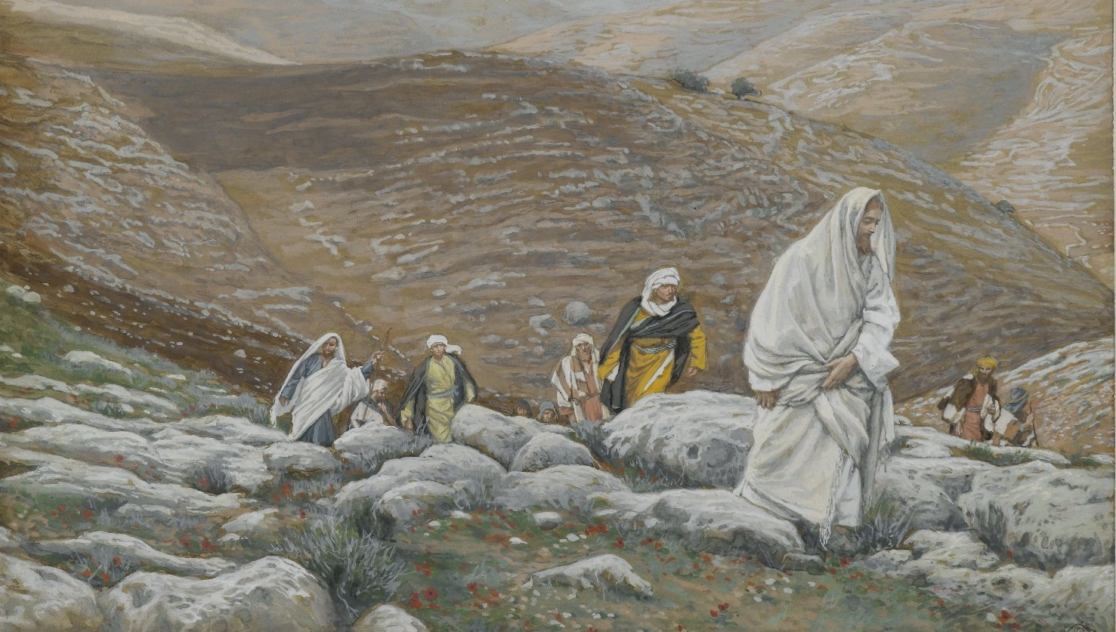
The Secret Life
^{Mark 1:35} In the early morning, while it was still dark, Jesus got up, left the house, and went away to a secluded place, and was praying there.³⁶ Simon and his companions searched for Him; ³⁷ they found Him, and said to Him, “Everyone is looking for You.”

Slide 21
The Secret Life
^{Mark 1:38} He said to them, “Let us go somewhere else to the towns nearby, so that I may preach there also; for that is what I came for.” ³⁹ And He went into their synagogues throughout all Galilee, preaching and casting out the demons.

Slide 22
The Secret Life
^{Mark 6:7} And He summoned the twelve and began to send them out in pairs, and gave them authority over the unclean spirits … ¹² They went out and preached that men should repent. ¹³ And they were casting out many demons and were anointing with oil many sick people and healing them.

Slide 23
What is the effect of this pattern on the “difficult missions” in our lives?
The Secret Life
^{Mark 6:30} The apostles gathered together with Jesus; and they reported to Him all that they had done and taught. ³¹ And He said to them, “Come away by yourselves to a secluded place and rest a while.” (For there were many people coming and going, and they did not even have time to eat.) ³² They went away in the boat to a secluded place by themselves.
^{Mark 6:30} The apostles gathered together with Jesus; and they reported to Him all that they had done and taught. ³¹ And He said to them, “Come away by yourselves to a secluded place and rest a while.” (For there were many people coming and going, and they did not even have time to eat.) ³² They went away in the boat to a secluded place by themselves.

Slide 24
What would be benefits of “launching out” from a vibrant devotional life?
Orients us before God for the day

Slide 25
What would be benefits of “launching out” from a vibrant devotional life?
Establish our audience for the day

Slide 26
What would be benefits of “launching out” from a vibrant devotional life?
Turns our “radio” on

Slide 27
What would be benefits of “launching out” from a vibrant devotional life?
We get our orders for the day

Slide 28
“Prayer is where planning starts. Our first goal in prayer is not to get a steamhead of power but to find out what God wants. Planning that arises from and is the product of prayer is far superior to planning that is merely "backed by" prayer. The plan that is God's plan, revealed by him to those who wait on him, is a plan that cannot fail. Real efficiency comes from waiting on God.
If the plan is not of God in the first place, no amount of prayer will make it count for eternity. It may "work" That is, it may achieve the goals the organizers are aiming at. But if the goals are not God's goals, of what value is it that they were achieved efficiently?”
- John White, Excellence in Leadership, 12
What would be benefits of “launching out” from a vibrant devotional life?
We get our orders for the day

Slide 29
What would be benefits of “launching out” from a vibrant devotional life?
We get our orders for the day

Slide 30
What would be benefits of “launching out” from a vibrant devotional life?
Emboldens us for the mission

Slide 31
What would be benefits of “launching out” from a vibrant devotional life?
Equips us for the work ahead

Slide 32
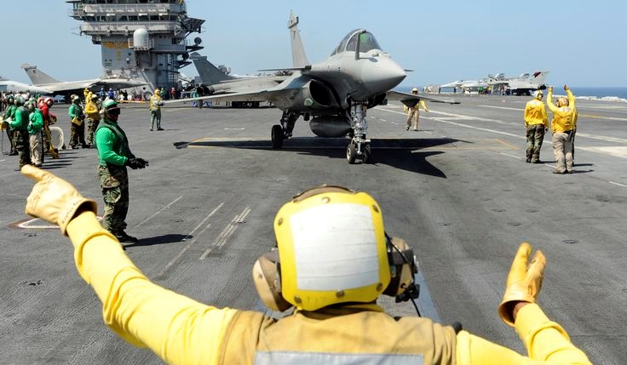
What would be benefits of
“returning back?”
The hangar is the place the fighter retreats to safety

Slide 33
What would be benefits of
“returning back?”
^{Psalm 18:2} The Lord is my rock and my fortress and my deliverer, My God, my rock, in whom I take refuge; My shield and the horn of my salvation, my stronghold.
When I got beat up on the mission …
The hangar is the place the fighter retreats to safety

Slide 34
What would be benefits of
“returning back?”
To debrief…
The hangar is the place the fighter retreats to safety

Slide 35
What would be benefits of
“returning back?”
To Nurse Wounds …
The hangar is the place the fighter retreats to safety

Slide 36
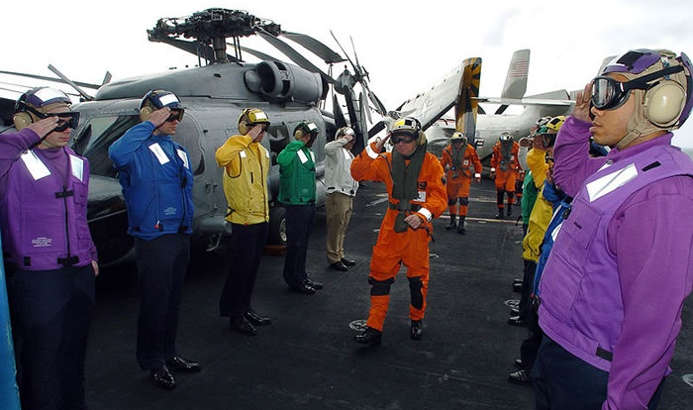
What would be benefits of
“returning back?”
To Celebrate Victories …
The hangar is the place the fighter retreats to safety

Slide 37
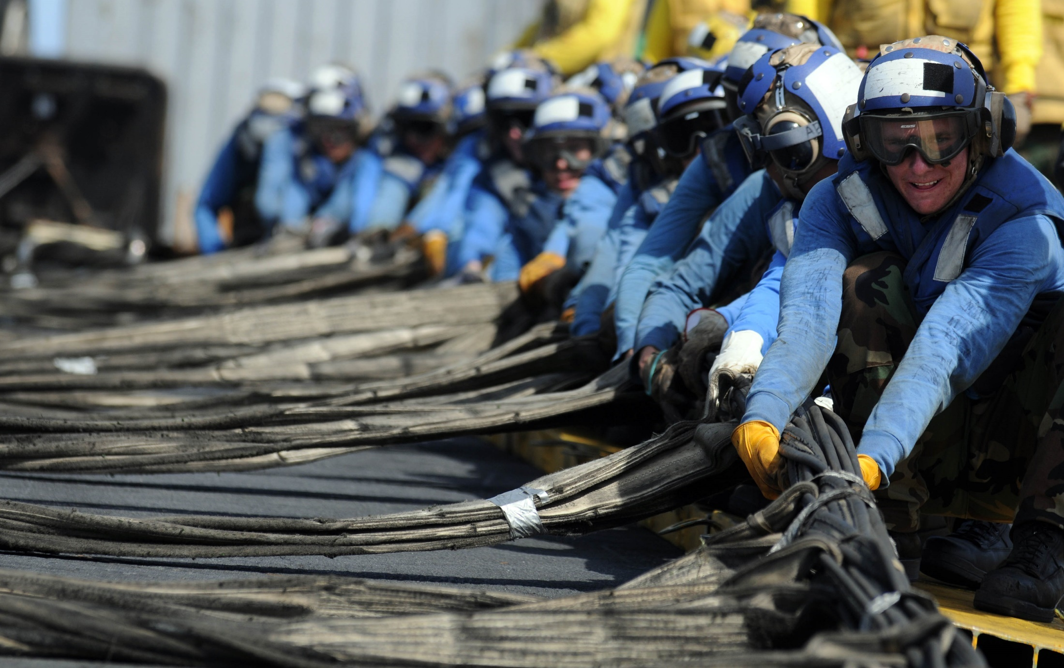
What would be benefits of
“returning back?”
For some R & R
^{Psalm 119:50} This is my comfort in my affliction, That Your word has revived me
The hangar is the place the fighter retreats to safety

Slide 38
^{Psalm 17:7} Wondrously show Your lovingkindness, O Savior of those who take refuge at Your right hand from those who rise up against them. ⁸ Keep me as the apple of the eye; Hide me in the shadow of Your wings ⁹ From the wicked who despoil me, My deadly enemies who surround me.
The effect is that we’re reinvigorated to launch out again!

Slide 39
^{Psalm 27:4} One thing I have asked from the Lord, that I shall seek: That I may dwell in the house of the Lord all the days of my life, To behold the beauty of the Lord And to meditate in His temple. ⁵ For in the day of trouble He will conceal me in His tabernacle; In the secret place of His tent He will hide me; He will lift me up on a rock.
And that next time, we can’t wait to come back in for a landing

Slide 40
Here’s the point: having a “secret life” is a game-changer
- In our ministry - in our relationships - in our spiritual vitality and longevity
For many of us, it is the missing key for spiritual revival!

Slide 41
You can have the Secret Life
Maybe you need to discover it
Maybe you need to re-discover it

Slide 42
Here’s the point: having a “secret life” is a BIG difference-maker
- In our ministry - in our relationships - in our life -
For many of us, it is THE missing key for spiritual revival

Slide 43
You can have the Secret Life
Maybe you need to discover it
Maybe you need to re-discover it
Holiday Challenge

Slide 44
You can have the Secret Life
Maybe you need a plan
Things that don’t matter:
- When and Where
- Which way of structuring your
time you choose
- That you keep your plan perfectly

Slide 45
You can have the Secret Life
Maybe you need a plan
Things that do matter:
- That you have a time and place
- That the structure you choose
works for you
- That it is regular

