Slide 1
Face-to-Face with Our Creator
ST Retreat 2023

Slide 2
“Set your minds on the things that are above” (Col. 3:2)
What do you think about most when it comes to heaven?

Slide 3
(1 Cor. 13:12) For now we see in a mirror dimly, but then face to face; now I know in part, but then I will know fully, just as I also have been fully known.

Slide 4
(1 Cor. 13:12) For now we see in a mirror dimly, but then face to face; now I know in part, but then I will know fully, just as I also have been fully known.

Slide 5
(1 Cor. 13:12) For now we see in a mirror dimly, but then face to face; now I know in part, but then I will know fully, just as I also have been fully known.
On the one hand…
“consuming fire” (Heb. 12:27)
“invisible” (1 Tim. 1:17; Rom. 1:20)
“Moses hid his face, for he was afraid to look at God” (Exodus 3:6)
“You cannot see my face, for no one may see me and live” (Exodus 33:20)
“Woe to me, for I am ruined!” (Isaiah 6:5)
“God…who lives in unapproachable light, whom no one has seen or can see” (1 Tim. 6:15,16)
“No one has ever seen God” (John 1:18; 1 John 4:12)
And yet… “they will see his face” (Rev. 22:4)

Slide 6
(1 Cor. 13:12) For now we see in a mirror dimly, but then face to face; now I know in part, but then I will know fully, just as I also have been fully known.
Intangible communication is tough
Distractions from close communion
Out-of-sight, out-of mind
Distortions about God’s character
Still approaching him in shame
It is true that we have confident access to God secured to us by Christ right now
For Paul though, this is only “seeing in a mirror dimly”
Many of us long for a more tangible relationship with God

Slide 7
(1 Cor. 13:12) For now we see in a mirror dimly, but then face to face; now I know in part, but then I will know fully, just as I also have been fully known.
(Rev. 21:1-4) Then I saw a new heaven and a new earth; for the first heaven and the first earth passed away, and there is no longer any sea. ² And I saw the holy city, new Jerusalem, coming down out of heaven from God, prepared as a bride adorned for her husband. ³ And I heard a loud voice from the throne, saying, “Behold, the tabernacle of God is among the people, and He will dwell among them, and they shall be His people, and God Himself will be among them, ⁴ and He will wipe away every tear from their eyes; and there will no longer be any death; there will no longer be any mourning, or crying, or pain; the first things have passed away.”
(Rev. 22:4-5) the throne of God and of the Lamb will be in [the city], and His bond-servants will serve Him; ⁴ they will see His face, and His name will be on their foreheads.”
“the happy-making sight”

Slide 8
What will it mean to see God’s face?
Charles Spurgeon
A Sermon Delivered On August 9, 1868,
At The Metropolitan Tabernacle, Newington.
We may also remark that they see him always, for when the text says they shall “see his face,” it implies that they never at any time are without the sight. Never for a moment do they unlock their arm from the arm of their Beloved.
We will look into the literal, physical face of God with our resurrected eyes (untainted by sin, disease, or death)
We will always see his face

Slide 9
What will it mean to see God’s face?
Charles Spurgeon
A Sermon Delivered On August 9, 1868,
At The Metropolitan Tabernacle, Newington.
They are not as we are—sometimes near the throne, sometimes far away; sometimes hot with love, sometimes cold with indifference, sometimes bright as angels, sometimes dull as clods.
We will look into the literal, physical face of God with our resurrected eyes (untainted by sin, disease, or death)
We will always see his face

Slide 10
What will it mean to see God’s face?
Charles Spurgeon
A Sermon Delivered On August 9, 1868,
At The Metropolitan Tabernacle, Newington.
Rather, forever and ever they are in closest association with the Master, for they shall “see his face.”
We will look into the literal, physical face of God with our resurrected eyes (untainted by sin, disease, or death)
We will always see his face

Slide 11
What will it mean to see God’s face?
Cornelis Venema
The Promise of the Future, pp. 487-488.
God's people will see him without any of the sinful limitations of the present. No sin-induced stupor, no failure of hearing, no blindness of vision will obscure the beauty of God from their knowledge.
We will look into the literal, physical face of God with our resurrected eyes (untainted by sin, disease, or death)
We will always see his face
We will enjoy all the benefits of face-to-face interaction
We will be able to understand God’s character and work in a fully accurate way
Radical implications for our personal transformation!

Slide 12
What will it be like?
“[He will] give relief to you who are troubled, and to us as well. This will happen when the Lord Jesus is revealed from heaven in blazing fire with his powerful angels.” (2 Thess. 1:7)

Slide 13
What will it be like?
RELIEF
“[He will] give relief to you who are troubled, and to us as well. This will happen when the Lord Jesus is revealed from heaven in blazing fire with his powerful angels.” (2 Thess. 1:7)

Slide 14
What will it be like?
RELIEF
“and He will wipe away every tear from their eyes; and there will no longer be any death; there will no longer be any mourning, or crying, or pain; the first things have passed away” (Rev. 21:4)
The complete unburdening of a lifetime’s worth of stressors, sorrows, sicknesses, sins, and suffering in a single moment that will continue on forever

Slide 15
What will it be like?
RELIEF
“His master replied, ‘Well done, good and faithful servant! You have been faithful with a few things; I will put you in charge of many things. Come and share your master’s happiness!’”(Matt. 25:23)
Knowing that what you did here and the sacrifices that you have made truly matters

Slide 16
What will it be like?
CS Lewis
“The Weight of Glory”
In the end that Face which is the delight or the terror of the universe must be turned upon each of us…
RELIEF
“His master replied, ‘Well done, good and faithful servant! You have been faithful with a few things; I will put you in charge of many things. Come and share your master’s happiness!’”(Matt. 25:23)
Knowing that what you did here and the sacrifices that you have made truly matters

Slide 17
What will it be like?
CS Lewis
“The Weight of Glory”
It is written that we shall “stand before” Him, shall appear, shall be inspected.
RELIEF
“His master replied, ‘Well done, good and faithful servant! You have been faithful with a few things; I will put you in charge of many things. Come and share your master’s happiness!’”(Matt. 25:23)
What you did here truly matters

Slide 18
What will it be like?
CS Lewis
“The Weight of Glory”
The promise of glory is the promise, almost incredible and only possible by the work of Christ, that some of us, that any of us who really chooses, shall actually survive that examination, shall find approval, shall please God.
RELIEF
“His master replied, ‘Well done, good and faithful servant! You have been faithful with a few things; I will put you in charge of many things. Come and share your master’s happiness!’”(Matt. 25:23)
What you did here truly matters

Slide 19
What will it be like?
CS Lewis
“The Weight of Glory”
To please God…
to be a real ingredient in the divine happiness…
RELIEF
“His master replied, ‘Well done, good and faithful servant! You have been faithful with a few things; I will put you in charge of many things. Come and share your master’s happiness!’”(Matt. 25:23)
What you did here truly matters

Slide 20
What will it be like?
CS Lewis
“The Weight of Glory”
to be loved by God, not merely pitied, but delighted in as an artist delights in his work or a father in a son—
RELIEF
“His master replied, ‘Well done, good and faithful servant! You have been faithful with a few things; I will put you in charge of many things. Come and share your master’s happiness!’”(Matt. 25:23)
What you did here truly matters

Slide 21
What will it be like?
CS Lewis
“The Weight of Glory”
it seems impossible, a weight or burden of glory which our thoughts can hardly sustain. But so it is.”
RELIEF
“His master replied, ‘Well done, good and faithful servant! You have been faithful with a few things; I will put you in charge of many things. Come and share your master’s happiness!’”(Matt. 25:23)
Knowing that what you did here and the sacrifices that you have made truly matters

Slide 22
What will it be like?
“on the day he comes to be glorified among his holy people and to be marveled at among all those who have believed.” (2 Thess. 1:10)

Slide 23
What will it be like?
AWE & AMAZEMENT
“on the day he comes to be glorified among his holy people and to be marveled at among all those who have believed.” (2 Thess. 1:10)

Slide 24
What will it be like?
AWE & AMAZEMENT
“on the day he comes to be glorified among his holy people and to be marveled at among all those who have believed.” (2 Thess. 1:10)
When we see God, no one will have to remind us, beg us, or plead with us to worship and praise him.

Slide 25
What will it be like?
AWE & AMAZEMENT
“So whether you eat or drink or whatever you do, do it all for the glory of God.” (1 Cor. 10:31)
No matter what we’re doing in heaven, we will overflow with gratitude and praise, and in that sense we will be continuously worshipping God

Slide 26
What will it be like?
Intimacy
“but then I will know fully” (1 Cor. 13:12)

Slide 27
What will it be like?
Intimacy
“and He will wipe away every tear from their eyes” (Rev. 21:4)
“Blessed are you who weep now, for you will laugh…Rejoice in that day and leap for joy, because great is your reward in heaven” (Luke 6:21-23, NIV).

Slide 28
What will it be like?
Intimacy
& Laughter
“and He will wipe away every tear from their eyes” (Rev. 21:4)
“Blessed are you who weep now, for you will laugh…Rejoice in that day and leap for joy, because great is your reward in heaven” (Luke 6:21-23, NIV).

Slide 29
What will it be like?
Taking part in and enjoying good gifts
“It will be good for those servants whose master finds them watching when he comes. Truly I tell you, he will dress himself to serve, will have them recline at the table and will come and wait on them.” (Luke 12:37)
"On this mountain the Lord Almighty will prepare a feast of rich food for all peoples" (Isaiah 25:6).

Slide 30
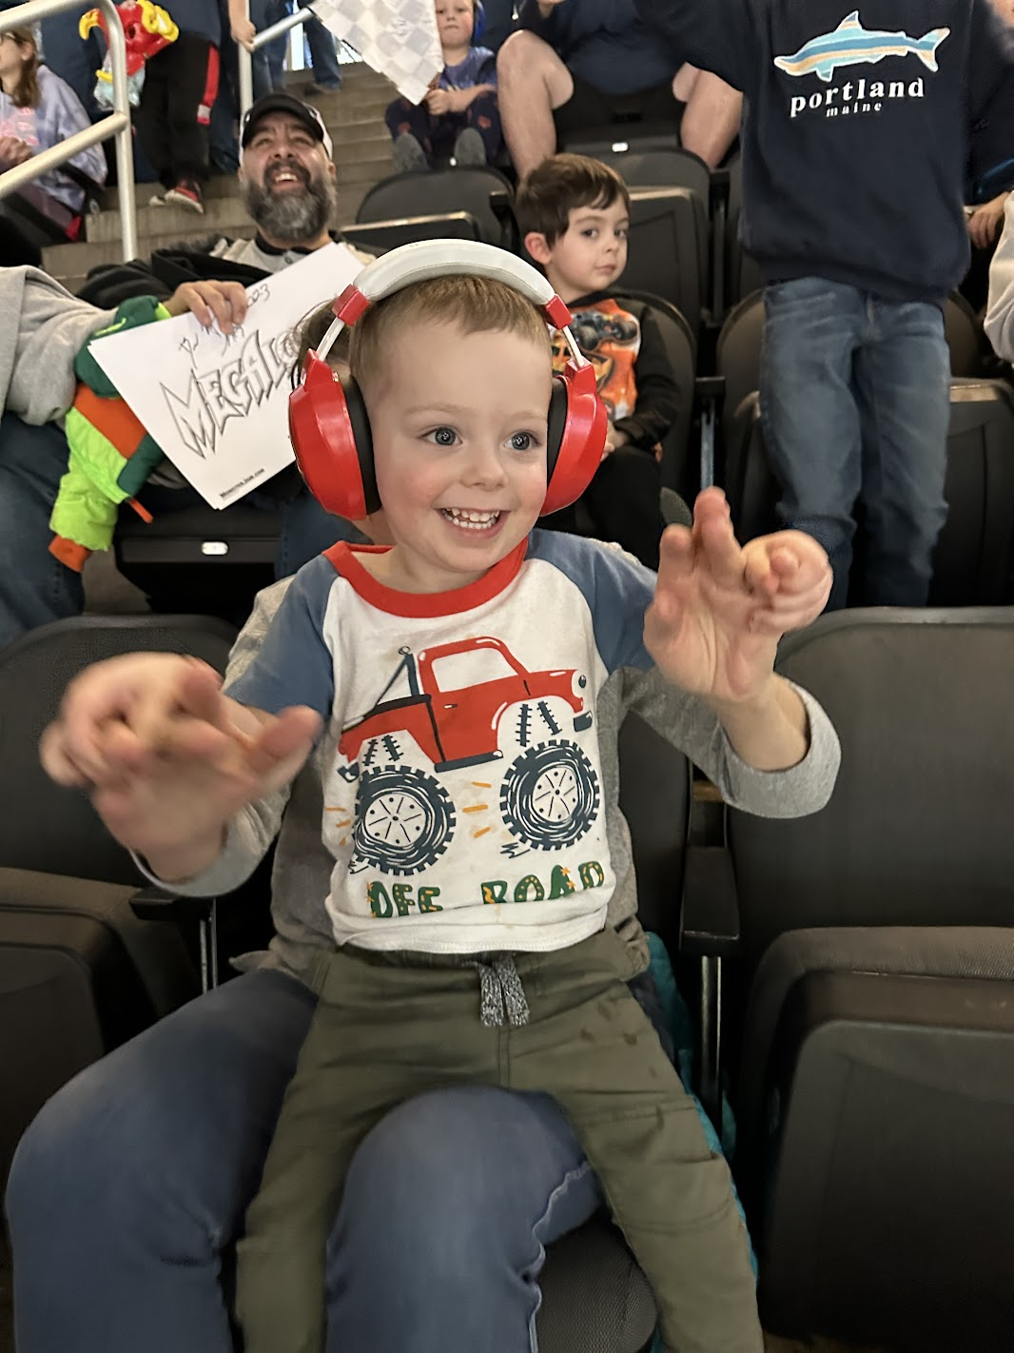
What will it be like?
Taking part in and enjoying good gifts
Seeing and knowing God will be our primary joy in heaven.
But it will also be the basis for the joy we find in all of the other gifts and rewards God has for us.
Every other heavenly joy will derive from and flow out of our relationship with God.
And all of the amazing things that will be in heaven will just direct us back to appreciating God himself more and more.
“The world is full of praise-prompters – the New Earth will overflow with them.”
-Randy Alcorn

Slide 31
What will it be like?
A Bride Seeing Her Groom
“I saw the Holy City, the new Jerusalem, coming down out of heaven from God, prepared as a bride beautifully dressed for her husband.” (Rev. 21:2)
"Blessed are those who are invited to the wedding supper of the Lamb!"(Revelation 19:9).
We’re not just invited….we’re the bride!!!

Slide 32
What will it be like?
A Bride Seeing Her Groom
“I saw the Holy City, the new Jerusalem, coming down out of heaven from God, prepared as a bride beautifully dressed for her husband.” (Rev. 21:2)
"Blessed are those who are invited to the wedding supper of the Lamb!"(Revelation 19:9).
We’re not just invited….we’re the bride!!!

Slide 33
Why are we told about this?
We should anticipate this, look forward to this, and long for this in a concrete way
“O God, you are my God, earnestly I seek you; my soul thirsts for you, my body longs for you, in a dry and weary land where there is no water" (Psalm 63:1)

Slide 34
Why are we told about this?
We should anticipate this, look forward to this, and long for this in a concrete way
"I know that my Redeemer lives, and that in the end he will stand upon the earth. And after my skin has been destroyed, yet in my flesh I will see God; I myself will see him with my own eyes—I, and not another. How my heart yearns within me!" (Job 19:25-27)

