Slide 2
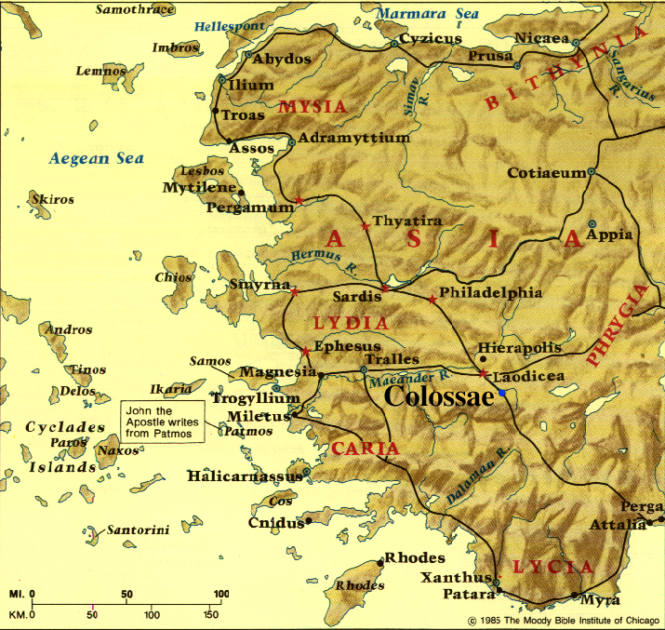

Slide 3
Spiritual Development through Love
GOD
ME
GOD & OTHERS
RECEIVE GOD’S LOVE
GIVE GOD’S LOVE

Slide 4
Spiritual Development through Love
TOWARD GOD (THANKFULNESS)
TOWARD OTHER CHRISTIANS (UNITY)
TOWARD NON-CHRISTIANS (OUTREACH)
GOD
ME
GOD & OTHERS
RECEIVE GOD’S LOVE
GIVE GOD’S LOVE
^{Colossians 3:17} Whatever you do in word or deed, do all in the name of the Lord Jesus, giving thanks through Him to God the Father.

Slide 5
Spiritual Development through Love
TOWARD GOD (THANKFULNESS)
TOWARD OTHER CHRISTIANS (UNITY)
TOWARD NON-CHRISTIANS (OUTREACH)
GOD
ME
GOD & OTHERS
RECEIVE GOD’S LOVE
GIVE GOD’S LOVE
^{Colossians 3:17} Whatever you do in word or deed, do all in the name of the Lord Jesus, giving thanks through Him to God the Father.

Slide 6
Spiritual Development through Love
TOWARD GOD (THANKFULNESS)
TOWARD OTHER CHRISTIANS (UNITY)
TOWARD NON-CHRISTIANS (OUTREACH)
GOD
ME
GOD & OTHERS
RECEIVE GOD’S LOVE
GIVE GOD’S LOVE
^{Colossians 3:17} Whatever you do in word or deed, do all in the name of the Lord Jesus, giving thanks through Him to God the Father.

Slide 7
Spiritual Development through Love
TOWARD GOD (THANKFULNESS)
TOWARD OTHER CHRISTIANS (UNITY)
TOWARD NON-CHRISTIANS (OUTREACH)
“In word” – sharing the message of God’s love through Jesus (4:2-6)
GOD
ME
GOD & OTHERS
RECEIVE GOD’S LOVE
GIVE GOD’S LOVE

Slide 8
Spiritual Development through Love
TOWARD GOD (THANKFULNESS)
TOWARD OTHER CHRISTIANS (UNITY)
TOWARD NON-CHRISTIANS (OUTREACH)
“In deed” – showing God’s love through our actions & attitudes (3:18-4:1)
GOD
ME
GOD & OTHERS
RECEIVE GOD’S LOVE
GIVE GOD’S LOVE

Slide 9
Colossians 3:17 – 4:1 Showing God’s Love to Non-Christians
THROUGH OUR SOCIAL ROLES
YOU
FAMILY
WORK
NEIGHBORS
COMMUNITY

Slide 10
Colossians 3:17 – 4:1 Showing God’s Love to Non-Christians
THROUGH OUR SOCIAL ROLES
YOU
^{3:18} Wives, be subject to your husbands, as is fitting in the Lord. ¹⁹ Husbands, love your wives and do not be embittered against them. ²⁰ Children, be obedient to your parents in all things, for this is well-pleasing to the Lord. ²¹ Fathers, do not exasperate your children, so that they will not lose heart.
FAMILY
WORK
NEIGHBORS
COMMUNITY

Slide 11
Colossians 3:17 – 4:1 Showing God’s Love to Non-Christians
THROUGH OUR SOCIAL ROLES
YOU
^{3:18} Wives, be subject to your husbands, as is fitting in the Lord. ¹⁹ Husbands, love your wives and do not be embittered against them. ²⁰ Children, be obedient to your parents in all things, for this is well-pleasing to the Lord. ²¹ Fathers, do not exasperate your children, so that they will not lose heart.
FAMILY
WORK
NEIGHBORS
COMMUNITY

Slide 12
Colossians 3:17 – 4:1 Showing God’s Love to Non-Christians
THROUGH OUR SOCIAL ROLES
YOU
^{3:22} Slaves, in all things obey those who are your masters on earth, not with external service, as those who merely please men, but with sincerity of heart, fearing the Lord. ²³ Whatever you do, do your work heartily, as for the Lord rather than for men . . . ^{4:1} Masters, grant to your slaves justice and fairness, knowing that you too have a Master in heaven.
FAMILY
WORK
NEIGHBORS
COMMUNITY

Slide 13
Colossians 3:17 – 4:1 Showing God’s Love to Non-Christians
THROUGH OUR SOCIAL ROLES
YOU
^{Romans 13:8} Owe nothing to anyone except to love . . . for he who loves his neighbor has fulfilled the law.
⁹ For . . . “You shall love your neighbor as yourself.” ¹⁰ Love does no wrong to a neighbor; therefore love is the fulfillment of the law.
FAMILY
WORK
NEIGHBORS
COMMUNITY

Slide 14
Colossians 3:17 – 4:1 Showing God’s Love to Non-Christians
THROUGH OUR SOCIAL ROLES
YOU
FAMILY
WORK
NEIGHBORS
COMMUNITY

Slide 15
Colossians 3:17 – 4:1 Showing God’s Love to Non-Christians
THROUGH OUR SOCIAL ROLES
YOU
^{Titus 3:1} Remind them to be subject to rulers, to authorities, to be obedient, to be ready for every good deed, ² to malign no one, to be peaceable, gentle, showing every consideration for all people.
FAMILY
WORK
NEIGHBORS
COMMUNITY

Slide 16
Colossians 3:17 – 4:1 Showing God’s Love to Non-Christians
THROUGH OUR SOCIAL ROLES
YOU
“Are we the kind of church of which our city says: ‘We don’t share a lot of their beliefs, but I shudder to think of this city without them. They are such an important part of the community. They give so much! If they left we’d have to raise taxes because others won’t give of themselves like they do.’” (Tim Keller)
FAMILY
WORK
NEIGHBORS
COMMUNITY

Slide 17
Colossians 3:17 – 4:1 Showing God’s Love to Non-Christians
THROUGH OUR SOCIAL ROLES
God gives us opportunities to show His love to people in these arenas every single day!
YOU
FAMILY
WORK
NEIGHBORS
COMMUNITY

Slide 18
Colossians 3:17 – 4:1 Showing God’s Love to Non-Christians
A CLOSER LOOK AT THIS KIND OF LOVE
^{3:19} Husbands, love your wives and do not be embittered against them . . . ²¹ Fathers, do not exasperate your children, so that they will not lose heart . . . ^{4:1} Masters, grant to your slaves justice and fairness . . .

Slide 19
Colossians 3:17 – 4:1 Showing God’s Love to Non-Christians
A CLOSER LOOK AT THIS KIND OF LOVE
Servant-leadership vs. Lording it over others
^{3:19} Husbands, love your wives and do not be embittered against them . . . ²¹ Fathers, do not exasperate your children, so that they will not lose heart . . . ^{4:1} Masters, grant to your slaves justice and fairness . . .

Slide 20
Colossians 3:17 – 4:1 Showing God’s Love to Non-Christians
A CLOSER LOOK AT THIS KIND OF LOVE
^{3:18} Wives, be subject to your husbands . . . ²⁰ Children, be obedient to your parents in all things . . . ²² Slaves, in all things obey those who are your masters on earth . . . ²³ Whatever you do, do your work heartily . . .

Slide 21
Colossians 3:17 – 4:1 Showing God’s Love to Non-Christians
A CLOSER LOOK AT THIS KIND OF LOVE
Sincerely cooperative vs. Self-willed, lazy, etc.
^{3:18} Wives, be subject to your husbands . . . ²⁰ Children, be obedient to your parents in all things . . . ²² Slaves, in all things obey those who are your masters on earth . . . ²³ Whatever you do, do your work heartily . . .

Slide 22
Colossians 3:17 – 4:1 Showing God’s Love to Non-Christians
A CLOSER LOOK AT THIS KIND OF LOVE
God-centered vs. self-centered mind-set & motivation
^{3:17} Whatever you do . . . do as representatives of Jesus . . . ¹⁸ . . . as is fitting in the Lord . . . ²⁰ . . . for this is well-pleasing to the Lord . . . ²² . . . not with external service, as those who merely please men, but with sincerity of heart, fearing the Lord. ²³ . . . as for the Lord rather than for men, ²⁴ knowing that from the Lord you will receive the reward of the inheritance. It is the Lord Christ whom you serve . . . ^{4:1} . . . knowing that you too have a Master in heaven.

Slide 23
Colossians 3:17 – 4:1 Showing God’s Love to Non-Christians
A CLOSER LOOK AT THIS KIND OF LOVE
God-centered vs. self-centered mind-set & motivation
^{3:17} Whatever you do . . . do as representatives of Jesus . . . ¹⁸ . . . as is fitting in the Lord . . . ²⁰ . . . for this is well-pleasing to the Lord . . . ²² . . . not with external service, as those who merely please men, but with sincerity of heart, fearing the Lord. ²³ . . . as for the Lord rather than for men, ²⁴ knowing that from the Lord you will receive the reward of the inheritance. It is the Lord Christ whom you serve . . . ^{4:1} . . . knowing that you too have a Master in heaven.

Slide 24
Colossians 3:17 – 4:1 Showing God’s Love to Non-Christians
A CLOSER LOOK AT THIS KIND OF LOVE
God-centered vs. self-centered mind-set & motivation
^{3:17} Whatever you do . . . do as representatives of Jesus . . . ¹⁸ . . . as is fitting in the Lord . . . ²⁰ . . . for this is well-pleasing to the Lord . . . ²² . . . not with external service, as those who merely please men, but with sincerity of heart, fearing the Lord. ²³ . . . as for the Lord rather than for men, ²⁴ knowing that from the Lord you will receive the reward of the inheritance. It is the Lord Christ whom you serve . . . ^{4:1} . . . knowing that you too have a Master in heaven.

Slide 25
Colossians 3:17 – 4:1 Showing God’s Love to Non-Christians
A CLOSER LOOK AT THIS KIND OF LOVE
God-centered vs. self-centered mind-set & motivation
^{3:17} Whatever you do . . . do as representatives of Jesus . . . ¹⁸ . . . as is fitting in the Lord . . . ²⁰ . . . for this is well-pleasing to the Lord . . . ²² . . . not with external service, as those who merely please men, but with sincerity of heart, fearing the Lord. ²³ . . . as for the Lord rather than for men, ²⁴ knowing that from the Lord you will receive the reward of the inheritance. It is the Lord Christ whom you serve . . . ^{4:1} . . . knowing that you too have a Master in heaven.

Slide 26
Colossians 3:17 – 4:1 Showing God’s Love to Non-Christians
A CLOSER LOOK AT THIS KIND OF LOVE
God-centered vs. self-centered mind-set & motivation
^{3:17} Whatever you do . . . do as representatives of Jesus . . . ¹⁸ . . . as is fitting in the Lord . . . ²⁰ . . . for this is well-pleasing to the Lord . . . ²² . . . not with external service, as those who merely please men, but with sincerity of heart, fearing the Lord. ²³ . . . as for the Lord rather than for men, ²⁴ knowing that from the Lord you will receive the reward of the inheritance. It is the Lord Christ whom you serve . . . ^{4:1} . . . knowing that you too have a Master in heaven.

Slide 27
Colossians 3:17 – 4:1 Showing God’s Love to Non-Christians
A CLOSER LOOK AT THIS KIND OF LOVE
We can’t self-generate this kind of love . . .
. . . We must get it from God by regularly receiving His love (3:1-4), by prayer (4:2), & through Christian fellowship (3:12-16)

Slide 28
Colossians 3:17 – 4:1 Showing God’s Love to Non-Christians
SHOWING LEADS TO SHARING
It discredits slander & corrects misconceptions about Jesus/Christianity
^{Titus 3:3} Older women likewise are to be reverent in their behavior . . . ⁴ so that they may encourage the young women to love their husbands, to love their children . . . ⁵ . . . so that the word of God will not be dishonored. ⁶ Likewise urge the young men to be sensible; ⁷ in all things show yourself to be an example of good deeds . . . so that the opponent will be put to shame, having nothing bad to say about us.

Slide 29
Colossians 3:17 – 4:1 Showing God’s Love to Non-Christians
SHOWING LEADS TO SHARING
It arouses positive curiosity & provides opportunities to share about Jesus
^{1 Peter 2:12} Keep your behavior excellent among the non-Christians, so that in the thing in which they slander you as evildoers, they may because of your good deeds, as they observe them, glorify God in the day of visitation.

Slide 30
Colossians 3:17 – 4:1 Showing God’s Love to Non-Christians
SHOWING LEADS TO SHARING
It arouses positive curiosity & provides opportunities to share about Jesus
^{1 Peter 3:15} Set apart Christ as Lord in your hearts, always being ready to make a defense to everyone who asks you to give an account for the hope that is in you, yet with gentleness and reverence;

Slide 31
Colossians 3:17 – 4:1 Showing God’s Love to Non-Christians
SHOWING LEADS TO SHARING
It gives credibility to what we share about Jesus
^{Titus 2:9} Urge bondslaves to be subject to their own masters in everything, to be well-pleasing, not argumentative, ¹⁰ not pilfering, but showing all good faith so that they will adorn the doctrine of God our Savior in every respect.

Slide 32
Colossians 3:17 – 4:1 Showing God’s Love to Non-Christians
SHOWING LEADS TO SHARING
Maybe this is why the letters of the New Testament emphasize “showing” so much!

Slide 33
NEXT WEEK:
Colossians 4:2-6 Sharing the Message of God’s Love with Non-Christians

Slide 34
Questions?
Comments?

