Slide 1
1 Peter 3
The Reasons for Our Hope

Slide 2
1 Peter
“How is the Christian supposed to live in a hostile world?”
Good deeds (1 Peter 2:15)
Kindness and gentleness (1 Peter 3:9)
Speak truth…

Slide 3
1 Peter 3:14-15
Do not fear their intimidation and do not be troubled, but set apart Christ as Lord in your hearts,
always being ready to make a defense to everyone who asks you to give an account for the hope that is in you,
yet with gentleness and reverence

Slide 4
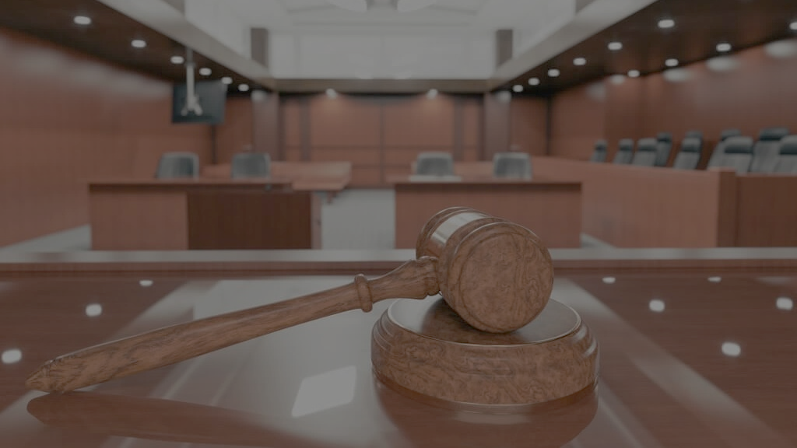
ready to make a defense

Slide 5
ready to make a defense
= apologia (“apologetics”)
What do you believe?
Why do you believe it?

Slide 6
ready to make a defense
“What do you believe?”
“What is the meaning of life?”
“Where did we come from?”
“What happens when we die?”
“Is there such a thing as right and wrong?”

Slide 7
ready to make a defense
“Why do you believe that?”
“Because I was raised to believe this.”
“Because it makes me feel better.”
“Because the people around me believe it.”
“Because my religion says to believe this.”

Slide 8
ready to make a defense
“Why do you believe that?”
“Because it’s true!”

Slide 9
Arguments from Science
The “fine tuning” of our universe

Slide 10
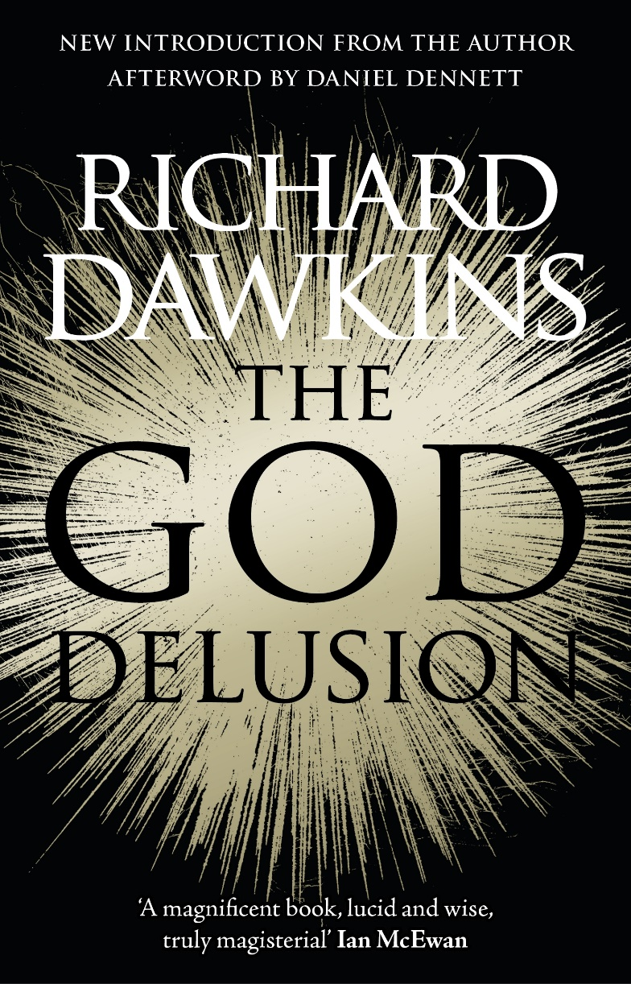
Richard Dawkins, The God Delusion (Boston: Houghton Mifflin, 2006), 169-170.
Physicists have calculated that, if the laws and constants of physics had been even slightly different,
the universe would have developed in such a way that life would have been impossible.

Slide 11
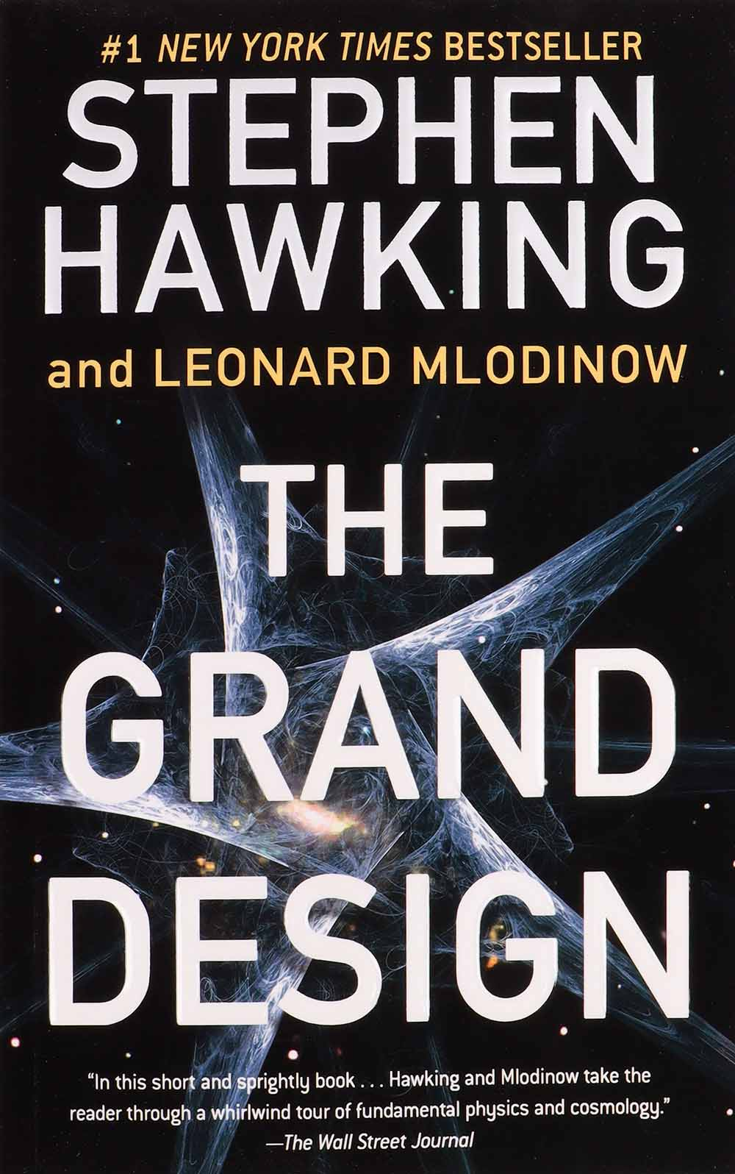
Hawking, S.W., and Leonard Mlodinow. The Grand Design. New York: Bantam, 2010, 160-161
Most of the fundamental constants in our theories appear fine-tuned in the sense that if they were altered by only modest amounts,
the universe would be qualitatively different,
and in many cases unsuitable for the development of life....

Slide 12
Hawking, S.W., and Leonard Mlodinow. The Grand Design. New York: Bantam, 2010, 160-161
For example, if … the weak [nuclear] force were much weaker,
in the early universe all the hydrogen in the cosmos would have turned to helium, and hence there would be no normal stars;

Slide 13
Hawking, S.W., and Leonard Mlodinow. The Grand Design. New York: Bantam, 2010, 160-161
if it were much stronger, exploding supernovas would not eject their outer envelopes,
and hence would fail to seed interstellar space with the heavy elements planets require to foster life.

Slide 14
Hawking, S.W., and Leonard Mlodinow. The Grand Design. New York: Bantam, 2010, 160-161
If protons were 0.2 percent heavier, they would decay into neutrons, destabilizing atoms…

Slide 15
Speed of expansion from the big bang
1 part in 10⁵⁵

Slide 16
Strength of Gravity
1 part in 10⁴⁰

Slide 17
Cosmological Constant
1 part in 10¹²⁰

Slide 18
Up to 50 lines!

Slide 19
Hawking, S.W., and Leonard Mlodinow. The Grand Design. New York: Bantam, 2010, 160-161
Were it not for a series of startling coincidences in the precise details of physical law,
it seems, humans and similar life-forms would never have come into being…
What can we make of these coincidences? …

Slide 20
Hawking, S.W., and Leonard Mlodinow. The Grand Design. New York: Bantam, 2010, 160-161
Our universe and its laws appear to have a design that both is tailor-made to support us
and, if we are to exist, leaves little room for alteration.
That is not easily explained and raises the natural question of why it is that way

Slide 21
Hawking, S.W., and Leonard Mlodinow. The Grand Design. New York: Bantam, 2010, 160-161
Our universe and its laws appear to have a design that both is tailor-made to support us
and, if we are to exist, leaves little room for alteration.
That is not easily explained and raises the natural question of why it is that way

Slide 22
Arguments from Science
The “fine tuning” of our universe
The beginning of our universe (and time!)

Slide 23
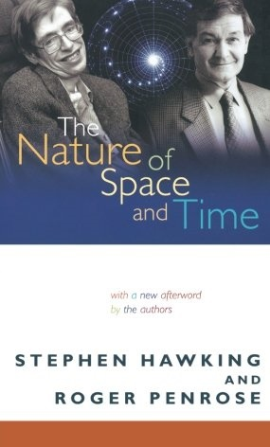
Stephen Hawking and Roger Penrose, The Nature of Space and Time, The Isaac Newton Institute Series of Lectures (Princeton, N.J.: Princeton University Press, 1996), 20.
Almost everyone now believes that the universe, and time itself, had a beginning at the Big Bang.

Slide 24
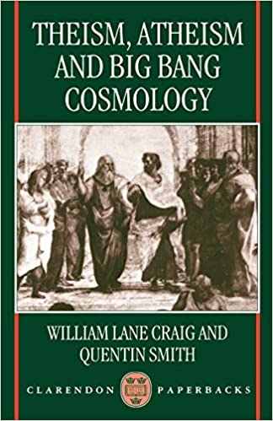
Quentin Smith, Atheist Philosopher, Western Michigan William Lane Craig and Quentin Smith, Theism, Atheism, and Big Bang Cosmology (Oxford [England: Clarendon, 1993), 135.
The most reasonable belief is that
we came from nothing, by nothing, and for nothing.

Slide 25
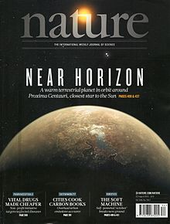
Tryon, Edward P. "Is the Universe a Vacuum Fluctuation?". Nature. Retrieved March 26, 2016.
The universe is simply one of those things that happens from time to time.

Slide 26
Arguments from Science
The “fine tuning” of our universe
The beginning of our universe (and time!)
The complexity of life in our universe

Slide 27
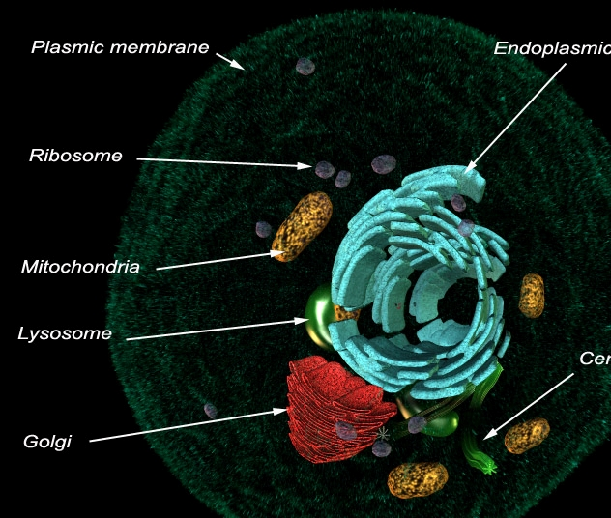
Total cells:
~30 trillion
Cells created per day:
~200 billion
Letters in each DNA strand:
3 billion (e.g. SETI project)

Slide 28
Arguments from Science
The “fine tuning” of our universe
The beginning of our universe (and time!)
The complexity of life in our universe
The origin of life in our universe

Slide 29
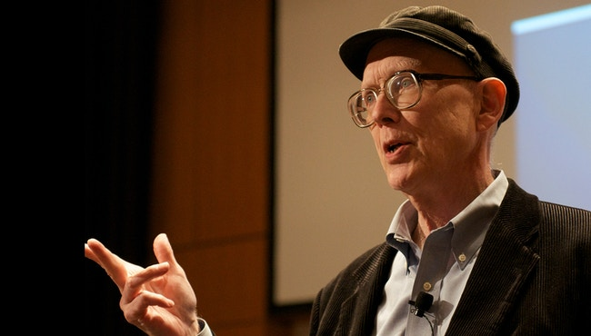
George Whitesides, Harvard, Upon receiving the top award of the Amer. Chem. Society, 2007 George M. Whitesides, “Revolutions In Chemistry: Priestley Medalist George M. Whitesides’ Address,” Chemical and Engineering News, 85: 12-17 (March 26, 2007).
This problem is one of the big ones in science. It begins to place life, and us, in the universe.
Most chemists believe, as do I, that life emerged spontaneously from mixtures of molecules in the prebiotic Earth.
How? I have no idea.

Slide 30
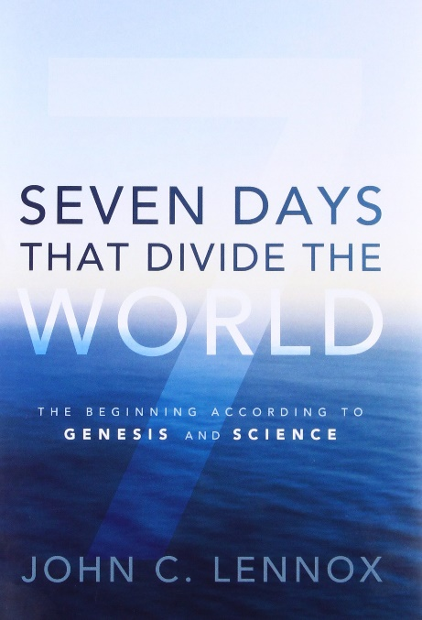
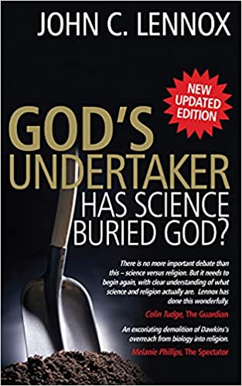
Arguments from Science
The “fine tuning” of our universe
The beginning of our universe (and time!)
The complexity of life in our universe
The origin of life in our universe

Slide 31
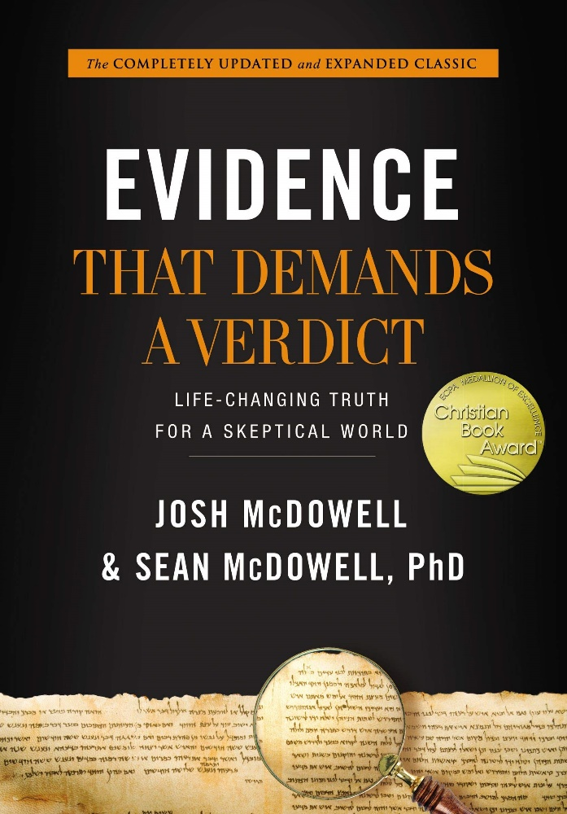
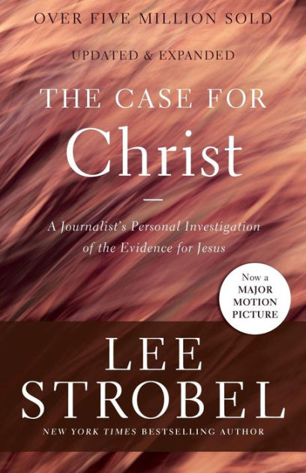
Arguments from History
Predictive Prophecy
Jesus’s Resurrection

Slide 32
Arguments from “Common Sense”
Is there such a thing as right and wrong?

Slide 33
Dawkins, River out of Eden, 1995. p 133.
The universe we observe has precisely the properties we should expect if there is, at bottom, no design, no purpose,
no evil and no good, nothing but blind pitiless indifference.

Slide 34
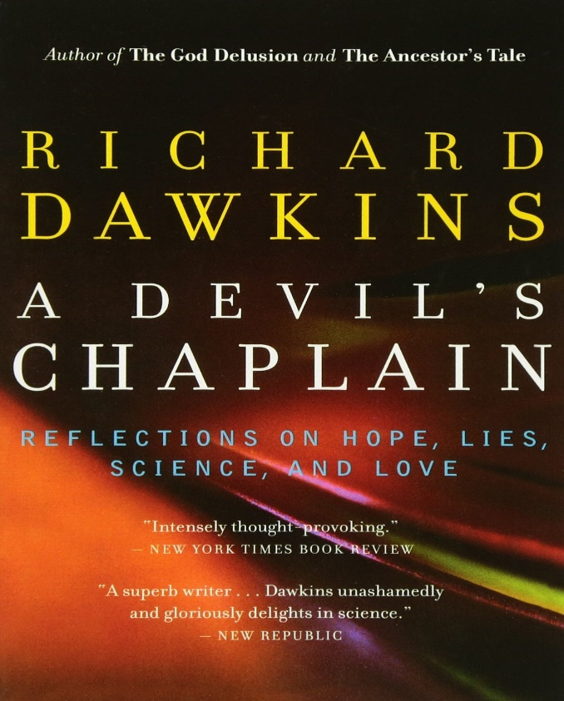
Richard Dawkins, The Devil’s Chaplain: Reflections on Hope, Lies, Science, and Love (New York: Houghton Mifflin Company, 2004), 10-11.
As I support Darwinism as a scientist,
I am a passionate anti-Darwinian when it comes to politics and how we should conduct our human affairs.

Slide 35
Arguments from “Common Sense”
Is there such a thing as right and wrong?
Are humans equal, and do they have value?
What is our basis for free will?

Slide 36
Hawking, S.W., and Leonard Mlodinow. The Grand Design. New York: Bantam, 2010, 32
The molecular basis of biology shows that biological processes are governed by the laws of physics and chemistry
and therefore are as determined as the orbits of the planets...
so it seems that we are no more than biological machines and that free will is just an illusion.

Slide 37
Dawkins Video Here

Slide 38
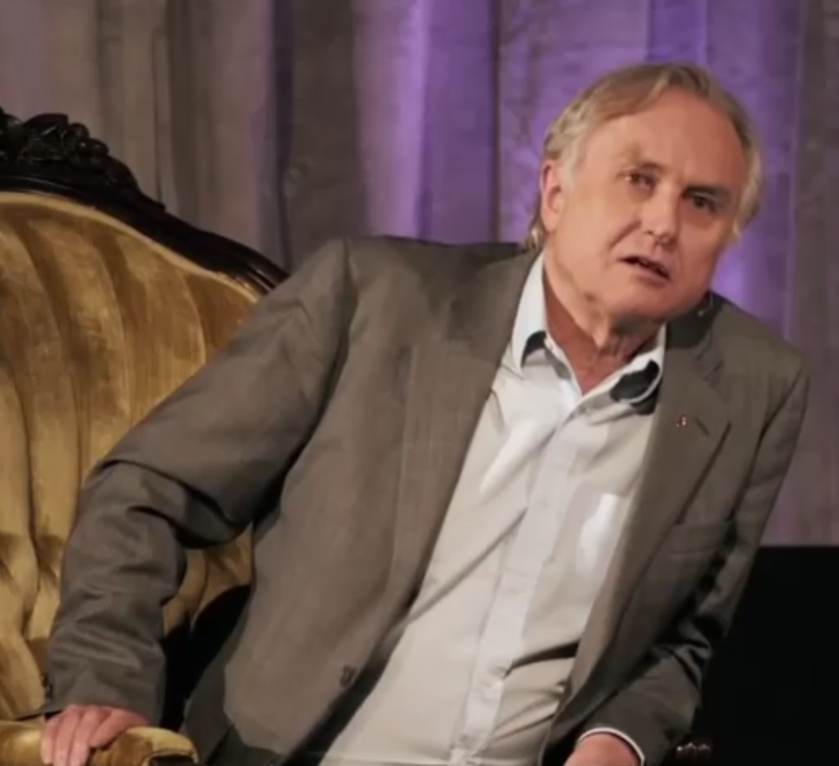
It’s a question that I dread actually because I don’t have a very well thought- out view about it
I have a materialist view of the world… things are determined in a rational way by antecedent events
When I think I have free will… I am deluding myself… my brain states are determined

Slide 39
And yet that seems to contradict the very powerful subjective impression that we all have that we do have free will

Slide 40
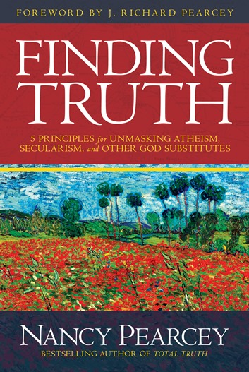
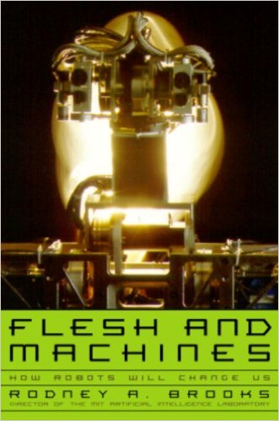
Nancy Pearcey, Finding God (David C. Cook, 2015), 164-165, quoting Rodney Brooks, MIT
Brooks writes that a human being is nothing but a machine—
a “big bag of skin full of biomolecules” interacting by the laws of physics and chemistry.
In ordinary life, of course, it is difficult to actually see people that way.
But, he says, “when I look at my children, I can, when I force myself, … see that they are machines.”

Slide 41
Nancy Pearcey, Finding God (David C. Cook, 2015), 164-165, quoting Rodney Brooks, MIT
Is that how he treats them, though? Of course not:
“That is not how I treat them.… I interact with them on an entirely different level.
They have my unconditional love, the furthest one might be able to get from rational analysis.” …

Slide 42
Nancy Pearcey, Finding God (David C. Cook, 2015), 164-165, quoting Rodney Brooks, MIT
How does he reconcile such a heart-wrenching cognitive dissonance?
He doesn’t.
Brooks ends by saying, “I maintain two sets of inconsistent beliefs.”
He has given up on any attempt to reconcile his theory with his experience.

Slide 43
What Do You Believe… And Why?
How did both space and time begin at the “Big Bang”?
Why does our universe seem so precisely calibrated to support life?
How did such complex living organisms arise from non-living matter?
What are we to make of the hundreds of fulfilled prophecies in Scripture?

Slide 44
What Do You Believe… And Why?
Is there anything special about humans?
Is there such a thing as right and wrong?
Do I have freedom to choose? (Or are my choices determined by physical laws?)
Does what I call “love” mean anything?

Slide 45
What Do You Believe… And Why?
The point of a worldview is to explain reality… not to explain it away!
I’ve given you a lot of reasons
But reasons alone aren’t enough (Revelation 3:20)

Slide 46
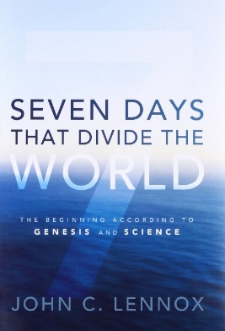
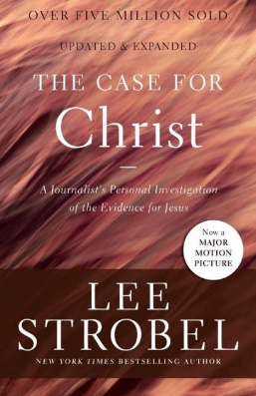
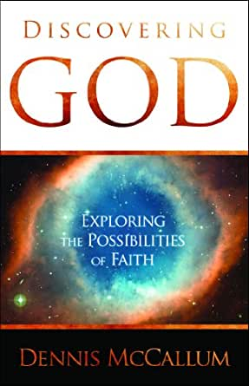
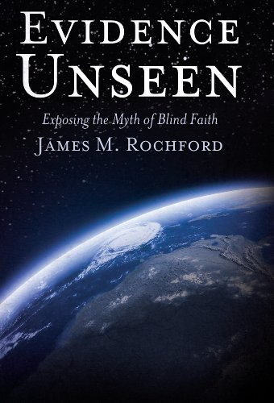
1 Peter 3
Questions?
Comments?
Experiences?
risleys@dwellcc.org
See the Dwell App OR teachings.dwellcc.org
Next time: 1 Peter 3-4 – Lessons from Noah

