Slide 1
PHILIPPIANS
THE BOOK OF

Slide 2
Philippians 1
²⁷ Whatever happens, conduct yourselves in a manner worthy of the gospel of Christ. Then, whether I come and see you or only hear about you in my absence, I will know that you stand firm in [one] Spirit, striving together as one for the faith of the gospel.

Slide 3
Philippians 1
^{27a} Whatever happens, conduct yourselves in a manner worthy of the gospel of Christ…

Slide 4
Philippians 1
^{27a} Whatever happens, conduct yourselves in a manner worthy of the gospel of Christ…

Slide 5
Philippians 1
^{27a} Whatever happens, conduct yourselves in a manner worthy of the gospel of Christ…

Slide 6
Philippians 1
^{27a} Whatever happens, conduct yourselves in a manner worthy of the gospel of Christ…
politeuomai = “act as a citizen.”
“you must live as citizens of heaven conducting yourselves in a manner worthy of the Good News” (NLT).

Slide 7
Philippians 1
^{27a} Whatever happens, conduct yourselves in a manner worthy of the gospel of Christ…
politeuomai = “act as a citizen.”
The Philippians were quite proud of their Roman citizenship.

Slide 8
Philippians 1
^{27b} Then, whether I come and see you or only hear about you in my absence, I will know that you stand firm in one Spirit…

Slide 9
Philippians 1
^{27b} Then, whether I come and see you or only hear about you in my absence, I will know that you stand firm in one Spirit…

Slide 10
Philippians 2
¹ Therefore, if you have any encouragement from being united with Christ, if any comfort from his love, if any fellowship in the Spirit, if any tenderness and compassion

Slide 11
Philippians 2
¹ Therefore if you have any encouragement from being united with Christ, if any comfort from his love, if any fellowship in the Spirit, if any tenderness and compassion
² Then make my joy complete by being like-minded, having the same love, being one in spirit and of one mind.

Slide 12
Philippians 2
¹ Therefore if you have any encouragement from being united with Christ, if any comfort from his love, if any fellowship in the Spirit, if any tenderness and compassion
² Then make my joy complete by being like-minded, having the same love, being one in spirit and of one mind.
1 Corinthians 12:13: For by one Spirit we were all baptized into one body, whether Jews or Greeks…we were all made to drink of one Spirit.
Mystical Union

Slide 13
Philippians 2
¹ Therefore if you have any encouragement from being united with Christ, if any comfort from his love, if any fellowship in the Spirit, if any tenderness and compassion
² Then make my joy complete by being like-minded, having the same love, being one in spirit and of one mind.
The Body of Christ contains both unity and diversity like a real body.

Slide 14
Philippians 2
¹ Therefore if you have any encouragement from being united with Christ, if any comfort from his love, if any fellowship in the Spirit, if any tenderness and compassion
² Then make my joy complete by being like-minded, having the same love, being one in spirit and of one mind.
Ephesians 4:3: Make every effort to keep the unity of the Spirit through the bond of peace.

Slide 15
Philippians 2
¹ Therefore if you have any encouragement from being united with Christ, if any comfort from his love, if any fellowship in the Spirit, if any tenderness and compassion
² Then make my joy complete by being like-minded, having the same love, being one in spirit and of one mind.
Paul was bringing this up due to in-fighting in this group.
4:2-3: I plead with Euodia and I plead with Syntyche to be of the same mind in the Lord. Yes, and I ask you, my true companion, help these women since they have contended at my side in the cause of the gospel.

Slide 16
Philippians 2
¹ Therefore if you have any encouragement from being united with Christ, if any comfort from his love, if any fellowship in the Spirit, if any tenderness and compassion
² Then make my joy complete by being like-minded, having the same love, being one in spirit and of one mind.
Division among believers in Christ can harm God’s spiritual community.
It has the potential to destroy God’s community

Slide 17
Philippians 2
¹ Therefore if you have any encouragement from being united with Christ, if any comfort from his love, if any fellowship in the Spirit, if any tenderness and compassion
² Then make my joy complete by being like-minded, having the same love, being one in spirit and of one mind.
Division among believers in Christ can harm God’s spiritual community.
The light of Christ –which is projected through God’s community– will grow dim.
Ephesians 2:19: You Gentiles are no longer strangers and foreigners. You are citizens along with all of God’s holy people. You are members of God’s family.

Slide 18
Philippians 2
¹ Therefore if you have any encouragement from being united with Christ, if any comfort from his love, if any fellowship in the Spirit, if any tenderness and compassion
² Then make my joy complete by being like-minded, having the same love, being one in spirit and of one mind.
Division among believers in Christ can harm God’s spiritual community.
The light of Christ –which is projected through God’s community– will grow dim.
John 13:35: All men will know that you are my disciples, if you love one another.

Slide 19
Philippians 2
¹ Therefore if you have any encouragement from being united with Christ, if any comfort from his love, if any fellowship in the Spirit, if any tenderness and compassion
² Then make my joy complete by being like-minded, having the same love, being one in spirit and of one mind.
What are some of the causes of in-fighting and disunity?
Jealousy
James 4:1-2: What causes fights and quarrels among you? Don’t they come from your desires that battle within you? You want something but don’t get it. You kill and covet, but you cannot have what you want. You quarrel and fight.

Slide 20
Philippians 2
¹ Therefore if you have any encouragement from being united with Christ, if any comfort from his love, if any fellowship in the Spirit, if any tenderness and compassion
² Then make my joy complete by being like-minded, having the same love, being one in spirit and of one mind.
What are some of the causes of in-fighting and disunity?
Jealousy
» Focusing on the negative aspects of a person
» A strong aversion to being around that person
» Feeling like it’s “unfair” when they succeed or get something they don’t deserve

Slide 21
Philippians 2
¹ Therefore if you have any encouragement from being united with Christ, if any comfort from his love, if any fellowship in the Spirit, if any tenderness and compassion
² Then make my joy complete by being like-minded, having the same love, being one in spirit and of one mind.
What are some of the causes of in-fighting and disunity?
Jealousy
» Secretly being happy when they fail, but outwardly expressing sympathy
» Gossiping about that person hoping to poison other people’s perception of them

Slide 22
Philippians 2
¹ Therefore if you have any encouragement from being united with Christ, if any comfort from his love, if any fellowship in the Spirit, if any tenderness and compassion
² Then make my joy complete by being like-minded, having the same love, being one in spirit and of one mind.
What are some of the causes of in-fighting and disunity?
Jealousy
» Qualifying people’s praise about a person when they are not around

Slide 23
Philippians 2
¹ Therefore if you have any encouragement from being united with Christ, if any comfort from his love, if any fellowship in the Spirit, if any tenderness and compassion
² Then make my joy complete by being like-minded, having the same love, being one in spirit and of one mind.
What are some of the causes of in-fighting and disunity?
God’s Enemy
James 3:14-16: If you harbor bitter envy and selfish ambition in your hearts, do not boast about it or deny the truth. Such “wisdom” does not come down from heaven but is earthly, unspiritual, demonic.

Slide 24
Philippians 2
¹ Therefore if you have any encouragement from being united with Christ, if any comfort from his love, if any fellowship in the Spirit, if any tenderness and compassion
² Then make my joy complete by being like-minded, having the same love, being one in spirit and of one mind.

Slide 25
Philippians 1
^{27c} [I will know that you are]…striving together as one for the faith of the Gospel.

Slide 26
Philippians 1
^{27c} [I will know that you are]…striving together as one for the faith of the Gospel.
We can experience another level of unity that comes from working together to carry out this mission.

Slide 27
Philippians 1
^{27c} [I will know that you are]…striving together as one for the faith of the Gospel.
= “fighting side by side”

Slide 28
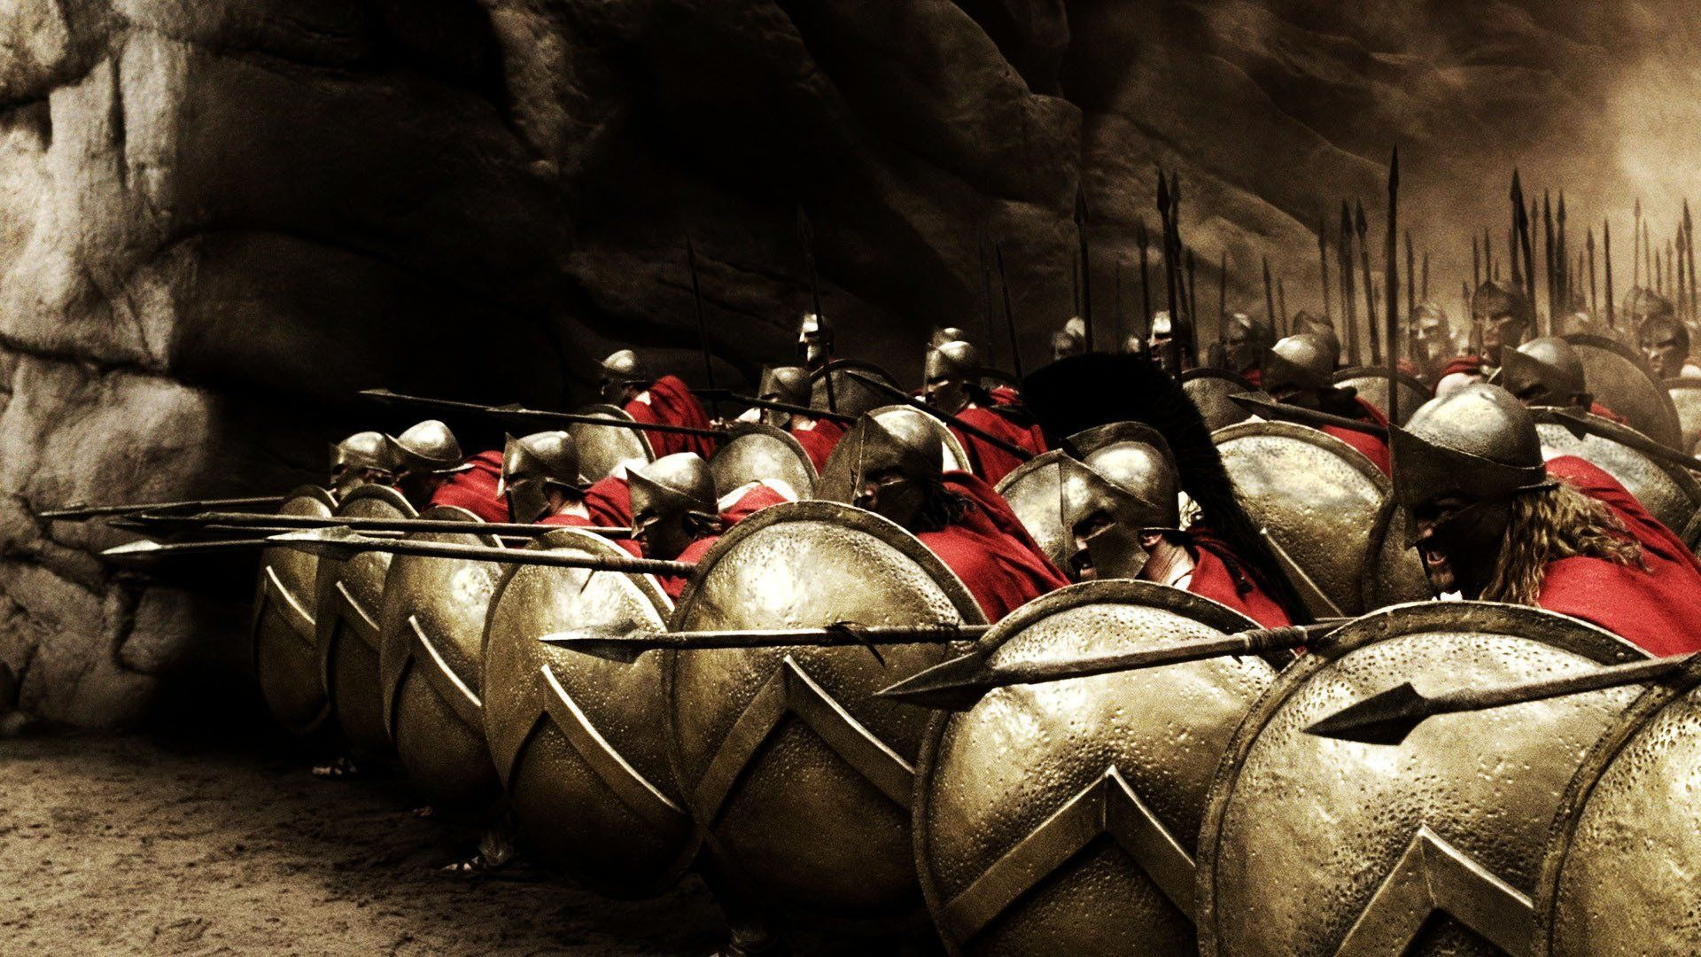
300 clip

Slide 29
300 clip

Slide 30
Philippians 1
^{27c} [I will know that you are]…striving together as one for the faith of the Gospel.
= “fighting side by side”

Slide 31
Application
» You can experience deep unity with others through Jesus.
» Are you doing your part to make every effort to maintain the “unity of the Spirit?”
» Throw in and experience the unity that’s forged by carrying out God’s mission.

Slide 32
PHILIPPIANS
THE BOOK OF

