Slide 2
WELCOME TO 10AM
Main Campus CT!

Slide 3
2 Timothy
^{2 Tim 1:1} Paul, an apostle of Christ Jesus by the will of God, according to the promise of life in Christ Jesus, ² To Timothy, my beloved son: Grace, mercy, and peace from God the Father and Christ Jesus our Lord.

Slide 4
2 Timothy
^{2 Tim 1:1} Paul, an apostle of Christ Jesus by the will of God, according to the promise of life in Christ Jesus, ² To Timothy, my beloved son: Grace, mercy, and peace from God the Father and Christ Jesus our Lord.

Slide 5
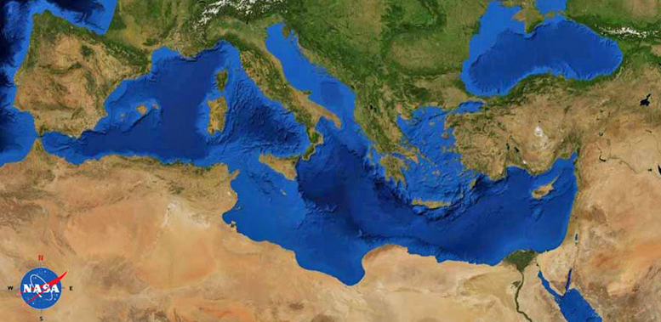
2 Timothy
Rome
^{2 Tim 1:1} Paul, an apostle of Christ Jesus by the will of God, according to the promise of life in Christ Jesus, ² To Timothy, my beloved son: Grace, mercy, and peace from God the Father and Christ Jesus our Lord.

Slide 6
2 Timothy
Rome
^{2 Tim 1:1} Paul, an apostle of Christ Jesus by the will of God, according to the promise of life in Christ Jesus, ² To Timothy, my beloved son: Grace, mercy, and peace from God the Father and Christ Jesus our Lord.

Slide 7
2 Timothy
Rome
Ephesus
^{2 Tim 1:1} Paul, an apostle of Christ Jesus by the will of God, according to the promise of life in Christ Jesus, ² To Timothy, my beloved son: Grace, mercy, and peace from God the Father and Christ Jesus our Lord.

Slide 8
2 Timothy
Rome
Ephesus
^{2 Tim 1:1} Paul, an apostle of Christ Jesus by the will of God, according to the promise of life in Christ Jesus, ² To Timothy, my beloved son: Grace, mercy, and peace from God the Father and Christ Jesus our Lord.

Slide 9
2 Timothy
Rome
Ephesus
^{2 Tim 1:3} I thank God, whom I serve with a clear conscience the way my forefathers did, as I constantly remember you in my prayers night and day, ⁴ longing to see you, even as I recall your tears, so that I may be filled with joy.

Slide 10
2 Timothy
Rome
Ephesus
^{2 Tim 1:5} For I am mindful of the sincere faith within you, which first dwelled in your grandmother Lois and your mother Eunice, and I am sure that it is in you as well.

Slide 11
2 Timothy
Rome
Ephesus
^{2 Tim 1:6} For this reason I remind you to kindle afresh the gift of God which is in you through the laying on of my hands. ⁷ For God has not given us a spirit of timidity, but of power and love and discipline.

Slide 12
2 Timothy
Rome
Ephesus
^{2 Tim 1:6} For this reason I remind you to kindle afresh the gift of God which is in you through the laying on of my hands. ⁷ For God has not given us a spirit of timidity, but of power and love and discipline.

Slide 13
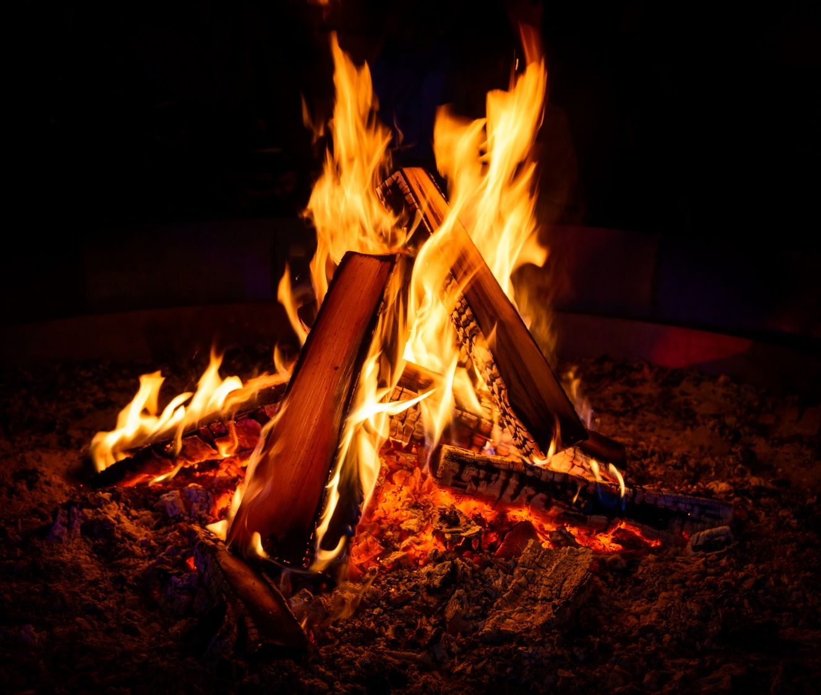
^{2 Tim 1:6} For this reason I remind you to kindle afresh the gift of God which is in you through the laying on of my hands. ⁷ For God has not given us a spirit of timidity, but of power and love and discipline.

Slide 14
^{2 Tim 1:6} For this reason I remind you to kindle afresh the gift of God which is in you through the laying on of my hands. ⁷ For God has not given us a spirit of timidity, but of power and love and discipline.

Slide 15
Stoke up your spiritual fire
Timothy had reason for his fire to burn low …
^{2 Tim 1:6} For this reason I remind you to kindle afresh the gift of God which is in you through the laying on of my hands. ⁷ For God has not given us a spirit of timidity, but of power and love and discipline.

Slide 16
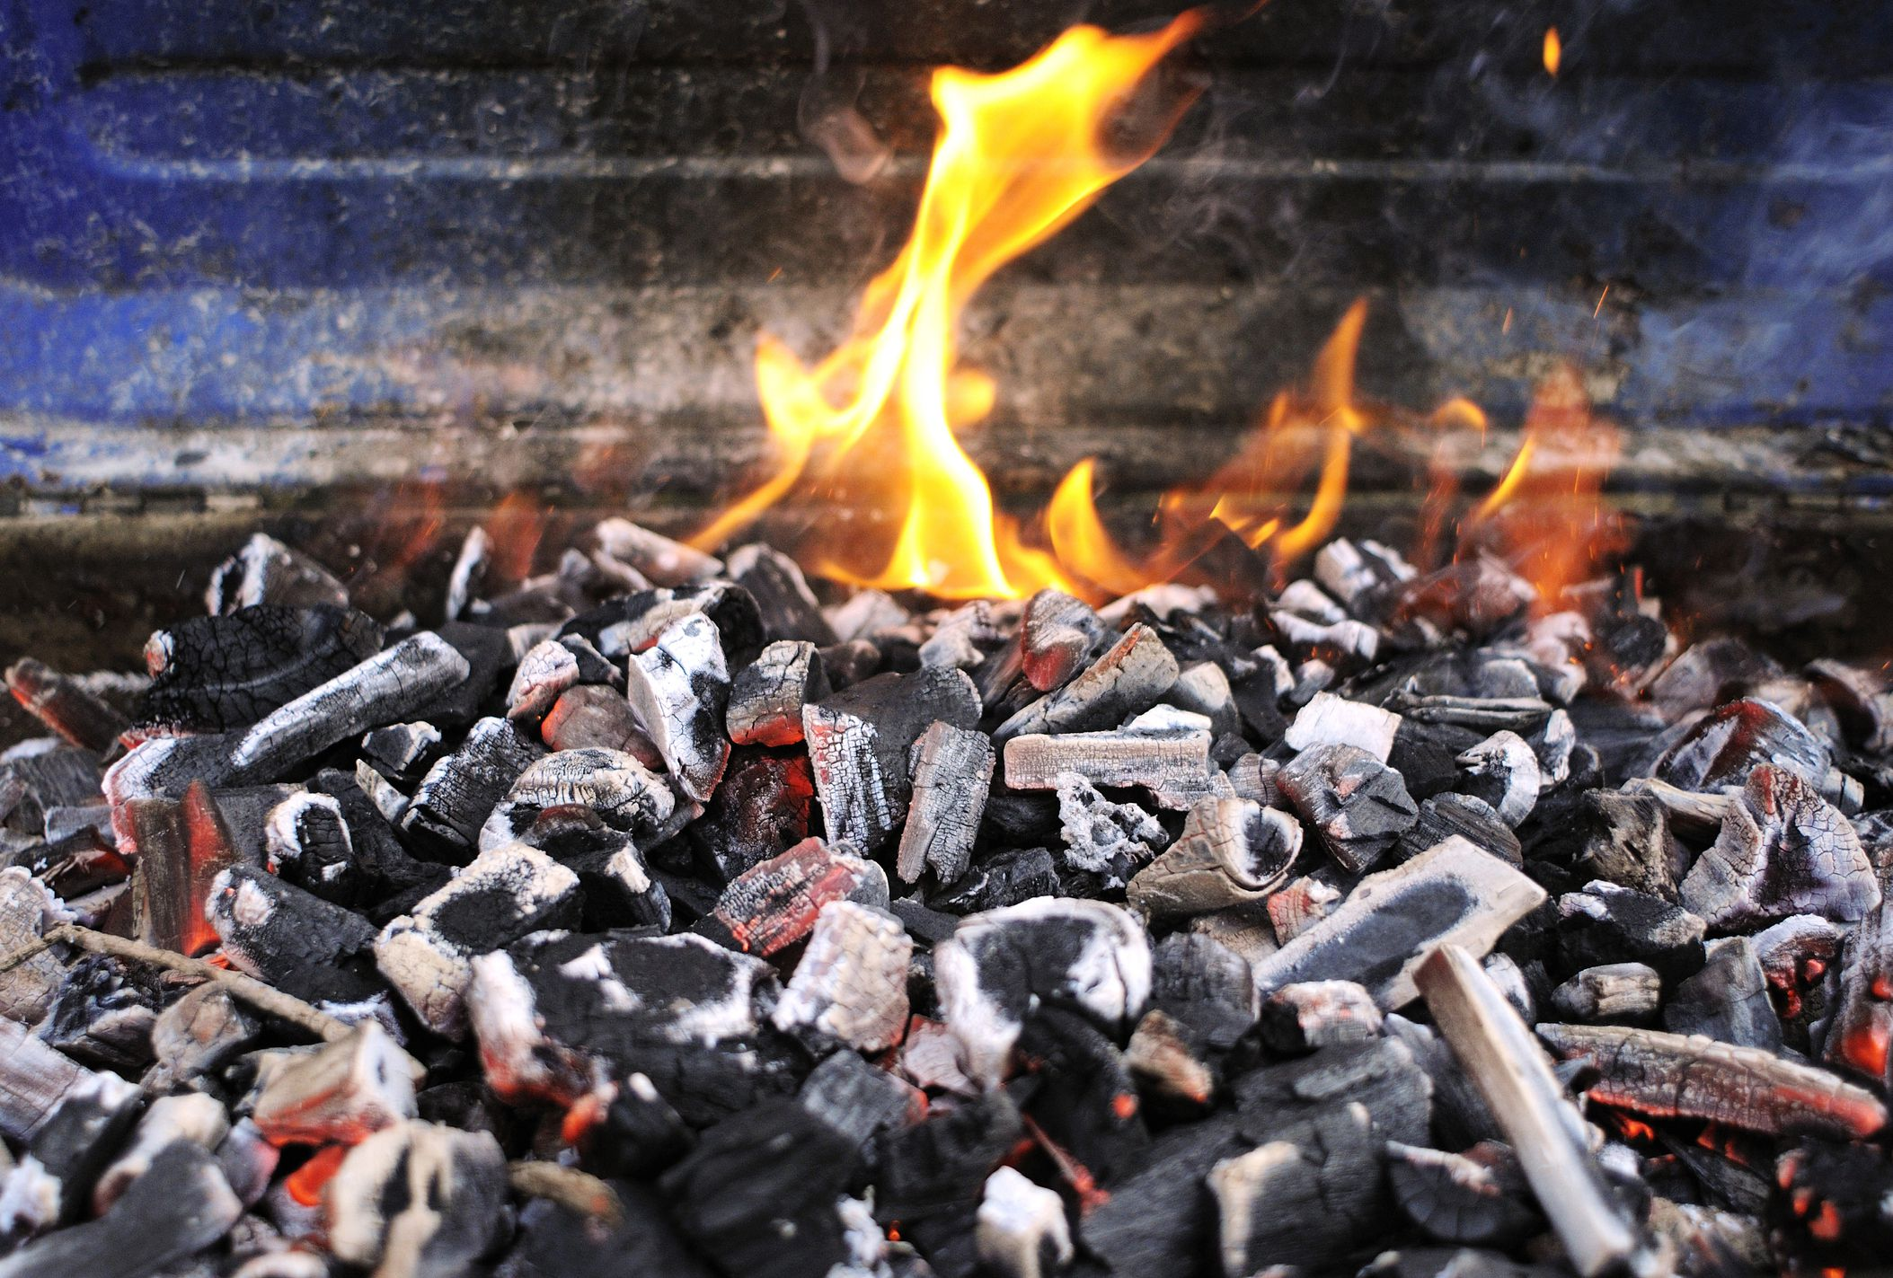
Stoke up your spiritual fire
Timothy had reason for his fire to burn low …
And so do we!
^{2 Tim 1:6} For this reason I remind you to kindle afresh the gift of God which is in you through the laying on of my hands. ⁷ For God has not given us a spirit of timidity, but of power and love and discipline.

Slide 17
Stoke up your spiritual fire
Timothy had reason for his fire to burn low …
And so do we!
^{2 Tim 1:6} For this reason I remind you to kindle afresh the gift of God which is in you through the laying on of my hands. ⁷ For God has not given us a spirit of timidity, but of power and love and discipline.

Slide 18
Stoke up your spiritual fire
1) Remember the fire you already have
2) Stoke it up!
^{2 Tim 1:6} For this reason I remind you to kindle afresh the gift of God which is in you through the laying on of my hands. ⁷ For God has not given us a spirit of timidity, but of power and love and discipline.

Slide 19
1) Remember the fire you already have
Timothy’s spiritual foundation:
His relationship with Paul
^{2 Tim 1:3} I thank God, whom I serve with a clear conscience the way my forefathers did, as I constantly remember you in my prayers night and day, ⁴ longing to see you, even as I recall your tears, so that I may be filled with joy.

Slide 20
1) Remember the fire you already have
Timothy’s spiritual foundation:
His relationship with Paul
^{2 Tim 1:3} I thank God, whom I serve with a clear conscience the way my forefathers did, as I constantly remember you in my prayers night and day, ⁴ longing to see you, even as I recall your tears, so that I may be filled with joy.

Slide 21
1) Remember the fire you already have
Timothy’s spiritual foundation:
His relationship with Paul
^{2 Tim 1:3} I thank God, whom I serve with a clear conscience the way my forefathers did, as I constantly remember you in my prayers night and day, ⁴ longing to see you, even as I recall your tears, so that I may be filled with joy.

Slide 22
1) Remember the fire you already have
Timothy’s spiritual foundation:
His relationship with Paul
^{2 Tim 1:3} I thank God, whom I serve with a clear conscience the way my forefathers did, as I constantly remember you in my prayers night and day, ⁴ longing to see you, even as I recall your tears, so that I may be filled with joy.

Slide 23
1) Remember the fire you already have
Timothy’s spiritual foundation:
His relationship with Paul
^{2 Tim 1:3} I thank God, whom I serve with a clear conscience the way my forefathers did, as I constantly remember you in my prayers night and day, ⁴ longing to see you, even as I recall your tears, so that I may be filled with joy.

Slide 24
1) Remember the fire you already have
Timothy’s spiritual foundation:
His relationship with Paul
^{2 Tim 1:3} I thank God, whom I serve with a clear conscience the way my forefathers did, as I constantly remember you in my prayers night and day, ⁴ longing to see you, even as I recall your tears, so that I may be filled with joy.

Slide 25
1) Remember the fire you already have
Timothy’s spiritual foundation:
His relationship with Paul
His sincere faith in Christ
^{2 Tim 1:5} For I am mindful of the sincere faith within you, which first dwelled in your grandmother Lois and your mother Eunice, and I am sure that it is in you as well.

Slide 26
1) Remember the fire you already have
Timothy’s spiritual foundation:
^{2 Tim 3:14} … continue in the things you have learned and become convinced of, knowing from whom you have learned them, ¹⁵ and that from childhood you have known the sacred writings which are able to give you the wisdom that leads to salvation through faith which is in Christ Jesus.
His relationship with Paul
His sincere faith in Christ
His family legacy
^{2 Tim 1:5} For I am mindful of the sincere faith within you, which first dwelled in your grandmother Lois and your mother Eunice, and I am sure that it is in you as well.

Slide 27
1) Remember the fire you already have
Timothy’s spiritual foundation:
His relationship with Paul
His sincere faith in Christ
His family legacy
His calling and mission
^{2 Tim 1:6} For this reason I remind you to kindle afresh the gift of God which is in you through the laying on of my hands. ⁷ For God has not given us a spirit of timidity, but of power and love and discipline.

Slide 28
1) Remember the fire you already have
Timothy’s spiritual foundation:
His relationship with Paul
His sincere faith in Christ
His family legacy
His calling and mission
God’s Spirit in you!
^{2 Tim 1:6} For this reason I remind you to kindle afresh the gift of God which is in you through the laying on of my hands. ⁷ For God has not given us a spirit of timidity, but of power and love and discipline.

Slide 29
1) Remember the fire you already have
This is Timothy’s bed of coals
What’s yours?
^{2 Tim 1:6} For this reason I remind you to kindle afresh the gift of God which is in you through the laying on of my hands. ⁷ For God has not given us a spirit of timidity, but of power and love and discipline.

Slide 30
2) Stoke it up
How do you put life back in a fire?
^{2 Tim 1:6} For this reason I remind you to kindle afresh the gift of God which is in you through the laying on of my hands. ⁷ For God has not given us a spirit of timidity, but of power and love and discipline.

Slide 31
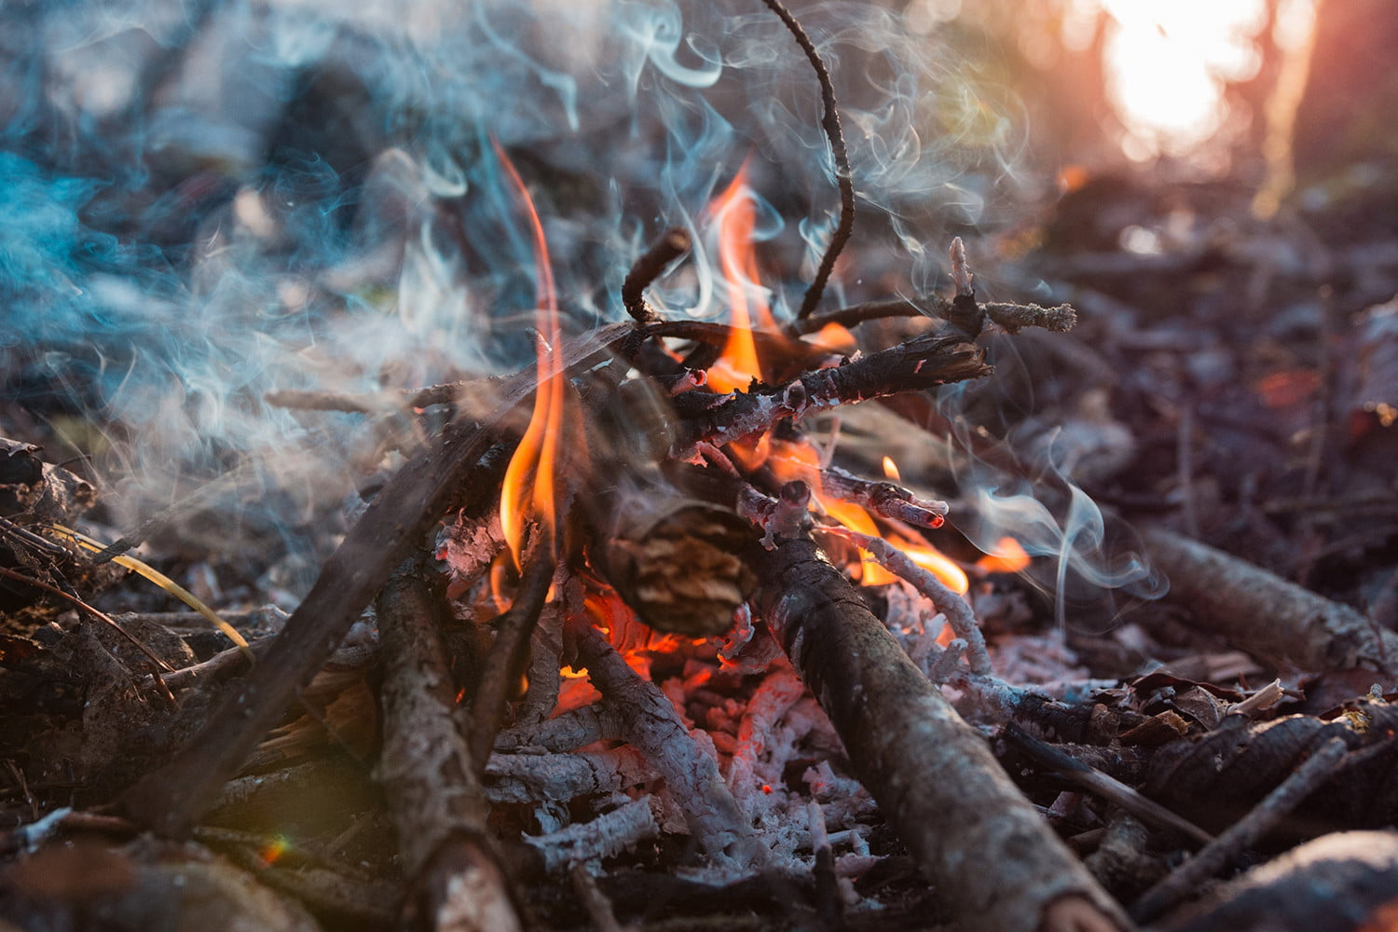
2) Stoke it up
How do you put life back in a fire?
^{2 Tim 1:6} For this reason I remind you to kindle afresh the gift of God which is in you through the laying on of my hands. ⁷ For God has not given us a spirit of timidity, but of power and love and discipline.

Slide 32
2) Stoke it up
What can I do to refresh my spiritual fire?
^{2 Tim 1:6} For this reason I remind you to kindle afresh the gift of God which is in you through the laying on of my hands. ⁷ For God has not given us a spirit of timidity, but of power and love and discipline.

Slide 33
2) Stoke it up
What can I do to refresh my spiritual fire?
Tend to the basics
Lie: “I’ve outgrown the basics”
^{2 Tim 1:6} For this reason I remind you to kindle afresh the gift of God which is in you through the laying on of my hands. ⁷ For God has not given us a spirit of timidity, but of power and love and discipline.

Slide 34
2) Stoke it up
What can I do to refresh my spiritual fire?
Start with the source
^{2 Tim 1:6} For this reason I remind you to kindle afresh the gift of God which is in you through the laying on of my hands. ⁷ For God has not given us a spirit of timidity, but of power and love and discipline.

Slide 35
2) Stoke it up
What can I do to refresh my spiritual fire?
Ask: what are my spiritual inputs & outputs?
^{2 Tim 1:6} For this reason I remind you to kindle afresh the gift of God which is in you through the laying on of my hands. ⁷ For God has not given us a spirit of timidity, but of power and love and discipline.

Slide 36
2) Stoke it up
What can I do to refresh my spiritual fire?
What did 2020 do to them?
^{2 Tim 1:6} For this reason I remind you to kindle afresh the gift of God which is in you through the laying on of my hands. ⁷ For God has not given us a spirit of timidity, but of power and love and discipline.

Slide 37
2) Stoke it up
What can I do to refresh my spiritual fire?
How can I adapt spiritual provisions to fit today?
Lie: “life is too crazy right now to do those things”
^{2 Tim 1:6} For this reason I remind you to kindle afresh the gift of God which is in you through the laying on of my hands. ⁷ For God has not given us a spirit of timidity, but of power and love and discipline.

Slide 38
2) Stoke it up
What can I do to refresh my spiritual fire?
How can I adapt spiritual provisions to fit today?
Lie: “life is too crazy right now to do those things”
^{2 Tim 1:6} For this reason I remind you to kindle afresh the gift of God which is in you through the laying on of my hands. ⁷ For God has not given us a spirit of timidity, but of power and love and discipline.

Slide 39
^{2 Tim 1:6} For this reason I remind you to kindle afresh the gift of God which is in you through the laying on of my hands. ⁷ For God has not given us a spirit of timidity, but of power and love and discipline.

