Slide 1
Hebrews 12:1-3 Run with Endurance

Slide 2
Hebrews 12:1-3
Heb. 12:1-3: “Therefore, since we have so great a cloud of witnesses surrounding us, let us also lay aside every encumbrance and the sin which so easily entangles us, and let us run with endurance the race set before us, fixing our eyes on Jesus, the author and perfecter of faith, who for the joy set before Him endured the cross, despising the shame, and has sat down at the right hand of the throne of God. For consider Him who has endured such hostility by sinners against Himself, so that you will not grow weary or lose heart.”

Slide 3
Hebrews 12:1-3
Basics about the race

Slide 4
Hebrews 12:1-3
1. God has given you a race to run
12:1…let us run with endurance the race that is set before us,…
It will revolve around showing/sharing love of Christ
Your life matters

Slide 5
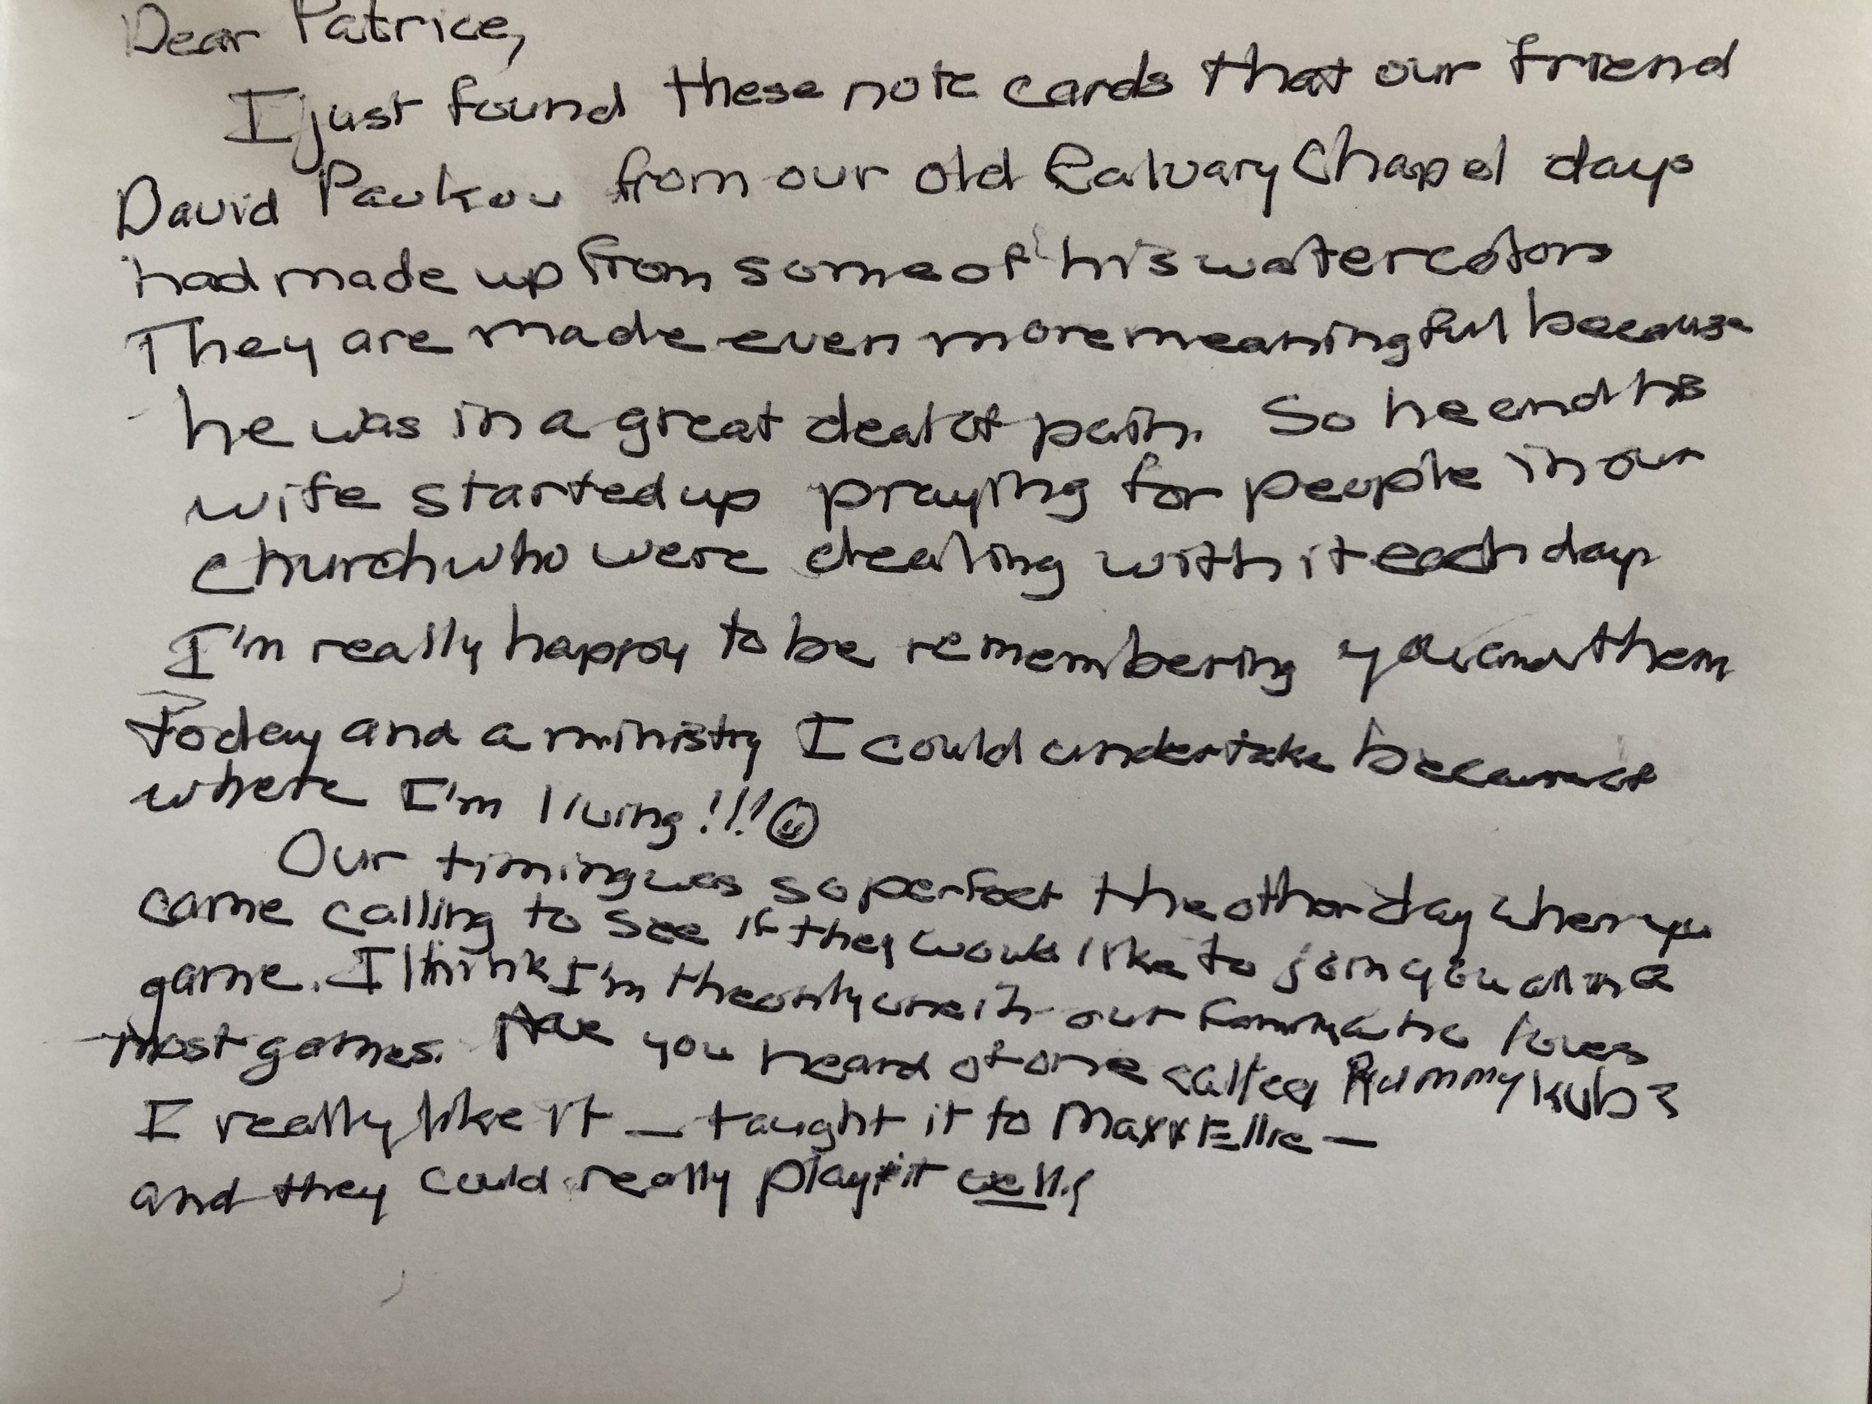
Hebrews 12:1-3

Slide 6
Hebrews 12:1-3
1. God has given you a race to run
12:1…let us run with endurance the race that is set before us,…
It will revolve around showing/sharing love of Christ
Your life matters
2. Entry into the race is not automatic

Slide 7
Hebrews 12:1-3
Roms. 3:23 “For all have sinned and fall short of the glory of God,”
Roms. 5:1 “Therefore, since we have been justified through faith, we have peace with God through our Lord Jesus Christ.”

Slide 8
Hebrews 12:1-3
Roms. 3:23 “For all have sinned and fall short of the glory of God,”
Roms. 5:1 “Therefore, since we have been justified through faith, we have peace with God through our Lord Jesus Christ.”

Slide 9
Hebrews 12:1-3
1. God has given you a race to run
2. Entry into the race is not automatic
3. It is not run alone

Slide 11
Hebrews 12:1-3
Heb. 12:1-3: “Therefore, since we have so great a cloud of witnesses surrounding us, let us also lay aside every encumbrance and the sin which so easily entangles us, and let us run with endurance the race set before us, fixing our eyes on Jesus, the author and perfecter of faith, who for the joy set before Him endured the cross, despising the shame, and has sat down at the right hand of the throne of God. For consider Him who has endured such hostility by sinners against Himself, so that you will not grow weary or lose heart.”

Slide 12
Hebrews 12:1-3
If flagging, are you trying to run your race on your own?

Slide 13
Hebrews 12:1-3
How to run the race
It will take endurance to run this race.

Slide 14
Hebrews 12:1-3
Heb. 12:1-3: “Therefore, since we have so great a cloud of witnesses surrounding us, let us also lay aside every encumbrance and the sin which so easily entangles us, and let us run with endurance the race set before us, fixing our eyes on Jesus, the author and perfecter of faith, who for the joy set before Him endured the cross, despising the shame, and has sat down at the right hand of the throne of God. For consider Him who has endured such hostility by sinners against Himself, so that you will not grow weary or lose heart.”

Slide 15
Hebrews 12:1-3
It will take endurance
patience, fortitude, steadfastness, perseverance
I like it in other people

Slide 16
Hebrews 12:1-3

Slide 17
Hebrews 12:1-3

Slide 18
Hebrews 12:1-3
It will take endurance
patience, fortitude, steadfastness, perseverance
We like it in others
Value God esteems

Slide 19
Hebrews 12:1-3
Chap 11: Hall of Fame of Faith
Paul prays for it: strengthened with all power, according to His glorious might, for the attaining of all steadfastness and patience (Col. 1:11)
Called to pursue it: But flee from these things, ...and pursue righteousness...perseverance (Tim 6:11)
It is a noteworthy traits of both people and churches: therefore, we ourselves speak proudly of you among the churches of God for your perseverance and faith in the midst of all your persecutions and afflictions which you endure (2 Thes. 1:4)
God grants it: Now may the God who gives perseverance and encouragement (Rom 15:5)

Slide 20
Hebrews 12:1-3
Run the race with endurance
1. Remember the cloud of witnesses
12:1 Therefore, since we have so great a cloud of witnesses surrounding us

Slide 21
Hebrews 12:1-3

Slide 22
Hebrews 12:1-3
Remember the cloud of witnesses
“He was faithful to us and He will be faithful to you.”
History of God working through and for flawed, sinful people like ourselves
Google search bar: “Where to you find the story of _______in the Bible?

Slide 23
Hebrews 12:1-3
Run the race with endurance
1. Remember the cloud of witnesses
2. Get rid of excess baggage
12:1…let us also lay aside every encumbrance and the sin which so easily entangles us,

Slide 24
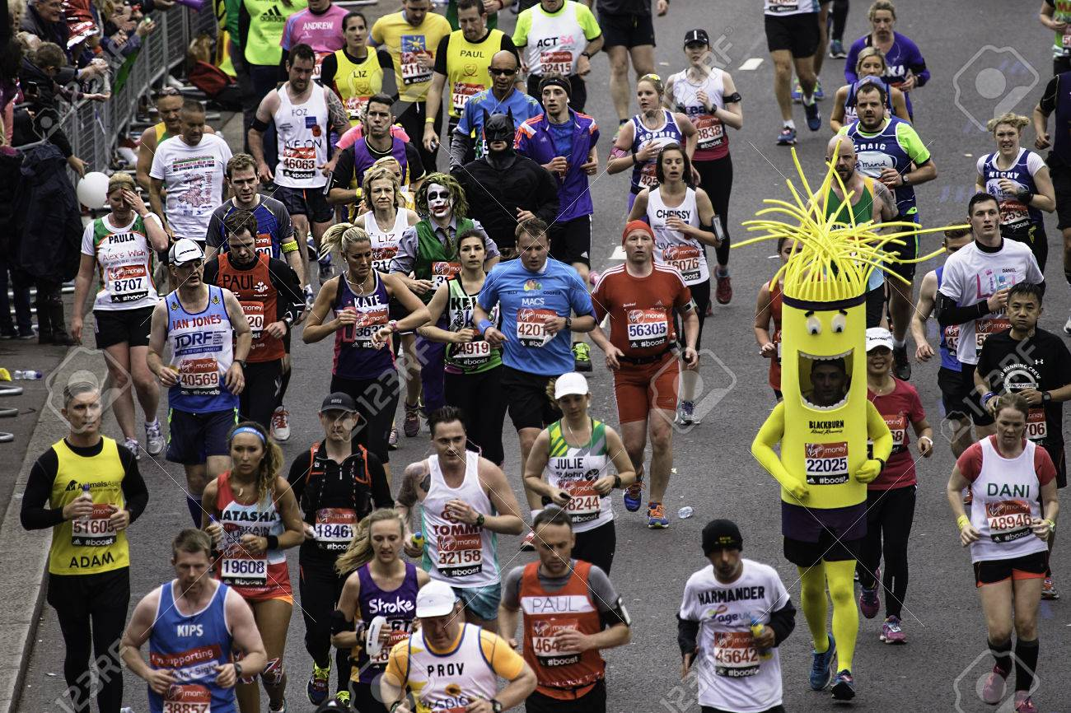
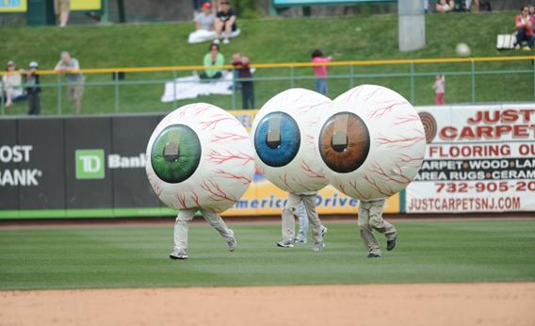
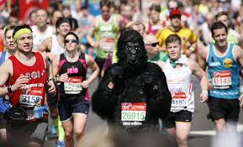
Hebrews 12:1-3

Slide 25
Hebrews 12:1-3
12:1 …let us also lay aside every encumbrance and sin which so easily entangles us…
Get rid of excess baggage
Encumbrances: things that make the race more difficult to run
Not an issue of right or wrong but is it helpful/detrimental to my spiritual life?

Slide 26
Hebrews 12:1-3

Slide 27
Hebrews 12:1-3
12:1 …let us also lay aside every encumbrance and sin which so easily entangles us…
Get rid of excess baggage (encumbrances & Sin)
Encumbrances: things that make race more difficult to run
Not an issue of right or wrong but is it helpful/detrimental to my spiritual life?
Steal time, emotional resources, thought life, and energy needed to run the race

Slide 28
Hebrews 12:1-3
2. Get rid of excess baggage
Sin: things that you know God says is wrong and are destructive
Not mean you can’t run if commit sin
Clutching onto and rationalizing
Will sap motivation and stamina

Slide 29
Hebrews 12:1-3
2. Get rid of excess baggage
Ask God to identify the baggage
Talk to him and others
Take small step

Slide 30
Hebrews 12:1-3
3. Focus on Christ
12:2 fixing our eyes on Jesus…
12:3 For consider Him …
Fixing our eyes
to turn your eyes away from other things and fix them on something

Slide 31
Hebrews 12:1-3

Slide 32
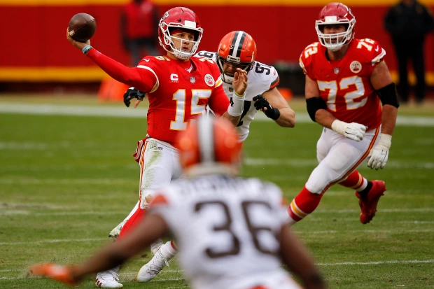
Hebrews 12:1-3

Slide 33
Hebrews 12:1-3
Focus on Christ
12:2 fixing our eyes on Jesus…
12:3 For consider Him …
Fixing our eyes
to turn eyes away from other things and fix them on something
Biggest challenge for most of us
End result: grow weary and lose heart

Slide 34
Hebrews 12:1-3
Focus on Christ
12:2 fixing our eyes on Jesus…
12:3 For consider Him …
Fixing our eyes
For consider Him
Give our utmost attention,

Slide 35
Hebrews 12:1-3
Why?
Puts our sufferings in perspective
Rom 8:18 “For I consider that the sufferings of this present time are not worthy to be compared with the glory that is to be revealed to us.”

Slide 36
Hebrews 12:1-3
Why?
Puts our sufferings in perspective
Issue of expectations of this life

Slide 37
Hebrews 12:1-3
“If we are not suffering at the moment, there is a tendency for us to take credit for it in our minds. It’s not luck or grace – it’s because we are living good and smart lives…(in Christ) …we see the one person in the history of the world who really did live a good life, even a perfect life, and merited the full love of God. He actually earned a pass from suffering and inconvenience. Yet his life went terribly! ...There will be a steady progression of rejection, attempts on his life, betrayal, poverty, grief, loss, torture and finally death.” Timothy Keller, Encounters with Jesus (New York: Riverhead Books, 2013) pg. 108.

Slide 38
Hebrews 12:1-3
Summary:
God has a race set before you. By His strength, we can run it with endurance.

Slide 39
Hebrews 12:1-3
Questions?
Comments

