Slide 1
1 Peter 1:17-25
Our Temporary Residence

Slide 2
1 Peter 1: 17-25
17. And if you address as Father the one who impartially judges according to each one’s work, live out the time of your temporary residence here
in reverence.

Slide 3
1 Peter 1: 17-25
17. And if you address as Father the one who impartially judges according to each one’s work, live out the time of your temporary residence here
in reverence.

Slide 4
What if we viewed this life as our permanent residence?
Investment
Recreation
Involvement
Sacrifice
Resources
Marriage
Family
Relationships
Leadership
Discipleship

Slide 5
What if we viewed this life as our permanent residence?
There is a great benefit in learning to detach ourselves from this view!
Investment
Recreation
Involvement
Sacrifice
Resources
Marriage
Family
Relationships
Leadership
Discipleship

Slide 6
What if we viewed this life as our permanent residence?
(Nee) ﻿Of course we must use the world, because we need it; but let us not want it, let us not desire it. Jesus explains, “But stay alert at all times, praying that you may have strength to escape all these things…” (Lk. 21:36)
Would God urge us to watch and pray were there not a spiritual force to guard against?...
There is a great benefit in learning to detach ourselves from this view!
Investment
Dedication
Involvement
Sacrifice
Resources
Marriage
Family
Relationships
Leadership
Discipleship

Slide 7
What if we viewed this life as our permanent residence?
(Nee) ﻿Of course we must use the world, because we need it; but let us not want it, let us not desire it. Jesus explains, “But stay alert at all times, praying that you may have strength to escape all these things…” (Lk. 21:36)
Would God urge us to watch and pray were there not a spiritual force to guard against?...
There is a great benefit in learning to detach ourselves from this view!
Investment
Dedication
Involvement
Sacrifice
Resources
Marriage
Family
Relationships
Leadership
Discipleship
(1 Pt. 1:13) Therefore, get your minds ready for action by being fully sober, and set your hope completely on the grace that will be brought to you when Jesus Christ is revealed.

Slide 8
What if we viewed this life as our permanent residence?
(Nee) ﻿Of course we must use the world, because we need it; but let us not want it, let us not desire it. Jesus explains, “But stay alert at all times, praying that you may have strength to escape all these things…” (Lk. 21:36)
Would God urge us to watch and pray were there not a spiritual force to guard against?...
There is a great benefit in learning to detach ourselves from this view!
Investment
Dedication
Involvement
Sacrifice
Resources
Marriage
Family
Relationships
Leadership
Discipleship
(Phil. 3:20) But we are citizens of heaven, where the Lord Jesus Christ lives. And we are eagerly waiting for him to return as our Savior.

Slide 9
What if we viewed this life as our permanent residence?
(Nee) ﻿Of course we must use the world, because we need it; but let us not want it, let us not desire it. Jesus explains, “But stay alert at all times, praying that you may have strength to escape all these things…” (Lk. 21:36)
Would God urge us to watch and pray were there not a spiritual force to guard against?...
There is a great benefit in learning to detach ourselves from this view!
In many cases, our desires need to be transformed.
Investment
Dedication
Involvement
Sacrifice
Resources
Marriage
Family
Relationships
Leadership
Discipleship
(Rom. 12:2) Do not be conformed to this present world, but be transformed by the renewing of your mind, so that you may test and approve what is the will of God—what is good and well-pleasing and perfect.
(Phil. 3:20) But we are citizens of heaven, where the Lord Jesus Christ lives. And we are eagerly waiting for him to return as our Savior.

Slide 10
What if we viewed this life as our permanent residence?
(Nee) ﻿Of course we must use the world, because we need it; but let us not want it, let us not desire it. Jesus explains, “But stay alert at all times, praying that you may have strength to escape all these things…” (Lk. 21:36)
Would God urge us to watch and pray were there not a spiritual force to guard against?...
There is a great benefit in learning to detach ourselves from this view!
Investment
Dedication
Involvement
Sacrifice
Resources
Marriage
Family
Relationships
Leadership
Discipleship

Slide 11
What if we viewed this life as our permanent residence?
(1 Jn. 5:19-21) We know that we are from God, and the whole world lies in the power of the evil one…
(Nee) ﻿Of course we must use the world, because we need it; but let us not want it, let us not desire it. Jesus explains, “But stay alert at all times, praying that you may have strength to escape all these things…” (Lk. 21:36)
Would God urge us to watch and pray were there not a spiritual force to guard against?...
There is a great benefit in learning to detach ourselves from this view!
Investment
Dedication
Involvement
Sacrifice
Resources
Marriage
Family
Relationships
Leadership
Discipleship

Slide 12
What if we viewed this life as our permanent residence?
(1 Jn. 5:19-21)…And we know that the Son of God has come and has given us insight to know him who is true, and we are in him who is true, in his Son Jesus Christ…
(Nee) ﻿Of course we must use the world, because we need it; but let us not want it, let us not desire it. Jesus explains, “But stay alert at all times, praying that you may have strength to escape all these things…” (Lk. 21:36)
Would God urge us to watch and pray were there not a spiritual force to guard against?...
There is a great benefit in learning to detach ourselves from this view!
Investment
Dedication
Involvement
Sacrifice
Resources
Marriage
Family
Relationships
Leadership
Discipleship

Slide 13
What if we viewed this life as our permanent residence?
(1 Jn. 5:19-21)…Little children, guard yourselves from idols.
(Nee) ﻿Of course we must use the world, because we need it; but let us not want it, let us not desire it. Jesus explains, “But stay alert at all times, praying that you may have strength to escape all these things…” (Lk. 21:36)
Would God urge us to watch and pray were there not a spiritual force to guard against?...
There is a great benefit in learning to detach ourselves from this view!
Investment
Dedication
Involvement
Sacrifice
Resources
Marriage
Family
Relationships
Leadership
Discipleship

Slide 14
What if we viewed this life as our permanent residence?
(1 Jn. 5:19-21)…Little children, guard yourselves from idols.
(Nee) ﻿Of course we must use the world, because we need it; but let us not want it, let us not desire it. Jesus explains, “But stay alert at all times, praying that you may have strength to escape all these things…” (Lk. 21:36)
Would God urge us to watch and pray were there not a spiritual force to guard against?...
There is a direct connection between desiring the things of this world and falling into a trap laid by Satan.
There is a great benefit in learning to detach ourselves from this view!
Investment
Dedication
Involvement
Sacrifice
Resources
Marriage
Family
Relationships
Leadership
Discipleship

Slide 15
What if we viewed this life as our permanent residence?
(1 Jn. 5:19-21)…Little children, guard yourselves from idols.
(Nee) ﻿Of course we must use the world, because we need it; but let us not want it, let us not desire it. Jesus explains, “But stay alert at all times, praying that you may have strength to escape all these things…” (Lk. 21:36)
Would God urge us to watch and pray were there not a spiritual force to guard against?...
There is a direct connection between desiring the things of this world and falling into a trap laid by Satan.
There is a great benefit in learning to detach ourselves from this view!
Investment
Dedication
Involvement
Sacrifice
Resources
Marriage
Family
Relationships
Leadership
Discipleship
(1 Tim. 6:9,11) But those who want to get rich fall into temptation and a snare and many foolish and harmful desires which plunge men into ruin and destruction…But flee from these things, you man of God

Slide 16
What if we viewed this life as our permanent residence?
(1 Jn. 5:19-21)…Little children, guard yourselves from idols.
(Nee) ﻿Of course we must use the world, because we need it; but let us not want it, let us not desire it. Jesus explains, “But stay alert at all times, praying that you may have strength to escape all these things…” (Lk. 21:36)
Would God urge us to watch and pray were there not a spiritual force to guard against?...
There is a direct connection between desiring the things of this world and falling into a trap laid by Satan.
There is a great benefit in learning to detach ourselves from this view!
Investment
Dedication
Involvement
Sacrifice
Resources
Marriage
Family
Relationships
Leadership
Discipleship
(1 Tim. 6:9,11) But those who want to get rich fall into temptation and a snare and many foolish and harmful desires which plunge men into ruin and destruction…But flee from these things, you man of God

Slide 17
What if we viewed this life as our permanent residence?
…We dare not take our destiny as a matter of course, but must be constantly on the alert that we be truly disentangled in spirit from the elements of this world.
There is a great benefit in learning to detach ourselves from this view!
Investment
Dedication
Involvement
Sacrifice
Resources
Marriage
Family
Relationships
Leadership
Discipleship

Slide 18
What if we viewed this life as our permanent residence?
…We dare not take our destiny as a matter of course, but must be constantly on the alert that we be truly disentangled in spirit from the elements of this world.
There is a great benefit in learning to detach ourselves from this view!
Investment
Dedication
Involvement
Sacrifice
Resources
Marriage
Family
Relationships
Leadership
Discipleship

Slide 19
What if we viewed this life as our permanent residence?
…We dare not take our destiny as a matter of course, but must be constantly on the alert that we be truly disentangled in spirit from the elements of this world.
There are things of the world that are essential to our very existence. To be concerned with them is legitimate, but to be weighed down by them is illegitimate and may cause us to forfeit God’s best…
There is a great benefit in learning to detach ourselves from this view!
Investment
Dedication
Involvement
Sacrifice
Resources
Marriage
Family
Relationships
Leadership
Discipleship

Slide 20
What if we viewed this life as our permanent residence?
…So the problem that confronts us these days is not how to refrain from buying and selling, from eating and drinking, marrying and giving in marriage; the problem now is to avoid the power behind these things, for we dare not let that power triumph over us…
There is a great benefit in learning to detach ourselves from this view!
Investment
Dedication
Involvement
Sacrifice
Resources
Marriage
Family
Relationships
Leadership
Discipleship

Slide 21
What if we viewed this life as our permanent residence?
…﻿You and I must be perfectly willing to part with anything at any moment. It matters not whether I leave two thousand dollars or merely two.
There is a great benefit in learning to detach ourselves from this view!
Investment
Dedication
Involvement
Sacrifice
Resources
Marriage
Family
Relationships
Leadership
Discipleship

Slide 22
What if we viewed this life as our permanent residence?
(Matt. 6:21) For where your treasure is, there your heart will be also.
…﻿You and I must be perfectly willing to part with anything at any moment. It matters not whether I leave two thousand dollars or merely two.
What matters is whether I can leave whatever I have without a twinge of regret…
There is a great benefit in learning to detach ourselves from this view!
Investment
Dedication
Involvement
Sacrifice
Resources
Marriage
Family
Relationships
Leadership
Discipleship

Slide 23
What if we viewed this life as our permanent residence?
…﻿ ﻿I hold myself in the will of God and am not afraid to give if God asks me to give. I keep nothing because I love it, but let it go without regret when the call comes to leave it behind. That is what it means to be detached.
There is a great benefit in learning to detach ourselves from this view!
Investment
Dedication
Involvement
Sacrifice
Resources
Marriage
Family
Relationships
Leadership
Discipleship

Slide 24
1 Peter 1: 17-25
17. And if you address as Father the one who impartially judges according to each one’s work, live out the time of your temporary residence here
in reverence.

Slide 25
1 Peter 1: 17-25
17. And if you address as Father the one who impartially judges according to each one’s work, live out the time of your temporary residence here
in reverence.
Motivating Factor # 1:
Our future rewards

Slide 26
1 Peter 1: 17-25
17. And if you address as Father the one who impartially judges according to each one’s work, live out the time of your temporary residence here
in reverence.
(Matt. 5:11-12) Blessed are you when people insult you and persecute you and say all kinds of evil things about you falsely on account of me. Rejoice and be glad because your reward is great in heaven
Motivating Factor # 1:
Our future rewards

Slide 27
1 Peter 1: 17-25
17. And if you address as Father the one who impartially judges according to each one’s work, live out the time of your temporary residence here
in reverence.
(Matt. 6:4,6,18) And your Father who sees what is done in secret will reward you.
Motivating factor # 1:
Our Future Rewards

Slide 28
1 Peter 1: 17-25
17. And if you address as Father the one who impartially judges according to each one’s work, live out the time of your temporary residence here
in reverence.
(1 Cor. 3:8) The one who plants and the one who waters work as one, but each will receive his reward according to his work.
Motivating factor # 1:
Our Future Rewards

Slide 29
1 Peter 1: 17-25
17. And if you address as Father the one who impartially judges according to each one’s work, live out the time of your temporary residence here
in reverence.
(2 Jn. 8) Watch out, so that you do not lose the things we have worked for, but receive a full reward.
Motivating factor # 1:
Our Future Rewards

Slide 30
1 Peter 1: 17-25
(Schaeffer) We Christians should be asking ourselves, “What must we do to speak effectively to such a world?” I believe with all my heart that in order to speak to this generation we must act like a Bible-believing people. We can emphasize a message faithful to the Bible and the purity of the visible church, but if we do not practice this truth we cannot expect anyone to listen to us…
17. And if you address as Father the one who impartially judges according to each one’s work, live out the time of your temporary residence here
in reverence.
(2 Jn. 8) Watch out, so that you do not lose the things we have worked for, but receive a full reward.
Motivating factor # 1:
Our Future Rewards

Slide 31
1 Peter 1: 17-25
…Yet we must go on even deeper than this; we must go on to a Bible-centered spirituality… each person sits in one of two chairs — either the naturalist chair or the supernaturalist chair — and he perceives everything in the universe from the perspective of that chair. When an individual is born again, he moves from the former chair to the latter…
17. And if you address as Father the one who impartially judges according to each one’s work, live out the time of your temporary residence here
in reverence.
(2 Jn. 8) Watch out, so that you do not lose the things we have worked for, but receive a full reward.
Motivating factor # 1:
Our Future Rewards

Slide 32
1 Peter 1: 17-25
…The tragedy is that even after a Christian has affirmed the supernatural it is perfectly possible for him, in practice, to move back to the naturalist chair and spend most of the rest of his life there, seeing things from the same perspective as the world and living on the same basis…
17. And if you address as Father the one who impartially judges according to each one’s work, live out the time of your temporary residence here
in reverence.
(2 Jn. 8) Watch out, so that you do not lose the things we have worked for, but receive a full reward.
Motivating factor # 1:
Our Future Rewards

Slide 33
1 Peter 1: 17-25
…Tragically, all too many of us live out this antithesis of true spirituality. We all tend to live “ash heap lives”; we spend most of our time and money for things that will end up in the city dump…
17. And if you address as Father the one who impartially judges according to each one’s work, live out the time of your temporary residence here
in reverence.
(2 Jn. 8) Watch out, so that you do not lose the things we have worked for, but receive a full reward.
Motivating factor # 1:
Our Future Rewards

Slide 34
1 Peter 1: 17-25
…Imagine a man speaking about his retirement. “When I retire,” he says, “I am going to live in such-and-such a house.” He talks about this house incessantly, so much so that finally you decide to take a look at it. You are surprised to find it a shambles — with its shutters off, its windows broken, and everything grown over…
17. And if you address as Father the one who impartially judges according to each one’s work, live out the time of your temporary residence here
in reverence.
(2 Jn. 8) Watch out, so that you do not lose the things we have worked for, but receive a full reward.
Motivating factor # 1:
Our Future Rewards

Slide 35
1 Peter 1: 17-25
…Would we believe that the man really thought to retire there?
Well, what about us? We say we are looking forward to Heaven, but we let our heavenly home fall into ruins while we invest everything we have in a house that is not going to last.
Why should people take us seriously when we claim we really believe we are going to be in Heaven?...
17. And if you address as Father the one who impartially judges according to each one’s work, live out the time of your temporary residence here
in reverence.
(2 Jn. 8) Watch out, so that you do not lose the things we have worked for, but receive a full reward.
Motivating factor # 1:
Our Future Rewards

Slide 36
1 Peter 1: 17-25
…The tragedy is that after we are born again, we can build upon the Rock things that are going to be consumed, so that after we have stood before the Lord Jesus Christ as judge we have little left. This is a danger not only to businessmen but to missionaries and ministers, not only to individuals but to congregations and organizations…
17. And if you address as Father the one who impartially judges according to each one’s work, live out the time of your temporary residence here
in reverence.
(2 Jn. 8) Watch out, so that you do not lose the things we have worked for, but receive a full reward.
Motivating factor # 1:
Our Future Rewards

Slide 37
1 Peter 1: 17-25
… By God’s grace, let us not be infiltrated by the values of affluence and personal peace.
17. And if you address as Father the one who impartially judges according to each one’s work, live out the time of your temporary residence here
in reverence.
(2 Jn. 8) Watch out, so that you do not lose the things we have worked for, but receive a full reward.
Motivating factor # 1:
Our Future Rewards

Slide 38
1 Peter 1: 17-25
… By God’s grace, let us not be infiltrated by the values of affluence and personal peace.
Let us use the treasures God has given us in such a way that when we come to that day we will have treasures laid up in Heaven and people eagerly waiting for us.
The people who are with us in eternity, who have escaped Hell due to our life work, will be our real everlasting reward!
17. And if you address as Father the one who impartially judges according to each one’s work, live out the time of your temporary residence here
in reverence.
(2 Jn. 8) Watch out, so that you do not lose the things we have worked for, but receive a full reward.
Motivating factor # 1:
Our Future Rewards

Slide 39
1 Peter 1: 17-25
17. And if you address as Father the one who impartially judges according to each one’s work, live out the time of your temporary residence here
in reverence.
Motivating Factor # 2:
Who we are working for
(Is. 40:28-31) Do you not know? Have you not heard? The Lord is an eternal God, the creator of the whole earth. He does not get tired or weary; there is no limit to his wisdom…

Slide 40
1 Peter 1: 17-25
17. And if you address as Father the one who impartially judges according to each one’s work, live out the time of your temporary residence here
in reverence.
Motivating Factor # 2:
Who we are working for
(Is. 40:28-31)…He gives strength to those who are tired; to the ones who lack power, he gives renewed energy. Even youths get tired and weary; even strong young men clumsily stumble…

Slide 41
1 Peter 1: 17-25
17. And if you address as Father the one who impartially judges according to each one’s work, live out the time of your temporary residence here
in reverence.
Motivating Factor # 2:
Who we are working for
(Is. 40:28-31)…But those who wait for the Lord’s help find renewed strength; they rise up as if they had eagles’ wings, they run without growing weary, they walk without getting tired.

Slide 42
1 Peter 1: 17-25
18. You know that from your empty way of life inherited from your ancestors you were ransomed—not by perishable things like silver or gold,

Slide 43
1 Peter 1: 17-25
18. You know that from your empty way of life inherited from your ancestors you were ransomed—not by perishable things like silver or gold,
Motivating Factor # 3:
Remembering what God has saved you from

Slide 44
1 Peter 1: 17-25
18. You know that from your empty way of life inherited from your ancestors you were ransomed—not by perishable things like silver or gold,
(Ps. 107:17-21) Some were fools; they rebelled and suffered for their sins. They couldn’t stand the thought of food, and they were knocking on death’s door…
Motivating Factor # 3:
Remembering what God has saved you from

Slide 45
1 Peter 1: 17-25
18. You know that from your empty way of life inherited from your ancestors you were ransomed—not by perishable things like silver or gold,
(Ps. 107:17-21)…“Lord, help!” they cried in their trouble, and he saved them from their distress. He sent out his word and healed them, snatching them from the door of death…

Slide 46
1 Peter 1: 17-25
18. You know that from your empty way of life inherited from your ancestors you were ransomed—not by perishable things like silver or gold,
(Ps. 107:17-21)…Let them praise the Lord for his great love and for the wonderful things he has done for them.

Slide 47
1 Peter 1: 17-25
Remember when God saved you.
Remember how exciting it was to teach the Bible for the first time.
Remember the people who worked in your life when you first started walking with God.
Remember what your life was like before you knew God.
18. You know that from your empty way of life inherited from your ancestors you were ransomed—not by perishable things like silver or gold,
(Ps. 107:17-21)…Let them praise the Lord for his great love and for the wonderful things he has done for them.

Slide 48
1 Peter 1: 17-25
Remember how freeing it was when you first understood grace.
Remember how powerful it was the first time you shared the Gospel with someone.
Remember what it was like the first time you were encouraged for your faith.
Remember how it felt when you first heard God speaking to you through his Word.
18. You know that from your empty way of life inherited from your ancestors you were ransomed—not by perishable things like silver or gold,
(Ps. 107:17-21)…Let them praise the Lord for his great love and for the wonderful things he has done for them.

Slide 49
1 Peter 1: 17-25
Remember how freeing it was when you first understood grace.
Remember how powerful it was the first time you shared the Gospel with someone.
Remember what it was like the first time you were encouraged for your faith.
Remember how it felt when you first heard God speaking to you through his Word.
(Billy Graham) We all have a hunger in our hearts for God — an empty place in our souls that only He can fill. The problem is that instead of turning to God and letting Him fill our souls, we turn to other things…
18. You know that from your empty way of life inherited from your ancestors you were ransomed—not by perishable things like silver or gold,
(Ps. 107:17-21)…Let them praise the Lord for his great love and for the wonderful things he has done for them.

Slide 50
1 Peter 1: 17-25
Remember how freeing it was when you first understood grace.
Remember how powerful it was the first time you shared the Gospel with someone.
Remember what it was like the first time you were encouraged for your faith.
Remember how it felt when you first heard God speaking to you through his Word.
…For a time, they may think they’ve found what they were looking for, but in the end, they’re just as empty as they ever were. Tragically, some will even discover that they’ve almost destroyed their lives.
18. You know that from your empty way of life inherited from your ancestors you were ransomed—not by perishable things like silver or gold,
(Ps. 107:17-21)…Let them praise the Lord for his great love and for the wonderful things he has done for them.

Slide 51
1 Peter 1: 17-25
18. You know that from your empty way of life inherited from your ancestors you were ransomed—not by perishable things like silver or gold,

Slide 52
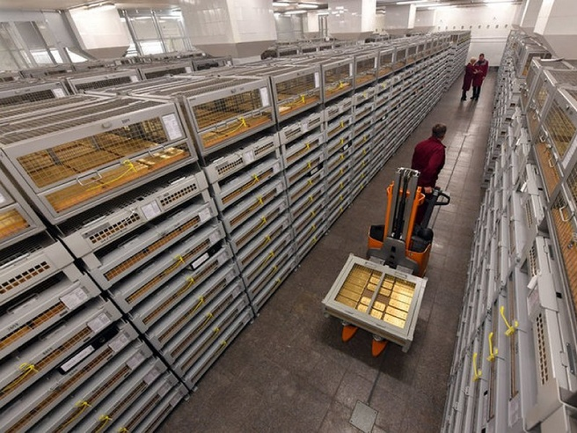
Fort Knox contains 147.3 million ounces of gold. At the current price of $1776 per ounce, that equals $261.6 billion.

Slide 53
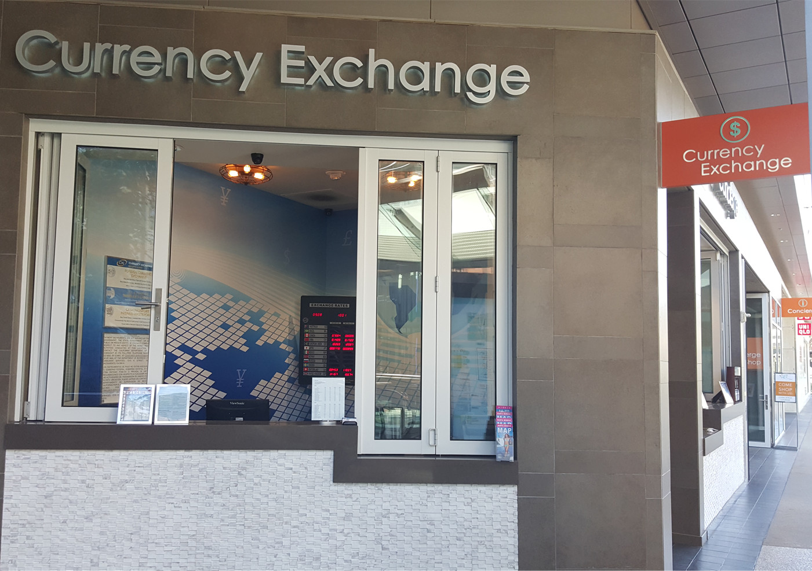

Slide 54
1 Peter 1: 17-25
19. but by precious blood like that of an unblemished and spotless lamb, namely Christ.
(Rev. 5:9) “Worthy is the Lamb… because you were killed, and at the cost of your own blood you have purchased for God persons from every tribe, language, people, and nation.”

Slide 55
1 Peter 1: 17-25
20. He was foreknown before the foundation of the world but was manifested in these last times for your sake.

Slide 56
1 Peter 1: 17-25
21. Through him you now trust in God, who raised him from the dead and gave him glory, so that your faith and hope are in God.
Motivating Factor # 4:
A basis for trusting God

Slide 57
1 Peter 1: 17-25
21. Through him you now trust in God, who raised him from the dead and gave him glory, so that your faith and hope are in God.
(Ps. 130:3-4) Lord, if you kept a record of our sins, who, O Lord,
could ever survive? But you offer forgiveness, that we might learn to fear you.
Motivating Factor # 4:
A basis for trusting God

Slide 58
1 Peter 1: 17-25
22. You have purified your souls by obeying the truth in order to show sincere mutual love. So love one another earnestly from a pure heart.
Motivating Factor # 5:
Loving others

Slide 59
1 Peter 1: 17-25
22. You have purified your souls by obeying the truth in order to show sincere mutual love. So love one another earnestly from a pure heart.
(1 Tim. 1:5) But the aim of our instruction is love that comes from a pure heart, a good conscience, and a sincere faith.
Motivating Factor # 5:
Loving others

Slide 60
1 Peter 1: 17-25
23. You have been born anew, not from perishable but from imperishable seed, through the living and enduring word of God.

Slide 61
1 Peter 1: 17-25
23. You have been born anew, not from perishable but from imperishable seed, through the living and enduring word of God.
Motivating Factor # 6:
The reality of our new life

Slide 62
1 Peter 1: 17-25
23. You have been born anew, not from perishable but from imperishable seed, through the living and enduring word of God.
(1Pt. 1:3) Blessed be the God and Father of our Lord Jesus Christ! By his great mercy he gave us new birth into a living hope through the resurrection of Jesus Christ from the dead
Motivating Factor # 6:
The reality of our new life

Slide 63
1 Peter 1: 17-25
23. You have been born anew, not from perishable but from imperishable seed, through the living and enduring word of God.
(Eph. 4:22-24) You were taught with reference to your former way of life to lay aside the old man who is being corrupted in accordance with deceitful desires…
Motivating Factor # 6:
The reality of our new life

Slide 64
1 Peter 1: 17-25
23. You have been born anew, not from perishable but from imperishable seed, through the living and enduring word of God.
For a Christian to believe that this life is all there is, either in practice or concept, is living a lie.
(Eph. 4:22-24)…to be renewed in the spirit of your mind and to put on the new man who has been created in God’s image—in righteousness and holiness that comes from truth.
Motivating Factor # 6:
The reality of our new life

Slide 65
1 Peter 1: 17-25
24-25. For all flesh is like grass and all its glory like the flower of the grass; the grass withers and the flower falls off, but the word of the Lord endures forever.

Slide 66
1 Peter 1: 17-25
24-25. For all flesh is like grass and all its glory like the flower of the grass; the grass withers and the flower falls off, but the word of the Lord endures forever.
(Is. 40:10) Yes, the Sovereign Lord is coming in power. He will rule with a powerful arm. See, he brings his reward with him as he comes.
Is. 40:6-8

Slide 67
1 Peter 1: 17-25
24-25. For all flesh is like grass and all its glory like the flower of the grass; the grass withers and the flower falls off, but the word of the Lord endures forever.
Which residence will you invest in?
(Is. 40:10) Yes, the Sovereign Lord is coming in power. He will rule with a powerful arm. See, he brings his reward with him as he comes.

Slide 68
1 Peter 1:17-25
Our Temporary Residence

