Slide 1
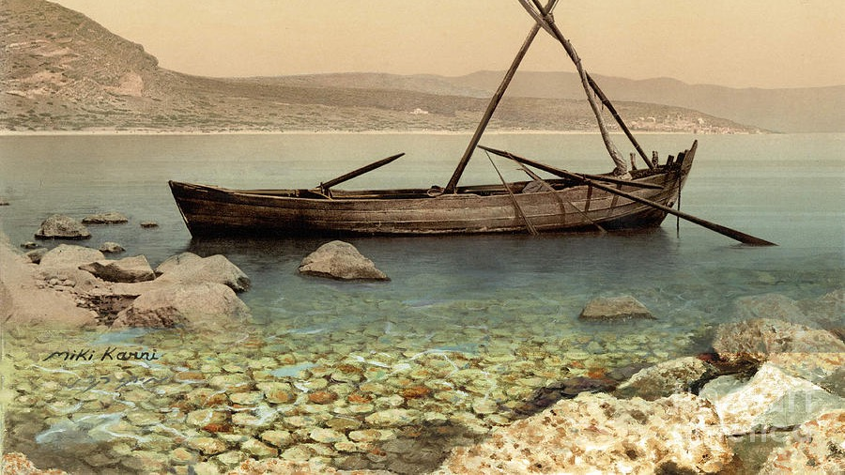
The
Gospel
of Mark
Chapter 13: Signs of the End

Slide 2
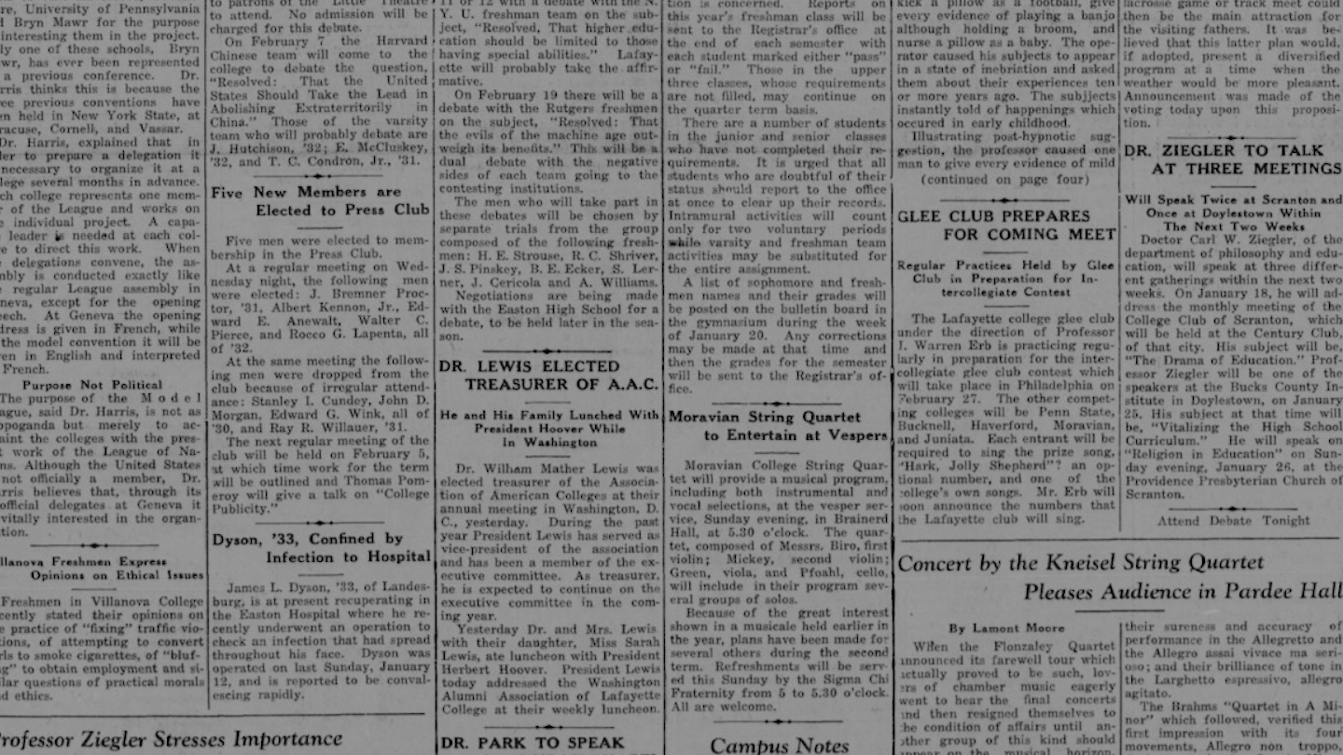

Slide 3
“When the month began, a confluence of hurricanes, floods, earthquakes, wildfires and a brewing international nuclear confrontation already had some Americans thinking about End Times…

Slide 4
… A summer that seemed destined to be remembered for its magnificent solar eclipse had lurched suddenly toward the eve of destruction. And autumn hasn’t been much better…

Slide 5
…So much has gone wrong so fast it’s fair to review the overlapping calamities:

Slide 6
In the span of two weeks, two major hurricanes, Harvey and Irma, hit the continental U.S., the first time two category 4 storms have ever done so in a single season.
Mexico was shaken by two earthquakes 12 days apart that killed hundreds of people.

Slide 7
Wildfires, spurred by some of the driest, hottest late summer weather on record…air quality plummeted…the governor declared a state of emergency and told everyone…to stay indoors.
The leaders of the U.S. and North Korea traded insults and threats.

Slide 8
A 15-year-old with the Twitter handle of Mickel made a similar point: ‘I don't like the general direction of where the world is going.’
The question was why…?”

Slide 9
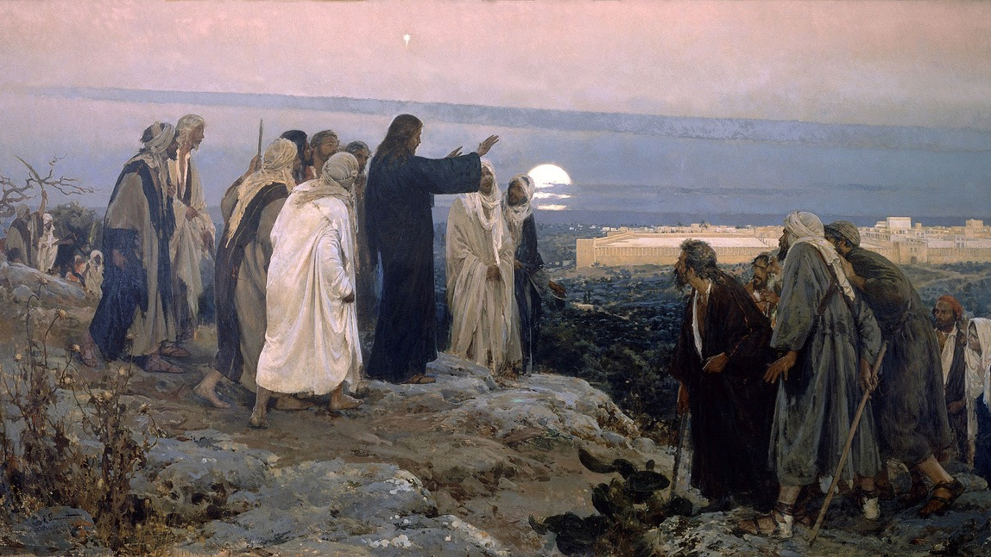

Slide 10
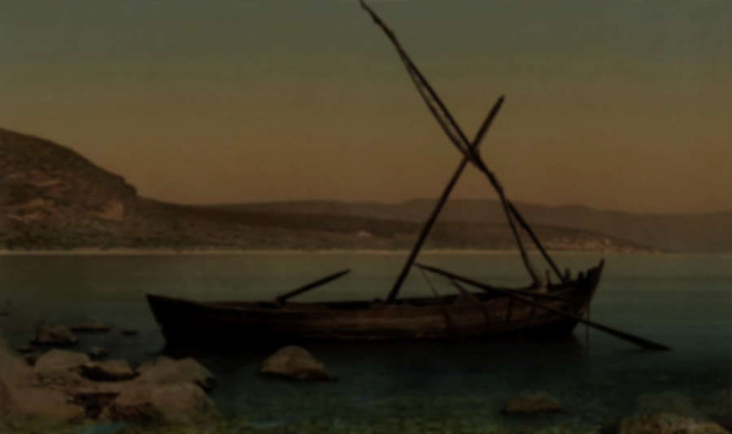
1. Now as Jesus was going out of the temple courts, one of his disciples said to him, “Teacher, look at these tremendous stones and buildings!”
Mark 13

Slide 11
2. Jesus said to him, “Do you see these great buildings? Not one stone will be left on another. All will be torn down!”
Mark 13

Slide 12
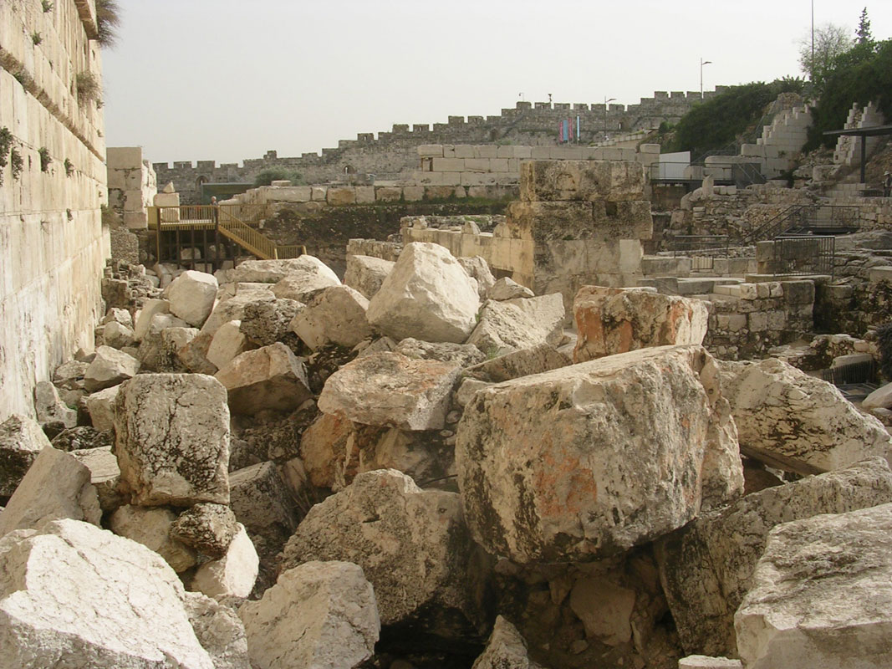
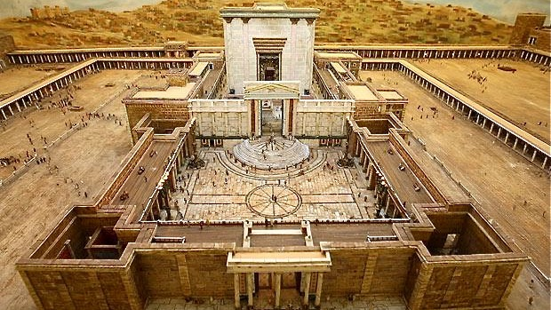

Slide 13
3. So while he was sitting on the Mount of Olives opposite the temple, Peter, James, John, and Andrew asked him privately,
Mark 13

Slide 14
3. So while he was sitting on the Mount of Olives opposite the temple, Peter, James, John, and Andrew asked him privately,
Mark 13

Slide 15
3. So while he was sitting on the Mount of Olives opposite the temple, Peter, James, John, and Andrew asked him privately,
Mark 13

Slide 16
4. “Tell us, when will these things happen? And what will be the sign that all these things are about to take place?”
(Matt. 24: 3) “Tell us, when will these things happen? And what will be the sign of your coming and of the end of the age?”
Mark 13

Slide 17
For the disciples, it was inconceivable that the end of the Temple would not accompany the end of all things!
4. “Tell us, when will these things happen? And what will be the sign that all these things are about to take place?”
(Matt. 24: 3) “Tell us, when will these things happen? And what will be the sign of your coming and of the end of the age?”
Mark 13

Slide 18
4. “Tell us, when will these things happen? And what will be the sign that all these things are about to take place?”
(Matt. 24: 3) “Tell us, when will these things happen? And what will be the sign of your coming and of the end of the age?”
Mark 13

Slide 19
Why do signs of the end matter?
Like a shadow, as the world is approaching its end, signs signal that the substance is approaching.
The climatic end, that the Bible tells us is to come, will not pop up out of nowhere.
Jesus and his disciples taught on these signs of the end throughout the New Testament.
Large sections of scripture and the entirety of the last book of the Bible, are devoted to this end time.
We have urgent business to attend to before closing time!

Slide 21
(Mark Hitchcock) ﻿Another way to picture this is to imagine that you’re at a play. You have taken your seat in the audience, and before the curtain goes up for Act One you can hear sounds behind the curtain. The stage is being set for the beginning of the play. The props are put in place, and the actors take their positions. These events are not the play itself but are a natural, necessary preparation for it. The setting of the stage creates anticipation for the raising of the curtain…

Slide 22
…In the same way, God is preparing the world stage for His drama of the ages. The curtain is still down. But God is allowing world events to take place and players to assume their roles for the drama to begin.

Slide 23
5. Jesus began to say to them, “Watch out that no one misleads you.
Mark 13

Slide 24
6. Many will come in my name, saying, ‘I am he,’ and they will mislead many.
Mark 13

Slide 25
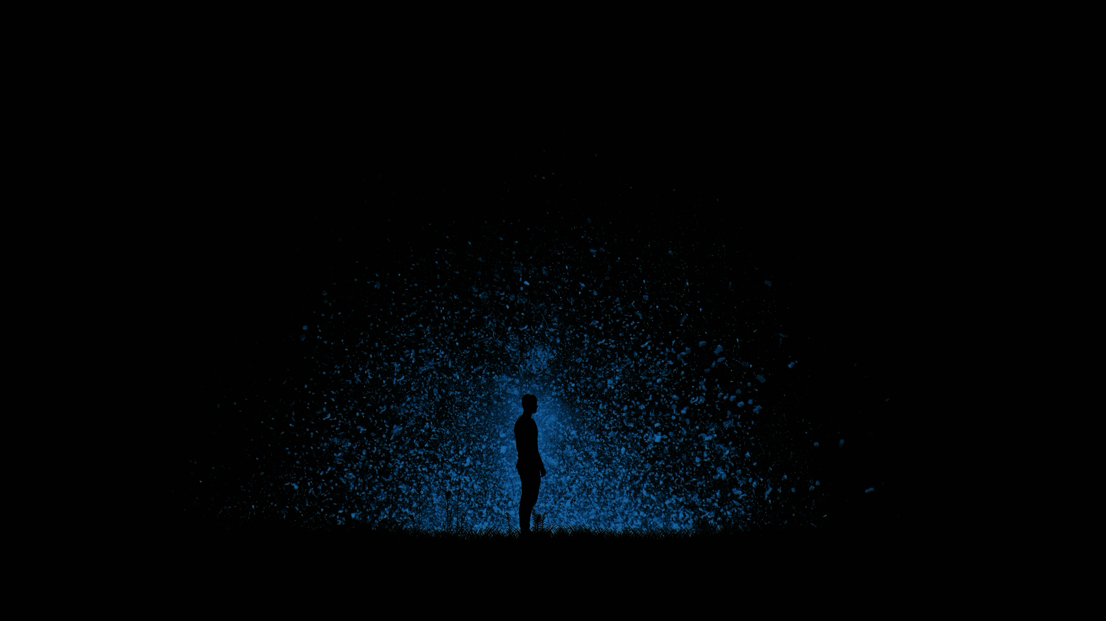
Matthew 24:11-12
And many false prophets will appear and deceive many, and because lawlessness will increase so much, the love of many will grow cold.

Slide 26
Acts 20:29-30
I know that after I am gone fierce wolves will come in among you, not sparing the flock. Even from among your own group men will arise, teaching perversions of the truth to draw the disciples away after them.

Slide 27
The Dangers of Deception
Nobody becomes deceived on purpose.
Typically it happens in small steps over long periods of time and begins with falsely believing that ‘it could never happen to me’.
The promise of the deception sounds really good.
Attempts to provide something desired. (i.e. security, fulfillment, pleasure)
Many times comes from someone “trusted”.
The Bible warns that as time goes on deception will increase.

Slide 28
The Dangers of Deception
Nobody becomes deceived on purpose.
Typically it happens in small steps over long periods of time and begins with falsely believing that ‘it could never happen to me’.
The promise of the deception sounds really good.
Attempts to provide something desired. (i.e. security, fulfillment, pleasure)
Many times comes from someone “trusted”.
The Bible warns that as time goes on deception will increase.
(2 Tim. 3:13-14) But evil people and charlatans will go from bad to worse, deceiving others and being deceived themselves. You, however, must continue in the things you have learned and are confident about.

Slide 29
7. When you hear of wars and rumors of wars, do not be alarmed. These things must happen, but the end is still to come.
Mark 13

Slide 30
8. For nation will rise up in arms against nation, and kingdom against kingdom. There will be earthquakes in various places, and there will be famines…
Mark 13

Slide 31
8…These are but the beginning of birth pains.
Birth pains don’t start at the beginning of the pregnancy, but near the end.
Mark 13

Slide 32
9. You must watch out for yourselves. You will be handed over to councils and beaten in the synagogues. You will stand before governors and kings because of me, as a witness to them.
Mark 13

Slide 33
10. First the gospel must be preached to all nations.
In context, Jesus is saying that as a result of persecution, the truth of the gospel will span the world.
Mark 13

Slide 34
11. When they arrest you and hand you over for trial, do not worry about what to speak. But say whatever is given you at that time, for it is not you speaking, but the Holy Spirit.
Mark 13

Slide 35
12. Brother will hand over brother to death, and a father his child. Children will rise against parents and have them put to death.
Mark 13

Slide 36
13. You will be hated by everyone because of my name. But the one who endures to the end will be saved.
Mark 13

Slide 37
14. But when you see the abomination of desolation standing where it should not be (let the reader understand), then those in Judea must flee to the mountains.
Mark 13

Slide 38
14. But when you see the abomination of desolation standing where it should not be (let the reader understand), then those in Judea must flee to the mountains.
Mark 13

Slide 39
14. But when you see the abomination of desolation standing where it should not be (let the reader understand), then those in Judea must flee to the mountains.
(Matt. 24: 15) So when you see the abomination of desolation(spoken about by Daniel the prophet) standing in the holy place (let the reader understand)
Mark 13

Slide 40
Daniel 9:27
He will confirm a covenant with many for one ‘seven.’ In the middle of the ‘seven’ he will put an end to sacrifice and offering. And at the temple he will set up an abomination that causes desolation, until the end that is decreed is poured out on him.

Slide 41
14. But when you see the abomination of desolation standing where it should not be (let the reader understand), then those in Judea must flee to the mountains.
(Matt. 24: 15) So when you see the abomination of desolation(spoken about by Daniel the prophet) standing in the holy place (let the reader understand)
Mark 13

Slide 42
Daniel 9:27
He will confirm a covenant with many for one ‘seven.’ In the middle of the ‘seven’ he will put an end to sacrifice and offering. And at the temple he will set up an abomination that causes desolation, until the end that is decreed is poured out on him.

Slide 43
Daniel 9:27
He will confirm a covenant with many for one ‘seven.’ In the middle of the ‘seven’ he will put an end to sacrifice and offering. And at the temple he will set up an abomination that causes desolation, until the end that is decreed is poured out on him.

Slide 44
15-18. The one on the roof must not come down or go inside to take anything out of his house. The one in the field must not turn back to get his cloak. Woe to those who are pregnant and to those who are nursing their babies in those days! Pray that it may not be in winter.
Mark 13

Slide 45
19. For in those days there will be suffering unlike anything that has happened from the beginning of the creation that God created until now,
or ever will happen.
Mark 13

Slide 46
19. For in those days there will be suffering unlike anything that has happened from the beginning of the creation that God created until now,
or ever will happen.
(Matt. 24:21) For then there will be a great tribulation, such as has not occurred since the beginning of the world until now, nor ever will.
Mark 13

Slide 47
19. For in those days there will be suffering unlike anything that has happened from the beginning of the creation that God created until now,
or ever will happen.
Mark 13

Slide 48
20. And if the Lord had not cut short those days, no one would be saved. But because of the elect, whom he chose, he has cut them short.
Mark 13

Slide 49
20. And if the Lord had not cut short those days, no one would be saved. But because of the elect, whom he chose, he has cut them short.
Mark 13

Slide 50
21. Then if anyone says to you, ‘Look, here is the Christ!’ or ‘Look, there he is!’ do not believe him.
Mark 13

Slide 51
22. For false messiahs and false prophets will appear and perform signs and wonders to deceive, if possible, the elect.
Mark 13

Slide 52
22. For false messiahs and false prophets will appear and perform signs and wonders to deceive, if possible, the elect.
Mark 13

Slide 53
Matthew 24:25-26
Remember, I have told you ahead of time. So then, if someone says to you, ‘Look, he is in the wilderness,’ do not go out, or ‘Look, he is in the inner rooms,’ do not believe him.

Slide 54
23. Be careful! I have told you everything ahead of time.”
Mark 13

Slide 55
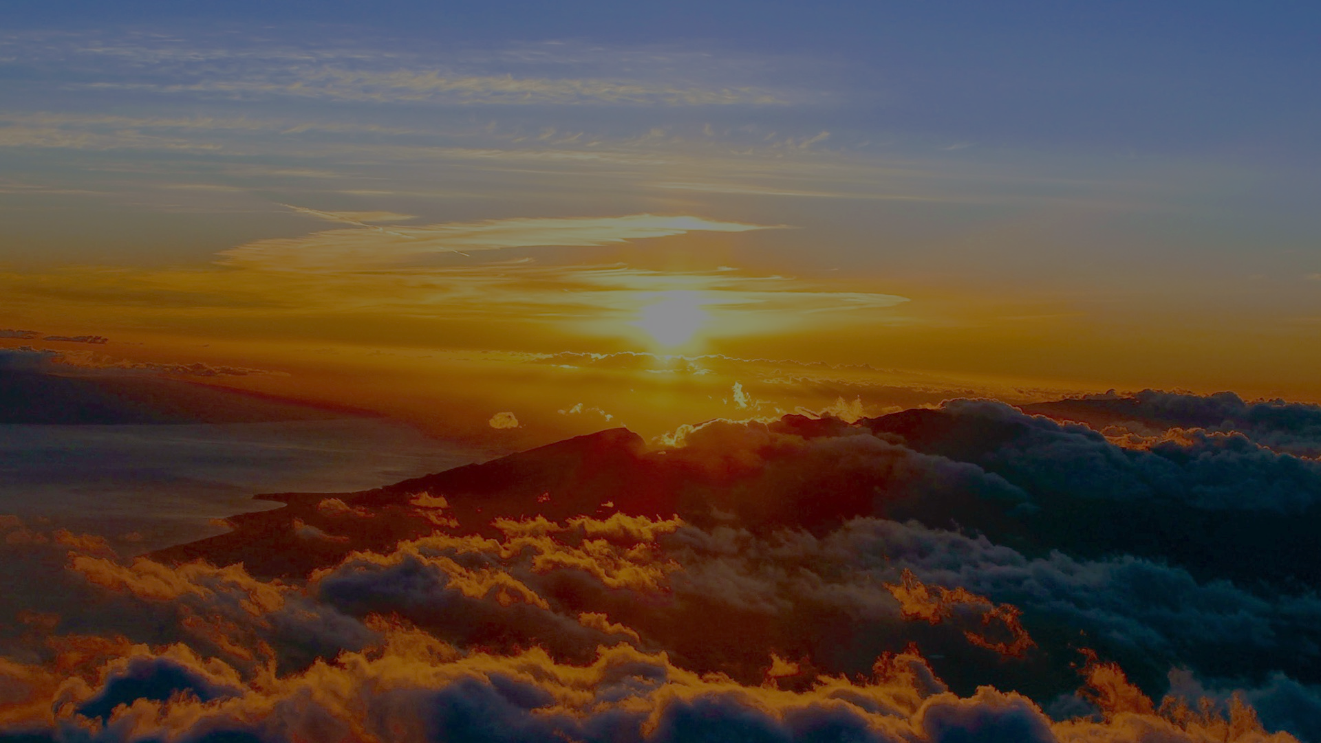
John 14:1-3
Jesus told them, “Do not let your hearts be distressed! You believe in God; believe also in me. There are many dwelling places in my Father’s house. Otherwise, I would have told you, because I am going away to make ready a place for you. And if I go and make ready a place for you, I will come again and take you to be with me, so that where I am you may be too.”
Next week, we’ll study Jesus’ return…

Slide 56
Questions for Consideration:
Does the current state of our world cause you to consider the end of all things?
What does it say about the character of God, that he would reveal these things to us ahead of time?
How might we best prepare ourselves to avoid being deceived?
How should or does having a relationship with Christ bring real comfort and security?

