Slide 1
Acts
Acts 12 Peter & Herod

Slide 2
Acts
God’s 3-stage plan for “the gospel”

Slide 3
Acts
Focus shifts back to Jerusalem in Ch 12

Slide 4
Acts
^{Acts 12:1} Now about that time Herod the king laid hands on some who belonged to the church in order to mistreat them. ² And he had James the brother of John put to death with a sword.
^{Acts 12:1} Now about that time Herod the king laid hands on some who belonged to the church in order to mistreat them. ² And he had James the brother of John put to death with a sword.
Focus shifts back to Jerusalem in Ch 12

Slide 5
Acts
Herod the Great?
^{Acts 12:1} Now about that time Herod the king laid hands on some who belonged to the church in order to mistreat them. ² And he had James the brother of John put to death with a sword.
^{Acts 12:1} Now about that time Herod the king laid hands on some who belonged to the church in order to mistreat them. ² And he had James the brother of John put to death with a sword.
Focus shifts back to Jerusalem in Ch 12

Slide 6
Acts
Herod Anitpas?
^{Acts 12:1} Now about that time Herod the king laid hands on some who belonged to the church in order to mistreat them. ² And he had James the brother of John put to death with a sword.
^{Acts 12:1} Now about that time Herod the king laid hands on some who belonged to the church in order to mistreat them. ² And he had James the brother of John put to death with a sword.
Focus shifts back to Jerusalem in Ch 12

Slide 7
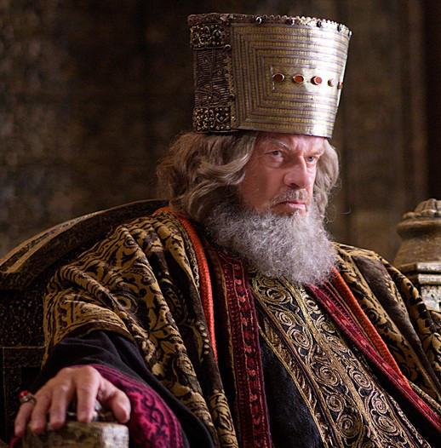
Acts
King Herod Agrippa 1
^{Acts 12:1} Now about that time Herod the king laid hands on some who belonged to the church in order to mistreat them. ² And he had James the brother of John put to death with a sword.
^{Acts 12:1} Now about that time Herod the king laid hands on some who belonged to the church in order to mistreat them. ² And he had James the brother of John put to death with a sword.
Focus shifts back to Jerusalem in Ch 12

Slide 8
Acts
King Herod Agrippa 1
^{Acts 12:1} Now about that time Herod the king laid hands on some who belonged to the church in order to mistreat them. ² And he had James the brother of John put to death with a sword.
^{Acts 12:1} Now about that time Herod the king laid hands on some who belonged to the church in order to mistreat them. ² And he had James the brother of John put to death with a sword.
^{Acts 12:1} Now about that time Herod the king laid hands on some who belonged to the church in order to mistreat them. ² And he had James the brother of John put to death with a sword.
Focus shifts back to Jerusalem in Ch 12

Slide 9
Acts
King Herod Agrippa 1
^{Acts 12:1} Now about that time Herod the king laid hands on some who belonged to the church in order to mistreat them. ² And he had James the brother of John put to death with a sword.
^{Acts 12:1} Now about that time Herod the king laid hands on some who belonged to the church in order to mistreat them. ² And he had James the brother of John put to death with a sword.
^{Acts 12:1} Now about that time Herod the king laid hands on some who belonged to the church in order to mistreat them. ² And he had James the brother of John put to death with a sword.
Focus shifts back to Jerusalem in Ch 12

Slide 10
Acts
King Herod Agrippa 1
^{Acts 12:3} When he saw that it pleased the Jews, he proceeded to arrest Peter also. ⁴ When he had seized him, he put him in prison, delivering him to four squads of soldiers to guard him, intending after the Passover to bring him out before the people.
^{Acts 12:3} When he saw that it pleased the Jews, he proceeded to arrest Peter also. ⁴ When he had seized him, he put him in prison, delivering him to four squads of soldiers to guard him, intending after the Passover to bring him out before the people.
^{Acts 12:1} Now about that time Herod the king laid hands on some who belonged to the church in order to mistreat them. ² And he had James the brother of John put to death with a sword.
^{Acts 12:1} Now about that time Herod the king laid hands on some who belonged to the church in order to mistreat them. ² And he had James the brother of John put to death with a sword.
Focus shifts back to Jerusalem in Ch 12

Slide 11
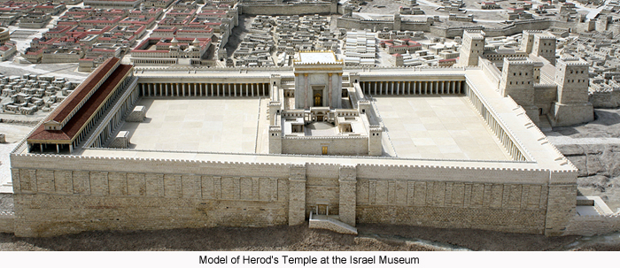
Acts
King Herod Agrippa 1
^{Acts 12:3} When he saw that it pleased the Jews, he proceeded to arrest Peter also. ⁴ When he had seized him, he put him in prison, delivering him to four squads of soldiers to guard him, intending after the Passover to bring him out before the people.
^{Acts 12:1} Now about that time Herod the king laid hands on some who belonged to the church in order to mistreat them. ² And he had James the brother of John put to death with a sword.
^{Acts 12:1} Now about that time Herod the king laid hands on some who belonged to the church in order to mistreat them. ² And he had James the brother of John put to death with a sword.
Focus shifts back to Jerusalem in Ch 12

Slide 12
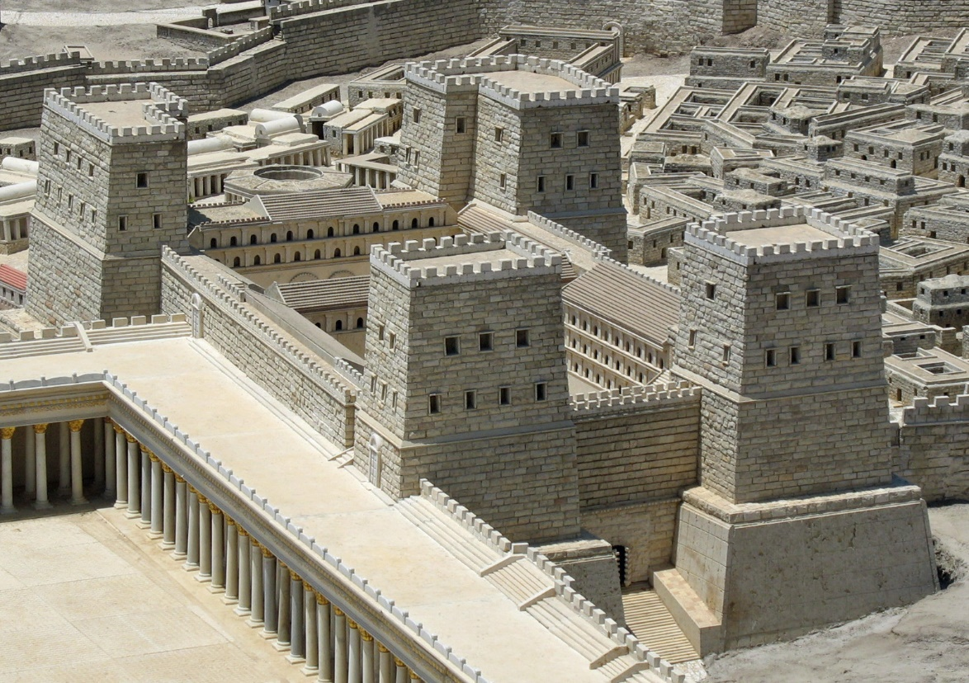
Acts
^{Acts 12:3} When he saw that it pleased the Jews, he proceeded to arrest Peter also. ⁴ When he had seized him, he put him in prison, delivering him to four squads of soldiers to guard him, intending after the Passover to bring him out before the people.
^{Acts 12:3} When he saw that it pleased the Jews, he proceeded to arrest Peter also. ⁴ When he had seized him, he put him in prison, delivering him to four squads of soldiers to guard him, intending after the Passover to bring him out before the people.
^{Acts 12:1} Now about that time Herod the king laid hands on some who belonged to the church in order to mistreat them. ² And he had James the brother of John put to death with a sword.
^{Acts 12:1} Now about that time Herod the king laid hands on some who belonged to the church in order to mistreat them. ² And he had James the brother of John put to death with a sword.
Focus shifts back to Jerusalem in Ch 12

Slide 13
Acts
This is BAD!
^{Acts 12:3} When he saw that it pleased the Jews, he proceeded to arrest Peter also. ⁴ When he had seized him, he put him in prison, delivering him to four squads of soldiers to guard him, intending after the Passover to bring him out before the people.
^{Acts 12:3} When he saw that it pleased the Jews, he proceeded to arrest Peter also. ⁴ When he had seized him, he put him in prison, delivering him to four squads of soldiers to guard him, intending after the Passover to bring him out before the people.
^{Acts 12:1} Now about that time Herod the king laid hands on some who belonged to the church in order to mistreat them. ² And he had James the brother of John put to death with a sword.
^{Acts 12:1} Now about that time Herod the king laid hands on some who belonged to the church in order to mistreat them. ² And he had James the brother of John put to death with a sword.
Focus shifts back to Jerusalem in Ch 12

Slide 14
Acts
^{Acts 12:5} So Peter was kept in the prison, but prayer for him was being made fervently by the church to God.

Slide 15
Acts
^{Acts 12:6} On the very night when Herod was about to bring him forward, Peter was sleeping between two soldiers, bound with two chains, and guards in front of the door were watching over the prison.

Slide 16
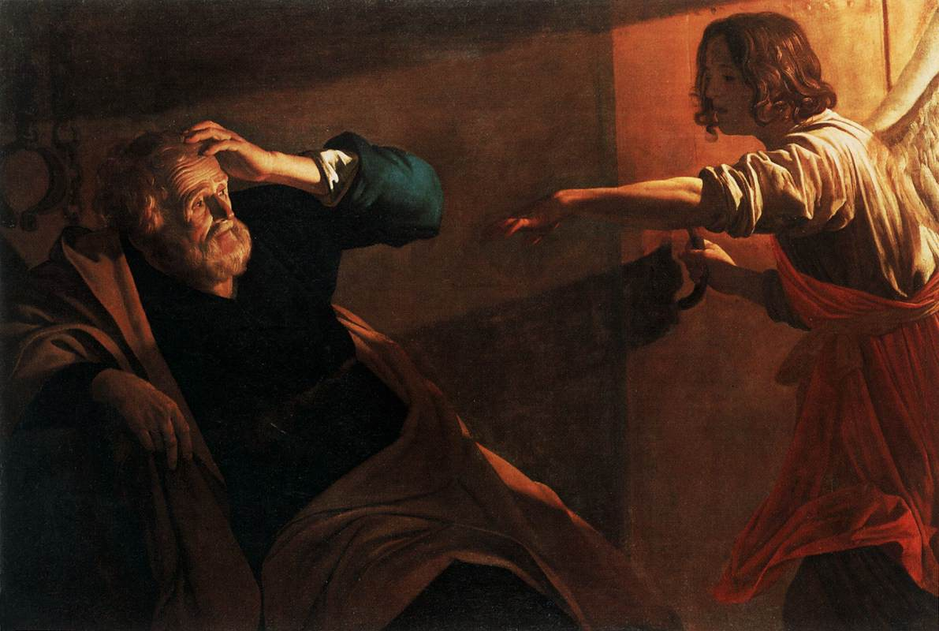
Acts
^{Acts 12:7} And behold, an angel of the Lord suddenly appeared and a light shone in the cell; and he struck Peter’s side and woke him up, saying, “Get up quickly.” And his chains fell off his hands.

Slide 17
Acts
^{Acts 12:8} And the angel said to him, “Gird yourself and put on your sandals.” And he did so. And he said to him, “Wrap your cloak around you and follow me.”

Slide 18
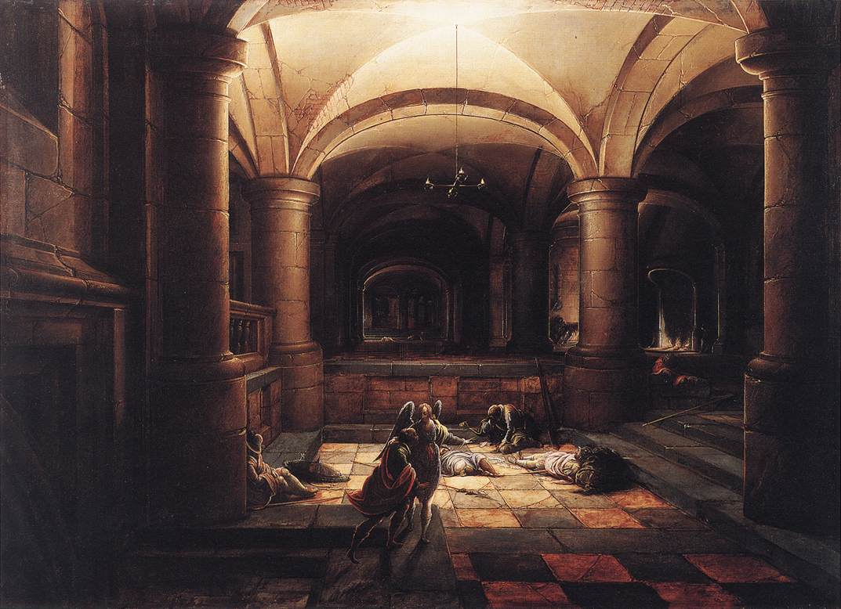
Acts
^{Acts 12:9} And he went out and continued to follow, and he did not know that what was being done by the angel was real, but thought he was seeing a vision.

Slide 19
Acts
^{Acts 12:10} When they had passed the first and second guard, they came to the iron gate that leads into the city, which opened for them by itself; and they went out and went along one street, and immediately the angel departed from him.

Slide 20
Acts
^{Acts 12:11} When Peter came to himself, he said, “Now I know for sure that the Lord has sent forth His angel and rescued me from the hand of Herod and from all that the Jewish people were expecting.”

Slide 21
Acts
^{Acts 12:12} And when he realized this, he went to the house of Mary, the mother of John who was also called Mark, where many were gathered together and were praying.
^{Acts 12:12} And when he realized this, he went to the house of Mary, the mother of John who was also called Mark, where many were gathered together and were praying.

Slide 22
^{Acts 12:13} When he knocked at the door of the gate, a servant-girl named Rhoda came to answer. ¹⁴ When she recognized Peter’s voice, because of her joy she did not open the gate, but ran in and announced that Peter was standing in front of the gate.
^{Acts 12:12} And when he realized this, he went to the house of Mary, the mother of John who was also called Mark, where many were gathered together and were praying.

Slide 23
^{Acts 12:15} They said to her, “You are out of your mind!” But she kept insisting that it was so. They kept saying, “It is his angel.”
^{Acts 12:15} They said to her, “You are out of your mind!” But she kept insisting that it was so. They kept saying, “It is his angel.”

Slide 24
^{Acts 12:16} But Peter continued knocking; and when they had opened the door, they saw him and were amazed.

Slide 25
^{Acts 12:16} But Peter continued knocking; and when they had opened the door, they saw him and were amazed.
^{Acts 12:16} But Peter continued knocking; and when they had opened the door, they saw him and were amazed.

Slide 26
There’s a lesson here…
How much faith do we need for God to answer?
^{Acts 12:16} But Peter continued knocking; and when they had opened the door, they saw him and were amazed.
^{Acts 12:16} But Peter continued knocking; and when they had opened the door, they saw him and were amazed.

Slide 27
There’s a lesson here…
How much faith do we need for God to answer?
A: just enough to pray
^{Acts 12:16} But Peter continued knocking; and when they had opened the door, they saw him and were amazed.
^{Acts 12:16} But Peter continued knocking; and when they had opened the door, they saw him and were amazed.

Slide 28
^{Acts 12:17} But motioning to them with his hand to be silent, he described to them how the Lord had led him out of the prison. And he said, “Report these things to James and the brethren.” Then he left and went to another place.
^{Acts 12:16} But Peter continued knocking; and when they had opened the door, they saw him and were amazed.

Slide 29
^{Acts 12:18} Now when day came, there was no small disturbance among the soldiers as to what could have become of Peter. ¹⁹ When Herod had searched for him and had not found him, he examined the guards and ordered that they be led away to execution.
^{Acts 12:18} Now when day came, there was no small disturbance among the soldiers as to what could have become of Peter. ¹⁹ When Herod had searched for him and had not found him, he examined the guards and ordered that they be led away to execution.
^{Acts 12:16} But Peter continued knocking; and when they had opened the door, they saw him and were amazed.

Slide 30
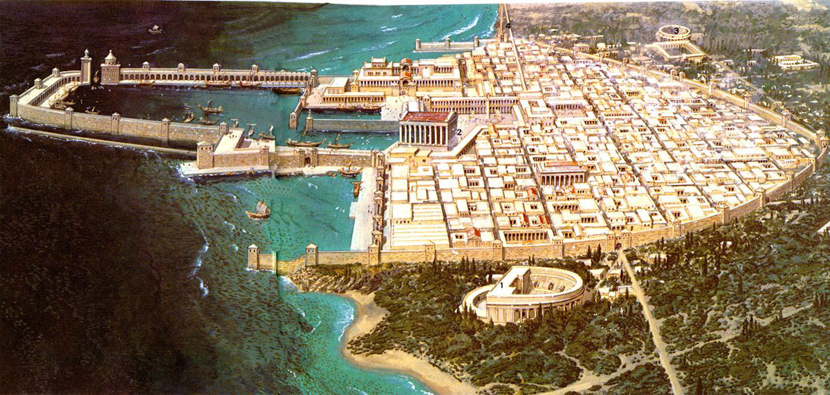
^{Acts 12:18} Then he went down from Judea to Caesarea and was spending time there.

Slide 31
^{Acts 12:20} Now he was very angry with the people of Tyre and Sidon; and with one accord they came to him, and having won over Blastus the king’s chamberlain, they were asking for peace, because their country was fed by the king’s country.

Slide 32
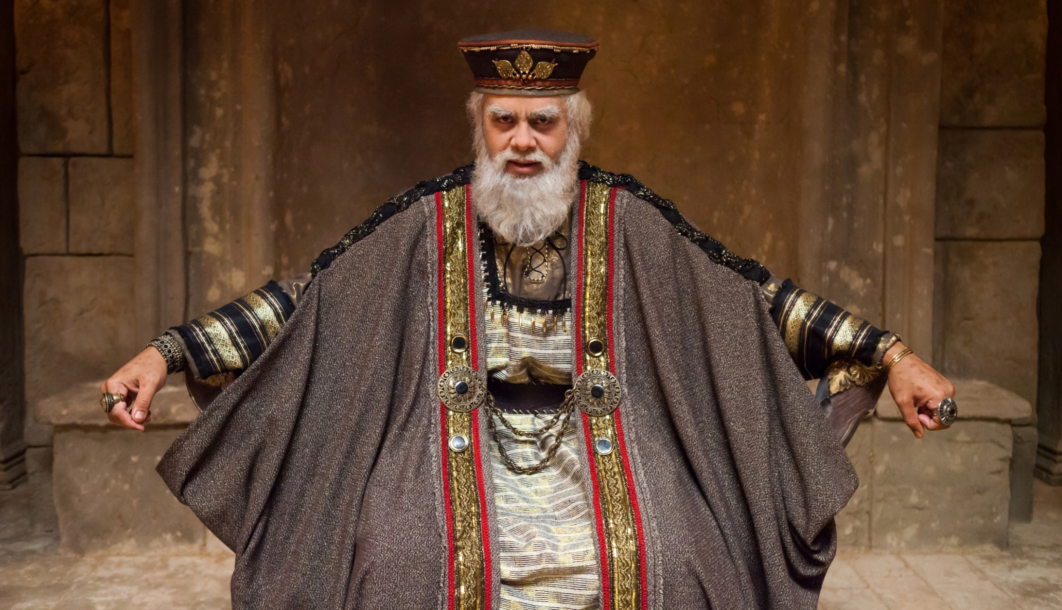
^{Acts 12:21} On an appointed day Herod, having put on his royal apparel, took his seat on the rostrum and began delivering an address to them.

Slide 33
^{Acts 12:22} The people kept crying out, “The voice of a god and not of a man!”

Slide 34
^{Acts 12:23} And immediately an angel of the Lord struck him because he did not give God the glory, and he was eaten by worms and died.
^{Acts 12:23} And immediately an angel of the Lord struck him because he did not give God the glory, and he was eaten by worms and died.
^{Acts 12:23} And immediately an angel of the Lord struck him because he did not give God the glory, and he was eaten by worms and died.
^{Acts 12:23} And immediately an angel of the Lord struck him because he did not give God the glory, and he was eaten by worms and died.

Slide 35
Sudden …
Gross …
Weird …
Hard to Believe!
^{Acts 12:23} And immediately an angel of the Lord struck him because he did not give God the glory, and he was eaten by worms and died.
^{Acts 12:23} And immediately an angel of the Lord struck him because he did not give God the glory, and he was eaten by worms and died.
^{Acts 12:23} And immediately an angel of the Lord struck him because he did not give God the glory, and he was eaten by worms and died.
^{Acts 12:23} And immediately an angel of the Lord struck him because he did not give God the glory, and he was eaten by worms and died.

Slide 36
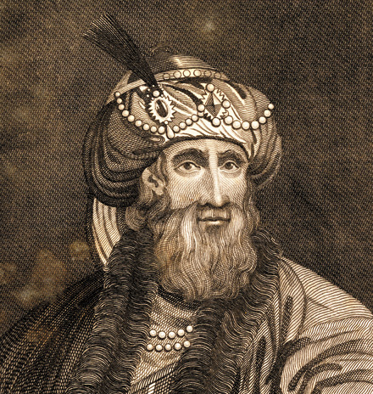
Flavius Josephus
Antiquities XIX.8.2

Slide 37
Now when Agrippa had reigned three years over all Judea, he came to the city Caesarea … a great multitude was gotten together of the principal persons, and such as were of dignity through his province. On the second day … he put on a garment made wholly of silver, and of a contexture truly wonderful, and came into the theater early in the
Flavius Josephus
Antiquities XIX.8.2
morning; at which time the silver of his garment being illuminated by the fresh reflection of the sun's rays upon it, shone out after a surprising manner, and was so resplendent as to spread a horror over those that looked intently upon him; and presently his flatterers cried out, one from one place, and another from another, (though not for his good,) that he was a god; and they added, "Be thou merciful to us;

Slide 38
for although we have hitherto reverenced thee only as a man, yet shall we henceforth own thee as superior to mortal nature." Upon this the king did neither rebuke them, nor reject their impious flattery. But as he presently afterward looked up … A severe pain also arose in his belly, and began in a
Flavius Josephus
Antiquities XIX.8.2
most violent manner… Accordingly he was
carried into the palace, and the rumor went abroad every where, that he would certainly die in a little time… All places were also full of mourning and lamentation. Now the king rested in a high chamber, and as he saw them below lying prostrate on the ground, he could not himself forbear weeping. And when he had been quite worn out by the pain in his belly for five days, he departed this life.

Slide 39
^{Acts 12:24} But the word of the Lord continued to grow and to be multiplied.

Slide 40
Luke has presented this story as a
Power Struggle
^{Acts 12:24} But the word of the Lord continued to grow and to be multiplied.

Slide 41
Luke has presented this story as a
Power Struggle
As a reversal and defeat of an enemy
^{Acts 12:24} But the word of the Lord continued to grow and to be multiplied.

Slide 42
^{Acts 12:23} … an angel of the Lord struck him …
As a reversal and defeat of an enemy
^{Acts 12:24} But the word of the Lord continued to grow and to be multiplied.

Slide 43
God defeats His enemies
^{Acts 12:23} … an angel of the Lord struck him …
As a reversal and defeat of an enemy
^{Acts 12:24} But the word of the Lord continued to grow and to be multiplied.

Slide 44
God defeats His enemies
And what was the church’s role in that?

Slide 45
God defeats His enemies
And what was the church’s role in that?
^{Acts 12:5} So Peter was kept in the prison, but prayer for him was being made fervently by the church to God.
^{Acts 12:5} So Peter was kept in the prison, but prayer for him was being made fervently by the church to God.

Slide 46
God defeats His enemies
And what was the church’s role in that?
^{Acts 12:5} So Peter was kept in the prison, but prayer for him was being made fervently by the church to God.
^{Acts 12:5} So Peter was kept in the prison, but prayer for him was being made fervently by the church to God.
Acts 12 is a battle, and prayer is the hero

Slide 47
Prayer is powerful
Somehow, our prayers are associated with the manifestation of His power
For some reason, God has decided that His power will be bound up with our prayers
What observations can we make about Prayer in our passage?

Slide 48
Prayer is powerful
When we pray,
things happen
What observations can we make about Prayer in our passage?

Slide 49
God Answers Prayers
God is not stingy – He loves to give us good things!
^{Luke 11:9} Ask and it will be given to you; seek and you will find; knock and the door will be opened to you. ¹⁰ For everyone who asks receives; the one who seeks finds; and to the one who knocks, the door will be opened.
What observations can we make about Prayer in our passage?

Slide 50
God Answers Prayers
God is not stingy – He loves to give us good things!
^{John 16:23} Truly, truly I say to you, if you ask the Father for anything in My name, He will give it to you.
What observations can we make about Prayer in our passage?

Slide 51
God Answers Prayers
Sometimes He answers in surprising ways
^{John 16:23} Truly, truly I say to you, if you ask the Father for anything in My name, He will give it to you.
What observations can we make about Prayer in our passage?

Slide 52
God Answers Prayers
Sometimes He answers, but it’s hard for us to recognize
^{John 16:23} Truly, truly I say to you, if you ask the Father for anything in My name, He will give it to you.
What observations can we make about Prayer in our passage?

Slide 53
God Answers Prayers
Sometimes He answers, but His timing is not our timing
^{John 16:23} Truly, truly I say to you, if you ask the Father for anything in My name, He will give it to you.
What observations can we make about Prayer in our passage?

Slide 54
God Answers Prayers
And sometimes the answer is “No.”
^{John 16:23} Truly, truly I say to you, if you ask the Father for anything in My name, He will give it to you.
^{John 16:23} Truly, truly I say to you, if you ask the Father for anything in My name, He will give it to you.
What observations can we make about Prayer in our passage?

Slide 55
God Answers Prayers
And sometimes the answer is “No.”
Maybe our prayers are not in line with His will …
^{John 16:23} Truly, truly I say to you, if you ask the Father for anything in My name, He will give it to you.
^{John 16:23} Truly, truly I say to you, if you ask the Father for anything in My name, He will give it to you.
What observations can we make about Prayer in our passage?

Slide 56
God Answers Prayers
And sometimes the answer is “No.”
Maybe our prayers are good, but He has a greater good in mind
^{John 16:23} Truly, truly I say to you, if you ask the Father for anything in My name, He will give it to you.
^{John 16:23} Truly, truly I say to you, if you ask the Father for anything in My name, He will give it to you.
What observations can we make about Prayer in our passage?

Slide 57
Prayer is our go-to in trials
What observations can we make about Prayer in our passage?

Slide 58
Prayer is our go-to in trials
^{Psalm 32:6} Therefore, let everyone who is godly pray to You in a time when You may be found; Surely in a flood of great waters they will not reach him. ⁷ You are my hiding place; You preserve me from trouble; You surround me with songs of deliverance.
What observations can we make about Prayer in our passage?

Slide 59
Prayer is our go-to in trials
What has life thrown at you today?
^{Psalm 32:6} Therefore, let everyone who is godly pray to You in a time when You may be found; Surely in a flood of great waters they will not reach him. ⁷ You are my hiding place; You preserve me from trouble; You surround me with songs of deliverance.
What observations can we make about Prayer in our passage?

Slide 60
Prayer is the rhythm of the Christian life
^{Acts 2:42} They were continually devoting themselves to the apostles teaching and to fellowship, to the breaking of bread and to prayer.
What observations can we make about Prayer in our passage?

Slide 61
Prayer is the rhythm of the Christian life
Prayer is something that we do together
^{Acts 2:42} They were continually devoting themselves to the apostles teaching and to fellowship, to the breaking of bread and to prayer.
What observations can we make about Prayer in our passage?

Slide 62
But here’s the thing:
I’m busy and the time isn’t convenient for me and I prefer solo prayer and I get intimidated and I don’t like being confined to a certain time and my voice sounds weird in public and Jim’s going to be there and let’s face it Jim’s annoying…
Prayer is the rhythm of the Christian life
Prayer is something that we do together
^{Acts 2:42} They were continually devoting themselves to the apostles teaching and to fellowship, to the breaking of bread and to prayer.
What observations can we make about Prayer in our passage?

Slide 63
But here’s the thing:
I’m busy and the time isn’t convenient for me and I prefer solo prayer and I get intimidated and I don’t like being confined to a certain time and my voice sounds weird in public and Jim’s going to be there and let’s face it Jim’s annoying…
But here’s the thing:
I’m busy and the time isn’t convenient for me and I prefer solo prayer and I get intimidated and I don’t like being confined to a certain time and my voice sounds weird in public and Jim’s going to be there and let’s face it Jim’s annoying…
Prayer is the rhythm of the Christian life
Prayer is something that we do together
^{Acts 2:42} They were continually devoting themselves to the apostles teaching and to fellowship, to the breaking of bread and to prayer.
What observations can we make about Prayer in our passage?

Slide 64
But here’s the thing:
I’m busy and the time isn’t convenient for me and I prefer solo prayer and I get intimidated and I don’t like being confined to a certain time and my voice sounds weird in public and Jim’s going to be there and let’s face it Jim’s annoying…
Prayer is the rhythm of the Christian life
Prayer is something that we do together
Jesus: there’s something special about praying together
^{Matt 18:19} … if two of you agree on earth about anything that they may ask, it shall be done for them by My Father who is in heaven. ²⁰ For where two or three have gathered together in My name, I am there in their midst.
What observations can we make about Prayer in our passage?

Slide 65
But here’s the thing:
I’m busy and the time isn’t convenient for me and I prefer solo prayer and I get intimidated and I don’t like being confined to a certain time and my voice sounds weird in public and Jim’s going to be there and let’s face it Jim’s annoying…
Prayer is the rhythm of the Christian life
Prayer is something that we do together
You will be built up by their prayers
^{Matt 18:19} … if two of you agree on earth about anything that they may ask, it shall be done for them by My Father who is in heaven. ²⁰ For where two or three have gathered together in My name, I am there in their midst.
What observations can we make about Prayer in our passage?

Slide 66
But here’s the thing:
I’m busy and the time isn’t convenient for me and I prefer solo prayer and I get intimidated and I don’t like being confined to a certain time and my voice sounds weird in public and Jim’s going to be there and let’s face it Jim’s annoying…
Prayer is the rhythm of the Christian life
Prayer is something that we do together
And they will be built up by your prayers!
^{Matt 18:19} … if two of you agree on earth about anything that they may ask, it shall be done for them by My Father who is in heaven. ²⁰ For where two or three have gathered together in My name, I am there in their midst.
What observations can we make about Prayer in our passage?

Slide 67
What next step does God have for you when it comes to corporate prayer?

Slide 68
What next step does God have for you when it comes to corporate prayer?
Maybe it’s to discover it …

Slide 69
What next step does God have for you when it comes to corporate prayer?
Maybe it’s to discover it …
Agree = συμφωνέω sumphōneō
^{Matt 18:19} if two of you agree on earth about anything…

Slide 70
What next step does God have for you when it comes to corporate prayer?
Maybe it’s to re-discover it …

Slide 71
What next step does God have for you when it comes to corporate prayer?
Maybe it’s to show up

Slide 72
What next step does God have for you when it comes to corporate prayer?
Maybe it’s to speak up

Slide 73
What next step does God have for you when it comes to corporate prayer?
Maybe it’s to step up

Slide 74
What next step does God have for you when it comes to corporate prayer?
If you devote yourself to prayer you should expect resistance
But you should also expect to see God do some amazing things!

Slide 75
Acts
Next Time . . .

