Slide 1
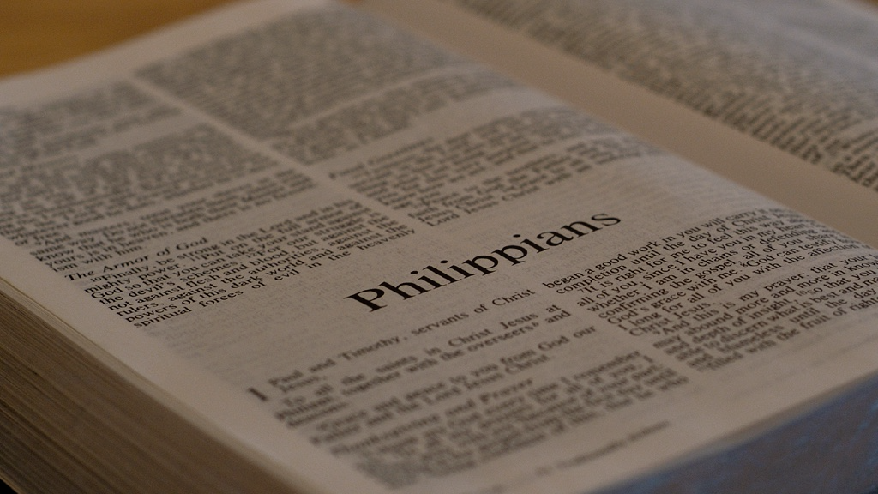
Philippians
Fellowship of the Gospel

Slide 2
3-5. I thank my God every time I remember you. I always pray with joy in my every prayer for all of you because of your participation in the gospel from the first day until now.
Philippians

Slide 3
3-5. I thank my God every time I remember you. I always pray with joy in my every prayer for all of you because of your participation in the gospel from the first day until now.
koinōnia(κοινωνία): fellowship; partnership; sharing in common.
(Acts 2:42) They were devoting themselves to the apostles’ teaching and to fellowship, to the breaking of bread and to prayer.
Philippians

Slide 4
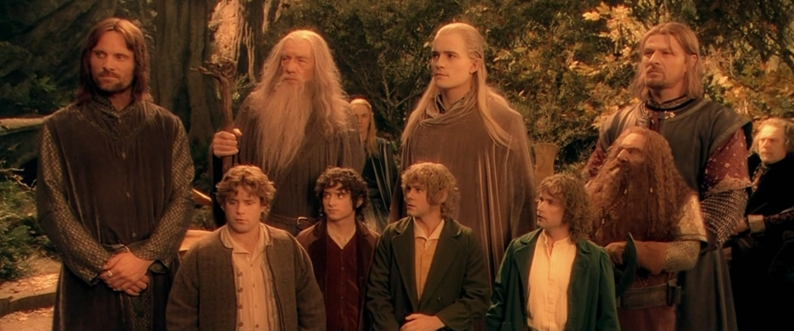
What was it that Paul and the Philippians had that gave them good fellowship?
How can we emulate that kind of fellowship in Dwell today?
Biblical Fellowship is NOT:
Just hanging out together.
Having similar hobbies.
Sharing similar political views.
Coming from similar backgrounds.

Slide 5
3-5. I thank my God every time I remember you. I always pray with joy in my every prayer for all of you because of your participation in the gospel from the first day until now.
Toys
Philippians

Slide 6
3-5. I thank my God every time I remember you. I always pray with joy in my every prayer for all of you because of your participation in the gospel from the first day until now.
Genuine fellowship supports longevity through thick & thin.
Philippians

Slide 7
3-5. I thank my God every time I remember you. I always pray with joy in my every prayer for all of you because of your participation in the gospel from the first day until now.
Genuine fellowship engages the mind towards others.
Philippians

Slide 8
3-5. I thank my God every time I remember you. I always pray with joy in my every prayer for all of you because of your participation in the gospel from the first day until now.
Fellowship through prayer bridges all distances.
Philippians

Slide 9
3-5. I thank my God every time I remember you. I always pray with joy in my every prayer for all of you because of your participation in the gospel from the first day until now.
Philippians

Slide 10
If you were brought up on trial for being a follower of Jesus, would there be enough evidence to convict you?
6. For I am sure of this very thing, that the one who began a good work in you will perfect it until the day of Christ Jesus.
Paul had witnessed evidence in their lives that God was at work.
Philippians

Slide 11
6. For I am sure of this very thing, that the one who began a good work in you will perfect it until the day of Christ Jesus.
God is the one to initiate!
(Acts 16:14)…The Lord opened her heart to respond to what Paul was saying.
Philippians

Slide 12
6. For I am sure of this very thing, that the one who began a good work in you will perfect it until the day of Christ Jesus.
The entire scope of the Christian life.
Philippians

Slide 13
6. For I am sure of this very thing, that the one who began a good work in you will perfect it until the day of Christ Jesus.
The entire scope of the Christian life.
Philippians

Slide 14
6. For I am sure of this very thing, that the one who began a good work in you will perfect it until the day of Christ Jesus.
The spiritual life is a work of God from beginning to end.
The entire scope of the Christian life.
Philippians

Slide 15
7. For it is right for me to think this about all of you, because I have you in my heart, since both in my imprisonment and in the defense and confirmation of the gospel all of you became partners in God’s grace together with me.
Philippians

Slide 16
7. For it is right for me to think this about all of you, because I have you in my heart, since both in my imprisonment and in the defense and confirmation of the gospel all of you became partners in God’s grace together with me.
Genuine fellowship engages the heart towards others.
People get on our nerves!
Philippians

Slide 17
8. For God is my witness that I long for all of you with the affection of Christ Jesus.
Philippians

Slide 18
8. For God is my witness that I long for all of you with the affection of Christ Jesus.
Super Serious
Philippians

Slide 19
7. For it is right for me to think this about all of you, because I have you in my heart, since both in my imprisonment and in the defense and confirmation of the gospel all of you became partners in God’s grace together with me.
Genuine fellowship involves active participation.
(1 Cor. 9:23) I do all these things because of the gospel, so that I can be a participant in it.
Philippians

Slide 20
7. For it is right for me to think this about all of you, because I have you in my heart, since both in my imprisonment and in the defense and confirmation of the gospel all of you became partners in God’s grace together with me.
Philippians

Slide 21
8. For God is my witness that I long for all of you with the affection of Christ Jesus.
Y’all
Reminder for us that this was written to a group.
Philippians

Slide 22
9. And I pray this, that your love may abound even more and more in knowledge and every kind of insight
Philippians

Slide 23
9. And I pray this, that your love may abound even more and more in knowledge and every kind of insight
His main petition here is for a growing of love.
Philippians

Slide 24
9. And I pray this, that your love may abound even more and more in knowledge and every kind of insight
Not just any love, but an experiential, knowledgeable and discerning love.
Philippians
Textbook?

Slide 25
Love
Both
Discernment
9. And I pray this, that your love may abound even more and more in knowledge and every kind of insight
Real love is directed, intentional & educated.
Philippians

Slide 26
10. so that you can decide what is best, and thus be sincere and blameless for the day of Christ,
If your love is growing in knowledge and discernment…
Philippians

Slide 27
10. so that you can decide what is best, and thus be sincere and blameless for the day of Christ,
Understanding the difference between sufficient and significant.
Turntable
Philippians

Slide 28
10. so that you can decide what is best, and thus be sincere and blameless for the day of Christ,
To become more and more like Christ.
Philippians

Slide 29
to judge in the light of the sun
10. so that you can decide what is best, and thus be sincere and blameless for the day of Christ,
Sine Cera
Philippians

Slide 30
10. so that you can decide what is best, and thus be sincere and blameless for the day of Christ,
Philippians

Slide 31
10. so that you can decide what is best, and thus be sincere and blameless for the day of Christ,
This should be our deepest motivation.
Philippians

Slide 32
11. filled with the fruit of righteousness that comes through Jesus Christ to the glory and praise of God.
“filled with the results of God’s GRACE in your lives”
Philippians

Slide 33
11. filled with the fruit of righteousness that comes through Jesus Christ to the glory and praise of God.
(Heb. 12:2) keeping our eyes fixed on Jesus, the pioneer and perfecter of our faith.
Philippians

Slide 34
Final Thoughts
There is a vertical and a horizontal aspect to Biblical fellowship.

Slide 35
Final Thoughts
Jesus is mentioned 7 times in these first 11 verses!

Slide 36
Final Thoughts
Biblical fellowship involves the mind, the heart and our prayers.

Slide 37
Interested in learning more?
Pick up a FREE copy of “Discovering God”
First time joining us?

Slide 38
Philippians
Thoughts?
Questions?

