Slide 1
Joshua 2
Rahab’s Faith and God’s Grace

Slide 2
Joshua 2
1 Then Joshua secretly sent out two spies from the Israelite camp at Acacia Grove.
He instructed them, “Scout out the land on the other side of the Jordan River, especially around Jericho.”

Slide 3
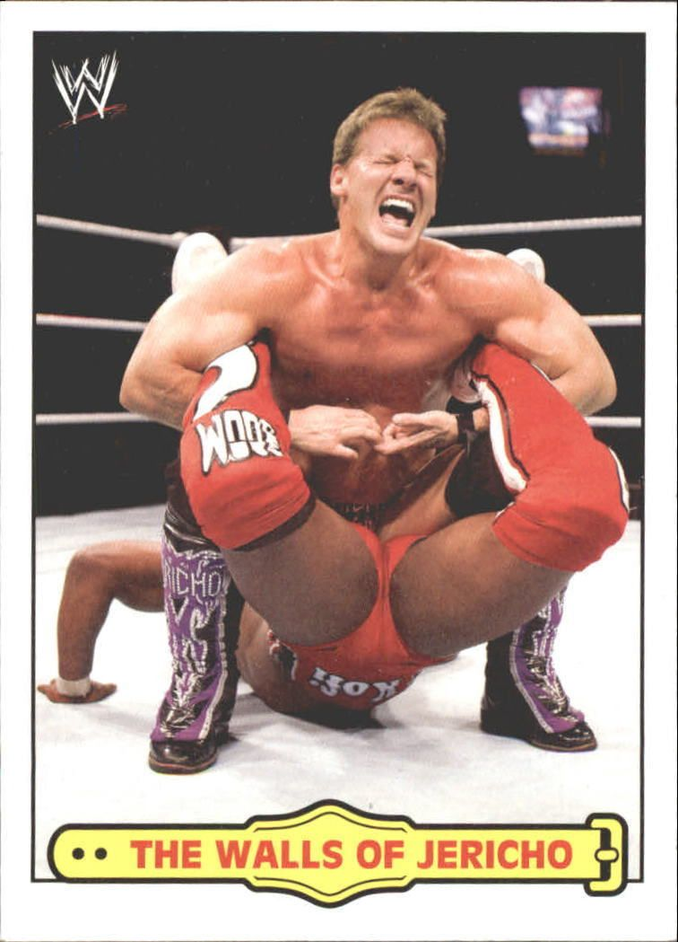

Slide 4
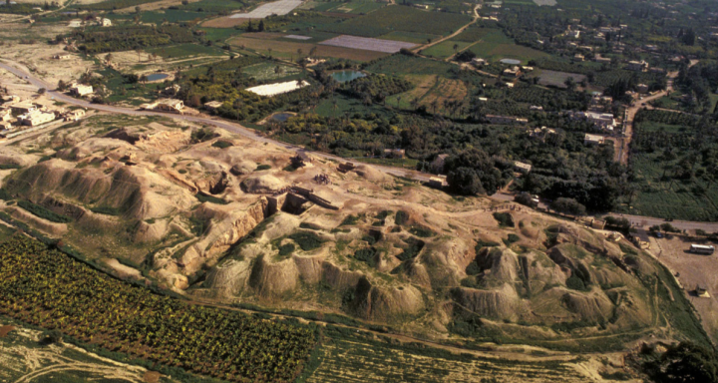

Slide 5
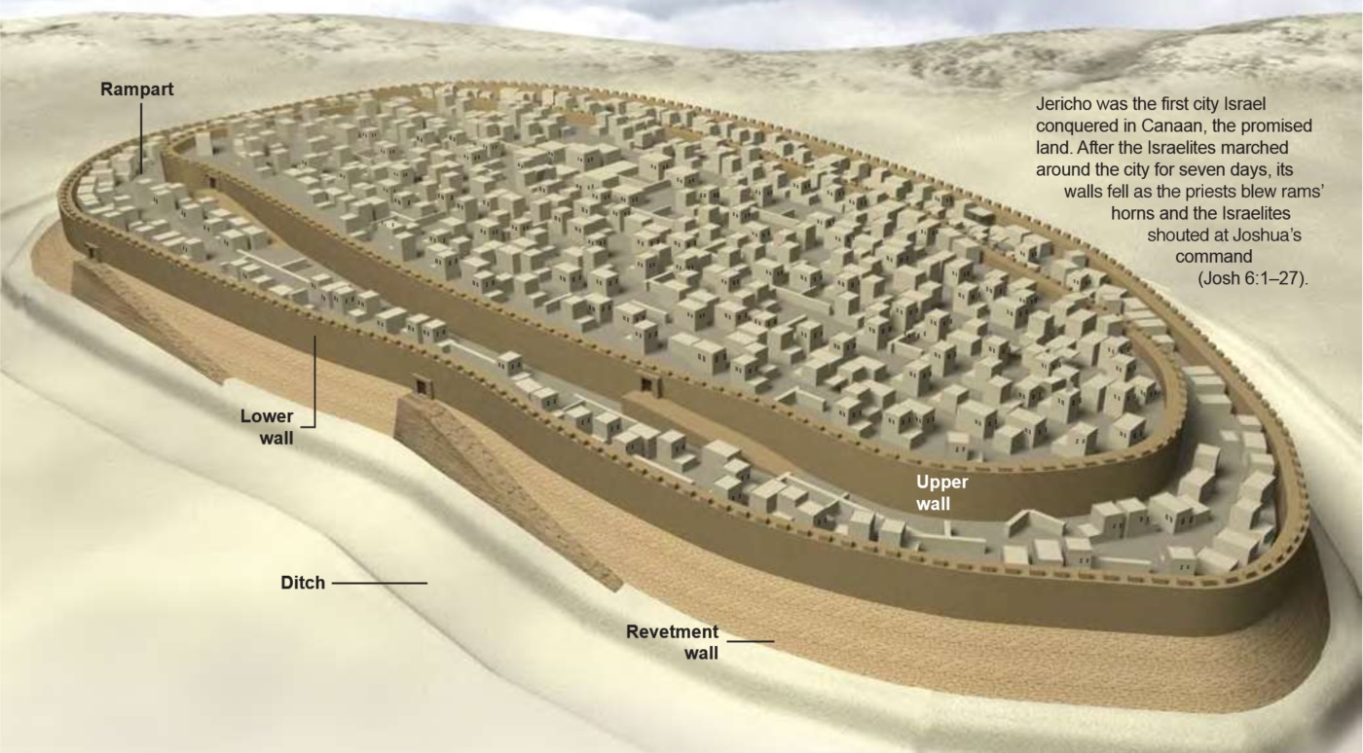

Slide 6
Joshua 2
1 So the two men set out and came to the house of a prostitute named Rahab and stayed there that night.

Slide 7
Joshua 2
How did the spies end up there?
The usual reason?
A good place to hide out
Because God had something in mind
1 So the two men set out and came to the house of a prostitute named Rahab and stayed there that night.

Slide 8
Joshua 2
How did Rahab end up there?
The life of a prostitute was awful
Short life expectancy
She was probably a sweet little girl at one time…
1 So the two men set out and came to the house of a prostitute named Rahab and stayed there that night.

Slide 9
Joshua 2
How did Rahab end up there?
Rahab knew she was created for something more, but here she was
Then she began to hear rumors about these Israelites
1 So the two men set out and came to the house of a prostitute named Rahab and stayed there that night.

Slide 10
Joshua 2
How did Rahab end up there?
She saw them camped across the river
Then she went out to the gate for the night shift and met these two
And she saw an opportunity…
1 So the two men set out and came to the house of a prostitute named Rahab and stayed there that night.

Slide 13
Joshua 2
2 But someone told the king of Jericho, “Some Israelites have come here tonight to spy out the land.”

Slide 14
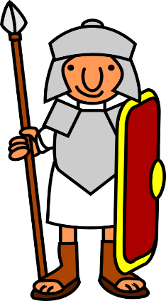
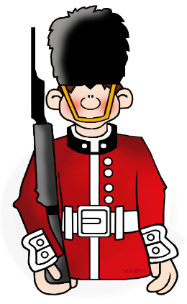
Joshua 2
3 So the king of Jericho sent orders to Rahab:

Slide 15
Joshua 2
3 “Bring out the men who have come into your house, for they have come here to spy out the whole land.”
So, these guys really stink at being spies

Slide 16
Joshua 2
4 Rahab had hidden the two men…

Slide 17
Joshua 2
6 (She had taken them up to the roof and hidden them beneath bundles of flax she had laid out.)

Slide 18
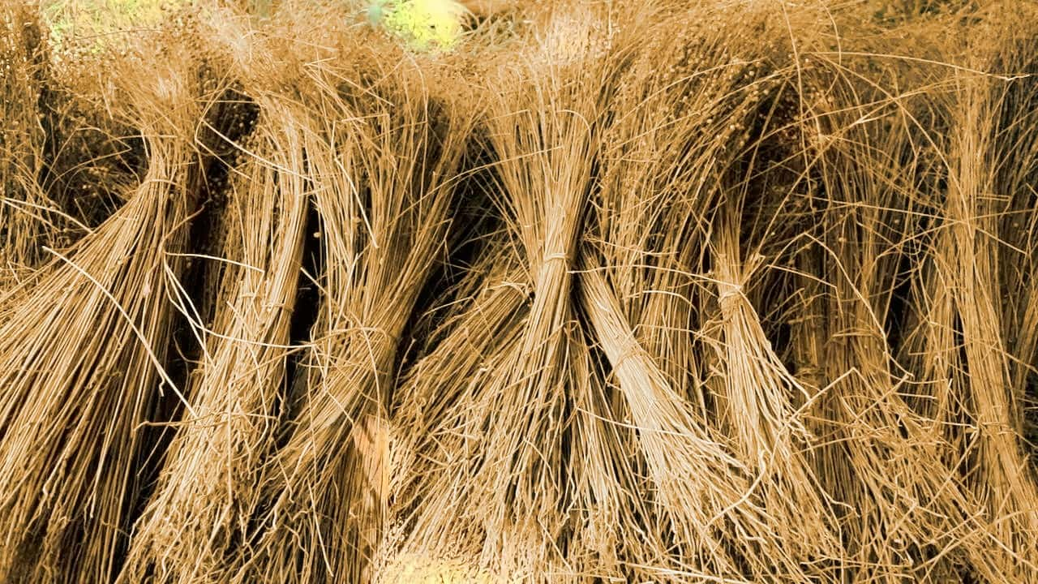

Slide 19
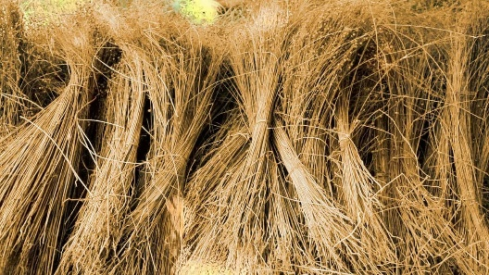
Joshua 2
4 “Yes, the men were here earlier, but I didn’t know where they were from.

Slide 20
Joshua 2
5 They left the town at dusk, as the gates were about to close.

Slide 21
Joshua 2
5 I don’t know where they went. If you hurry, you can probably catch up with them.”

Slide 22
Joshua 2
7 The king’s men went looking for the spies
along the road leading to the shallow crossings of the Jordan River.

Slide 23
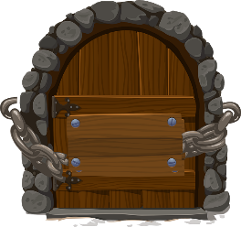
Joshua 2
7 And as soon as the king’s men had left, the gate of Jericho was shut.

Slide 24
Joshua 2
8 Before the spies went to sleep that night, Rahab went up on the roof to talk with them.

Slide 25
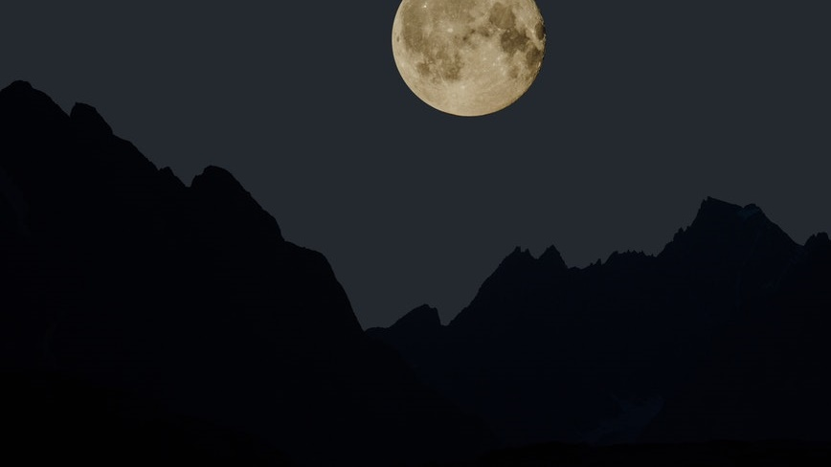
Joshua 2
9 “I know Yahweh has given you this land,” she told them.
“We are all afraid of you. Everyone in the land is living in terror.
Rahab is a woman of faith!!
Faith = Knowing

Slide 26
World English Dictionary
http://dictionary.reference.com/browse/faith
Faith = strong or unshakeable belief in something, esp. without proof or evidence…
a conviction of the truth of certain doctrines of religion, esp. when this is not based on reason

Slide 27
Joshua 2
9 “I know Yahweh has given you this land,” she told them.
“We are all afraid of you. Everyone in the land is living in terror.
Perhaps it’s time for you to start feeding your mind with God’s truth
If you want your faith to grow, it starts with what you know
Faith = Knowing

Slide 28
Joshua 2
10 For we have heard how Yahweh made a dry path for you through the Red Sea when you left Egypt. [Ex 14]
And we know what you did to Sihon and Og, the two Amorite kings east of the Jordan River, whose people you completely destroyed. [Num 21]
Faith = Knowing

Slide 29
Joshua 2
11 No wonder our hearts have melted in fear! No one has the courage to fight after hearing such things.
For Yahweh your God is the supreme God of the heavens above and the earth below.
Faith = Knowing

Slide 30
Joshua 2
11 No wonder our hearts have melted in fear! No one has the courage to fight after hearing such things.
For Yahweh your God is the supreme God of the heavens above and the earth below.
Faith = Knowing + Believing

Slide 31
Joshua 2
11 No wonder our hearts have melted in fear! No one has the courage to fight after hearing such things.
For Yahweh your God is the supreme God of the heavens above and the earth below.
Everything Rahab had been taught about God and life and sex and the world was wrong!
She had acted on those lies and done so much damage
Faith = Knowing + Believing

Slide 32
Joshua 2
11 No wonder our hearts have melted in fear! No one has the courage to fight after hearing such things.
For Yahweh your God is the supreme God of the heavens above and the earth below.
But then she began to hear stories about Yahweh…
Faith = Knowing + Believing

Slide 33
Joshua 2
11 No wonder our hearts have melted in fear! No one has the courage to fight after hearing such things.
For Yahweh your God is the supreme God of the heavens above and the earth below.
We live in a culture where people are being taught all of the wrong things
But Rahab stands as a ray of hope that no one is too far gone!
Faith = Knowing + Believing

Slide 34
Joshua 2
12-13 Now swear to me by Yahweh that you will show kindness to me and my family since I have helped you.
Give me a pledge of truth that when Jericho is conquered, you will let me live,
along with my father and mother, my brothers and sisters, and all their families.”
Faith = Knowing + Believing

Slide 35
Joshua 2
12-13 Now swear to me by Yahweh that you will show kindness to me and my family since I have helped you.
Give me a pledge of truth that when Jericho is conquered, you will let me live,
along with my father and mother, my brothers and sisters, and all their families.”
hesed = God’s loving-kindness, mercy
It’s not enough just to believe in God and be afraid of Him
You also need to come with empty hands of faith
Faith = Knowing + Believing

Slide 36
Joshua 2
12-13 Now swear to me by Yahweh that you will show kindness to me and my family since I have helped you.
Give me a pledge of truth that when Jericho is conquered, you will let me live,
along with my father and mother, my brothers and sisters, and all their families.”
Isa 64:6 –
We are all like one who is unclean,
all our so-called righteous acts are like a menstrual rag in your sight
Faith = Knowing + Believing

Slide 37
Joshua 2
12-13 Now swear to me by Yahweh that you will show kindness to me and my family since I have helped you.
Give me a pledge of truth that when Jericho is conquered, you will let me live,
along with my father and mother, my brothers and sisters, and all their families.”
Eph 2:8-9 –
For it is by grace (1)
you have been saved, (2)
through faith— (3)
and this not from yourselves, (4)
it is the gift of God— (5)
not by works, (6)
so that no one can boast. (7)
Faith = Knowing + Believing

Slide 38
Joshua 2
14 “We offer our own lives as a guarantee for your safety,” the men agreed.
“If you don’t betray us, we will keep our promise and be kind to you when Yahweh gives us the land.”
Faith = Knowing + Believing

Slide 39
Joshua 2
14 “We offer our own lives as a guarantee for your safety,” the men agreed.
“If you don’t betray us, we will keep our promise and be kind to you when Yahweh gives us the land.”
Maybe the action step is what is missing from your faith
Faith = Knowing + Believing + Acting

Slide 40
Joshua 2
15 Then, since Rahab’s house was built into the town wall, she let them down by a rope through the window.

Slide 41
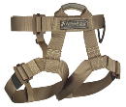
Joshua 2
15 Then, since Rahab’s house was built into the town wall, she let them down by a rope through the window.

Slide 42
Joshua 2
16 “Escape to the hill country,” she told them. “Hide there for three days from the men searching for you.

Slide 43
Joshua 2
16 Then, when they have returned, you can go on your way.”

Slide 44
Joshua 2
17 Before they left, the men had told her, “We will be bound by the oath we have taken only if you follow these instructions.

Slide 45
Joshua 2
18 When we come into the land, you must leave this scarlet rope hanging from the window through which you let us down.

Slide 46
Joshua 2
18 When we come into the land, you must leave this scarlet rope hanging from the window through which you let us down.
18 And all your family members—your father, mother, brothers, and all your relatives—must be here inside the house.
19 If they go out into the street and are killed, it will not be our fault.

Slide 47
Joshua 2
18 When we come into the land, you must leave this scarlet rope hanging from the window through which you let us down.
19 But if anyone lays a hand on people inside this house, we will accept the responsibility for their death.
20 If you betray us, however, we are not bound by this oath in any way.”

Slide 48
Joshua 2
18 When we come into the land, you must leave this scarlet rope hanging from the window through which you let us down.
Why the scarlet rope?
Joshua 5:10 – While the Israelites were camped at Gilgal on the plains of Jericho, they celebrated Passover

Slide 49
Joshua 2
21 “I accept your terms,” she replied.
And she sent them on their way, leaving the scarlet rope hanging from the window.

Slide 50
Joshua 2

Slide 51
Joshua 2
What ever happened to Rahab?
She waited
She watched
She was rescued
She married a guy named “Salmon”
She became royalty (Num 2:3; Rt 4:20)
She was praised in the New Testament (James 2:25; Heb. 11:31)
She became a mother (Rt 4:20; Mt 1)

Slide 52
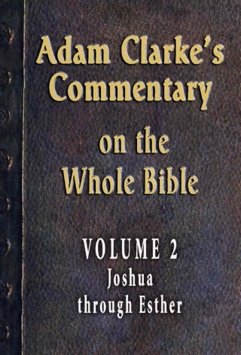
Adam Clarke
OT Scholar
Adam Clarke, Commentary on the Whole Bible, Vol. 2 (GraceWorks Multimedia, 2011)
Is it probable that a prince of Judah would have taken to wife such a person as our text represents Rahab to be?...

Slide 53
Adam Clarke
OT Scholar
Adam Clarke, Commentary on the Whole Bible, Vol. 2 (GraceWorks Multimedia, 2011)
To all this may be added, that as our blessed Lord came through the line of this woman,
it cannot be a matter of little consequence to know what moral character she sustained

Slide 54
Adam Clarke
OT Scholar
Adam Clarke, Commentary on the Whole Bible, Vol. 2 (GraceWorks Multimedia, 2011)
as an inn-keeper she might be respectable, if not honorable;
as a public prostitute she could be neither;

Slide 55
Adam Clarke
OT Scholar
Adam Clarke, Commentary on the Whole Bible, Vol. 2 (GraceWorks Multimedia, 2011)
and it is not very likely that the providence of God would have suffered a person of such a notoriously bad character to enter into the sacred line of his genealogy.

Slide 56
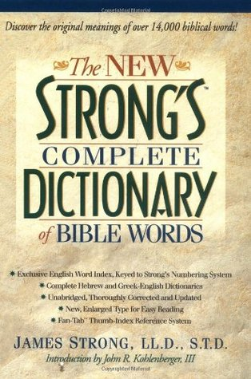
The New Strong’s Complete Dictionary
The NT Greek word is “porne”
Strong, James. The New Strong’s Dictionary of Hebrew and Greek Words. Nashville: Thomas Nelson, 1996.
“zonah” translation in the KJV =
“be a harlot” or “play the harlot” (36x)
“commit fornication” ( 3x)
“cause to be a whore” / “play the whore” (11x)
“commit whoredom” / “fall to whoredom” (15x)
“cause to go a whoring” (19x)
“whorish” ( 3x)

Slide 57
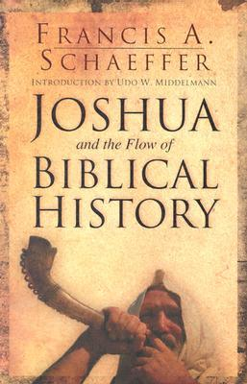
Francis Schaeffer
Francis Schaeffer, Joshua and the Flow of Biblical History, p. 81
Is Rahab any worse than we?
If it is not fitting that she should be the ancestress of Christ, is it fitting that we should be the bride of Christ? …
We all stand in Rahab’s place in the sight of the holy God.

Slide 58
Francis Schaeffer
Francis Schaeffer, Joshua and the Flow of Biblical History, p. 81
It doesn’t matter what you’ve done.
What matters is what Christ has done!
Is Rahab any worse than we?
If it is not fitting that she should be the ancestress of Christ, is it fitting that we should be the bride of Christ? …
We all stand in Rahab’s place in the sight of the holy God.

