Slide 2
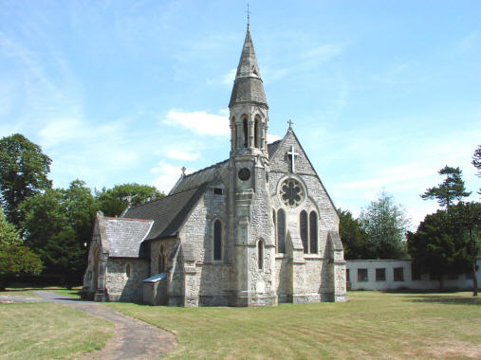

Slide 3
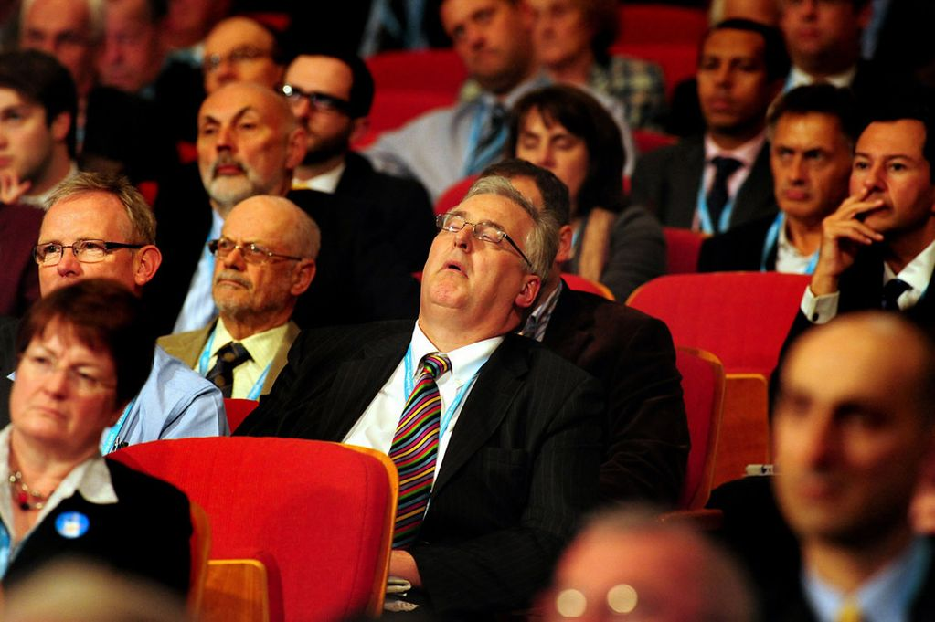
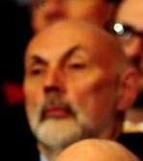

Slide 4
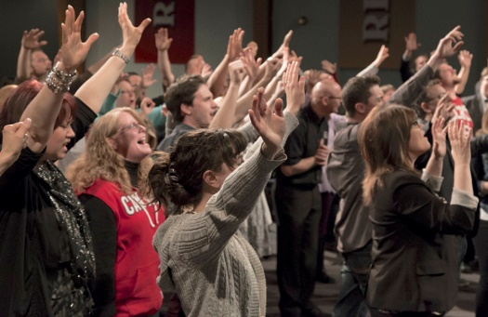

Slide 7
(1 Pet. 2:4) Coming to Him as to a living stone which has been rejected by men, but is choice and precious in the sight of God.
⁵ You also, as living stones, are being built up as a spiritual house for a holy priesthood, to offer up spiritual sacrifices acceptable to God through Jesus Christ.

Slide 8
(1 Pet. 2:4) Coming to Him as to a living stone which has been rejected by men, but is choice and precious in the sight of God.
⁵ You also, as living stones, are being built up as a spiritual house for a holy priesthood, to offer up spiritual sacrifices acceptable to God through Jesus Christ.

Slide 9
(1 Pet. 2:4) Coming to Him as to a living stone which has been rejected by men, but is choice and precious in the sight of God.
⁵ You also, as living stones, are being built up as a spiritual house for a holy priesthood, to offer up spiritual sacrifices acceptable to God through Jesus Christ.
Old Testament Temple?
Showed our separation from God.
Revealed a way of approach.
One man could enter once a year.

Slide 10
(1 Pet. 2:4) Coming to Him as to a living stone which has been rejected by men, but is choice and precious in the sight of God.
⁵ You also, as living stones, are being built up as a spiritual house for a holy priesthood, to offer up spiritual sacrifices acceptable to God through Jesus Christ.
Do we have a Temple today?
Yes!
We are the Temple!

Slide 11
(1 Pet. 2:6) For this is contained in Scripture:
‘Behold, I lay in Zion a choice stone,
a precious corner stone,
and he who believes in Him will not be disappointed.’
Why does Peter compare Christians to a Temple?

Slide 12
A Temple requires an Architect…

Slide 13
Each stone is incredibly close

Slide 15
Each stone took tremendous effort to get into the Temple

Slide 16
Each stone is unique and diverse

Slide 17
Each stone plays an important role

Slide 18
Each stone plays an important role

Slide 19
The stones are greater when assembled together

Slide 20
The stones are greater when assembled together

Slide 21
The stones are greater when assembled together

Slide 22
Each stone has an noticeable role

Slide 30
(1 Pet. 2:6b) ‘He who believes in Him will not be disappointed.’
⁷ This precious value, then, is for you who believe.
Columbus Census
God’s perspective
300,000
Church members
400,000
True believers

Slide 31
(1 Pet. 2:6b) ‘He who believes in Him will not be disappointed.’
⁷ This precious value, then, is for you who believe.
But for those who disbelieve, ‘The stone which the builders rejected, this became the very corner stone.’

Slide 32
(1 Pet. 2:8) To them, Jesus has become, ‘A stone of stumbling and a rock of offense.’

Slide 33
(1 Pet. 2:8) For they stumble because they are disobedient to the word,
and to this doom they were also appointed.
Divine determinism?
“This” (neuter relative pronoun) modifies the entire previous clause.
“It is a prearranged principle that those who do disobey will stumble.”
Craig Blomberg, From Pentecost to Patmos (Nashville, TN: B & H Academic, 2006), p.450.

Slide 34
(1 Pet. 2:8) For they stumble because they are disobedient to the word,
and to this doom they were also appointed.

Slide 37
(1 Pet. 2:9) But you are a chosen race, a royal priesthood, a holy nation, a people for God’s own possession,
so that you may proclaim the praises of Him
(2 Pet. 1:5) Make every effort to add to your faith goodness.
“Praises” (aretē)
“Virtue” or “excellence of character.”
NIDNT (1986), p.925.
BDAG (2000), p.130.
“Excellencies” (NASB, ESV), “virtues” (NET), “goodness of God” (NLT)
Never translated as “praise” in the NT!
(Phil. 4:8; 2 Pet. 1:3, 5)

Slide 38
(1 Pet. 2:9) But you are a chosen race, a royal priesthood, a holy nation, a people for God’s own possession,
so that you may proclaim the excellencies of Him
who has called you out of darkness into His marvelous light.

Slide 39
(1 Pet. 2:10) For you once were not a people,
but now you are the people of God;
you had not received mercy,
but now you have received mercy.

Slide 40
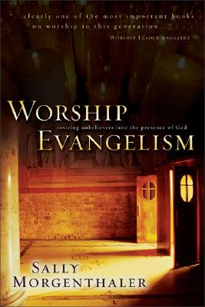
Sally Morgenthaler
(Worship Expert)
Sally Morgenthaler, Worship Evangelism: Inviting Unbelievers into the Presence of God (Grand Rapids, MI: Zondervan Pub. House, 1995), 9.
Unbelievers… will draw lasting conclusions about the veracity and uniqueness of our God based on what they see or do not see happening in our weekly church services.

Slide 41
Sally Morgenthaler
(Worship Expert)
Sally Morgenthaler, Worship Evangelism: Inviting Unbelievers into the Presence of God (Grand Rapids, MI: Zondervan Pub. House, 1995), 9.
Do they detect something supernatural and life-changing going on? Can they sense God’s presence and work among us? Are they experiencing something in our midst they have never seen before?

Slide 42
Sally Morgenthaler
(Worship Expert)
Sally Morgenthaler, “Worship as Evangelism,” Rev! May/June 2007. 48.
In 2001, a worship-driven congregation in my area finally did a survey as to who they were really reaching,
and they were shocked.

Slide 43
Sally Morgenthaler
(Worship Expert)
Sally Morgenthaler, “Worship as Evangelism,” Rev! May/June 2007. 48.
Big money is spent on these services!!
They’d thought their congregation was at least 50 percent unchurched.
The real number was 3 percent.

Slide 44
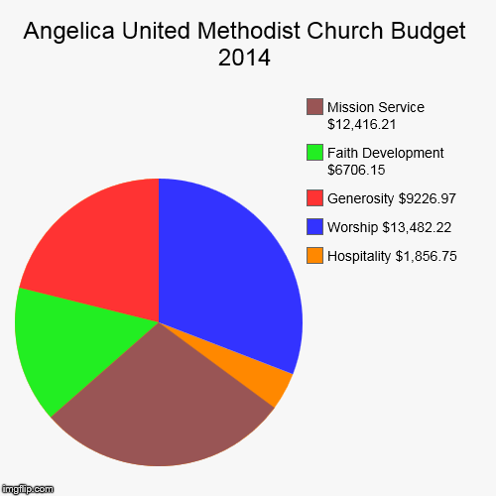

Slide 45
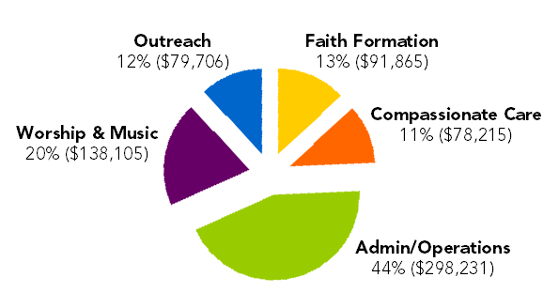

Slide 46
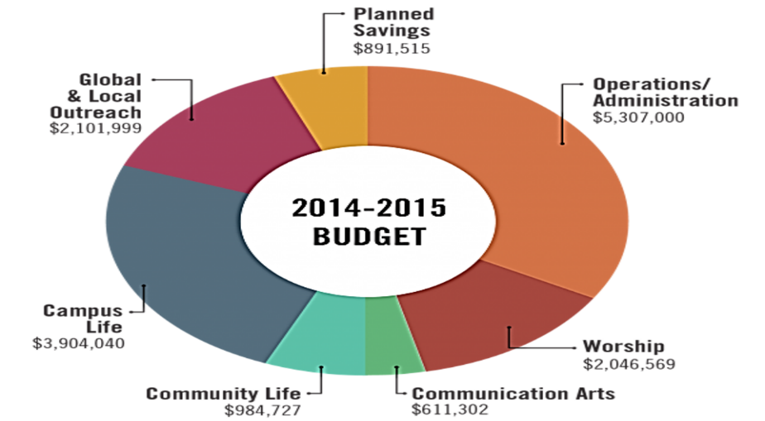
Creates a consumer mentality…

Slide 47
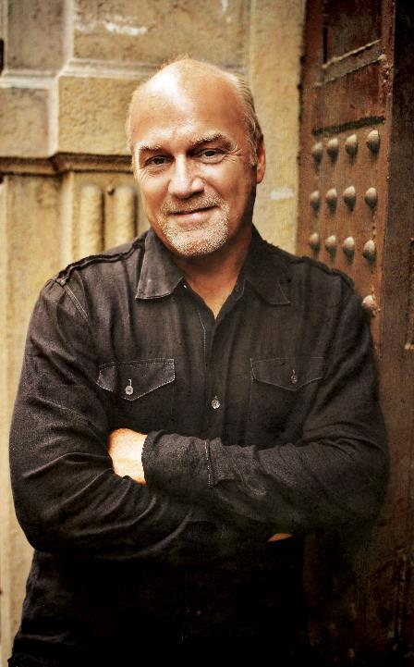
Greg Laurie
(Senior Pastor of Harvest Christian Fellowship)
Greg Laurie, “Church Growth.” http://www.equip.org/articles/church-growth/
The past two decades have witnessed a dramatic increase in the number of large churches, including “megachurches” (congregations of 1,000 or more), around the country…

Slide 48
Greg Laurie
(Senior Pastor of Harvest Christian Fellowship)
Greg Laurie, “Church Growth.” http://www.equip.org/articles/church-growth/
During the very time megachurches have sprouted across the landscape,
the proportion of Americans who claim to be “born again” has remained a constant 32 percent.

Slide 49
Greg Laurie
(Senior Pastor of Harvest Christian Fellowship)
Greg Laurie, “Church Growth.” http://www.equip.org/articles/church-growth/
Growth isn’t coming from conversions but from transfers—up to 80 percent of all growth taking place today.

Slide 50
Greg Laurie
(Senior Pastor of Harvest Christian Fellowship)
Greg Laurie, “Church Growth.” http://www.equip.org/articles/church-growth/
Some church growth experts are telling pastors their “customers” no longer attend to commune with God,
but to “consume” a personal or family service.

Slide 51
Greg Laurie
(Senior Pastor of Harvest Christian Fellowship)
Greg Laurie, “Church Growth.” http://www.equip.org/articles/church-growth/
In a recent survey of 1,000 church attenders, respondents were asked,
“Why does the church exist?”

Slide 52
Greg Laurie
(Senior Pastor of Harvest Christian Fellowship)
Greg Laurie, “Church Growth.” http://www.equip.org/articles/church-growth/
According to 89 percent, the church’s purpose was “to take care of my family’s and my spiritual needs.” Only 11 percent said the purpose of the church is “to win the world for Jesus Christ.”

Slide 53
Greg Laurie
(Senior Pastor of Harvest Christian Fellowship)
Greg Laurie, “Church Growth.” http://www.equip.org/articles/church-growth/
According to 89 percent, the church’s purpose was “to take care of my family’s and my spiritual needs.” Only 11 percent said the purpose of the church is “to win the world for Jesus Christ.”

Slide 54
(1 Pet. 2:6) “He who believes in Jesus will not be disappointed.”
The church is not a place—it’s people.
Our primary purpose is to share Jesus’ message with a hurting world.
We do not become a Christian by joining a church, but by personally trusting in Christ.

Slide 55
3 Myths about Church
#1. The church is a beautiful or boring building.
#2. To become a Christian, I need to join a church.
#3. The purpose of the church is to sing songs.

