Slide 2
1 Thessalonians
3 Components for a Healthy Church

Slide 3
1 Thessalonians 1:1–10 (NASB95)
1 Paul and Silvanus and Timothy, To the church of the Thessalonians in God the Father and the Lord Jesus Christ: Grace to you and peace.

Slide 4
1 Thessalonians 1:1–10 (NASB95)
1 Paul and Silvanus and Timothy, To the church of the Thessalonians in God the Father and the Lord Jesus Christ: Grace to you and peace.
A city of Macedonia

Slide 5
Acts 16:9–10 (NASB95)
9 A vision appeared to Paul in the night: a man of Macedonia was standing and appealing to him, and saying, “Come over to Macedonia and help us.” 10 When he had seen the vision, immediately we sought to go into Macedonia, concluding that God had called us to preach the gospel to them.

Slide 6
Acts 16:11–12 (NASB95)
11 So putting out to sea from Troas, we ran a straight course to Samothrace, and on the day following to Neapolis; 12 and from there to Philippi, which is a leading city of the district of Macedonia,…

Slide 7
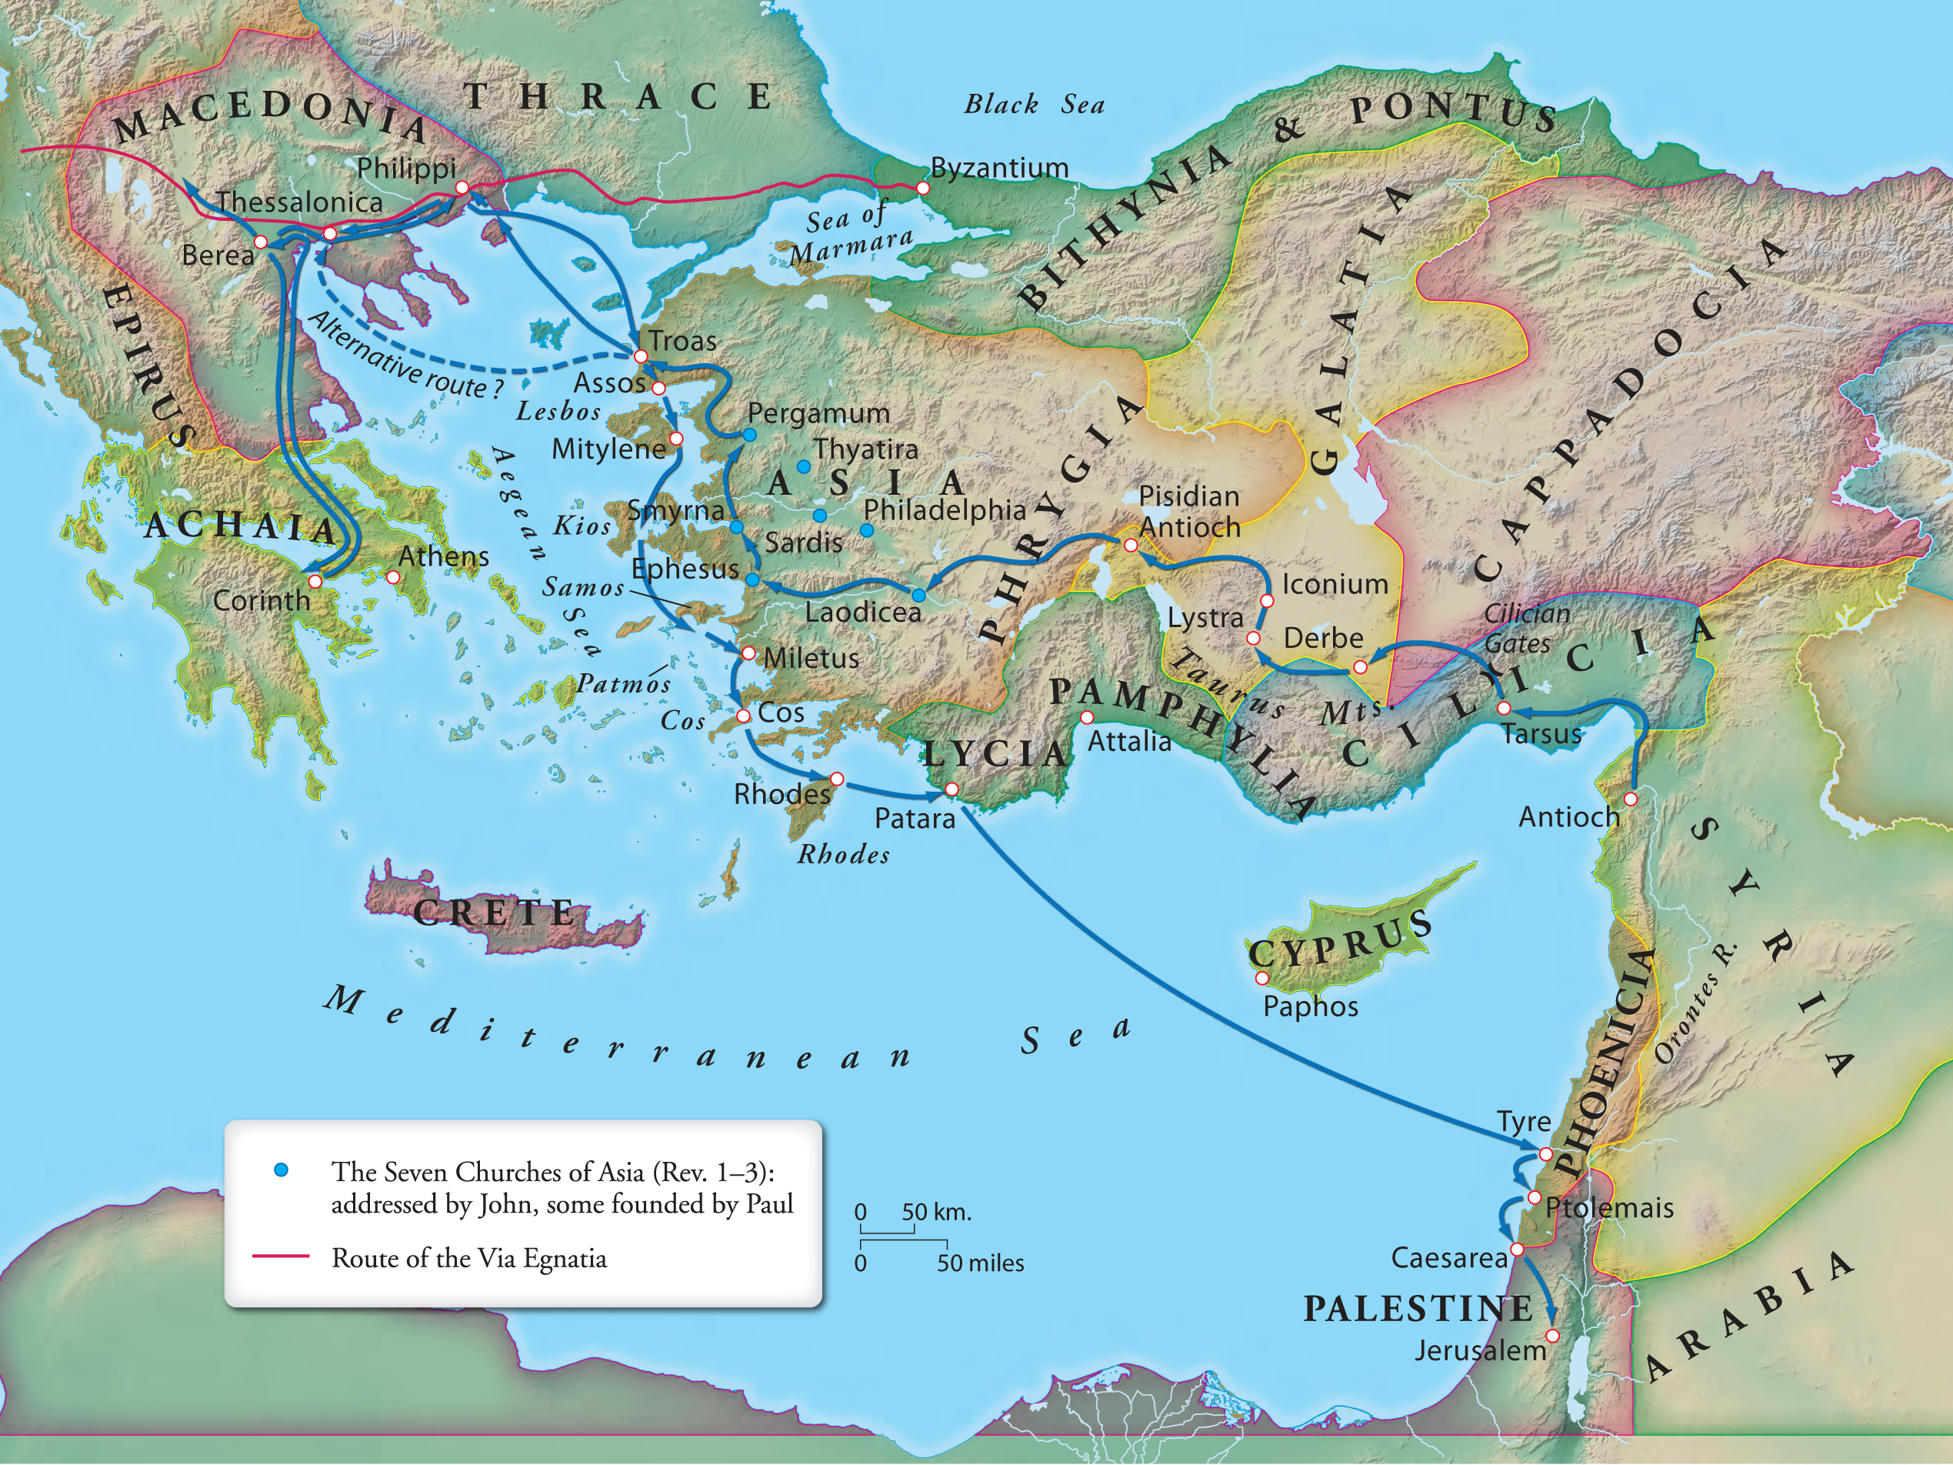

Slide 10
Thessalonica
A large city in Macedonia (pop. 200,000)
Named after Alexander’s half sister Thessalonica
One of the healthier churches in the Bible
A strong Jewish presence until WWII
60,000 Jews were deported and killed

Slide 11
1 Thessalonians
One of the older NT books
Written by Paul from Athens or Corinth
Heavily Greek/Non-Jewish audience

Slide 12
Thessalonians
Acts 17 records the establishment of the church

Slide 13
Acts 17:1–7 (NASB95)
1 Now when they had traveled through Amphipolis and Apollonia, they came to Thessalonica, where there was a synagogue of the Jews. 2 And according to Paul’s custom, he went to them, and for three Sabbaths reasoned with them from the Scriptures,

Slide 14
Acts 17:1–7 (NASB95)
1 Now when they had traveled through Amphipolis and Apollonia, they came to Thessalonica, where there was a synagogue of the Jews. 2 And according to Paul’s custom, he went to them, and for three Sabbaths reasoned with them from the Scriptures,

Slide 15
Acts 17:1–7 (NASB95)
3 explaining and giving evidence that the Christ had to suffer and rise again from the dead, and saying, “This Jesus whom I am proclaiming to you is the Christ.”

Slide 16
Acts 17:1–7 (NASB95)
3 explaining and giving evidence that the Christ had to suffer and rise again from the dead, and saying, “This Jesus whom I am proclaiming to you is the Christ.”

Slide 17
Acts 17:1–7 (NASB95)
4 And some of them were persuaded and joined Paul and Silas, along with a large number of the God-fearing Greeks and a number of the leading women.

Slide 18
Acts 17:1–7 (NASB95)
4 And some of them were persuaded and joined Paul and Silas, along with a large number of the God-fearing Greeks and a number of the leading women.

Slide 19
Acts 17:1–7 (NASB95)
5 But the Jews, becoming jealous and taking along some wicked men from the marketplace, formed a mob and set the city in an uproar; and attacking the house of Jason, they were seeking to bring them out to the people.

Slide 20
Acts 17:1–7 (NASB95)
6 When they did not find them, they began dragging Jason and some brethren before the city authorities, shouting, “These men who have upset the world have come here also; 7 and Jason has welcomed them, and they all act contrary to the decrees of Caesar, saying that there is another king, Jesus.”

Slide 21
How a church gets started
God gives a burden
Someone responds
Going to the “God fearers”
Proclaiming, reasoning, serving, loving
Persuasion/Repentance/Conversion

Slide 22
1 Thessalonians 1:1–10 (NASB95)
5 for our gospel did not come to you in word only, but also in power and in the Holy Spirit and with full conviction; just as you know what kind of men we proved to be among you for your sake.

Slide 23
NOT in word ONLY
Words are important
Reason is important
1 Corinthians 13:1 (NASB95) — 1 If I speak with the tongues of men and of angels, but do not have love, I have become a noisy gong or a clanging cymbal.

Slide 24
NOT in word ONLY
Words are important
Reason is important
Letting the Holy Spirit shine
Conviction=boldness
A demonstration of power
A demonstration of character
Real love

Slide 25
How a church gets started
God gives a burden
Someone responds
Going to the “God fearers”
Proclaiming, reasoning, serving, loving
Persuasion/Repentance/Conversion
Opposition

Slide 26
1 Thessalonians 1:1–10 (NASB95)
2 We give thanks to God always for all of you, making mention of you in our prayers; 3 constantly bearing in mind your work of faith and labor of love and steadfastness of hope in our Lord Jesus Christ in the presence of our God and Father, 4 knowing, brethren beloved by God, His choice of you;

Slide 27
3 Components
Faith
Labor of love
Hope in Jesus’ return

Slide 28
Faith
Hebrews 11:1 (NASB95) — 1 Now faith is the assurance of things hoped for, the conviction of things not seen.

Slide 29
Faith
Becoming aware of a need
Becoming aware of our inadequacies
Examining the evidence
Seeing something compelling in others
Making a decision that leads to action

Slide 30
3 Components
Faith
Labor of love

Slide 31
Labor of love
Faith
Labor of love
τοῦ κόπου τῆς ἀγάπης
κόπος kopos
-To tire oneself out
ἀγαπάω agapaō
-Sacrificial love

Slide 32
Labor of love
Hard work motivated by and as an expression of God’s love
It’s hard
It’s an expenditure of energy
Not from a sense of obligation
As a response to God’s love for us

Slide 33
Labor of love
All aspects of love
Demonstrating God’s character
Sharing the truth
Prioritizing the needs of others
Meeting their physical needs
Showing kindness
Self sacrifice

Slide 34
1 Thessalonians 1:1–10 (NASB95)
6 You also became imitators of us and of the Lord, having received the word in much tribulation with the joy of the Holy Spirit,

Slide 35
1 Thessalonians 1:1–10 (NASB95)
7 so that you became an example to all the believers in Macedonia and in Achaia. 8 For the word of the Lord has sounded forth from you, not only in Macedonia and Achaia, but also in every place your faith toward God has gone forth, so that we have no need to say anything.

Slide 36
1 Thessalonians 1:1–10 (NASB95)
9 For they themselves report about us what kind of a reception we had with you, and how you turned to God from idols to serve a living and true God,

Slide 37
1 Thessalonians 1:1–10 (NASB95)
9 For they themselves report about us what kind of a reception we had with you, and how you turned to God from idols to serve a living and true God,

Slide 38
1 Thessalonians 1:1–10 (NASB95)
10 and to wait for His Son from heaven, whom He raised from the dead, that is Jesus, who rescues us from the wrath to come.

Slide 39
3 Components
Faith
Labor of love
Hope in Jesus’ return

Slide 40
Hope in Jesus’ return
A real belief that this life is temporary
That God will set things right
That we will spend eternity with each other and Him
That we will live like our time here is short

