Slide 2
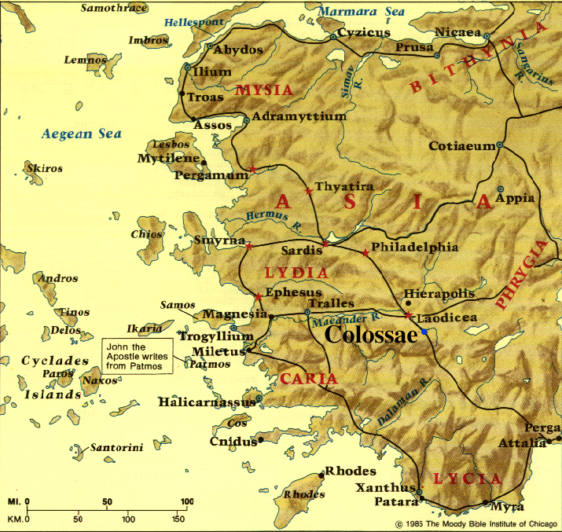

Slide 3
^{Colossians 3:17} And whatever you do or say, do it as a representative of the Lord Jesus, giving thanks through Him to God the Father.
YOU
FAMILY
WORK
NEIGHBORS
COMMUNITY

Slide 4
^{Colossians 3:17} And whatever you do or say, do it as a representative of the Lord Jesus, giving thanks through Him to God the Father.
Showing God’s love through our attitudes & actions (3:18-4:1)
YOU
FAMILY
WORK
^{Titus 3:1} Remind them to be subject to rulers, to authorities, to be obedient, to be ready for every good deed, ² to malign no one, to be peaceable, gentle, showing every consideration for all people.
NEIGHBORS
COMMUNITY

Slide 5
^{Colossians 3:17} And whatever you do or say, do it as a representative of the Lord Jesus, giving thanks through Him to God the Father.
Showing God’s love through our attitudes & actions (3:18-4:1)
Sharing God’s love through our words about Jesus (4:2-6)
YOU
FAMILY
WORK
^{2 Corinthians 5:20} We are therefore Christ’s ambassadors, as though God were making his appeal through us. We implore you on Christ’s behalf: “Be reconciled to God.”
NEIGHBORS
COMMUNITY

Slide 6
Colossians 4:2-6 Sharing Christ with Non-Christians
PRAY FOR OPEN DOORS
^{4:2} Devote yourselves to prayer, keeping alert in it with an attitude of thanksgiving; ³ praying at the same time for us as well, that God will open up to us a door for the word, so that we may speak forth the mystery of Christ, for which I have also been imprisoned; ⁴ that I may make it clear in the way I ought to speak.

Slide 7
Colossians 4:2-6 Sharing Christ with Non-Christians
PRAY FOR OPEN DOORS
God answered their prayers for open doors for Paul (Phil. 1:12-14) . . .
^{4:2} Devote yourselves to prayer, keeping alert in it with an attitude of thanksgiving; ³ praying at the same time for us as well, that God will open up to us a door for the word, so that we may speak forth the mystery of Christ, for which I have also been imprisoned; ⁴ that I may make it clear in the way I ought to speak.

Slide 8
Colossians 4:2-6 Sharing Christ with Non-Christians
PRAY FOR OPEN DOORS
. . . & God will answer our prayers for open doors for us - if we ask (Jas. 4:2)
^{4:2} Devote yourselves to prayer, keeping alert in it with an attitude of thanksgiving; ³ praying at the same time for us as well, that God will open up to us a door for the word, so that we may speak forth the mystery of Christ, for which I have also been imprisoned; ⁴ that I may make it clear in the way I ought to speak.

Slide 9
Colossians 4:2-6 Sharing Christ with Non-Christians
PRAY FOR OPEN DOORS
As you begin each day & as you encounter each situation
^{4:2} Devote yourselves to prayer, keeping alert in it with an attitude of thanksgiving; ³ praying at the same time for us as well, that God will open up to us a door for the word, so that we may speak forth the mystery of Christ, for which I have also been imprisoned; ⁴ that I may make it clear in the way I ought to speak.

Slide 10
Colossians 4:2-6 Sharing Christ with Non-Christians
PRAY FOR OPEN DOORS
As you begin each day & as you encounter each situation
For one another as you pray together
^{4:2} Devote yourselves to prayer, keeping alert in it with an attitude of thanksgiving; ³ praying at the same time for us as well, that God will open up to us a door for the word, so that we may speak forth the mystery of Christ, for which I have also been imprisoned; ⁴ that I may make it clear in the way I ought to speak.

Slide 11
Colossians 4:2-6 Sharing Christ with Non-Christians
MAKE THE MOST OF THE OPPORTUNITY
“Wisdom” because of many variables vs. “one-size-fits-all”
^{4:5} Conduct yourselves with wisdom toward outsiders, making the most of the opportunity.

Slide 12
Colossians 4:2-6 Sharing Christ with Non-Christians
MAKE THE MOST OF THE OPPORTUNITY
Giving credit to Jesus when complimented or thanked for your good deeds, love, etc.
Being honest about the spiritual aspect of your life
Answering a question or objection about Christianity
Sharing why & how you became a Christian
^{4:5} Conduct yourselves with wisdom toward outsiders, making the most of the opportunity.

Slide 13
Colossians 4:2-6 Sharing Christ with Non-Christians
MAKE THE MOST OF THE OPPORTUNITY
Correcting a misconception about Christianity
Giving a relevant book or recorded teaching
Giving an invitation to socialize with your Christian friends or to a Bible study
Issuing &/or repeating a challenge to personally receive Jesus
^{4:5} Conduct yourselves with wisdom toward outsiders, making the most of the opportunity.

Slide 14
Colossians 4:2-6 Sharing Christ with Non-Christians
MAKE THE MOST OF THE OPPORTUNITY
Wisdom comes from past experience & from asking the Holy Spirit on the spot
Everything we say about Jesus with Spirit-led wisdom is significant!
^{4:5} Conduct yourselves with wisdom toward outsiders, making the most of the opportunity.

Slide 15
Colossians 4:2-6 Sharing Christ with Non-Christians
USE GRACIOUS SPEECH
Showing genuine warmth & courtesy in everyday interactions
Listening with genuine other-centered curiosity
Sharing more than declaring
Picking carefully what disagreements to express
^{4:6} Let your speech always be with grace, as though seasoned with salt, so that you will know how you should respond to each person.

Slide 16
Colossians 4:2-6 Sharing Christ with Non-Christians
USE GRACIOUS SPEECH
Reading person’s receptivity & responding appropriately
Refusing to be belligerent or argumentative
Apologizing for offences
^{4:6} Let your speech always be with grace, as though seasoned with salt, so that you will know how you should respond to each person.

Slide 17
Colossians 4:2-6 Sharing Christ with Non-Christians
USE GRACIOUS SPEECH
Gracious speech encourages openness about personal needs, questions, hopes, etc. (cf. John 4)
^{4:6} Let your speech always be with grace, as though seasoned with salt, so that you will know how you should respond to each person.

Slide 18
Colossians 4:2-6 Showing God’s Love to Non-Christians
PRAY FOR OPEN DOORS
MAKE THE MOST OF THE OPPORTUNITY
USE GRACIOUS SPEECH
YOU
FAMILY
WORK
NEIGHBORS
COMMUNITY

Slide 19
NEXT WEEK:
Colossians 4:7-18 Serving God on a Team

