Slide 1
Psalm 19 The Speaking God
2 WAYS GOD SPEAKS TO US (19:1-11)
2 KEY RESPONSES TO GOD’S REVELATION (19:12-14)

Slide 2
Psalm 19 The Speaking God
GOD SPEAKS TO US THROUGH HIS CREATION
¹ The heavens proclaim the glory of God.
The skies display his craftsmanship.
² Day after day they continue to speak; night after night they make him known.
³ They speak without a sound or word; their voice is never heard.
⁴ Yet their message has gone throughout the earth, and their words to all the world.

Slide 3
Psalm 19 The Speaking God
GOD SPEAKS TO US THROUGH HIS CREATION
⁴ . . . God has made a home in the heavens for the sun.
⁵ It bursts forth like a radiant bridegroom after his wedding.
It rejoices like a great athlete eager to run the race.
⁶ The sun rises at one end of the heavens and follows its course to the other end.
Nothing can hide from its heat.

Slide 4
Psalm 19 The Speaking God
GOD SPEAKS TO US THROUGH HIS CREATION
The heavens’ revelation is non-verbal
¹ The heavens proclaim the glory of God.
The skies display his craftsmanship.
² Day after day they continue to speak; night after night they make Him known.
³ They speak without a sound or word; their voice is never heard.
⁴ Yet their message has gone throughout the earth, and their words to all the world.

Slide 5
Psalm 19 The Speaking God
GOD SPEAKS TO US THROUGH HIS CREATION
The heavens’ revelation is non-verbal – yet articulate & abundant & universal
¹ The heavens proclaim the glory of God.
The skies display his craftsmanship.
² Day after day they continue to speak; night after night they make Him known.
³ They speak without a sound or word; their voice is never heard.
⁴ Yet their message has gone throughout the earth, and their words to all the world.

Slide 6
Psalm 19 The Speaking God
GOD SPEAKS TO US THROUGH HIS CREATION
The heavens reveal God’s unique splendor
¹ The heavens proclaim the glory of God.
^{Isaiah 6:3} “The whole earth is full of His glory!”

Slide 7
Psalm 19 The Speaking God
GOD SPEAKS TO US THROUGH HIS CREATION
The heavens reveal God’s unique splendor
STRONG & VITAL
⁵ (The sun) bursts forth like a radiant bridegroom after his wedding.
It rejoices like a great athlete eager to run the race.
⁶ The sun rises at one end of the heavens and follows its course to the other end.

Slide 8
Psalm 19 The Speaking God
GOD SPEAKS TO US THROUGH HIS CREATION
The heavens reveal God’s unique splendor
STRONG & VITAL

Slide 9
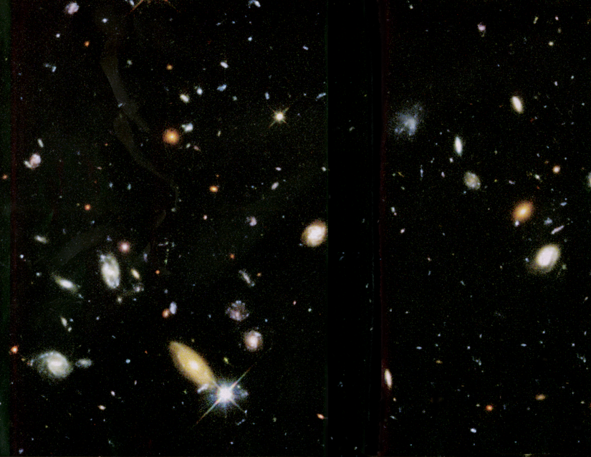
Psalm 19 The Speaking God
GOD SPEAKS TO US THROUGH HIS CREATION
The heavens reveal God’s unique splendor
POWERFUL

Slide 10
Psalm 19 The Speaking God
GOD SPEAKS TO US THROUGH HIS CREATION
The heavens reveal God’s unique splendor
BEAUTIFUL

Slide 11
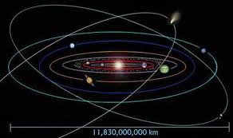
Psalm 19 The Speaking God
GOD SPEAKS TO US THROUGH HIS CREATION
The heavens reveal God’s unique splendor
ORDERLY & INTELLIGENT

Slide 12
Psalm 19 The Speaking God
GOD SPEAKS TO US THROUGH HIS CREATION
Creation has the ability to quiet & humble us & attract us to God . . .

Slide 13
Psalm 19 The Speaking God
GOD SPEAKS TO US THROUGH HIS CREATION
Creation has the ability to quiet & humble us & attract us to God . . .
. . . but urban living & internet overuse block our perception of this revelation of God

Slide 14
Psalm 19 The Speaking God
GOD SPEAKS TO US THROUGH HIS CREATION
Take the time to notice – & then “follow the trail” back to God to thank & praise Him

Slide 15
Psalm 19 The Speaking God
GOD SPEAKS TO US THROUGH HIS WORD
⁷ The instructions of the Lord are perfect, reviving the soul.
The decrees of the Lord are trustworthy, making wise the simple.
⁸ The commandments of the Lord are right, bringing joy to the heart.
The commands of the Lord are clear, giving insight for living.
⁹ Reverence for the Lord is pure, lasting forever.
The laws of the Lord are true; each one is fair.

Slide 16
Psalm 19 The Speaking God
GOD SPEAKS TO US THROUGH HIS WORD
David is referring to what was then the gradually growing Bible
¹⁰ They are more desirable than gold, even the finest gold.
They are sweeter than honey, even honey dripping from the comb.
¹¹ They are a warning to your servant, a great reward for those who obey them.

Slide 17
Psalm 19 The Speaking God
GOD SPEAKS TO US THROUGH HIS WORD
God’s Word reveals much more information about God than His creation does

Slide 18
Psalm 19 The Speaking God
GOD SPEAKS TO US THROUGH HIS WORD
God’s Word reveals much more information about God than His creation does
GOD’S CHARACTER (e.g., Ex. 34:6,7)
GOD’S TRI-UNITY
HUMANITY’S ROOT PROBLEM
GOD’S REDEMPTIVE PLAN
GOD’S DESIGN FOR OUR LIVES

Slide 19
Psalm 19 The Speaking God
GOD SPEAKS TO US THROUGH HIS WORD
God’s Word is more accurate than His revelation through creation
Because creation is now fallen, it sends a mixed message
The instructions of the Lord are perfect . . . trustworthy . . . right . . . clear . . . pure . . . true . . .

Slide 20
Psalm 19 The Speaking God
GOD SPEAKS TO US THROUGH HIS WORD
God’s Word can impact us far more positively than His revelation through creation
. . . reviving the soul . . . making wise the simple . . . bringing joy to the heart . . . giving insight for living . . . a warning to your servant, a great reward for those who obey them . . .

Slide 21
Psalm 19 The Speaking God
GOD SPEAKS TO US THROUGH HIS WORD
God’s Word can impact us far more positively than His revelation through creation
ASSURANCE OF GOD’S FORGIVENESS
JOY OF EXPERIENCING GOD’S LOVE
WISDOM TO LIVE AS GOD DESIGNED US
SOLID HOPE FOR LIFE AFTER DEATH

Slide 22
Psalm 19 The Speaking God
GOD SPEAKS TO US THROUGH HIS WORD
God’s Word can impact us far more positively than His revelation through creation
Although God’s Word has universal & constant transforming power, our experience of this depends on our response to it

Slide 23
Psalm 19 The Speaking God
2 KEY RESPONSES TO GOD’S WORD
¹² How can I know all the sins lurking in my heart? Cleanse me from these hidden faults. ¹³ Keep Your servant from deliberate sins! Don’t let them control me. Then I will be free of guilt and innocent of great sin.

Slide 24
Psalm 19 The Speaking God
2 KEY RESPONSES TO GOD’S WORD
Humility – especially a healthy mistrust of yourself
¹² How can I know all the sins lurking in my heart? Cleanse me from these hidden faults. ¹³ Keep Your servant from deliberate sins! Don’t let them control me. Then I will be free of guilt and innocent of great sin.
^{James 1:21} . . . humbly receive the word God has planted in your hearts, for it has the power to save your souls.

Slide 25
Psalm 19 The Speaking God
2 KEY RESPONSES TO GOD’S WORD
Speak God’s Word to yourself & others
“Lord, help me ruminate on Your Word & use it to correct my other ruminations”
¹⁴ May the words of my mouth and the meditation of my heart be pleasing to You,
O Lord, my Rock and my Redeemer.

Slide 26
Psalm 19 The Speaking God
2 KEY RESPONSES TO GOD’S WORD
Speak God’s Word to yourself & others
“Lord, help me to converse with others about Your Word”
¹⁴ May the words of my mouth and the meditation of my heart be pleasing to You,
O Lord, my Rock and my Redeemer.

