Slide 2
Biblical Provisions for Handling Anxiety
Merimnao: To be troubled with cares
Philippians 4 “do not be anxious about anything”

Slide 3
Biblical Provisions for Handling Anxiety
Some fear is good …
^{Philippians 2:19} I hope in the Lord Jesus to send Timothy to you soon … ²⁰ I have no one else like him, who will show genuine concern for your welfare.
^{Luke 12:25} “Who of you by worrying can add a single hour to his life?”
Merimnao: To be troubled with cares
Philippians 4 “do not be anxious about anything”

Slide 4
Biblical Provisions for Handling Anxiety
Excessive, Inordinate fear or apprehension
Fear that troubles and preoccupies
Activates nervous system stress response
Merimnao: To be troubled with cares
Philippians 4 “do not be anxious about anything”

Slide 5
Biblical Provisions for Handling Anxiety
Anxiety is part of the human experience
And this year… more than ever!

Slide 6
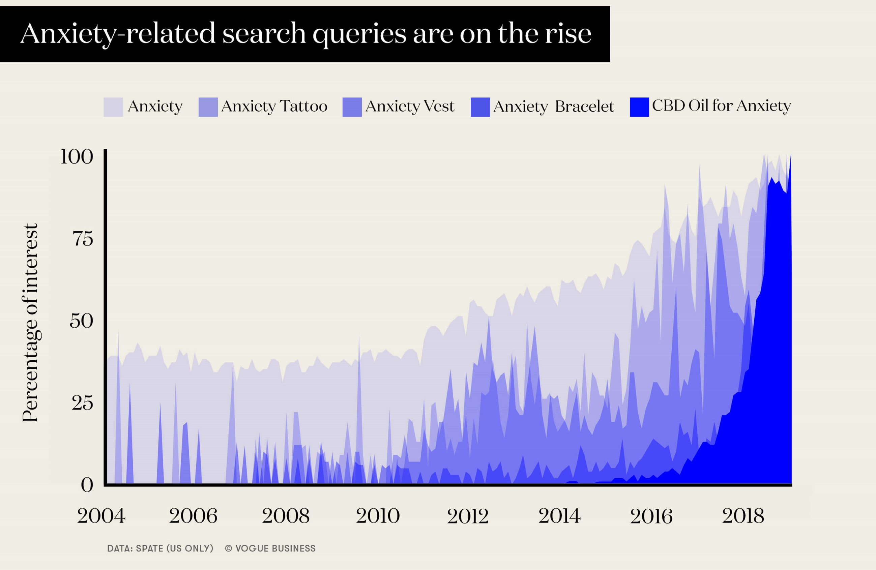
Relevance:

Slide 7
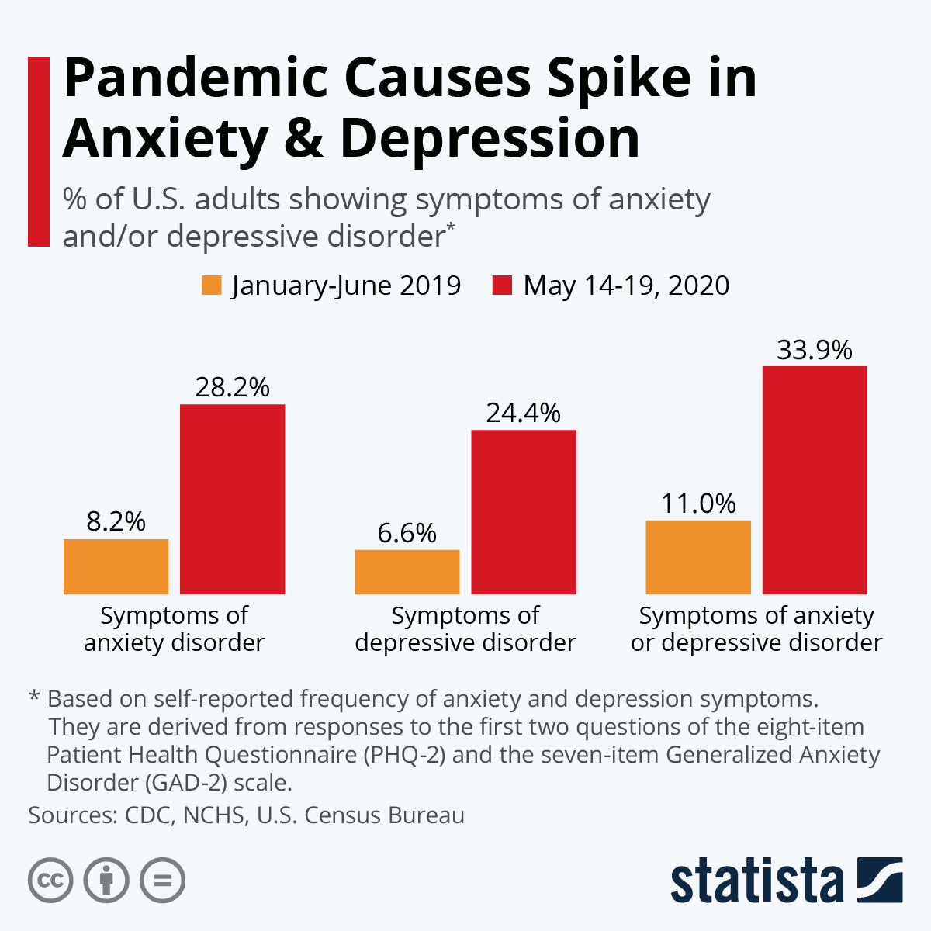

Slide 8
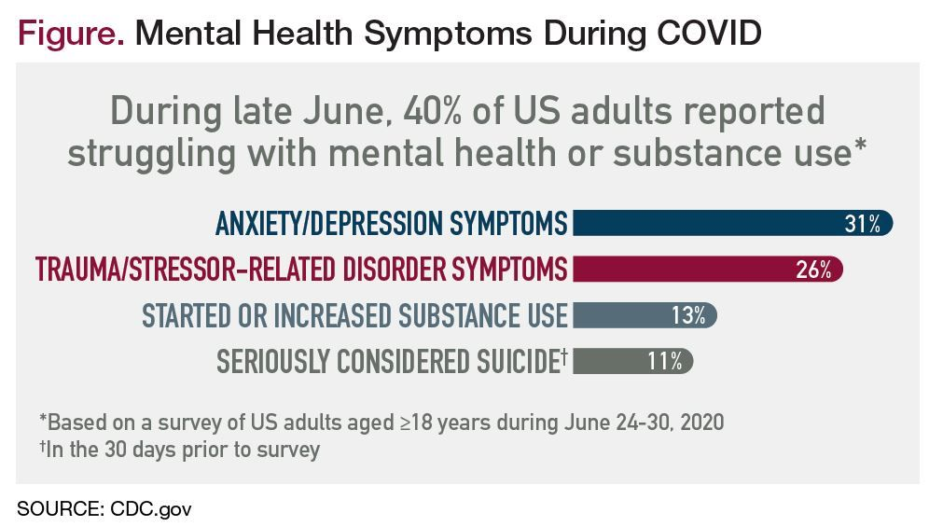

Slide 9
Biblical Provisions for Handling Anxiety
Anxiety is part of the human experience
But 2020 put it in overdrive
And we’re pretty bad at knowing how to deal with it!
My Credentials …

Slide 10
Anxiety - Some things that don’t work:
The “Dirty Dozen”
1. Seeking reassurance
2. Checking over and over
3. Trying to stop your thoughts
4. Collecting Information

Slide 11
Anxiety - Some things that don’t work:
The “Dirty Dozen”
5. Avoiding discomfort
6. Numbing yourself with CATS
7. Over-preparing
8. Safety Behaviors

Slide 12
Anxiety - Some things that don’t work:
The “Dirty Dozen”
9. Impressing Others
10. Ruminating
11. Demanding Certainty
12. Refusing to accept the fact that you may have “crazy thoughts”

Slide 13
Anxiety - Some things that don’t work:
The “Dirty Dozen”
Honorable mention:
Finding people to blame
Isolation

Slide 14
Philippians 4
^{Philippians 4:4} Rejoice in the Lord always; again I will say, rejoice! ⁵ Let your gentle spirit be known to all people. The Lord is near. ⁶ Do not be anxious about anything, but in everything by prayer and pleading with thanksgiving let your requests be made known to God. ⁷ And the peace of God, which surpasses all comprehension, will guard your hearts and minds in Christ Jesus.

Slide 15
Philippians 4
^{Phil 4:8} Finally, brothers and sisters, whatever is true, whatever is honorable, whatever is right, whatever is pure, whatever is lovely, whatever is commendable, if there is any excellence and if anything worthy of praise, think about these things. ⁹ As for the things you have learned and received and heard and seen in me, practice these things, and the God of peace will be with you.

Slide 16
Philippians 4
^{Philippians 4:4} Rejoice in the Lord always; again I will say, rejoice! ⁵ Let your gentle spirit be known to all people. The Lord is near.

Slide 17
Philippians 4
Principle: We can’t choose our circumstances or our feelings. But we can choose our attitude about them.
^{Philippians 4:4} Rejoice in the Lord always; again I will say, rejoice! ⁵ Let your gentle spirit be known to all people. The Lord is near.

Slide 18
Philippians 4
Principle: We can’t choose our circumstances or our feelings. But we can choose our attitude about them.
^{Philippians 4:4} Rejoice in the Lord always; again I will say, rejoice! ⁵ Let your gentle spirit be known to all people. The Lord is near.

Slide 19
Philippians 4
Principle: Acknowledge the Sovereignty of God
What drives a lot of anxiety is us trying to control things we can’t.
^{Philippians 4:4} Rejoice in the Lord always; again I will say, rejoice! ⁵ Let your gentle spirit be known to all people. The Lord is near.

Slide 20
Philippians 4
Principle: Acknowledge the Sovereignty of God
Anxiety therapies often emphasize 2 keys:
Accepting our limitations
Accepting uncertainty
Having a God (with a capital G) in the field of view really helps give the freedom to accept these things!
^{Philippians 4:4} Rejoice in the Lord always; again I will say, rejoice! ⁵ Let your gentle spirit be known to all people. The Lord is near.

Slide 21
Principle: humility and peace are deeply connected
The pride is an anxiety engine
^{1 Peter 5:6} Therefore humble yourselves under the mighty hand of God, so that He may exalt you at the proper time, ⁷ having cast all your anxiety on Him, because He cares about you.

Slide 22
Principle: humility and peace are deeply connected
The pride is an anxiety engine
^{1 Peter 5:6} Therefore humble yourselves under the mighty hand of God, so that He may exalt you at the proper time, ⁷ having cast all your anxiety on Him, because He cares about you.

Slide 23
Principle: humility and peace are deeply connected
The pride is an anxiety engine
^{1 Peter 5:6} Therefore humble yourselves under the mighty hand of God, so that He may exalt you at the proper time, ⁷ having cast all your anxiety on Him, because He cares about you.

Slide 24
Principle: humility and peace are deeply connected
The pride is an anxiety engine
^{1 Peter 5:6} Therefore humble yourselves under the mighty hand of God, so that He may exalt you at the proper time, ⁷ having cast all your anxiety on Him, because He cares about you.

Slide 25
Principle: humility and peace are deeply connected
The pride is an anxiety engine
^{1 Peter 5:6} Therefore humble yourselves under the mighty hand of God, so that He may exalt you at the proper time, ⁷ having cast all your anxiety on Him, because He cares about you.

Slide 26
Philippians 4
Principle: God’s Presence is the foundation for peace
^{Philippians 4:4} Rejoice in the Lord always; again I will say, rejoice! ⁵ Let your gentle spirit be known to all people. The Lord is near.

Slide 27
Philippians 4
^{Philippians 4:6} Do not be anxious about anything, but in everything by prayer and pleading with thanksgiving let your requests be made known to God.

Slide 28
Philippians 4
What should I do with my fears?
“Pray your Fears”
^{Philippians 4:6} Do not be anxious about anything, but in everything by prayer and pleading with thanksgiving let your requests be made known to God.

Slide 29
Philippians 4
What should I do with my fears?
1) Tell God
“Pray your Fears”
^{Philippians 4:6} Do not be anxious about anything, but in everything by prayer and pleading with thanksgiving let your requests be made known to God.

Slide 30
Philippians 4
What should I do with my fears?
1) Tell God
2) Give Thanks
^{Philippians 4:6} Do not be anxious about anything, but in everything by prayer and pleading with thanksgiving let your requests be made known to God.

Slide 31
Philippians 4
What should I do with my fears?
1) Tell God
2) Give Thanks
Gratitude is powerful in counteracting anxiety
^{Philippians 4:6} Do not be anxious about anything, but in everything by prayer and pleading with thanksgiving let your requests be made known to God.

Slide 32
Philippians 4
What should I do with my fears?
1) Tell God
2) Give Thanks
3) Ask
^{Philippians 4:6} Do not be anxious about anything, but in everything by prayer and pleading with thanksgiving let your requests be made known to God.

Slide 33
Philippians 4
What should I do with my fears?
1) Tell God
2) Give Thanks
“Have you prayed about it?”
3) Ask
^{Philippians 4:6} Do not be anxious about anything, but in everything by prayer and pleading with thanksgiving let your requests be made known to God.

Slide 34
Philippians 4
What should I do with my fears?
1) Tell God
2) Give Thanks
HOMEWORK ASSIGNMENT:
3) Ask
^{Philippians 4:6} Do not be anxious about anything, but in everything by prayer and pleading with thanksgiving let your requests be made known to God.

Slide 35
Philippians 4
Promise: God will guard your heart
^{Philippians 4:7} And the peace of God, which surpasses all comprehension, will guard your hearts and minds in Christ Jesus.

Slide 36
Philippians 4
^{Philippians 4:8} Finally, brothers and sisters, whatever is true, whatever is honorable, whatever is right, whatever is pure, whatever is lovely, whatever is commendable, if there is any excellence and if anything worthy of praise, think about these things.

Slide 37
Philippians 4
Principle: We have a say in what we think about
^{Philippians 4:8} Finally, brothers and sisters, whatever is true, whatever is honorable, whatever is right, whatever is pure, whatever is lovely, whatever is commendable, if there is any excellence and if anything worthy of praise, think about these things.

Slide 38
Philippians 4
Principle: We have a say in what we think about
And this may be a bigger factor than you realize:
Sonja Lyubomirsky, a professor of psychology at the U C, Riverside, authored a book called The How of Happiness.

Slide 39
Philippians 4
Principle: We have a say in what we think about
Our “habits of thought” are one aspect of anxiety that we do have control over
^{Philippians 4:8} Finally, brothers and sisters, whatever is true, whatever is honorable, whatever is right, whatever is pure, whatever is lovely, whatever is commendable, if there is any excellence and if anything worthy of praise, think about these things.

Slide 40
Philippians 4
Principle: We have a say in what we think about
Anxiety has a lot to do with focus
^{Philippians 4:8} Finally, brothers and sisters, whatever is true, whatever is honorable, whatever is right, whatever is pure, whatever is lovely, whatever is commendable, if there is any excellence and if anything worthy of praise, think about these things.

Slide 41
Philippians 4
Principle: We have a say in what we think about
Anxiety has a lot to do with focus
^{Philippians 4:8} Finally, brothers and sisters, whatever is true, whatever is honorable, whatever is right, whatever is pure, whatever is lovely, whatever is commendable, if there is any excellence and if anything worthy of praise, think about these things.

Slide 42
Philippians 4
Principle: We have a say in what we think about
Notice your patterns, and discipline your thought life
^{Philippians 4:8} Finally, brothers and sisters, whatever is true, whatever is honorable, whatever is right, whatever is pure, whatever is lovely, whatever is commendable, if there is any excellence and if anything worthy of praise, think about these things.

Slide 43
Philippians 4
Principle: We have a say in what we think about
- Focus on what’s good
- Focus on what God is doing
- Focus on what you can do
- Focus on others
^{Philippians 4:8} Finally, brothers and sisters, whatever is true, whatever is honorable, whatever is right, whatever is pure, whatever is lovely, whatever is commendable, if there is any excellence and if anything worthy of praise, think about these things.

Slide 44
Philippians 4
^{Philippians 4:9} As for the things you have learned and received and heard and seen in me, practice these things, and the God of peace will be with you.

Slide 45
Philippians 4
^{Philippians 4:9} As for the things you have learned and received and heard and seen in me, practice these things, and the God of peace will be with you.

Slide 46
Philippians 4
^{Philippians 4:9} As for the things you have learned and received and heard and seen in me, practice these things, and the God of peace will be with you.

Slide 47
Discussion Questions to-go:
There’s lots of advice out there about anxiety. What is unique about the spiritual advice in this passage?
Why do you think gratitude is so effective in counteracting anxiety?
What practical advice would you give someone who wanted to shift their focus from self and circumstances to God and others?

