Slide 1
FIRST PETER
THE BOOK OF

Slide 2
1 Peter 3
¹ In the same way, you wives, be submissive to your own husbands so that even if any of them are disobedient to the word, they may be won without a word by the behavior of their wives, ² as they observe your chaste and respectful behavior. ³ Your adornment must not be merely external—braiding the hair, and wearing gold jewelry, or putting on dresses…

Slide 3
1 Peter 3
⁴ but let it be the hidden person of the heart, with the imperishable quality of a gentle and quiet spirit, which is precious in the sight of God. ⁵ For in this way in former times the holy women also, who hoped in God, used to adorn themselves, being submissive to their own husbands; ⁶ just as Sarah obeyed Abraham, calling him lord, and you have become her children if you do what is right without being frightened by any fear…

Slide 4
1 Peter 3
⁷ You husbands in the same way, live with your wives in an understanding way, as with someone weaker, since she is a woman; and show her honor as a fellow heir of the grace of life, so that your prayers will not be hindered.
Galatians 3:28: There is neither Jew nor Greek, slave nor free, male nor female; for you are all one in Christ Jesus.

Slide 5
1 Peter 3
¹ In the same way, you wives, be submissive to your own husbands so that even if any of them are disobedient to the word, they may be won without a word by the behavior of their wives,
² as they observe your chaste and respectful behavior.

Slide 6
1 Peter 3
¹ In the same way, you wives, be submissive to your own husbands so that even if any of them are disobedient to the word, they may be won without a word by the behavior of their wives,
² as they observe your chaste and respectful behavior.
1 Peter 2:12: Keep your behavior excellent among the Gentiles, so that in the thing in which they slander you as evildoers, they may because of your good deeds, as they observe them, glorify God in the day of visitation.

Slide 7
1 Peter 3
¹ In the same way, you wives, be submissive to your own husbands so that even if any of them are disobedient to the word, they may be won without a word by the behavior of their wives,
² as they observe your chaste and respectful behavior.
Plutarch: “A wife ought not to make friends of her own, but to enjoy her husband’s friends in common with him. The gods are the first and most important friends. Wherefore it is becoming for a wife to worship and to know only the gods that her husband believes in, and to shut the front door tight upon all [strange] rituals and outlandish superstitions” (Advice 140.19)

Slide 8
1 Peter 3
¹ In the same way, you wives, be submissive to your own husbands so that even if any of them are disobedient to the word, they may be won without a word by the behavior of their wives,
² as they observe your chaste and respectful behavior.

Slide 9
1 Peter 3
¹ In the same way, you wives, be submissive to your own husbands so that even if any of them are disobedient to the word, they may be won without a word by the behavior of their wives,
² as they observe your chaste and respectful behavior.
How do we apply Peter’s instruction to submit?
» You cannot apply this in a straightforward way, arguing that wives should submit to their husbands.
Karen Jobes: “[Those] who does not understand Peter’s intent in his instruction of...wives, and husbands will not understand the message of 1 Peter...How shortsighted it is to use this passage as if it were a marriage manual simply addressing the relationship between husbands and wives!

Slide 10
1 Peter 3
¹ In the same way, you wives, be submissive to your own husbands so that even if any of them are disobedient to the word, they may be won without a word by the behavior of their wives,
² as they observe your chaste and respectful behavior.
How do we apply Peter’s instruction to submit?
» You cannot apply this in a straightforward way, arguing that wives should submit to their husbands.
Karen Jobes: “And how ironic it is that the words that first-century...wives would have read as affirming and empowering are criticized by some today as enslaving and oppressive.”

Slide 11
1 Peter 3
¹ In the same way, you wives, be submissive to your own husbands so that even if any of them are disobedient to the word, they may be won without a word by the behavior of their wives,
² as they observe your chaste and respectful behavior.
How do we apply Peter’s instruction to submit?
» You cannot apply this in a straightforward way, arguing that wives should submit to their husbands.
» Try to influence your non-Christian husband by your changed character.

Slide 12
1 Peter 3
¹ In the same way, you wives, be submissive to your own husbands so that even if any of them are disobedient to the word, they may be won without a word by the behavior of their wives,
² as they observe your chaste and respectful behavior.
There are other passages, however, that establish a pattern for leadership and submission in a Christian marriage.
» Within the context of marriage God calls on the husband to lead.
Ephesians 5:22-23: Wives submit to your husbands...for the husband is the head of the wife as Christ is head of the church.

Slide 13
1 Peter 3
¹ In the same way, you wives, be submissive to your own husbands so that even if any of them are disobedient to the word, they may be won without a word by the behavior of their wives,
² as they observe your chaste and respectful behavior.
There are other passages, however, that establish a pattern for leadership and submission in a Christian marriage.
» Within the context of marriage God calls on the husband to lead.
God defines leadership differently from our world (Mk. 10:42-45).
Jesus not only said it; he lived it.

Slide 14
1 Peter 3
¹ In the same way, you wives, be submissive to your own husbands so that even if any of them are disobedient to the word, they may be won without a word by the behavior of their wives,
² as they observe your chaste and respectful behavior.
There are other passages, however, that establish a pattern for leadership and submission in a Christian marriage.
» It’s with all of this in mind that Paul tells husbands to lead their wives.
Ephesians 5:25: Husbands, love your wives, just as Christ loved the church.

Slide 15
1 Peter 3
¹ In the same way, you wives, be submissive to your own husbands so that even if any of them are disobedient to the word, they may be won without a word by the behavior of their wives,
² as they observe your chaste and respectful behavior.
There are other passages, however, that establish a pattern for leadership and submission in a Christian marriage.
» It’s with all of this in mind that Paul tells husbands to lead their wives.
» Submitting in a Christian marriage means: Being responsive to your husband’s efforts to love and serve.

Slide 16
1 Peter 3
³ Your adornment must not be merely external—braiding the hair, and wearing gold jewelry, or putting on dresses
⁴ but let it be the hidden person of the heart, with the imperishable quality of a gentle and quiet spirit, which is precious in the sight of God.

Slide 17
1 Peter 3
³ Your adornment must not be merely external—braiding the hair, and wearing gold jewelry, or putting on dresses
⁴ but let it be the hidden person of the heart, with the imperishable quality of a gentle and quiet spirit, which is precious in the sight of God.
First century Greco-Roman culture
» Outward adornments were perceived to be instruments of seduction (Philo, On the Virtues 7.39)
» A woman’s use of cosmetics was viewed as an attempt to deceive (Xenophon, Oeconomicus 10.2).
» Plutarch makes a comment that most women stay indoors if you take from them gold-embroidered shoes, bracelets…and pearls (Advice 30:1).

Slide 18
1 Peter 3
³ Your adornment must not be merely external—braiding the hair, and wearing gold jewelry, or putting on dresses
⁴ but let it be the hidden person of the heart, with the imperishable quality of a gentle and quiet spirit, which is precious in the sight of God.

Slide 19
1 Peter 3
³ Your adornment must not be merely external—braiding the hair, and wearing gold jewelry, or putting on dresses
⁴ but let it be the hidden person of the heart, with the imperishable quality of a gentle and quiet spirit, which is precious in the sight of God.
» What you are hoping to attract guys with, will determine what kind of guys you will attract.
» If you want to have a successful marriage relationship, concentrate on adorning yourself with godly relational qualities (cf. “gentle”).
» Attractiveness is fleeting (Proverbs 31:30).
Proverbs 31:30: Charm is deceptive, and beauty does not last.

Slide 20
1 Peter 3
⁵ For in this way in former times the holy women also, who hoped in God, used to adorn themselves, being submissive to their own husbands;
⁶ just as Sarah obeyed Abraham, calling him lord, and you have become her children if you do what is right without being frightened by any fear.

Slide 21
1 Peter 3
⁵ For in this way in former times the holy women also, who hoped in God, used to adorn themselves, being submissive to their own husbands;
⁶ just as Sarah obeyed Abraham, calling him lord, and you have become her children if you do what is right without being frightened by any fear.
Genesis 18:12: So Sarah laughed to herself as she thought, “After I am worn out and my lord is old, will I now have this pleasure?”

Slide 22
1 Peter 3
⁵ For in this way in former times the holy women also, who hoped in God, used to adorn themselves, being submissive to their own husbands;
⁶ just as Sarah obeyed Abraham, calling him lord, and you have become her children if you do what is right without being frightened by any fear.
A few further points
» This passages is not suggesting that a woman should remain in a marriage that is physically or sexually abusive
» Paul makes an important qualification to Peter’s point in 1 Corinthians 7:13-17.

Slide 23
1 Peter 3
⁷ You husbands in the same way, live with your wives in an understanding way, as with someone weaker, since she is a woman; and show her honor as a fellow heir of the grace of life, so that your prayers will not be hindered.

Slide 24
1 Peter 3
⁷ You husbands in the same way, live with your wives in an understanding way, as with someone weaker, since she is a woman; and show her honor as a fellow heir of the grace of life, so that your prayers will not be hindered.

Slide 25
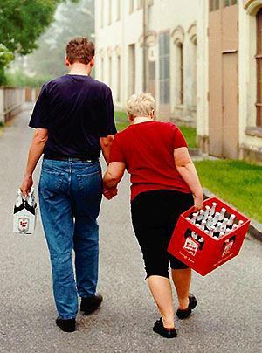
1 Peter 3
⁷ You husbands in the same way, live with your wives in an understanding way, as with someone weaker, since she is a woman; and show her honor as a fellow heir of the grace of life, so that your prayers will not be hindered.

Slide 26
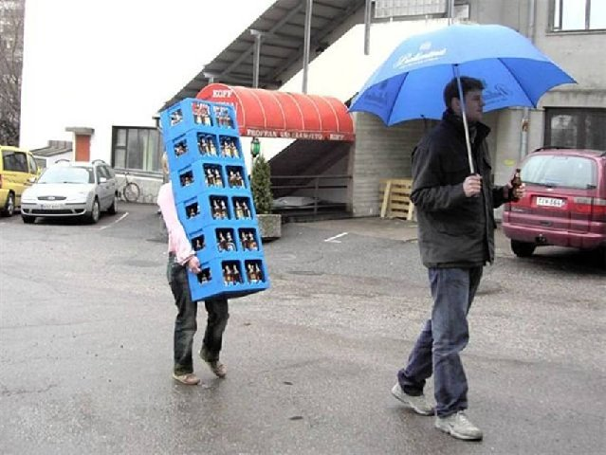
1 Peter 3
⁷ You husbands in the same way, live with your wives in an understanding way, as with someone weaker, since she is a woman; and show her honor as a fellow heir of the grace of life, so that your prayers will not be hindered.

Slide 27
1 Peter 3
⁷ You husbands in the same way, live with your wives in an understanding way, as with someone weaker, since she is a woman; and show her honor as a fellow heir of the grace of life, so that your prayers will not be hindered.
Physically
Verbally
Sexually
Emotionally
Financially
Practically
Spiritually

Slide 28
1 Peter 3
⁷ You husbands in the same way, live with your wives in an understanding way, as with someone weaker, since she is a woman; and show her honor as a fellow heir of the grace of life, so that your prayers will not be hindered.
» Does the way you treat your wife give full honor to her identity as a co-heir of God’s kingdom?
» Husbands, do you realize that your wife is God’s daughter?

Slide 29
1 Peter 3
⁷ You husbands in the same way, live with your wives in an understanding way, as with someone weaker, since she is a woman; and show her honor as a fellow heir of the grace of life, so that your prayers will not be hindered.

Slide 30
Conclusions
» The Bible has a high view of women.
» God’s leadership is very different from the world’s.
» Being a good husband means more than refraining from mistreating your wife.

Slide 31
Conclusions
» Unlike Peter’s audience, many of you can choose who you marry.
» Start by becoming the right person.
» This begins by starting a relationship with God

Slide 32
FIRST PETER
THE BOOK OF

