Slide 2
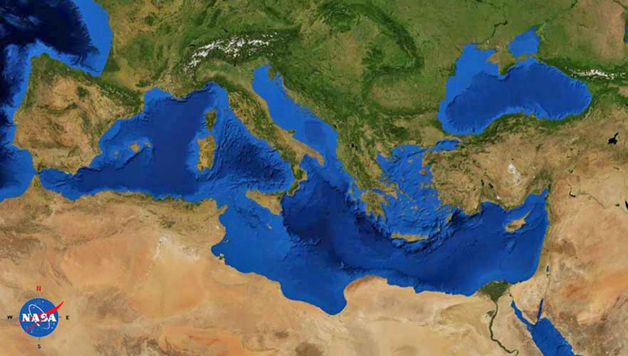
2 Timothy
Paul (Rome)
Timothy (Ephesus)

Slide 3
2 Timothy
Paul (Rome)
Timothy (Ephesus)
^{2 Tim 4:1} I solemnly exhort you in the presence of God and of Christ Jesus, who is to judge the living and the dead, and by His appearing and His kingdom: ² preach the word; be ready in season and out of season; correct, rebuke, and exhort, with great patience and instruction.

Slide 4
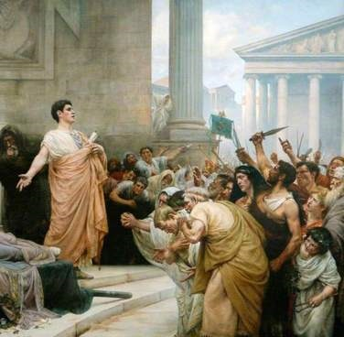
“herald the word”
^{2 Tim 4:1} I solemnly exhort you in the presence of God and of Christ Jesus, who is to judge the living and the dead, and by His appearing and His kingdom: ² preach the word; be ready in season and out of season; correct, rebuke, and exhort, with great patience and instruction.

Slide 5
“herald the word”
^{2 Tim 4:1} I solemnly exhort you in the presence of God and of Christ Jesus, who is to judge the living and the dead, and by His appearing and His kingdom: ² preach the word; be ready in season and out of season; correct, rebuke, and exhort, with great patience and instruction.

Slide 6
“herald the word”
^{2 Tim 4:3} For the time will come when they will not tolerate sound doctrine; but wanting to have their ears tickled, they will accumulate for themselves teachers in accordance with their own desires, ⁴ and they will turn their ears away from the truth and will turn aside to myths.

Slide 7
“herald the word”
^{2 Tim 4:5} But as for you, use self-restraint in all things, endure hardship, do the work of an evangelist, fulfill your ministry.

Slide 8
“herald the word”
^{2 Tim 4:5} But as for you, use self-restraint in all things, endure hardship, do the work of an evangelist, fulfill your ministry.

Slide 9
“herald the word”
^{2 Tim 4:5} But as for you, use self-restraint in all things, endure hardship, do the work of an evangelist, fulfill your ministry.

Slide 10
“herald the word”
^{2 Tim 4:5} But as for you, use self-restraint in all things, endure hardship, do the work of an evangelist, fulfill your ministry.

Slide 11
Your good news to tell …
^{2 Tim 4:5} But as for you, use self-restraint in all things, endure hardship, do the work of an evangelist, fulfill your ministry.

Slide 12
Your good news to tell …
^{2 Tim 4:5} But as for you, use self-restraint in all things, endure hardship, do the work of an evangelist, fulfill your ministry.

Slide 13
^{Eph 4:11} … pastors and teachers. ¹² their responsibility is to equip God’s people to do his work and build up the church, the body of Christ.
Do you have a category for your “ministry”?
diakonia: service
^{2 Tim 4:5} But as for you, use self-restraint in all things, endure hardship, do the work of an evangelist, fulfill your ministry.

Slide 14
Fulfill Your Ministry
^{2 Tim 4:5} But as for you, use self-restraint in all things, endure hardship, do the work of an evangelist, fulfill your ministry.

Slide 15
Fulfill Your Ministry
^{2 Tim 4:6} For I am already being poured out as a drink offering, and the time of my departure has come. ⁷ I have fought the good fight, I have finished the course, I have kept the faith; ⁸ in the future there is reserved for me the crown of righteousness, which the Lord, the righteous Judge, will award to me on that day; and not only to me, but also to all who have loved His appearing.

Slide 16
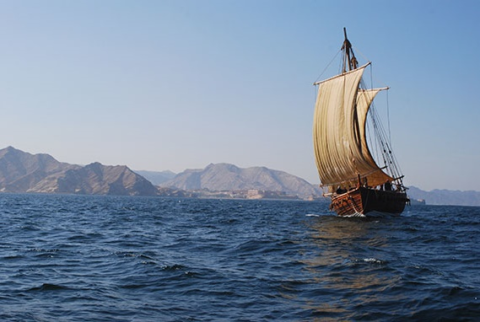
Fulfill Your Ministry
^{2 Tim 4:6} For I am already being poured out as a drink offering, and the time of my departure has come. ⁷ I have fought the good fight, I have finished the course, I have kept the faith; ⁸ in the future there is reserved for me the crown of righteousness, which the Lord, the righteous Judge, will award to me on that day; and not only to me, but also to all who have loved His appearing.

Slide 17
Fulfill Your Ministry
Paul’s example
^{2 Tim 4:6} For I am already being poured out as a drink offering, and the time of my departure has come. ⁷ I have fought the good fight, I have finished the course, I have kept the faith; ⁸ in the future there is reserved for me the crown of righteousness, which the Lord, the righteous Judge, will award to me on that day; and not only to me, but also to all who have loved His appearing.

Slide 18
Fulfill Your Ministry
Paul’s example
^{2 Tim 4:6} For I am already being poured out as a drink offering, and the time of my departure has come. ⁷ I have fought the good fight, I have finished the course, I have kept the faith; ⁸ in the future there is reserved for me the crown of righteousness, which the Lord, the righteous Judge, will award to me on that day; and not only to me, but also to all who have loved His appearing.

Slide 19
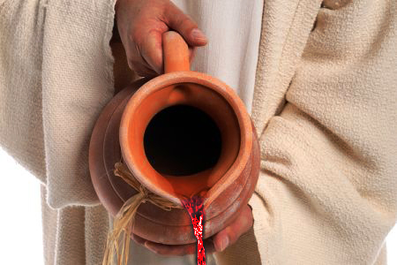
Fulfill Your Ministry
Paul’s example
^{2 Tim 4:6} For I am already being poured out as a drink offering, and the time of my departure has come. ⁷ I have fought the good fight, I have finished the course, I have kept the faith; ⁸ in the future there is reserved for me the crown of righteousness, which the Lord, the righteous Judge, will award to me on that day; and not only to me, but also to all who have loved His appearing.

Slide 20
Fulfill Your Ministry
^{2 Tim 4:7} I have fought the good fight, I have finished the course, I have kept the faith;

Slide 21
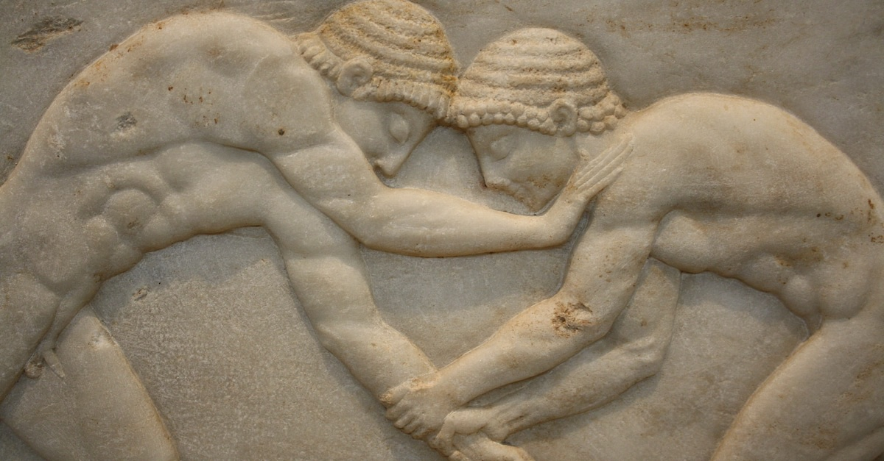
Fulfill Your Ministry
: fight your fight
It’s a fight
It’s good
What are you fighting for?
^{2 Tim 4:7} I have fought the good fight, I have finished the course, I have kept the faith;

Slide 22
Fulfill Your Ministry
: fight your fight
It’s a fight
It’s good
It can be fought to completion
^{2 Tim 4:7} I have fought the good fight, I have finished the course, I have kept the faith;

Slide 23
Fulfill Your Ministry
: fight your fight
^{2 Tim 4:7} I have fought the good fight, I have finished the course, I have kept the faith;

Slide 24
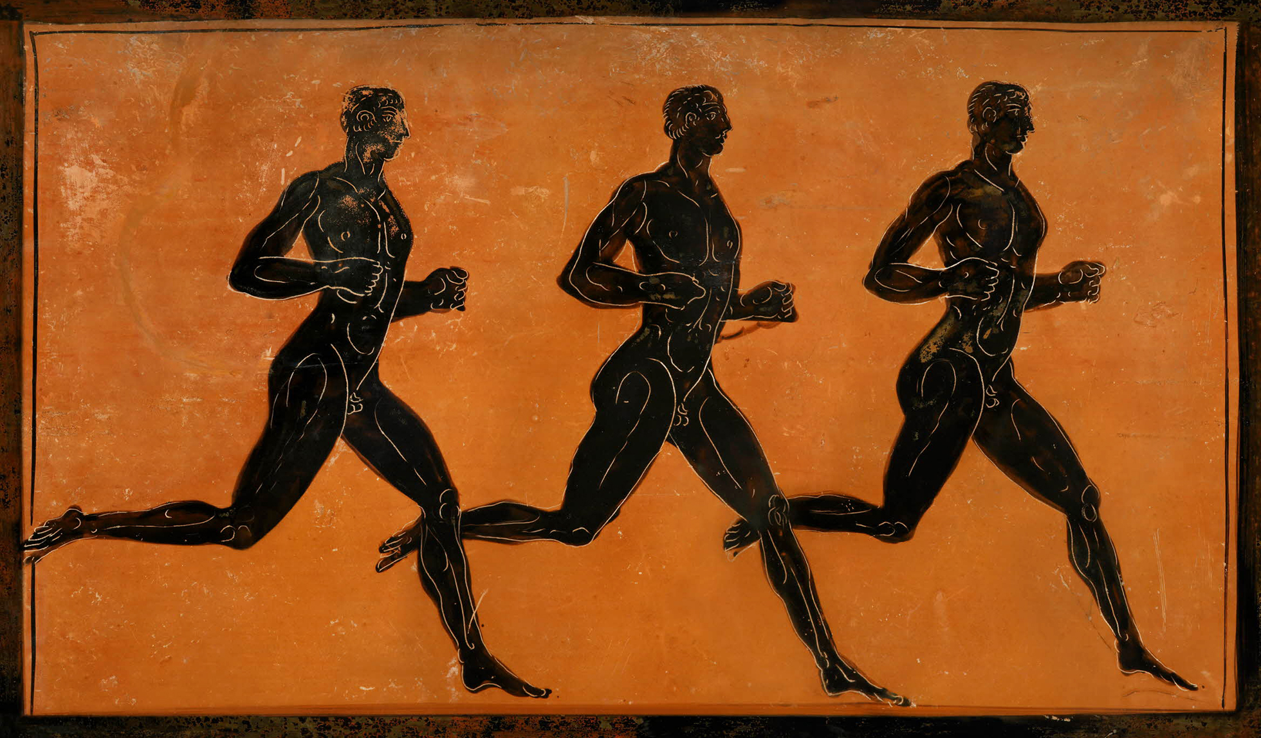
Fulfill Your Ministry
: finish your course
^{2 Tim 4:7} I have fought the good fight, I have finished the course, I have kept the faith;

Slide 25
Fulfill Your Ministry
: finish your course
^{Acts 9:15} “…for he is a chosen instrument of Mine, to bear My name before the Gentiles and kings and the sons of Israel; ¹⁶ for I will show him how much he must suffer for My name’s sake.”
You have a course
^{2 Tim 4:7} I have fought the good fight, I have finished the course, I have kept the faith;

Slide 26
Fulfill Your Ministry
: finish your course
You have a course
^{2 Tim 4:7} I have fought the good fight, I have finished the course, I have kept the faith;

Slide 27
Fulfill Your Ministry
: finish your course
What leg of the race are you in?
Courses have legs
^{2 Tim 4:7} I have fought the good fight, I have finished the course, I have kept the faith;

Slide 28
Fulfill Your Ministry
: finish your course
The “middle mile”
Courses have legs
^{2 Tim 4:7} I have fought the good fight, I have finished the course, I have kept the faith;

Slide 29
Fulfill Your Ministry
: finish your course
At some point, you will feel like quitting.
Courses have legs
^{2 Tim 4:7} I have fought the good fight, I have finished the course, I have kept the faith;

Slide 30
Fulfill Your Ministry
: finish your course
Races take endurance
^{2 Tim 4:7} I have fought the good fight, I have finished the course, I have kept the faith;

Slide 31
Fulfill Your Ministry
: finish your course
^{Hebrews 12:1} let us run with endurance the race that is set before us, ² fixing our eyes on Jesus, the author and perfecter of faith, who for the joy set before Him endured the cross, despising the shame, and has sat down at the right hand of the throne of God.
Races take endurance
^{2 Tim 4:7} I have fought the good fight, I have finished the course, I have kept the faith;

Slide 32
Fulfill Your Ministry
: finish your course
Success: finish the course
^{2 Tim 4:7} I have fought the good fight, I have finished the course, I have kept the faith;

Slide 33
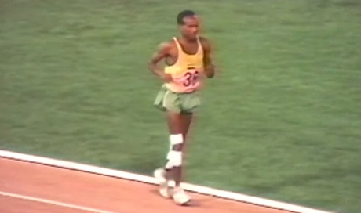
Fulfill Your Ministry
: finish your course
Success: finish the course
^{2 Tim 4:7} I have fought the good fight, I have finished the course, I have kept the faith;

Slide 34
Fulfill Your Ministry
: finish your course
It’s never too late to start running
The course goes your whole life
^{2 Tim 4:7} I have fought the good fight, I have finished the course, I have kept the faith;

Slide 35
Fulfill Your Ministry
: finish your course
It’s never too late to get back in the race
The course goes your whole life
^{2 Tim 4:7} I have fought the good fight, I have finished the course, I have kept the faith;

Slide 36
David Powlison: Making All Things New
Some people, during a season of life, leap like gazelles… other people (or the same people at another season of life) a steady, measured walk… other people (or the same people in another season) are trudging.
But if you trudge in the right direction, high praises to the Lord of Glory! One day you will see him face to face.
Fulfill Your Ministry
: finish your course
It’s never too late to get back in the race
The course goes your whole life
^{2 Tim 4:7} I have fought the good fight, I have finished the course, I have kept the faith;

Slide 37
David Powlison: Making All Things New
Some people crawl on their hands and knees for a long or short season … And there may be times when you’re not even moving … but you’re still facing in the right direction. There are times you might fall asleep in the blizzard and lie down, comatose and forgetful – There are times you slowly wander off in the wrong direction… And then there are times you revolt and do a face-plant in the muck, a swan dive into the abyss
Fulfill Your Ministry
: finish your course
It’s never too late to get back in the race
The course goes your whole life
^{2 Tim 4:7} I have fought the good fight, I have finished the course, I have kept the faith;

Slide 38
David Powlison: Making All Things New
But grace picks you up and washes you off again, and turns you back … Perhaps then you leap and bound, or walk steadily, or trudge, or crawl, of face with greater hope in the right direction.
Fulfill Your Ministry
: finish your course
It’s never too late to get back in the race
The course goes your whole life
^{2 Tim 4:7} I have fought the good fight, I have finished the course, I have kept the faith;

Slide 39
Fulfill Your Ministry
: finish your course
^{Phil 3:13} … one thing I do: forgetting what lies behind and reaching forward to what lies ahead, ¹⁴ I press on toward the goal for the prize of the upward call of God in Christ Jesus.
It’s never too late to get back in the race
The course goes your whole life
^{2 Tim 4:7} I have fought the good fight, I have finished the course, I have kept the faith;

Slide 40
Fulfill Your Ministry
: finish your course
² ^{Tim 4:8} in the future there is reserved for me the crown of righteousness, which the Lord, the righteous Judge, will award to me on that day; and not only to me, but also to all who have loved His appearing.

Slide 41
Fulfill Your Ministry
: finish your course
Runners focus on the future
² ^{Tim 4:8} in the future there is reserved for me the crown of righteousness, which the Lord, the righteous Judge, will award to me on that day; and not only to me, but also to all who have loved His appearing.

Slide 42
Fulfill Your Ministry
: finish your course
Runners focus on the future
² ^{Tim 4:8} in the future there is reserved for me the crown of righteousness, which the Lord, the righteous Judge, will award to me on that day; and not only to me, but also to all who have loved His appearing.

Slide 43
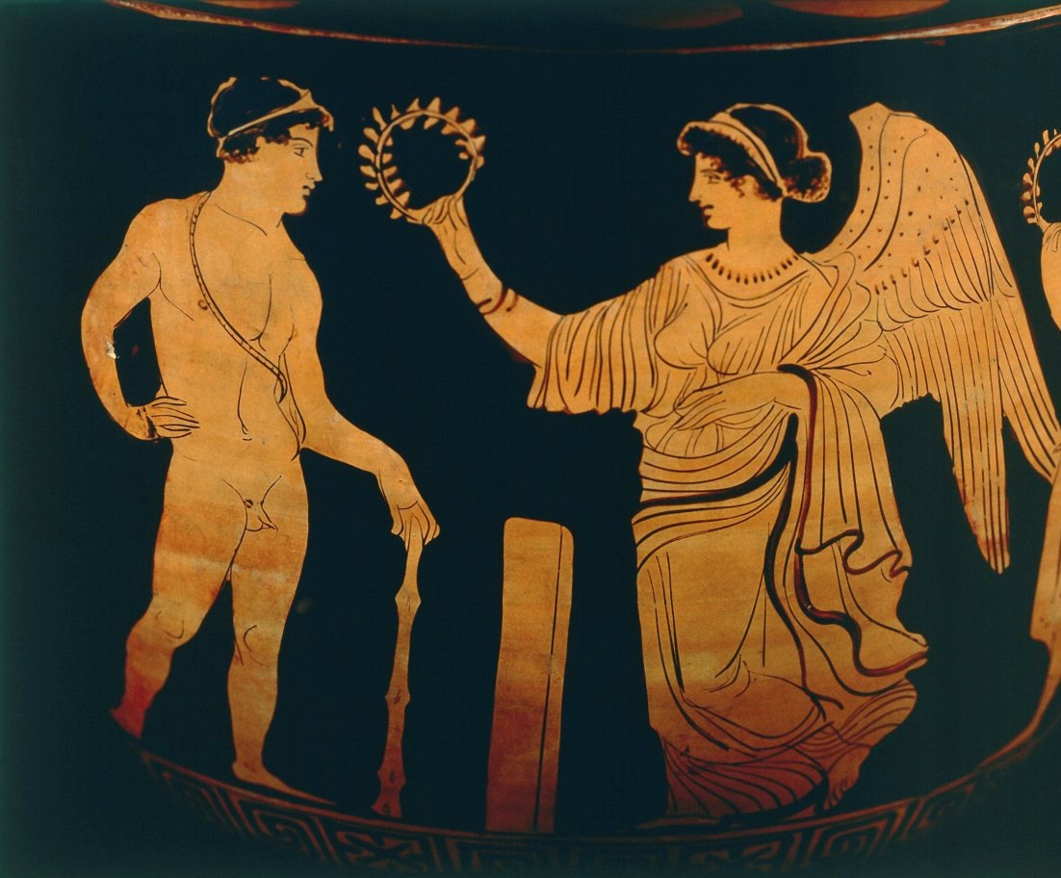
Fulfill Your Ministry
: finish your course
Runners focus on the future
² ^{Tim 4:8} in the future there is reserved for me the crown of righteousness, which the Lord, the righteous Judge, will award to me on that day; and not only to me, but also to all who have loved His appearing.

Slide 44
Fulfill Your Ministry
: finish your course
Runners focus on the future
² ^{Tim 4:8} in the future there is reserved for me the crown of righteousness, which the Lord, the righteous Judge, will award to me on that day; and not only to me, but also to all who have loved His appearing.

Slide 45
Fulfill Your Ministry
: finish your course
God is the Judge
² ^{Tim 4:8} in the future there is reserved for me the crown of righteousness, which the Lord, the righteous Judge, will award to me on that day; and not only to me, but also to all who have loved His appearing.

Slide 46
Fulfill Your Ministry
: finish your course
^{Matt 25:23 ”}Well done, my good and faithful servant! … Let’s celebrate together!”
God is the Judge
² ^{Tim 4:8} in the future there is reserved for me the crown of righteousness, which the Lord, the righteous Judge, will award to me on that day; and not only to me, but also to all who have loved His appearing.

Slide 47
Fulfill Your Ministry
: finish your course
God is the Judge
² ^{Tim 4:8} in the future there is reserved for me the crown of righteousness, which the Lord, the righteous Judge, will award to me on that day; and not only to me, but also to all who have loved His appearing.

Slide 48
Fulfill Your Ministry
: finish your course
God is the Judge
² ^{Tim 4:8} in the future there is reserved for me the crown of righteousness, which the Lord, the righteous Judge, will award to me on that day; and not only to me, but also to all who have loved His appearing.

Slide 49
Fulfill Your Ministry
: finish your course
God is the Judge
² ^{Tim 4:8} in the future there is reserved for me the crown of righteousness, which the Lord, the righteous Judge, will award to me on that day; and not only to me, but also to all who have loved His appearing.

Slide 50
Fulfill Your Ministry
: finish your course
It was worth it
God is the Judge
² ^{Tim 4:8} in the future there is reserved for me the crown of righteousness, which the Lord, the righteous Judge, will award to me on that day; and not only to me, but also to all who have loved His appearing.

Slide 51
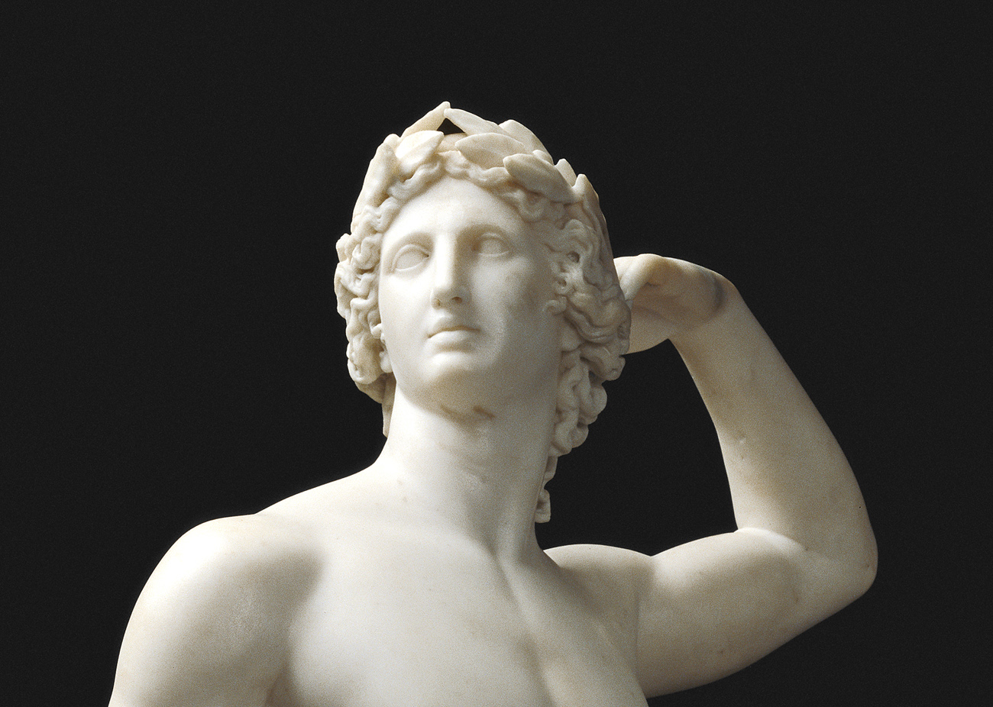
So finish your course!
Do you realize you have a course laid out for you?
How are you going to run the next leg of that race?

Slide 52
So finish your course!
Hear Paul’s encouragement from the finish line!

Slide 53
Discussion Questions to-go:
What struck you about Paul's farewell charge to Timothy and personal reflection?
What do you think is the next leg of the course God has laid out for you?
How much motivation should the Christian draw from the picture of “reward” at the end of the race?

