Slide 1
Romans 1:1-17
The Power of the Good News

Slide 2
Romans 1
1 This letter is from Paul, a slave of Christ Jesus,
chosen by God to be an apostle and sent out to preach his Good News [“gospel”].

Slide 3
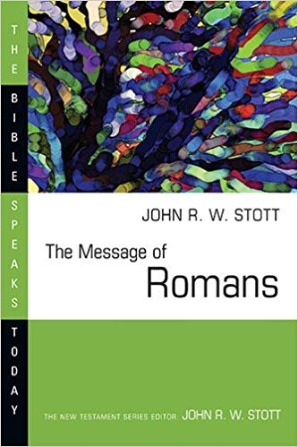
John Stott
20th c. Christian Author and Pastor
John R. W. Stott, The Message of Romans: God’s Good News for the World, The Bible Speaks Today (Leicester, England; Downers Grove, IL: InterVarsity Press, 2001), 19.
It is the fullest, plainest and grandest statement of the gospel in the New Testament.
It is not surprising that the church in every generation has acknowledged the importance of Romans
Notes:
When you consider the majestic sweeping scope of this letter, it’s not surprising to hear Bible scholars singing its praise. Theologian John Stott calls Romans
Oh yes. Romans can change your life. Many times in the course of human history when God has moved, he has done so through truths contained here in the book of Romans.

Slide 4
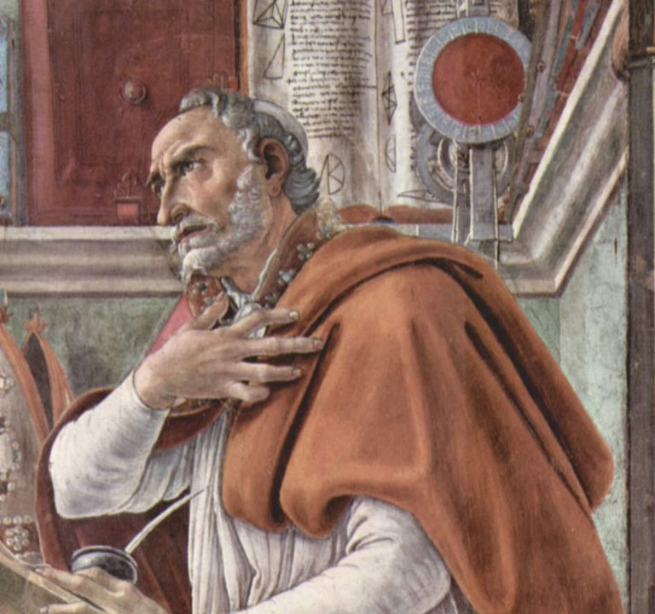
Augustine (354-430 AD)
‘The tumult of my heart took me out into the garden’, he wrote later in his Confessions,
‘where no-one could interfere with the burning struggle with myself in which I was engaged …

Slide 5
Augustine (354-430 AD)
I was twisting and turning in my chains …
I threw myself down somehow under a certain fig tree, and let my tears flow freely.’
Suddenly I heard a voice from the nearby house chanting…

Slide 6
Augustine (354-430 AD)
I neither wished nor needed to read further.
At once, with the last words of this sentence, it was as if a light of relief from all anxiety flooded into my heart.
All the shadows of doubt were dispelled.
Augustine, Book VIII, 19–29, pp. 146–153, cited in John R. W. Stott, The Message of Romans: God’s Good News for the World, The Bible Speaks Today (Leicester, England; Downers Grove, IL: InterVarsity Press, 2001).
Notes:
He went on to become one of the most influential theologians in the history of Christianity, and he traces his own breakthrough in his struggle with God back to the book of Romans.

Slide 7
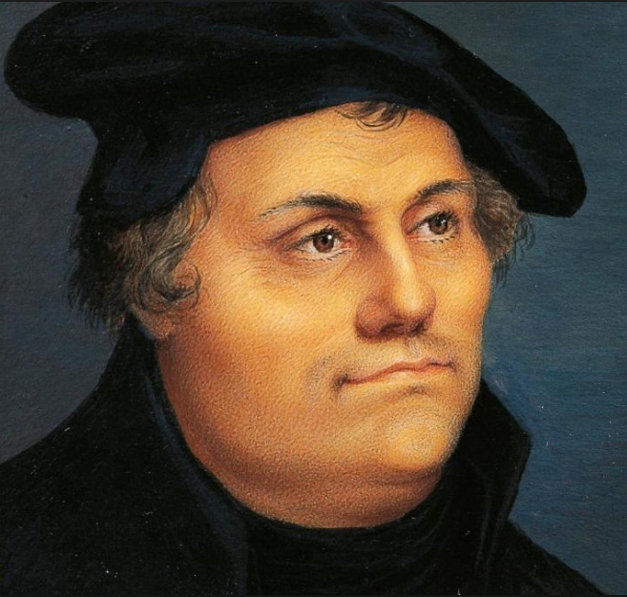
Martin Luther (1483-1546 AD)
Son of hard-working German peasants
Studying to be a lawyer
Sensitive conscience
Dropped out of law school to became a monk

Slide 8
Martin Luther (1483-1546 AD)
Son of hard-working German peasants
Studying to be a lawyer
Sensitive conscience
Dropped out of law school to became a monk
To the monastery he went like others, and even more than others, in order to make his peace with God. —Bainton, Here I Stand, 27

Slide 9
Martin Luther (1483-1546 AD)
Six worship services per day
“I tortured myself with prayers, fasting, vigils, and freezing; the frost alone might have killed me… I almost fasted myself to death…
I was very serious about it.” —Lindberg, The European Reformations, 64

Slide 10
Martin Luther (1483-1546 AD)
The harsh treatment took its toll on his body
After one year he led his first church service
And he froze up in front of everyone
“Who am I, that I should lift up mine eyes or raise my hands to the divine Majesty?” —Bainton, Here I Stand, 30

Slide 11
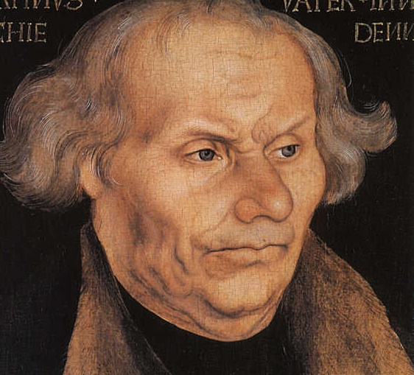
Martin Luther (1483-1546 AD)
Hans Luther (Martin’s dad)

Slide 12
Martin Luther (1483-1546 AD)
Redoubled his efforts
“I was a good monk, and I kept the rule of my order so strictly that I may say
that if ever a monk got to heaven by his monkery it was I.”

Slide 13
Martin Luther (1483-1546 AD)
All such drastic methods gave no sense of inner tranquility.
The purpose of his striving was to compensate for his sins, but he could never feel that the ledger was balanced…
He could not satisfy God at any point.

Slide 14
Martin Luther (1483-1546 AD)
“Sometimes my confessor said to me when I repeatedly discussed silly sins with him,
You are a fool… God is not angry with you,
but you are angry with God.’ ” (Bainton, 33-34)

Slide 15
Martin Luther (1483-1546 AD)
Johann von Staupitz:
Relax. Love God!
Luther:
“Love God?
I hated Him!”

Slide 16
Martin Luther (1483-1546 AD)
Staupitz couldn’t relate to Martin
So he did the only thing he could think of to extinguish young Martin’s spirit:
He sent Martin to go and get his PhD.
Then got him a job as a Bible professor.
Notes:
He confessed his hatred of God to his mentor, Staupitz, who couldn’t relate to Luther’s inordinate sense of guilt. So he did the only thing he could think of to extinguish young Martin’s spirit: he sent him to go and get his PhD. And he assigned him to work as a Bible professor.

Slide 17
Martin Luther (1483-1546 AD)
Martin began teaching through books of the Bible, verse-by-verse
Until he reached the book of Romans

Slide 18
Martin Luther (1483-1546 AD)
Martin began teaching through books of the Bible, verse-by-verse
Until he reached the book of Romans
For in the gospel the righteousness of God is revealed—
a righteousness that is by faith from first to last,
just as it is written:
“The righteous will live by faith.” (Rom 1:17)

Slide 19
Martin Luther (1483-1546 AD)
I had greatly longed to understand Paul’s letter to the Romans,
and nothing stood to the way but that one expression ‘the righteousness of God’…
“The righteous will live by faith.” (Rom 1:17)

Slide 20
Martin Luther (1483-1546 AD)
Night and day I pondered until I saw the connection between the justice of God
and the statement that “the just shall live by his faith.”
“The righteous will live by faith.” (Rom 1:17)

Slide 21
Martin Luther (1483-1546 AD)
Then I grasped that the justice of God is that righteousness
by which through grace and sheer mercy God justifies us through faith.
Thereupon I felt myself to be reborn and to have gone through open doors into paradise.
“The righteous will live by faith.” (Rom 1:17)

Slide 22
Martin Luther (1483-1546 AD)
The whole of Scripture took on a new meaning,
and whereas before the “justice of God” had filled me with hate,
now it became to me inexpressibly sweet in greater love.
This passage of Paul became to me a gate to heaven.
“The righteous will live by faith.” (Rom 1:17)

Slide 23
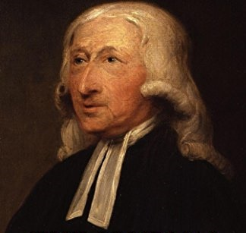
John Wesley (1703-1791 AD)
1729 – Founded ‘The Holy Club’ at Oxford
1735 – Sailed to America to work as a pastor
But was nearly killed in a violent storm
The Moravians…
1737 – returned, defeated
1738 – Visited a Moravian meeting ‘very unwillingly’

Slide 24
John Wesley (1703-1791 AD)
They were studying Romans & reading from Luther’s commentary
“About a quarter before nine, while he was describing the change which God works in the heart through faith in Christ,
I felt my heart strangely warmed.

Slide 25
John Wesley (1703-1791 AD)
I felt I did trust in Christ, Christ alone, for salvation;
and an assurance was given me that he had taken away my sins, even mine, and saved me from the law of sin and death.”
Notes:
Once again, his struggle with God ended after many years in the book of Romans

Slide 26
John Wesley (1703-1791 AD)
Wesley went on to lead the Methodist revival in England and the US.
This paved the way for many social reforms, including the abolition of slavery throughout the world.

Slide 27
Romans 1
1 This letter is from Paul, a slave of Christ Jesus,
chosen by God to be an apostle and sent out to preach his Good News.

Slide 28
Romans 1
2 God promised this Good News long ago through his prophets in the holy Scriptures.
3 The Good News is about his Son.
In his earthly life he was born into King David’s family line,
4 and he was shown to be the Son of God when he was raised from the dead by the power of the Holy Spirit.
He is Jesus Christ our Lord.

Slide 29
Romans 1
5 Through Christ, God has given us the privilege and authority as apostles to tell Gentiles everywhere what God has done for them,
so that they will believe and obey him, bringing glory to his name.
6 And you are included among those Gentiles who have been called to belong to Jesus Christ.

Slide 30
Romans 1
7 I am writing to all of you in Rome who are loved by God and are called as saints. [cf. NLT “to be his own holy people.”]
May God our Father and the Lord Jesus Christ give you grace and peace.

Slide 31
Romans 1
8 Let me say first that I thank my God through Jesus Christ for all of you, because your faith in him is being talked about all over the world.
9 God knows how often I pray for you.
Day and night I bring you and your needs in prayer to God, whom I serve with all my heart by spreading the Good News about his Son.

Slide 32
Romans 1
10 One of the things I always pray for is the opportunity, God willing, to come at last to see you.
11 For I long to visit you so I can bring you some spiritual gift that will help you grow strong in the Lord.
12 When we get together, I want to encourage you in your faith, but I also want to be encouraged by yours.

Slide 33
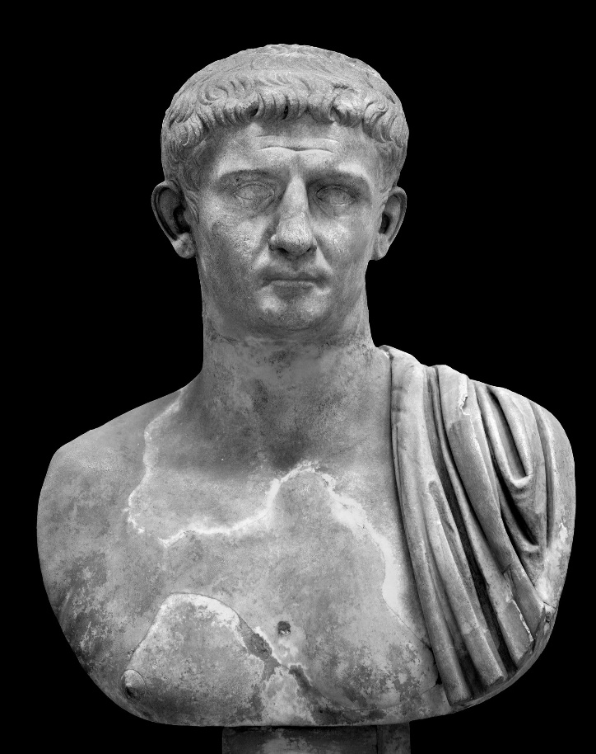
Romans 1
13 I want you to know, dear brothers and sisters, that I planned many times to visit you, but I was prevented until now.
Edict of Claudius, AD 49 (Acts 18:2)
Repealed Oct 54 AD

Slide 34
Romans 1
13 I want you to know, dear brothers and sisters, that I planned many times to visit you, but I was prevented until now.
I want to work among you and see spiritual fruit, just as I have seen among other Gentiles.

Slide 35
Romans 1
14 For I have a great sense of obligation to people in both the civilized world and the rest of the world, to the educated and uneducated alike.
15 So I am eager to come to you in Rome, too, to preach the Good News.

Slide 36
Romans 1
16 For I am not ashamed of this Good News about Christ.

Slide 37
Romans 1
16 For I am not ashamed of this Good News about Christ.
Why would Paul be ashamed?
What would he say to his family?
His Pharisee buddies?
His mentor, Gamaliel
He had suffered so much pain for opening his mouth
He had killed Christians and committed countless other atrocities

Slide 38
Romans 1
16 For I am not ashamed of this Good News about Christ.
It is the power of God at work, saving everyone who believes—the Jew first and also the Gentile.

Slide 39
Romans 1
17 This Good News tells us how God makes us right in his sight.
This is accomplished from start to finish by faith.
As the Scriptures say, “It is through faith that a righteous person has life.” [Hab. 2:4]
This seems too good to be true!

Slide 40
Romans 1
2 God promised this Good News long ago through his prophets in the holy Scriptures.
3 The Good News is about his Son.
In his earthly life he was born into King David’s family line

Slide 41
On the first pages of Scripture we see a perfect world ruined by evil
But God says he will one day send a Promised One to deal with this mess once and for all
The Promised One will born of the “seed of a woman” (Gen 3:15)

Slide 42
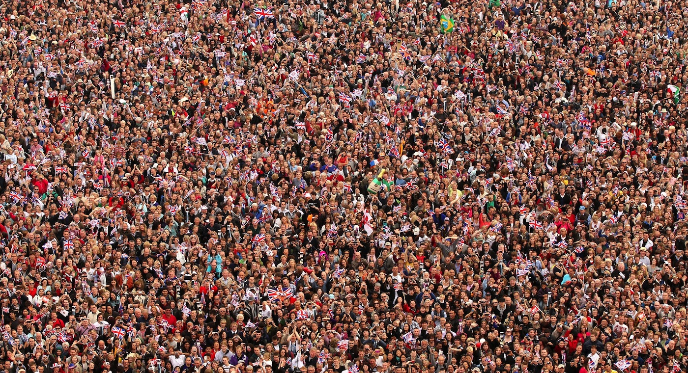

Slide 43
All Humans
Abraham (Gen 12:3)
Gen 12:2-3 – I will make you into a great nation… All the families on earth will be blessed through you.

Slide 44
All Humans
Abraham (Gen 12:3)
Isaac (Gen 17:19)
Gen 17:19 – You will name him Isaac, and I will confirm my covenant with him… as an everlasting covenant

Slide 45
All Humans
Abraham (Gen 12:3)
Isaac (Gen 17:19)
Jacob (Gen 28:14)
Gen 28:14 – Your descendants will be as numerous as the dust of the earth…
all the families of the earth will be blessed

Slide 46
All Humans
Abraham (Gen 12:3)
Isaac (Gen 17:19)
Jacob (Gen 28:14)
Judah (Gen 49:10)
Gen 49:10 – The scepter will not depart from Judah, nor… his descendants, until the coming of the one to whom it belongs, the one whom all nations will honor.

Slide 47
All Humans
Abraham (Gen 12:3)
Isaac (Gen 17:19)
Jacob (Gen 28:14)
2 Sam 7:16 – Your house and your kingdom will endure forever before me; your throne will be established forever.
Judah (Gen 49:10)
800+ yrs
David (2 Sam 7:16)

Slide 48
David (2 Sam 7:16)

Slide 49
David (2 Sam 7:16)
Psalm 16 – A Psalm of David
9 No wonder my heart is glad, and I rejoice. My body rests in safety.
10 For you will not leave my soul among the dead or allow your holy one to rot in the grave.

Slide 50
David (2 Sam 7:16)
Psalm 110 – A Psalm of David
1 Yahweh said to my Lord,
“Sit in the place of honor at my right hand until I humble your enemies, making them a footstool under your feet.”

Slide 51
David (2 Sam 7:16)
Psalm 22 – A Psalm of David
1 My God, my God, why have you abandoned me?
7 Everyone who sees me mocks me. They sneer and shake their heads, saying,
8 “Is this the one who relies on Yahweh? Then let Yahweh save him!
15 My tongue sticks to the roof of my mouth…
16 My enemies surround me like a pack of dogs…
They have pierced my hands and feet.

Slide 52
David (2 Sam 7:16)
Psalm 22
17 I can count all my bones…
18 They divide my garments among themselves and throw dice for my clothing.
19 O Yahweh, do not stay far away! You are my strength; come quickly to my aid!
21 Snatch me from the lion’s jaws…
22 I will proclaim your name to my brothers and sisters.

Slide 53
David (2 Sam 7:16)
Psalm 22
30 Our children will serve him; future generations will be told about the Lord.
31 They will proclaim his righteousness, declaring to a people yet unborn:
He has done it!

Slide 54
David (2 Sam 7:16)
Isa 7:14 – The Lord himself will give you the sign. Look! The virgin will conceive a child! She will give birth to a son and will call him Immanuel (which means ‘God is with us’)

Slide 55
David (2 Sam 7:16)
Isa 9:6-7
For a child is born to us, a son is given to us.
The government will rest on his shoulders. And he will be called:

Slide 56
David (2 Sam 7:16)
Isa 9:6-7
Wonderful Counselor, Mighty God,
Everlasting Father,
Prince of Peace.

Slide 57
David (2 Sam 7:16)
Isa 9:6-7
His government and its peace will never end.
He will rule with fairness and justice from the throne of his ancestor David

Slide 58
David (2 Sam 7:16)
Jer 23:5-6 “For the time is coming when I will raise up a righteous descendant from King David’s line…
And this will be his name: ‘Yahweh Is Our Righteousness’”

Slide 59
David (2 Sam 7:16)
Micah 5:2 – But you, O Bethlehem Ephrathah, are only a small village among all the people of Judah.
Yet a ruler of Israel whose origins are in the distant past, will come from you on my behalf.

Slide 60
David (2 Sam 7:16)
David (2 Sam 7:16)
1000 yrs
Matt 1:1 – This is a record of the ancestors of Jesus the Messiah, a descendant of David
Jesus

Slide 61
David (2 Sam 7:16)
David (2 Sam 7:16)
Matt 21:9 – “Praise God for the Son of David!”
1000 yrs
Jesus

Slide 62
David (2 Sam 7:16)
David (2 Sam 7:16)
Matt 21:9 – “Praise God for the Son of David!”
Luke 19:39-40
Some of the Pharisees in the crowd said to Jesus, “Teacher, rebuke your disciples!”
“I tell you,” he replied, “if they keep quiet, the stones will cry out.”
1000 yrs
Jesus

Slide 63
Romans 1
2 God promised this Good News long ago through his prophets in the holy Scriptures.
3 The Good News is about his Son.
In his earthly life he was born into King David’s family line,
4 and he was shown to be the Son of God when he was raised from the dead by the power of the Holy Spirit.
He is Jesus Christ our Lord.

Slide 64
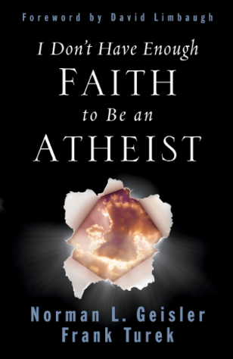
Norman Geisler and Frank Turek
Christian Authors/ Apologists
Geisler and Turek, I Don’t Have Enough Faith To Be An Atheist (Wheaton, Ill: Crossway, 2004), p. 315-317
Craig: Would there be anything, Dr. Crossan, that could convince you that Jesus was risen from the dead as a historical fact?
Crossan: One has the right to say, “I by faith believe that God has intervened here.”

Slide 65
Norman Geisler and Frank Turek
Christian Authors/ Apologists
Geisler and Turek, I Don’t Have Enough Faith To Be An Atheist (Wheaton, Ill: Crossway, 2004), p. 315-317
Crossan: But it’s a theological presupposition of mine that God does not operate that way. . . .
I could imagine discovering tomorrow morning that every tree outside my house has moved ﬁve feet. That needs some explanation. I don’t know the explanation, but I won’t immediately presume a miracle.

Slide 66
Norman Geisler and Frank Turek
Christian Authors/ Apologists
Geisler and Turek, I Don’t Have Enough Faith To Be An Atheist (Wheaton, Ill: Crossway, 2004), p. 315-317
Of course Crossan doesn’t speak for all skeptical scholars.
But certainly a majority of them deny the plain reading of the New Testament because they share his philosophical bias against miracles.

Slide 67
Norman Geisler and Frank Turek
Christian Authors/ Apologists
Geisler and Turek, I Don’t Have Enough Faith To Be An Atheist (Wheaton, Ill: Crossway, 2004), p. 315-317
It is not that the historical evidence for the New Testament is weak (it’s very strong indeed).
It’s that they’ve ruled out miracles in advance.
They arrive at the wrong conclusion because their bias makes it impossible for them to arrive at the right conclusion.

Slide 68
Norman Geisler and Frank Turek
Christian Authors/ Apologists
Geisler and Turek, I Don’t Have Enough Faith To Be An Atheist (Wheaton, Ill: Crossway, 2004), p. 315-317
Let’s take a look at Crossan’s ﬁnal comment about the trees in his yard moving ﬁve feet overnight.
He says he wouldn’t “immediately presume a miracle.”

Slide 69
Norman Geisler and Frank Turek
Christian Authors/ Apologists
Geisler and Turek, I Don’t Have Enough Faith To Be An Atheist (Wheaton, Ill: Crossway, 2004), p. 315-317
Well, neither would we, because most events actually do have a natural explanation
(which, incidentally, helps miracles stand out when they do occur).
So it makes perfect sense to seek a natural explanation ﬁrst.

Slide 70
Norman Geisler and Frank Turek
Christian Authors/ Apologists
Geisler and Turek, I Don’t Have Enough Faith To Be An Atheist (Wheaton, Ill: Crossway, 2004), p. 315-317
But does that mean we should never conclude that any event (such as the trees moving) was a miracle? …
Let’s suppose that Crossan’s tree moving event occurred in the following context:

Slide 71
Norman Geisler and Frank Turek
Christian Authors/ Apologists
Geisler and Turek, I Don’t Have Enough Faith To Be An Atheist (Wheaton, Ill: Crossway, 2004), p. 315-317
Two hundred years in advance, someone claiming to be a prophet of God writes down a prediction
that all of the trees in one area of Jerusalem would indeed move ﬁve feet one night during a particular year.

Slide 72
Norman Geisler and Frank Turek
Christian Authors/ Apologists
Geisler and Turek, I Don’t Have Enough Faith To Be An Atheist (Wheaton, Ill: Crossway, 2004), p. 315-317
Two hundred years later, a man arrives to tell the townspeople that the tree moving miracle will occur shortly.
This man claims to be God, teaches profound truths, and performs many other unusual acts that appear to be miracles.

Slide 73
Norman Geisler and Frank Turek
Christian Authors/ Apologists
Geisler and Turek, I Don’t Have Enough Faith To Be An Atheist (Wheaton, Ill: Crossway, 2004), p. 315-317
Then one morning numerous eyewitnesses claim that the trees in Crossan’s Jerusalem yard—including several deep-rooted, 100-foot oaks—actually moved ﬁve feet during the night,
just as the God-man predicted.

Slide 74
Norman Geisler and Frank Turek
Christian Authors/ Apologists
Geisler and Turek, I Don’t Have Enough Faith To Be An Atheist (Wheaton, Ill: Crossway, 2004), p. 315-317
These eyewitnesses also say this is just one of more than thirty miracles performed by this God-man.
They then suffer persecution and martyrdom for proclaiming these miracles and for refusing to recant their testimony.

Slide 75
Norman Geisler and Frank Turek
Christian Authors/ Apologists
Geisler and Turek, I Don’t Have Enough Faith To Be An Atheist (Wheaton, Ill: Crossway, 2004), p. 315-317
Opponents of the God-man don’t deny the evidence about the trees or the other miracles,
but offer natural explanations that have numerous fatal ﬂaws.

Slide 76
Norman Geisler and Frank Turek
Christian Authors/ Apologists
Geisler and Turek, I Don’t Have Enough Faith To Be An Atheist (Wheaton, Ill: Crossway, 2004), p. 315-317
Many years later, after all the eyewitnesses are dead, skeptics offer additional natural explanations that prove to be fatally ﬂawed as well.
In fact, for the next 1,900 years skeptics try to explain the event naturally, but no one can.

Slide 77
Norman Geisler and Frank Turek
Christian Authors/ Apologists
Geisler and Turek, I Don’t Have Enough Faith To Be An Atheist (Wheaton, Ill: Crossway, 2004), p. 315-317
Question: Given that context, wouldn’t it be reasonable to assume that the movement of the trees was supernatural rather than natural in origin?
Of course. The context makes all the difference.

Slide 78
Norman Geisler and Frank Turek
Christian Authors/ Apologists
Geisler and Turek, I Don’t Have Enough Faith To Be An Atheist (Wheaton, Ill: Crossway, 2004), p. 315-317
This is the case we have with the Resurrection.
It’s not just that we lack a natural explanation for the empty tomb.
It’s that we have positive eyewitness and corroborating circumstantial evidence for the resurrection miracle.

Slide 79
Summary
The Gospel it is the power of God for salvation to everyone who believes
This is accomplished from start to finish by faith
It was predicted beforehand and confirmed through the Resurrection
Do you want God to unleash this saving power in your life?

Slide 80
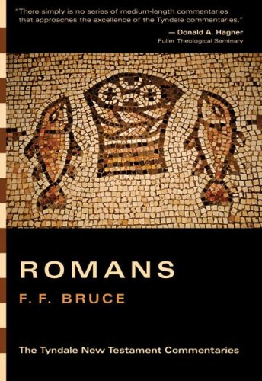
Dr. F.F. Bruce
Christian Professor and Author
F. F. Bruce, Romans: An Introduction and Commentary, vol. 6, Tyndale New Testament Commentaries (Downers Grove, IL: InterVarsity Press, 1985), 67–68.
There is no saying what may happen when people begin to study the letter to the Romans.
What happened to Augustine, Luther, Wesley [and others] launched great spiritual movements which have left their mark in world history.

Slide 81
Dr. F.F. Bruce
Christian Professor and Author
F. F. Bruce, Romans: An Introduction and Commentary, vol. 6, Tyndale New Testament Commentaries (Downers Grove, IL: InterVarsity Press, 1985), 67–68.
But similar things have happened, much more frequently, to very ordinary men and women as the words of this letter came home to them with power.
So, let those who have read thus far be prepared for the consequences of reading farther: you have been warned!

