Slide 1
Self-Focus, Self-Awareness and The New Self
Scott Risley

Slide 2
Three-Dimensional Living
Scripture calls us to love God and one another (Mt 22:37-40)
We are called to trust God (Prov 3:5), walk with God (Gal 5:25), and glorify God in all we do (1 Cor 10:31)
We are called to prioritize others’ interests over our own (Phil 2:3-4)
This will require self-awareness, self-control, self-monitoring
God

Slide 3
Three-Dimensional Living
I’m not talking about self-focus.
God

Slide 4
Three-Dimensional Living
I’m not talking about self-focus.
I’m not talking about an inflated sense of self-importance
God

Slide 5
Three-Dimensional Living
I’m not talking about self-focus.
I’m not talking about an inflated sense of self-importance
I’m talking about self-awareness
God

Slide 6
Self-awareness
“The human heart is the most deceitful of all things, and desperately wicked.
Who really knows how bad it is?
But I, Yahweh, search all hearts” (Jer. 17:9-10)

Slide 7
Self-awareness
Search me, O God, and know my heart; test me and know my anxious thoughts.
Point out anything in me that offends you, and lead me along the path of everlasting life. (Ps. 139:23-24)

Slide 8
Self-awareness
“Whoever has ears to hear, let them hear.” (Mark 4:9)
Do not be like the horse or the mule, which have no understanding
but must be controlled by bit and bridle or they will not come to you. (Psalm 32:9)

Slide 9
Self-awareness
Jesus: “Why do you look at the speck that is in your brother’s eye,
but do not notice the log that is in your own eye?
You hypocrite, first take the log out of your own eye, and then you will see clearly to take the speck out of your brother’s eye.” (Matt 7:3, 5)

Slide 10
Self-awareness
Two areas:
Emotional awareness
Receiving feedback from others

Slide 11
Neocortex
Data enters the limbic system through the thalamus, which is like the reception area of an office.
The thalamus then sends impulses to other parts of the brain, including the amygdala and the neocortex.
Thalamus
Amygdala
Ken Sande, DRW 3.0 – Lesson 3 – https://www.rw-academy.org/courses/487381/lectures/9799050

Slide 12
Neocortex
The amygdala is like an emotional filing cabinet. It stores experiences and emotions.
Thalamus
Amygdala
Ken Sande, DRW 3.0 – Lesson 3 – https://www.rw-academy.org/courses/487381/lectures/9799050

Slide 13
Neocortex
For example, if you had a very bad experience with snakes in your childhood,
even a picture of a snake will trigger fear and cause you to recoil.
Thalamus
Amygdala
Ken Sande, DRW 3.0 – Lesson 3 – https://www.rw-academy.org/courses/487381/lectures/9799050

Slide 14
Neocortex
Because of the way brain is wired, data arrives at the amygdala a few nanoseconds before it gets to the neocortex…
Thalamus
Amygdala
Ken Sande, DRW 3.0 – Lesson 3 – https://www.rw-academy.org/courses/487381/lectures/9799050

Slide 15
Neocortex
If that data triggers intense emotions, the amygdala can take control of your mind, body and words before your neocortex has time to process the data.
Thalamus
Amygdala
Ken Sande, DRW 3.0 – Lesson 3 – https://www.rw-academy.org/courses/487381/lectures/9799050

Slide 16
Neocortex
This “amygdala hijacking” typically results in a behavioral process that has three characteristics:
strong emotions …
which trigger an impulsive reaction …
that is quickly regretted.
Thalamus
Amygdala
Ken Sande, DRW 3.0 – Lesson 3 – https://www.rw-academy.org/courses/487381/lectures/9799050

Slide 17
Neocortex
To put this in simple terms, when emotions go up, reasoning usually goes down.
Thalamus
Fight / Flight / Fawn response
Amygdala
Aundi Kolber, Try Softer (Tyndale, 2020) p. 26
Ken Sande, DRW 3.0 – Lesson 3 – https://www.rw-academy.org/courses/487381/lectures/9799050

Slide 18
Neocortex
How to deal with this?
First, learn to recognize your emotions and read your feelings.
One way to do this is to notice physical cues that your emotions are intensifying.
Thalamus
Amygdala
Ken Sande, DRW 3.0 – Lesson 7 – https://www.rw-academy.org/courses/487381/lectures/9924351

Slide 19
Neocortex
Is your heart beating faster? Have your muscles tensed up? Are you sweating?
These are all signs that something is triggering your limbic system and may soon move you to say or do something you may regret.
Thalamus
Amygdala
Ken Sande, DRW 3.0 – Lesson 7 – https://www.rw-academy.org/courses/487381/lectures/9924351

Slide 20
Neocortex
As soon as you sense that an emotion, try to give it a name:
sadness, embarrassment, nervousness, happiness, fondness, confusion, aversion or irritation … to name just a few possibilities.
Thalamus
Amygdala
Ken Sande, DRW 3.0 – Lesson 7 – https://www.rw-academy.org/courses/487381/lectures/9924351

Slide 21
Neocortex
Naming your emotions provides a huge benefit to your brain, as demonstrated by a fascinating experiment.
A test was run on two control groups of people…
Thalamus
Amygdala
Ken Sande, DRW 3.0 – Lesson 7 – https://www.rw-academy.org/courses/487381/lectures/9924351

Slide 22
Neocortex
Individuals in both groups were then placed in a functional MRI machine…
The scientists would then use a small audio speaker to mention one of the emotional events of a subject’s life
Thalamus
Amygdala
Ken Sande, DRW 3.0 – Lesson 7 – https://www.rw-academy.org/courses/487381/lectures/9924351

Slide 23
Neocortex
Group #1: remain as mentally passive as possible, to simply experience the emotion without analyzing it.
Thalamus
Amygdala
Ken Sande, DRW 3.0 – Lesson 7 – https://www.rw-academy.org/courses/487381/lectures/9924351

Slide 24
Neocortex
Group #2 had one additional instruction:
as soon as they heard a memory that triggered an emotion, they were supposed to mentally name the emotion.
Not verbally, just mentally.
Thalamus
Amygdala
Ken Sande, DRW 3.0 – Lesson 7 – https://www.rw-academy.org/courses/487381/lectures/9924351

Slide 25
Neocortex
Group #2 had one additional instruction:
as soon as they heard a memory that triggered an emotion, they were supposed to mentally name the emotion.
Not verbally, just mentally.
Thalamus
Amygdala
An integrated prefrontal cortex is able to secrete a substance called GABA that helps calm the amygdala
Ken Sande, DRW 3.0 – Lesson 7 – https://www.rw-academy.org/courses/487381/lectures/9924351
Aundi Kolber, Try Softer (Tyndale, 2020) p. 103; citing Daniel Siegel, Mindsight (Bantam, 2010), p. 28

Slide 26
Neocortex
Group #2 had one additional instruction:
as soon as they heard a memory that triggered an emotion, they were supposed to mentally name the emotion.
Not verbally, just mentally.
Thalamus
Amygdala
“Name it to tame it”
Ken Sande, DRW 3.0 – Lesson 7 – https://www.rw-academy.org/courses/487381/lectures/9924351
Aundi Kolber, Try Softer (Tyndale, 2020) p. 174; citing Daniel Siegel, Mindsight (Bantam, 2010), p. 116

Slide 27
Neocortex
As Christians, we want to go beyond just naming it
We can examine the feeling – “Why am I feeling that way?”
Don’t just squash
We can integrate truth from God’s word (2 Cor 10:5)
We can talk with God and other believers
Thalamus
Amygdala

Slide 28
Psalm 73 – Asaph
² But as for me, I almost lost my footing. My feet were slipping, and I was almost gone.
³ For I envied the proud when I saw them prosper despite their wickedness.
¹³ Did I keep my heart pure for nothing? Did I keep myself innocent for no reason?
¹⁴ I get nothing but trouble all day long; every morning brings me pain.
“Grumblers” stop here

Slide 29
Psalm 73 – Asaph
¹⁵ If I had really spoken this way to others, I would have been a traitor to your people.
¹⁷ Then I went into your sanctuary, O God, and I finally understood…
²¹ Then I realized that my heart was bitter, and I was all torn up inside.
²² I was so foolish and ignorant— I was a brute beast before you.

Slide 30
Psalm 73 – Asaph
²³ Yet I still belong to you; you hold my right hand.
²⁴ You guide me with your counsel, leading me to a glorious destiny.
²⁵ Whom have I in heaven but you? I desire you more than anything on earth.
²⁶ My health may fail, and my spirit may grow weak, but God remains the strength of my heart; he is mine forever.
Most of the Bible speaks to us;
the Psalms speak for us.
(Athanasius)

Slide 31
Psalm 55 – David
⁴ My heart pounds in my chest. The terror of death assaults me.
⁵ Fear and trembling overwhelm me, and I can’t stop shaking…
¹⁷ Morning, noon, and night I cry out in my distress, and Yahweh hears my voice.
¹⁸ He ransoms me and keeps me safe…
¹⁹ God, who has ruled forever, will hear me and humble them.
A good start
Laments only take a minute to read…

Slide 32
Matthew 26:37-39 – Jesus
He took Peter, James and John, and he became anguished and distressed.
He was in such agony of spirit that his sweat fell to the ground like great drops of blood (Luke 24:44)

Slide 33
Matthew 26:37-39 – Jesus
He took Peter, James and John, and he became anguished and distressed.
“My soul is crushed with grief to the point of death”
“My Father! If it is possible, let this cup of suffering be taken away from me.
Yet I want your will to be done, not mine.”

Slide 34
Paul Miller, A Praying Life (NavPress, 2009), 122
Christians rush to “not my will, but yours be done” without first expressing their hearts.
They submit so quickly that they disappear…
When we stop being ourselves with God, we are no longer in real conversation with God.

Slide 35
Genesis 4:5-7 – Cain
So Cain became very angry, and his expression was downcast.
Then Yahweh said to Cain, “Why are you angry, and why is your expression downcast?
Is it not true that if you do what is right, you will be fine? But if you do not do what is right, sin is crouching at the door.
It desires to dominate you, but you must subdue it.”
Identify
Evaluate
Act

Slide 36
Feelings
Can be pleasant or painful
Not inherently right or wrong
Awareness and curiosity – Why do I feel that way?
May flow from right or wrong beliefs
May lead to right or wrong actions (Philippians 4:6-7)
Our goal: right beliefs and right actions
And transformed emotions! (Galatians 5:22; Philippians 4:6-7)

Slide 37
Feelings
A prayer journal can be helpful here
But also need to do this in the moment
How am I doing? What is coming at me? Am I happy, sad, thankful, discouraged, angry, frustrated?
What is God saying to me? What does the Word say? (Paul Miller, Praying Life (NavPress, 2011) p. 252

Slide 38
Feelings
A prayer journal can be helpful here
But also need to do this in the moment
Dropping things. Banging my limbs on things
Sudden drowsiness
Eye tics/ fidgeting
Anger – clenching fists or teeth, breathing louder or faster, tensed shoulders, scowl
Random urges to eat or use the bathroom

Slide 39
Feedback
Any information you get about yourself.

Slide 40
Feedback
If you ignore criticism, you will end in poverty and disgrace;
if you accept correction, you will be honored. (Prov 13:18)

Slide 41
Feedback
As iron sharpens iron, so one person sharpens another. (Prov 17:17)

Slide 42
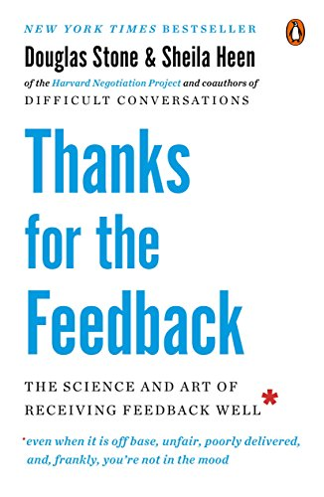
Douglas Stone & Sheila Heen, Thanks for the Feedback (New York: Penguin, 2015), p. 3
When we give feedback, the receiver isn’t good at receiving it.
When we receive feedback, the giver isn’t good at giving it.

Slide 43
Douglas Stone & Sheila Heen, Thanks for the Feedback (New York: Penguin, 2015), p. 6
“It’s well and good to hope for that special mentor or coach (and cherish the ones you come across).
But don’t put off learning until they arrive.
“Come to Me… learn from Me, for I am gentle and humble in heart” (Matt 11:28-29)

Slide 44
Douglas Stone & Sheila Heen, Thanks for the Feedback (New York: Penguin, 2015), p. 8
“Receiving feedback well doesn’t mean you always have to take the feedback.
Receiving it well means engaging in the conversation skillfully
and making thoughtful choices about whether and how to use the information and what you’re learning.

Slide 45
Douglas Stone & Sheila Heen, Thanks for the Feedback (New York: Penguin, 2015), p. 8
“It’s about managing your emotional triggers so that you can take in what the other person is telling you,
and being open to seeing yourself in new ways.
And sometimes… it’s about setting boundaries and saying no.”

Slide 46
Feedback Blockers
1. Truth triggers
Intensified by
Emotional reasoning: “Always trust your feelings”
Memory is biased

Slide 47
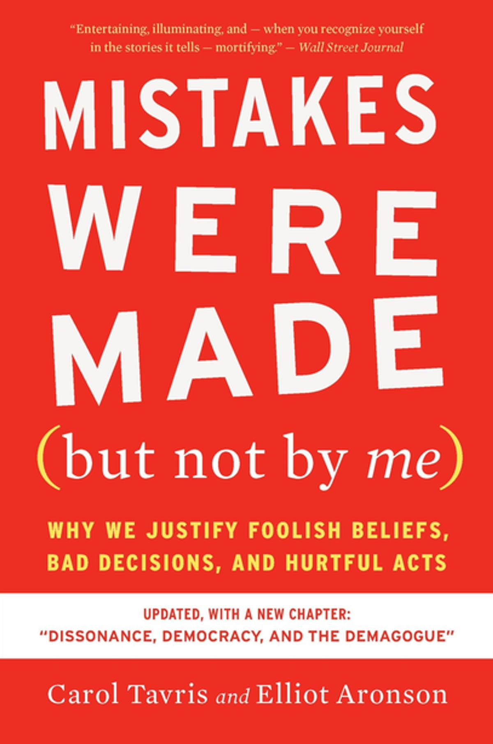
Tavris and Aronson, Mistakes Were Made (but not by me) (New York: Houghton Mifflin, 2020), Chapter 3
Chapter 3: “Memory, the Self-Justifying Historian”
When two people produce entirely different memories of the same event, observers usually assume that one of them is lying.
Of course, some people do…

Slide 48
Tavris and Aronson, Mistakes Were Made (but not by me) (New York: Houghton Mifflin, 2020), Chapter 3
All of us, as we tell our stories, add details and omit inconvenient facts;
we give the tale a small, self-enhancing spin.
That spin goes over so well that the next time we add a slightly more dramatic embellishment…

Slide 49
Tavris and Aronson, Mistakes Were Made (but not by me) (New York: Houghton Mifflin, 2020), Chapter 3
Eventually the way we remember the event may bring us a far distance from what actually happened.
In this way, memory becomes our personal, live-in, self-justifying historian…

Slide 50
Feedback Blockers
1. Truth triggers
Memory bias in Scripture: Exodus
“Why did you make us leave Egypt? Didn’t we tell you this would happen while we were still in Egypt? We said, ‘Leave us alone! Let us be slaves to the Egyptians.’” (Ex 14:11-12)
“We sat around pots filled with meat” (Ex 16:3)

Slide 51
Feedback Blockers
1. Truth triggers
Intensified by
Emotional reasoning: “Always trust your feelings”
Memory is biased
Use of vague labels
Our own blind spots

Slide 52
Feedback Blockers
1. Truth triggers
Ideas to overcome
Remember who you are!!
“wrong spotting” vs “right spotting”
Think in terms of “contribution” vs. “blame”
Dig beneath the label

Slide 53
Douglas Stone & Sheila Heen, Thanks for the Feedback (New York: Penguin, 2015), pp. 46-73
Wow. That’s upsetting to hear.
I never would have imagined that.
That is so far from how I see myself—or hope to be seen—that I’m almost speechless.
I want to explain why, but I also want to make sure that I really understand what you’re saying.

Slide 54
Feedback Blockers
2. Relationship triggers
Something about the relationship makes it hard to receive feedback
Sometimes there’s already a sore spot in the relationship…
Do not let the sun go down on your anger, and do not give the devil an opportunity (Eph 4:26-27)

Slide 55
Feedback Blockers
2. Relationship triggers
Something about the relationship makes it hard to receive feedback
Sometimes there’s already a sore spot in the relationship
Sometimes we feel like the feedback giver lacks credibility
Sometimes we suspect their motives

Slide 56
Feedback Blockers
2. Relationship triggers
Authority relationships face special challenges
E.g. the cop and the speeder
Scripture speaks to this dynamic:
“Household codes” (Col 3, Eph 5-6, 1 Peter 2-3)

Slide 57
Feedback Blockers
2. Relationship triggers
Remember who you are!!
Even if my father and mother abandon me, Yahweh will hold me close. (Psalm 27:10)

Slide 58
Feedback Blockers
3. Identity triggers
Something about my identity is on the line
Often accompanied by a feeling of shame.
There’s something wrong with me. I’m a failure.
I’ll never cut it as a _________
Fatalistic thinking often follows

Slide 59
Feedback Blockers
3. Identity triggers
Ideas to overcome
Remember who you are!!
Awareness (Self-awareness and Satan-awareness)
Embrace identity nuance

Slide 60
Feedback Blockers
3. Identity triggers
Ideas to overcome
Cultivate a growth identity.
Psalm 139 – Search me… examine me… lead me
Philippians 1:6 – “Until the day of Christ Jesus”
1 Thess 4:1, 10 – “Excel still more”

Slide 61
Acting on Feedback
As with our feelings, once we have identified and examined feedback, we decide what to do with it
We may respond to the person OR we may not respond

Slide 62
Acting on Feedback
“How have I listened to and glorified God in this situation?”
“How can this help me be more like Christ?”
“How can I use this knowledge to better love others?”

Slide 63
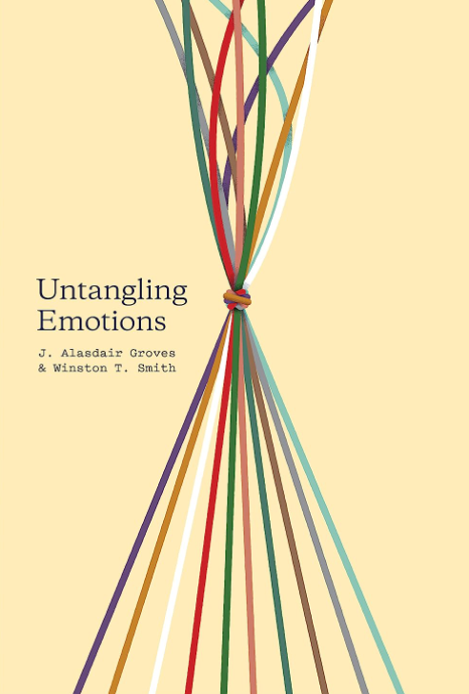
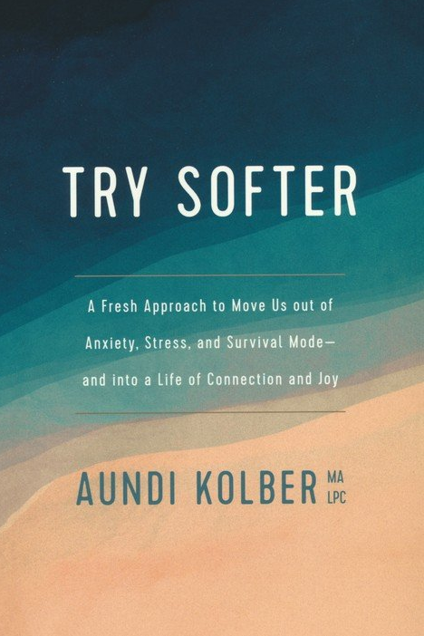
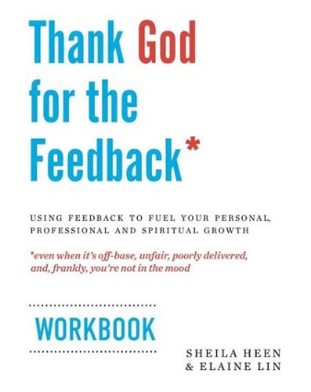
Further Resources
On Emotions
RW360.org Discovering Relational Wisdom 3.0
On Feedback:
1 hour workshop with several exercises (https://dwellcc.org/ministries/counseling/workshops)

