Slide 2
WELCOME TO 10AM
Main Campus CT!

Slide 3
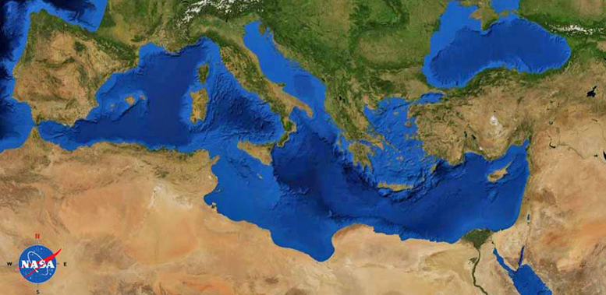
2 Timothy
Paul (Rome)
Timothy (Ephesus)
^{2 Tim 1:6} For this reason I remind you to kindle afresh the gift of God which is in you through the laying on of my hands. ⁷ For God has not given us a spirit of timidity, but of power and love and discipline.

Slide 4
2 Timothy
Paul (Rome)
Timothy (Ephesus)
^{2 Tim 1:8} Therefore do not be ashamed of the testimony of our Lord or of me His prisoner, but join with me in suffering for the gospel according to the power of God,

Slide 5
2 Timothy
Paul (Rome)
Timothy (Ephesus)
^{2 Tim 1:8} Therefore do not be ashamed of the testimony of our Lord or of me His prisoner, but join with me in suffering for the gospel according to the power of God,

Slide 6
2 Timothy
Paul (Rome)
Timothy (Ephesus)
^{2 Tim 1:8} Therefore do not be ashamed of the testimony of our Lord or of me His prisoner, but join with me in suffering for the gospel according to the power of God,

Slide 7
Join with me in suffering
“accompany me in my mistreatment”
Sugkakopatheo: “to bear evil treatment along with”
^{2 Tim 1:8} Therefore do not be ashamed of the testimony of our Lord or of me His prisoner, but join with me in suffering for the gospel according to the power of God,

Slide 8
Join with me in suffering
“accompany me in my mistreatment”
“… rather than retreating in shame”
^{2 Tim 1:8} Therefore do not be ashamed of the testimony of our Lord or of me His prisoner, but join with me in suffering for the gospel according to the power of God,

Slide 9
Do not be ashamed
^{2 Tim 1:8} Therefore do not be ashamed of the testimony of our Lord or of me His prisoner, but join with me in suffering for the gospel according to the power of God,

Slide 10
Do not be ashamed
That feeling when you are associated with something that has fallen out of favor….
^{2 Tim 1:8} Therefore do not be ashamed of the testimony of our Lord or of me His prisoner, but join with me in suffering for the gospel according to the power of God,

Slide 12
Do not be ashamed
We love to use shame
And it’s effective!
^{2 Tim 1:8} Therefore do not be ashamed of the testimony of our Lord or of me His prisoner, but join with me in suffering for the gospel according to the power of God,

Slide 13
Do not be ashamed
Why would Timothy be tempted to retreat in shame?
^{2 Tim 1:8} Therefore do not be ashamed of the testimony of our Lord or of me His prisoner, but join with me in suffering for the gospel according to the power of God,

Slide 14
Do not be ashamed
of the truth about Christ
Why would Timothy be tempted to retreat in shame?
To tell it like you see it
^{2 Tim 1:8} Therefore do not be ashamed of the testimony of our Lord or of me His prisoner, but join with me in suffering for the gospel according to the power of God,

Slide 15
Do not be ashamed
of the truth about Christ
of Paul
^{2 Tim 1:15} You are aware of the fact that all who are in Asia turned away from me, among whom are Phygelus and Hermogenes.
^{2 Tim 1:8} Therefore do not be ashamed of the testimony of our Lord or of me His prisoner, but join with me in suffering for the gospel according to the power of God,

Slide 16
Do not be ashamed
of the truth about Christ
of Paul
^{1 Cor 1:23} but we preach Christ crucified, to Jews a stumbling block and to Gentiles foolishness
of the Gospel
^{2 Tim 1:8} Therefore do not be ashamed of the testimony of our Lord or of me His prisoner, but join with me in suffering for the gospel according to the power of God,

Slide 17
Do not be ashamed
of the truth about Christ
of Paul
of the Gospel
These are all reasons Timothy might be tempted to shrink back…
^{2 Tim 1:8} Therefore do not be ashamed of the testimony of our Lord or of me His prisoner, but join with me in suffering for the gospel according to the power of God,

Slide 18
Do not be ashamed
of the truth about Christ
of Paul
of the Gospel
How about us?
^{2 Tim 1:8} Therefore do not be ashamed of the testimony of our Lord or of me His prisoner, but join with me in suffering for the gospel according to the power of God,

Slide 19
Do not be ashamed
of the truth about Christ
of Paul
of the Gospel
^{2 Tim 1:8} Therefore do not be ashamed of the testimony of our Lord or of me His prisoner, but join with me in suffering for the gospel according to the power of God,

Slide 20
Do not be ashamed
of the truth about Christ
of Paul
of the Gospel
^{2 Tim 1:8} Therefore do not be ashamed of the testimony of our Lord or of me His prisoner, but join with me in suffering for the gospel according to the power of God,

Slide 21
Join with me in suffering
“Don’t shrink back in shame… but stand with me”
“Move forward willingly into what others will find shameful”
^{2 Tim 1:8} Therefore do not be ashamed of the testimony of our Lord or of me His prisoner, but join with me in suffering for the gospel according to the power of God,

Slide 22
Join with me in suffering
Why?
What we suffer FOR
Who we suffer WITH
The POWER with which we face it
^{2 Tim 1:8} Therefore do not be ashamed of the testimony of our Lord or of me His prisoner, but join with me in suffering for the gospel according to the power of God,

Slide 23
1) What we suffer FOR:
What would be worth enduring shame for?
^{2 Tim 1:8} Therefore do not be ashamed of the testimony of our Lord or of me His prisoner, but join with me in suffering for the gospel according to the power of God,

Slide 24
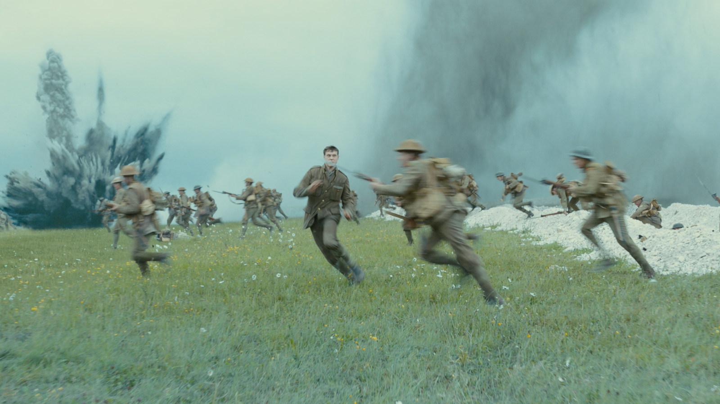
1) What we suffer FOR
What would be worth joining in suffering for?
^{2 Tim 1:8} Therefore do not be ashamed of the testimony of our Lord or of me His prisoner, but join with me in suffering for the gospel according to the power of God,

Slide 25
1) What we suffer FOR:
What would be worth enduring shame for?
^{2 Tim 1:8} Therefore do not be ashamed of the testimony of our Lord or of me His prisoner, but join with me in suffering for the gospel according to the power of God,

Slide 26
1) What we suffer FOR:
What would be worth enduring shame for?
^{2 Tim 1:8} Therefore do not be ashamed of the testimony of our Lord or of me His prisoner, but join with me in suffering for the gospel according to the power of God,

Slide 27
1) What we suffer FOR:
euaggelion: “good news”
^{2 Tim 1:8} Therefore do not be ashamed of the testimony of our Lord or of me His prisoner, but join with me in suffering for the gospel according to the power of God,

Slide 28
1) What we suffer FOR:
The Gospel
“Join me as a shameless messenger of the news that saves”
^{Rom 1:16} For I am not ashamed of the gospel, for it is the power of God for salvation to everyone who believes
^{2 Tim 1:8} Therefore do not be ashamed of the testimony of our Lord or of me His prisoner, but join with me in suffering for the gospel according to the power of God,

Slide 29
1) What we suffer FOR:
The Gospel
^{1 Cor 1:23} but we preach Christ crucified, to Jews a stumbling block and to Gentiles foolishness, ²⁴ but to those who are the called, both Jews and Greeks, Christ the power of God and the wisdom of God.
“Join me as a shameless messenger of the news that saves”
^{2 Tim 1:8} Therefore do not be ashamed of the testimony of our Lord or of me His prisoner, but join with me in suffering for the gospel according to the power of God,

Slide 30
1) What we suffer FOR:
The Gospel
^{1 Cor 1:23} but we preach Christ crucified, to Jews a stumbling block and to Gentiles foolishness, ²⁴ but to those who are the called, both Jews and Greeks, Christ the power of God and the wisdom of God.
“Join me as a shameless messenger of the news that saves”
^{2 Tim 1:8} Therefore do not be ashamed of the testimony of our Lord or of me His prisoner, but join with me in suffering for the gospel according to the power of God,

Slide 31
1) What we suffer FOR:
The Gospel
^{2 Tim 1:9} who saved us and called us with a holy calling, not according to our works, but according to His own purpose and grace, which was granted to us in Christ Jesus from all eternity, ¹⁰ but has now been revealed by the appearing of our Savior Christ Jesus, who abolished death and brought life and immortality to light through the gospel,

Slide 32
1) What we suffer FOR:
The Gospel
^{2 Tim 1:9} who saved us and called us with a holy calling, not according to our works, but according to His own purpose and grace, which was granted to us in Christ Jesus from all eternity, ¹⁰ but has now been revealed by the appearing of our Savior Christ Jesus, who abolished death and brought life and immortality to light through the gospel,

Slide 33
1) What we suffer FOR:
The Gospel
^{2 Tim 1:9} who saved us and called us with a holy calling, not according to our works, but according to His own purpose and grace, which was granted to us in Christ Jesus from all eternity, ¹⁰ but has now been revealed by the appearing of our Savior Christ Jesus, who abolished death and brought life and immortality to light through the gospel,

Slide 34
1) What we suffer FOR:
The Gospel
^{2 Tim 1:9} who saved us and called us with a holy calling, not according to our works, but according to His own purpose and grace, which was granted to us in Christ Jesus from all eternity, ¹⁰ but has now been revealed by the appearing of our Savior Christ Jesus, who abolished death and brought life and immortality to light through the gospel,

Slide 35
1) What we suffer FOR:
The Gospel
^{2 Tim 1:9} who saved us and called us with a holy calling, not according to our works, but according to His own purpose and grace, which was granted to us in Christ Jesus from all eternity, ¹⁰ but has now been revealed by the appearing of our Savior Christ Jesus, who abolished death and brought life and immortality to light through the gospel,

Slide 36
1) What we suffer FOR:
The Gospel
^{2 Tim 1:9} who saved us and called us with a holy calling, not according to our works, but according to His own purpose and grace, which was granted to us in Christ Jesus from all eternity, ¹⁰ but has now been revealed by the appearing of our Savior Christ Jesus, who abolished death and brought life and immortality to light through the gospel,

Slide 37
1) What we suffer FOR:
The Gospel
^{2 Tim 1:10} the gospel … ¹¹ for which I was appointed a preacher, an apostle, and a teacher. ¹² For this reason I also suffer these things; but I am not ashamed, for I know whom I have believed, and I am convinced that He is able to protect what I have entrusted to Him until that day.

Slide 38
1) What we suffer FOR:
The Gospel
^{2 Tim 1:10} the gospel … ¹¹ for which I was appointed a preacher, an apostle, and a teacher. ¹² For this reason I also suffer these things; but I am not ashamed, for I know whom I have believed, and I am convinced that He is able to protect what I have entrusted to Him until that day.

Slide 39
1) What we suffer FOR:
The Gospel
^{2 Tim 1:10} the gospel … ¹¹ for which I was appointed a preacher, an apostle, and a teacher. ¹² For this reason I also suffer these things; but I am not ashamed, for I know whom I have believed, and I am convinced that He is able to protect what I have entrusted to Him until that day.

Slide 40
1) What we suffer FOR:
The Gospel
^{2 Tim 1:10} the gospel … ¹¹ for which I was appointed a preacher, an apostle, and a teacher. ¹² For this reason I also suffer these things; but I am not ashamed, for I know whom I have believed, and I am convinced that He is able to protect what I have entrusted to Him until that day.

Slide 41
2) Who we suffer WITH:
Accompany me in suffering … as I am accompanying Christ
^{2 Tim 1:10} the gospel … ¹¹ for which I was appointed a preacher, an apostle, and a teacher. ¹² For this reason I also suffer these things; but I am not ashamed, for I know whom I have believed, and I am convinced that He is able to protect what I have entrusted to Him until that day.

Slide 42
2) Who we suffer WITH:
When you align with Christ, you align with him against the grain
You can expect rejection, and indeed shame
^{2 Tim 1:10} the gospel … ¹¹ for which I was appointed a preacher, an apostle, and a teacher. ¹² For this reason I also suffer these things; but I am not ashamed, for I know whom I have believed, and I am convinced that He is able to protect what I have entrusted to Him until that day.

Slide 43
2) Who we suffer WITH:
^{Heb 12:2} Because of the joy awaiting him, he endured the cross, disregarding its shame. Now he is seated in the place of honor beside God’s throne.
^{2 Tim 1:10} the gospel … ¹¹ for which I was appointed a preacher, an apostle, and a teacher. ¹² For this reason I also suffer these things; but I am not ashamed, for I know whom I have believed, and I am convinced that He is able to protect what I have entrusted to Him until that day.

Slide 44
2) Who we suffer WITH:
^{2 Tim 1:10} the gospel … ¹¹ for which I was appointed a preacher, an apostle, and a teacher. ¹² For this reason I also suffer these things; but I am not ashamed, for I know whom I have believed, and I am convinced that He is able to protect what I have entrusted to Him until that day.

Slide 45
3) The POWER with which we face it:
^{2 Tim 1:8} Therefore do not be ashamed of the testimony of our Lord or of me His prisoner, but join with me in suffering for the gospel according to the power of God,

Slide 46
3) The POWER with which we face it:
^{2 Tim 1:8} Therefore do not be ashamed of the testimony of our Lord or of me His prisoner, but join with me in suffering for the gospel according to the power of God,

Slide 47
3) The POWER with which we face it:
^{2 Tim 1:7} For God has not given us a spirit of timidity, but of power and love and discipline.

Slide 48
3) The POWER with which we face it:
^{2 Tim 1:7} For God has not given us a spirit of timidity, but of power and love and discipline.

Slide 49
3) The POWER with which we face it:
^{2 Tim 1:7} For God has not given us a spirit of timidity, but of power and love and discipline.

Slide 50
3) The POWER with which we face it:
^{2 Tim 1:7} For God has not given us a spirit of timidity, but of power and love and discipline.

Slide 51
3) The POWER with which we face it:
^{2 Tim 1:7} For God has not given us a spirit of timidity, but of power and love and discipline.

Slide 52
3) The POWER with which we face it:
^{Mark 5:15} “In his right mind”
² ^{Cor 5:13} “sound mind”
^{Romans 12:3} “think so as to have sound judgement”
^{Titus 2:6} “sensible”
Sophronismos: “to recall one to his senses”
^{2 Tim 1:7} For God has not given us a spirit of timidity, but of power and love and discipline.

Slide 53
3) The POWER with which we face it:
^{2 Tim 1:7} For God has not given us a spirit of timidity, but of power and love and discipline.
renewed thinking

Slide 54
3) The POWER with which we face it:
This is the Spirit alive in you:
a Spirit of bold love and truth!
So don’t let fear or shame or embarrassment bully you into clamming up about what Christ has done in your life!
^{2 Tim 1:7} For God has not given us a spirit of timidity, but of power and love and discipline.

Slide 56
Discussion Questions to-go:
How would I know if I was “ashamed” of the gospel?
What would it look like for you personally to be unashamed?

