Slide 1
XSI 2017
How to Ask Good Questions
John Ross | rossj@xenos.org

Slide 2
The art and science of asking questions is the source of all knowledge.
Thomas Berger

Slide 3
The quality of a leader cannot be judged by the answers he gives, but by the questions he asks.
Simon Sinek

Slide 4
A wise man can learn more from a foolish question than a fool can learn from a wise answer.
Bruce Lee

Slide 5
Overview
Learning to ask compelling, creative questions is key to sharing your faith, developing close relationships and leading people into the fullness of Jesus Christ.

Slide 6
Discussion
How would you describe a really good question?

Slide 7
Discussion
What barriers do you think hold us back from asking these kinds of questions?

Slide 8
How to Ask Questions
Before
During
After

Slide 9
Before: Hang with the Skilled
Be quiet… then really nosy
Seek counsel about tough convos
Read books, do research
Study the questions God asks

Slide 10
Before: Hang with the Skilled
Luke 18:18-19 A certain ruler asked him, “Good teacher, what must I do to inherit eternal life?”
“Why do you call me good?” Jesus answered. “No one is good — except God alone.”

Slide 11
Before: Hang with the Skilled
Genesis 4:4-7 And the LORD was pleased with Abel and his offering, but with Cain and his offering he was not pleased. So Cain became very angry, and his expression was downcast.

Slide 12
Before: Hang with the Skilled
Genesis 4:4-7 Then the Lord said to Cain, “Why are you angry, and why is your expression downcast? Is it not true that if you do what is right, you will be fine?”

Slide 13
Before: Set a Goal
Determine 1-2 things you’d like to accomplish in a conversation
Maybe you didn’t find out anything in a conversation because you didn’t know what you were looking for!

Slide 14
Before: Set a Goal
Determine 1-2 things you’d like to accomplish in a conversation
Example 1
A Christian friend who recently entered a dating relationship started sharing doubts about God

Slide 15
Before: Set a Goal
Determine 1-2 things you’d like to accomplish in a conversation
Example 2
A new believer told you about being teased at work for being a Christian

Slide 16
Before: Set a Goal
Determine 1-2 things you’d like to accomplish in a conversation
Determine one thing you would like to avoid in the conversation

Slide 17
Before: Set a Goal
Plan out what to ask – not just what to tell
Takes much diligent work
What questions do you have about the person, not just for the person?

Slide 18
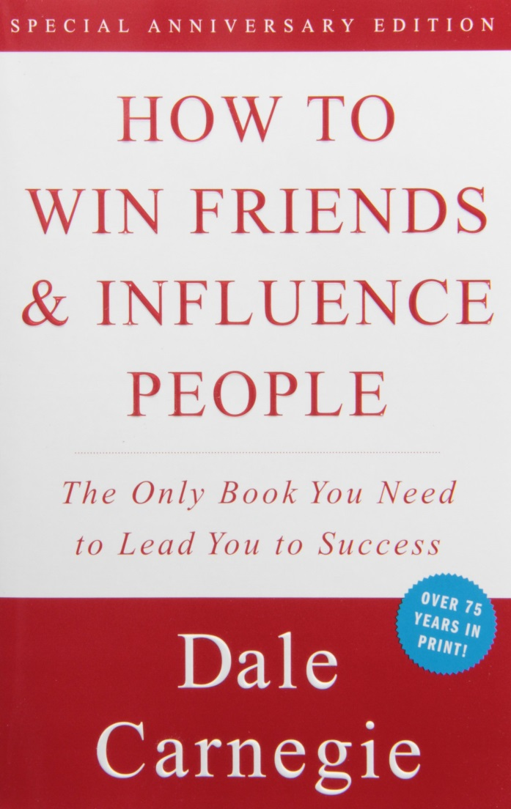
“Alfred Adler, the famous Viennese psychologist, wrote a book entitled What Life Should Mean to You. In that book he says: ‘It is the individual who is not interested in his fellow man who has the greatest difficulties in life and provides the greatest injury to others. It is from such individuals that all human failures spring.’”

Slide 19
Before: Know Tendencies
Identify your conversation pitfalls
Fear: What points will probably cause you to clam up?
Boredom: When do you normally find yourself itching to check your phone?

Slide 20
Before: Know Tendencies
Identify your conversation pitfalls
Arrogance: What usually triggers your first lecture?
Distraction: What will help you stay on track when you start along tangents?

Slide 21
During: Adjust Your Approach
Treat each conversation as unique
Be nimble on your feet

Slide 22
Fast
Casual
Random
Tame
Rigid
Slow
Deep
Direct
Risky
Loose

Slide 23
During: Adjust Your Approach
Treat each conversation as unique
Be nimble on your feet
Identify and minister to resistance

Slide 24
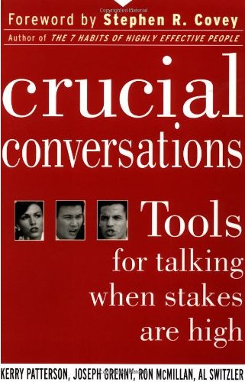
“As people begin to feel unsafe, they start down one of two unhealthy paths. They move either to silence (withholding information from the pool) or to violence (trying to force meaning in the pool)… knowing a few of the common forms of silence and violence helps you see safety problems when they first start to happen. That way you can step out, restore safety, and return to dialogue – before the damage is too great.”

Slide 25
“Silence consists of any act to purposefully withhold information from the pool of meaning… The three most common forms of silence are masking, avoiding, and withdrawing… Violence consists of any verbal strategy that attempts to convince, control, or compel others to your point of view… The three most common forms are controlling, labeling, and attacking.”

Slide 26
During: Listen Wisely
Summarize
Redirect
Clarify
Delve

Slide 27
After: Take Some Notes
What did I hear?
What did I not hear?

Slide 28
Cathy is a nominal Christian work friend who just went through a divorce. She responds to invitations for coffee, talking endlessly about her ex, problems with your boss, the weather. However, when you bring up spiritual topics, she casually insists God has a plan for everything, then changes the subject. You want to get into spiritual territory but aren’t sure how to proceed.

Slide 29
Jen is a recent convert who came to your Bible study for the first time two weeks ago. She shows clear excitement for Jesus but is mousy and nervous after teachings. Last week, when you talked with her, she barely made eye contact and offered one-word answers. You’re hoping to welcome Jen into the group, but you aren’t sure how to break through.

Slide 30
Bill is a smart, likable member of your Bible study. He contributes and serves consistently. You believe this guy could be a future leader and disciple-maker – but he is terrified to share his faith. You and several others have shown him scripture about evangelism and challenged him, but you sense Bill has deeper fears that hold him back.

